Slide 1

Minnetonka Baseball Association 2026 Team Manager Meeting 4.7.26

Slide 2
Agenda
Welcome
Tina McIntyre - Director of Team Managers, Sponsorship & Fundraising
Team Manager Overview
Conducting a Team Meeting
Team Communication
Uniforms
League Rules
Sports Engine APP
MBL Site
Scoreboards
Concessions
Volunteer Duty
Team Picture Day
Opening Day + Golf Fundraiser
End of Season Event
League Contacts
FAQs

Slide 3
Team Manager Overview
A Team Manager is a critical role on our teams. Along with the coaching staff, Team Managers help to manage team activities, communication, and expectations with parents.
Conduct Team Meetings with Coaching Staff
Weekly communication with parents
Field Clean up, Opening Day, Volunteer duty, etc
Uniforms – Picked up/Distributed
Communicate Photo Day
Coordinate Team treat schedule (if desired)
Team Treasurer (money for uniforms, parties, treats, etc.)
Coordinate end of season party / social gatherings
Coordination with Miracle League (10+) *Fall games
Travel Teams- Tournament communication, check-in, game schedule and bracket updates, travel & accommodations coordination, coaches binder & team documentation

Slide 4
Team Meeting
Optional, but highly recommended to have an annual team meeting to kick off the season.
Topics may include:
Player/Parent Intros
Coach Updates
Team Manager Updates
Safety Guidelines
Rules
Consider adding in an activity or have
Players share about themselves
Location Ideas:
Coach/Parents home or backyard
Local park or playground
MBA Sponsors* such as…
Davanni’s Community Room
Snuffy’s (back seating area)
Adele’s deck seating
Gold Nugget private room
*Need to call and check availability

Slide 5
Team Communication
Weekly Team Email Updates
You will receive weekly emails from Director of Team Managers on important updates from the league to send to teams
You are responsible for keeping your team organized with weekly updates via email or by using the messaging function within our new website
Additional Communication Responsibilities:
Update team webpage as needed (announcements, messaging, events calendar, only administrator can cancel games)
Serve as liaison between team and league – if questions arise, funnel to the appropriate board member or league leader

Slide 6
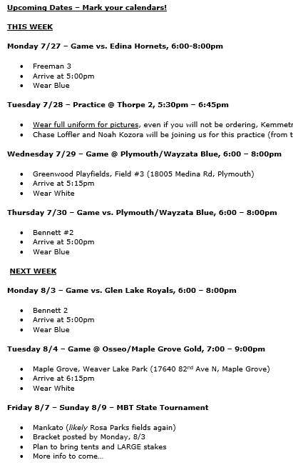
Team Communication
Tips/Suggestions
Wait to send your weekly email to your team until you receive Tina’s weekly email each week
Make sure to include your team name/age in the subject line – many families have multiple kids in the league
Format your email consistently each week. I use last week’s email, and edit for the next week!
Good idea to include key dates this week and next week – see example
Determine from your coach what time they want players to arrive before games – how early do you want to warm up? Is there space to warm up early if a game is going on before?

Slide 7
Uniforms
Community Teams
From Hanus Sports
952-473-1580
3311 County Rd 101
Hanus will contact you or head coach when uniforms are ready for your team to pick up
Personalization forms have already been turned in for your team. If you have players added late, please contact Hanus directly
Community 12+ coaches will receive their uniforms at equipment pick up 4/11
Rookies thru Community 9 will receive a jersey, cap, socks, and pants
Community 10+ will receive a jersey, cap, and belt. Players must purchase their own gray pants
Personalization on Hats (Last Name) is optional and comes at additional cost of $7/hat. Form will be sent after the meeting for you to turn into Hanus with payment if you want that option. Deadline is 4/10
All Community or Coach Uniform Questions can be directed to Tricia Varner tricanders@gmail.com

Slide 8
Uniforms
Travel Teams
From Lakeside Promotions
952-445-3970, E: MBA@LakesidePromotions.com
10769 Bren Rd. East
Travel 12+ uniforms will be ready shortly
Travel 9-11 – pick up dates will be announced at a later time to head coaches
Travel 9-11 will receive a jersey (2), cap, and belt. Players must purchase white pants with royal piping directly from Hanus. One pair is required, purchasing at least 2 is recommended
For pant questions - contact Hanus Sports: 952-473-1580
Location- 3311 County Road 101
Store Hours- Mon to Friday: 10:00am-6:00pm, Saturday: 9:00am-5:00pm, Sunday: Closed
Travel 12-15 will receive a jersey (2), cap, and pants
All Travel Uniform Questions can be directed Laura Dittbrenner Lauradittbrenner21@gmail.com

Slide 9
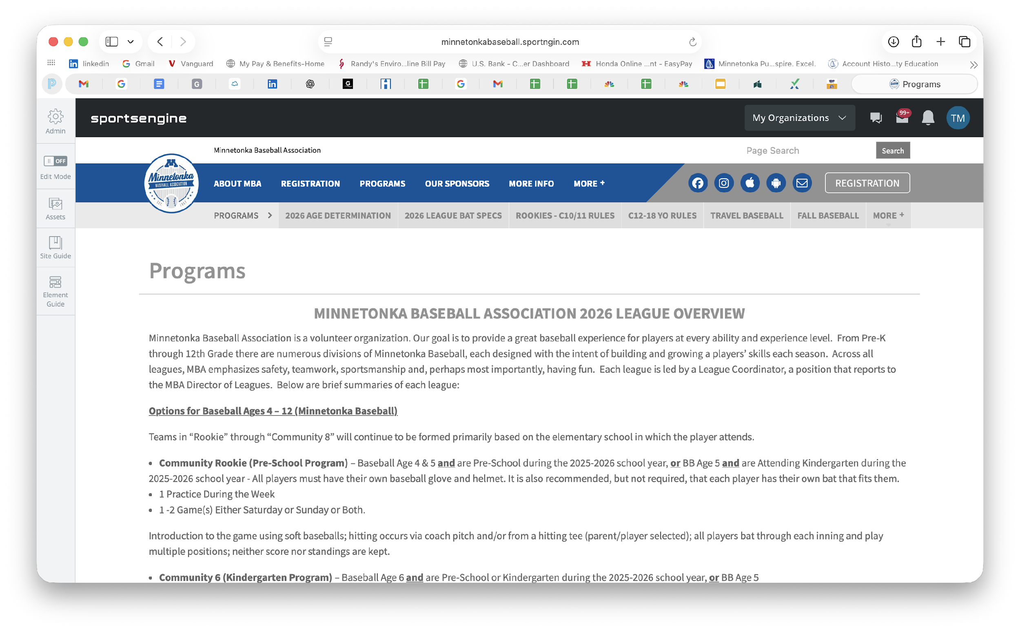
League Rules
Can be found on the MBA Website under Programs
Please ensure you have a copy of the rules with you (and your coaches do)
Travel rules can be found on the MBL website for league games, Tournaments will give you rule links

Slide 10
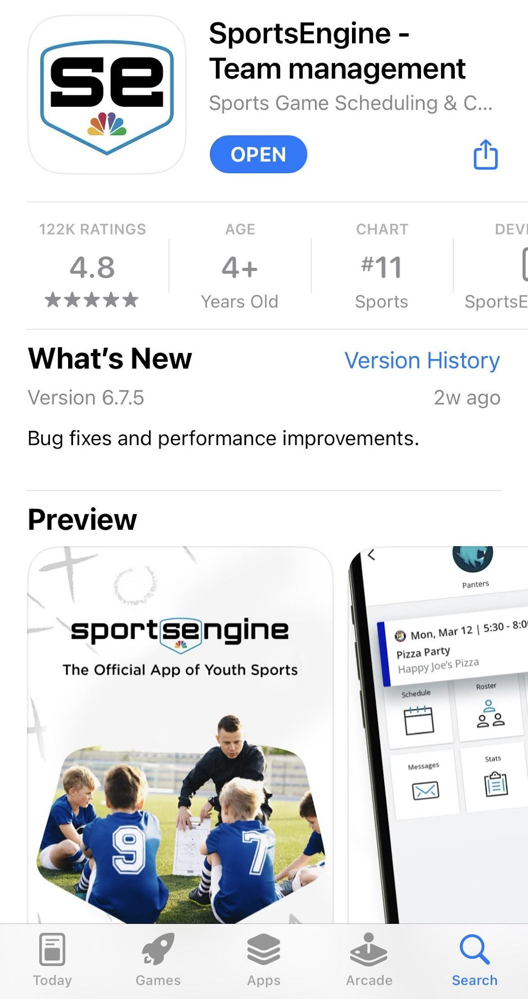
Sports Engine APP
Search for Sports Engine in the APP STORE or on GOOGLE PLAY
Ask that all families download to track up to date practice information and RSVP
Must have a profile that is linked to a player
Use Chat function for ‘at event’ updates
This is the only APP that automatically updates from the MBA website with game/practice information.
Notes:
I encourage you to download the SportsSignUp Play mobile app. The app provides the team practice and game schedule, a way to contact other team parents, a way for coaches to notify you about schedule changes or cancellations, and the ability to RSVP to practices and games. The RSVP feature is going to be crucial this year as many of us scheduled events around baseball and knowing how many players we will have at practices/games before they start will be helpful. You can download the SSUPlay app from the links below. When logging in to the app, please be sure to use an e-mail address associated with MBA, so your teams will be automatically pulled into your view.

Slide 11
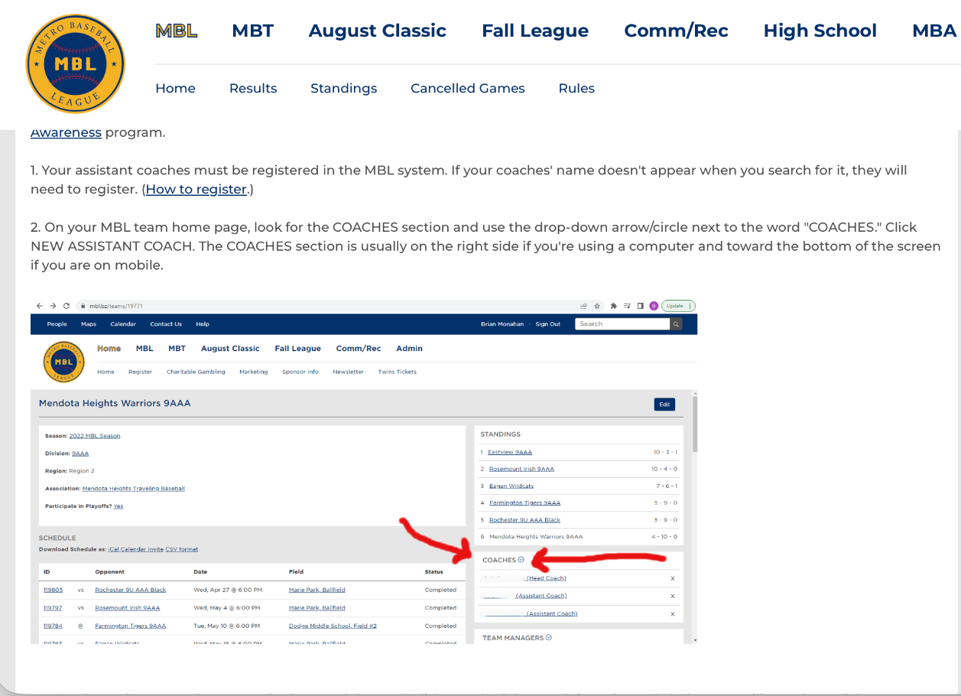
MBL Site (Community 8+ and All Travel)
New This Year:
Community 8+ using MBL Site
MBL site is the source of truth
Action Needed:
Coaches-Team Manager and Players need to register on the MBL site
Coaches need to add Assistant Coaches and Team Manager

Slide 12
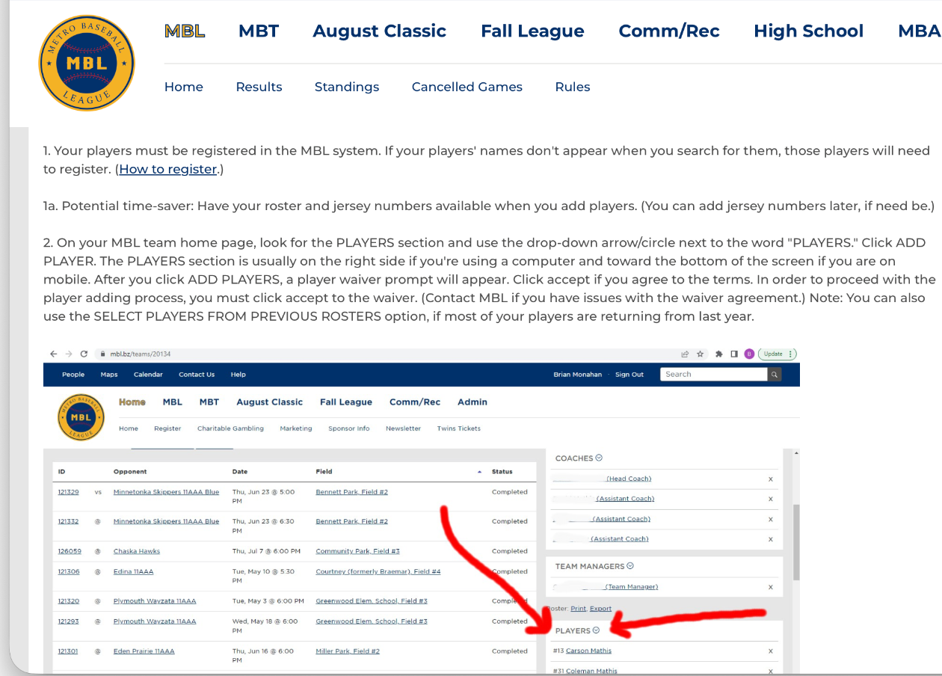
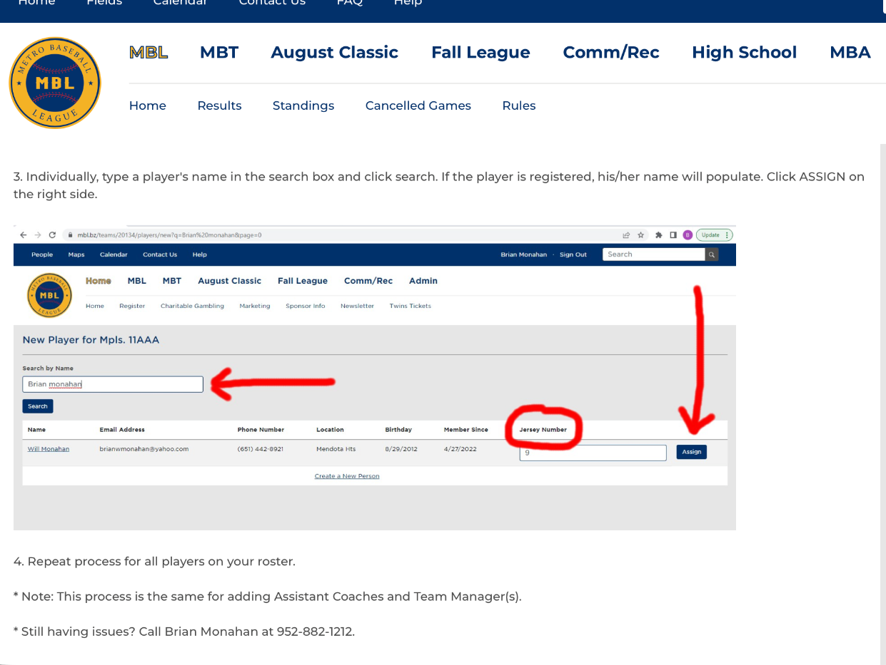
MBL Site (Community 8+ and All Travel)
Action Needed:
Coaches need to add players to the roster

Slide 13
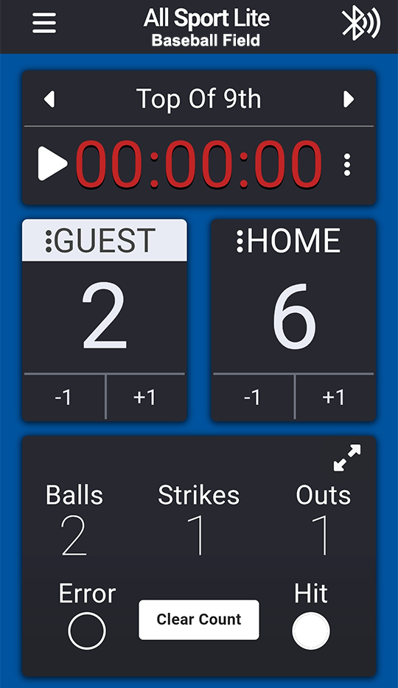
Scoreboards
Are controlled via Bluetooth from the All Sport Lite app from your phone
Anyone on your team can do this! Encourage your families to download this so they are ready to help out.
In most cases, the HOME team is responsible for running the scoreboard.
Only one phone can be connected at a time.
Notes:
I encourage you to download the SportsSignUp Play mobile app. The app provides the team practice and game schedule, a way to contact other team parents, a way for coaches to notify you about schedule changes or cancellations, and the ability to RSVP to practices and games. The RSVP feature is going to be crucial this year as many of us scheduled events around baseball and knowing how many players we will have at practices/games before they start will be helpful. You can download the SSUPlay app from the links below. When logging in to the app, please be sure to use an e-mail address associated with MBA, so your teams will be automatically pulled into your view.

Slide 14
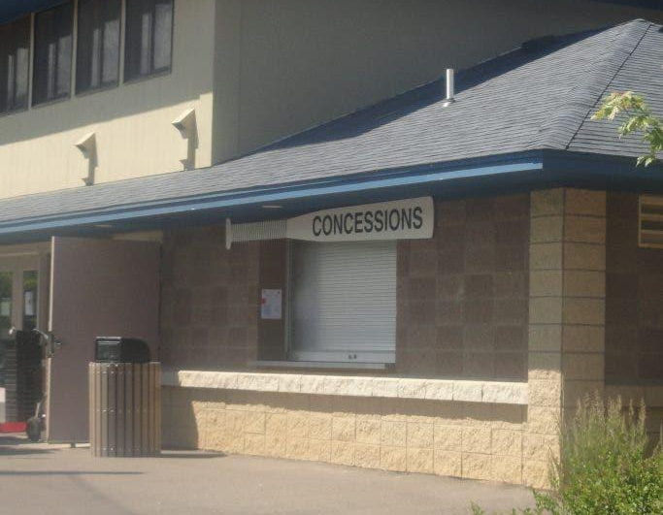
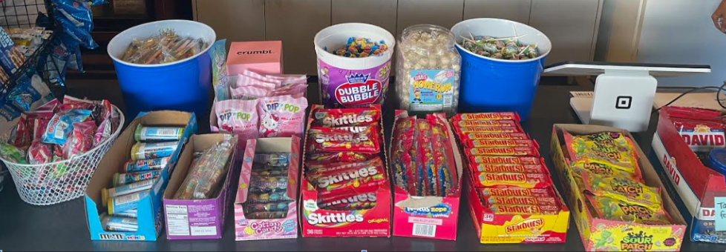
Concessions
Bennett Family Park
Separate non-profit organization from MBA
Continue with new fun options like Dippin’ Dots
Grill will be going on Saturdays!
Square payment for credit / debit cards
**Field 5 limited concession offerings during the weekdays if only game going
Located at Bennett Family Park and Freeman
Bennett concessions are open when games are scheduled at the park (outside food or drink is not allowed at Bennett)
Freeman is open weekends only
Vet’s (High School) for 14+ games
Freeman Concession Stand
MBA Fundraising – 100% of profit goes directly back to our association!
New items this year, focusing on peanut-free options, fun treats, candy, and hot food. Plus Square for credit/debit cards!

Slide 15
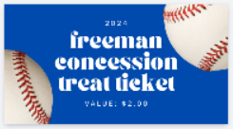
Treat Tickets @ Concessions
Treat Tickets (optional)
What are they?
A fun way to give teams ‘treats’ after games. Treat Tickets are paper tickets purchased at the concession stand ahead of games, and given to players to allow them to go up to concessions and ‘purchase’ their own item(s) for the treat ticket value
Cost: $3 each
Treats Best Practice
If using Treat Tickets, collect $$ from parents ahead of time for all games
If bringing treats to games (outside of Bennett), use a sign up app to allow families to sign up for each game. Ensure you have asked about allergies.
Highly encouraged to use Treat Tickets to support our concessions.
Make sure to remind parents to set expectations with their child on what they can get from concessions (i.e. soda, candy)

Slide 16
Volunteering
Every family needs to sign up for 1 shift per player (1 shift per family during Fall Baseball).
(Please note that once you selected a shift it will lock you in 3 days prior. You must find a replacement for your shift that you locked in)
The following people are exempt from volunteering for concession stand/shift duty:
Travel and Community Head Coaches
Travel and Community Assistant Coaches (up to 3)
Team Manager (1)
Travel GameChanger Manager (1)
Player family that make the opt-out payment during registration for that specific player paid for at registration
Team, League and Fundraiser Sponsors
Notes:
Team Managers do not manage this—but may be asked to notify parents when more shifts are added to the site

Slide 17
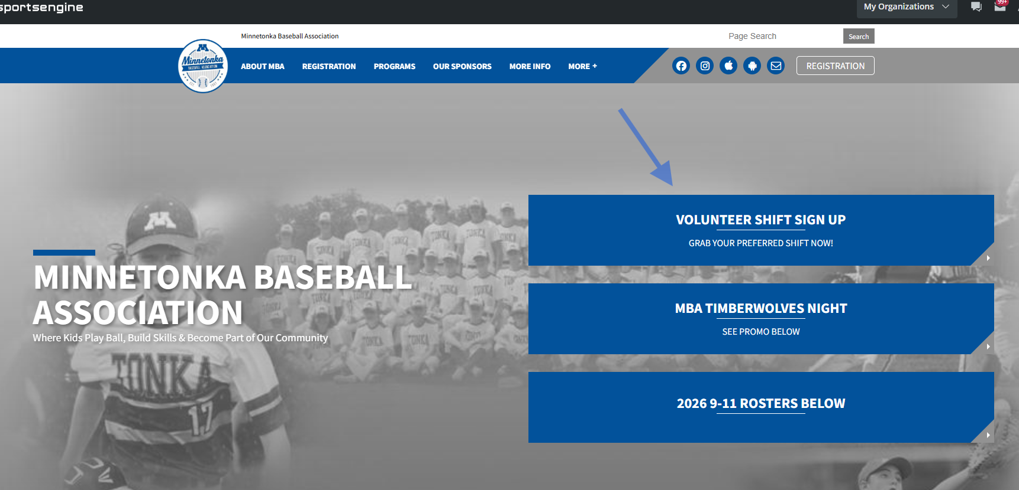
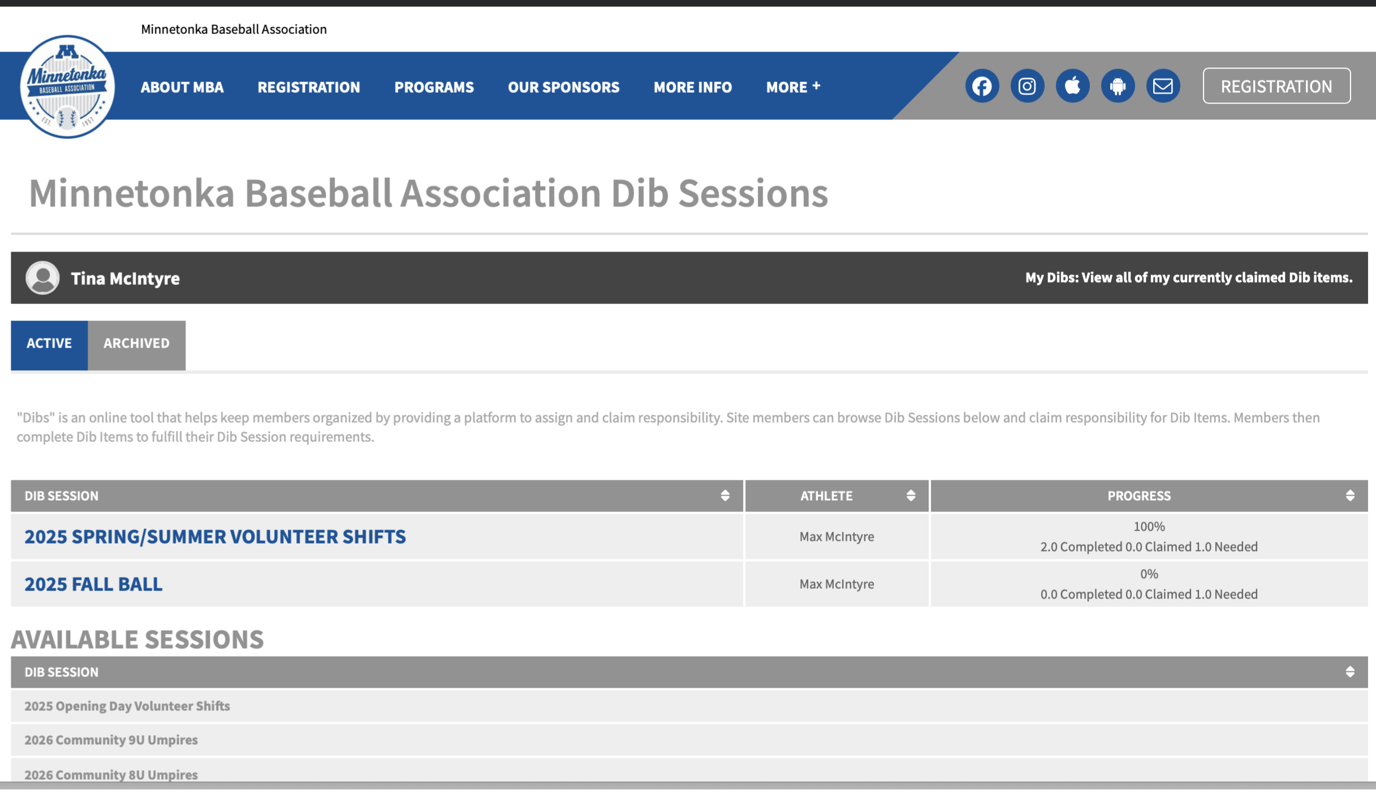
Volunteering
Volunteer shifts will use Dibs within the Sports Engine MBA site
There will be volunteer shifts added for Minnetonka-hosted tournaments mid-season. If a parent was unable to find a slot initially, please know more availability will be published!
#1
#2

Slide 18
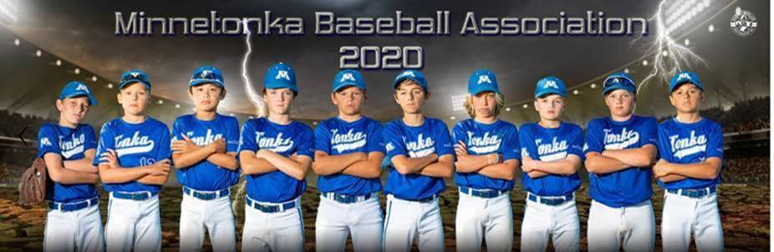
Team Picture Day
SAVE THE DATE
CHANGE: Rookie – Community 16/18 & Travel 9 – Travel 15
Kemmetmueller Photography
Saturday April 18th and April 25th (Black Box)
Minnetonka High School
18301 MN Hwy 7
Enter at West entrance and go straight into the school
Schedule is posted on the website homepage now!
Ordering will be online
No make-up day
Cut off day to make changes is April 13th
Add this date to your team’s schedule as a General Event
*CHANGE: For Community 14/15, 16/18 & Travel 13+ if you DON’T want pictures please reach out to Tina at mbateammanager@gmail.com

Slide 19
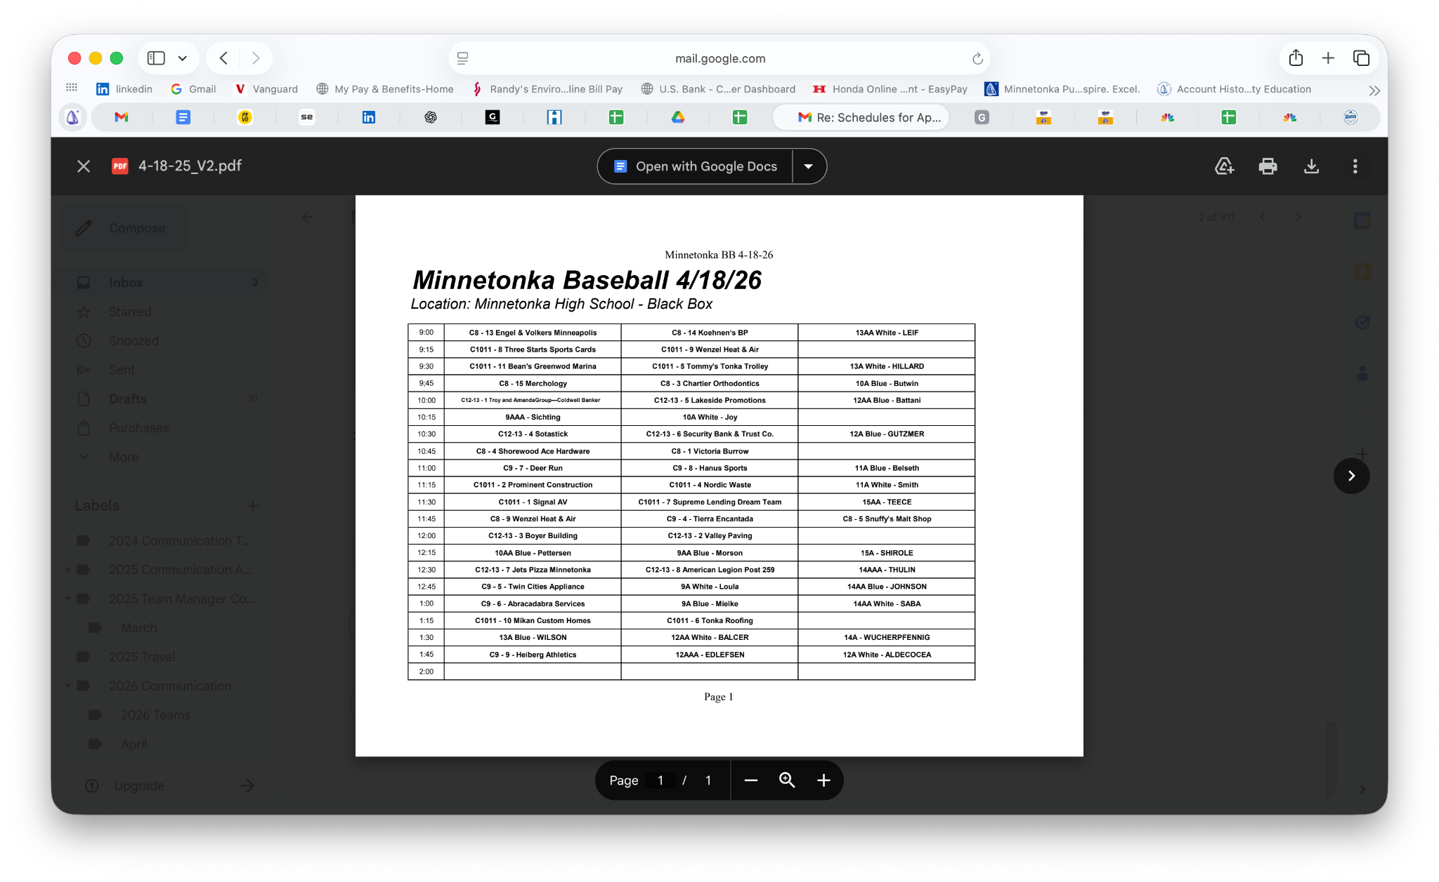
Schedule - APRIL 18TH

Slide 20
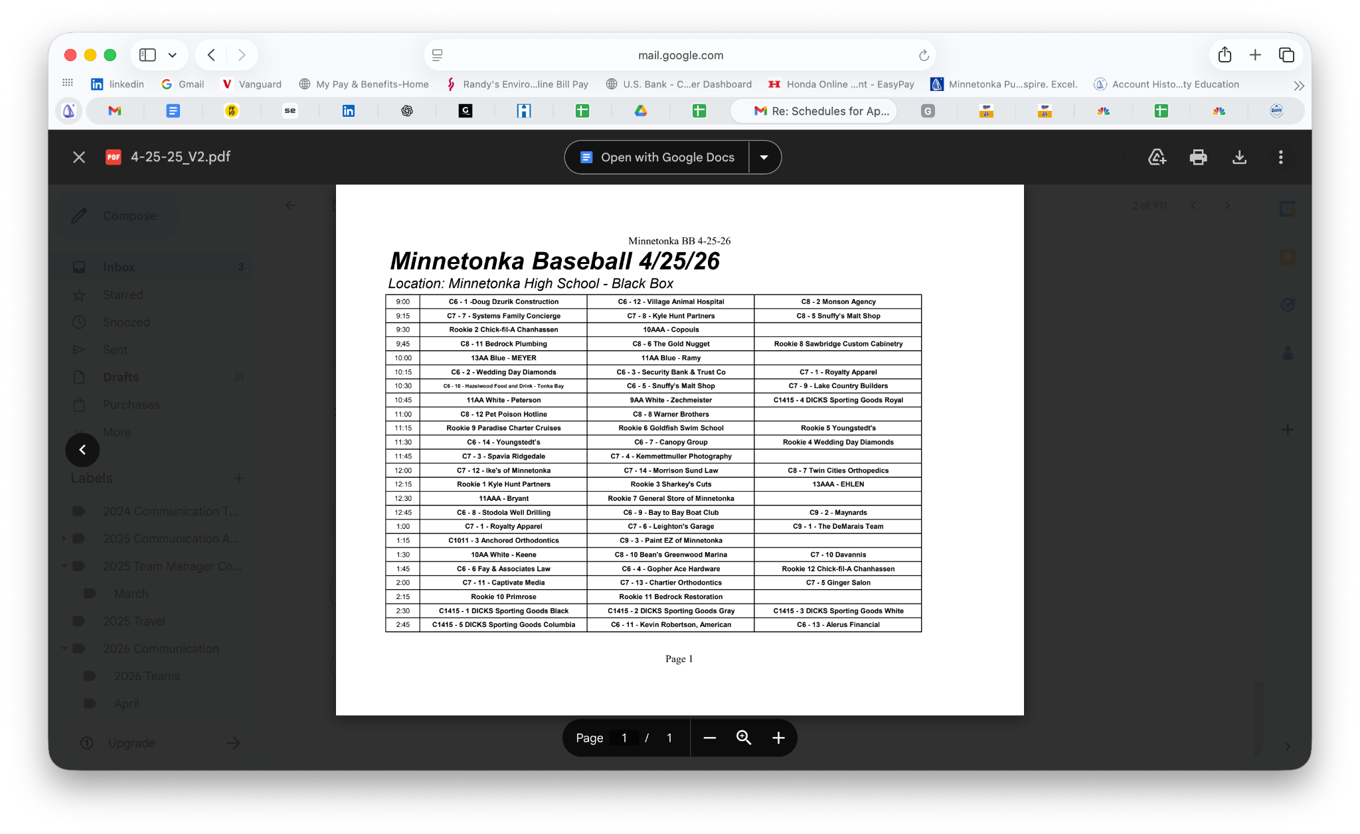
Schedule - APRIL 25TH

Slide 21
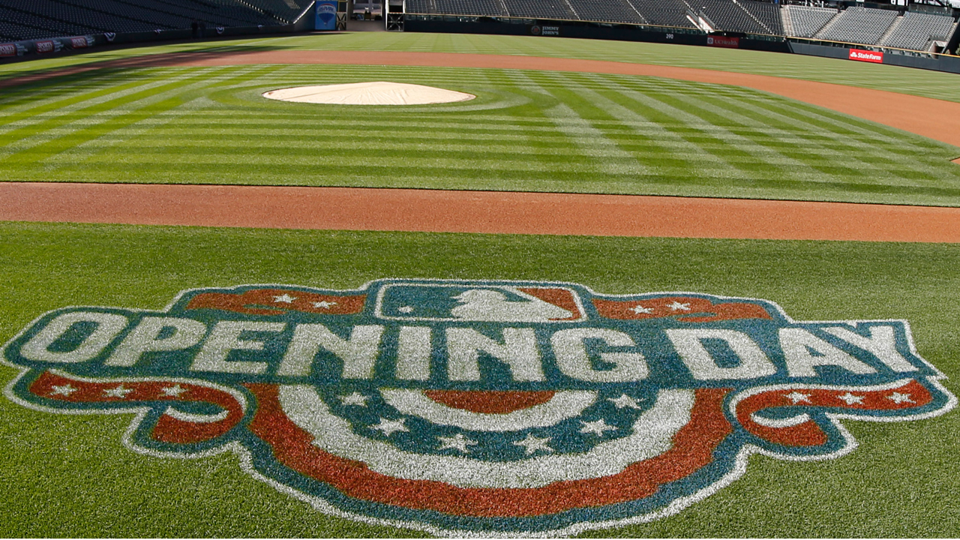

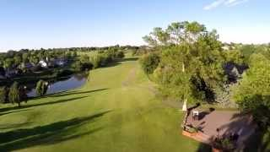
Opening Day & Golf Fundraiser
Opening Day is Saturday May 2nd
Bennett Family Park
Miracle Field & Bennett Pavilion
Games & Giveaways 10am – 4pm
Opening Day Ceremony 10:30am
More to come…
Deer Run Golf Tournament Fundraiser is Monday June 29th
Includes silent & live auction too!
Dinner-only option available
Registration already open
More information to come…

Slide 22
End of the Season Team Events
As the Team Manager, you are responsible for collaborating with your coaches to determine the best option and date for an End of Season Team event.
This is typically for entire families, and is a great way to celebrate the season, new friendships, and new skills!
Ideas:
Use MBA Sponsors* such as…
Davanni’s Community Room
Snuffy’s (back seating area)
Gold Nugget’s private dining space
BBQ at coach or parent home
Victoria Burrow
ETC!
Coaches gifts
While not required, it is customary for players/families to contribute to an end of season coach gift to thank them for the work this season
These can be as simple as a signed ball or photo, and gift card to a local coffee shop or restaurant!
If you need ideas at the end of the season – feel free to reach out!
Player recognition
At the end of season event, we recommend coaches taking turns speaking about each player and the contributions and skills gained over the season.

Slide 23
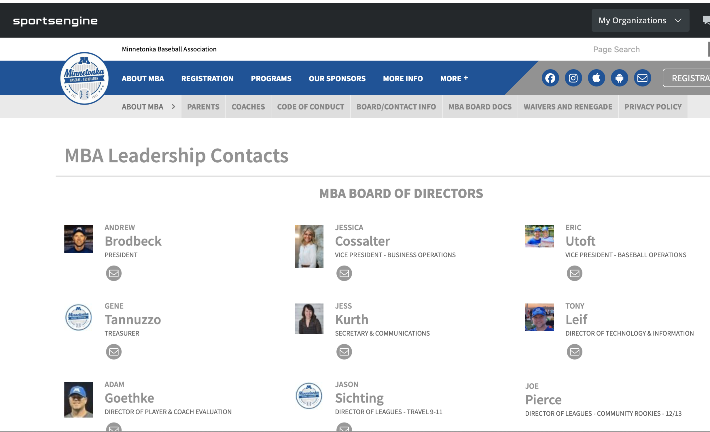
MBA Board & League Contacts Go to: Minnetonkabaseball.org Navigate to About MBA-> Board/Contact Info
Board Members
League Directors
Leaders –
Concessions
Volunteers
Equipment
Communications
Scholarships
Safety
Scheduling
Umpiring
We are always looking for MBA volunteers to help with these areas! Reach out to any board member for more info!

Slide 24
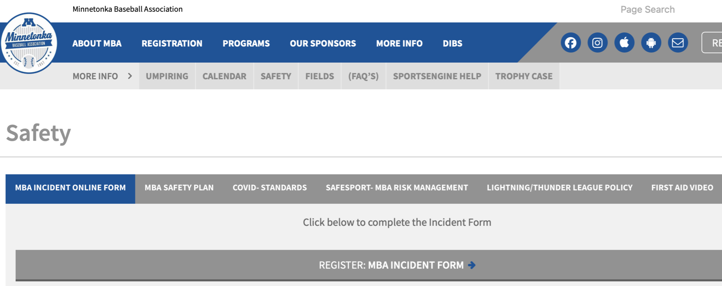
FAQs - Safety Protocol
INCIDENT FORM & AED
INCIDENT FORM: On the MBA Website under More Info -Safety. The form is filled out online by the Coach and is automatically sent to the Safety Director. These must be done within 12 hours of the incident, and should be done for any incident that takes the player out of a game or practice. If checked ‘yes’ to Professional Medical Treatment, the player must present a non-restrictive medical release prior to being allowed in a game or practice
AED: The AED will only be accessible from the Freeman concession stand if it is open (weekends). The Bennett AED is located within the concession stand. If an AED is required, always call 911.

Slide 25
FAQs GAMES AND GENERAL FAQ
What are the addresses of each field?
All field addresses are loaded in our website. The APP for your phone will integrate with your Maps function.
What if another parent on the team is volunteering to help with things on the team, can they get volunteer credit?
Only head coaches (1), assistant coaches (3), Team Managers (1) and Game Changer scorer* (1) receive volunteer credits for working with the team.
How do we know if a game is cancelled?
League officials will communicate with coaches and/or league wide communication via email and text (based on your user profile on the website). Check email often if weather is questionable.
Is there are a resource for buying and selling used baseball equipment?
Unfortunately not right now on our new site
*Travel Teams only
Which age groups receive trophies?
Rookies – Community 7 will receive participation trophies
Community 8+ participate in end of the season league tournaments with trophies, this occurs in the last week of June
My son lost his glove, is there a lost and found?
Both Bennett & Freeman have lost and found bins
We don’t have the lost and found on our website
Where do we get scoreboard controls?
Scoreboards are controlled via DAK Score APP
Anyone can download and score the game from their phone
Who do I contact if there is a question on game rules?
Coaches should contact their respective League Director

Slide 26
FAQs GAMES AND GENERAL FAQ
When does the season end?
Rookies – Community 7 will end June 21st
Community 8+ - ends after the end of season tournament
Travel teams can play to the end of July based on tournament qualifications

Slide 27
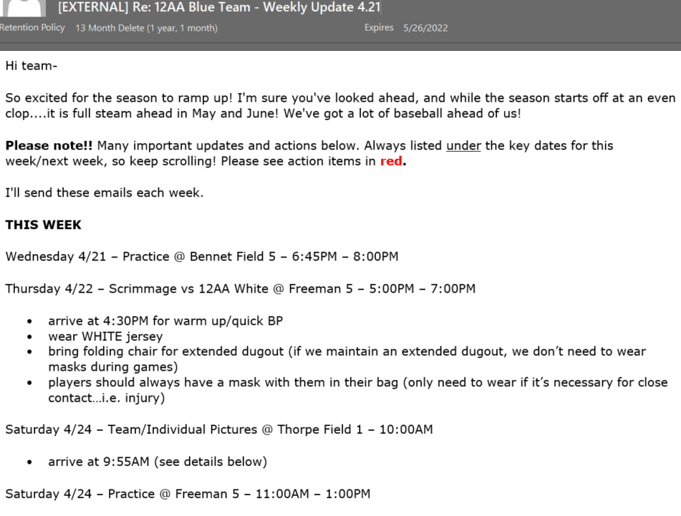
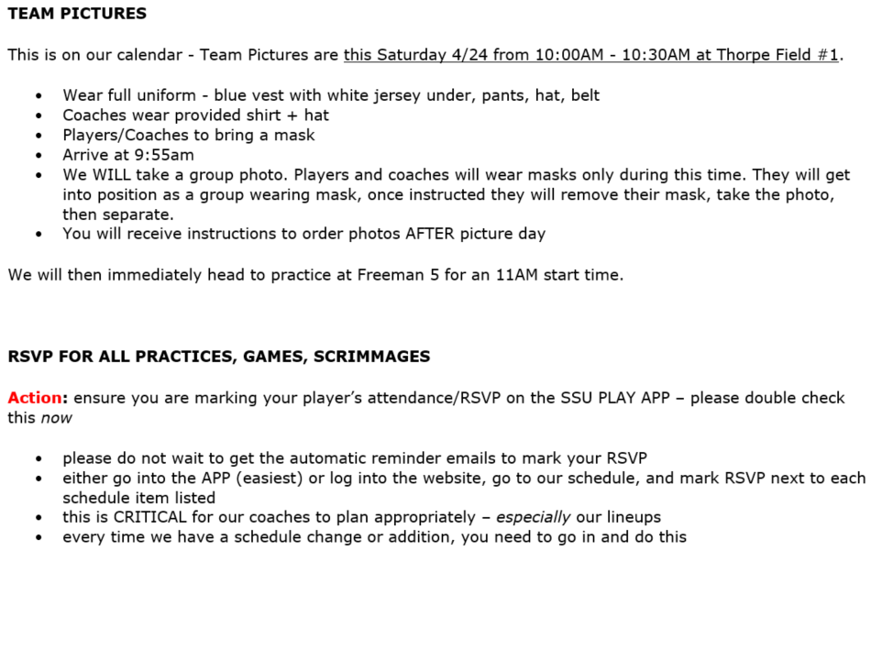
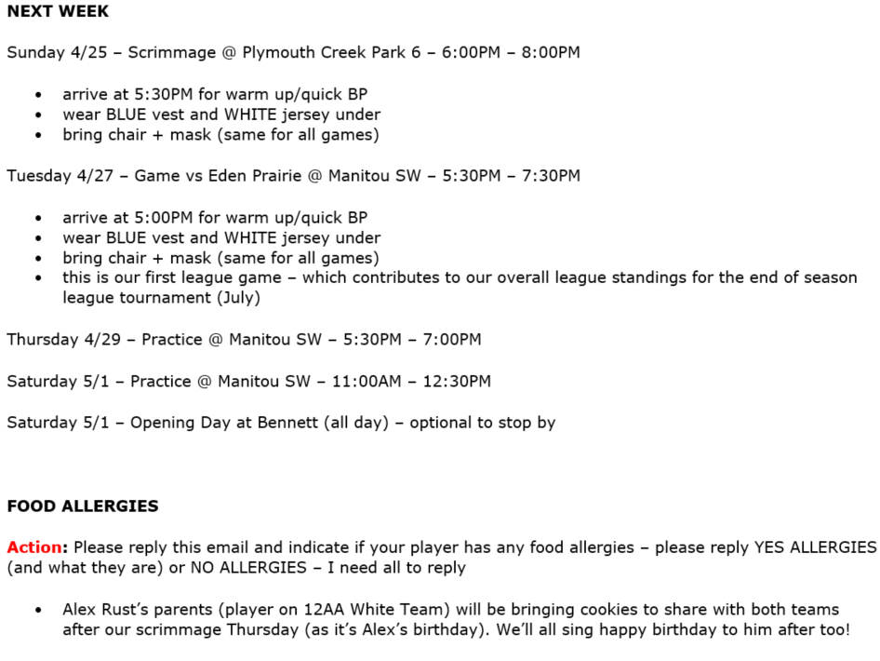
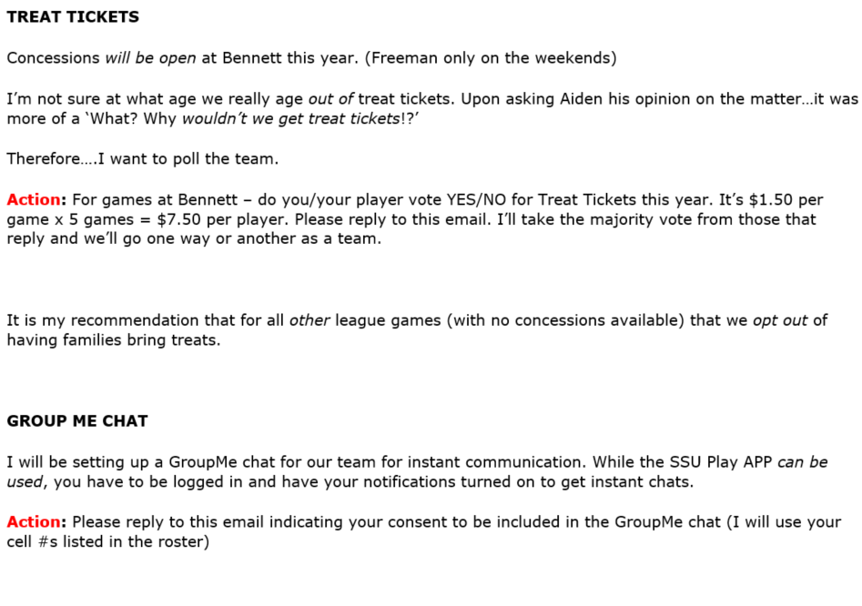
EXAMPLE COMMUNICATION

Slide 28
MBA TRAVEL TEAMS

Slide 29

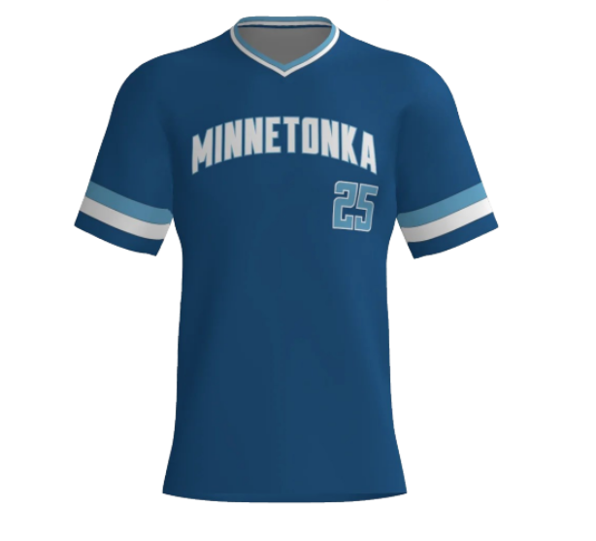
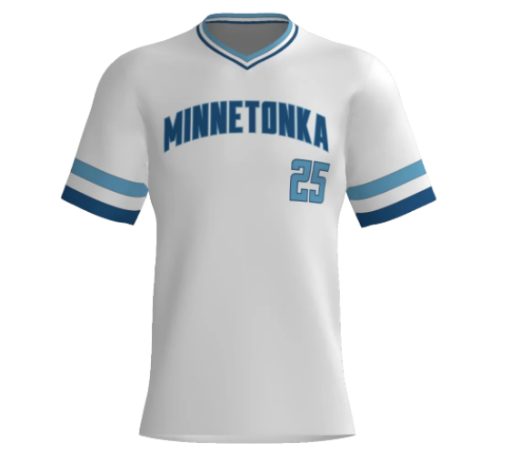
MBA TRAVEL TEAMS
MBA participates in the Metro Baseball League (MBL) Program for Travel Teams. Rules for regular season games can be found on their website at https://www.mbl.bz/​
(Gopher State/MYAS is the other large league in the metro area, MSF is the third and smallest league)
Uniforms:
Players will have 2 sets of jerseys (white and blue). Please have parents ensure players always have their 2nd uniform in their bags as teams may have to switch jerseys for both regular season games and tournaments.​
Games will be scheduled on weekday evenings against neighboring communities (your region) ​

Slide 30

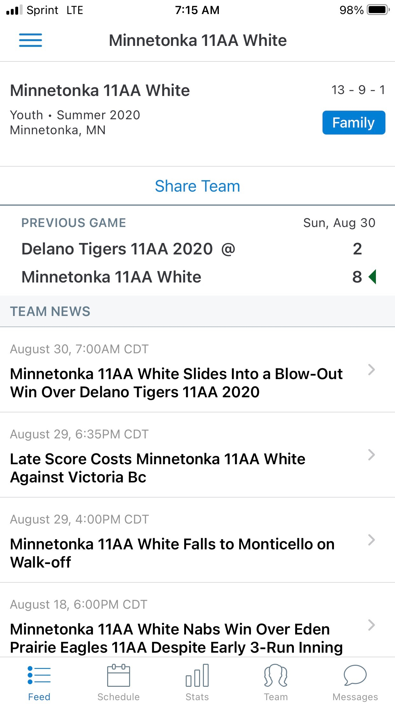
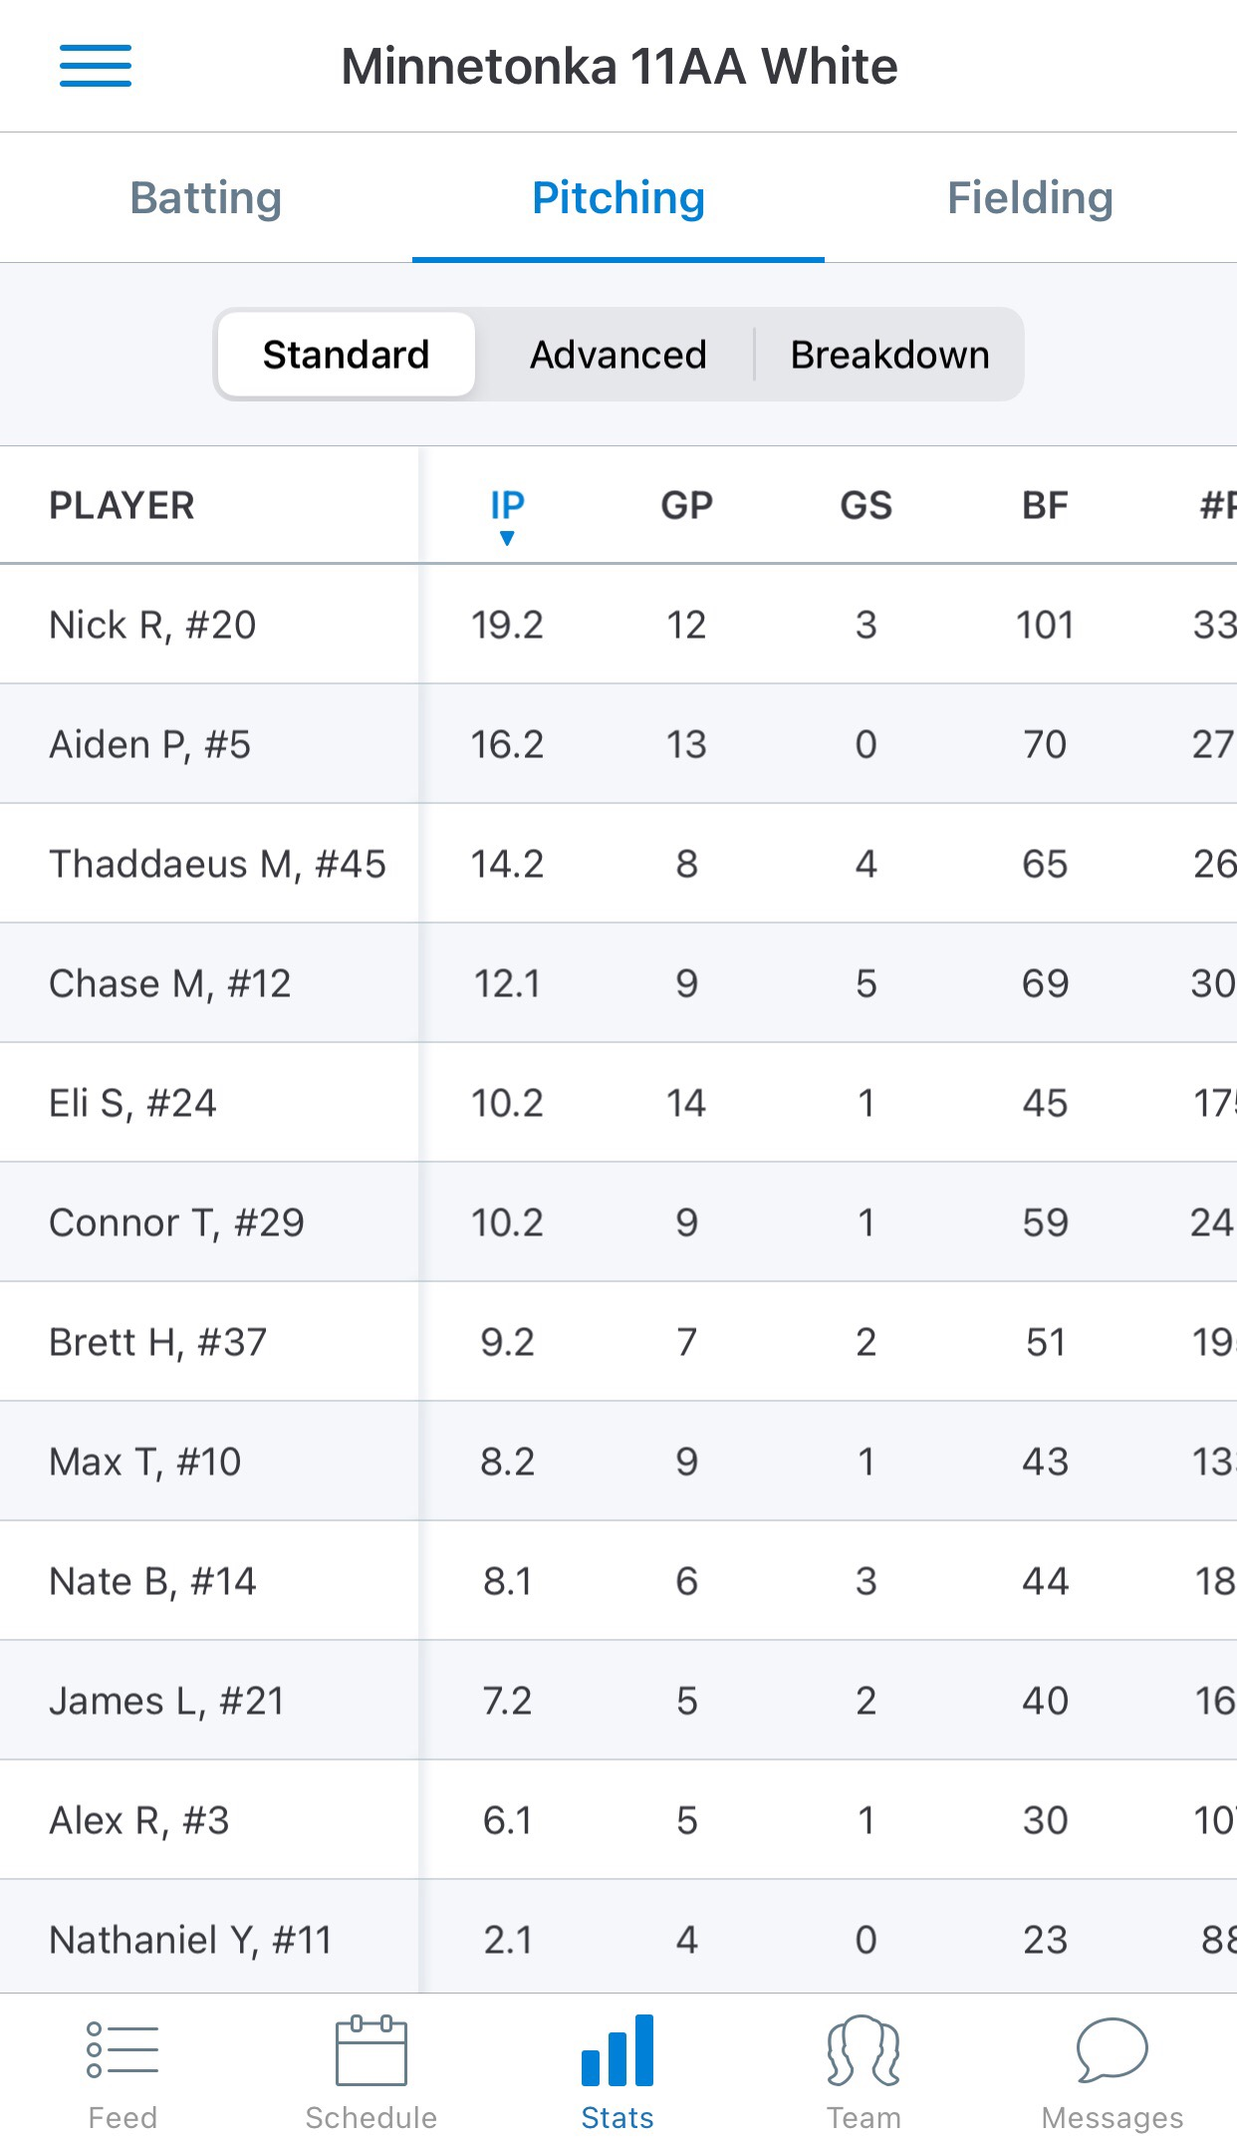
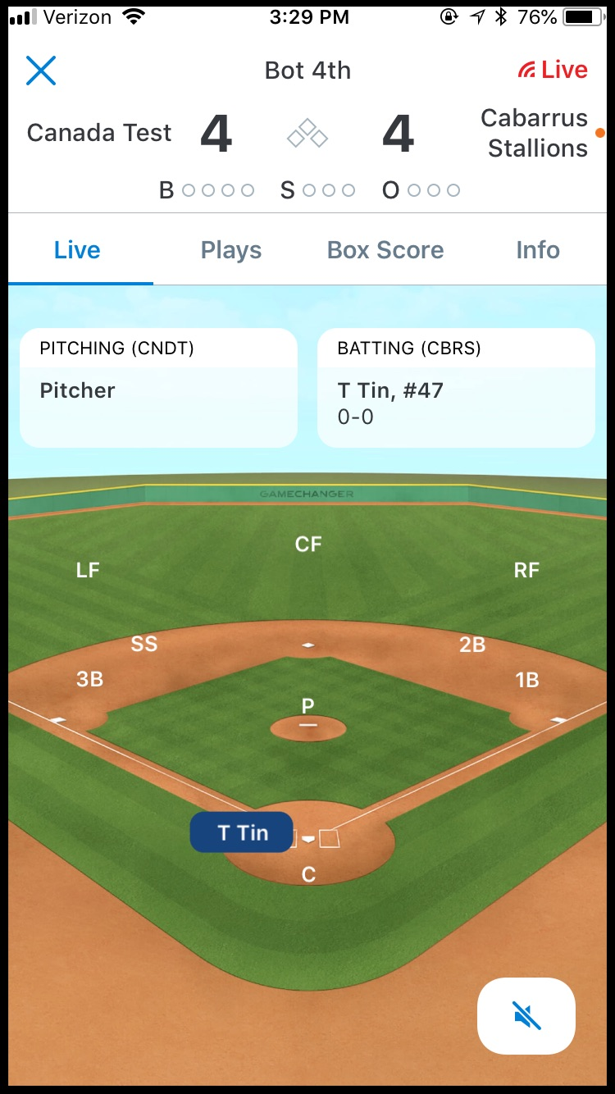
MBA TRAVEL TEAMS
All travel teams are required to use the Game Changer app to track games
Your coach will identify your main Game Changer volunteer, and back up. This person enters play by play within the app live at the game. This volunteer (1 only) is exempt from volunteer duty.
IMPORTANT! Please have all your families download the Game Changer APP
GAME STREAMING Consider asking for volunteers to use the game streaming function within Game Changer! This is optional, but a great feature. Requires use of parent’s phone attached to backstop to stream game. More info to be found with this helpful video on live game streaming & recording
Other helpful tools​:
Group Me (please get parent permission prior to adding them to a Group Me)​
Sign up Genius

Slide 31
Travel Tournaments
Each Travel Team will compete in 3-4 regular season tournaments. Tournaments are held on weekends (Fri/Sat/Sun). If you do not have a tournament on a given weekend, enjoy your weekend.​ Typically we never have tournaments Memorial Day Weekend, unless your coach decides to do one out of state.
Most tournaments are in the metro area​
Certain teams may have a tournament outside of the metro area (Mankato, Rochester, Sartell, Red Wing…)
Hotel blocks have been secured for all 9-11 Tournaments – all team managers should have this information already. 12+ should have secured themselves already.
Tournaments will be qualifiers for one or more State Tournaments
MBL will have an end-of-season tournament prior to state tournaments based on team standings in regular season games​. These occur generally in the last two weeks of July and are on weeknights.
The MBT August Classic occurs after state tournaments, and is only for select players from top teams

Slide 32
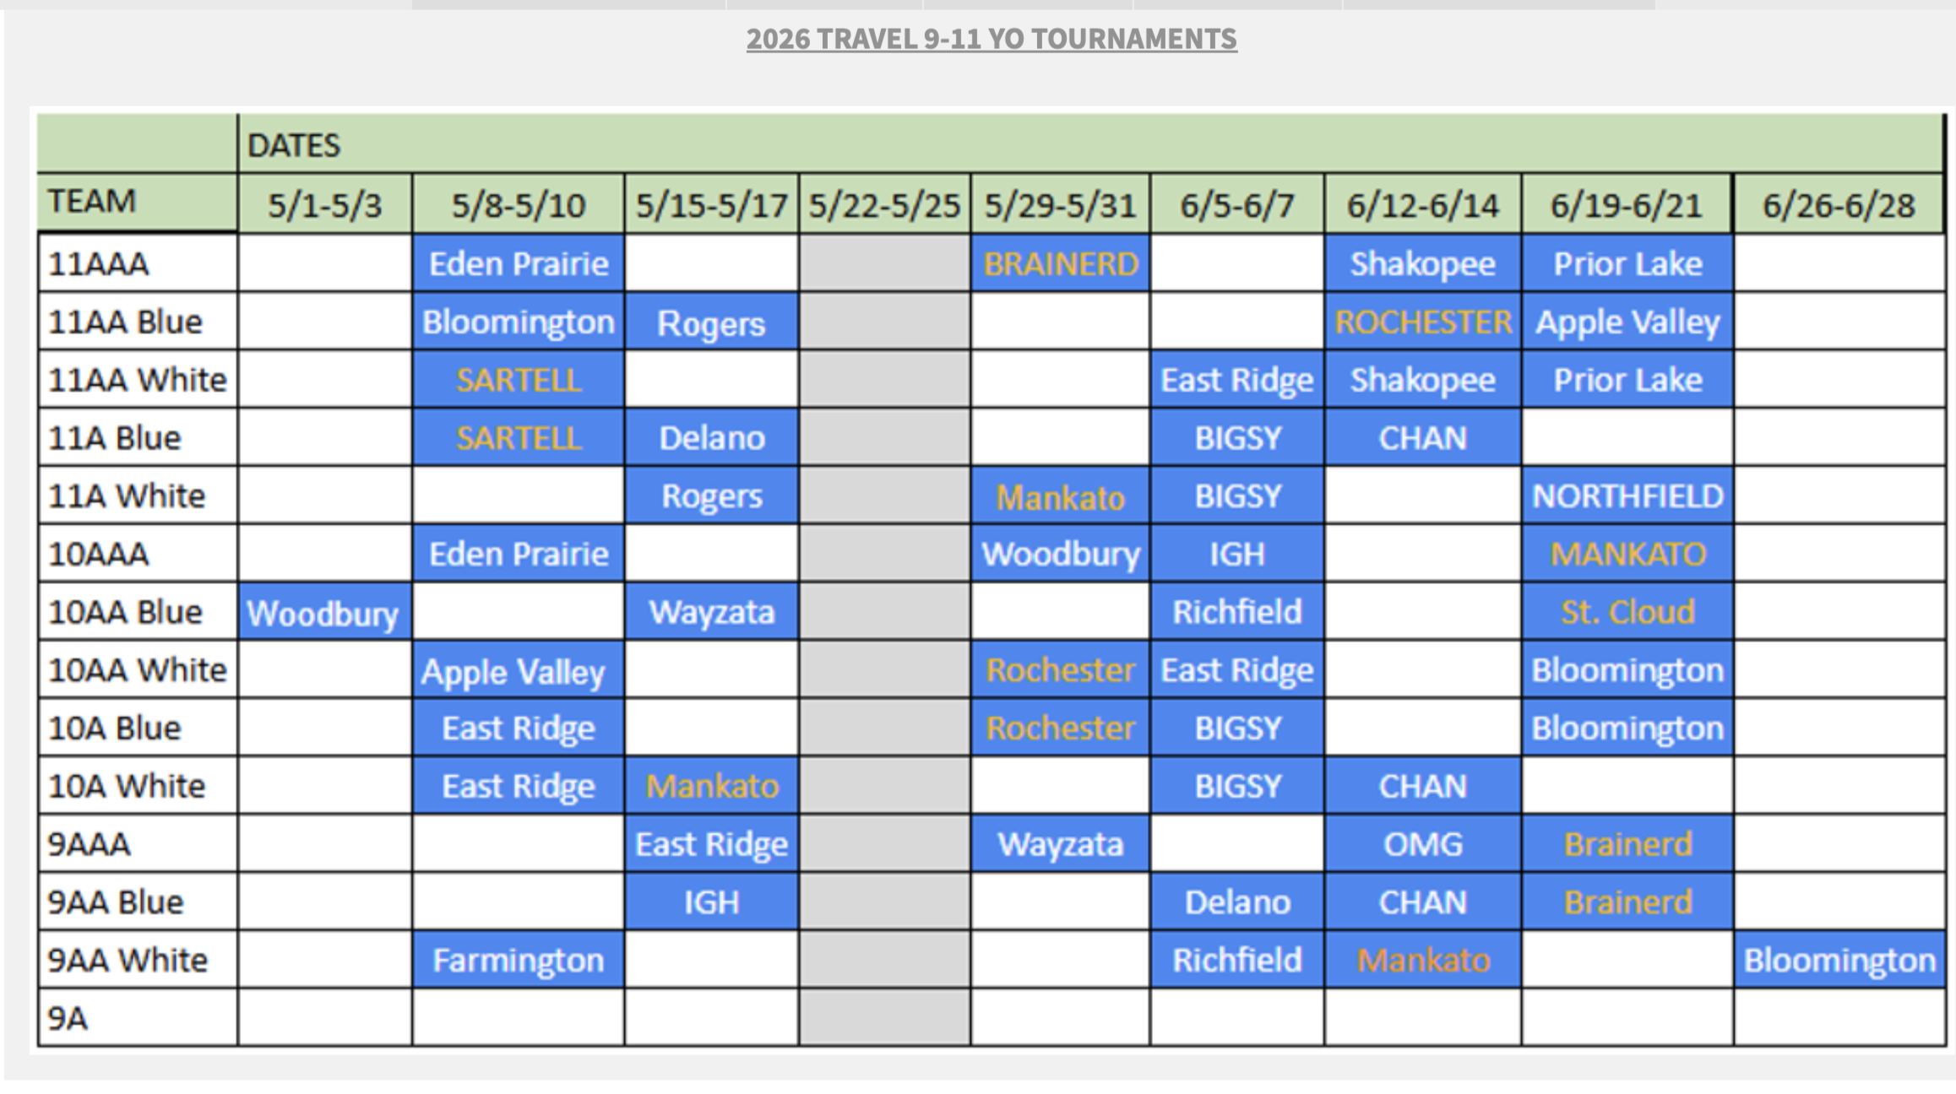
Travel 9-11 tournament schedule
Travel 12-15 tournaments are scheduled by Head Coaches (since Travel teams for 12+ are fielded in October each year). These schedules are completed, and should have already been communicated to your teams earlier in the year. If they are not on your schedule, please add them as placeholders. ​

Slide 33

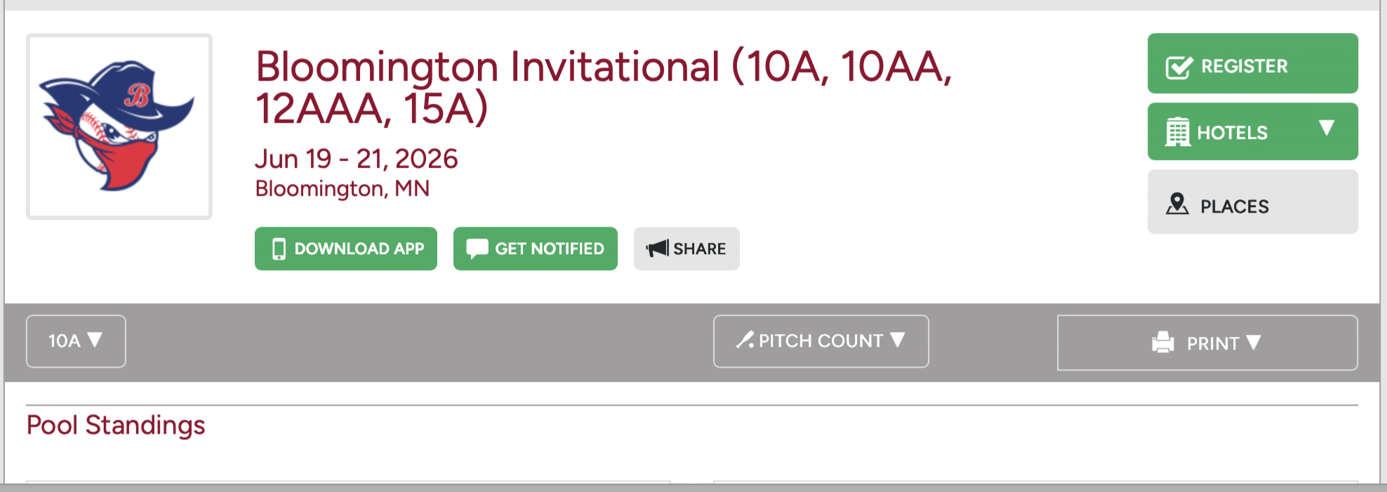
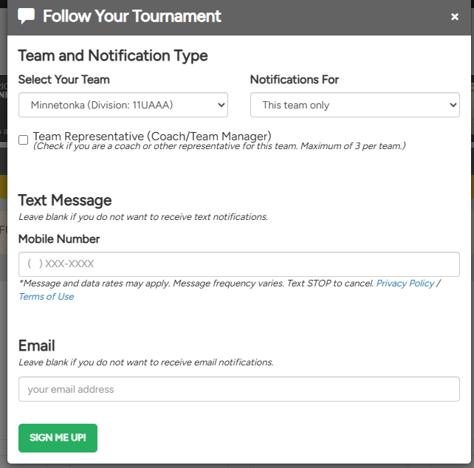
Travel Tournaments
Make sure you have the APP, too!
9-11 Travel Teams ONLY
You will need to edit your tournament contacts in Tourney Machine
Navigate to the website version here: https://tourneymachine.com/
Search for your Tournament and age group
Click Notifications->Fill in contact data for coaches and team managers.

Slide 34
Additional Tournament Info…
Team Managers will need to collect copies of the following for tournament check-in (usually 1 hour prior to the start time of your 1st game):​
A copy of each player’s birth certificate ​
A copy of each coach’s (head and assistants) concussion certificates ​& child safety certificates
Each tournament is run through an organization similar to MBA in a neighboring community. Websites with information will be provided prior to the tournament (brackets, rules, field information)​
Gopher State and MBT have different bat standards. Work with your coaches on ensuring your team knows what is needed for each tournament.​
All games for tournaments must be entered on the MBA website by a Team Manager or coach. It is helpful to put the full bracket schedule with TBD based on games on the invites.
All fields you are playing at should be available on the MBA website. ​
If a field is missing, DO NOT add the field to the website, select TBD and Brian Hallbalde with questions mba.blades@gmail.com
Notes:
Need to have…
Birth Certificates
Trusted Coaches certificates – Concussion & Child Safety for each coach in the dugout (incl those just helping for the weekend), and check dates!
3 yr expiration on Concussion
1 yr expiration on Child Safety
Copies of waivers (if required by hosting tournaments)
Copy of Roster (may be required to turn in)
Nice to have…
Copy of rules if different from MBL
Tournament bracket, contact information for tournament director
Team contact information

Slide 35
State Tournaments
Regular season tournaments are state qualifiers for 1 of 3 different organizations. A single tournament can be a qualifier for more than 1 state tournament (i.e. both a gopher state and MBT qualifier)​
Metro Baseball League Tournaments (MBT/ part of MBL) https://www.mbl.bz/​
Gopher State (also called MYAS) http://myas.org/baseball/​
Minnesota Sports Federation (MSF) https://msf1.org/?cat=14​
In order to qualify for a state tournament your team must place 1st or 2nd in a tournament
For MBT ONLY – if the teams in 1st or 2nd place have already been given bids, then it will be given to 3rd or 4th place teams when applicable. GSTC is not handing down bids to 3rd or 4th place this year.
MBA will pay for entry in up to 2 state tournaments. If your team makes all 3, you can determine if parents would like to pay for the entry in the 3rd tournament.​

Slide 36
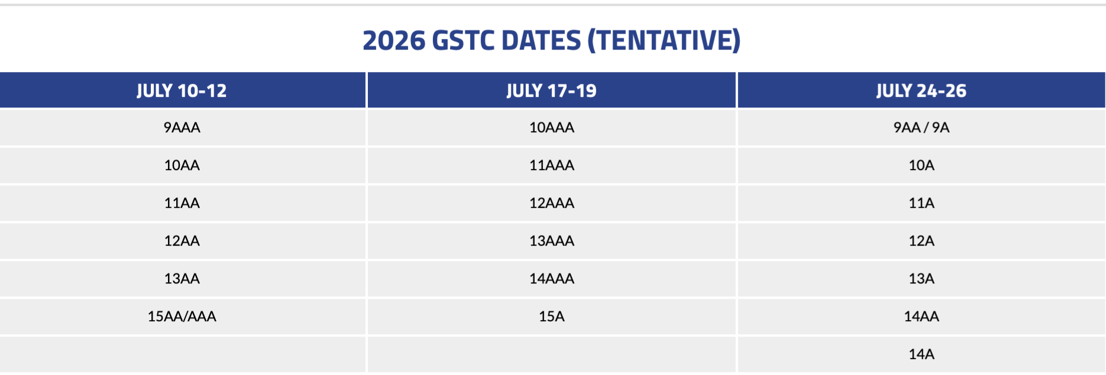
State Tournaments
You may want to consider booking hotel blocks for NOW
But this would be ahead of getting your state bids
Align with your Head Coach and then determine if the blocks can be canceled without penalty
MBT 2026 STATE TOURNAMENTS - for locations click here
JULY 10-12: MBT STATE TOURNAMENTS
10-14AAA, 10A, 12A, 13A, 15A & 14AA
JULY 18-20: MBT STATE TOURNAMENTS
9AAA, 15AAA, 9-13AA, 15AA, 9A, 11A & 14/15A
GOPHER STATE (MYAS) 2026
TOURNAMENT OF CHAMPIONS - locations TBD check here

Slide 37
Contacts
League Director – All Travel teams
Jason Sichting - sichting.mba@gmail.com
League Director – All Community teams
Joe Pierce – piercej33@gmail.com
Each Division has its own League Leader - see Additional Contact navigation below
Operations and Information Director
Tony Leif – tony.leif@gmail.com
Director of Team Managers
Tina McIntyre – mbateammanager@gmail.com
VP of Business/Admin Operations -
Jessica Cossalter - mbabaseball.vpbusinessops@gmail.com
Additional Contacts​
Go to: Minnetonkabaseball.org Navigate to About MBA -> Board/Contact Info

