Slide 1

Lakeville North High School Volleyball
BOOSTER ELECTIONS
2022
Membership & Transition Meeting
1/19/22

Slide 2

AGENDA
Welcome
Recognition of the 2021 LNHSVB Booster Club Board
Purpose and Objective of the Lakeville North High School Volleyball Booster Club (LNHSVBBC)
Booster Organizational Chart
Roles and Responsibilities
Election: 2022 Executive Board Members
Review: 2021 Sub-Committee and 2022 Nominations
Looking Ahead 2022
Key Off-Season Information
Conclusions/Questions

Slide 3


Volunteering
The heart of a volunteer is never measured in size, but by the depth of the commitment to make a difference in the lives of others.
-DeAnn Hollis
Volunteering in the LNHSVBBC includes:
    Welcome and Acceptance,
    Cooperation,
    Support (peer, financial, project etc.),
    Foundation and Flexibility/Creativity,
    Brainstorming and Problem-Solving,
    Contributions to a group (vs individual),
    Appreciation and Accomplishment.
Do things for people
not because of who they are
or what they do in return,
but because of who you are.
-Harold S. Kushner
Joy multiplies
when it is shared among friends.
-R.A. Salvatore

Slide 4
2021
LNHSVBBC EXECUTIVE BOARD
President: Barb Timm
Vice President: Linette Ramsay
Communications/Website: Delana Wherland
Finance Director(s): Lori/Scott Firm
Volunteer Director: Pam Dahl
Special Events Director: Mary Pat Blascziek
Tournaments Director(s): Dawn/Jim Jandro
Concessions Director: Karlene Driver

Slide 5
PURPOSE and
OBJECTIVE of the
LNHSVBBC
The purpose of the LNHSVBBC is to promote the sport of girls’ volleyball for the student-athletes of Lakeville North High School.
Ongoing dialogue with the LNHS Athletic Director and the LNHS volleyball coaching staff to ensure that the booster’s participation in and support of the volleyball program is at all times consistent with the highest goals and aspirations of the athletic competition among students.
The objective of the LNHSVBBC is to support the long-term growth of the volleyball program and ensure that the students have the proper training, equipment and facilities in which to learn and compete.
The goals include but are not limited to: providing financial support (financial and otherwise), to develop a sense of pride and tradition for the students, to promote and publicize the LNHS volleyball program in the community and to recognize the accomplishments of the team, the players and the coaches.

Slide 6
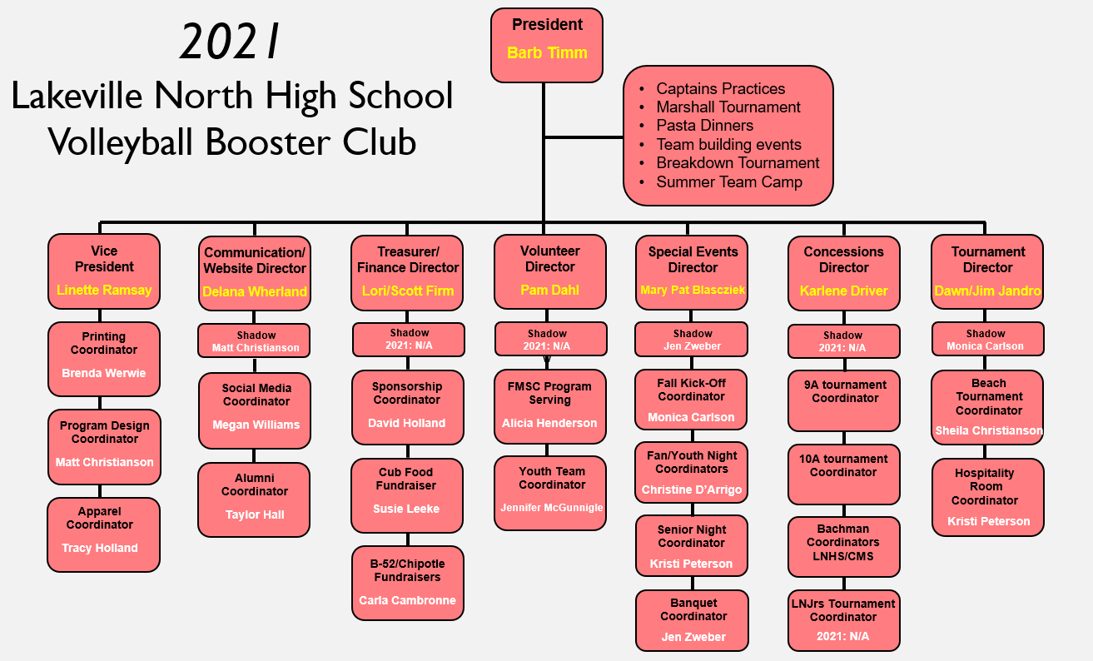
2021
LNHSVBBC
ORG
CHART

Slide 7
LNHSVBBC
ROLES and
RESPONSIBILITIES
President
Lead, guide and shape all LNHSVBBC meetings. Carry out the decisions of the general membership expressed by a majority vote of those present at vote. Carry out decisions expressed by the majority of the Executive Board. Vote only in the event there is a tie after a quorum is present. Authorized to direct the Treasurer to issued checks consistent with the budget (See Article IX). Act as the liaison between the coaching staff, school administration/Athletic Director, and the LNHSVBBC. Recommended to meet with the Head Coach & Athletic Director at the beginning of every season to discuss general business items, roles & responsibilities, new policies, etc.
Vice President
Act with the power and authority of the President in the absence of the President. Directly oversee the Apparel, Printing and Program Design Coordinators and guide/assist the responsibilities of each. The Vice President should not be a senior parent. The VP should be willing to work alongside the President and run for the President position when vacated by the current President. The Vice President is also responsible for other duties as assigned.
Communication/Website Director
Prepare and maintain full minutes of all booster meetings. This position shall conduct and keep all correspondence of the LNHSVBBC and perform other such duties that customarily pertain to communications. Keep and maintain the player/parent information including addresses, phone numbers and email addresses on a spreadsheet and update all Mail Chimp data as necessary. Keep a current list of alumni player contact information. Oversee aspects of communication from the Booster Club to the membership. All communications sent on behalf of the Booster Club to the Membership are first to be cleared through the President and Head Coach prior to sending. The Communication/Website Director is also responsible for other duties as assigned.
Special Events Director
Plan and organize all special events throughout the LNHSVB calendar year. Support, guide and direct subcommittee chairpersons dedicated specifically to the LNHSVB special events such as the Fall Kickoff, Youth/Fan Night, Senior Night, and the Banquet. The Special Events Director will assist the Captain’s Parents responsibilities as needed and other duties as assigned.

Slide 8
LNHSVBBC
ROLES and
RESPONSIBILITIES
(cont’d)
Finance Director
Receive, deposit and give account of the current assets of the LNHSVBBC; have charge of all funds, securities and financial records of the LNHSVBBC; maintain appropriate records; make payments for all LNHSVBBC liabilities; submit a financial statement at each monthly Board meeting; submit a fiscal year-end statement and interface with the LNHS Booster Club as appropriate. Plan and mentor subcommittee chairpersons, organize and optimize revenue stream from events such as Tournament Ticket & Concession Sales, oversee other fundraising event(s), as well as find new sources of revenue; and other duties as assigned. The Treasurer must ensure all fundraising events are approved by the LNHSVB Head Coach, the LNHSVBBC and the LNHS Activities office.
Volunteer Director
Responsible for all aspects of recruiting and organizing volunteers for all volunteer needs of the LNHSVBBC. This includes (but not limited to): establishing volunteer needs with other LNHSVBBC Officers, creating a map of volunteer needs for each season, creating signup and reminder communications, and reporting the status and needs to the Executive Board on a frequent basis (as well as other duties as assigned).
Tournament Director
Oversee and organize all aspects of tournament operations with the guidance and cooperation of the on-site LNHSVB Head Coach. Post and maintain all visible tournament brackets, programs, signage and operations during tournament events. Oversee the Hospitality Room Coordinator (Bachman Invitational only) and the Pan-O-Prog Beach Tournament (July) Coordinator: distribute direction and assistance as needed. The Tournament Director is also responsible for other duties as assigned.
Concessions Director
Oversee the complete operations of concessions at each tournament with the help of the on- site Concession Coordinators. Supervise the setup and breakdown of the concession stand; the production of all menu items; costing; shopping and delivery of the concession items. The Concession Director will pre-order all items needed the day of by local businesses (as well as other duties as assigned).

Slide 9
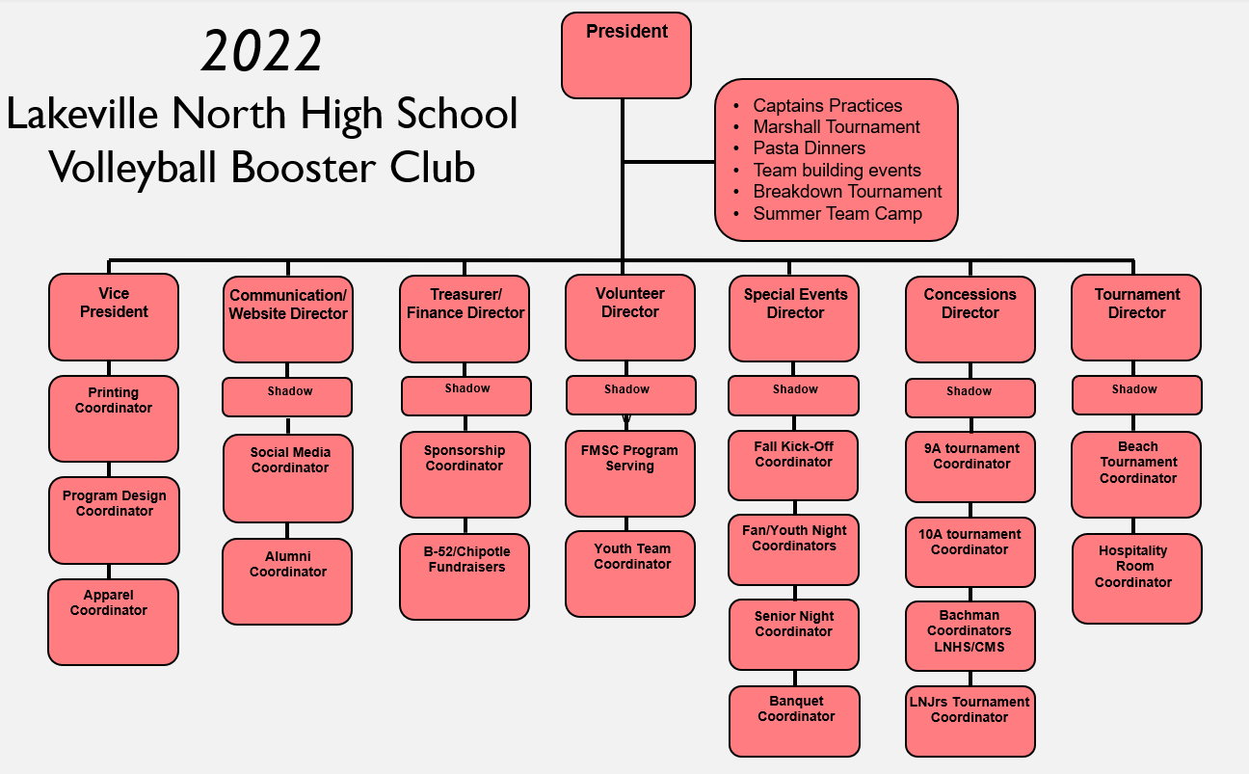
2022
ORG
CHART
LNHSVBBC

Slide 10
2022
ORG
CHART
LNHSVBBC
Highlights
Addition of the LNHSVBBC Shadow positions in 2021 was a success!
  A LNHSVBBC Shadow will spend time observing, learning from and assisting a LNHSVBBC Director by attending monthly LNHSVB Booster Club meetings, participating in positional meetings with their Director, volunteering with and for the Director or board specific needs, and being an active recipient of all position-specific communications.
  No Shadow position is required for Directors with sophomore (or younger) daughters.
Addition of the Program Design Coordinator position:
  The LNHSVBBC Program Design Coordinator will be responsible for the general design needs of the LNHS Volleyball Season Program. Specifically, the creative design work (layout and design) from conception to delivery of the Home Match Program, Bachman Tournament Program and Beach Tournament Flyer. Collaboration with the Team Photographer, Printing Coordinator and Sponsorship Director as needed. Knowledge of Adobe or design printing software helpful.
Elimination of the Cub Foods Coordinator position
As of today (1/19/22) , the LN Juniors Tournament is back on for 2022!

Slide 11
2022
BOOSTER BOARD EXECUTIVE
NOMINATIONS
LNHSVB
Position | Nominees
President | Linette Ramsay
Vice President | Kristi Peterson
Finance Director(s) | Lori/Scott Firm
Communications/Website Director | Matt Christianson
Volunteer Director
Special Events Director | Mary Pat Blascziek
Tournament Director(s) | Monica Carlson
Concessions Director | Karlene Driver

Slide 12
2022
BOOSTER BOARD
SHADOW
NOMINATIONS
LNHSVB
Position | Nominees
Finance Director Shadow
Volunteer Director Shadow
Special Events Director Shadow | Jen Zweber
Tournament Director Shadow
Sponsorship Coordinator Shadow

Slide 13
2021
EVENT
COORDINATORS
LNHSVBBC
Position | Volunteer
Social Media | Megan Williams
Apparel | Tracy Holland
Fall Kick-Off Meeting | Monica Carlson
Beach Tournament | Sheila Christianson
Alumni | Taylor Hall
Printing | Brenda Werwie
Fan/Youth Night | Christine D’Arrigo
Hospitality Room | Kristi Peterson
Senior Night | Kristi Peterson
Youth Team | Jen McGunnigle
Sponsorship | David Holland
Chipotle Fundraiser | Carla Cambronne
Program Design | Matt Christianson
FMSC | Alicia Henderson
Banquet | Jen Zweber

Slide 14
2022
EVENT
COORDINATOR
NOMINEES
LNHSVBBC
Position | Volunteer
Apparel Coordinator | Tracy Holland
FMSC Service Event | Alicia Henderson
Fall Kick-Off Meeting
Beach Tournament | Sheila Christianson
Printing Coordinator | Brenda Werwie
Program Design Coordinator | Matt Christianson
Fan/Youth Night | Christine D’Arrigo
Senior Night | Nicole Paterson
Youth Team Coordinator | Jennifer McGunnigle
Banquet Coordinator | Jen Zweber
Sponsorship Coordinator | David Holland
B52/Chipotle Coordinator
Bachman Hospitality Room
LNJrs Tournament Concessions

Slide 15
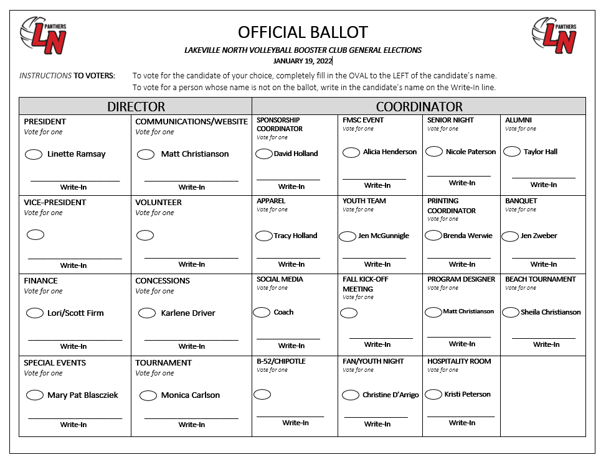
2022
VOTING
(1.19.22)
LNHSVBBC

Slide 16
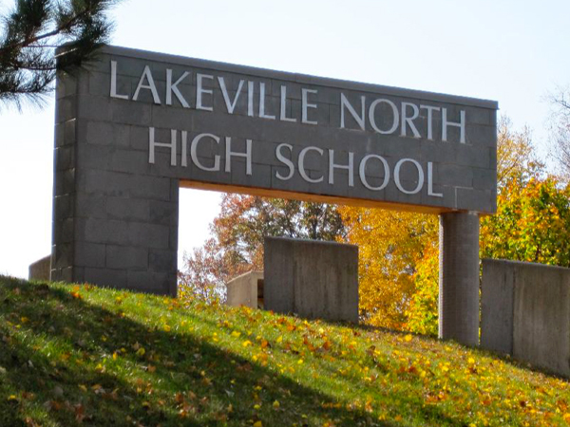
2021
Booster
Meetings
Wednesday, 2/9/22 from 6:30-8:00pm in Room 212
Wednesday, 3/9/22 from 6:30-8:00pm in Room 212
Wednesday, 4/13/22 from 6:30-8:00pm in Room 212
Wednesday, 5/11/22 from 6:30-8:00pm in Room 224
Wednesday, 6/8/22 from 6:30-8:00pm in Room 212
***Dates and locations are subject to change***
***Additional dates may be added for event preparations***
***Positional meetings may be added***

Slide 17

LOOKING
AHEAD
LNHSVB
2022

Slide 18

LNHSVBBC
Foundation and
Working Points
Reminder and Emphasis: Less is More (addition by subtraction and continue to brainstorm ways to make our operations, choices and season better).
Continued and yearly investment into the development and organization within each position (transparency in the role and the responsibilities for yearly transitions).
Continued transition emphasis (binders, shadow positions, etc.)
Directors and Coordinators within each position composing communications (emails and other information) to distribute to the program (per the Communications Director) for every event (with a CC to Jackie before mass distribution).
Financial investments to support on court/program success (Equipment, Training & Season: Hudl, Strength Room, Overnight Trip, State Tournament, Buses, Panther Prep day, Leadership Speakers, Camps, College Matches, Connection events etc.)

Slide 19

2022
OFFSEASON
EVENTS
LNHSVB
LEADERSHIP MEETINGS
Thursday 2/3/22
Thursday 3/3/22
Thursday 4/7/22
Thursday 5/5/22
Thursday 6/2/22
Thursday 7/14/22
3pm-4:15pm

Slide 20

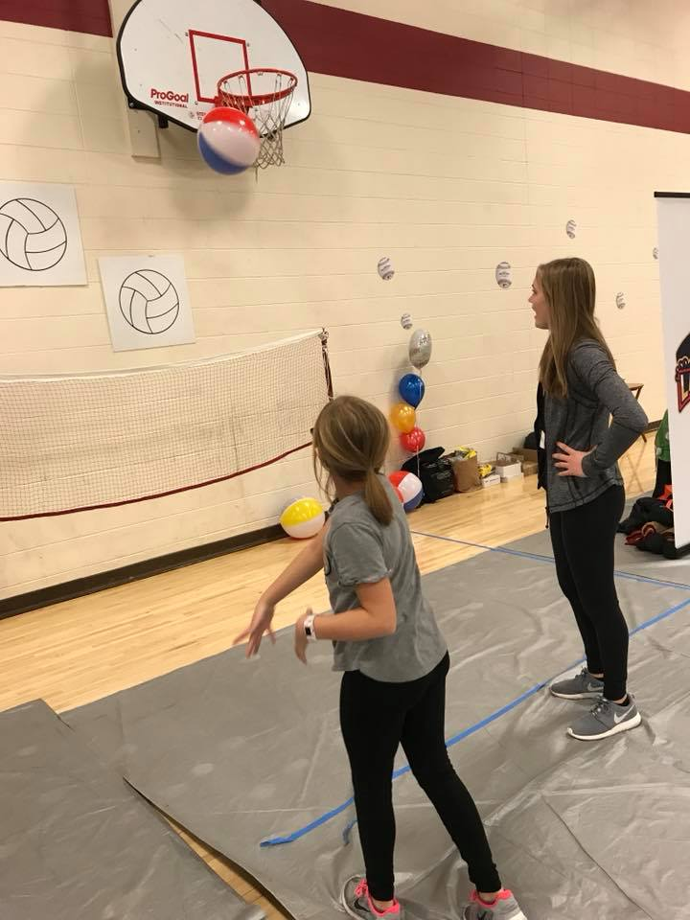
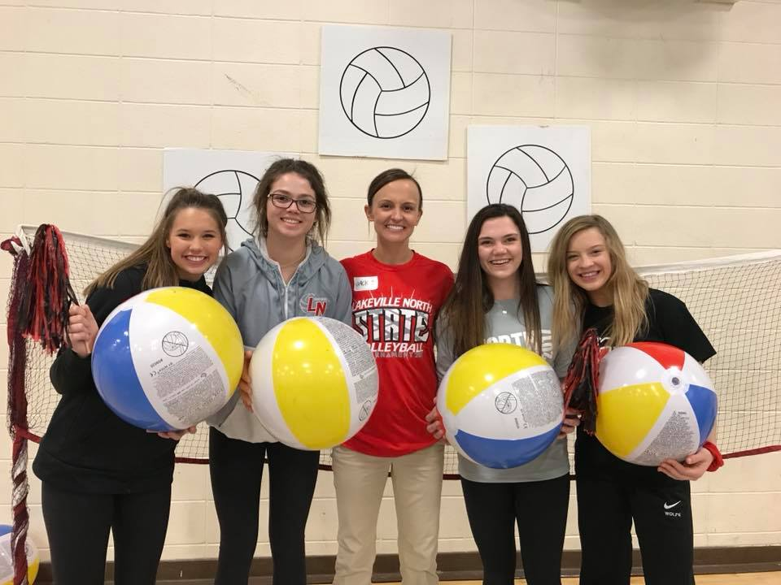
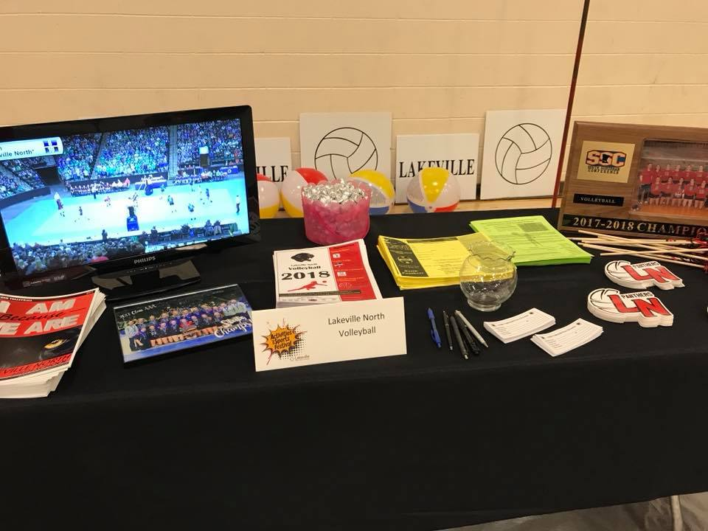
2022
OFFSEASON
EVENTS
LNHSVB

Slide 21
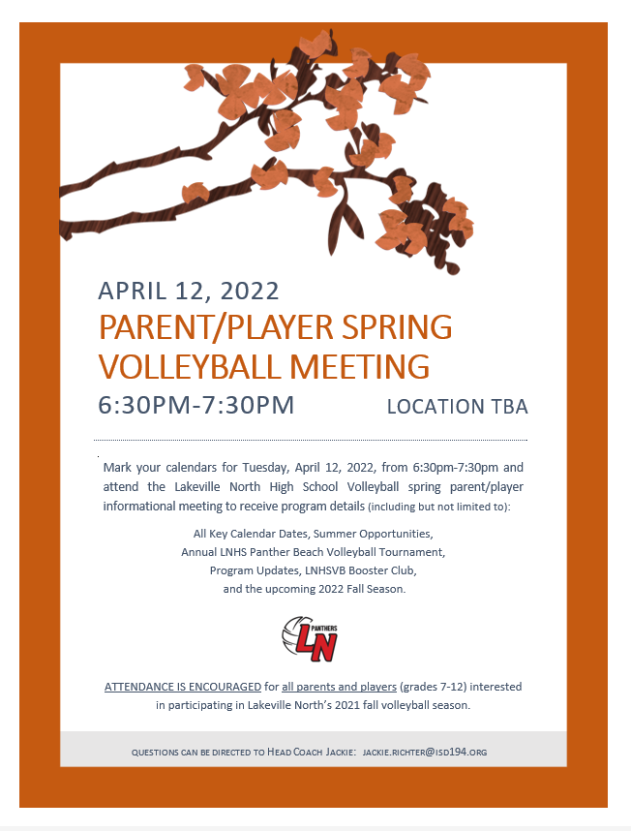
2022
OFFSEASON
EVENTS
LNHSVB

Slide 22
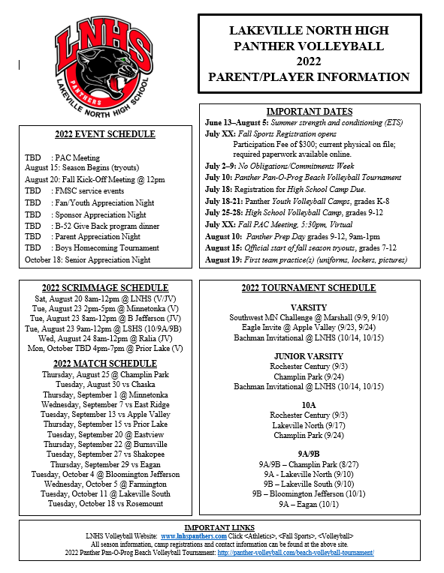
2022
OFFSEASON
EVENTS
LNHSVB

Slide 23

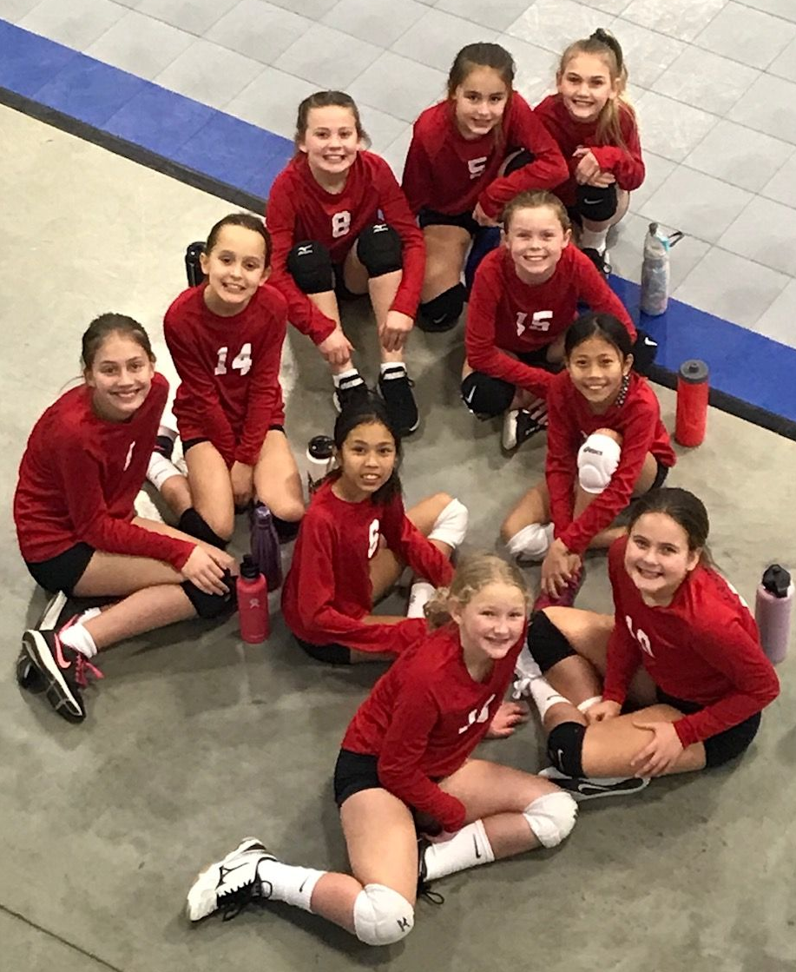
2022
OFFSEASON
EVENTS
LNHSVB
LAKEVILLE NORTH JUNIORS' TOURNAMENT
Saturday, April 30th
LNHS

Slide 24


2022
SUMMER
EVENTS
LNHSVB
Begins June 13, 2022
Mon, Wed, Fri mornings
7:30am-9:30am
Hosted at:
Lakeville North High School
No commitments week
7/2/22 – 7/9/22

Slide 25

2022
SUMMER
EVENTS
LNHSVB
Sunday
July 10th, 2022
Hosted at:
Antlers Park, Lakeville
*Tournament Fees
*Raffle
*Bags Tournament
ALL HANDS-ON DECK:
VOLUNTEERS NEEDED!

Slide 26

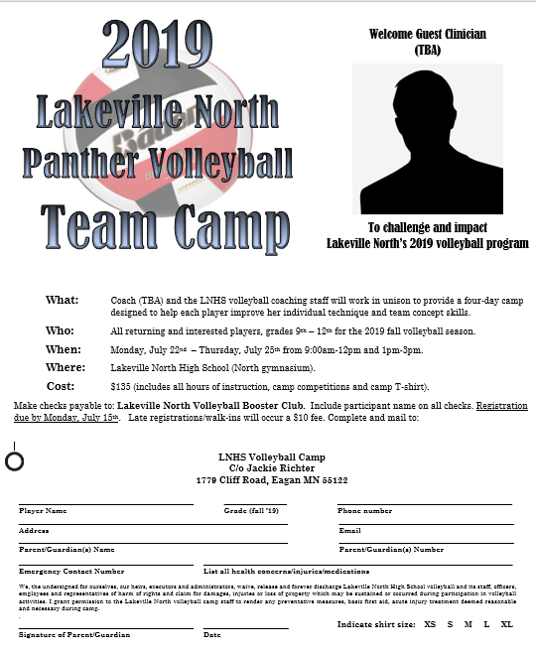
2022
SUMMER
EVENTS
LNHSVB
Panther Youth Camp
(tentative)
Monday, 7/18/22 –
Thursday, 7/21/22
Grades K-8
Hosted at:
Lakeville North High School
Panther HS Camp
(tentative)
Monday, 7/25/22 –
Thursday, 7/28/22
Grades 9-12
Hosted at:
Lakeville North High School

Slide 27
2022
SUMMER
EVENTS
LNHSVB
PARENT ATHLETE COACH (PAC) MEETING
(tentative) Tuesday, July 26, 2022
5:30pm Auditorium
McCUTCHEON TEAM CAMP
Friday/Saturday/Sunday, July 15-17, 2022
UMN
CONCORDIA UNIVERSITY TEAM CAMP
Saturday/Sunday, July 30-31, 2022
9:30am-3:30pm

Slide 28

2022
FALL
START
LNHSVB
PANTHER PREP DAY
Wednesday, August 10, 2022
9am-1pm
Antlers Park
2022 LNVB TRYOUTS
Begin on Monday, August 15th

Slide 29

THANK YOU
for your attendance
and
commitment to the 2022
LNHS volleyball season
Questions?

