Slide 1
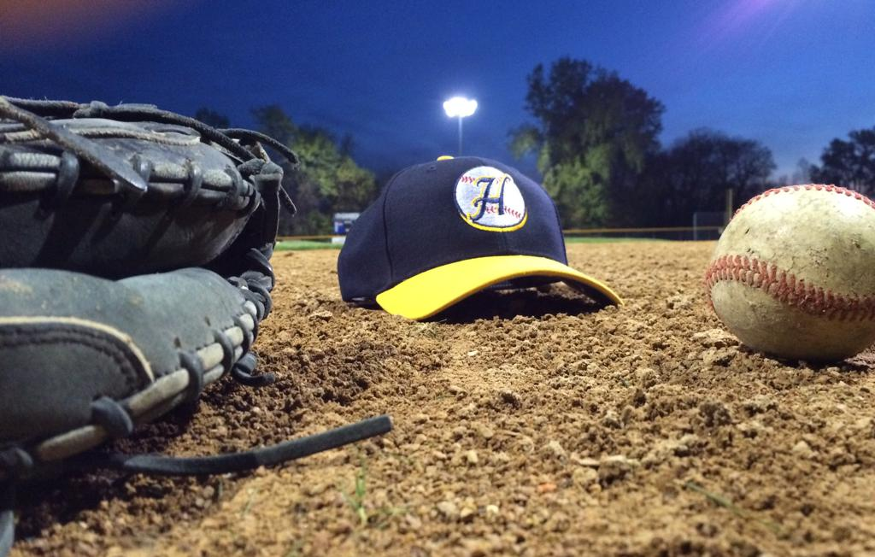
St. Paul Highland Ball
Baseball Acumen/IQ

Slide 2


Defense – Pre-Pitch Preparation
Drill #1 – Ready Position - Infielder

Slide 3
Defense – Pre-Pitch Preparation
Drill #2 – Ready Position - Outfielder

Slide 4
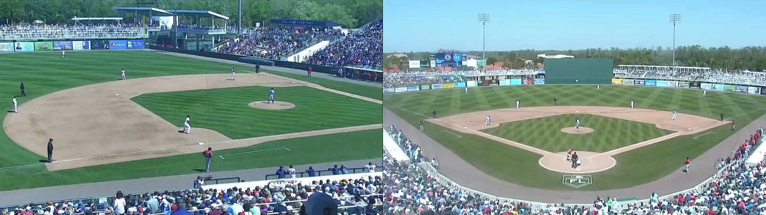
Post-Pitch Movement
Moving On Pitched or Batted Ball

Slide 5
Baseball Acumen Drill
Around The Horn

Slide 6
Defensive Angles
Infielder Angles

Slide 7
Defensive Angles
Outfielder Angles

Slide 8
Cutoffs and Relays

Slide 9
Defensive Cheat Sheet
Nine Legged Monster

Slide 10
Baserunning

Slide 11
Sliding

Slide 12
Diving

Slide 13
Tracking the Baseball

Slide 14
Timing

Slide 15
Conquer Fear of the Baseball

Slide 16
Baseball Situational Quizzes
Links:
https://www.proprofs.com/quiz-school/story.php?title=fielding-quiz
https://quizlet.com/23761546/baseball-situations-flash-cards/
https://www.allthetests.com/quiz26/quiz/1223432051/Prove-that-you-know-baseballs-RULES-and-STRATEGIES
https://www.helpteaching.com/questions/Baseball
Cool App to Reasearch:
https://www.thinkingbaseball.com/

