Slide 1

Pine Richland Youth Wrestling
2025-2026 Season
Parent Meeting
www.prywrestling.org
1

Slide 2
WELCOME
Board Members
  Jim Fawcett – President
  Jill Priscott– Vice President
  Kelly Sulkosky– Secretary
  Bridget Escobar– Treasurer
  Sean McMurray– Fund Raising Coordinator
  Greg Sikora- Bout Coordinator
  Rachel Glass– Events Coordinator
  Mark Himes– Head Coach
2

Slide 3
Additional Roles
Coaches:
  Head & Open : Mark Himes
  Novice Team Leader: Jesse Kohser, Anton Sulkosky, Adam Glass
Bout Coordinator and RSVPS: Greg Sikora
Fund Raising: Sean McMurray
Apparel / Uniforms: Jill Priscott
Volunteer Commitments: Rachel Glass
Social Media: Kelly Sulkosky
3

Slide 4
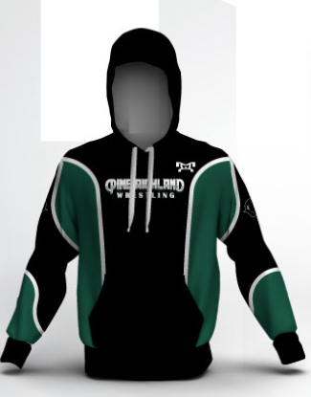
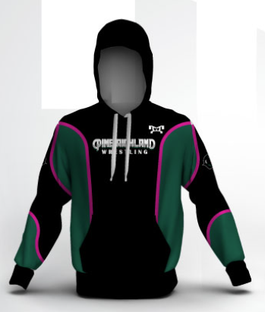
Equipment Issued / Non-Issued
Customized Sweat Suit
Sponsor PRYW T-Shirt
End of year swag
PRYW Wrestling Novice Bags & Open Rudis bags
PRYW Wrestling bag for new wrestlers
  Use last year’s bag if able
PRYW Singlet- this is included in your registration fee (uniform required to wrestle a match)
  $50 deposit required!
You will need to provide:
  Shoes, head gear, mouthpiece (mandatory w/ braces)
    We have several donated shoes, first come, first served. We ask that you simply donate back at end of season.
4

Slide 5
Definitions: Novice & Open
NOVICE: A wrestler with <2 years of officiated experience – “First year wrestlers or second year wrestlers”
  Any “redshirt” wrestlers (wrestlers who only practiced in the prior year and did not compete) will not have that year of eligibility counted against their novice status
  If you wrestled in even one competitive match, that full year counts towards eligibility purposes
OPEN: A wrestler with >2 years of officiated experience
  Doesn’t matter how old or size, if they’ve competed for >2 years they are considered open and will practice with the open wrestlers
Intermediate Practice Group
  January we will be creating a third group which will be a mixture of Open and Novice
5

Slide 6
PRACTICE SCHEDULE & ATTIRE
NOVICE: 6:30-8pm ONLY M / T / W
  Wrestlers are encouraged to attend at least 2 practices a week
OPEN: 6:30-8pm M / T / W / Th
  Novice are not permitted to Thursday’s practice as we cannot account for a practice partner or coaching
  If not planning on attending all days, we strongly encourage open wrestlers pick Thursdays as one of the days as practice will be held in the Aux Gym
We ask that wrestlers arrive at 6:15 and are ready for practice at 6:25 (shoes tied)
  Changing area is the hallway & no spectator access
  If late, please assist your wrestler with shoes and have them join when ready
  Please have your wrestler go to the restroom prior to arriving to the gym
  Coaches will supervise bathroom visits during practice
  FULL SCHEDULE AVAILABLE IN SPORTSENGINE
Practice attire:
  Wrestling Shoes | Head gear | Standard fitted t-shirt / fitted long sleeved shirt | Gym shorts OR sweatpants
6

Slide 7
PRACTICE EXPECTATIONS
Warm up – 10 minutes (break a sweat)
Light drilling with partners
Instructional periods
Live situations
Occasional games to end practice
Coaches are instructed to work in designated areas providing coaching support and monitoring safety
Parents may stay and watch outside the room, though we ask not to interfere with instruction, or we’ll ask you to be a coach!
We ask parents to first be a parent and care for your wrestler, but also to understand this is a physical sport and your wrestler will be uncomfortable from time to time.
MAT MOMS
  Jen
  https://www.linkedin.com/in/margaretannebrenner/
7

Slide 8
Mat Moms
Jena Piscitelli
Heather Bartley
The Mat Mom role is to help facilitate the “blind spots”
Injury documenting (“level 2 injuries”)
Behavior documenting (Zero tolerance for bullying)
Hall monitor bathroom breaks
Swag distributions
Match check ins
8

Slide 9
IN-SEASON: WAWA LEAGUE
PRYW is a part of the Western Area Wrestling Association (WAWA)
There are 30+ teams in the league across Western PA and Eastern Ohio
WAWA’s overall goal is to provide competitive matches for all size, age and skill levels
In preparation for the match day, each wrestler is manually paired with a like size and ability opponent, promoting a quality match outcome
RSVPing in Sports Engine is mandatory for these pairing meetings
You will be required to RSVP by a certain date, usually two weeks from the match date
Failure to report after RSVPing without advance notice could result in suspension from further PRYW sponsored events
9

Slide 10
2025/2026 Event Schedule
Date | Location | WAWA Point?
12/6/25 | Cannon Mac | YES
12/14/25* | Hampton Tournament | NO
12/21/25 | Chartiers Houston | YES
1/4/26 | WAWA Duals (West A) | ALL GET A POINT
1/10/26 | Pine-Richland | YES
1/17/26 | Seneca Valley | YES
1/25/26* | South Fayette Tournament | YES
1/31/26* | RAM SLAM (PR) | YES
2/7/26 | Butler | YES
2/14 (Girls / Open) & 2/15 (Novice) | WAWA EOY (Cannon Mac) | Need 5 Points
WAWA Duals
One wrestler will qualify per weight class
There will be wrestle offs (tryouts) held a few weeks prior
ALL PR wrestlers get a WAWA point regardless if they make the team
WAWA conducts an end of the year tournament (Feb 14/15) for all teams to participate in
To participate your wrestler must receive five WAWA “points.” Of the Five, three must be earned from matches, one can be from a WAWA tournament.
*Tournament, requires registration through website
10

Slide 11
IN-SEASON EXPECTATIONS:
WAWA MATCHES
You will be instructed to RSVP for the upcoming match about two weeks in advance
All wrestlers are guaranteed two matches, though often we’ll be able to give more
Your wrestler will be paired with like size / age / experience wrestler based on 11/10 weigh-in
Only approved coaches with clearances can coach mat side. Parents are to view from the stands or off the mats
Matches will be broken up by ages (alternating time slots per match)
Time slot example
  8U 9AM -12PM
  9-12 1PM - 4PM
Failure to report after RSVPing without advance notice could result in suspension from further PRYW sponsored events
11

Slide 12
IN-SEASON EXPECTATIONS: TOURNAMENTS
All tournaments will require a registration directly through the school’s webpage
www.pywrestling.org publishes all tournaments by date and will provide a link to register
You are responsible for paying the registration fee
Pay attention to the weigh-in times / locations. YOU MUST MAKE WEIGHT at the weight you are registering
  E.g, Jimmy weighs 82lbs, Jimmy would register for 85lbs
All tournaments are at a minimum double elimination
Trophies and other rewards are common for the top places
Prepare siblings for a long day (bring phone chargers!)
12

Slide 13
IN-SEASON: MATCHES 101
Match Numbers: The first number is the Mat #, the second number is the match # (starting at zero)
  Example: 413, Mat 4 – Match 13 or 200, Mat 2 – Match 0 (First up!)
Red Vs. Green: Each wrestler will receive either a red or green ankle bracelet to be identified by the referee and score table
3 periods, each period is 1 minute
  Overtime = 1 minute sudden victory followed a ride out session should no one score in SV
Four ways to win: 1) By points, 2) Pin (both shoulder blades touching mat for a 1-3 count), 3) Technical Fall (15 point margin), or 4) DQ (injury/behavior)
Three Situations: 1) Neutral 2) Top 3) Bottom
Every match starts in neutral; 2nd period: Coin flip winner will have choice of N/T/B or may defer to the third period; 3rd period: The other team has choice (but cannot defer)
  PRYW will mostly choose bottom as an escape is the easiest way to score
Ways to score: Takedown (3 points), Back points (2 or 3 or 4 points), Reversal (2 points), or Escape (1 point)
Each match starts with a handshake
Each match ends with a handshake, then the wrestler is instructed to shake the hand of the opposing coach
Each wrestler should expect a brief coaching session from a coach who observed the match
  Often after a loss, immediately after is not the best time to provide feedback. Have them cool down, wait five minutes and find the coach for the session
  Coaches are instructed to praise “the good” focusing on only one two items to keep the wrestler engaged
  Feel free to film the match to help the coach remember!
13

Slide 14
Volunteering
1/10 Home WAWA Match
1/31 RAM SLAM
There will be between 1,500-2,000 attendees at each event.
We DON’T need money, we need labor!!
Rachel Glass will run point with time slots, donations and other volunteer coordination.
This takes an Army, but is the core fundraising event(s) for our program.
The last two RAM SLAMS enabled us to purchase $30,000 worth of wrestling mats for the entire program to use
  Jr. Rams, Youth, JR High, Girls, Boys Varsity have all benefited – because of our volunteers!!
14

Slide 15
Parent Expectations
Arrive on time!
We ask that you cheer on your wrestler (and their teammates)
We ask that you let the coaches coach, the refs ref, and the wrestlers wrestle
All referee calls are final and are unable to be contested
All coach decisions are final and are unable to be contested
If your wrestler is in OPEN: We encourage you to record your wrestler’s matches and ask a coach to review (outside of the match time) for instructional coaching
EVERY WRESTLER WILL LOSE, EVERY WRESTLER WILL CRY
3 core tips for wrestling parents
  Yell as loud as you can (but realize, they can’t hear you)
  Record on your phone horizontal (think about your flat screen at home)
  If you have to coach at a tournament, always choose bottom (easiest way to score)
15

Slide 16
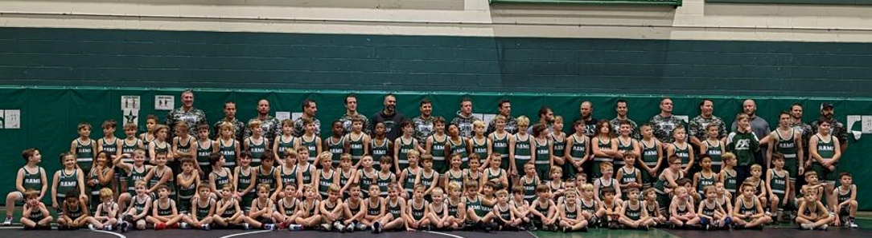
Miscellaneous
Post Season
  After the WAWA EOY tournament, several of the wrestlers will participate in the regional and state tournaments
  If you think your wrestler can compete or simply wants to compete, we strongly encourage him/her to participate!
End of Year Banquet SAVE THE DATE 3/19 | Double Tree Cranberry
  Awards
  More Swag encourage them to come participate in the post-season!
download sports engine app
Weekly Communication
  recap of prior week
  schedule for the week
  inspirational message from Coach Himes
  volunteer opportunities
16

