Slide 1
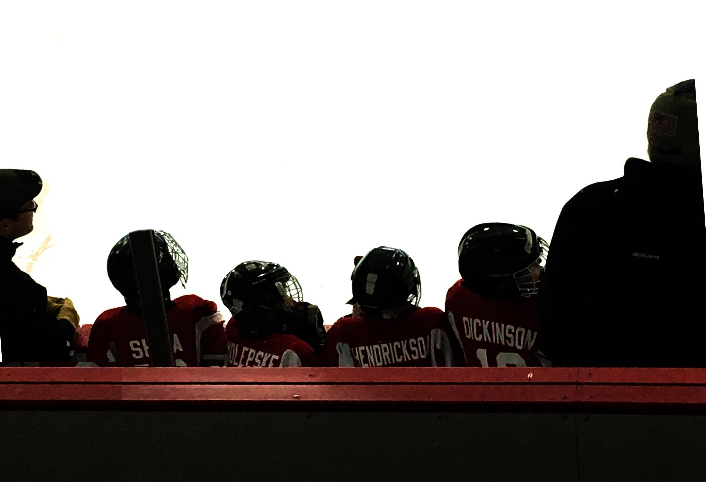

2025-26 Mite/8U Season
PARENT INFORMATION MEETING

Slide 2

Agenda
Mite/8U Team
Welcome & Introductions
Mission and Goals of Mite Hockey
Mite Levels & Fees
Communication
Pre-Season Clinics and Evaluations
Season Timeline
Player & Parent Expectations
DIBS Hours Requirement
Player Development
Questions
Joe Martin
Mite Director
Maria Waltman
Girls Director
Jessica Engelstad
Growth Director
Mite Board Volunteers
Role | Volunteers
Mite Hockey Development | Joe Krmpotich Brooks DeZellar
8U Hockey Development | Dani Benson
Scheduling/Mite Day | Brianna Held OPEN
Engagement Manager | Susan Pauling OPEN

Slide 3



EPHA Mission
The Eden Prairie Hockey Association’s mission is “Player & Goalie Development.” We are 100% committed to providing our athletes with the best possible age-appropriate training and coaching so they can fully realize their athletic potential.
Through the fulfillment of our mission, we prepare our athletes to compete with excellence on our boys’ and girls’ youth and high school hockey teams.
Every decision that is made by the EPHA board is governed by USA Hockey’s guidelines for Long Term Athlete Development. From team structure and bench philosophy to practice plans and dryland training programs, USA hockey has compiled decades of data and science to help guide how we at Eden Prairie develop young athletes.
EPHA BOARD GOALS
  Communication & Transparency
  Player & Goalie Development
  Growth & Retention

Slide 4
Goals of Mite/8U Hockey
Create a positive atmosphere
Foster a love of playing team sports
Learn the fundamentals of hockey
Develop sportsmanship and work ethic
Learn responsibility and leadership
Make new friends
Learn through structured chaos
Most importantly HAVE FUN!

Slide 5
Mite/8U Levels
8U LEVELS (GIRLS)
Level | Guidelines | Fees
8U 1 | New to EP Hockey($99), typically K-1st Grade and first year of 8U Returning to 8U1 hockey with previous EPHA experience | $450
8U 2 | New to EP Hockey($99), typically 1st-2nd Grade and first year of 8U Players with 1-2 years previous 8U experience within EPHA, Typically 1st-3rd grade | $450
8U 3 | Players with 2-3 years previous 8U experience | primarily 2nd-3rd graders, based on evaluations | $750
MITE LEVELS (BOYS)
Level | Guidelines | Fees
Mite 1 | New to EP Hockey ($99), typically K-1st Grade and first year of Mites Returning to Mite 1 hockey with previous EPHA experience | $450
Mite 2 | New to EP Hockey($99), typically 1st-2nd Grade and first year of 8U Players with previous Mite experience within EPHA, Typically 1st-3rd grade | $450
Mite 3 | Players with 1-3 years previous Mites experience | primarily 2nd-3rd graders and 3rd graders new to hockey | $750
Mite 4 | Players with 2-3 years of previous Mites experience | 2nd-3rd graders, based on evaluations (1st Graders are not eligible) | $750

Slide 6
Where do my Fees go?
Direct Costs (~90%)
Indirect Costs (~10%)
Ice time
Jamboree Fees (partial)
Mite Evaluations
Mite Day
Jersey/Socks
Each team’s share of EPHA overhead costs:
Professional fees
Insurance
Recruiting, etc.

Slide 7
MN Hockey Mite/8U Rules
Net size: Intermediate/junior net for all Mite/8U events (practices, games, scrimmages, and jamborees)
Games
Mite 3/4 + 8U3: 10 full ice games allowed after Jan 1st
  Does not include jamborees
  Each team and EPHA are responsible for tracking
  Only half ice before Jan 1
    Velocity is considered half ice
Mite 2 + 8U2
  Teams can play cross ice or half ice games
    Cross ice will be advised prior to Jan 1
Mite 1 + 8U1
  Teams can play cross ice or half ice games
    Cross ice games will be strongly advised
District lines: EPHA is a member of District 6 hockey. All games outside of District 6 need to be preapproved. Other associations in D6 are Bloomington, Burnsville, Chaska-Chan, Edina, Minnetonka, New Prague, Prior Lake, Shakopee, and Waconia

Slide 8
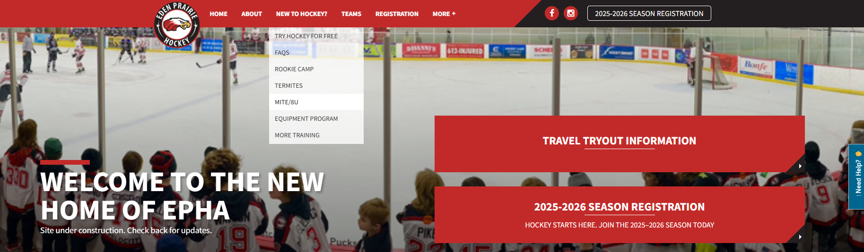
Communication
Mite/Girls Director
Team Managers
EPHA email blasts
Mites/8U page (go to ephockey.com > New to Hockey? > Mites/8U)

Slide 9
Pre-Season Clinics
& Evaluations
Pre-season Clinics: September 29 through Oct. 31
Clinics are the kick-off of the Mite/8U season and begin September 29 and run through October 31. These are approximately one hour long sessions, led by volunteer coaches.
Please attend with your designated group.
Clinic groups and schedules will be posted to the Mites/8U page at www.ephockey.com.
Evaluations: November 1 and 2
This year we will be modifying the preseason and tryout process melding both historical processes and some of the new ideas introduced last season. The process is being implemented based on feedback from parents, coaches, evaluators, and the overall success of team composition.
NOTE: Evaluations at the Mite 3/4 and 8U3 level are optional, and not mandatory for team placement. Any player opting out of evaluations will be placed on a Mite 3 or 8U3 team.
Mite/8U 3 and Mite 4:
Evaluations will be November 1 and 2 with teams determined and posted to the Mites/8U page on www.ephockey.com after the evals.
Day 1 will be graded skills, days 2 will be scrimmages that are graded
Mite/8U 1 and 2:
There are no evaluations at the Mite/8U 1 & 2 levels, however coaches will observe the players during clinics to help form balanced teams at these levels.
Teams will be determined and posted to the Mites/8U page on www.ephockey.com

Slide 10
Evaluation Highlights
Mite 3/4 and 8U Evaluation Format
  Day 1: Graded Skills & Games
    Line skating drills
    4 stations - skating and puck handling drills, small area games, and cross-ice scrimmages
    Players will be in clinic groups, see website for assigned times
    No make-ups, players must be present to be evaluated
  Day 2: Scrimmage
    Mite 3/4 – Approximately the top half ranked skaters (2nd and 3rd Graders) after Skills Evaluation will participate in the scrimmage sessions to determine potential placement on one of the tiered Mite 4 teams. Scrimmage teams to be posted after the skills day
    8U3 – All skaters after Skills Evaluation will participate in the scrimmage. This will determine potential placement on our Advanced 8U3 team.
    Scrimmage groups will be posted on ephockey.com

Slide 11
Evaluation Highlights
Gear
For evaluations, all players shall wear
  a black helmet (preferred);
  black breezers (preferred);
  Gloves should be Eden Prairie colors
  a plain white, red, grey or black jersey without visible names or identifying words or marks; Jerseys worn inside-out are permitted, provided all identifying information is not visible.
  socks may be from a previous EPHA season or plain white, red or black or combination of those colors.
  All non-EPHA provided stickers and any numbers shall be removed from helmets.
  No AAA team gear, stickers or identification should be visible on your player

Slide 12
Evaluation Highlights
Mite 3/4 and 8U Team Placement
Team placement
  Players will be assigned to a team based solely on their evaluation scores
  Players are allowed to play up one level if they are assessed in the top 1/3 of the level that they want to play in. If they are not rated in the top 1/3 of the level, they will be assigned to a team in the level with their age/grade range.
  No player will be allowed to play up two levels, e.g., a 1st grade player (who would typically be a Mite 2) will not be permitted to play Mite 4.
  8U1-2 & Mite 1-4: balanced teams.
    Number of teams based on registration numbers
  8U3: 1 advanced, 1 intermediate (based on registration numbers)
  No player will be allowed to tryout as a goalie in Mite/8U
  Registration numbers will ultimately dictate the number of teams EPHA is able to field at any of our Mite/8U levels. Changes to number of forecasted teams are at the discretion of the EPHA Board and subject to change at any time.
  These changes have been thoughtfully discussed and considered by the EPHA Board to ensure that all athletes play at a level which will afford them the best opportunity to enhance their skill development and continue to form their love of the game.

Slide 13
Season Timeline
Mite/8U Season: Early November through Mid March
Note: There will be no scheduled practices Thanksgiving or Winter Break
Mite/8U1 & Mite/8U2
Saturdays and Sundays
Weeknight (occasional)
Practice/Games/Scrimmages primarily at Velocity
Jan-Feb
Optional outdoor Ice
Mite Jamboree
Mite/8U3 & Mite 4
Saturdays and Sundays
Weeknight (occasional)
Practice/Games/Scrimmages primarily at EPCC
Jan-Feb
Optional outdoor Ice
Mite Jamboree(s)

Slide 14
Player Expectations
Player code of conduct
  Be a good teammate
  Be coachable
  Show up both on and off the ice
Teaching kids to not only be good hockey players but good people
If you are wearing the EP hockey logo – you are a representation of the association and the Eden Prairie community
Respect for practice and game locations
  EPCC is a community center – not an ice arena
  Velocity hockey is a private business

Slide 15
Parent Expectations
Arriving on time
  Ice time is *GOLD*
  Recommended to get dressed in the living room vs. the locker room, especially for Velocity
  Be dressed, skates tied and ready to take the ice 5 minutes before your scheduled ice time
Keep it in perspective
  Teach respect for coaches, teammates, referees, facilities, opposing teams and parents
  Promote a positive team atmosphere
“I love to watch you play!”
  Avoid coaching from the front seat in the car on the ride home
  24-hour rule
VOLUNTEER! COACH!

Slide 16
Volunteer Requirement:
DIBS Hours
Mite/8U 1 & Mite/8U 2
  No “required” volunteer hours
  The more you volunteer, the more fun you’ll have!
Mite/8U 3 & Mite 4
  6 hours required per player
  $250 buyout at registration
  Penalty of $75 per incomplete hour
  We need many volunteers to have a successful association, from Rookie Camp on up

Slide 17
Volunteer Opportunities
Coaches (Mite 3/4 and 8U3 only)
  Head Coach: exempt from Mite/8U volunteer requirement
  Assistant Coaches: 12 hours to split between assistant coaches
Team Managers (Mite 3/4 and 8U3 only)
  Exempt from volunteer requirement
  Will receive half credit when sharing the role (3 hours each)
Mite Support
  Mite Day Co-Coordinator needed
Special Event Help
  Mite Day
  Try Hockey for Free
  Rookie Camp
Join the Board
  Lifetime Dibs after 3 year term
  Many members terms ending this year
Traditional DIBS opportunities
  Home EP tournament volunteers
  Committees
  Travel Tryouts POD

Slide 18
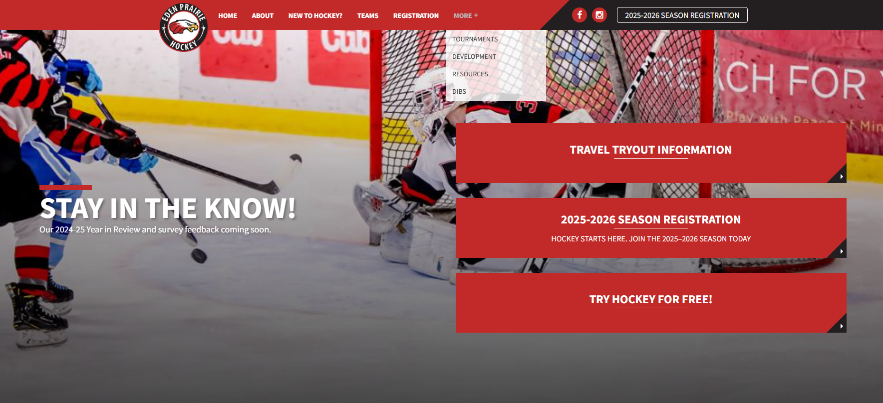
Volunteer Opportunities

Slide 19
EP Hockey Board
Go to ephockey.com | More | Board
for email and contact information
Executive Committee:
Jessica Kiecker…...……...…….……… President
Ryan Richards..…………..…….…Vice President
Ross Hedlund…..………………….……Treasurer
Patty Walters…………………...…..……Secretary
Joe Martin……...……..….…….…...……..Mite Director
Maria Waltman…..……………...…....…..Girls Director
Michael Rochford.........................................Registrar
Mike Sarazine.……………….…...…Coaching Director
Aric Day…………Travel Player Development Director
Jessica Engelstad.............................Growth Director
John Pike….....Commissioner & Volunteers Director
Cully Huestis…….Sponsorship/Fundraising Director
Eric Langaard………………..….Tournament Director
Patrick Steidl…………….…Communications Director
Kira Hilden………….Apparel and Equipment Director

Slide 20
Hockey Player Development
The perception of most parents is that hockey players develop in a “linear” fashion similar to the red line in the chart below. The reality is that they actually develop in a “non-linear” fashion similar to the blue line in the same chart.
Growth
Perception
Reality
5
10
15
20
Age

Slide 21
Hockey Player Development – Goaltending Clinics
To help our players explore interest in playing the goalie position, we will be offering 3 Introduction To Goalie training sessions this year. This opportunity is extended to any registered 25-26 Mite/8U players to try the goalie position and experience focused training on proper movement and position fundamentals.
Dates are 9/28, 10/26, and 11/23
Amanda Leveille (PWHL, Univ Minn, OS Hockey) will be the lead instructor for these training sessions. The registration to sign up for sessions is now live. Please visit the link below to add your player to 1, 2 or all 3 sessions. We will have additional opportunities for our Mite/8U players to try goalie throughout the 25-26 season, so stay tuned for more updates once teams are formed.
PLEASE NOTE:
These clinics Require Full Goalie Equipment. This means goalie leg pads, chest protector, glove, blocker and goalie stick at a minimum. If your player does not have goalie skates or helmet, it is fine to wear regular player skates and helmet.
We will have goalie equipment available to lend out for these sessions. If you will need to borrow equipment, please indicate your player will need to borrow goalie equipment in the sign up form, with a "Yes-Need Gear" along with the player's name in the sign up comments section.
If you have any questions you can contact Aric Day
EPHA: Introduction to Goalie

Slide 22
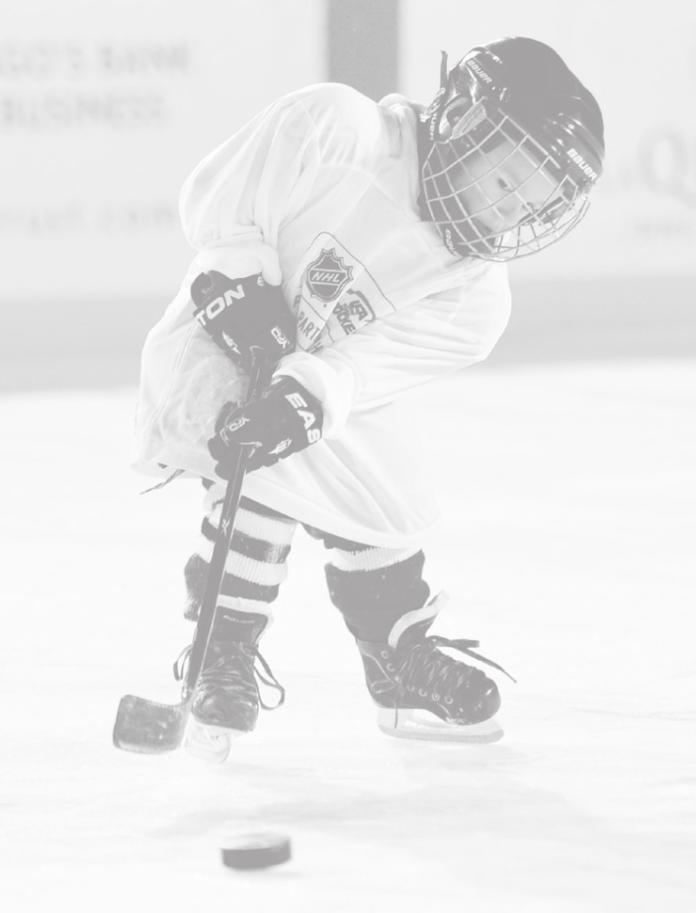
What’s Important At Mites?
What’s Important?
They are having fun and developing friendships. We want our players to fall in love with the game of hockey
They enjoy coming to the rink
Small Area Games, and Station Based Practices
Lots of repetitions, and not a lot of standing around
They are listening and fully engaged in the on-ice activity
They are trying their best
You see them making improvements throughout the season
2 Things Everyone Can Control: Attitude & Effort

Slide 23
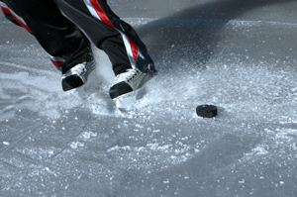
QUESTION & ANSWER

