Slide 1


Schaumburg Athletic Association - Baseball
Infield progression
Done with a partner
Tony Tichy

Slide 2
Infield progression
Two knee rollers
Two knee one hops
Two knee forehand
Two knee backhand
Two knee combo
Stand up with glove short hop
Stand up with glove short hop-forehand
Stand up with glove short hop-backhand
Slow roller ground balls
Slow roller forehands
Slow roller backhands
Crawlers

Slide 3
Points of emphasis when working two knee progression
on rollers work in
on one hops work out
keep head down-beanie beanie
Chin to chest

Slide 4
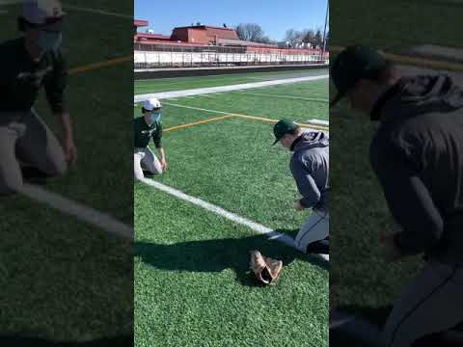
Two knee rollers

Slide 5
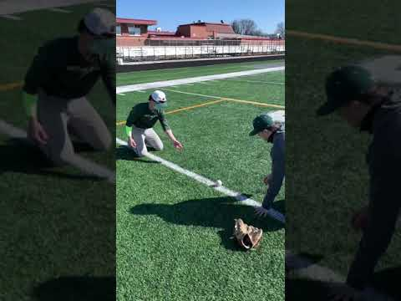
Two knee one hops

Slide 6
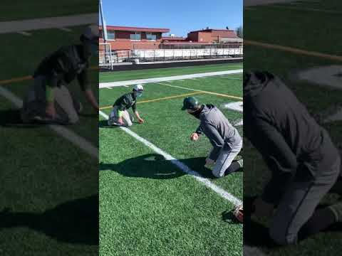
Two knee forehand

Slide 7
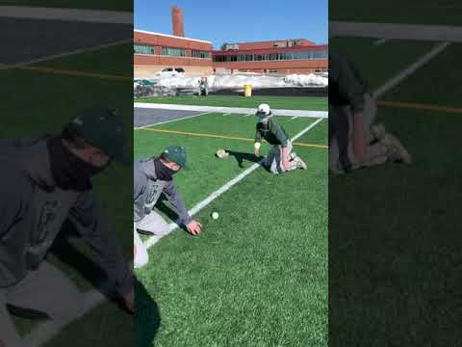
Two knee backhand

Slide 8
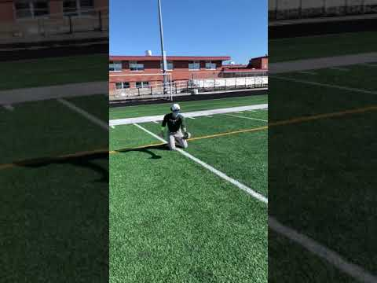
Two knee short hop combo

Slide 9
Points of emphasis on stand up progression
All previous points rollover to these drills
Glove should be on a 45 degree angle to the ground
Field ball out in front of body-create fielding triangle

Slide 10
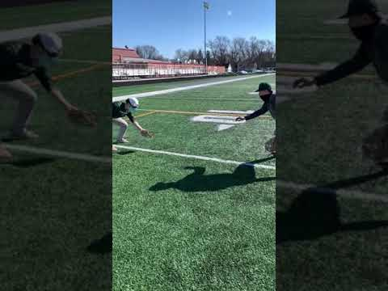
Stand up with glove short hop

Slide 11
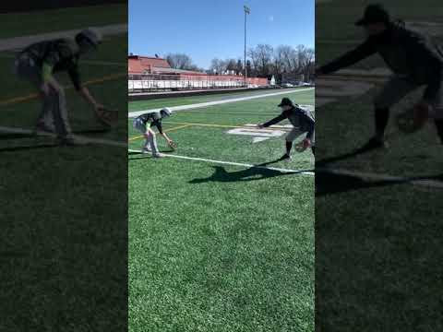
Stand up with glove short hop forehand

Slide 12
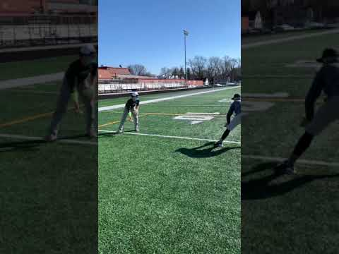
Stand up with glove short hop backhand

Slide 13
Points of interest on slow rollers progression
Work to get to the right of the ball to read it better
Then slide back under and behind ball

Slide 14
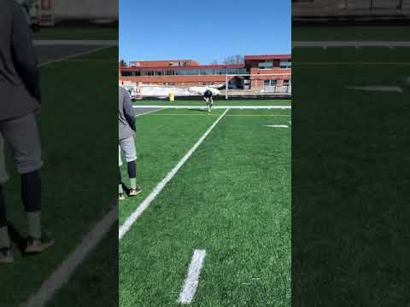
Slow roller ground balls

Slide 15
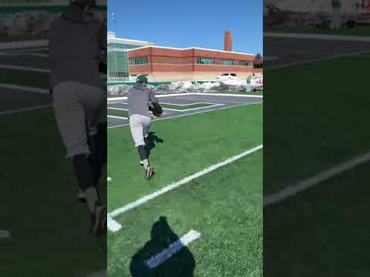
Slow rollers forehand

Slide 16
Slow rollers backhand

Slide 17
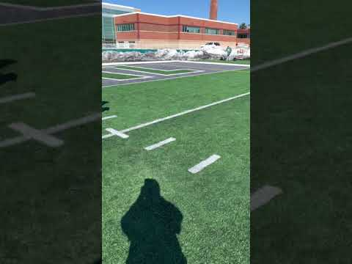
Crawlers

