Slide 1

Travel Softball
Pre-Tryout Parent Meeting
10U and 12U Teams

Slide 2
Agenda
CAA Softball Overview
Players & Coach Registration
Evaluations & Team Selection
Winter Development
Key Dates

Slide 3

CAA Softball Mission & Values
Mission Statement:
To provide girls in the Chanhassen-Victoria area a place to play the great game of softball while developing lifelong physical and interpersonal skills, learning to compete and be a good teammate, and most importantly, having fun.
Core Values:
Teamwork - We work together to achieve more
Effort- We give our all in everything we do
Pride - We are proud to represent our team, association & communities
Respect - We treat ourselves and others with dignity, kindness & respect
Fun - We have a positive attitude and enjoy being with our team on and off the field

Slide 4
CAA Diamond Sports Commitments
On the field…
Quality instruction and positive coaching
Preparing players for the next level of play – whatever that may be
…AND off the field
Representing our community well in all situations
Creating a positive environment where we all work together
Developing character, encouraging personal responsibility and the growth of our players
Notes:
Each of us on the board believe in and are fully committed to these values
We do everything we can to live up to them and to provide a quality experience for every player, family member, community member

Slide 5
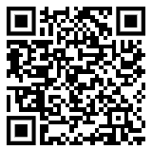
Softball Operating Committee (SOC)
  Brett Sween – VP Softball
  Julie Vasatka – Player Agent and Tryouts Director
  Matt Birkenholz – Director of Player & Coach Development
  Mike Miller [NEW!] – K/1/2 – 8U Director
  Open Roles as of October:
  10U/12U Travel Director *
  Uniforms Coordinator
  Equipment Coordinator
  Hosted Tournaments Coordinator
We would love your help!
* 1+ Applicant so far

Slide 6
CAA Travel Softball Expectations
Participants in the Spring/Summer program dedicate to Softball as their main in-season activity and attend all practices, weeknight games and weekend tournaments in-season (April – mid-July)
Practice and game absences should be communicated to the coach as soon as possible
Unexcused absences may impact playing time.
Please play catch with your daughter! It’s fun, it’s the best thing you can do to improve her confidence.
Softball is a TEAM SPORT and depends on consistent commitment of all players

Slide 7
Registration

Slide 8
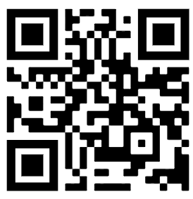
10U/12U Travel Softball Registration
NOW OPEN! Closes on 9/17
Ages:
  10U: 9/1/2014 – 8/31/2016
  12U: 9/1/2012 – 8/31/2014
Registration Fees: $300 Deposit+ $25 Tryout Fee
  Deposit allows us to be more consistent across CAA Diamond Sports and help us set rosters earlier to minimize scramble ahead of the season
  Deposit is nonrefundable after 10/10;
  Remainder of 2026 fees will be collected prior to the season
  Tryout Fee is non-refundable after 9/17
Coach Registration
  Our program is only as strong as our volunteer coaches!
  Identifying coaches early allows us to form teams quickly
  Please Register before 9/17

Slide 9
Evaluations

Slide 10
Player Evaluations Overview
GOAL: place players at the best skill level to have fun and also be competitive
There are 2 Parts to CAA Softball Player Evaluations:
  Coaches Evaluations (50%) – coaches assess skills, game awareness, attitude and coachability from prior season
  Tryout Evaluations (50%) – independent observers assess core skills
Why do tryouts in the fall?
  Hold tryouts outdoors (weather permitting)
  Allows girls moving to a new age level to play a season at that level prior to evals
  More time for team selection & coach identification
  Provide a break between summer and fall seasons and allow FUN to be the emphasis of fall ball
  No “perfect time”

Slide 11
Tryout Evaluation Detail
9/20 – 9/21 @ Victoria Lions Park
ALL Travel players are expected to attend!
There will be no makeup date; please let us know if you cannot attend
Schedule:
    NEW: each age level will have 1 day of tryouts (players will still have two rounds per station)
    9/20 (12U):
      Pitchers & Catchers check-in at 8:30am; start tryouts @ 9:00am
      All others check-in @ 9:00am; start tryouts @ 9:30am
      Should be done by 12:30pm
    9/21 (10U):
      Pitchers & Catchers check-in at 8:30am; start tryouts @ 9:00am
      All others check-in @ 9:00am; start tryouts @ 9:30am
      Should be done by 12:30pm
Bring your volunteer check – needed at check-in!
There are volunteer shifts posted on DIBS to help with tryouts!!
  Bring a glove!
  Note you cannot volunteer at the same time your daughter is being evaluated

Slide 12
Tryout Evaluation Detail
Skills Evaluated:
  Hitting** – mechanics, contact, power, bunting (using pitching machine)
  Infield – mechanics, range, throwing accuracy**, arm strength**
  Outfield – mechanics, judging balls, arm strength **
  Speed / Baserunning
  Pitching – velocity, control, off-speed pitches
  Catching – mechanics, blocking, pop-time/thrown-down,
Format
  Each player will have 2 opportunities to be evaluated on each skill
  Evaluations are scored by independent observers
  Players will rotate from station-to-station
  Parents are NOT permitted to be within the park observing tryouts
  ** Extra weighting is given to hitting and throwing skills

Slide 13
Team Selection

Slide 14
Team Selection
Our goal is to provide as much transparency into the team selection process as possible:
Equal weighting given to tryouts + prior year coach evaluation
Evaluation are used to generate an overall ranking for each player
Team Selection is multi-step process starting with the top team at each age level
  “Locked Players” – based on overall rankings that top ~8 players are automatically assigned to the top team.
  “Pool Players” – based on overall rankings, the Player Agent and head coach will select from the next ~8 players to complete the roster (~3-4 players)
  Once the top team is formed, this process is repeated for each subsequent team within each age level
  If no coach has volunteered prior to team selection the roster will be set by the CAA Softball Operating Committee.
Once all teams are formed, rosters will be published to the CAA Website

Slide 15
Winter Development Opportunities

Slide 16
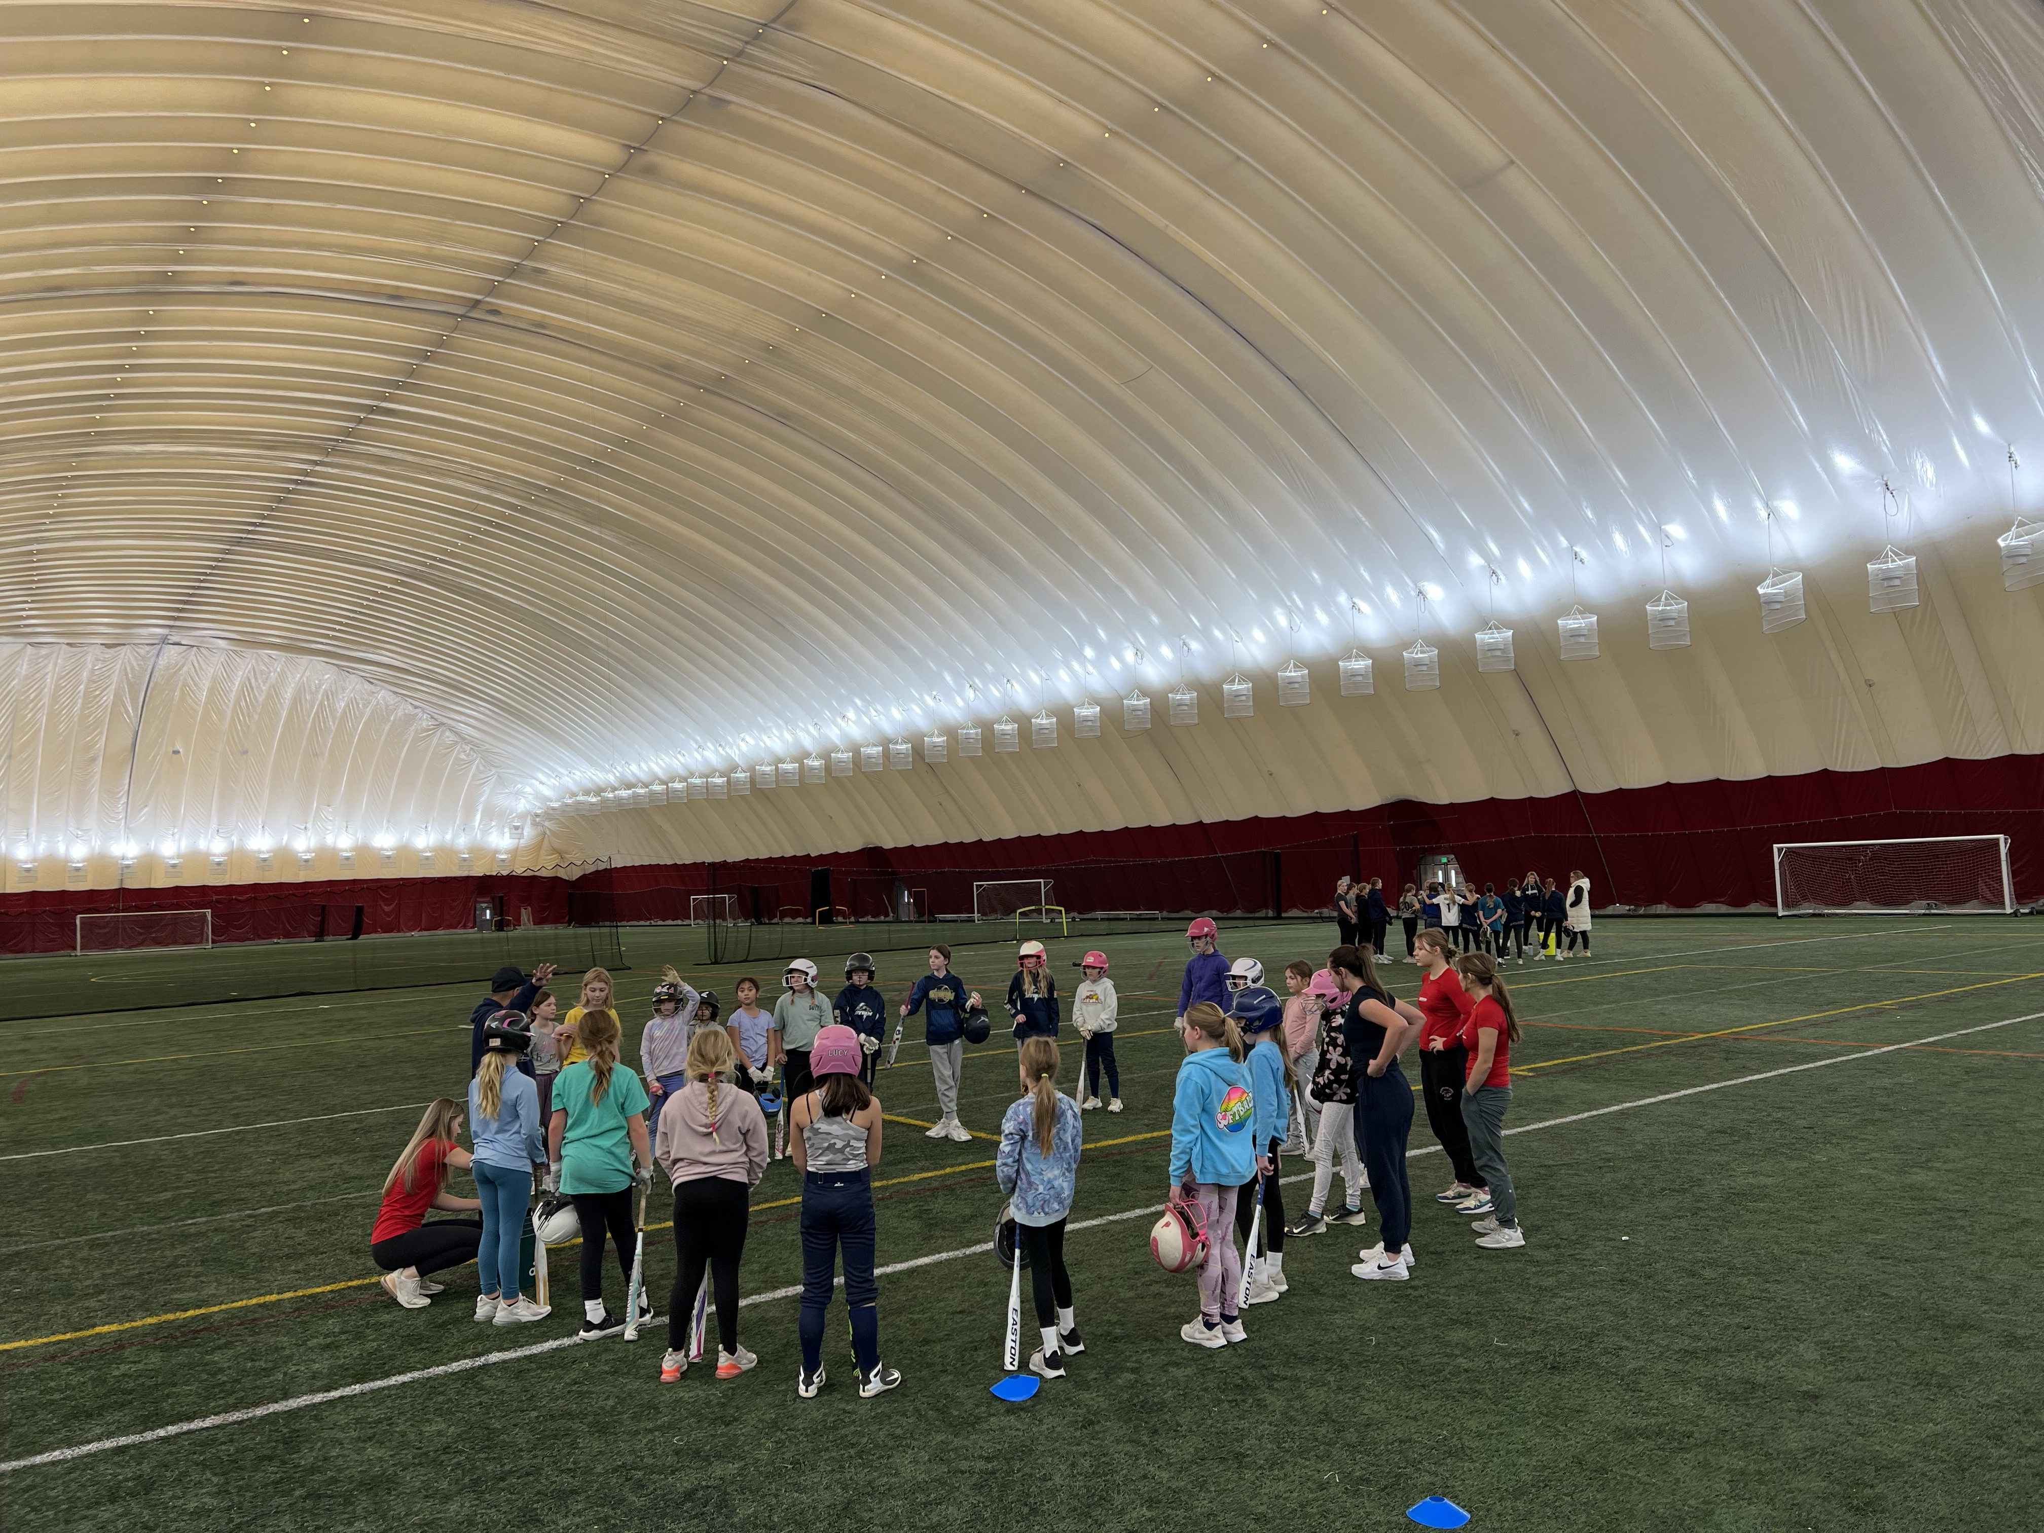
Winter Development
Goal: Provide multiple options for players to stay engaged in softball and improve skills ahead of next season.
Off Season
  Cage Training
  Clinics
  Open Gyms
  DBATS
  *CAA Softball Night at DBATS Nov.2nd

Slide 17
Winter Development
NEW! Winter Dome Ball
Tournament Team (10U and 12U)
  8 weeks starting in Nov. through the beginning of Jan.
  Chanhassen High School players as coaches
  2-hour practice once a week
  One day Turkey Trot tournament
  One day Winter Bash tournament
  Rough cost: $250-300

Slide 18
Key Dates
9/17: Travel Softball Registration Closes
9/20 – 9/21: Travel Softball Tryouts (10U/12U)
10/10: Deadline for requesting Registration Refund
Rosters are expected to be published around 10/15

Slide 19
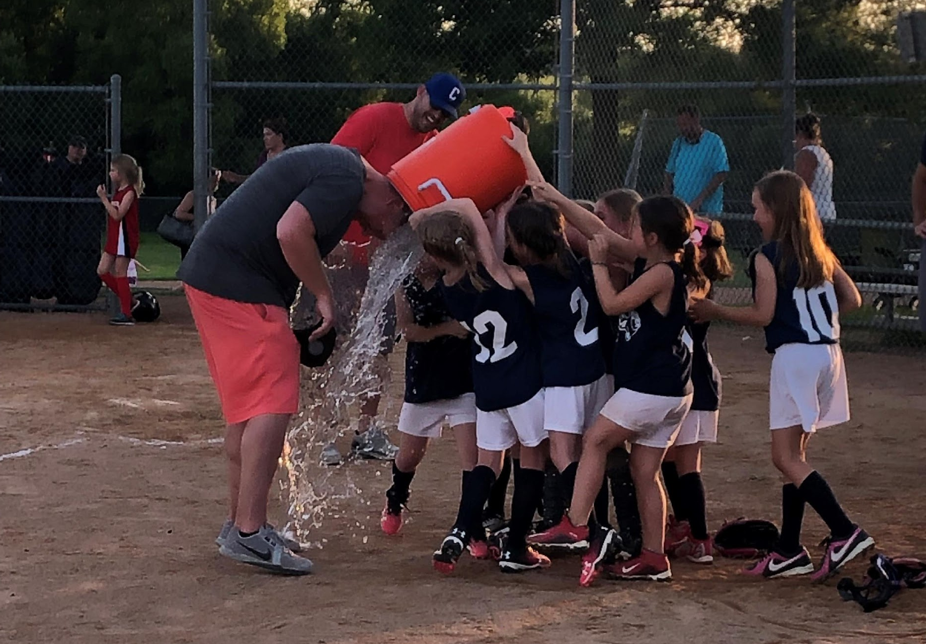
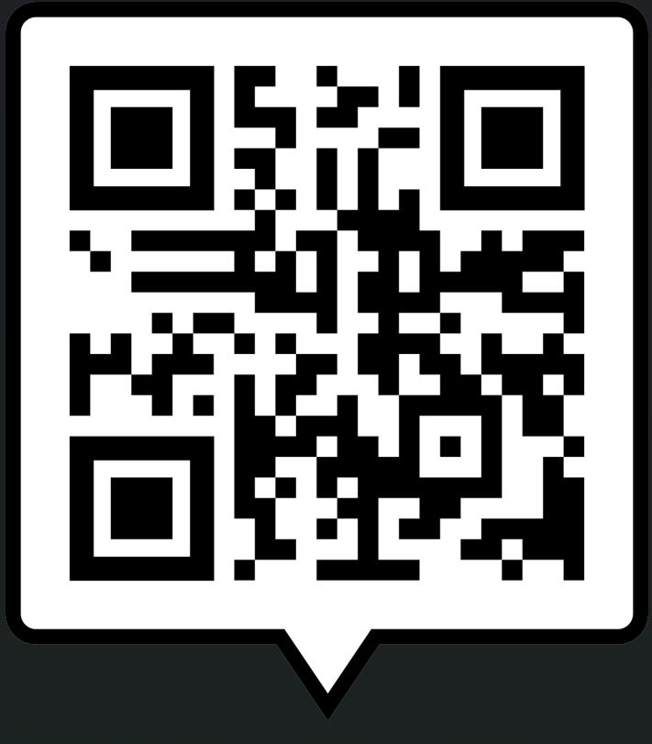
REMINDER…
COACHES, WE NEED YOU!!!
- Register on same site as softball registration

Slide 20
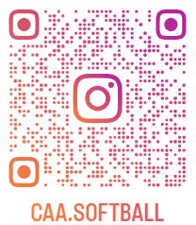
Follow us on Instagram!
Notes:
Hoping to capture more of those moments…
We’ll pause throughout to answer any questions – any general questions as I drag Matt to the front?

Slide 21


