Slide 1
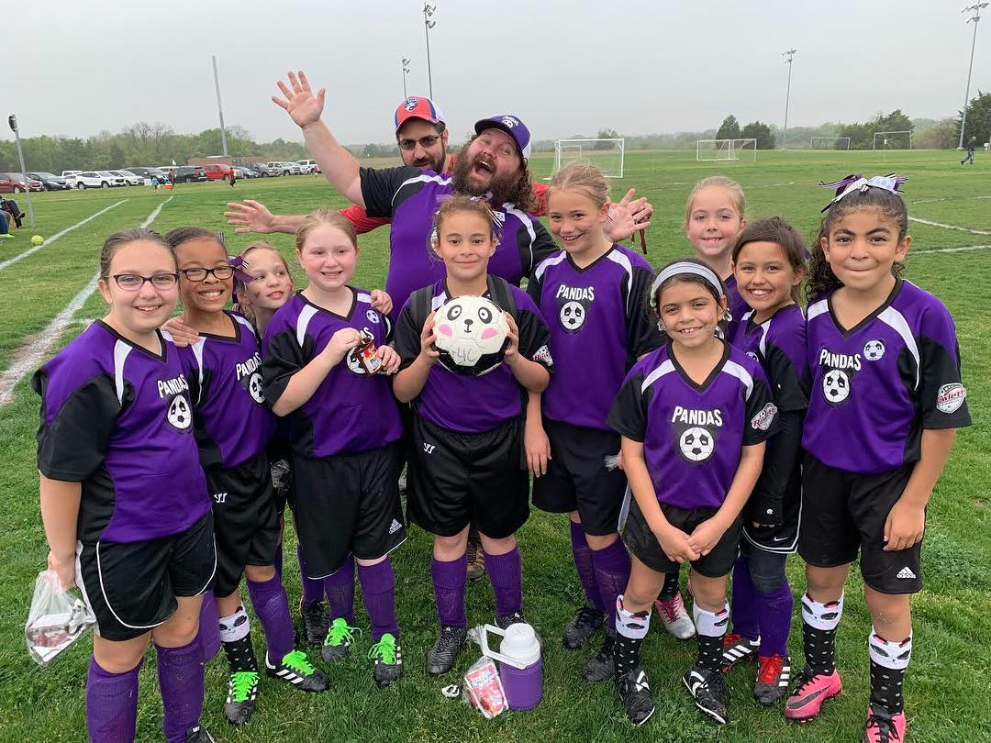
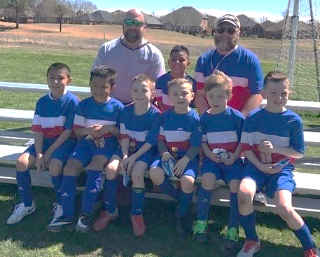
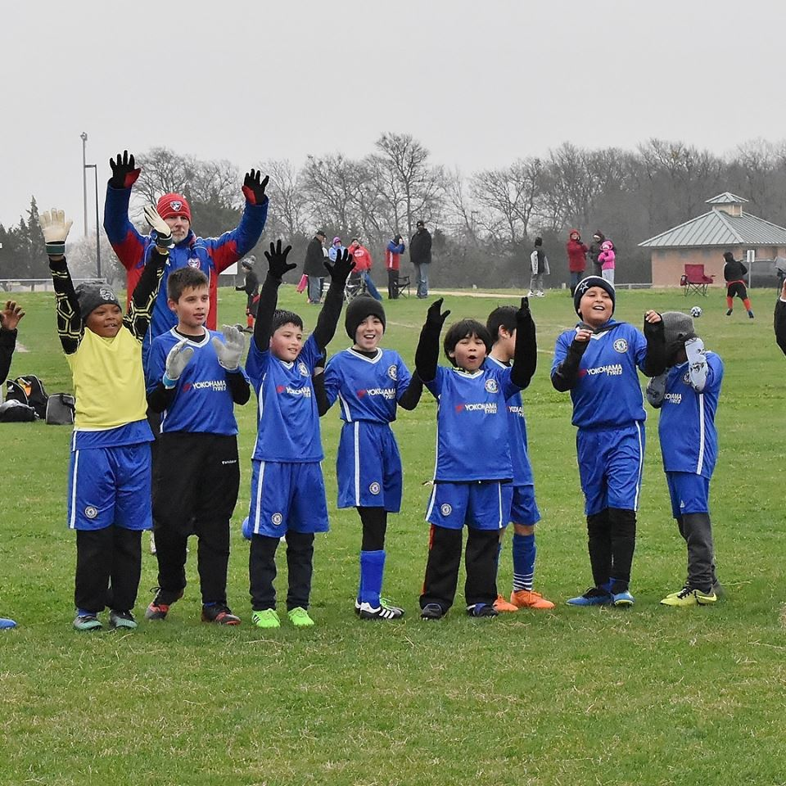

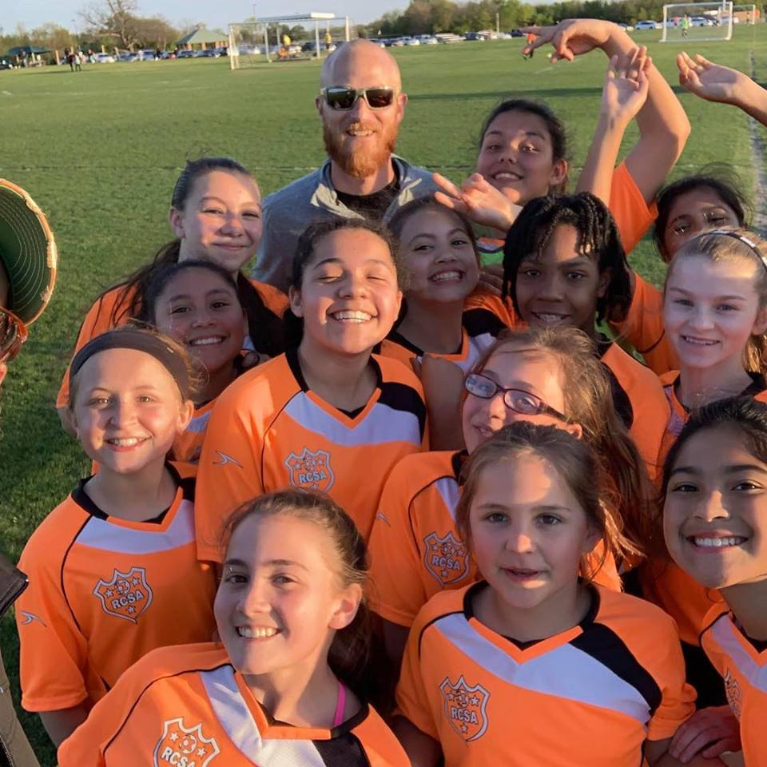
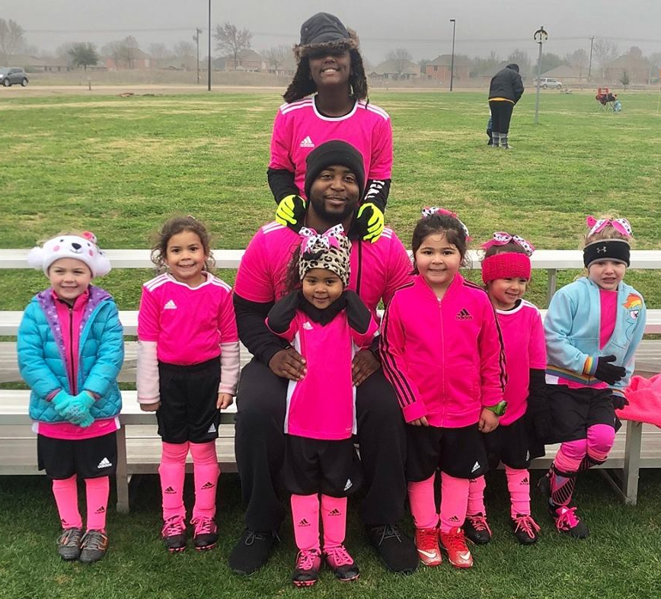
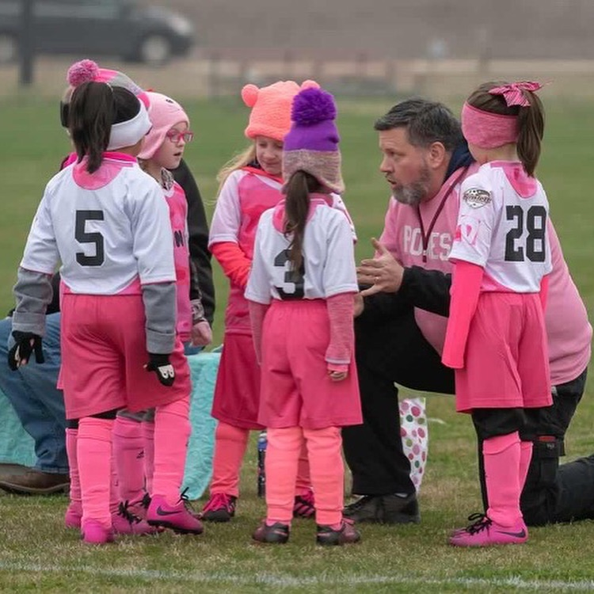
Rowlett Youth
Soccer Association
End of Season Coach Meeting Fall 2025
www.rowlettsoccer.org
Notes:
To Do;
Treasurer’s Report
Fall Dates
Number of Referees
Operation Updates
Coaches to return flags to the office between 8-3

Slide 2
End of Season Agenda
 | Topic | Speaker
1 | Call to Order | Ismael Parra
2 | Opening Statement & State of the Association | Ismael Parra
3 | Treasurer’s Report | Carla Crouse
4 | Legacy FC | Dana Shipley
5 | Operations Update | John Ranta
6 | Referee Update | Richard Moreno
7 | Appeals & Discipline | James Petre
8 | Rules and Board Positions | Ismael Parra
9 | Spring 2025 Dates | Ismael Parra
10 | New Business | All
11 | Closing Statement & Adjourn | Ismael Parra
www.rowlettsoccer.org

Slide 3
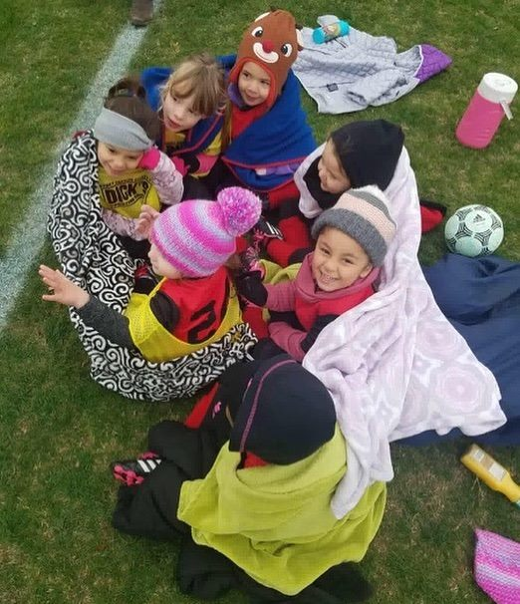
Meeting Etiquette
Ismael Parra
Meeting will follow Robert’s Rules of Order, Newly Revised (RONR) to facilitate this meeting.
You must be recognized by the chair to speak (to have the floor)
Motions cannot be debated or discussed until it’s been seconded
Speakers have 2-minute time limit for discussion or debate on seconded motions (speakers who have already used their two minutes will need to wait until all others have spoken before they are recognized again by the chair)
www.rowlettsoccer.org

Slide 4
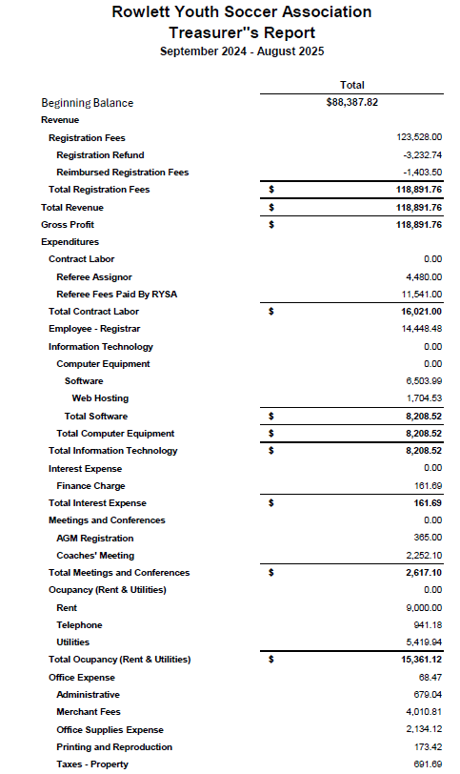
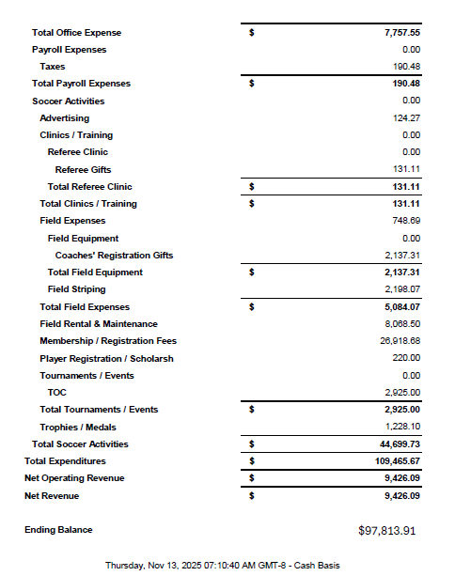
RYSA Treasurer’s Report
www.rowlettsoccer.org
Carla

Slide 5

Legacy FC Staff
Chris / Rebecca
Dana Shipley
  dana.shipley@rowlettsoccer.org
Chris Dougherty
  christopher.dougherty@yahoo.com
www.rowlettsoccer.org

Slide 6
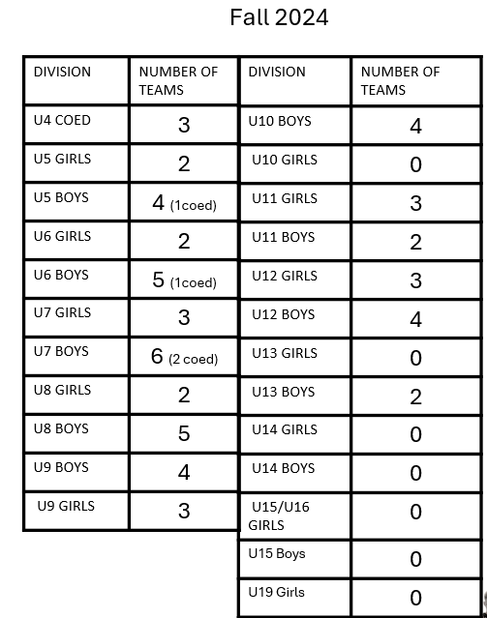
Operational Updates
2025
John
Updates on annual evaluation of RYSA programs
No Bylaws/Rules changes to review today.
Volunteer to support recreational soccer with RYSA!
Field Updates
www.rowlettsoccer.org

Slide 7
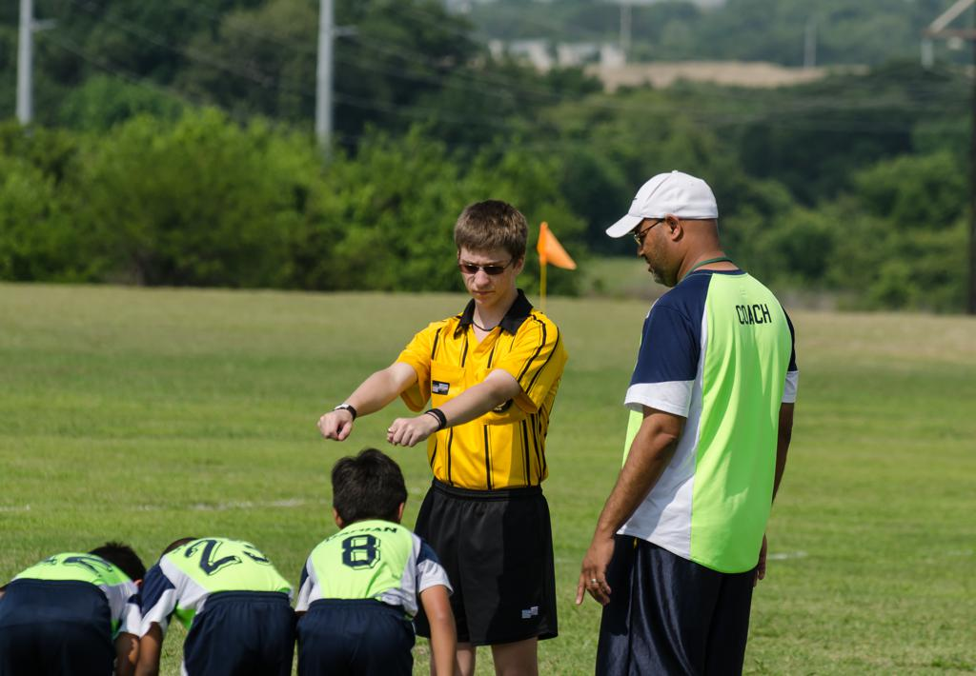
Referee Updates
Richard Moreno
Mentor Program
New Referees to date (21).
Seasoned Mentors training new referees.
37 total Referees
New Referees
Need more adult or young teen Referees – tell your teenagers.
Appreciation
Referees applaud and thank the coaches, players, and parents for a great season!
Feedback from coaches.
RICHARD MORENO - Referee Development Director & Referee Assignor
www.rowlettsoccer.org

Slide 8
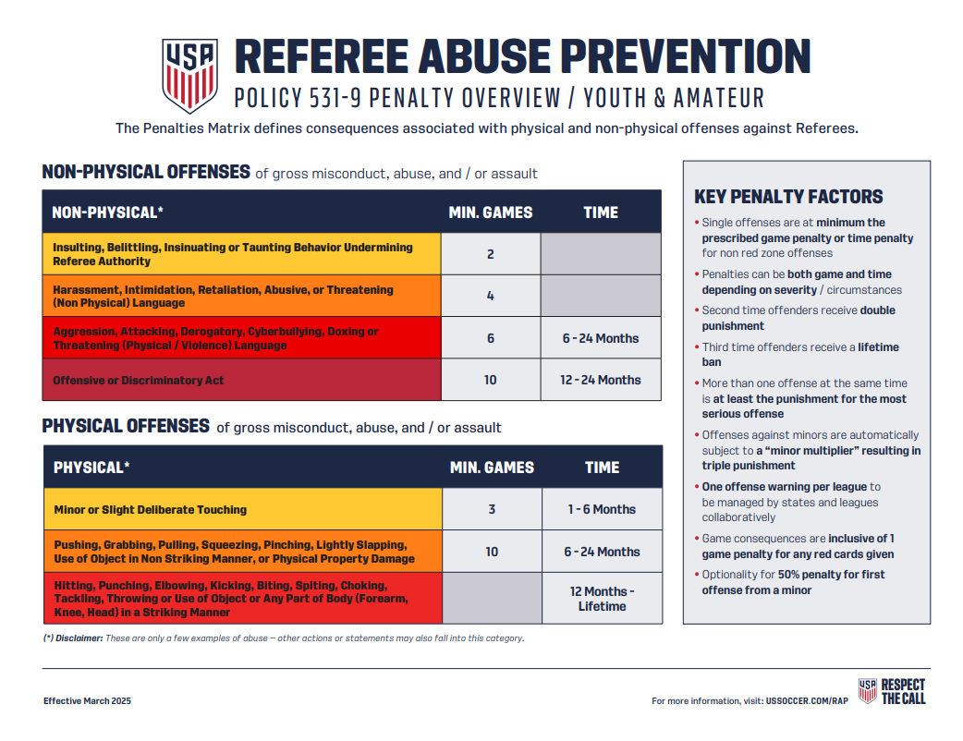

Slide 9

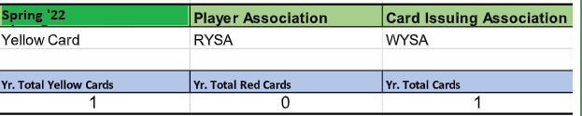
Appeals & Discipline
James Petre
3 Yellow Cards
Fall 2024
Sideline behavior
2 ( Players) 0 1(Coach)
-Waiting for Wylie’s count
-Coaches- You are in charge of your player’s parents. Respect to the Referees.
www.rowlettsoccer.org

Slide 10
RYSA Board Positions
Vacancies in yellow
RYSA President¹ | Ismael Parra
VP of Operations² | John Ranta
VP of A&D (Appeals & Discipline)¹ | James Petre
VP of Operations (Competitive)¹ | Rebecca Fitzgerald
Referee Development Director & Referee Assignor² | Richard Moreno
Treasurer¹ | Carla Crouse
Secretary² | Gabriel Martinez
Coaching Education Director¹ | John Ranta
Promotions & Awards / Marketing² | Haley Arriaga
4U Age Group Director¹ | Jonathan Foresee
5U-6U Age Group Director² | Jonathan Foresee
7U – 8U Age Group Director² | Tim Hopkins
9U – 10U Age Group Director¹ | Andrew Balettie
11U – 19U Major League¹ | Adrew Balettie
Fields and Equipment Director² | Dana Shipley
1 – Positions elected odd-number years. Reference By-laws, Section 2.0 (up for election)
2 – Positions elected even-number years. Reference By-laws, Section 2.0
www.rowlettsoccer.org

Slide 11
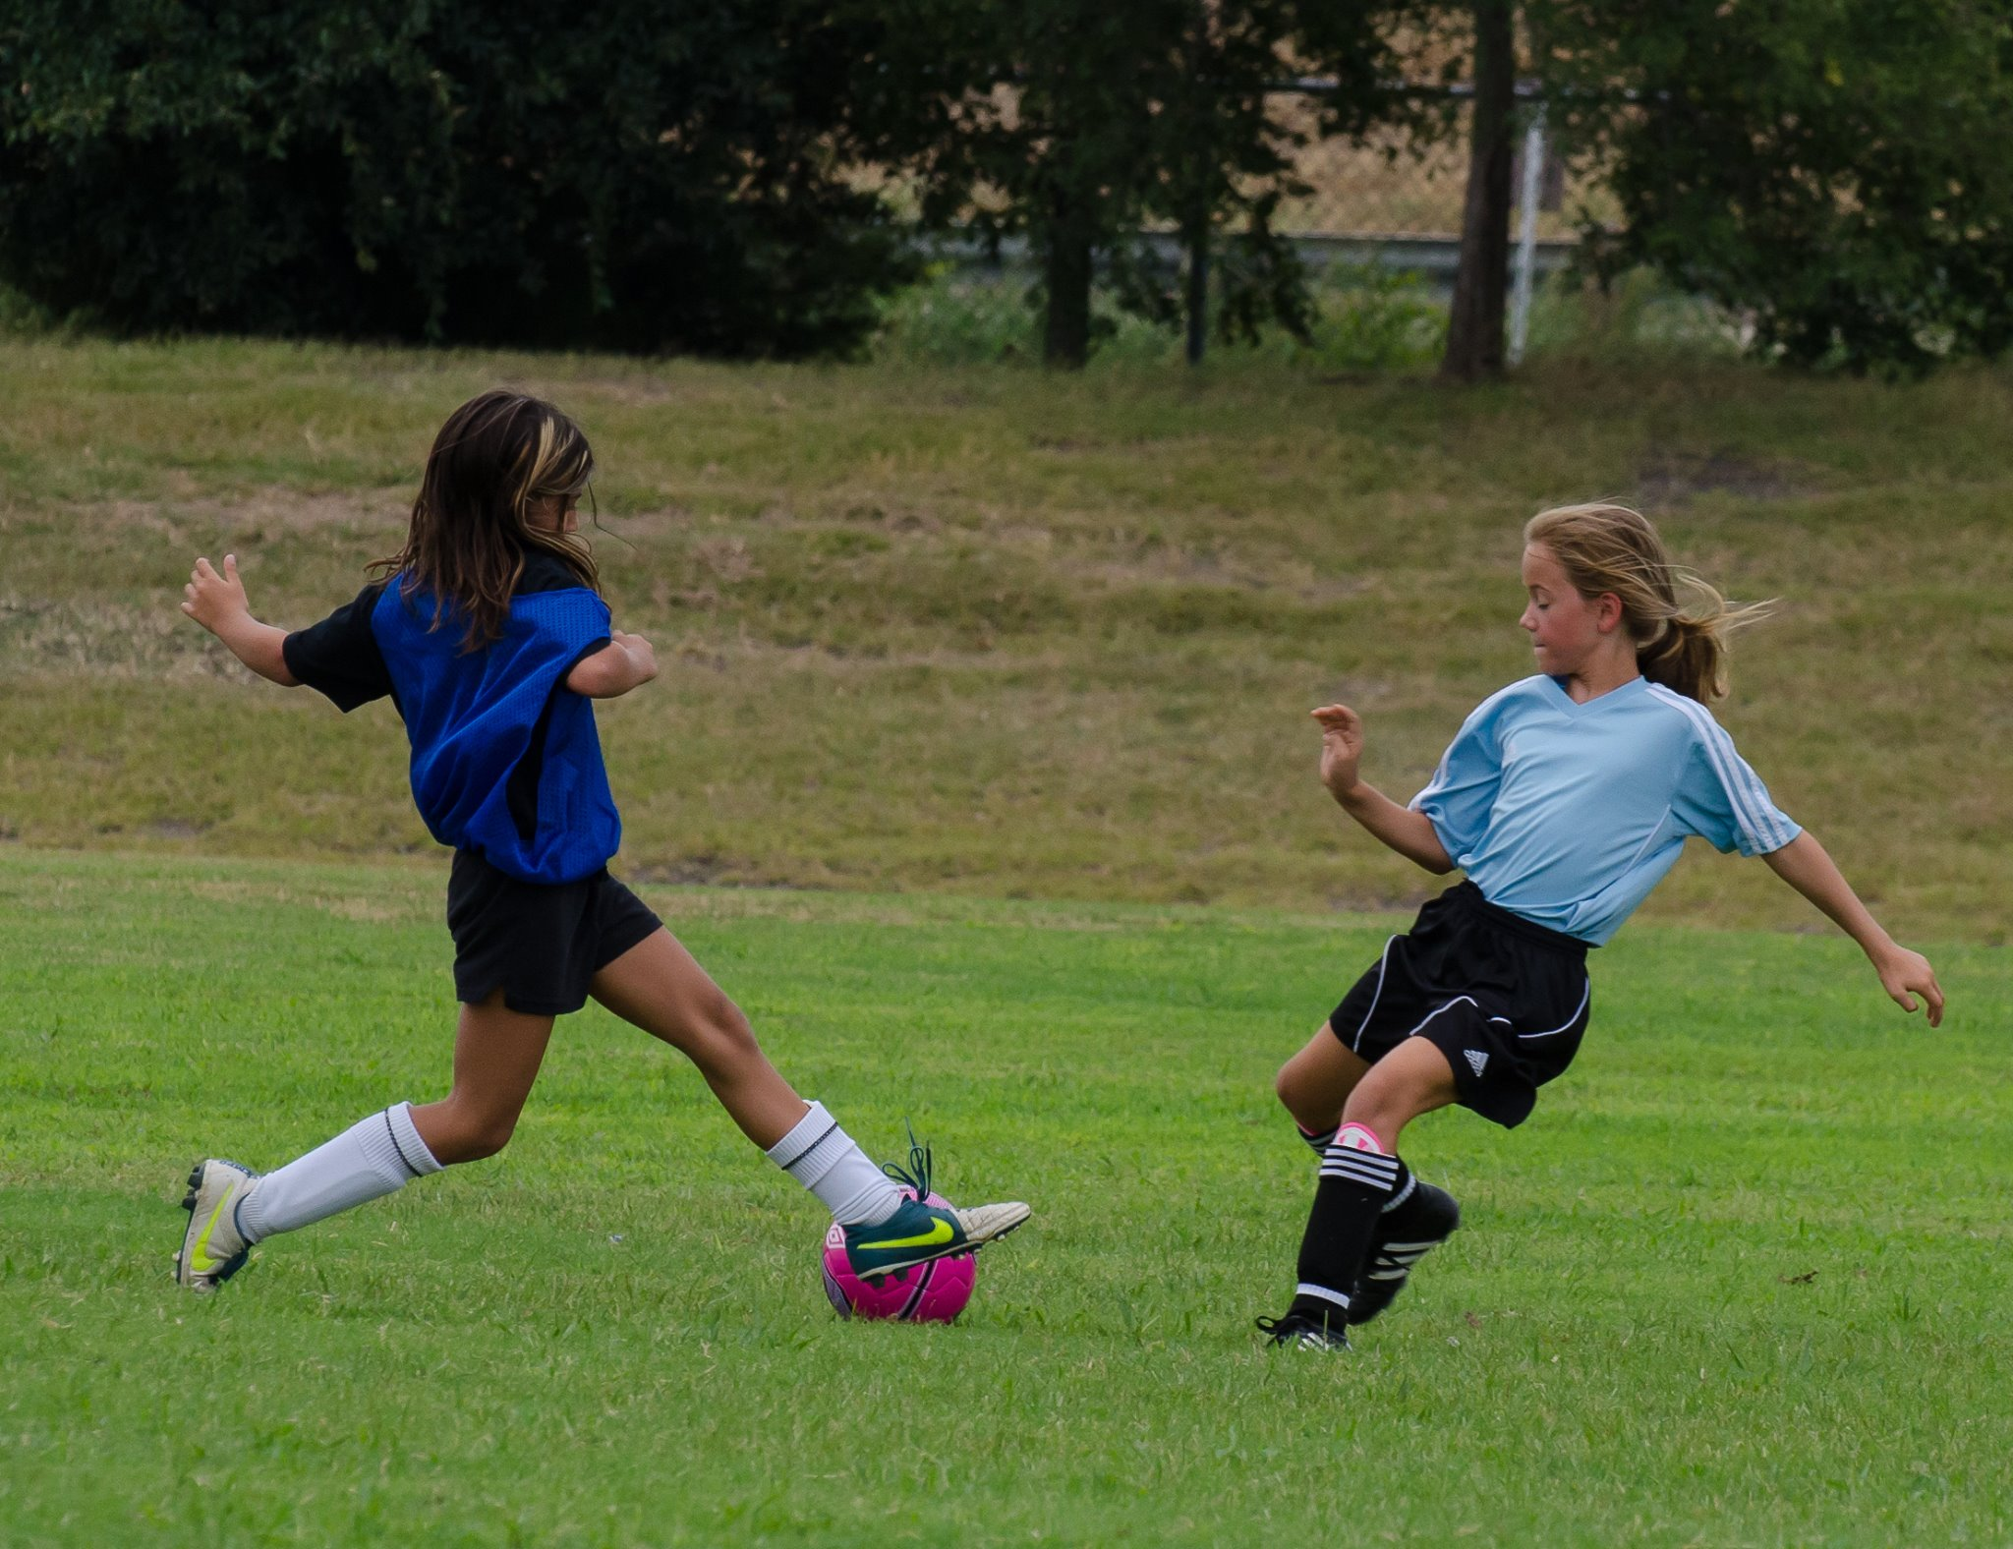


Position Descriptions
Notes:
Talk to coaches about how to engage referees respectfully.

Slide 12
RYSA Spring 2026 Dates
www.rowlettsoccer.org
Tentative – Not finalized
Open Registration | December 6th – January 17th(Online Only)*
------Late Registration | January 18th-31st ($25 late fee)
 | Payments and Birth certificates are due at time of registration.
Team Formation | 01/19 – 02/01(Directors will finalize the 1st)
No team changes after 02/01
Coach Orientation | February 21st
Season Open | February 28th(based on Wylie’s schedule)
Season Ends | Season Ends: 5/2 (Minor & Major League) 8 weekends (5/3 rainout weekend)
End of Season Coach Meeting | 04/23 (Majors and Minors)
No Games | Easter (4/20), Mother’s Day (5/11)
Fall Break | GISD/Wylie Same Break: 03/17-03/21 No Games: 3/14 and weeknights 3/17-3/21 (Games will be played the 2nd weekend of Spring Break)
Note: Need to stress to returning team’s coaches how important it is for returning players to register as early as possible, as we are trying to hit these milestone dates set by Wylie.

Slide 13
Rule Changes
-If you have suggestions for new Rules changes, please submit your suggestions for the board to discuss.
-Nothing for Fall 2024
Notes:
Talk to coaches about how to engage referees respectfully.

Slide 14
Tournament of Champions
8 Teams Representing Rowlett.
Fields availability only after season is over.
Make sure Rosters are properly filled.
No guest players.
Very strict with the 50% playing time for all players.
www.rowlettsoccer.org

Slide 15



New Business & Closing
Season Items
New Business Discussion
Closing Statement
Follow us on so·cial me·di·a
for news, announcements, updates, rainouts, and more!
facebook.com/rowlettsoccer
@RowlettSoccer
www.rowlettsoccer.org

Slide 16

Season Items
www.rowlettsoccer.org

