Slide 1

Youth Protection Program
Clarence Soccer Club – HOUSE LEAGUE
Version 2

Slide 2
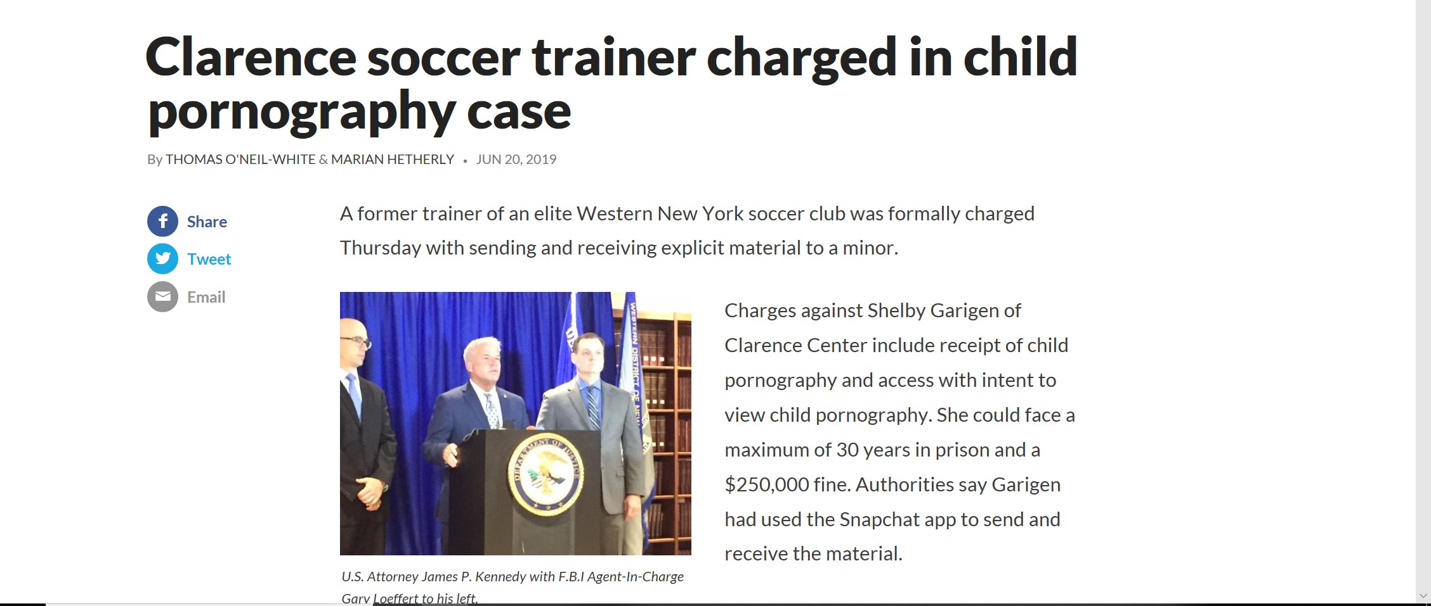
Why Youth Protection?
Youth abuse can happen anywhere, even in Clarence!
IMPORTANT DSICLAIMER – This was NOT a CSC coach!

Slide 3
Purpose
The Clarence Soccer Club (CSC) understands the importance of protecting youth in the community and in our programs and therefore wishes to provide a safe and secure environment. The Board Of Directors of the Clarence Soccer Club has adopted this policy on 7/1/2019 in order to provide practices that will protect youth from incidents of misconduct or inappropriate behavior and also protect the employees and volunteers from false accusations.

Slide 4
Policy
Registered Sex Offenders (Levels 1,2,&3) will NOT be permitted to administer or coach in CSC House League.
All House League staff and parent coaches will be trained to CSC Youth Protection Guidelines.
Records of all background checks and training to be kept for 7 years.

Slide 5
Background Check
All adult administrators and coaches (18 years and older) to supply personal information as follows:
  Full Name
  Current Address
  Date of Birth
This information to be checked against NYS Registered Sex Registry for Level 1, 2, & 3 offenders. Anyone determined to be on this list will not permitted to coach or administer in the CSC House League.

Slide 6
CSC Youth Protection Guidelines
“Two-Deep” Coaching
  Never, ever coach alone. If one coach will not be there for a practice or game, ask another parent to stay with you, even if they only observe from the sideline.
  Always make sure that there is at least one other adult parent with you when you are with any child other than your own.
  This is for your protection as much as the children’s.
Stay Visible
  Always be on the field or in a public area, if you are with any of your players.
  Staff members will never be alone with an individual youth where they are not observable by others.

Slide 7
CSC Youth Protection Guidelines (cont.)
All team communications must be with parents.
  Do not contact any players directly (i.e. text, social media, etc.)
Wear a CSC coach shirt to identify yourself as a coach.
  As much as possible.
  Previous year shirts acceptable.
Youth never to be left unsupervised.
Know your parents.
  Do not release youth to anyone other than parents, legal guradians, or other known family members who they arrived with.
  Call the parent if any questions about who is picking them up.

Slide 8
CSC Youth Protection Guidelines
(cont.)
Prevent Bullying:
  Utilize constructive methods for maintaining group control and managing youth behavior. Never demean and insult any of your players.
  Do not allow any bullying to any of your players, even from their teammates.
Parents will always be allowed to observe practices and games.
Enlist Parental Support:
  Notify your parents about these rules and ask them for their support to help protect our children.
Avoid inappropriate and/or affectionate touching of your players.

Slide 9
Game Injuries
Help us limit any rough play by players to avoid injuries.
Head injuries – please take any hits to the head seriously.
  Remove the player from the game if any hit to the head.
  Do not return player to the game unless 100% sure that there are no lingering effects.
  Notify parent after the game that their player was hit in the head.
Have parent take any injured player to doctor/hospital. Call 911 if there is an emergency or serious injury.
Accident report for any injury requiring medical attention. Blank forms are on the Coach Resource webpage: https://www.clarencesoccer.org/page/show/2716365-coach-resources Please send completed form to your Division Manager.

Slide 10
Remember, Soccer is Fun!
Purpose for House League is for our kids to have fun playing soccer.
Our job as coaches and other volunteers is to make that happen in a safe and friendly environment.
The Score is not important!
Our kids will remember whether they had an enjoyable experience.
Let’s make sure that happens for all of our players.

