Slide 1
First things first
Our friends at Vista Ridge are hurting
2 Gofundme’s for Wade Langston
Praying for our friends w/Colorado United TC, too

Slide 2
The TCA Way
Thoughts on building a thriving distance program

Slide 3
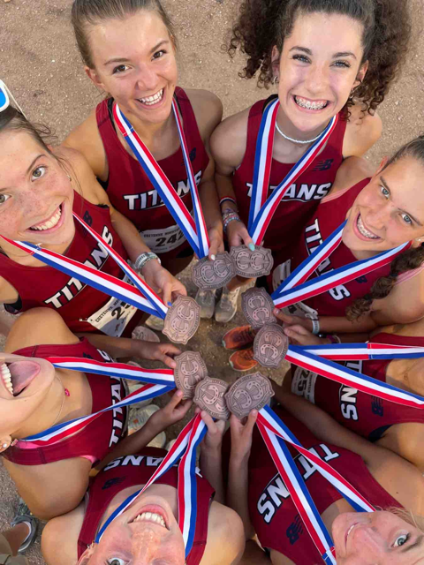
People, Philosophy and Plan
This is a human endeavor, not AI or fantasy track!
What do I and our community stand for?
What kind of running do we do?

Slide 4
People: Who’s on your team?
Student athletes
~90% have been at TCA since kindergarten
Attending a rigorous academic school
Pretty high percentage of regular church goers
Most of our kids really value relationship
Most want to carry on “the tradition”
Slightly above average commitment level to running?
Parents
Chose a public charter school a long time ago
Some take jobs at TCA so kids can attend
Above average means, but not typically mega-rich
Want kids to be successful, learn lessons and be well-rounded
Great support
Above average military involvement
Strong booster club

Slide 5
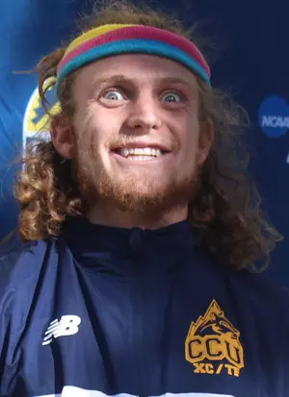
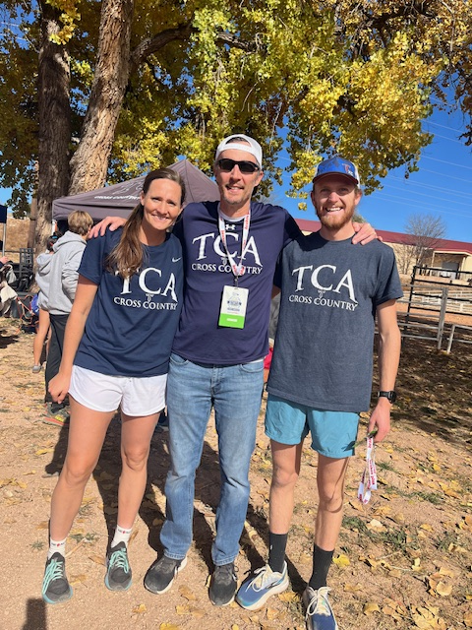
People: Coaches by my side
Ran for Kelly C at PR, and CCU
firm believer in individualized and well-structured training plans for every athlete
importance of an encouraging-yet-competitive team atmosphere
shaped my worldview through the lenses of resilience, self- confidence, integrity, discipline, and hard work
6th grade teacher at TCA, runs marathons
Famous for his fast-food enjoyment index spreadsheet
Craves specific tasks
Coach Means

Slide 6
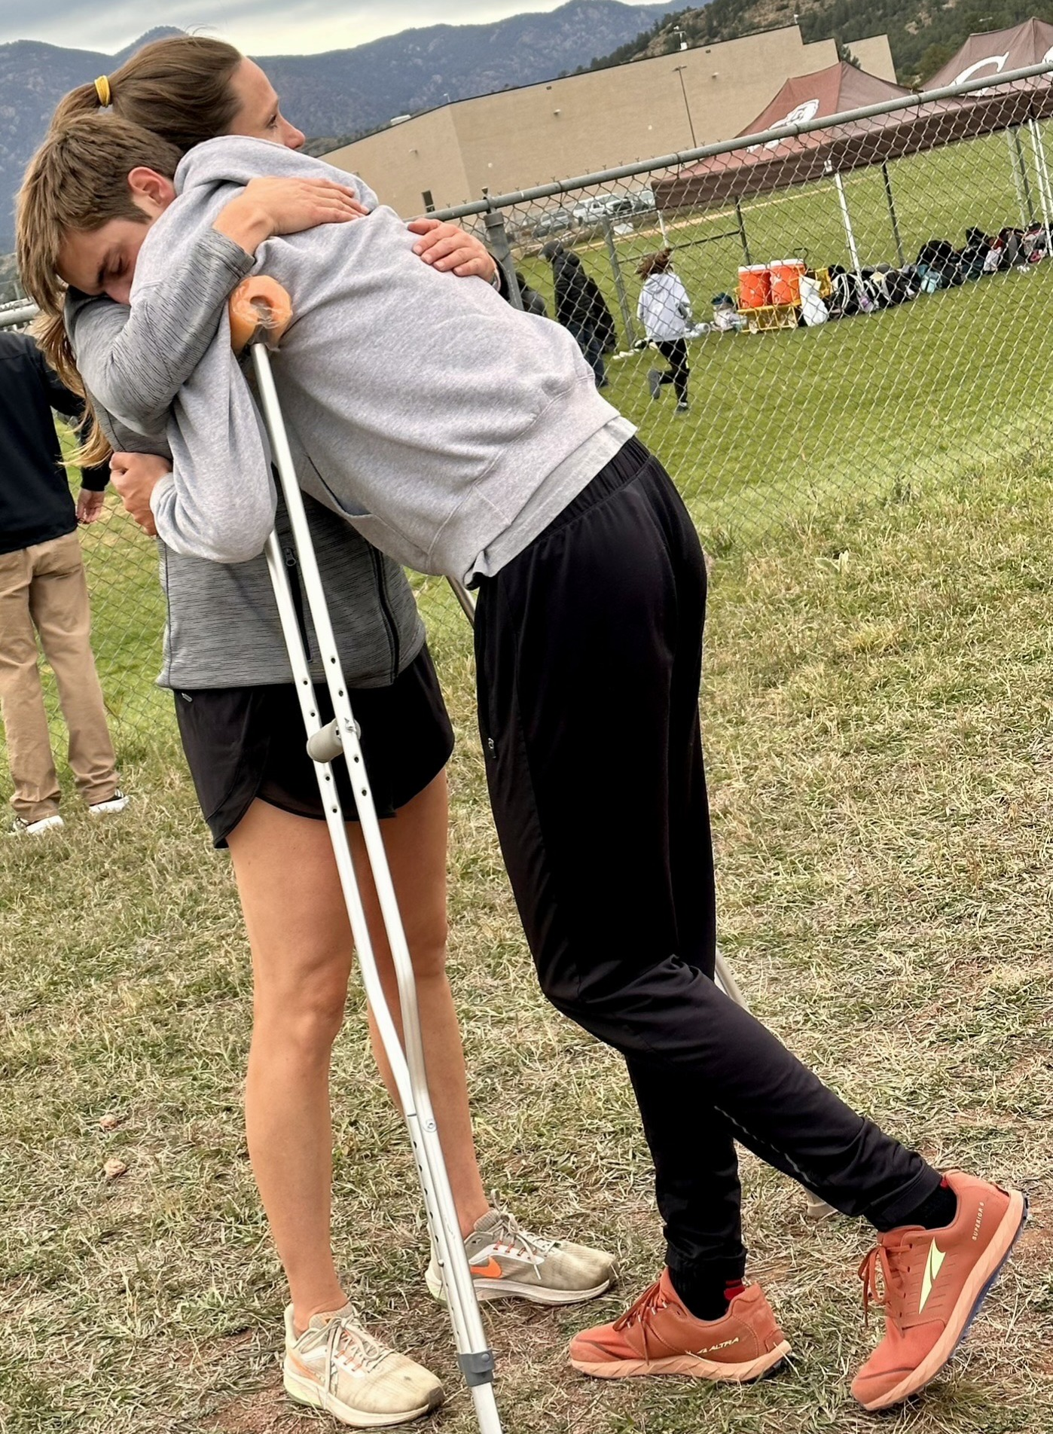
People: Coaches by my side
Coach Hanenburg
Soccer/bball background: Ran for Alan V and Mark Wetmore; super competitive!
Head of our fine arts dept and knows most every kid in the school
Counselor at Jim Ryun Running Camps
Mom has had Parkinson’s for last 15 years
“My own experience in college was challenging and often disappointing because of injury setbacks that made me turn outward.”
“…walking alongside and listening to people who are struggling is of highest importance…”
Seek and trust her input on my thinking, planning and communicating

Slide 7
People: Coaches by my side
Coach Daggett
Head TC
Trusted buddy
Gives me a ton of latitude in track
Cares a lot about team
Cares a lot about process
Cares a lot about “Why”
Share 400m kids w/him
Coach Paisley
Mom of athletes on team
Tim’s longest-tenured asst
Loves track and XC
Cares a lot about encouragement
Share some 300h w/her

Slide 8
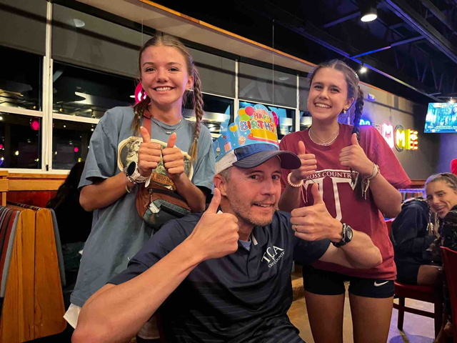
People: Nort-Dog
Played HS football and ran track
Passionate HS coaches, discus thrower for a college coach
Teach 9th English
An introspective, introverted communicator and vision setter
Only child
Competitive—only punched one person in my life
Not an instructions reader
How do I overcome or use these weaknesses
Married, 9th and 7th grader

Slide 9
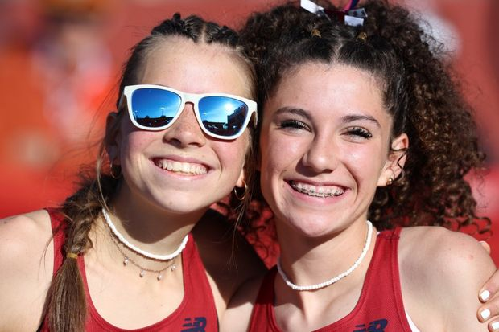
Philosophy: Why run at TCA?
It’s a charter school
Everyone has an important role to serve on the team
Competition is a gift
Running challenges us to grow as a whole person

Slide 10
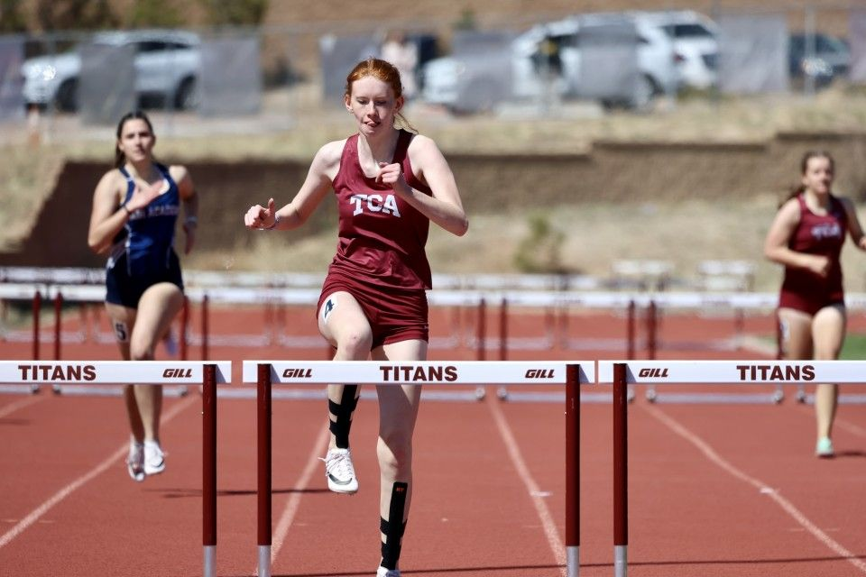
We believe that everyone on the team has an important, positive role that they can and should serve for the team
1 Corinthians 12: a lesson for a young church on how to get along and understand value
Passionate buy in and true humility
Water bottle award
Year-end award: aiming for a JV/C kid who shows care

Slide 11
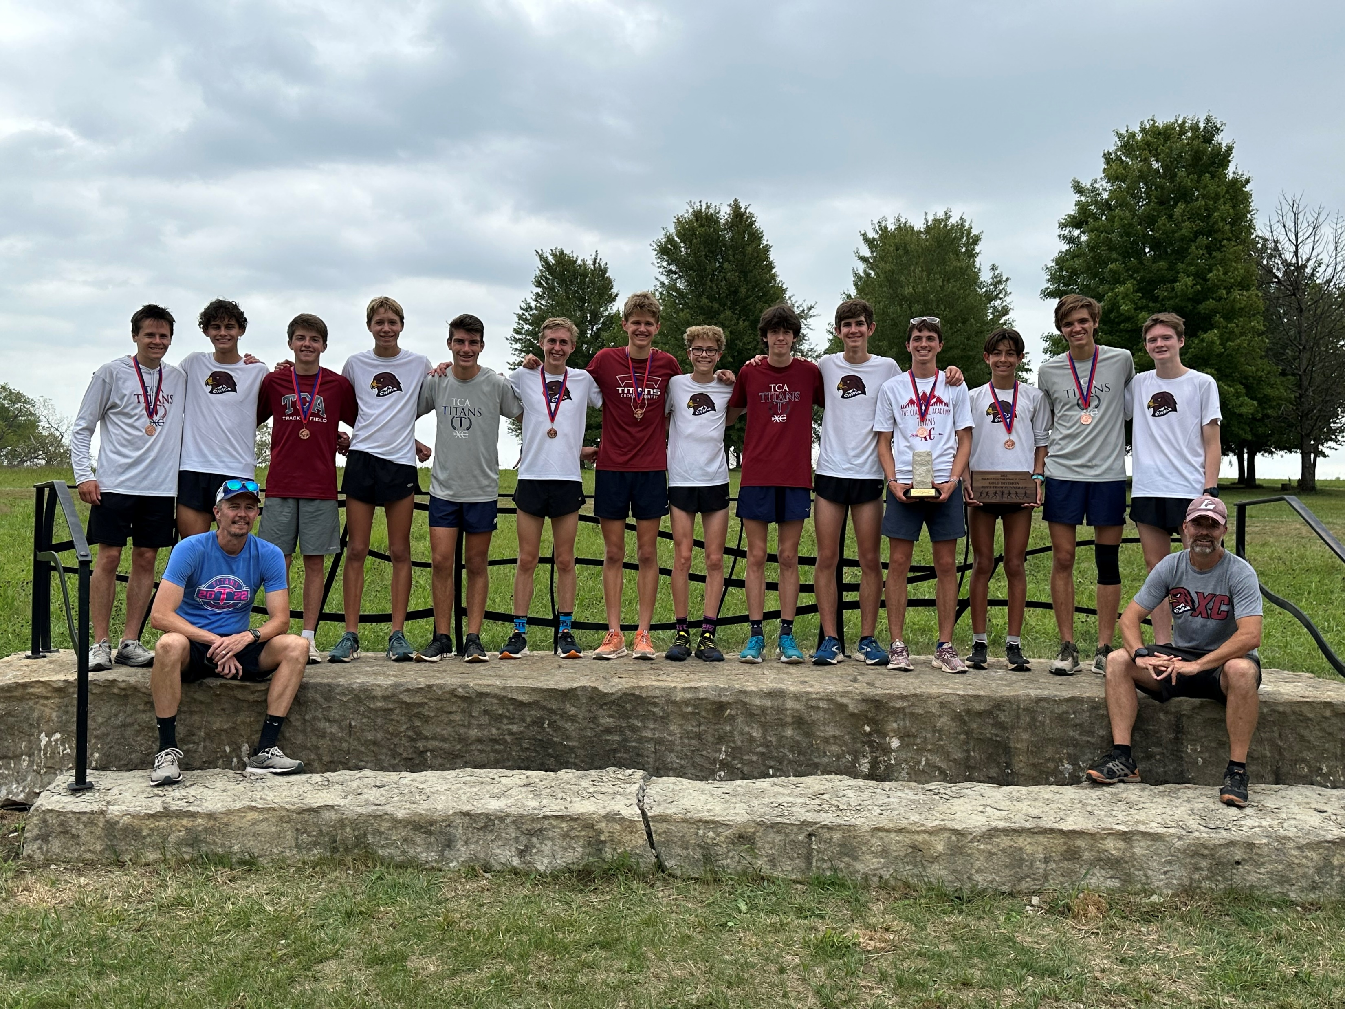
We believe that competition is a gift and joyful
Purpose of competition?
Value of Fellow competitors?
Thankfulness kills a lot of negative thoughts
Building relationships with other programs
Year-end award: breakthrough, enthusiasm for training and/or racing

Slide 12
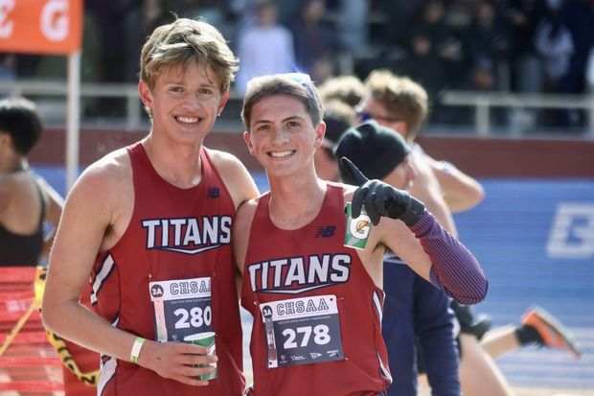
We believe in the ways cross country challenges an athlete to grow as a whole person
Vulnerability, teachability, wise risk-taking
The opportunity in big workouts and races
Year-end award: celebrate someone who struggled, overcame and/or stayed engaged

Slide 13
Plan: Training and planning is a science AND an art
I’ve certainly read: Daniels, Coe, Johnson, plenty of other articles
Did the USATF Level 1 school back in the day
Trial and error and what makes sense to you?
Should have cornerstone workouts
Should be things tweaked, scrapped or shelved for later every year
Take notes: sometimes share, sometimes don’t
How will you group athletes?
What Challenging workouts do your kids love?
Workouts that teach the race
Dealing with elevation: Northgate is different than Loveland!
TCA Racing goals

Slide 14
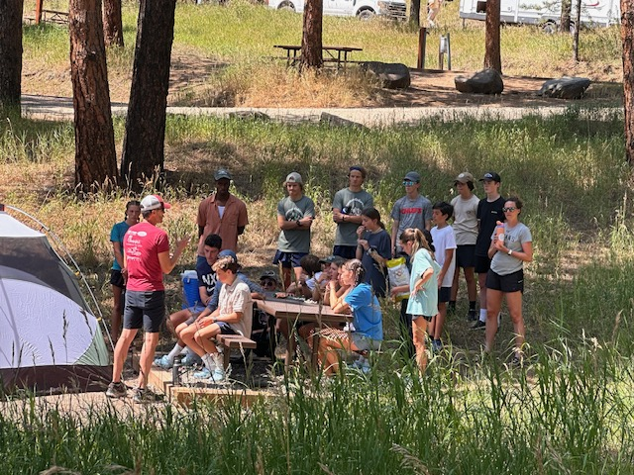
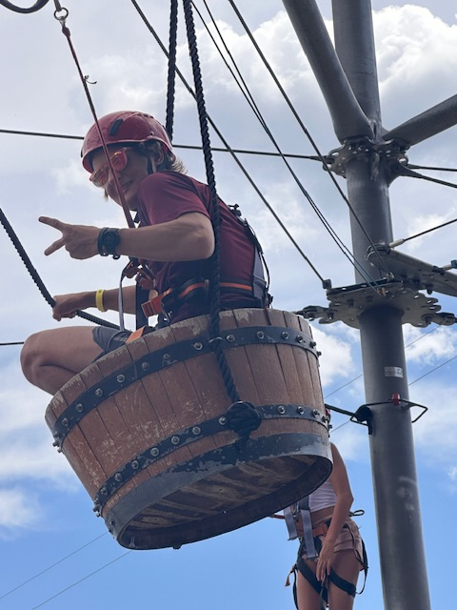
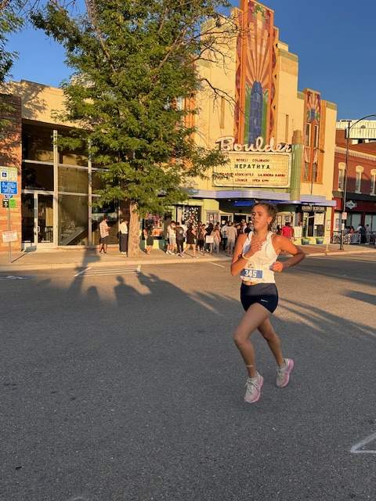
Plan: TCA training at-a-glance
Summer
Usually start last week of June; encourage seniors to lead runs before that
Weekly visit to “fun” trails
Build the JJ long run
1-2x grass 500s at goal 5k, 30-45-60-second hills toward end of summer
Short team trip around fun and a race: Evergreen 5/10k, Pearl Street Mile…

Slide 15
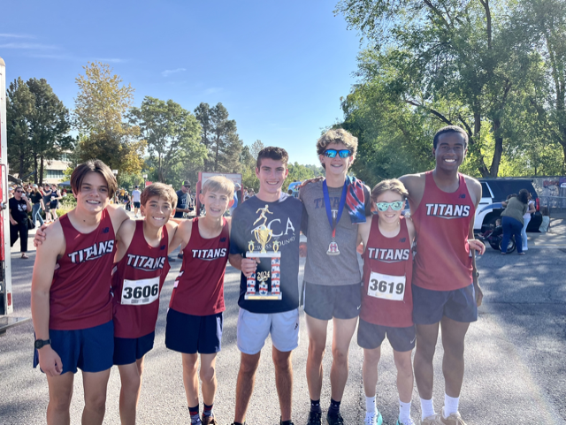
Plan: TCA training at-a-glance
Cross Country
900 or 1800 fartleks on our “state course”
Long runs on non-race weeks, at least
800 fluxes: thanks Sean O!
Track 4:15 intervals on 8:00: thanks Alan V!
1600/3200 pace ~1x a month
2024: 9th/10th girls 30-35 mpw
2023: senior boys ~50, Edwards or Wilburn pushing 60

Slide 16
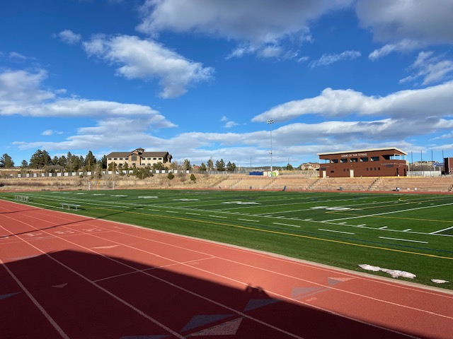
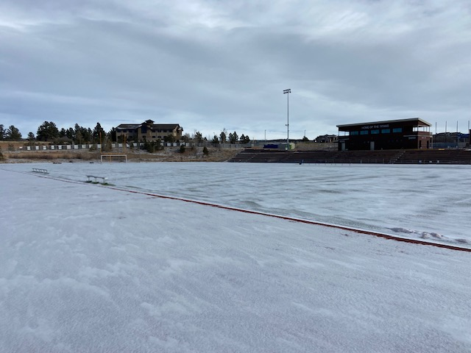
Plan: TCA training at-a-glance
Winter
“Hold on Loosely”
Lift 2x a week
200-300m hills on sidewalk near school
Threshold relays
JJs 800/1600 development workouts
Re-establish long run
600 TT before indoor meet
Mid-Feb indoor/preseason Meet
321m TT with whole team 1st week of real practice

Slide 17
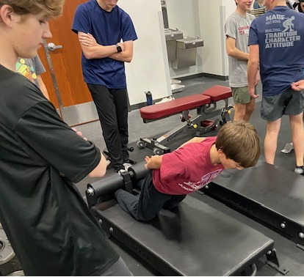
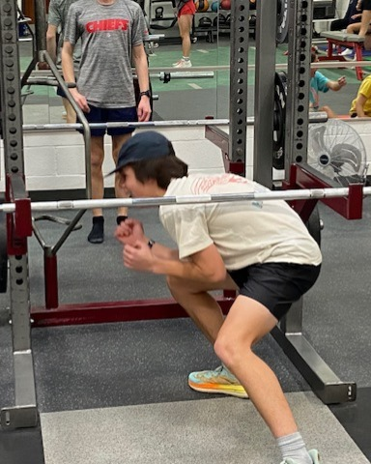
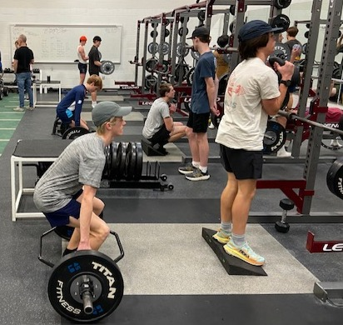
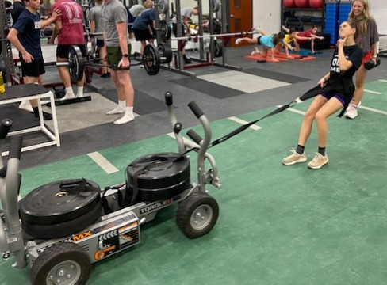
Plan: TCA training at-a-glance

Slide 18
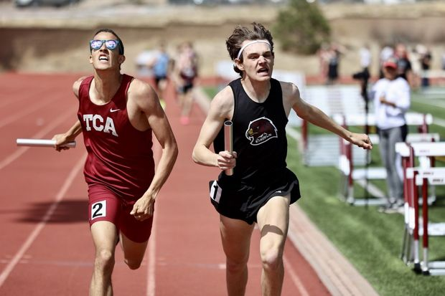
Plan: TCA training at-a-glance
Track
4 speeds every two-ish weeks
400 pace: 500-800m of work
800: 1000-1600m of work
1600: 3k-5k of work
3200: 4k-6k of work
These are early-week, “main” workouts
JJ’s 48-hour workouts late in week
Have replaced in-season TTs
1-2 more long runs where we can fit them; 1-2 threshold workouts as needed
Lift 1x, plyo 1x a week
Late season TT/Race sim
600 TT
1200-800-400 @ 3200 w/400 jog
600-300 @ 800 w/300 jog

Slide 19
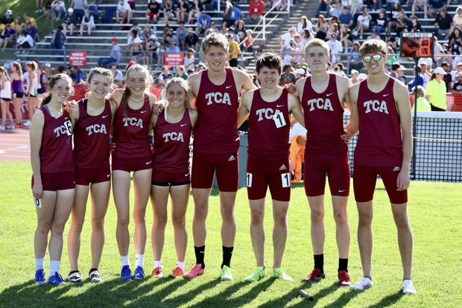
Plan: TCA training at-a-glance
Track racing principles
Work backward from the state meet
As broad of race experiences as possible
2nd race always lower-key, unless a top 4x4; only triple at our home meet
4x8 and 3200 usually fairly easy to run fast off the bat
Open 800 next, 1600 longest to be ready
Use smaller meets for weaker distances or try tactics
Kids want to race; with more options and shorter distances, not a huge fan of taking weekends off
Photo creds: Tim McDonald, Alicia Whitcomb, the web

Slide 20
Sample TCA workouts
2024 XC: flux 800s
Our kids fell in love with this workout
Wednesday before the state meet
I wanted to hold kids back but they kept going
This year, just recorded total time; next year, maybe kids get their 200-300-200 splits?
Kids mostly got faster by cutting down 300 recovery in the middle, while shortening rest from 3:00 (Aug 6) to 2:00 (Oct 30)
Maybe you went to O’Day’s prez at BRC …
TCA XC 2024 |  | 30-Oct |  | 5x800 fluxes |  | 300-200-300
2:00 rest | splits | total | lap | 1 | 2 | 3 | 4 | 5 | AVG | 10/1 avg (2:15 rest) | 9/11 avg (4-6) | 8/28 avg (4-6) | 8/21 avg (2-3) | 8/6 avg (4-6) | 8/6= 3:00 rest
NBA | 57-43-57 | 2:37 | 1:18 | 2:33.0 | 2:36.4 | 2:35.7 | 2:34.7 | 2:30.4 | 2:34.0 | 2:34 (6) | 2:35 | sick | 2:40 | 2:38 | 57-50-57
Ryan | 59-45-59 | 2:43 | 1:21 | 2:39.9 | 2:46.9 | 2:41.5 | 2:42.8 | 2:31.5 | 2:40.5 | 2:40 (6) | 2:42 | 2:45 (6) | 2:47 | 2:48 | 61-52-61
Braden | 59-45-59 | 2:43 | 1:21 | 2:39.4 | 2:47.5 | 2:43.1 | 2:45.0 | 2:41.0 | 2:43.2 | 2:44 (5) | DNR | DNR | 2:50 | 2:47 | 61-52-61
Barrett | 61-45-61 | 2:47 | 1:23 | 2:43.1 | 2:475 | 2:47.5 | 2:47.9 | 2:41.2 | 2:45.4 | 2:46 (5) | 2:48 | 2:56 (5) | 2:50 | 2:52 | 63-55-63
Marcus | 61-45-61 | 2:47 | 1:23 | 2:42.7 | 2:47.5 | 2:46.4 | 2:47.1 | 2:42.4 | 2:45.2 | 2:44 (5) | 2:47 | 2:45 (2) | 2:47 | 2:50 | 63-55-63
Luke | 61-45-61 | 2:47 | 1:23 | 2:43.3 | 2:47.5 | 246.9 | 2:47.7 | 2:43.7 | 2:45.8 | 2:45 (5) | 2:43 | 2:48 (5) | 2:51 | NA | NA
Sam | 61-47-61 | 2:49 | 1:24 | 2:42.9 | 2:47.5 | 2:46.6 | 2:47.3 | 2:45.9 | 2:46.0 | 2:47 (5) | 2:49 | 2:54 (5) | 2:54 | NA | NA
Kehren | 61-47-61 | 2:49 | 1:24 | 2:43.5 | 2:47.5 | 2:47.1 | 2:46.8 | 2:42.7 | 2:45.5 | 2:47 (5) | 2:51 | 2:57 (5) | 2:55 | NA | NA
DeCoste |  |  |  | 2:43.7 | 2:47.5 | 2:47.5 | 2:47.5 | 2:46.0 | 2:46.4 | NA | 2:48 | 2:52 (5) | 2:54 | NA | NA
TCA XC 2024 |  | 30-Oct |  | 5x800 fluxes |  | 300-200-300
2:00 rest | splits | total | lap | 1 | 2 | 3 | 4 | 5 | AVG | 10/1 avg (2:15 rest) | 9/11 avg (4-6) | 8/28 avg | 8/21 avg (2-3) | 8/6 avg (4-6)
Viv | 63-50-63 | 2:56 | 1:28 | 3:02.6 | 2:53.8 | 2:55.9 | 2:51.9 | 2:48.8 | 2:54.6 | 2:55 (6) | 2:54 | 3:03 (6) | 3:07 | 3:08 | 67-60-67
Ellie | 64-50-64 | 2:58 | 1:29 | 3:03.7 | 2:56.1 | 2:58.0 | 2:55.9 | 2:51.6 | 2:57.1 | 2:57 (6) | 2:59 | sick | 3:07 | 3:10 | 67-60-67
Jana | 64-50-64 | 2:58 | 1:29 | 3:04.6 | 2:57.6 | 2:59.4 | 2:57.5 | 2:53.4 | 2:58.5 | 3:03 (5) | 3:03 | 3:05 (6) | 3:08 | 3:10 | 67-60-67
Gabby | 65-54-65 | 3:04 | 1:32 | 3:07.6 | 3:20.7 | 3:07.0 | 3:25.3 | 3:27.9 | 3:17.7 | 3:03 (6) | 3:06 | 3:10 (6) | 3:09 | 3:11 | 70-60-70
Lena | 65-54-65 | 3:04 | 1:32 | DNR |  |  |  |  |  | 3:04 (5) | dnr | abs | DNR | NA | NA
Paris | 65-54-65 | 3:04 | 1:32 | 3:06.5 | 3:05.9 | 3:07.1 | 3:15.4 | 3:15.6 | 3:10.1 | 3:05 (5) | 3:07 | 3:06 (6) | 3:11 | NA | NA
Caroline | 66-55-66 | 3:07 | 1:33 | 3:07.6 | 3:05.9 | 3:07.1 | 3:08.8 | 2:59.7 | 3:05.8 | 3:03 (5) | 3:07 | 3:09 (5) | 3:11 | 3:13 | 70-60-70
Brynlee | 66-55-66 | 3:07 | 1:33 | 3:07.6 | 3:05.9 | 3:07.1 | 3:09.4 | 3:06.4 | 3:07.3 | 3:04 (5) | 3:07 | 3:09 (5) | 3:11 | 3:14 | 70-60-70
Elle | 66-55-66 | 3:07 | 1:33 | 3:05.4 | 3:04.9 | 3:06.6 | 3:18.1 | 3:08.7 | 3:08.7 | 3:05 (5) | 3:05 | 3:08 (5) | 3:11 | 3:14 | 70-60-70
Photo creds: Tim McDonald, Alicia Whitcomb, the web

Slide 21
Sample TCA workouts
March, 24: “VO2” 500s
I think at TVHS, this would almost always been repeat 800s or such—the difference in living/training at 6700’
This was a significant effort for most all the kids
Logan and Cass PR’d at 3200 10 days later
Took Joy another 2 months to figure out the 3200
16 and 32 workouts ideally end with the fastest rep—the older kids (Logan, David, Jack, Cass) all did
TCA Track 2024 |  |  | 5-Mar | 500s @ 3200 pace |  |  | Boys 2, Girls 2:20 rest
 | pace | goal | 1 | 2 | 3 | 4 | 5 | 6 | 7 | 8 | AVG
Logan | 1:12 | 1:30 | 92.5 | 87.6 | 91.8 | 90.8 | 89.7 | 88.2 | 87.9 | 84.3 | 89.1
David | 1:12 | 1:30 | 92.5 | 87.6 | 91.8 | 90.8 | 89.7 | 87.4 | 87.9 | 85.3 | 89.1
Kieran | 1:12 | 1:30 | 92.5 | 87.6 | 91.8 | 90.8 | 90.5 | 89.5 | 93.3 | 89.3 | 90.7
Jack | 1:14 | 1:32 | 96.1 | 89.7 | 95.6 | 94.0 | 95.8 | 93.3 | 94.3 | 90.7 | 93.7
Grant | 1:14 | 1:32 | 96.1 | 90.0 | 95.6 | 94.7 | 95.8 | 94.3 | 97.3 | 92.0 | 94.5
NBA | 1:14 | 1:32 | 96.1 | 91.1 | 95.6 | 96.7 | 97.3 | 94.5 | 95.9 | 91.3 | 94.8
BraDEN | 1:19 | 1:38 | 97.5 | 92.5 | 98.7 | 99.1 | 99.3 | 98.5 | 98.7 | xxxx | 97.8
Cass | 1:26 | 1:47 | 112.1 | 102.7 | 109.7 | 105.8 | 106.6 | 105.9 | 106.3 | 96.3 | 105.7
Viv | 1:26 | 1:47 | 111.2 | 101.2 | 109.1 | 104.9 | 105.4 | 104.7 | 103.4 | xxxx | 105.7
Joy | 1:27 | 1:48 | 112.1 | 103.1 | 109.7 | 106.2 | 107.2 | x | 107.4 | xxxx | 107.6
Paris | 1:27 | 1:48 | 112.1 | 103.5 | 109.7 | 106.9 | 107.2 | 107.6 | 108.7 | xxxx | 108.0
Gabby | 1:28 | 1:50 | Dnr |  |  |  |  | ? | ? | xxxx
Photo creds: Tim McDonald, Alicia Whitcomb, the web

Slide 22
Sample TCA workouts
April 24: 500s @1600
One way I’ve changed is looking at less volume, but less rest/jog recoveries
Lots of opportunities to show kids they were faster in ‘24 than ‘23—confidence
Good place to sneak some 400-pace stuff in
Helps the 500s
Last 120 feels like a race
BTW, My engineering wife turned me onto excel for the math-calculating functions…
TCA Track 2024 |  |  | 24-Apr
3x500 @1600 w/300 jog; 120 @400 before and anfetr
 | 120 | 500 (quick 1st 200) | 500 (run even Pace) | 500 (kick last 200) | 120 | 24 pace | 24 time | 4/27/23 pace | 4/27/23 time | 16 goal | 500
Logan | 14.9 | 83.2 | 81.8 | 76.9 | 14.5 | 258.0 | 4:18.0 | 278.4 | 4:38.4 | 4:15 | 1:19
David | 15.3 | 84.3 | 80.9 | 78.6 | 15.1 | 260.1 | 4:20.1 | 272.6 | 4:32.6 | 4:25 | 1:22
Meister | 14.6 | 84.3 | 81.8 | 81.5 | 14.5 | 264.1 | 4:24.1 | NA |  | 4:35 | 1:25
Kieran | 16.1 | 84.7 | 85.1 | 83.1 | 16.5 | 269.8 | 4:29.8 | 281.3 | 4:41.3 | 4:45 | 1:29
Grant | 14.9 | 83.2 | 84.3 | 81.8 | 14.5 | 265.9 | 4:25.9 | 288.6 | 4:48.6 | 4:55 | 1:32
Jack | 15.0 | 84.7 | 85.1 | 79.3 | 15.3 | 265.7 | 4:25.7 | 297.0 | 4:57.0 | 5:00 | 1:33
NBA | 16.0 | 86.8 | 89.9 | 88.9 | 16.4 | 283.3 | 4:43.3 | 298.6 | 4:58.6 | 5:05 | 1:35
Isaac | 15.0 | 87.5 | 92.3 | sick |  | 287.7 | 4:47.7 | 297.3 | 4:57.3 | 5:15 | 1:38
Stew | 15.1 | 86.8 | 93.8 | 102.9 | 15.0 | 302.4 | 5:02.4 | 300.5 | 5:00.5 | 5:25 | 1:41
Braden | 16.4 | 88.5 | 93.8 | 89.3 | 15.8 | 289.7 | 4:49.7 | NA |  | 5:35 | 1:44
Matty |  | 83.0 |  |  |  |  |  |  |  | 5:45 | 1:47
Ryan | 17.0 | 89.6 | 101.2 | 94.9 | 18.7 | 304.7 | 5:04.7 | NA |  | 5:55 | 1:50
Mason | 16.1 | 95.0 | 105.9 | 102.2 | 16.1 | 323.3 | 5:23.3 | 323.3 | 5:33.4 | 6:05 | 1:54
DeCoste | 17.3 | 91.8 | 101.7 | 95.7 | 18.1 | 308.5 | 5:08.5 | NA |  | 6:15 | 1:57
Sam | dnr
Seth | 19.7 | 99.4 | 117.1 | 115.9 | 18.1 | 354.6 | 5:54.6 | 354.6 | 6:04.7
Peter | sick
Matthew | sick
Thomas | 17.4 | 99.4 | 114.4 | 105.5 | 19.0 | 340.6 | 5:40.6 | NA
TCA Track 2024 |  |  | 24-Apr
3x500 @1600 w/300 jog; 120 @400 before and anfetr |  |  |  |  |  |  |  |  |  | 16 goal | 500
 | 120 | 500 (quick 1st 200) | 500 (run even Pace) | 500 (kick last 200) | 120 | 24 pace | 24 time | 4/27/23 pace | 4/27/23 time | 4:15 | 1:19
Viv | 17 | 98.1 | 100.3 | 94.3 | 18.2 | 312.2 | 5:12.2 | NA | NA | 4:25 | 1:22
Jana | 16 | 98.4 | 101.5 | 94.9 | 16.1 | 314.5 | 5:14.5 | NA | NA | 4:35 | 1:25
Mak | 16.6 | 99.5 | 102.0 | 92.7 | 16.6 | 313.8 | 5:13.8 | 328.2 | 5:28.2 | 4:45 | 1:29
Joy | 17.1 | 99.5 | 102.0 | 98.9 | 17.3 | 320.4 | 5:20.4 | NA | NA | 4:55 | 1:32
Gabby | 17.1 | 99.5 | 102.0 | 98.1 | 16.5 | 319.6 | 5:19.6 | NA | NA | 5:00 | 1:33
Paris | 17 | 99.5 | 104.1 | 105.8 | 19 | 330.0 | 5:30.0 | NA | NA | 5:05 | 1:35
Caroline | 17.5 | 100.5 | 106 |  | 17 | 330.4 | 5:30.4 | NA | NA | 5:15 | 1:38
Megan | 18.9 | 113.3 | 127.5 | 121.6 | 19 | 386.6 | 6:26.6 | 339.8 | 5:39.8 | 5:25 | 1:41
Karissa | 18.5 | 109.5 | 114.9 | 114.3 | 18.5 | 361.3 | 6:01.3 | NA | NA | 5:35 | 1:44

Slide 23
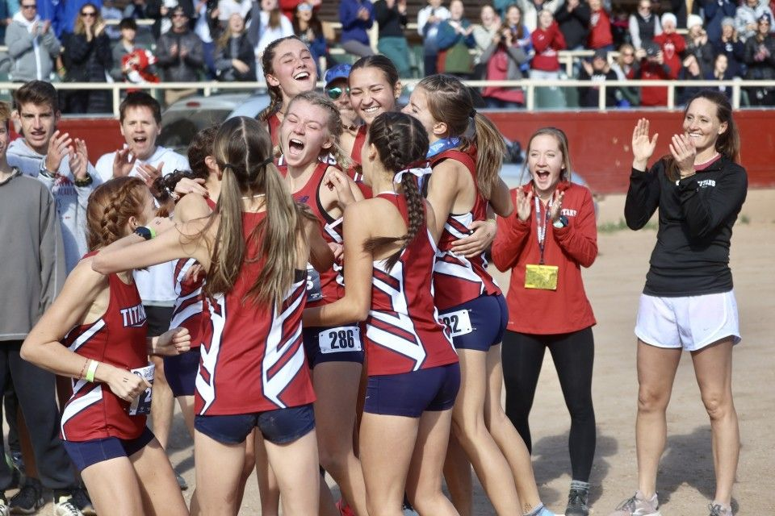
That’s It!
Email me any time: mnorton@asd20.org
Hope to see ya tomorrow!

