Slide 1
Softball Scoring
Michael Hawkins
Sunrise Field Supervisor

Slide 2
Responsibilities
Home team will provide the official scorekeeper
Visiting team will provide a scoreboard operator
We suggested they sit together behind the backstop during the game.
That way any disagreements concerning the score, etc. will be address, when they occur
There will not be any changes to the official scorebook after
the game has ended and the umpire signs the scorebook
If there are any questions, concerning scorekeeping, operating the scoreboard, unruly fans, etc., or the umpire requests assistance, the scorekeeper will contact the Field Supervisor.

Slide 3
Scorekeeper Will
Properly complete scorebook
Batters
Base runners
Runs scored
How outs occurred
Provide updates to the umpire on time, runs, etc.
Have umpire sign the scorebook after the game
Leave scorebook in metal case at the end of the game

Slide 4
Other Scorebook Entries
The scorekeeper will note the time remaining at suspension of play
This time will be used determine game time remaining
Games that have finished 3 complete innings will be considered a
complete game
- Final score will be score at the end of the last complete inning
Scorekeepers are required to note all ejections in the scorebook, with
names of the people involved
Protest must be noted on the official score sheet at the time of the
infraction, signed by the protester and umpire

Slide 5
What Do You Notify Umpire About
If the wrong batter comes up to bat
What do you do?
You do not notify umpire
The opposing coach has to question the batting order
Do not notify the Umpire of rules violations
Things To Notify Umpire Of:
3rd out
(8u) 5 runs scored in an inning
(6u) 4 runs scored in an inning
Anything they ask you

Slide 6
Scorebook
Page 6 of scorebook (no page numbers)
Player Positions
How to score game, track batters, etc.
Lets look at the scorebook pages, terms, etc.

Slide 7
Scorebook Terms
PREPRINTED IN SCOREBOOK
HR: Home Run
3B: Triple
2B: Double
1B: Single
SAC: Sacrifice
HP: Hit by Pitcher
BB: Base on Balls (Walk)
OTHER ABBRIEVATIONS
- SB: Stolen Base - CS: Caught Stealing
- E: Error - F: Fly ball/U: Unassisted
- K/Ks: Swinging Strikeout - ꓘ/Kc: Called Strike Out
- FC: Fielder’s Choice

Slide 8
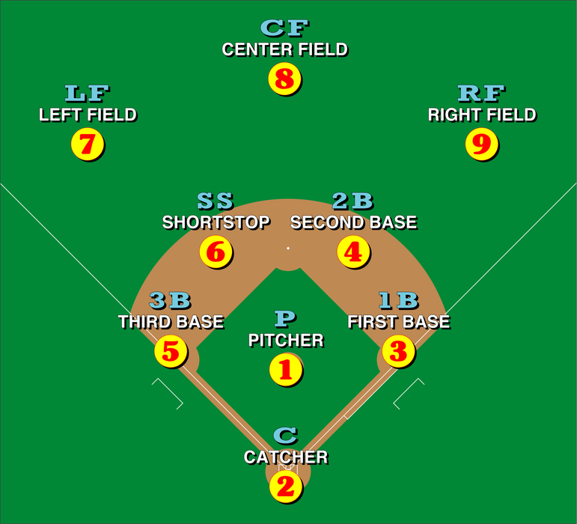
10

Slide 9
During a Game
Lot of Distractions
Your Children
Other Children
Parent/Coaches/Umpire asking questions
Expect to get asked the score a lot, if there is no scoreboard operator

Slide 10
Prior to Start of Game
Coaches should provide lineup cards 15 mins before game time
Yellow copy
Ensure it is completed correctly:
Team Name
Players Full Name
Jersey Number
Position
Coaches Names

Slide 11
Line-up Card
TEAM: | 14U Heat |  |  |  | TEAM:
DATE: | 5/15/2026 |  |  |  | DATE:
# | PLAYER | POS |  |  | # | PLAYER | POS
10 | Anna Smith | 2 |  |  | 10 | Anna S
8 | Bella Ray | 7 |  |  | 8 | Bella
13 | Lylie Frank | 5 |  |  | 13 | Lylie Frank
22 | Jane Doe | 1 |  |  | 22 | Doe
54 | Donna Bigler | 3 |  |  | 54 | Donna Bigler
3 | Ashlee Langevin | 8 |  |  |  | Ashlee Langevin
11 | Sue Bird | 4 |  |  |  | S. Bird
44 | Della Burke | 6 |  |  | 44 | Della Burke
26 | Riley Storm | 9 |  |  | 26 | Riley Storm
COACH: | Bill Franklin James Ash |  |  |  | COACH:

Slide 12
Prior/At Start of Game (After Coin Flip)
Enter the Team Names at top of the book
One on each page
Identify if they are Home or Visitor
A circled H or V next to the team name
Enter the player’s name, number and position in
the book
Enter number to left of Name in margin
Game starts when the coin is flipped
We won’t flip coin/Based off Schedule
Start game clock (If keeping time)
Enter game start time at bottom of page
PLAYERS | POS
Sub.
Sub.

Slide 13
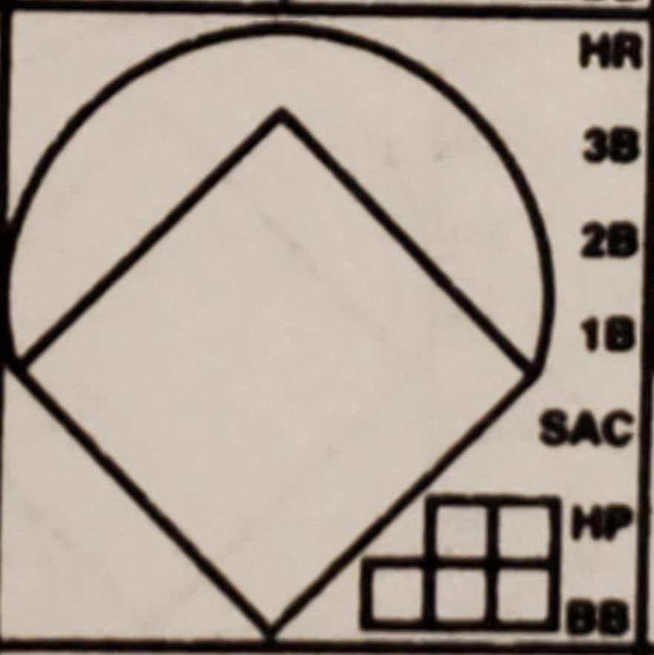
Balls/Strikes and Hits
BALLS/STRIKES
Two horizontal boxes represent strikes
Three boxes below that represent balls
Mark/Fill these boxes after every pitch
HITS:
Circle/Mark the type of hit
Indicate where batter is on base by drawing a line
Any runner on base that advances from one base to another must also be recorded
If player scores, complete the diamond and color it in to indicate a run

Slide 14
Balls/Strikes
Mark boxes by:
- Filling them in
- With a X
With a /
With a
Color in box

Slide 15
Base Runners
Base Running
If a base runner advances, you must update book to reflect movement of the runners.
Steals - if a runner steals a base, draw a line on the diamond from the base the player started at to the base they ended at and add the term "SB" above the line.
Other reasons include, Walks, Errors, Sacrifices, Hit by Pitch, etc.

Slide 16
Outs
Indicate who recorded the out and how
by writing down their numerical positions
Annotate somewhere, which out it was
and circle it
Any outs made on the base path will
marked by drawing a line halfway from
the base they left to the base attempted,
and who made the out

Slide 17
Tracking Run Totals
RUNS
 | Hits
ERRORS
 | LOB
3
4
At bottom of the page, after each half inning, enter the number of runs scored
Quick way to determine score

Slide 18
PRACTICE SCOREKEEPING

Slide 19
Score a Game
Game Scenarios

Slide 20
GAME START
Umpire Calls Coaches to Home plate (Coin Flip)
Plate meeting is over
Clock is running

Slide 21
1st Batter # 10 is at the Plate
First Batter
First pitch: Ball
Waiting for First Batter
Second Pitch: Strike
Third Pitch: Ball

Slide 22
First Batter, cont.
Batter hits ball to 3rd base
3rd base throws ball to 1st base
Runner is out
5 - 3
1

Slide 23
Second Batter # 8
Hits fly ball to Center Field
Center catches ball
Runner is out
8u or F8
2

Slide 24
Third Batter # 13
Hits ball to 3rd base
3rd base throws to 1st base
Runner beats the throw
Runner is safe

Slide 25
Fourth Batter # 22
Hits first pitch
Line drive up the middle, pass the center fielder
Runner gets a double
Who moved the third batter, who was on 1st base to 3rd base?

Slide 26
Fifth Batter # 54
Hits first pitch
Over the fence in left field
Did everyone advance all previous base runners home and fill in the diamonds?

Slide 27
Sixth Batter # 3
Count is three Balls, No Strikes
Walks on 4 pitches

Slide 28
Seventh Batter # 11
Count is 2 Balls, 1 Strike
4th pitch is a passed ball

Slide 29
Sixth Batter cont.
Runner on 1st Attempts to steal to second
Catcher throws ball to 2nd base and runner is out
CS
2 - 4
3
How do you annotate book for sixth batter/runner?
Notes:
Draw line to 2nd, enter SB if made it

Slide 30
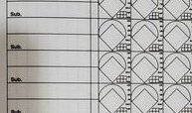
Once team completes an inning, mark a horizontal line directly under the last batter and a vertical line in the unused areas of that inning/column
Horizontal line will be quick reference on who next batter is
Vertical line will ensure you don’t use same column for the next inning
3 Ashlee Langevin
11 Sue Bird
Did everyone put the line under
#3 and not #11
Why?

Slide 31
Record Strikeout
Batter Strikes Out Swinging
Batter Strikes out, Called third strike
(Struck out Looking)
Ks
ꓘ/KL/Kc

Slide 32
Other Things to Track Base runner on 1st
Runners advance
Stolen base
SB

Slide 33
Other Things to Track Base runner on 1st
Runners advance
Error
Runner steals 1 base after
passed ball
E2

Slide 34
Other Things to Track Base runner on 1st
Runners advance
Sacrifice
Batter hits ball to left field,
ball is caught for an out.
Runner advances 1 base
SAC

Slide 35
Other Things to Track Base runner on 1st
Fielders Choice
Batter hits ball to the pitcher
Pitcher throws ball to SS at 2nd to get lead runner
How are you marking batter?
What happens with runner?
FC

Slide 36
Other Things to Track Base runner on 1st
Runner from Fielders Choice Play
How would you mark the runner?
1 - 6
3

Slide 37
When Game Is Over
Enter the stop time at the bottom of the page
Identify the winner and enter the final score somewhere on the scorebook pages
Make sure the lineup cards are stapled to the left page of the scorebook
Print your name at the bottom of the scorebook page
Have Umpire sign the scorebook
Put scorebook in metal case
Text the field, team names and final score to the Field Supervisor

Slide 38
Two outs, batter has 3 balls, 1 strike
Runner on 1st attempts to steal to 2nd gets out
What happens to batter?
International Tie-Breaker
Last Scheduled Batter to complete an at bat, from inning before goes to 2nd base
How to show double play
Batter hits ball to short
Short throws ball to second
Second throws ball to first
6 – 4 – 3 for batter
6 – 4 for base runner
How did the sixth batter get out?

Slide 39
QUESTIONS

