Slide 1
Parent/Athlete Presentation
Athletic Director - Steve Mahoney
mahoneys@fortschools.org
563-7811 Ext. 1104
Administrative Assistant – Miranda Cottrell
Cottrellm@fortschools.org Ext. 1100
Assistant Athletic Directors – Brian Bosch Twitter @FAHSAthletics
www.fortathletics.com
Instagram - fahsathletics

Slide 2
Motivation
https://www.youtube.com/watch?v=Z2PloBdHeow

Slide 3

Fort Athletics

Slide 4
Website
www.fortathletics.com
How to use it?
Registration – use this link for a tutorial
https://www.fortathletics.com/page/show/1960155-athlete-registration
Fees – 1st Sport 50.00 2nd- 40.00 3rd – 30.00

Slide 5
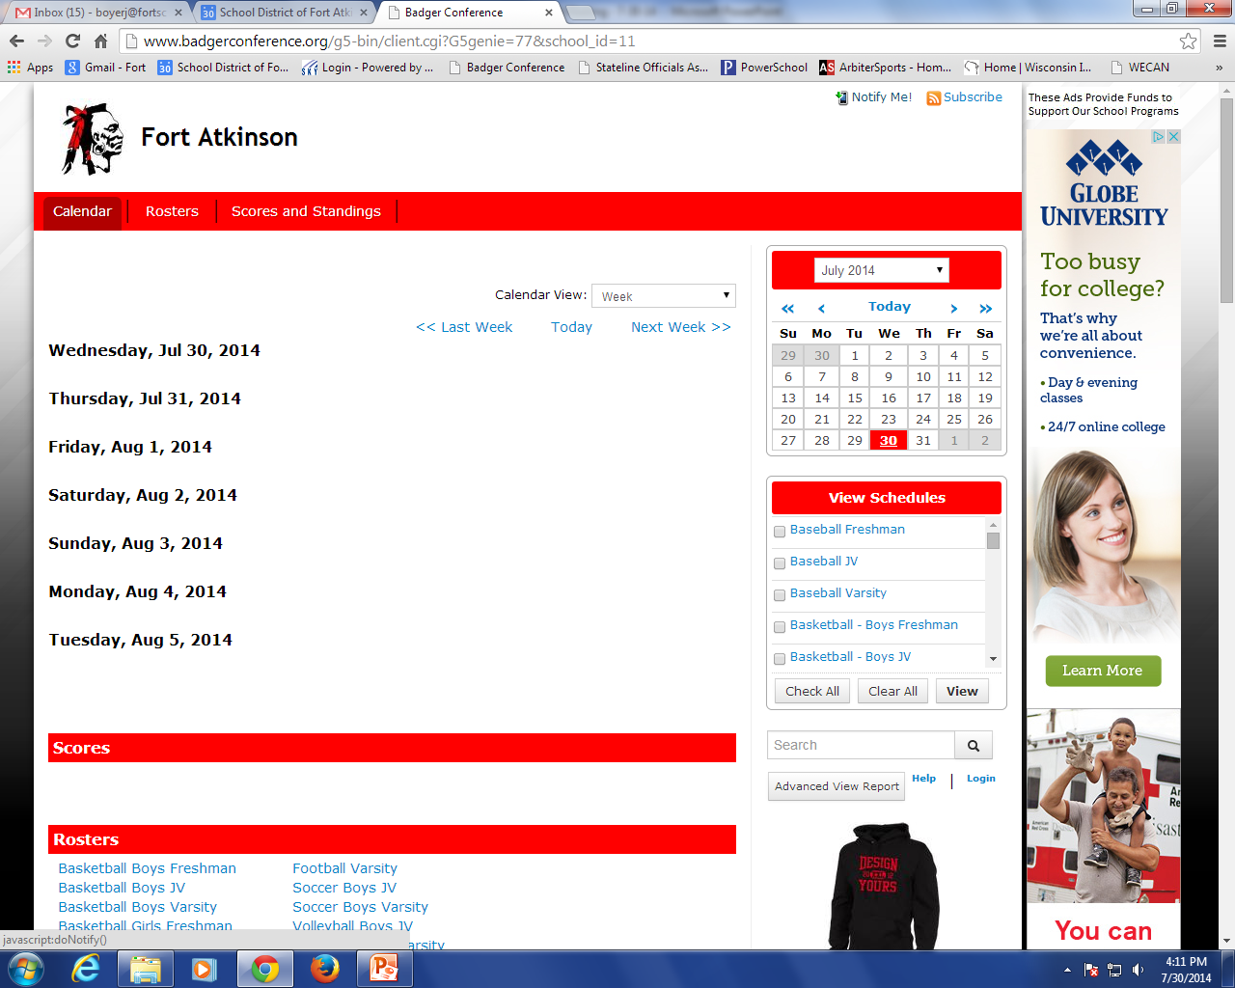
Schedules and Notifications
All game schedules are located here:
https://badgerconference.org/public/genie/77/school/11/
Sign up for the notify me notice, this tells you if something is cancelled immediately.
https://badgerconference.org/public/notify/genie/77/school/11

Slide 6
Athletic Philosophy
The athletic program is an integral part of our school district’s educational program that provides our students with enriching and healthful experiences in which physical, mental and social growth shall be stimulated. Participation in athletics provides opportunities and experiences that are difficult to duplicate in other school activities. These experiences are developmental in nature and consider the age related characteristics and needs of our students as they move through the grades.
Athletics are a privilege made available to students who abide by the rules and regulations. Students involved in athletics have an obligation to present a positive image to fellow students and the general public; such as abstaining from drug and alcohol use and inappropriate behavior.
Athletics are secondary to academics and are made available only if the student meets the academic eligibility requirements.

Slide 7
Fall Sports
Sport | Start Date
Football | August 5
Girls Golf | August 11
Girls Swimming | August 12
Girls Tennis | August 12
Boys Soccer | August 18
Boys/Girls Cross Country | August 18
Girls Volleyball | August 18
Boys Volleyball | August 18

Slide 8
Eligibility Rules - Physical
All athletes must have a physical examination and have a WIAA exam card on file in the high school office.
Must be signed and dated by a licensed physician.
Examination taken AFTER April 1 is good for the following TWO school years. Examinations PRIOR to April 1 are good for the duration of that school year and the following school year. *Key Date = April 1, 2024
If you turned in a physical card the prior year, an alternate year card must be signed off for the current school year within the registration process.

Slide 9
Eligibility Rules
All athletes are required to use the mode of transportation provided by the school while participating in interscholastic athletics. Special requests, in writing, must be directed to the Athletic Director if an athlete will not be using the school’s mode of transportation.
If an athlete is not in school by 12:30 pm, he/she may not practice or participate in contest on that day, unless special permission is granted by the Athletic Director. Pre-arranged absences are the only exception to this rule.
You are INELIGIBLE If you have more than ONE failing grade at the 9 week grading period. 1st quarter, 1st semester, 3rd quarter, 2nd semester.

Slide 10
Unexcused Policy
Any student that is marked UNV for any co-curricular for the current day will not be allowed to compete, perform or practice. A report will be sent out every day to all club advisors, the music department and coaches at 2:30 pm. If a student contests this, they need to see the attendance secretary or AP. If a student has a discrepancy with the marking, allow them to practice with the understanding if they were UNV, the penalty will double. (This allows for reporting mistakes to be cleared up.)

Slide 11


Concussions 101

Slide 12
What is a concussion?
A type of brain injury that interferes with normal functioning of the brain.
Mild traumatic brain injury
There is no such thing as a minor brain injury, i.e. bell ringer, head dinger.
Notes:
Any alteration of mental function following a blow to the head that may or may not involve loss of consciousness- American Academy of Neurology (1997)
A complex pathophysiological process affecting the brain, induced by traumatic biomechanical forces, direct or indirect force to head, rapid onset, short-lived impairment of neurological function, typically resolving spontaneously; may or may not involve LOC, functional disturbance, not structural injury; thus normal CT scan/MRI.

Slide 13
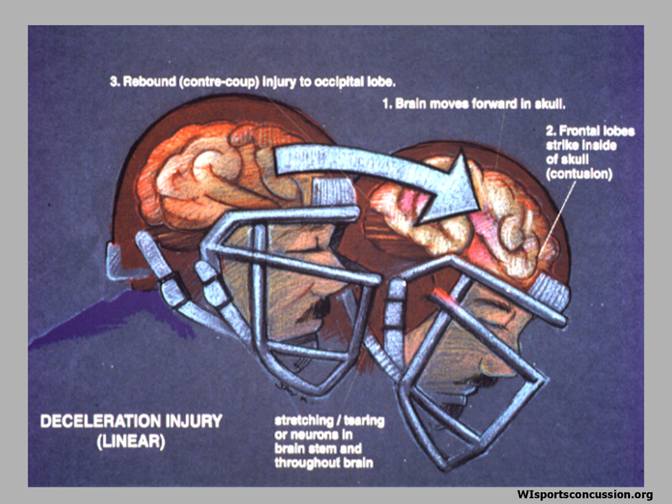
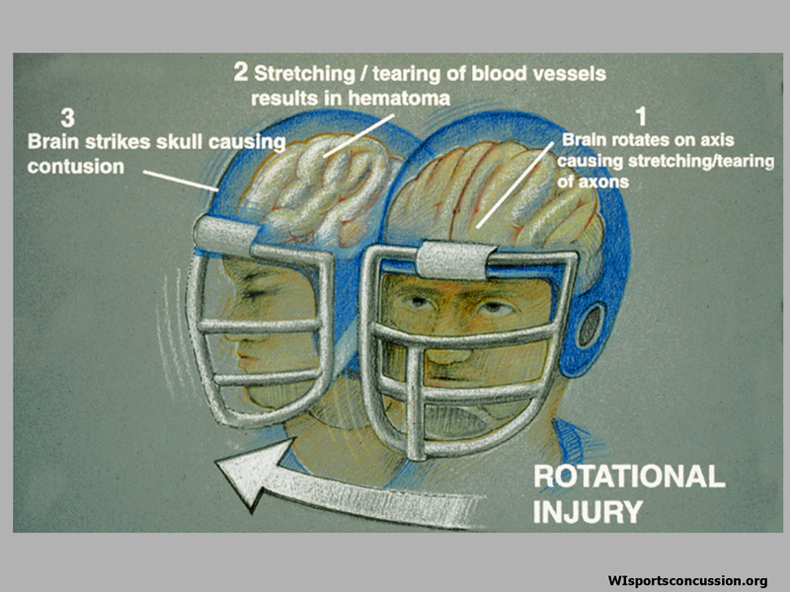
How do concussions occur?

Slide 14
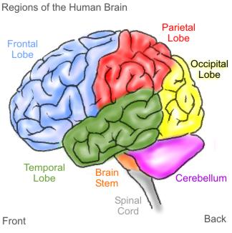
Concussions affect 4 areas of functionality
How they feel (ex. headache, fatigue)
How they think (ex. memory, concentration)
Changes in emotions (ex. irritability, sad)
Problems with sleep (ex. difficulty falling asleep)

Slide 15
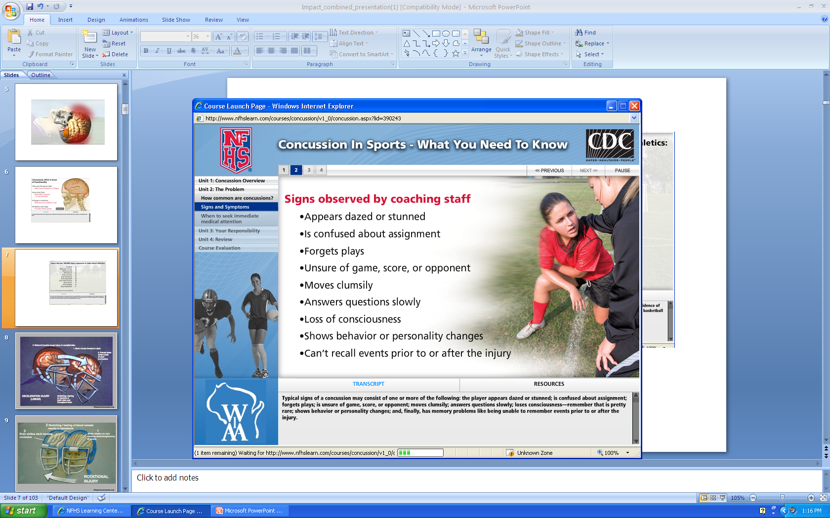
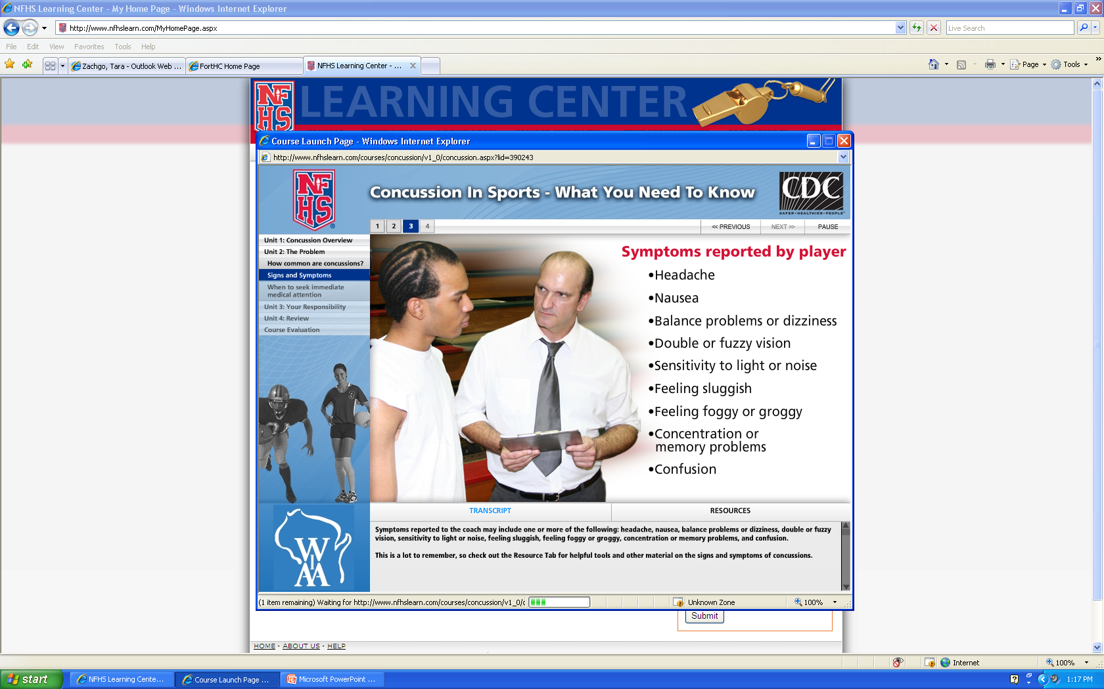
Signs & Symptoms of Concussions

Slide 16
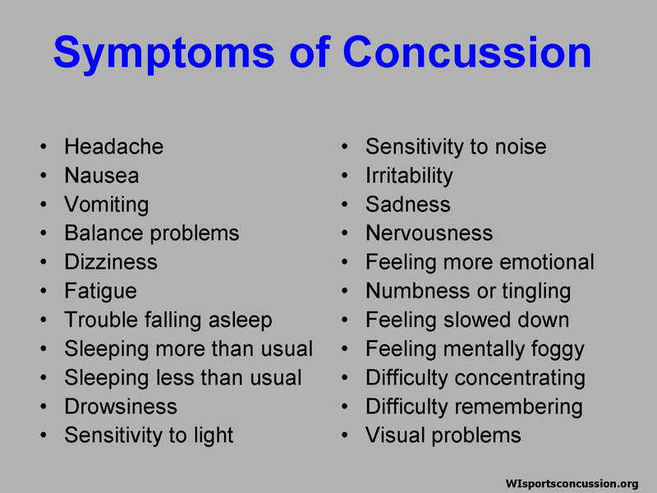

Slide 17
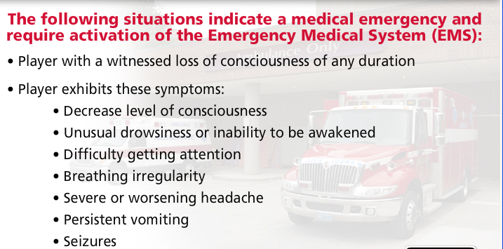
Management of a concussion
Players should be observed continuously until evaluated by a health care professional
Never send the player to the bus or locker room alone!
Seek medical attention right away if signs or symptoms worsen
Contact primary care provider for follow-up appointment

Slide 18
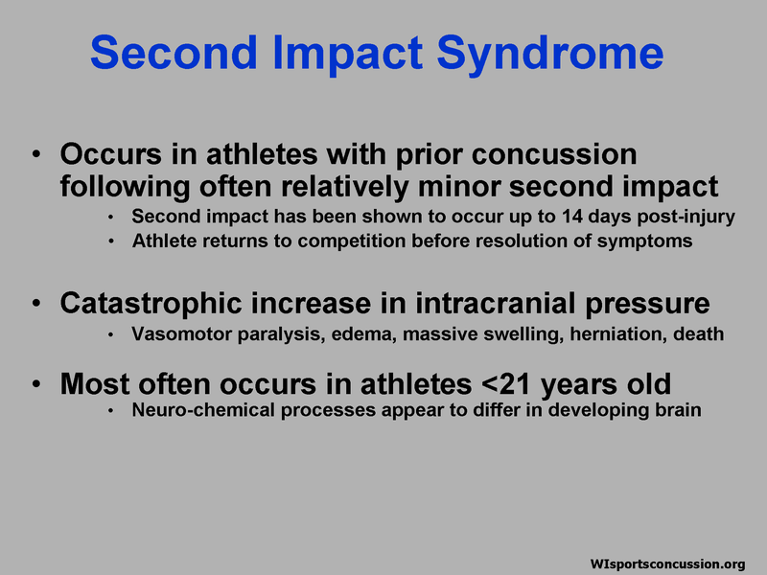

Slide 19
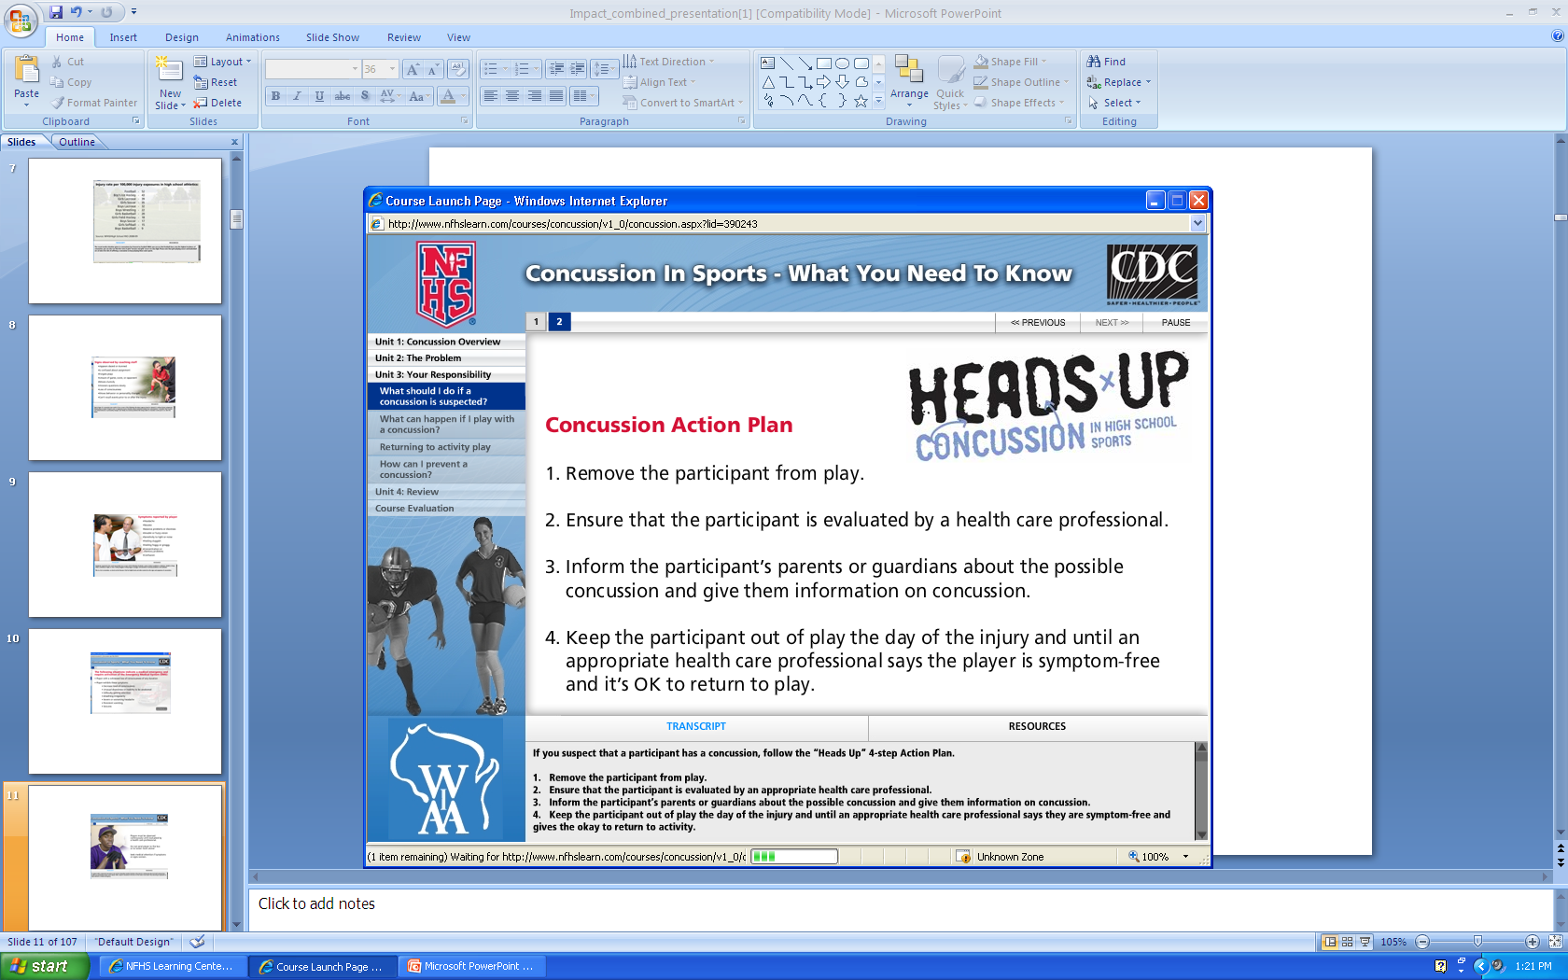

Slide 20

Notes:
20

Slide 21
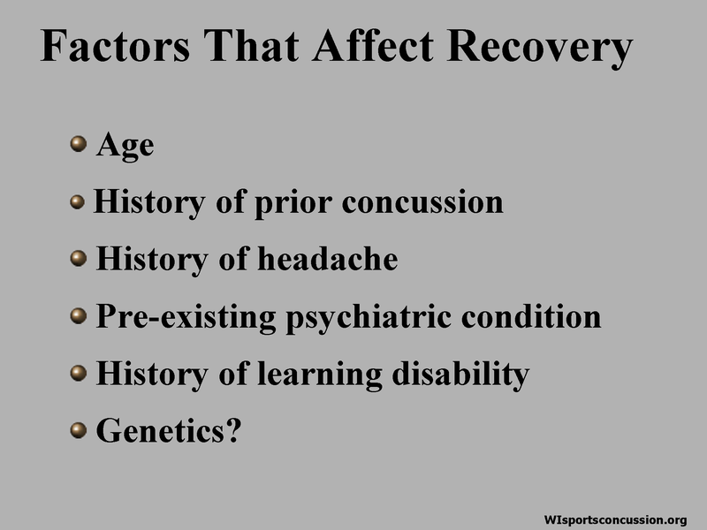
Notes:
21

Slide 22


Slide 23

Notes:
23

Slide 24
Return to Play Protocol
No activity with complete physical and cognitive rest.
Minimal heart rate increase (light jog)
Light aerobic exercise (less than 70% of max heart rate).
Sport specific exercise (drills specific to athletes sport).
Non-contact training drills (more intense sport drills with no contact from other players.)
Full contact practice (following Medical clearance).
Return to play (normal game play).
*Athlete can progress to next level only after being symptom-free for 24 hours

Slide 25
Code of Conduct Policy See the Player/Parent Handbook for more details Player/Parent Handbook
Use or possession of tobacco (smoking and/or chewing) which includes Vapes/smoking devices.
Possession, use, or sale of illegal drugs or controlled substances as defined by Wisconsin State law.
Possession, consumption, or sale of intoxicants including all fermented malt beverages, wine and intoxicating liquors as defined by Wisconsin State law.
Attendance at parties where there is illegal consumption of alcohol or use of other controlled substances is considered a violation and will result in a suspension whether the athlete consumed alcohol or used any other controlled substance or not.
Any criminally related activity (shoplifting, burglary, vandalism, etc.), or municipal ordinance violation.
Any behavior deemed “code unbecoming an athlete” including, but not limited to:
Acts of immorality or any other unacceptable conduct (fighting, harassment, insubordination, etc.), in or out of school, which makes an athlete unqualified to represent the ideals, principles, students of our school, and/or the Wisconsin Interscholastic Athletic Association.
Stealing
Flagrant misbehavior in class
Poor school attendance
Out of school suspension
Disorderly conduct as defined by state law in or out of school
Harassment
Hazing
Improper use of the internet (Twitter, Facebook, Snap Chat and inappropriate websites or e-mailing during school hours).

Slide 26
Code of Conduct Penalties
First Violation: The athlete will be suspended from a minimum of one third (33%) of the season’s contests in which he/she is currently participating, or the next season in which the athlete chooses to participate.
Second Violation: The athlete will be suspended from a minimum of two-thirds (66%) of the season’s contests in which he/she is currently participating, or the next season in which the athlete chooses to participate.
Third Violation: The athlete will be suspended from all co-curricular activities for one calendar year from the date of the incident.

Slide 27
Communication
Appropriate Concerns Athlete/Parent May Address With Coaching Staff:
The treatment of the athlete mentally and physically.
Ways to help the athlete mentally and physically.
Concerns about the athletes’ behavior in school/practices/games.
Areas That Are Not Appropriate For Parents To Discuss With Coaches:
An individuals playing time
Team strategy
Play selections
The make-up of the team and the decision as to who plays on a particular team
Other members of the team, other parents, and other coaches

Slide 28
Communication Cont.
The Proper Method To Address a Concern:
Step One:
The athlete speaks with the coach. (I would suggest the coaching staff be involved/present when this conference takes place.) Parents should help the child prepare to discuss his/her concerns with the coach, to empower them to take responsibility.
Step Two:
If the meeting between the athlete and the coach does not resolve the concern, the parent should schedule a conference with the coach (with the student-athlete present).
Please do not approach a coach before or after a contest. If the coach cannot be reached, the parent should contact the athletic director and he will arrange for the coach to contact the parent.
Step Three:
If the conference between the parent/athlete does not resolve the concern, there will be a meeting set up by the athletic director. The A.D. will moderate the conference.
The conference will deal with the specific issues that the parent/athlete has. Both parties will be allowed to speak in an uninterrupted manner. The conference will be in a non-threatening environment.
Step Four:
If there is no resolution, the parent must put in writing his/her concern(s) and submit to the District Administrator. Within ten days after receipt of the letter, the District Administrator will meet with the parent(s) in an effort to resolve the concern(s).

Slide 29
Expectations of Parents
Our expectations for parents:
Communicate with staff
Be supportive of your student athlete/Encourage off-season
Be supportive of our coaching staff
Be excited to be a part of Fort Atkinson Athletics

Slide 30
Responsibilities of Student-Athletes
The privilege of participating in our athletic program is extended to all students, provided they are willing to assume certain responsibilities. Therefore, it is required that each athlete:
Displays a high standard of social behavior, and follows the Parent-Athlete Handbook
Displays appropriate sportsmanship
Displays respect for those in authority
The care of athletic equipment as well as other school property.
The original equipment issued to an athlete must be returned at the close of the season. Substitution of equipment among athletes cannot be permitted.
Athletes will be held financially responsible for all equipment that is issued to them and not returned at the conclusion of the season for whatever reason.

Slide 31
NIL Language
New this year!
Amateur Status: Please see the WIAA High School Handbook for language with the addition of the new NIL rule.
If you are interested in more information on NIL, please contact Mr. Mahoney

Slide 32
Our “WHY”
Fort Atkinson High School Athletic Department Mission, Values, and Goals

Slide 33

Blackhawk Booster Club Mission
The mission of the Blackhawk Booster Club is to foster a close working relationship with the Fort Atkinson High School and Middle School athletic departments in order to promote athletic excellence. In so doing the Blackhawk Booster Club will provide support where needed to maintain a healthy and competitive sports program beyond what is provided by the athletic departments.

Slide 34
Thank you! Fort Atkinson Athletic Dept.

