Slide 1

ANNUAL GENERAL MEMBERSHIP MEETING
April 17, 2024
Creekside Place

Slide 2
Call to order – Introduction of Board
Interim President – Nick Bitz
Interim Vice President – John Swise
Treasurer – Jaime Harris
Registrar – Jessica Roberts (Appointed Position)
Secretary – Tamara Wallisch
Communications Director – Stephanie LaBeause
Field Coordinator & Equipment Manager – Jill Thies
MAYSA Advisor – Lisa James
Interim Youth Director – Stephanie Swise
Past President – Julie Tran
*MAYSA 7V7 Commissioner – David LaBeause
*Volunteer Coordinator – Vacant
*9 v9 MAYSA Commissioner
*11 v11 MAYSA Commissioner
*Fundraiser Coordinator
*Player Development/Camp Coordinator
*Non-voting positions

Slide 3
AGENDA
Consent items
Treasurer report
Business
Review since last AGM and Membership update
Fall Registration
Election of Officers and Board Members
Volunteer Opportunities

Slide 4
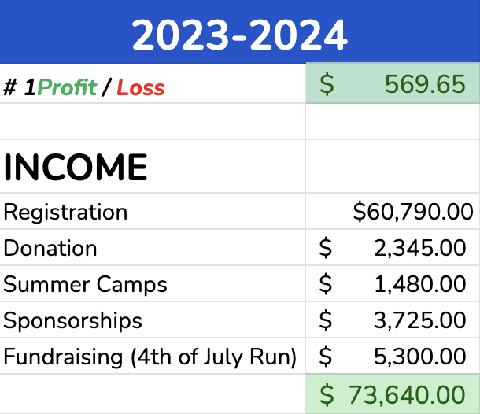
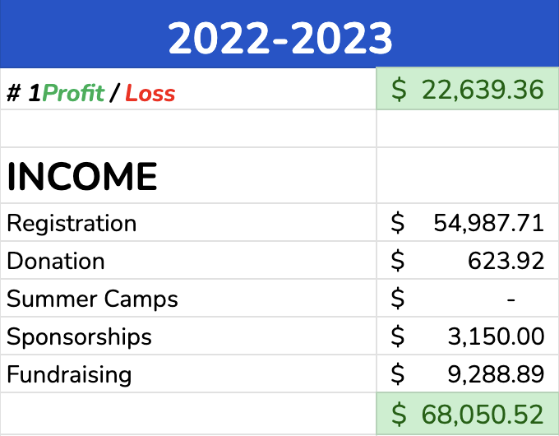
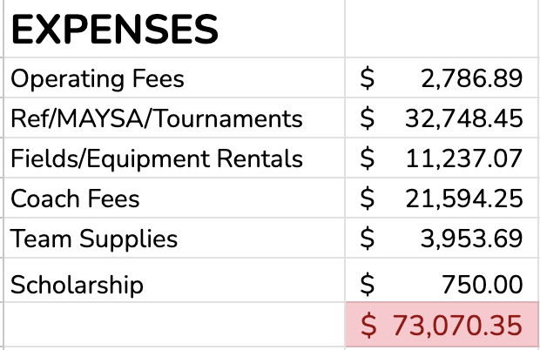
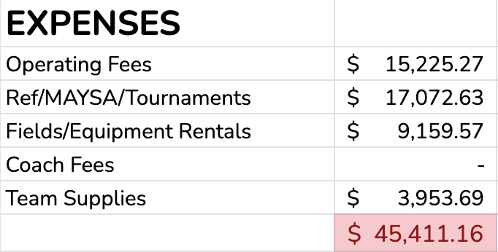
TREASURER REPORTS
Profit & Loss
(Income vs. Expenses)

Slide 5
Review since last AGM and Membership update
Membership
2020-2021 = 172
2021-2022 = 217
2022-2023 = 252
2023 - 2024 Registration = 314
191 MAYSA Players
123 In-House Players

Slide 6
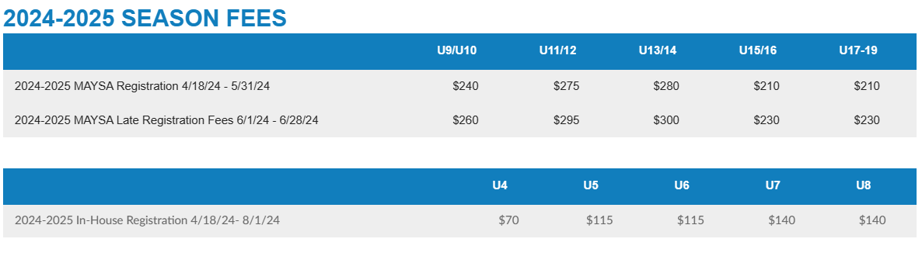
Registration fees will remain the same as they were last year.
Professional coach for 24-25 ESC seasons has been approved.

Slide 7
Election of Officers and Board Members
President – Nick Bitz
Treasurer – Jaime Harris
Field and Equipment Coordinator – Jill Thies

Slide 8
Volunteer Opportunities
Coach/Assistant Coach | Reach out to Club Sponsors
Fill in Coach at Practice | Sponsorship Lead
Place cones/flags for Home Games | Event Leads (4th of July Parade)
Live Score Updates | Registration Promotion Lead
Pay Refs/complete Ref Log Sheet | Team Managers
Manage Team FB page with Pics/updates | Fourth Fun Run
Tournament Coordinator | Youth Night Posters
Net set up (spring) | Net removal (fall)
Monthly volunteer opportunities
* - The above are larger volunteer opportunities, we will also provide additional opportunities monthly as they become available

Slide 9
Questions and Comments
Thank You For Attending

