Slide 1
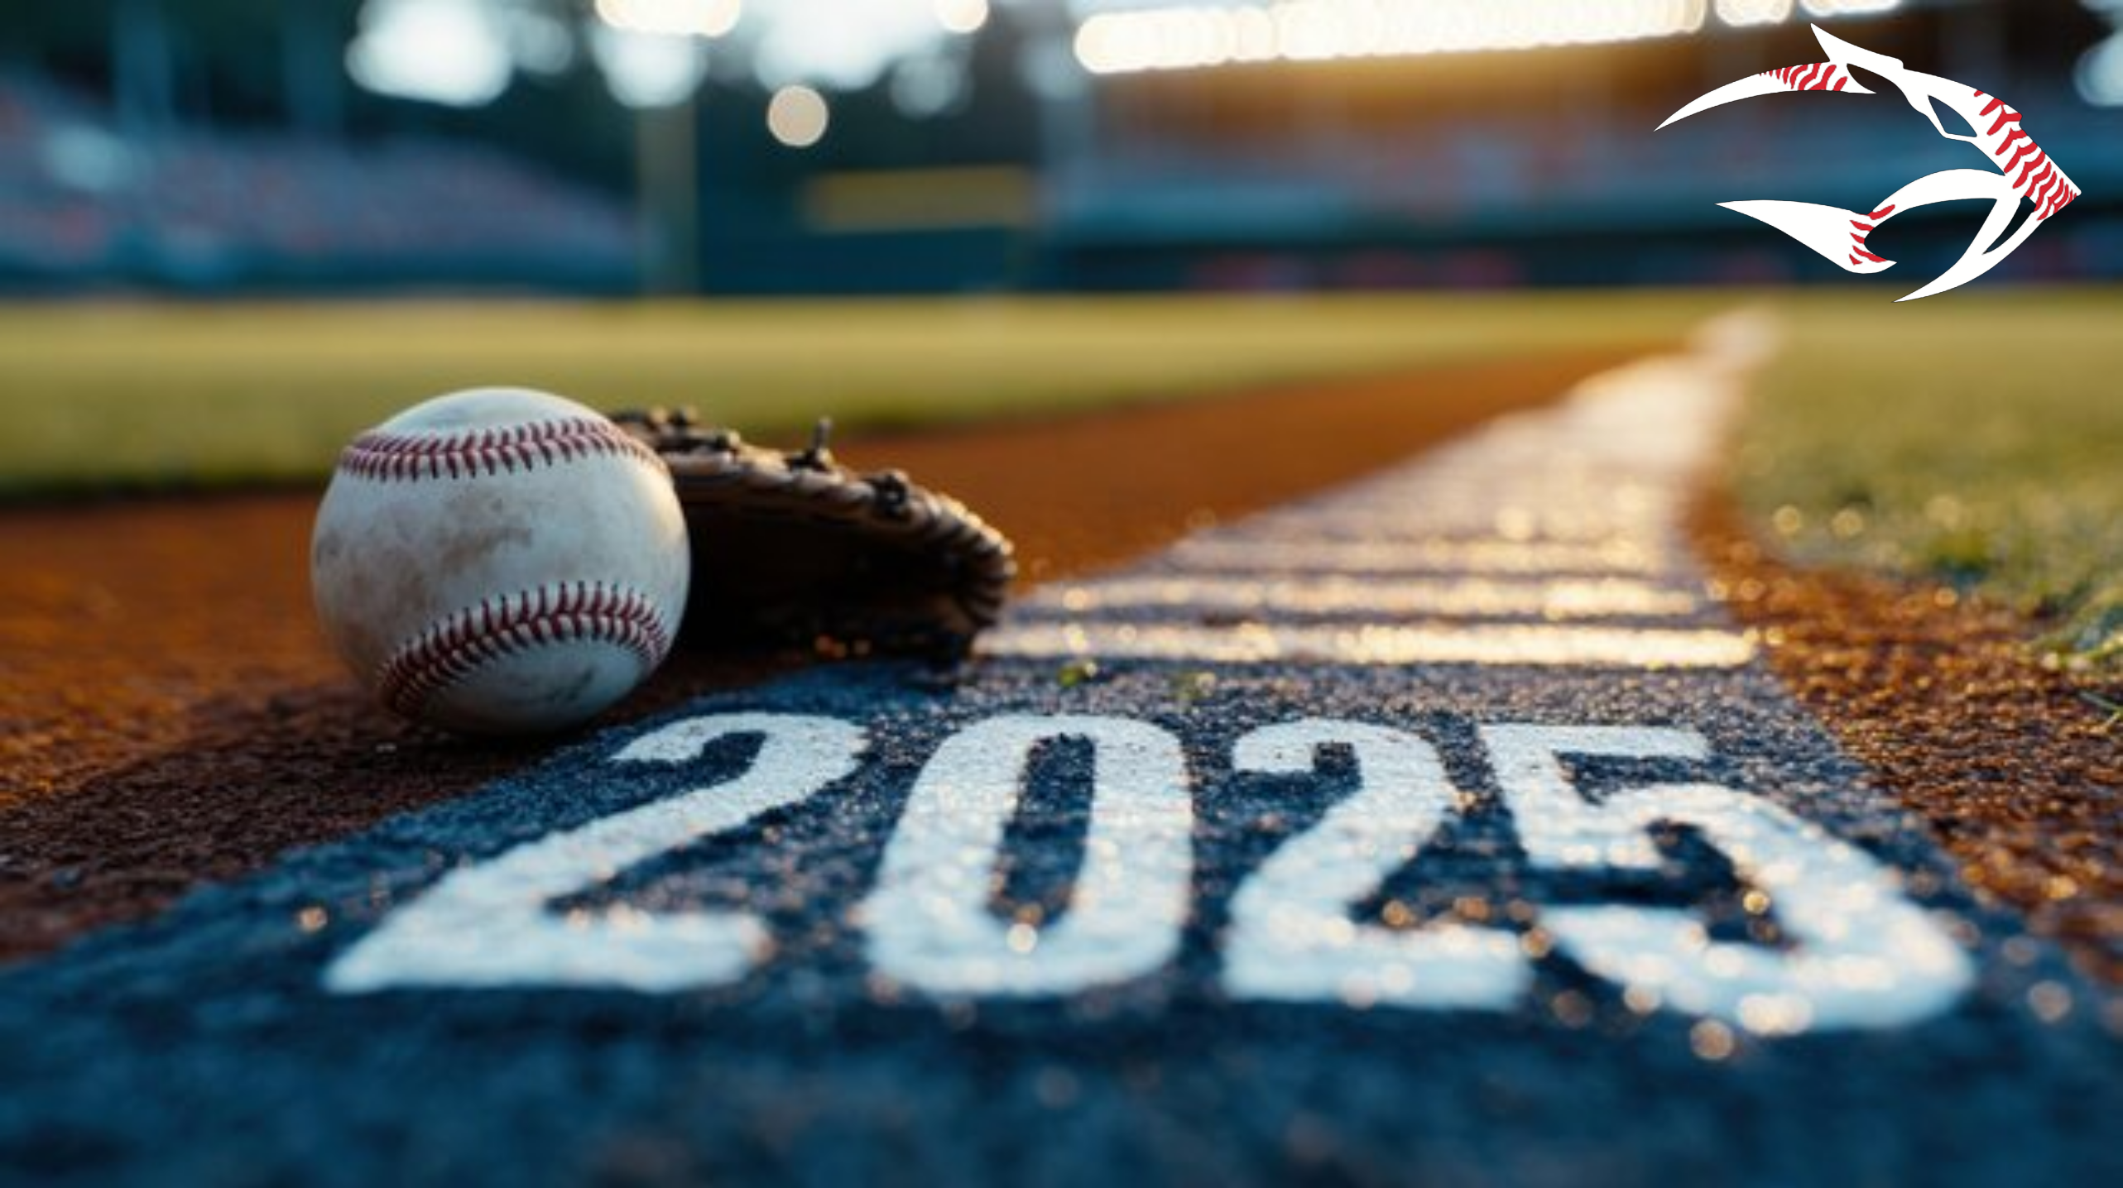
Shakopee Youth
Baseball Association
Year End Meeting

Slide 2
AGENDA
2024-25 Board Members
2025-2026 Board Candidates - Elections
Survey Results
What was new in 2025
Financial Report
Possible Changes for 2026
Open Discussion
Election Results

Slide 3
2023/2024 SYBA BOARD
President: Shane Hofmann
Vice President: Kyle Rice
Treasurer: Rob Deuth
Secretary: Mike Hanson
In-house Director: Jason Mousel
In-house Director: Jim Malone
Traveling Director: Aaron Olson
Traveling Director: Blake Grefe
Community League Director: Ryan Schmitz
Varsity Baseball Coach: Eric Schmitz
Tournament Director: Dan Woodall
Asst Tournament Director: Katie Johnson
Equipment Coordinator: Eric Schroeder
Umpire Coordinator: Brent Vannier
Communications: Mark Amundson

Slide 4
Thank You!
Board members whose terms expired
  Mike Hanson – 4 years of service
  Aaron Olson – 8 years of service
  Jim Malone – 2 years of service
  Dan Woodall – 3 years of service
  Eric Schroeder – 6 years of service

Slide 5
Thank You!
Field Coordinator Duties – Tyler Menden
Concession Coordinator – Emily Brinkman and Amanda Kieffer
Non-parent Coach – Brett Thorney (14AAA Travel)
City and School District grounds crew
Volunteers / Player Family’s
SYBA Sponsors

Slide 6
Thank You!
Sponsorships
Rookie Sponsorships: $100 Donation
  Kubes Realty
  McNearney-Schmidt Funeral and Cremation

Slide 7
Thank You!
Sponsorships (Continued)
All-Star Sponsorships: $250 Donation
  Affinity Plus Federal Credit Union
  Coffee Ta Cream
  Farmers Insurance – Whitcomb Agency
  Golf Garage
  Hometown Bank
  Lion’s Tap
  Everlight Solar
  Drop Shot
  O’Brien Dental Care

Slide 8
Thank You!
Sponsorships (Continued)
MVP Sponsorships: $500 Donation
  American National Bank
  Jaspers, Moriarty & Wetherille, P.A.
  Wells Fargo Advisors (via Mark Heller)

Slide 9
Thank You!
Sponsorships (Continued)
Tournament / MVP Sponsorship:
$1,000+ Donation
  Bill’s Toggery
  Choice Electric
  Lampert Lumber
  Affinity Plumbing & Water Conditioning (this year’s jersey sponsor)

Slide 10
2024/25 BOARD CANDIDATES
Travel Director: Jason Lenz, Adam Stier
In-House Director: ???
Assistant Tournament Director: Tatum Heil
Assistant Equipment Director (non-voting): ???
Fundraising Coordinator (new position): Billy Wermerskirchen
Social Media Director 1 (new position): Sara Lewis/Tracey Domke, Christina Tibbetts, and Jim Malone
President (New 3-year term): Shane Hofmann
Secretary Sean Dolan
Field & Facilities Coordinator ???

Slide 11
BOARD ELECTIONS
Majority of Board positions are for an elected 2-year term (President is a 3-year position)
Traveling and In-House Directors (1 position each elected on an every other year rotation)
If no one has applied for an open position, the Board may actively recruit and may appoint someone to fill the role

Slide 12
N
Registration Numbers
 | 2025 | 2024 | 2023 | 2022 | 2021 | 2020 | 2019 | 2018 | 2017 | 2016 | 2015 | 2014
Traveling - 9s-15s | 174 | 175 | 199 | 201 | 202 | 213 | 216 | 220 | 232 | 234 | 229 | 216
Legion - 16-18s | 35 | 31 | 35 | 30 | 45 | 47 | 41 | 44 | 42 | 51 | 39 | 26
Community League - 4th - 12th grade | 67 | 66 | 71 | 106 | 60 | 71 | 91 | 87 | 92 | 83 | 87 | 130
In House - 1st-3rd grade | 108 | 142 | 151 | 153 | 143 | 160 | 179 | 170 | 140 | 175 | 201 | 224
Total | 384 | 414 | 456 | 490 | 450 | 491 | 527 | 521 | 506 | 543 | 556 | 596
Change | (30) | (42) | (34) | 40 | (41) | (36) | 6 | 15 | (37) | (13) | (40) | (19)

Slide 13
Survey Results
Travel – 109 responses out of 174 registrations = 63%
Community – 12 responses out of 67 registrations = 17%
In House – 58 responses out of 108 registrations = 53%

Slide 14
Travel Survey Results
Positives:
  Coaches continue to get great reviews
  Professional behavior towards umpires & opposing coaches/teams
  Number of games played
  The Shed training – VERY positive feedback on this partnership
  Overwhelming support to continue working with SnapRaise for fundraising

Slide 15
Travel Survey Results
Areas of Opportunity
  More practice time
  More opportunities for skill development
  Tryout Process
  Making baseball fun – building culture with SYBA

Slide 16
2025 Community League Season Highlights
  Increased board presence at evals received glowing responses
  Players chose jersey #s for first time – HUGE hit
  2x practices scheduled vs PY
  4th/5th Red & White teams finished league play in 4th and 5th place
  6th/7th Red team finished league play in 1st place, White in last place
  8th/9th Grade team finished league play in 6th place
  Fielded a 10-12th Grade team for first time in at least 2 years
    Won Silver Bracket Championship in season ending tourney

Slide 17
2025 Community League Positives & Opportunities
  Positives
    Levels with multiple teams having either Travel Red or White jerseys vs the same jersey in PY offered team differentiation shows a more cohesive SYBA brand
    Practice jerseys were a hit
    Coaches fostered a positive experience and improved player skills and knowledge
    Equipment coordinators teaching field maintenance before the season was well received
    Adding more practices was well received however players would like more
    Shakopee had a 10-12th grade team for the first time in at least 2 years
    Registrations increased slightly vs PY
  Areas of Opportunity
    More practices added in the future especially at lower age groups
    Little to no time to practice before games start (can we secure fieldhouse in April?)
    Improve fields specifically EMS and WMS
      Storage shed issue at WMS did not get resolved until after the first game was played
      EMS lots of weeds in the IF and grass
      School fields need to be mowed more regularly
    Process for rescheduling games/practices has too many layers
    Parents not aware of league details, communication not clear
    Off Season programs feel more intended for Travel players
    Timing of creating 10-12th Grade team does not align with the SW Community League and the team plays ½ a season

Slide 18
In House Survey Results
Majority of respondents:
Program value viewed as either a good or excellent value
very satisfied/satisfied with communication from SYBA
very easy/easy to find program information
very satisfied/satisfied with coaches
very satisfied/satisfied with schedule and balance between practices and games
very satisfied/satisfied with length of time for games/practices
Year end jamboree exceeded or met expectations. Of the 28 responses from 8/9U 86% enjoyed the two-day schedule
player skill and baseball knowledge improved ‘a great deal/a lot’ since beginning of season
very satisfied/satisfied with player’s experience

Slide 19
In-House Survey
Comment themes:
Confusing email communications (would like to see emails go to targeted groups IE: travel, community, in-house, & general)
Grass length on school owned fields
Inconsistency in rules (some rules were deviated from the distributed rules throughout the course of the season)
9U in-house (some disappointment about having to combine 8U/9U due to 3 travel 9U teams and not enough #’s for stand-alone 9U in-house
Appreciate the evaluation process prior to forming teams
Liked the winter training options
Liked having an umpire for the Jamboree games at 8U/9U

Slide 20
Jr & Sr Legion
      Senior Legion went 32-7-1.
      WON STATE!
      Made it to Regional Semifinals up in Fargo
      Massive success this season.
      Senior Legion coach was Dave Johnson
      Junior Legion went 15-15.
      Junior Legion coach was Kolin Williams
      Due to the length of the season & the great success that was had, the legion survey will be distributed later than usual, but one will be sent out to the families soon.

Slide 21
Umpires
Huge Success, Thank you Brent Vannier!!
108 umpires, mainly Shakopee middle and high school
250 games including all umps for Shakopee Tourney and in-house Jamboree
Many compliments about the quality of these young men
Provided umpires for 2 outside association tournaments
Working to get even more training for the current and any new umpires next year

Slide 22
What was new in 2025
SnapRaise (In house and Travel)
Corporate Donations
Partial tryouts at Mash
Kids participating in high school games/events
Baseball day in Shakopee (Fox 9 news)
Offseason Training at The Shed

Slide 23
2025 Capital Investments
$12,080 invested player equipment, field equipment and maintenance
Baseballs: $5,188
Player Equipment: $3,775
Field Maintenance: $1,388
Field Equipment & Materials: $1,035
Storage Equipment: $694

Slide 24
2025 Shakopee Tournament
Hosted 91 teams at 4 different field locations – Tahpah (8 fields), Johnson (4 fields), Westminster (2 fields), Muenchow (4 fields).
Thank you to all parents for their flexibility in working their DIBs hours.
Shakopee youth kids continue to be used as umps. We had many games using two umps to both help our younger umps and also have two for bracket games.
Profit = $16,945 – previous 3 yr average = $19,656.

Slide 25
Fundraising Recap
All Net Dollars Raised
Snapraise (Travel): $20,945
Snapraise (InHouse): $5,829
SYBA Tournament: $16,945
Sponsorships: $9,344
MVP “Gold” Card: $5,131
Player Yard Signs: $975
In House Tourney Concessions: $799
Misc Cash Donations: $1,376
TOTAL DOLLARS RAISED: Over $60,000!!!

Slide 26
Cash/Other Donations
THANK YOU FOR YOUR DONATIONS!!
$1,000 from Wells Fargo
  (via Allen Larson and Aaron Olson)
$250 from Fidelity Charitable
  (via John Schaidler)
$500 value of equipment from Shakopee Chevrolet
SYBA made annual $1,000 donation to Shakopee Dollars for Scholars

Slide 27
Cash Balance
Organizeation Wide
8/18/2021 | 8/17/2022 | 8/21/2023 | 8/19/2024 | 8/21/2025
71,276 | 67,498 | 69,978 | 65,888 | $96,712

Slide 28
Things that we are thinking about for 2026?
Setting up committees within the board, including non-board members
Fun committee/increase social media presence
New board positions
Westminster Project Dream
More offseason training & opportunities (shed, savage dome, open gyms)
Continue to grow sponsorships (local and programs)
Field improvements across the board
Possible new website – more to come

Slide 29
Mark your calendars
Traveling Parent Information / Uniform Sizing Meeting – February 1.
Traveling Tryouts – March 21 & 22.
March 21st will be fully at the MASH facility.
March 22nd will be at the Shakopee Field House.
SYBA Traveling Tournament – June 26-28

Slide 30

OPEN DISCUSSION
Suggestions to the Board for improving the Shakopee Youth Baseball Association
Election Results

