Slide 1


ROOSEVELT HIGH SCHOOL
FALLS SPORTS INFORMATION NIGHT
Wednesday, August 9th, 2023 6:00pm - 8:00pm

Slide 2

AGENDA
Opening/Welcome
Opening Statement / Roosevelt Athletic DIrector / Adam Flanders
Introductions
Building Principal / Christian Ledesma
Assistant Athletic Director (6:12pm)
Athletic Trainer (6:13pm)
School Based Clinic Staff (6:14pm)
Paperwork Requirements for Student-Athletes (6:15pm)
MSHSL and MPS Registration
Current Sport Physical
Participation Fee = Uniform Fee
Eligibility Requirement (6: 21pm)
Grades (Credit and GPA Requirements)
Attendance
Participation Fee = Uniform Fee = 100% goes directly to RHS Athletics
College Athletics
MSHSL
Closing Remarks (6:27pm)
Introduction of Fall Head Coaches (6:39pm)
Head Coaches - Lead Breakout Sport Sessions (6:43pm - 8:00pm)

Slide 3
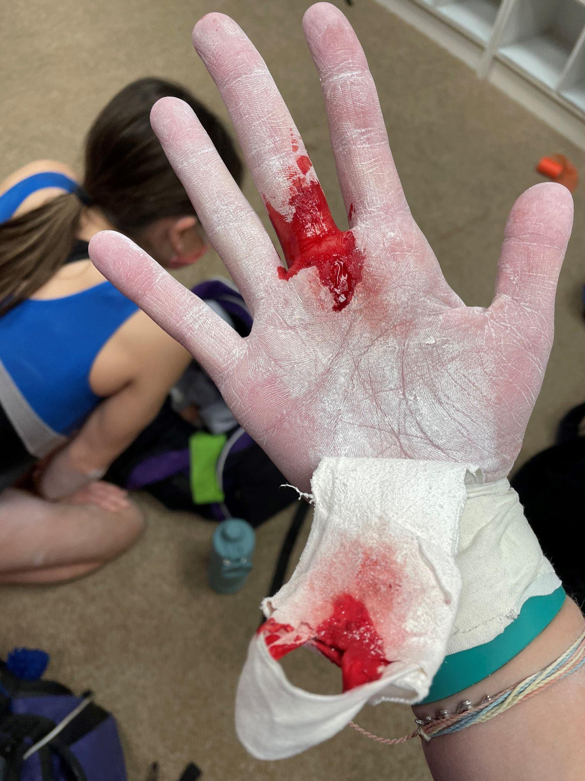
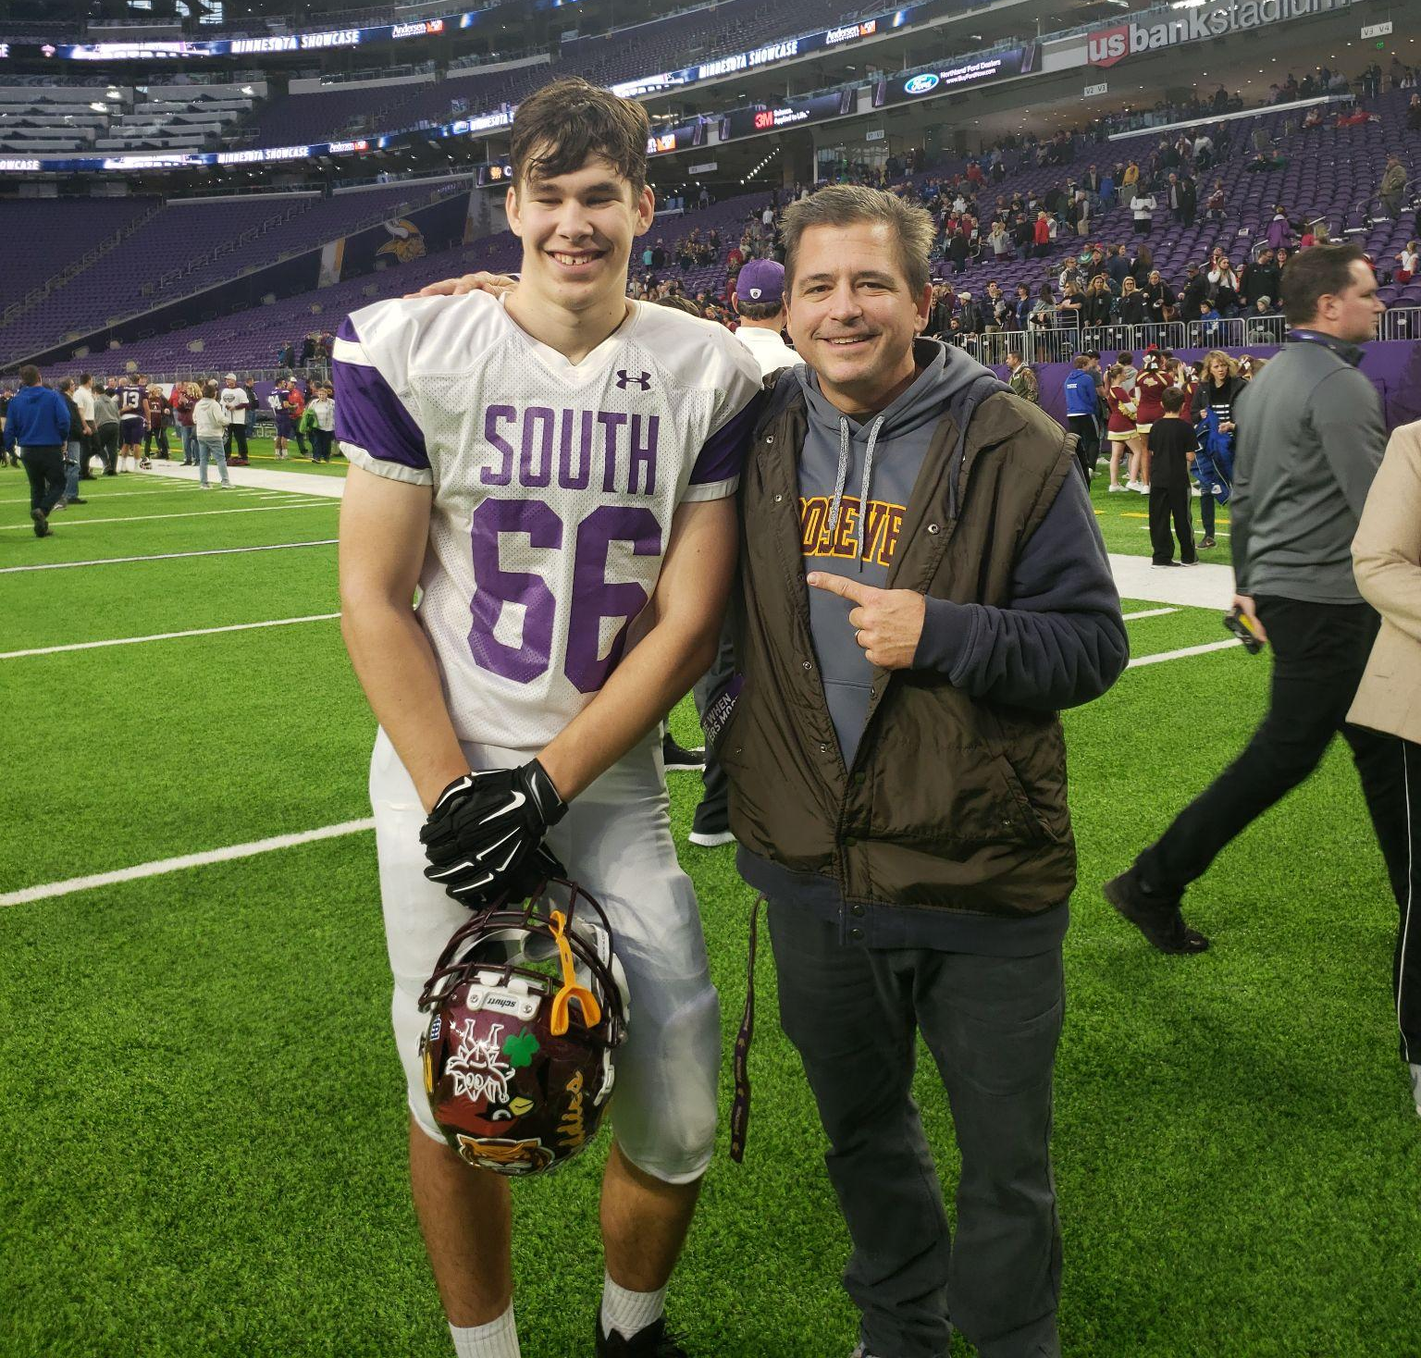

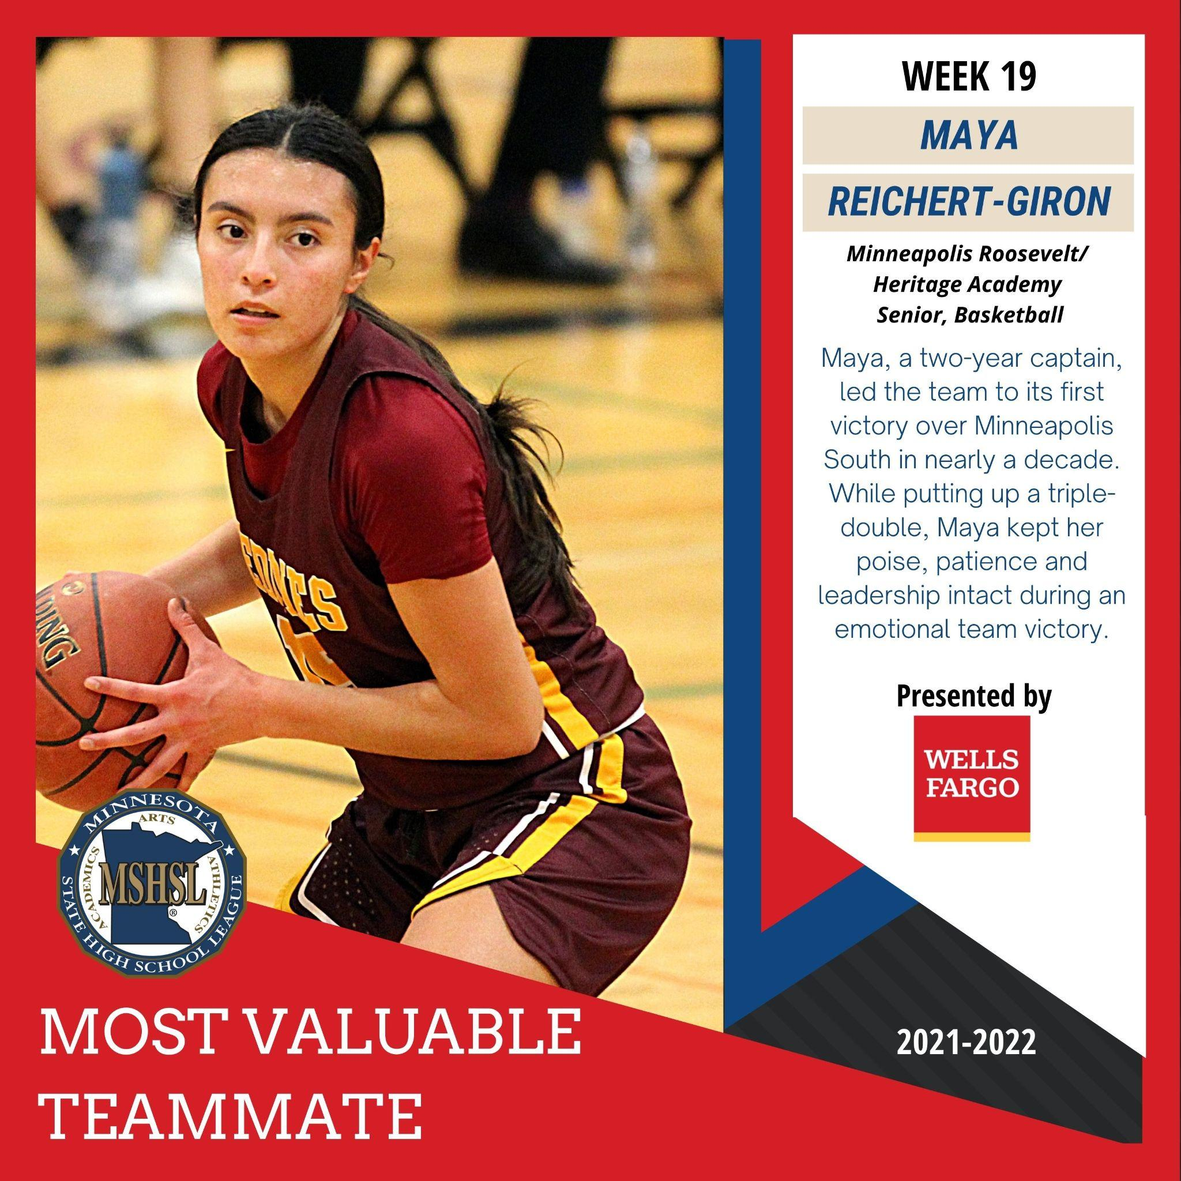

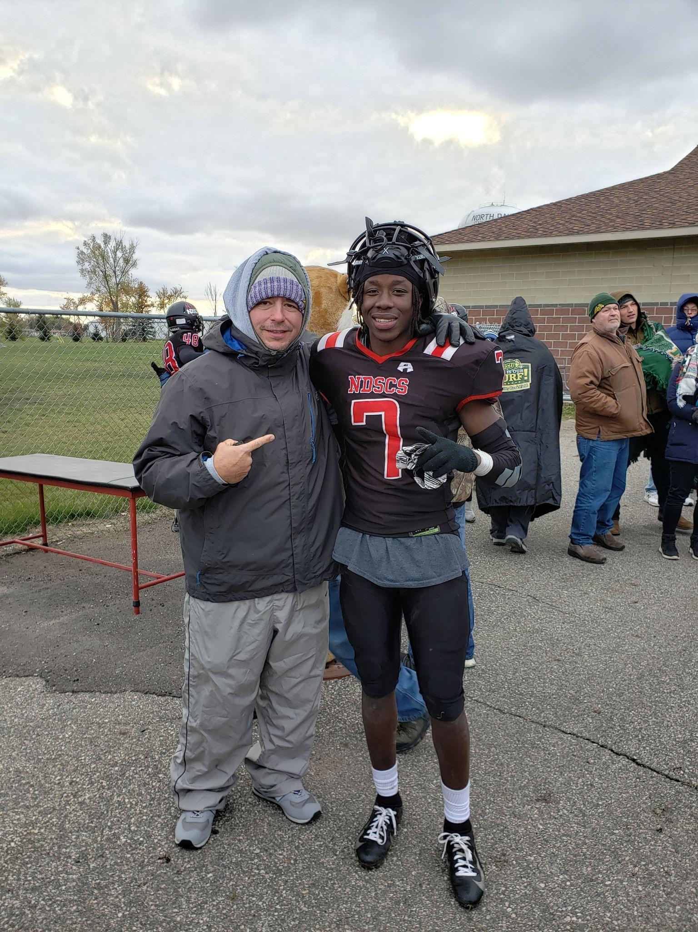
TEDDY NATION ATHLETICS
MY “WHY”
Adam Flanders
Athletic Director
I lead with love, empathy and passion to help foster a desire for participation and competition in multiple extra curricular activities and athletics while developing meaningful and positive relationships with our student-athletes, families and community.
Notes:
Russ

Slide 4
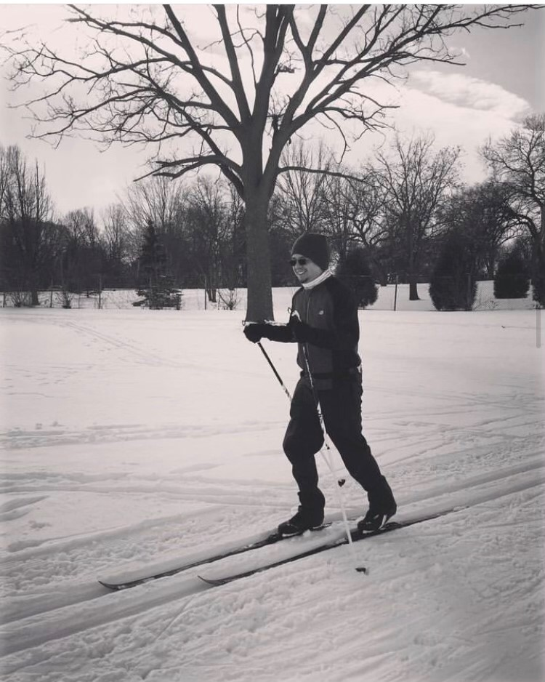
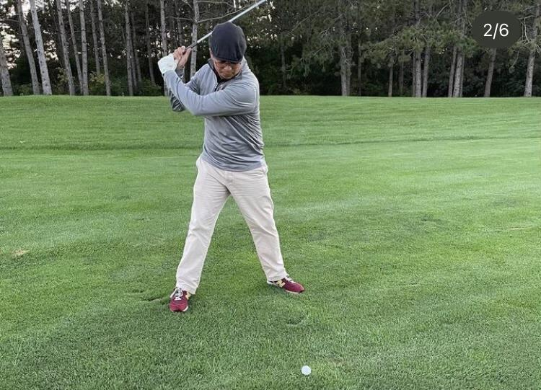
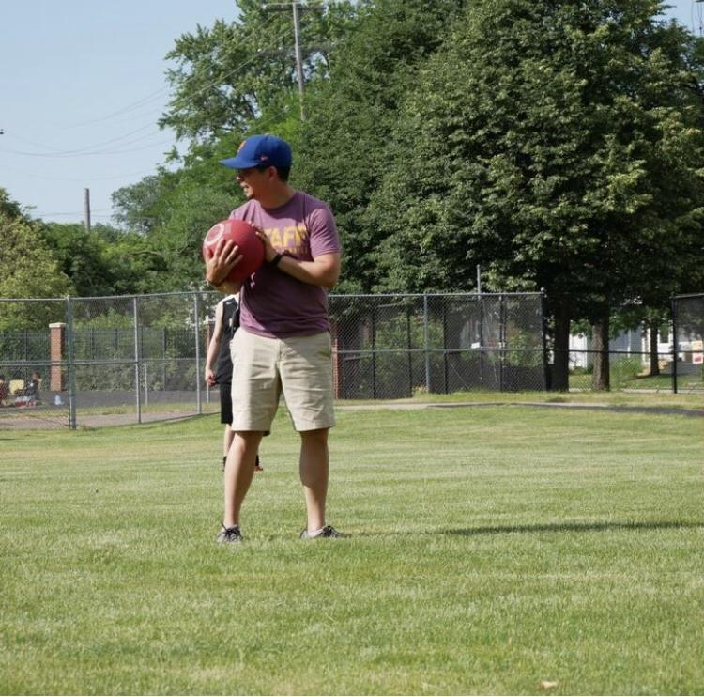
PRINCIPAL (AND ATHLETE) LEDESMA

Slide 5
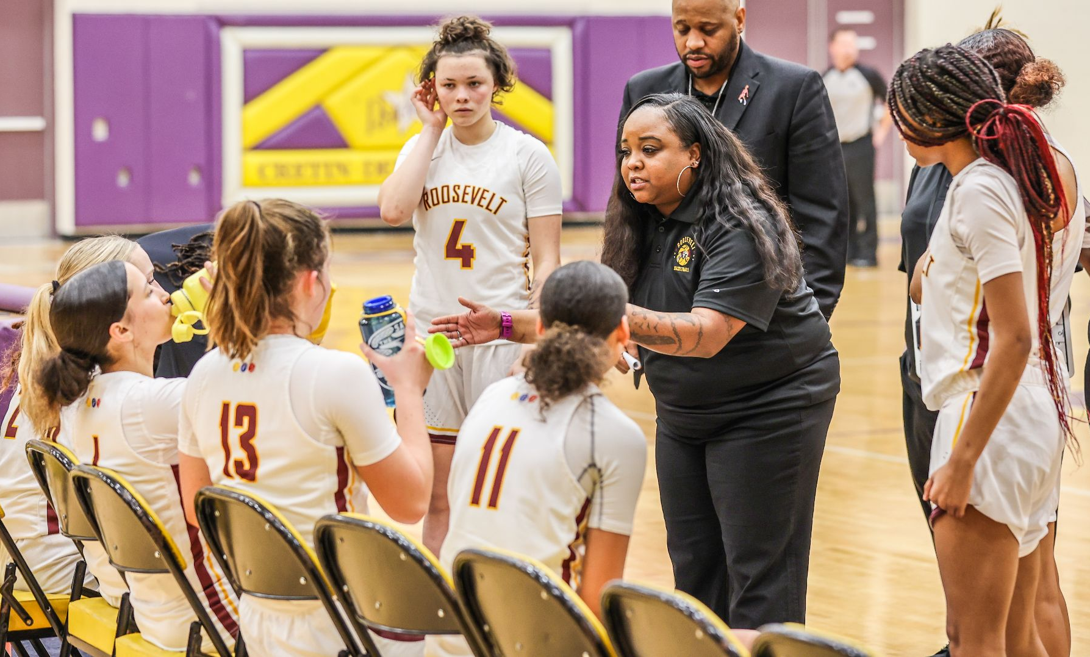
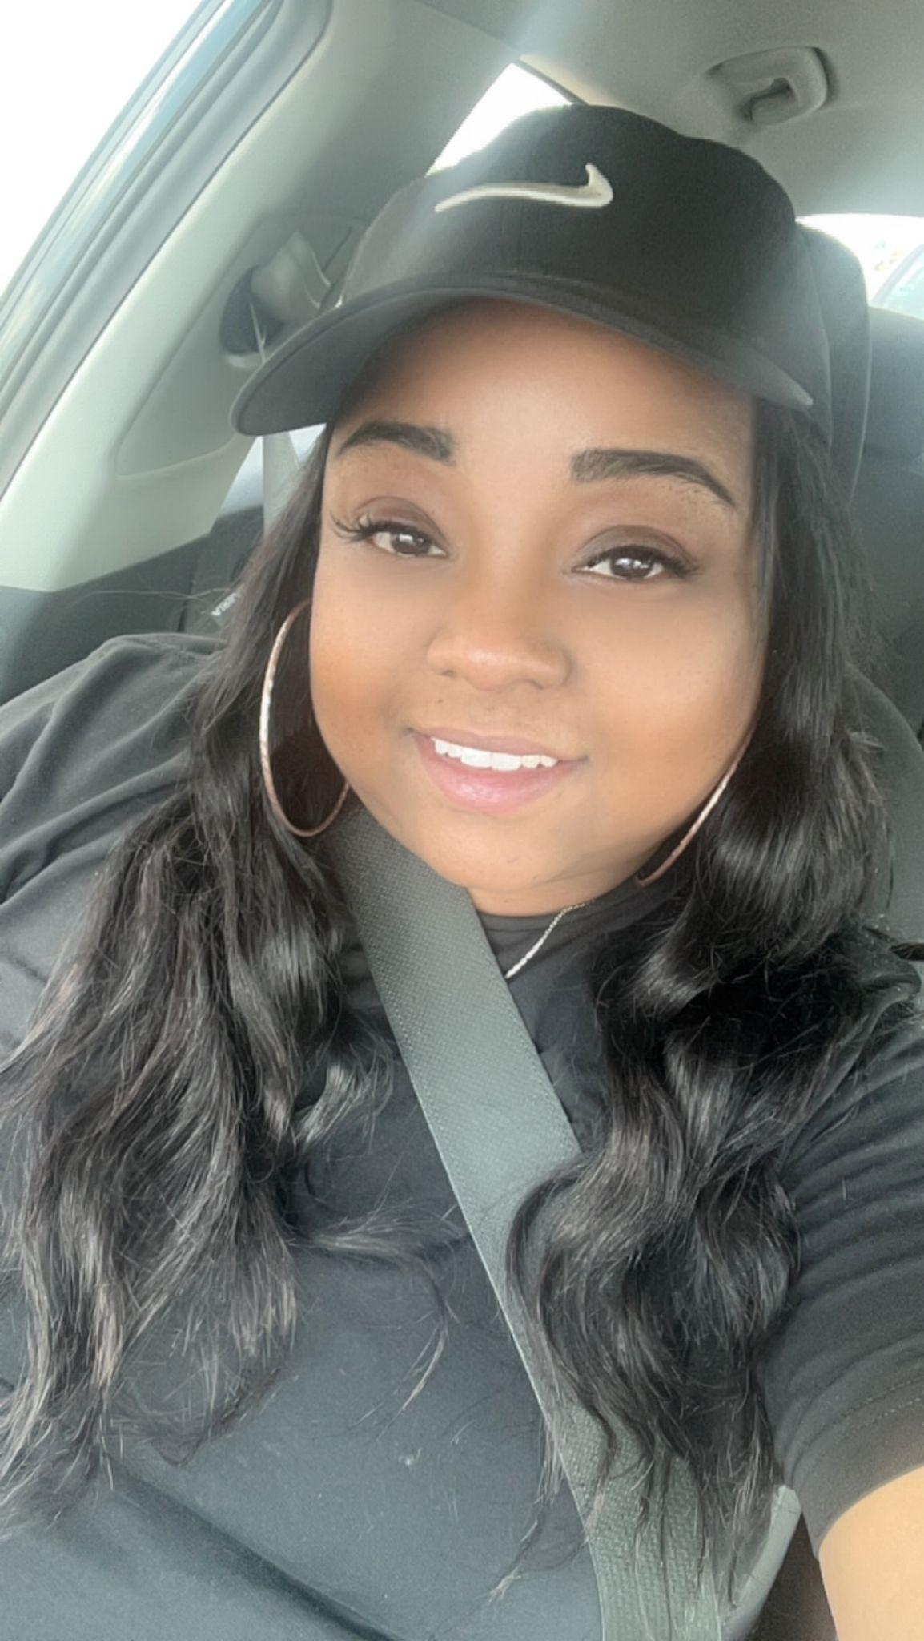
ASSISTANT ATHLETIC DIRECTOR
& GIRLS BASKETBALL HEAD COACH
TY WRIGHT

Slide 6

ATHLETIC TRAINER
SONYA EIKUM
New office this year: Door 3A (outside), 159 (inside)
Office hours after school for practices
Available for injury prevention and rehabilitation
Present at home games
New Process:
TRIA Call Ahead Program
To get an orthopedic injury evaluated, contact me sonya.eikum@tria.com
I’ll call ahead so you can be roomed first in our orthopedic urgent care (at any TRIA location)
Gatorade Protein Shakes & Bars $1

Slide 7

MSHSL RETURN TO PLAY
MSHSL & School board policy govern our activities
If your son/daughter is seen or treated by a physician for an injury or serious illness, they must bring a written note from the physician before they can return to practice or play in a game
This is for the student’s protection as well as to keep everyone informed as to the student’s readiness to return to participation
Post Concussion Graduated Return to Play process
Notes:
Teri

Slide 8

ROOSEVELT SCHOOL BASED CLINIC
Sport Physicals and more
Location: Room 143
Contact Us: Call us 612-668-4834 or text us at 612-599-7290
*We may not reply after 4pm or over weekends.
For medical emergencies, please call 911.

Slide 9

TEDDY NATION ATHLETICS
MISSION & VISION
MISSION: At Roosevelt, we strive to ensure all our students feel welcomed and able to participate in any purpose based activity we have to offer and will consistently encourage our students to regularly engage in competitive school based activities.
VISION: The Roosevelt High School Athletic Department strives to offer our student-athletes an elite experience with all of their chosen purpose based and competitive athletic endeavors and will support all areas of the student-athletes’ development and high school experiences.
Notes:
Russ

Slide 10
PURPOSED BASED & COMPETITIVE
ATHLETIC PROGRAMS
We are an extension of the school day
Our coaches are teachers; the learning continues!
We hear you & we will get better
We prepare the person, not the path.
Our athletes are human beings first and human doings second.
We PREPARE, PLAN and PLAY TO WIN, but MISTAKES are part of the learning process.
We define success in ALL of our Programs beyond the scoreboard Although we, Play to WIN the game.
Competition breeds excellence
Evaluations vs Tryouts
Notes:
Russ

Slide 11
COMMUNICATION CHAIN
PROGRAM SPECIFIC GUIDELINES
IN ADDITION:
Message delivered vs Message received
24-hour rule (includes sending an email)
Meeting procedures/sequence
Athlete & Coach
Athlete, Parents & Coach
Athlete, Parents, Coach & A.D.
Athlete, Parents, Coach, A.D. & Assistant Principal/Principal
Notes:
Russ

Slide 12
SCHOOL ATTENDANCE
MSHSL & School board policy govern our activities
Athletes must be in school all day to be eligible for practice or game (NO Unexcused/U’s in attendance)
Dr. Appt/Parent Excusal is allowable but student must produce a note to the activity office upon return
School sponsored field trips are allowable
Notes:
Russ

Slide 13
ATTENDANCE/EARLY DISMISSAL
MSHSL & School board policy govern our activities
If your student-athlete needs to be dismissed early from class to attend a competition or ride the team bus:
the COACH will send a list of students to the attendance office
only those students participating in the competition will be excused
Parents do not need to call the attendance office or send a note to excuse their student early for competition
Any students who leave early who are not on the coach’s roster will be marked as unexcused absence
Notes:
Russ

Slide 14
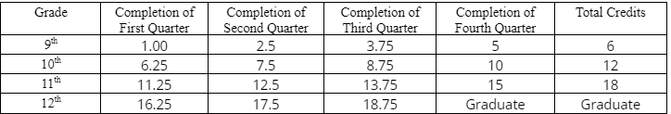
ACADEMIC REQUIREMENTS
MSHSL & School board policy govern our activities
Athletes are eligible for 12 consecutive semesters starting with day 1 of 7th grade
Athletes must be on track to graduate with their peers AND have a MINIMUM 2.0 Cumulative GPA
Grade checks at mid-terms may result in academic contracts and loss of playing time
FINAL GRADE reports may result in loss of eligibility
Notes:
Russ

Slide 15
TO BE ELIGIBLE TO PLAY:
MSHSL & School board policy govern our activities
MUST HAVE a 2.0 GPA AND be on track to graduate (credits)
MUST be Registered and PAY Participation/Uniform Fee
MUST HAVE a current Sport Physical (good for 3 years)
MUST attend school 100% of the time (ZERO
Unexcused absences to participate)
Notes:
Russ

Slide 16


COLLEGE ATHLETICS
NCAA CLEARINGHOUSE,
HUDL & RECRUITING
NCAA CLEARINGHOUSE: https://web3.ncaa.org/ecwr3/
HUDL: Our programs have THE BEST programming HUDL has to offer. PLEASE USE!
Automatic Stat Upload
Highlight Film development
Much More………
RECRUITING
Our Coaches are knowledgeable & experienced in communicating with college coaches
College Coaches call & ask about players
College Coaches call & ask about parents
Notes:
Russ

Slide 17


MSHSL OFFICIALS
Officials are part of a team that helps keep activities safe, fair & fun.
Contests can only happen when we have eligible officials.
Officials strive to give their best effort at every contest.
Spectators at Roosevelt are expected to respect officials at every contest.
91% of officials say their officiating experience has been “Good or Great”
40% of MSHSL Officials officiate 2 or more sports
Top 3 reasons Officials get into Officiating:
Recruited by a fellow official
Officiated at a lower-level
Looking for extra income
More info: https://www.mshsl.org/who-are-you/officiating
Notes:
Russ

Slide 18
RHS FALL SPORT
HEAD COACHES:
VOLLEYBALL Liz Larson /elizabeth.larson.1@gmail.com
CROSS COUNTRY Dave Sharp / sharp017@umn.edu
GIRLS TENNIS Jack Nelson / jack@jacksartwork.com
GIRLS SOCCER Rosie Crossley / rosiecrossley.rhs@gmail.com
BOYS SOCCER Akey Jumale / akeyjumale@hotmail.com
GIRLS SWIMMING Jeff Sanders/ Jeff.Sanders@mpls.k12.mn.us
FOOTBALL Tom Krambeer / Thomas.Krambeer@mpls.k12.mn.us
ULTIMATE FRISBEE Kristin Green / ratigangreen@gmail.com (Club)
Notes:
Russ

Slide 19



THANK YOU!
QUESTIONS?
COMMENTS?
CONCERNS?
Adam Flanders
Roosevelt HS/Heritage Academy Athletic Director
612.668.4859 /adam.flanders@mpls.k12.mn.us
RHSathletics.com
Athletic News
Athletic Calendar
Specific Sports webpages
Game schedules
Coach contact info
Season details
Rosters
Notes:
Russ

Slide 20
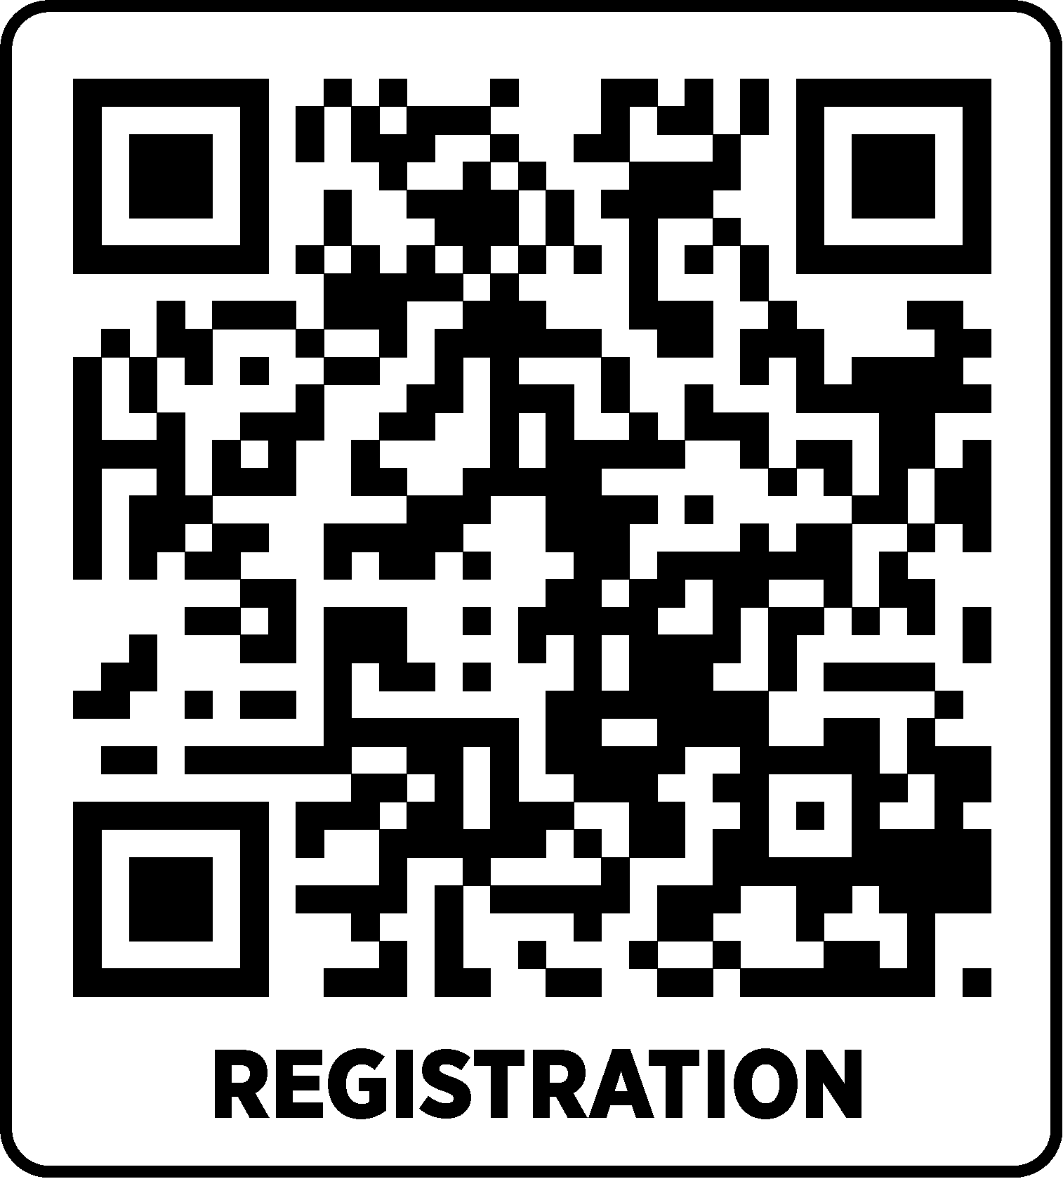
MEET WITH COACHES
GET REGISTERED
Problems Registering? rSchool Helpline: 612.605.1623
Notes:
Russ

