Slide 1

LASSITER WRESTLING
40th Season
2021-2022

Slide 2
AWARDS FORMAT
Intro/Season Recap
Junior Varsity
Varsity
Special Awards
  Scholar Athlete Excellence Award
  Coaches Award
  Lassiter Trojan Warrior Award
  The Kevin Metzer Courage Award
Manager Recognition
Senior Recognition

Slide 3
2021-2022 Special Recognition
The LHS Wrestling Team would like to thank Nicole Snapp, Mike Flisser, Matt Brantley, Amanda Prado, Kathy Fiorenza, Jenni Panone, Kelly Brickley, and all the volunteers that helped during the season. Your time and commitment to the program is greatly appreciated!
LHS Wrestling would also like to thank the Fiorenza family for the time spent taking photos and creating videos for the team!
Lastly, we’d like to thank the LHS Administration and teachers for all their support during the season.

Slide 4
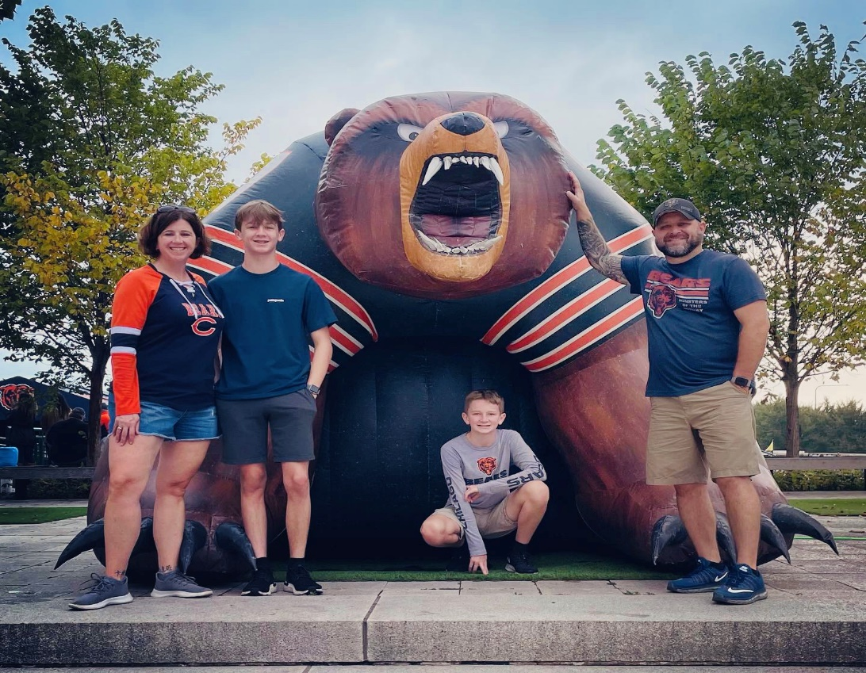
Coach Matt Brickley
Matt Brickley completed his 26th year of coaching this season, 20th as a head coach. He is a 1995 graduate of Ursuline High School in Youngstown, Ohio where he wrestled 103-119 throughout his career. While attending Youngstown State University and majoring in Education and Social Studies, Matt coached at Canfield Middle School for 5 years, winning 2 league titles and having back-to-back undefeated seasons.
After graduation, Coach Brickley moved to Georgia where he taught Social Studies and coached wrestling at Central Gwinnett High School for 8 years and Wheeler High School for 4 years. Matt Brickley was named Head Coach at Lassiter High School in May of 2013.
  232-98 Dual Record
  33 state place winners
  Cobb County Head Coach of the Year 2017, 2021
  Cobb County Assistant Coach of the Year 2010, 2011
  2012, 2017, 2022 Traditional Region Champions
  2011, 2013, 2020, 2021 Traditional Region Runners Up
  2017, 2018 Region Duals Champions
  2013, 2020, 2021, 2022 Region Duals Runners Up
  Top 8 finish at State Duals 2013
  Top 12 finish at State Duals 2017
  Top 6 finish at State Duals 2022
  2017, 2018, 2022 Region Coach of the Year
  2020 Cobb County Invitational Champions
  2021 GHSA Traditional State Runners Up
Coach Brickley holds a Master’s degree in Sports Management from The United States Sports Academy and a 6-year degree from Walden University. Matt has been married to his wife Kelly since 2004 and they have 2 boys, Carter and Jax.

Slide 5
Lassiter Coaching Staff
James Sanchez- Assistant Coach- Social studies teacher entering his 24th year teaching. Has taught and coached at various metro Atlanta schools. Has also spent the last 8 years officiating wrestling with GWOA
Tony Brown - Community Coach- Married to Karen Brown and has three children, Maya, Bear, and Wolf. Tony wrestled at CD East High school in Pennsylvania and went undefeated for 2 years as a heavyweight wrestler. He played football at Virginia Tech from 1977-1982 and now lives in Marietta, GA. Tony is a Freshmen Football Coach for Lassiter and assists with the varsity defensive line for games. He is in his 11th year as an assistant wrestling coach.
Brett Shedd- Community Coach- Graduated from Woodland High School in 2016. Attended Shorter University on a football scholarship for two years. He is currently attending Kennesaw State University in pursuit of a degree in health and physical education. He is a 2-time state qualifier at 195lbs and 4-time state duals runner up. He coached within the Woodland program from the fall of 2016 to the spring of 2021.

Slide 6
John Stulak – Community Coach / Head Junior Coach – Coach Stu wrestled for Brecksville High School in Ohio in the 98 and 105 pound weight classes. He is a 1989 graduate of Miami University where he earned a BS in Finance and Accounting. In 2002, he moved from California to Georgia to start a software company who develops accounting products for Microsoft Dynamics Business applications. Coach Stu has been married to his wife Jodi since 1999 and their daughter, Sage is currently studying education at KSU. He is passionate about health and fitness, and he just completed his 10th year of coaching and running youth wrestling tournaments in Georgia. When Stu is not sharing his wisdom on the mat, he applies his "together is better" perspective as he co-hosts a global reach podcast called The WizeGuys. Stu is committed to helping others cultivate wisdom and do life "just a little bit better".
Rommell Neu- Community Coach-Coach Neu started wrestling at the early age of six years old in Port Charlotte, Florida. He was coached by his father who learned to wrestle and coach in central Minnesota. Through his adolescent years, Coach Neu competed nationally and twice in Mexico from the mid-1970’s to the mid-1980’s. He is a Georgia High School State Champion, runner-up, and 3rd place finisher in the mid to late 1980’s. Coach Neu was offered chances to wrestle in college but decided to join the United States military instead.
Coach Neu was a community coach for Coach Ramos’ feeder program at Collins Hill High School in the late 1990’s. Additionally, he assisted the Campbell High School wrestling team during 2012 and 2013 seasons. He has also coached youth baseball and volunteered to coach high school baseball and raider teams.

Slide 7
Philip Murray- Community Coach- Coach Murray is a local from Marietta, GA and graduated from Georgia Tech this past year with an Industrial Engineering degree. He is excited to be supporting the coaching staff this year after spending his wrestling career through the Lassiter High School program (2011-2015). Philip is a former GHSA State Medalist finishing 6th overall in the 7A Tournament. Coach Murray is looking forward to growing this program to new heights with some very talented wrestlers.
Matt Brantley- Community Coach- Matt Brantley is a Georgia native and Lassiter High School graduate (1999). He began wrestling in the Lassiter Junior program in 8th grade and continued for all 4 years in high school. Matt coaches in the LHS youth program for 5 years and joined the high school staff last season as a community coach.
Coach Brantley participated in Track and Field at Life University on an athletic scholarship before graduating from Kennesaw Sate University with a BS in Exercise and Health Science. Matt and his wife Rachel have 4 children, Brooke, Brody, Brenden, and Brevin.

Slide 8
High School Roster
Wrestlers
Russell Beers | Dima Krizek
Carter Brickley | Alex Le
Will Cochran | Ananth Manibushan
JaCobee Connell | Riley McElligott
Adam Cuppels | David Panone
Zachary DeMontigny | May Prado
Joshua Everden | Grant Rhue
Anthony Fiorenza
Dominic Fiorenza
Noah Flisser
Samuel Gadsden
Isaac Hoshide
Alex Johnson
Andrew Jones
Graham Jones
Mark Keith
Managers
Diana Valle | Sophia Awtrey
Alexa McCombs | Alex Brush
Camryn Flisser

Slide 9
2021-22 Accomplishments
◦ Cobb County Runners Up
◦ 3 County Champions
◦ Region Duals Runners Up
◦ State Quad 1st Place
◦ State Duals Top 6
◦ Traditional Region Champs
◦ 6 Region Champions
◦ 11 Sectional Qualifiers
◦ 11 State Qualifiers
◦ 5 State Medalists
◦ 2 State Champions
◦ 8th Place Traditional Finish
◦ Cobb County Team of the Year
◦ 4 All-County 1st Team
◦ 1 All-County 2nd Team
◦ 2 All-County Honorable Mention
◦ Varsity Average GPA-3.37
◦ Co-Female Wrestler of the Year
◦ Assistant Coach of the Year-Tony Brown
Individual Stat Leaders
Top 5 Wins: Panone, David 46, Fiorenza, Anthony 44, Brickley, Carter 42, Flisser, Noah 41, McElligott, Riley 39
Top 5 Falls: Flisser, Noah 29, Fiorenza, Anthony 26, McElligott, Riley 24, Connell, JaCobee 24, Panone, David 21, Brickley, Carter 21
Top 5 Takedowns: Panone, David 98, Gadsden, Samuel 81, McElligott, Riley 81, Flisser, Noah 77, Manibushan, Ananth 69

Slide 10
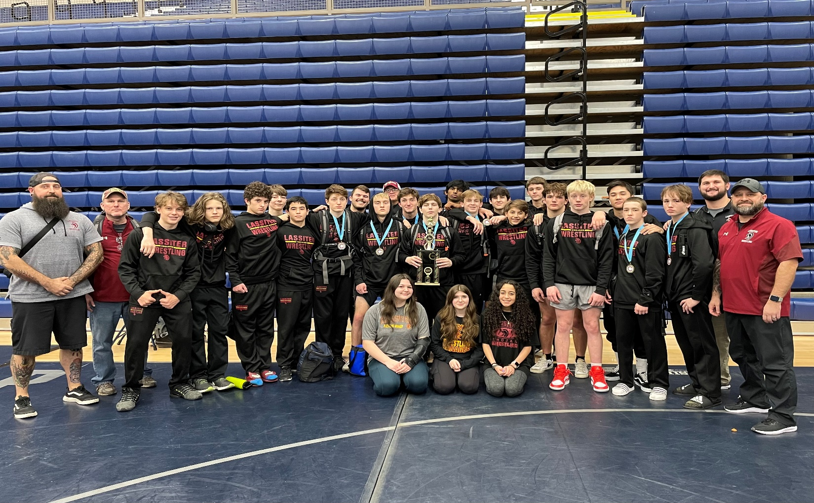
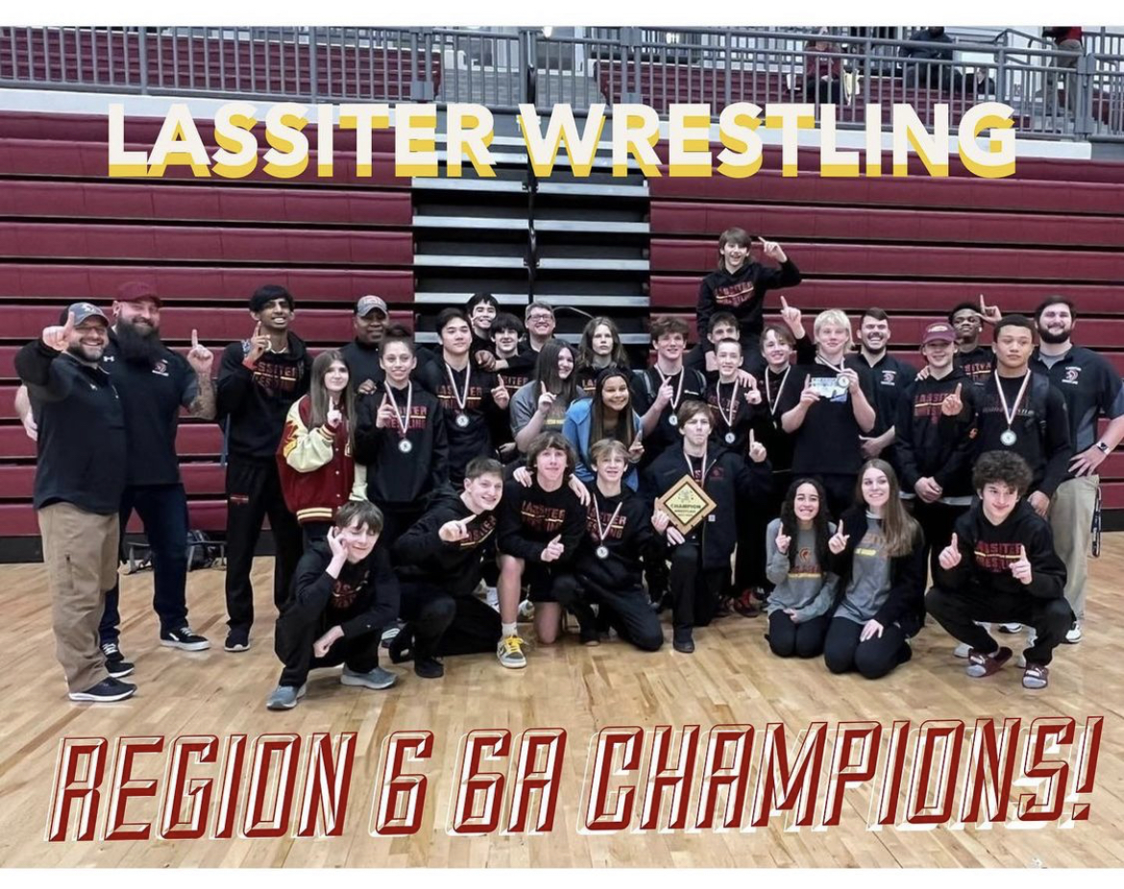

Slide 11
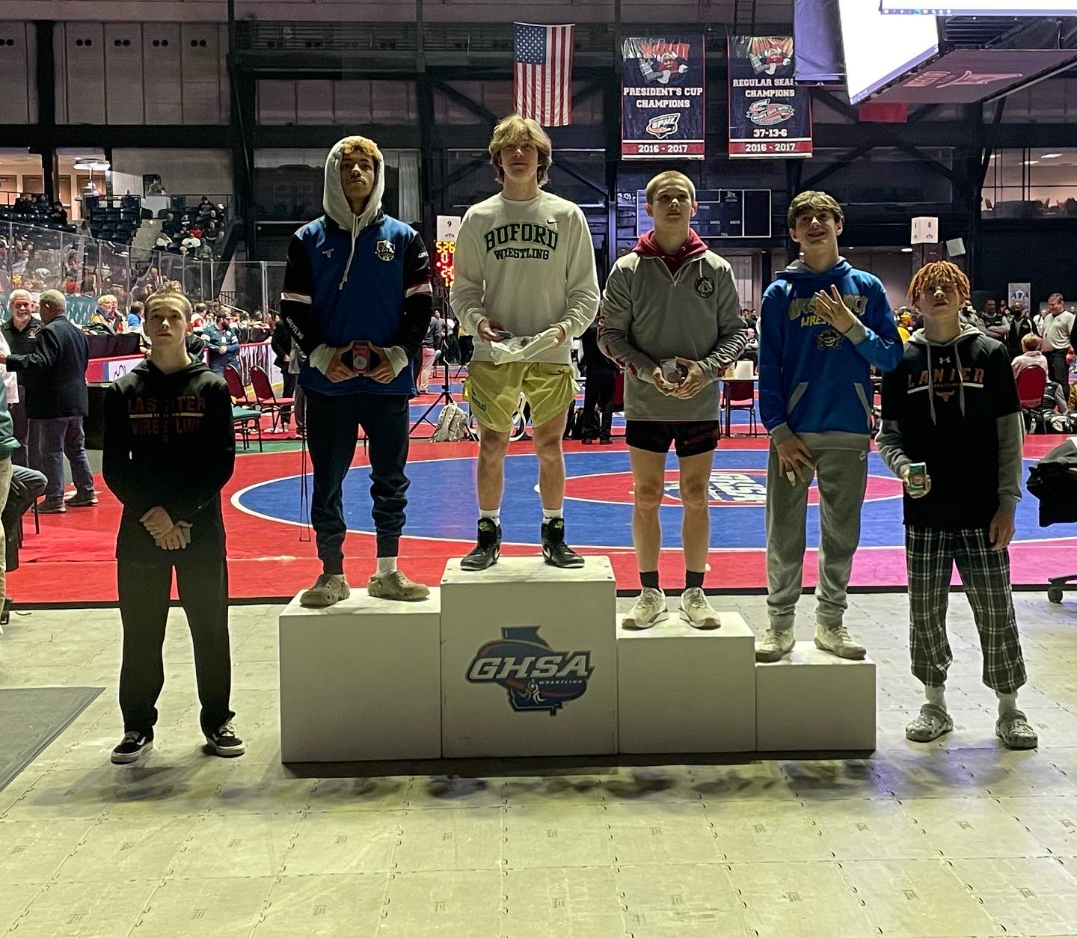
2021-22 GHSA State Medalists
Riley McElligott 5th Place 106 lbs.

Slide 12
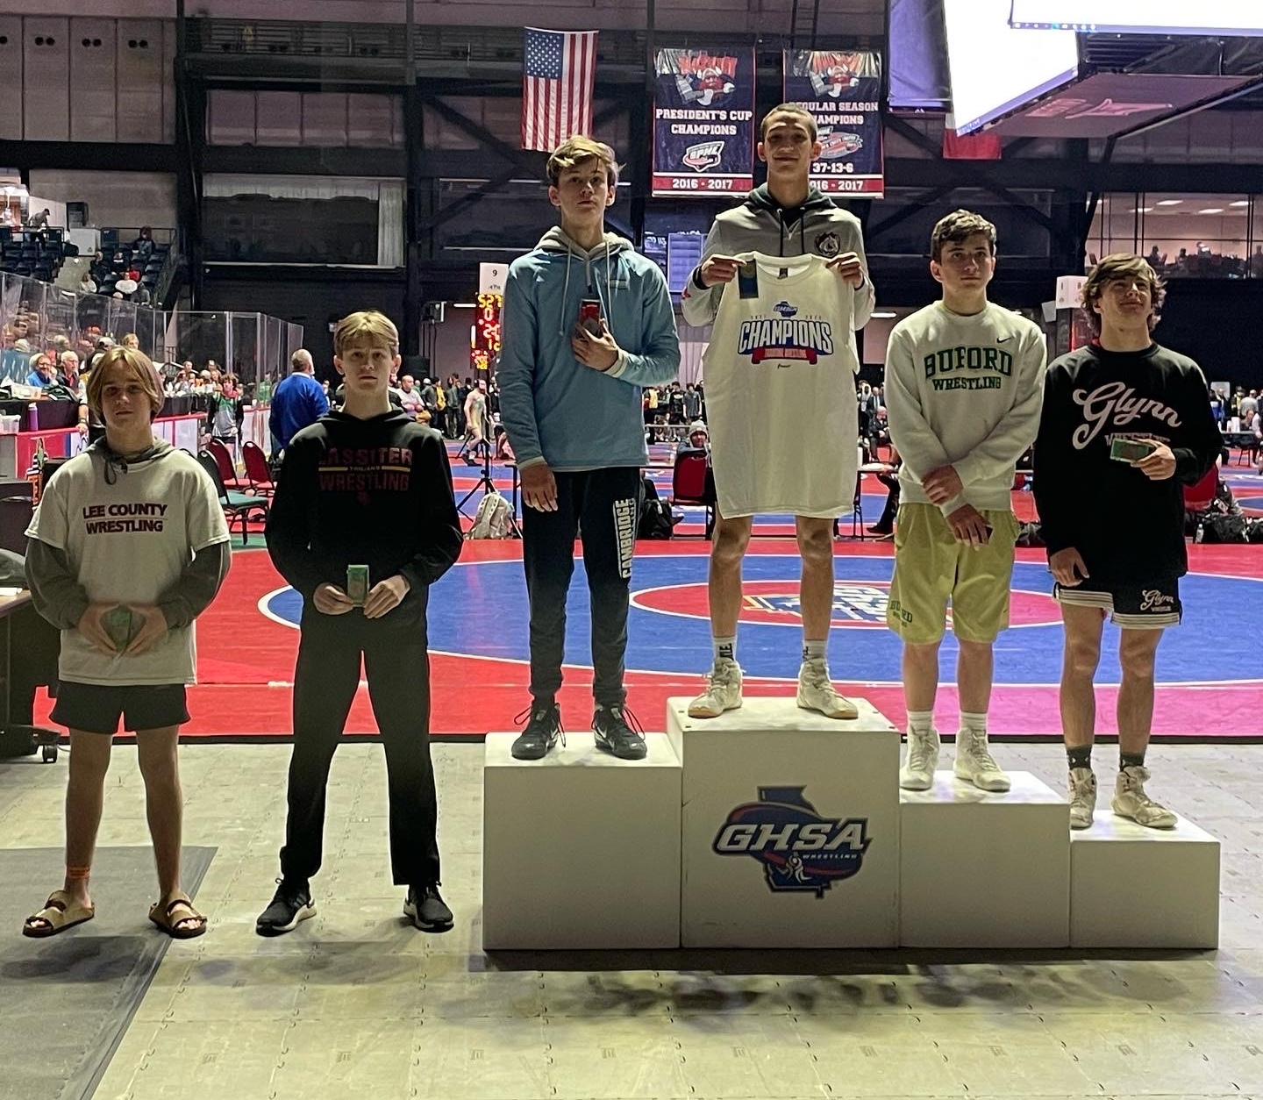
2021-22 GHSA State Medalists
Carter Brickley 5th Place 113 lbs.

Slide 13
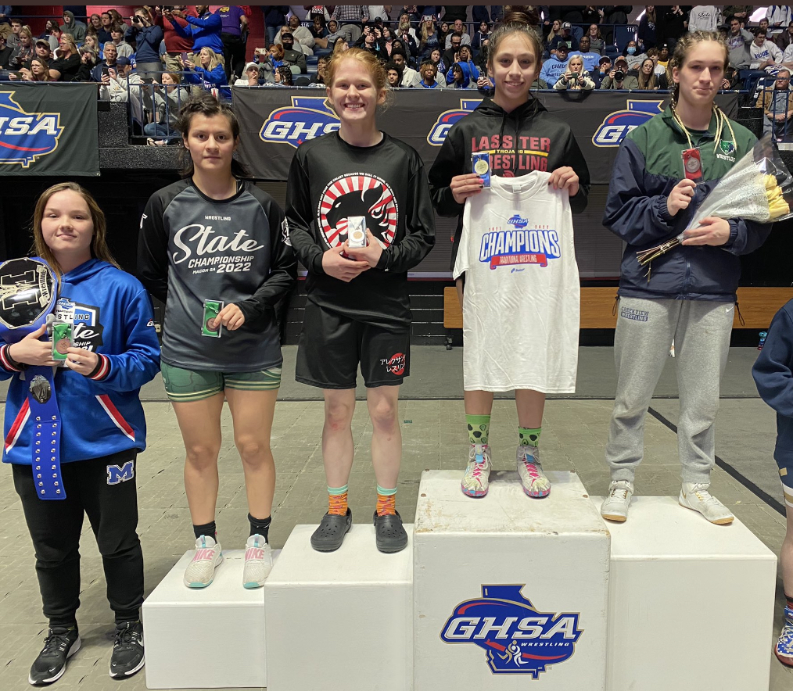
2021-22 GHSA State Medalists
May Prado State Champion 132 lbs.

Slide 14
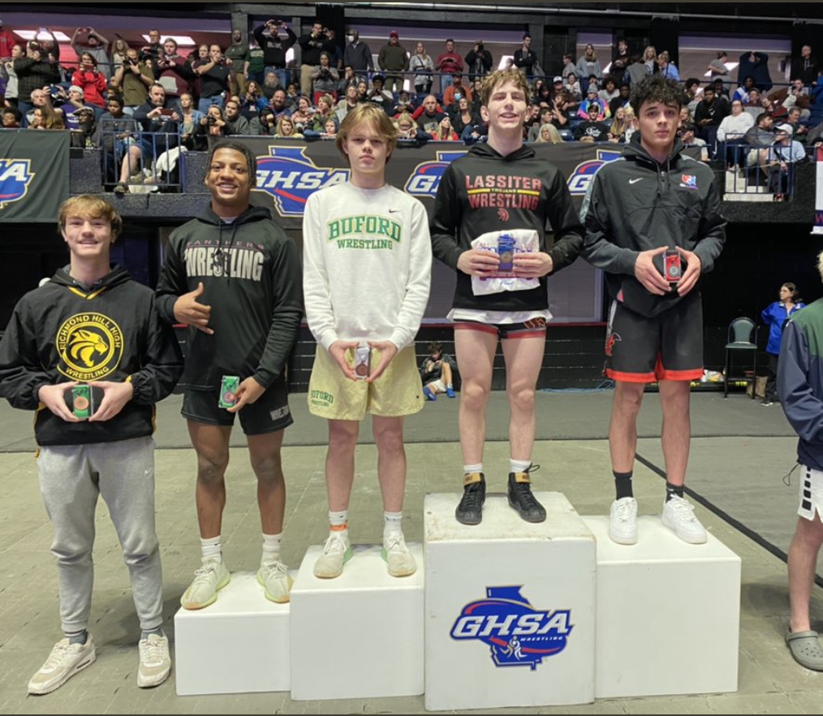
2021-22 GHSA State Medalists
David Panone State Champion 138 lbs.

Slide 15
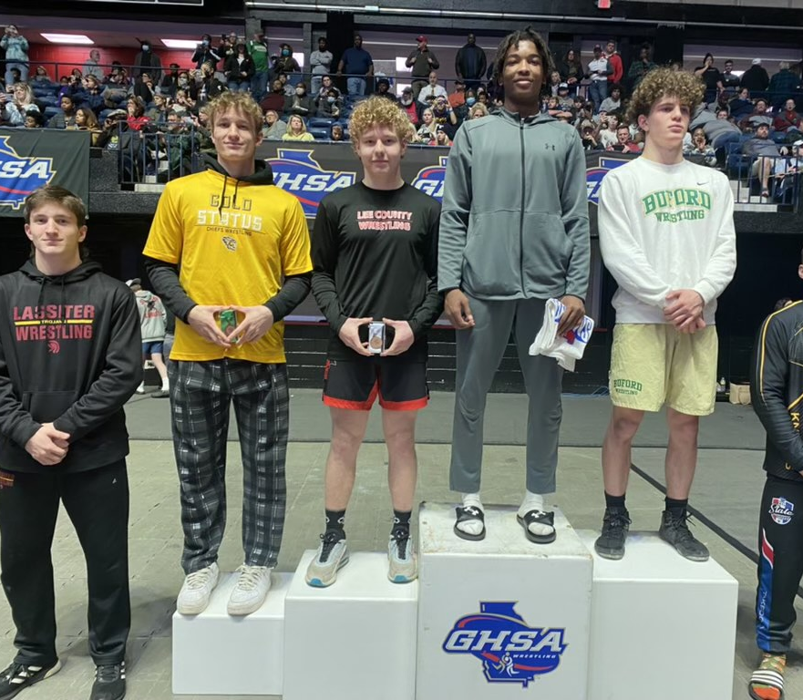
2021-22 GHSA State Medalists
Anthony Fiorenza 5th Place 170 lbs.

Slide 16
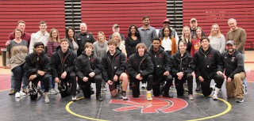
2022 Lassiter Senior Wrestlers

Slide 17
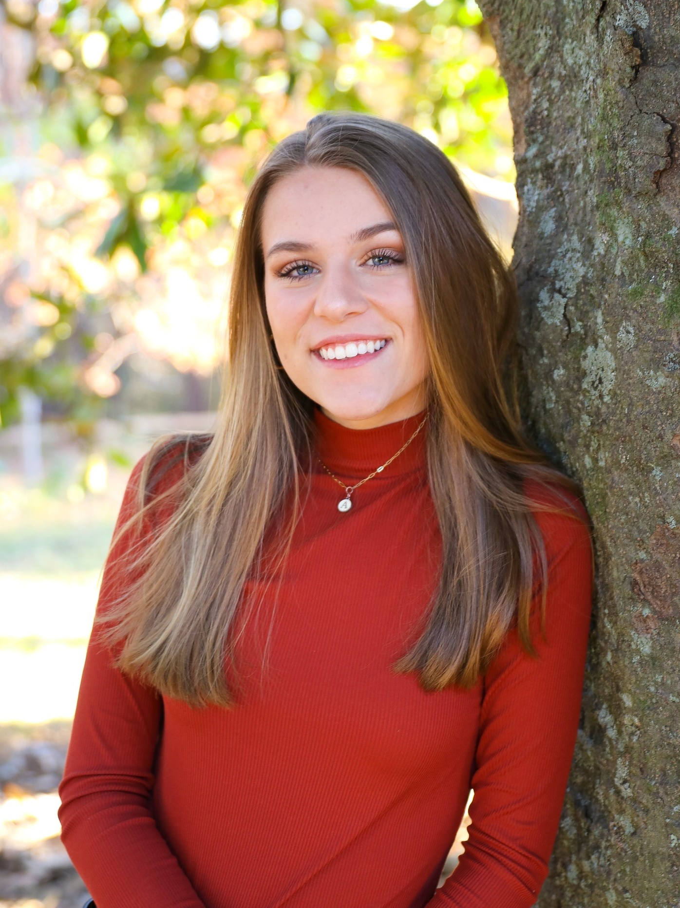
Alex Brush
Alex Brush is a Senior who managed for one year and learned a lot and enjoyed every moment of it. For the past year she has been working for a local real estate company and is planning on getting her license right after graduation to continue in the real estate industry. She enjoyed how close the team was with each other and that there wasn’t a dull moment!

Slide 18
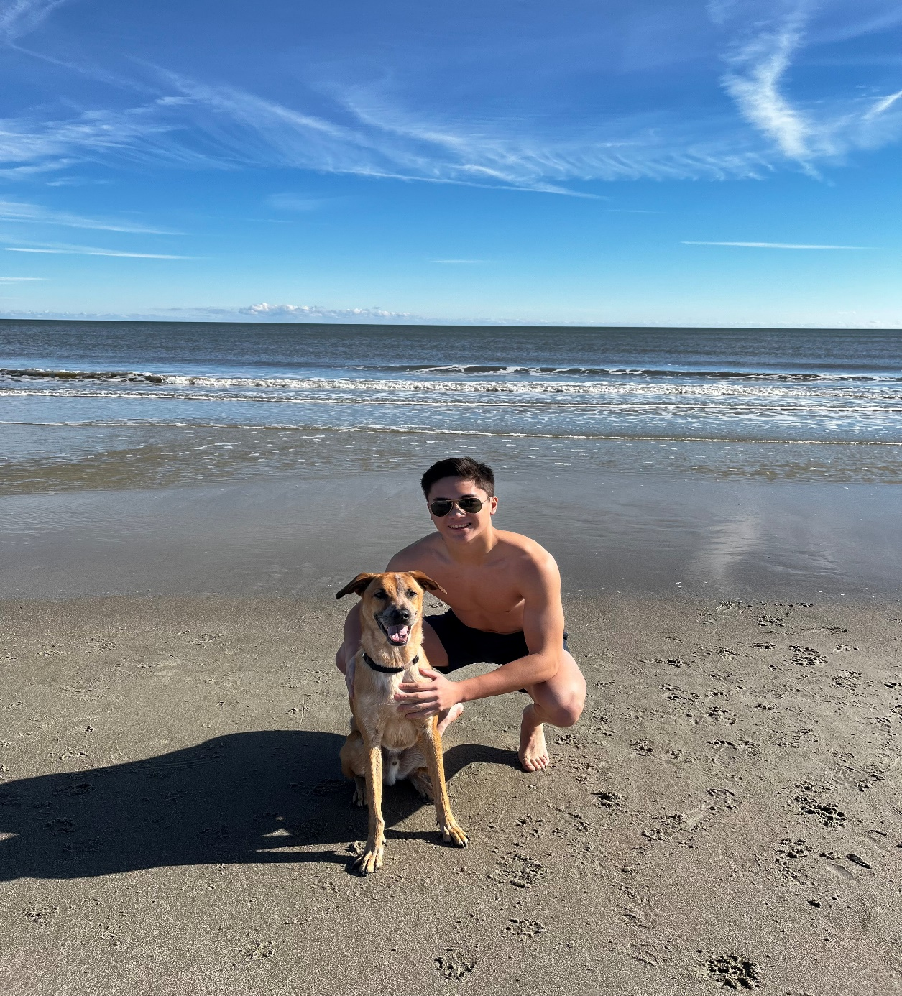
Alex Le
Alex started wrestling in the Lassiter youth program in 5th grade. His high school career consisted of wrestling at 113, 126, 132, and 152 weight classes. He has gone to State twice for both dual and individual tournaments and was Region Champion this year. He also plays lacrosse for Lassiter and is a starting defenseman. Alex enjoys the outdoors where he hikes, bikes, does snow sports and various water sports. He intends to study engineering in college.

Slide 19
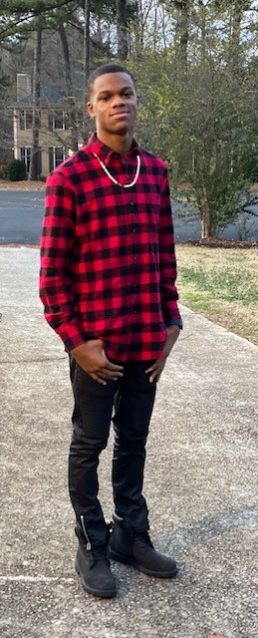
Andrew Jones
Andrew “Drew” Jones started his sports interest with Track & Field. Running 100m, 200m, 4x4, 4x1 in middle & high school. During summer months Drew spent his time studying Brazilian jujitsu. He developed a love for the sport. 9th grade year he decided to joined the wrestling team at Whitewater High school, his passion grew to learn the sport. After transferring to Lassiter during the pandemic, he join the wrestling team his senior year and will be attending Georgia State University.

Slide 20
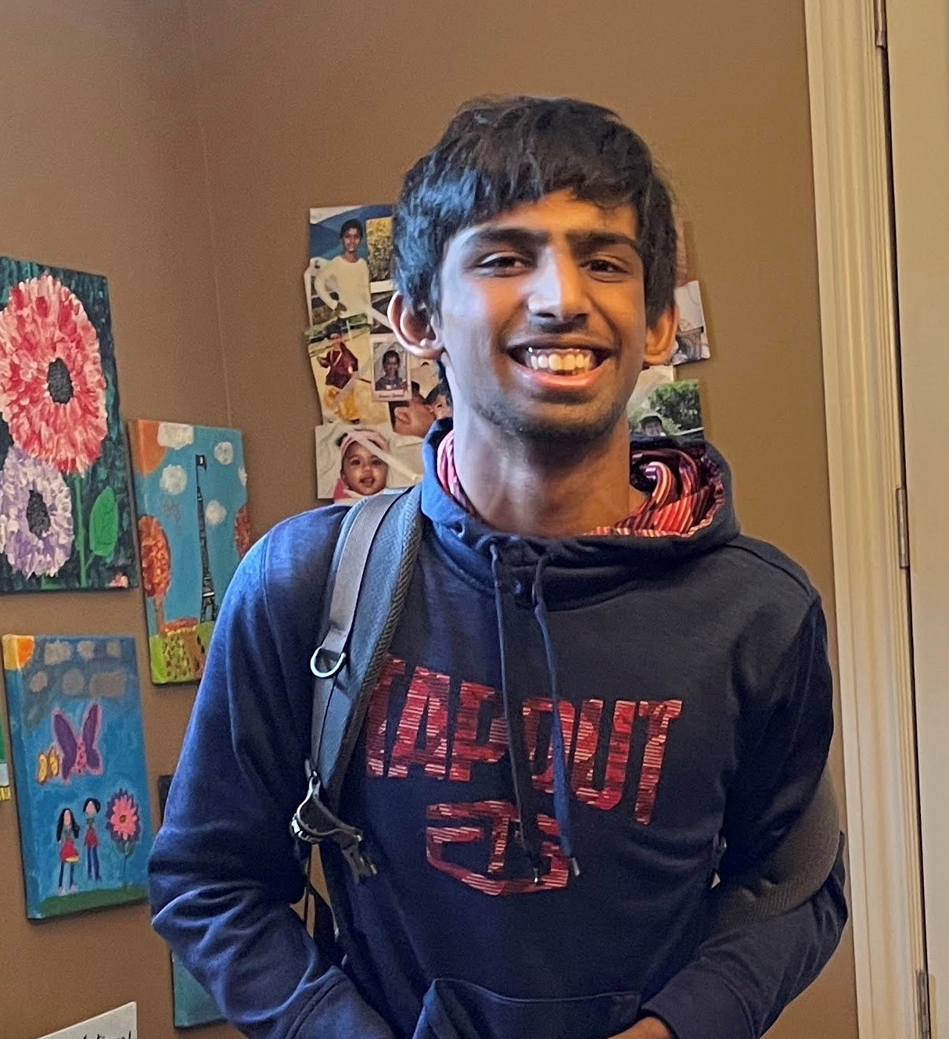
Ananth Manibushan
Ananth’s love for wrestling came from an early age. He started doing Brazilian Jiujitsu when he was 7 and then got into wrestling in middle school. He has been wrestling all 4 yrs of High school. Ananth is very passionate about wrestling and when he graduates, he will go on to wrestle for Queens University in Charlotte while pursuing a degree in Business. Ananth is an analytical thinker. He looks at every wrestling match critically and analyses how to learn and grow from the experience. Ananth is a foodie, he enjoys cooking and trying new dishes with his own flair.

Slide 21
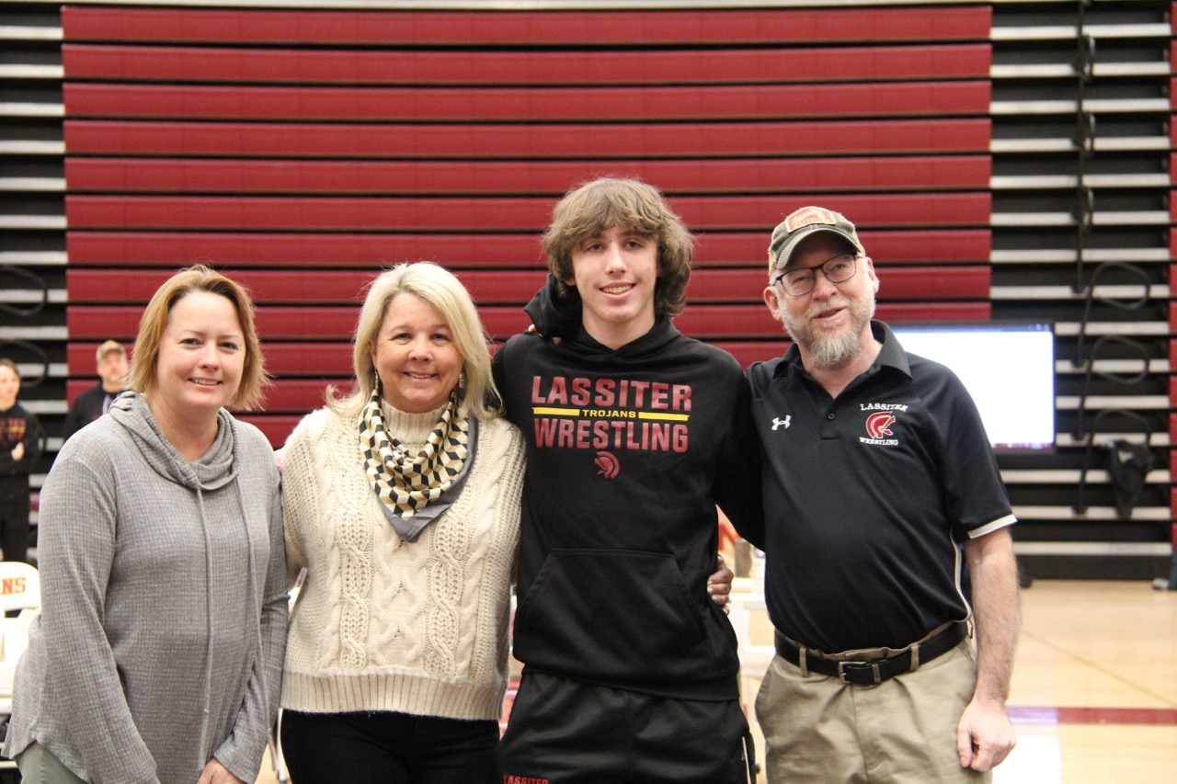
Adam Cuppels
Adam started wrestling in 8th grade in the youth program. He wrestled at the 106, 113, 126, and 138 weight classes across his four years of high school. Adam was a great teammate throughout high school, he thoroughly enjoyed pushing through the tough practices and helping others improve. He enjoys being around his friends and staying active by going to the gym and playing other sports like basketball and soccer.

Slide 22
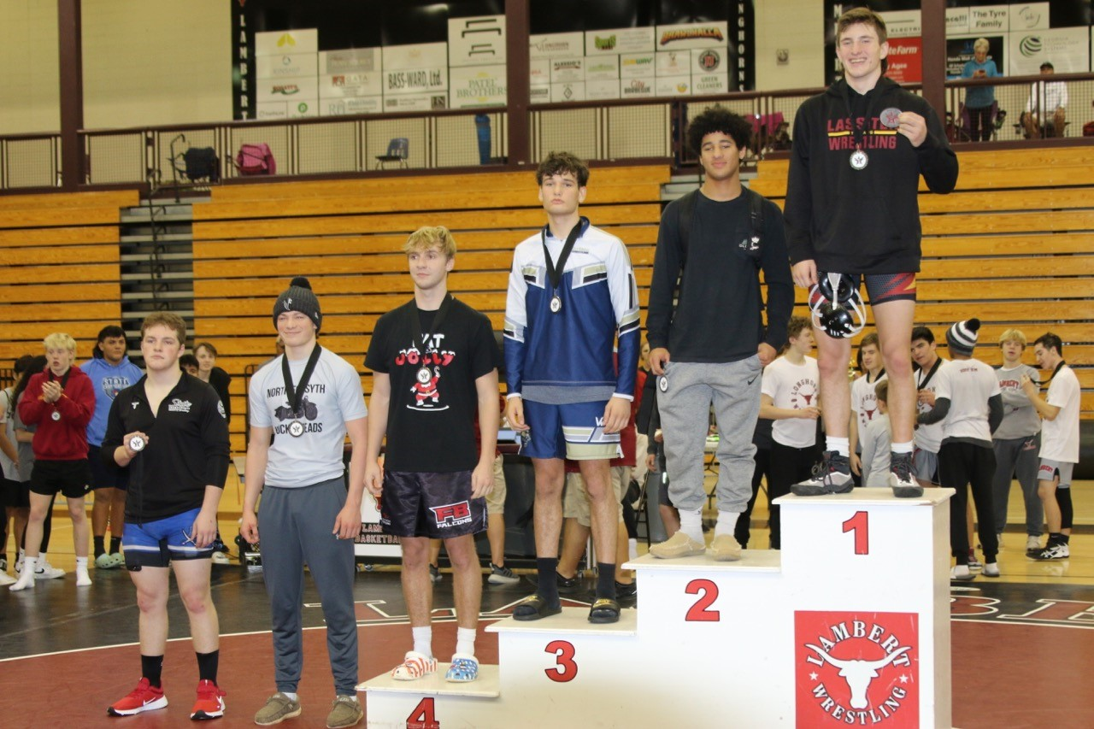
Anthony Fiorenza
During Anthony’s first year in the Lassiter HS Wrestling program, an injury to an upper classman left a vacancy in the 160 lbs. weigh class. Anthony was thankful that Coach Brickley placed his faith, confidence, and encouragement in him to fill the role for the team. Through hard work, he had moderate success and earned the Lassiter "Breakout Wrestler of the Year" for 2019. This was also his introduction to the invaluable mentorship of Coach Tony Brown.
As a sophomore he moved up to the 170 lb. weight class. Although continuing to improve with the help of sparring with Coach Donaldson, he was one sectional win shy of qualifying for the State Tournament.
Anthony's junior season was nothing less than "eventful"! He earned wins and pins in 4 different weight classes in less than a month. Three of those wins in three different weight classes came against rival Pope HS wrestlers, which gave him a certain sense of joy. He started the season in the 182 lb. weight class, while also wrestling bouts at the 170 lb. class. He cut to the 160 lb. weight class for Region/State Duals, where he earned a victory by pin versus Pope. After State Duals he lost a roster challenge match for the 182 lb. class for the traditional tournament. Undeterred, he committed to wrestling in the 195 lb. class and qualified for the State Tournament. He earned a win (21 second pin, 5th fastest of the tournament) at State despite struggling to make the 174 lb. minimum for the 195 lb. class. His perseverance earned him the Lassiter Trojan Warrior Award for 2021.
Entering his senior year, he was quietly committed to placing at State. Although the ups and downs of the season sometimes made reaching that goal questionable, the guidance and sparring sessions from Coach Murray, Coach Shedd, Coach Stu, and Coach Neu kept him plugging along. Overcoming the adversity of elimination matches at both Region and Section, he fought back each time to make the State semifinal and ultimately placed 5th at State.
In his 4 years at Lassiter, Anthony is grateful for many things. He values the camaraderie of his Lassiter wrestling teammates and his sparring partners over these four years. Always valuing family, he was able to share his success with his grandparents, parents, sister and “little" brother. Having Varsity wins on the same night with his little brother Dominic was truly special. The trust placed in him and the mentoring received from Coach Brickley and the whole coaching staff has built bonds of gratitude that go far beyond the wrestling mat.

Slide 23
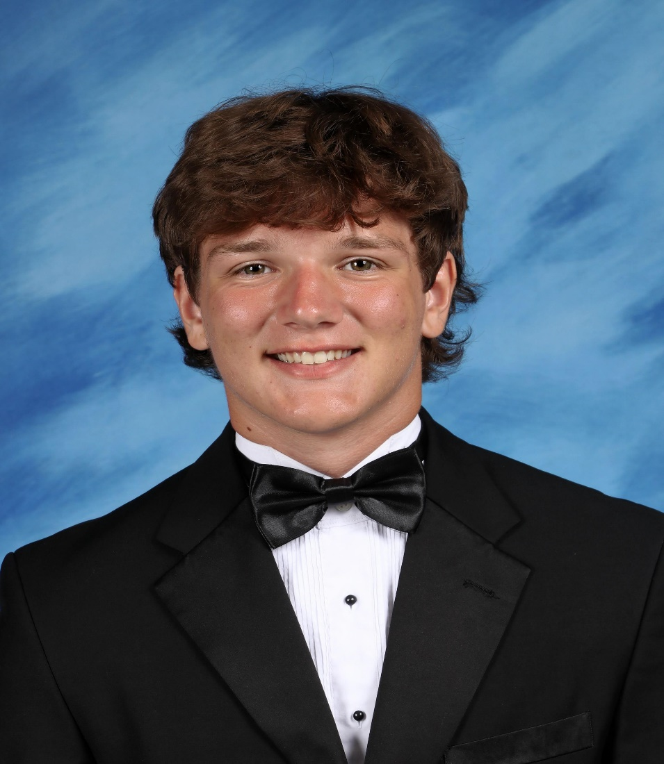
Noah Flisser
Noah Flisser is 4-year wrestler, 3-year letter-winner. He has competed at 152, 160, 170, and 182 lbs..
Noah was a 2022 Regional Champ, 2022 All Cobb County 2nd team honorable mention, and a two-time GA state qualifier. Noah finished his senior season with 41 Wins, 77 takedowns, and team leader with 29 falls.
Noah lives with his Father Mike, Mother Heidi, and Sister Camryn. Plans to Wrestle at Life University and go to Chiropractic school.

Slide 24
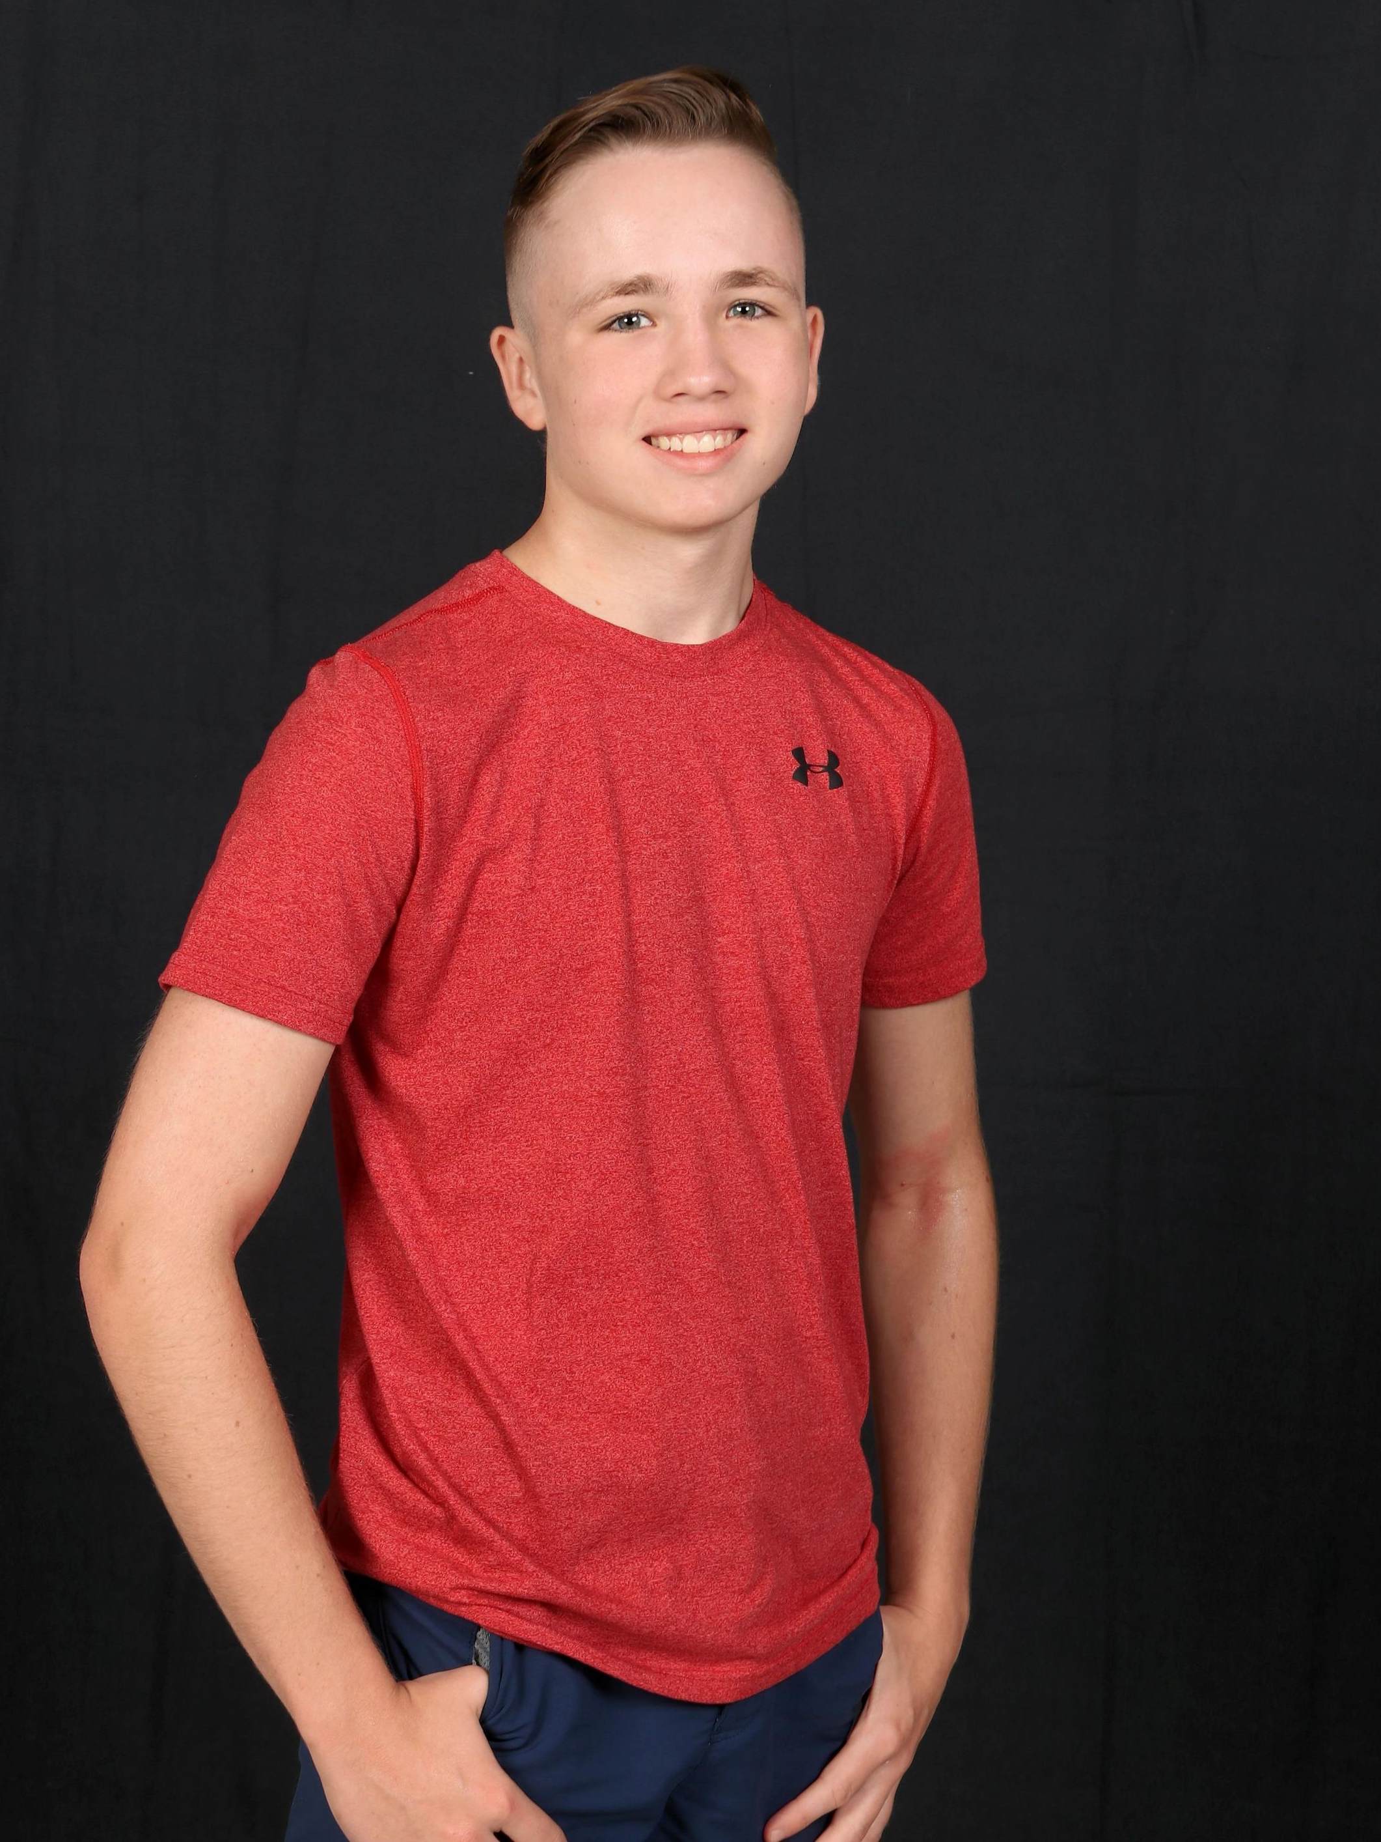
Dima Krizek
•Dima began his wrestling career 8 years ago with the Lassiter Junior program. Coach Brickley and Coach Brown have been with him from the start – thank you. Wrestling became Dima’s favorite sport immediately and has been an important part of his life. Dima has shown great perseverance in his personal career and has been the part of numerous successful teams. During his senior season Dima took 2nd place in Regionals. Dima was also a state qualifier accomplishing the goal he set for senior year. Thanks for the great memories and teammates.

Slide 25
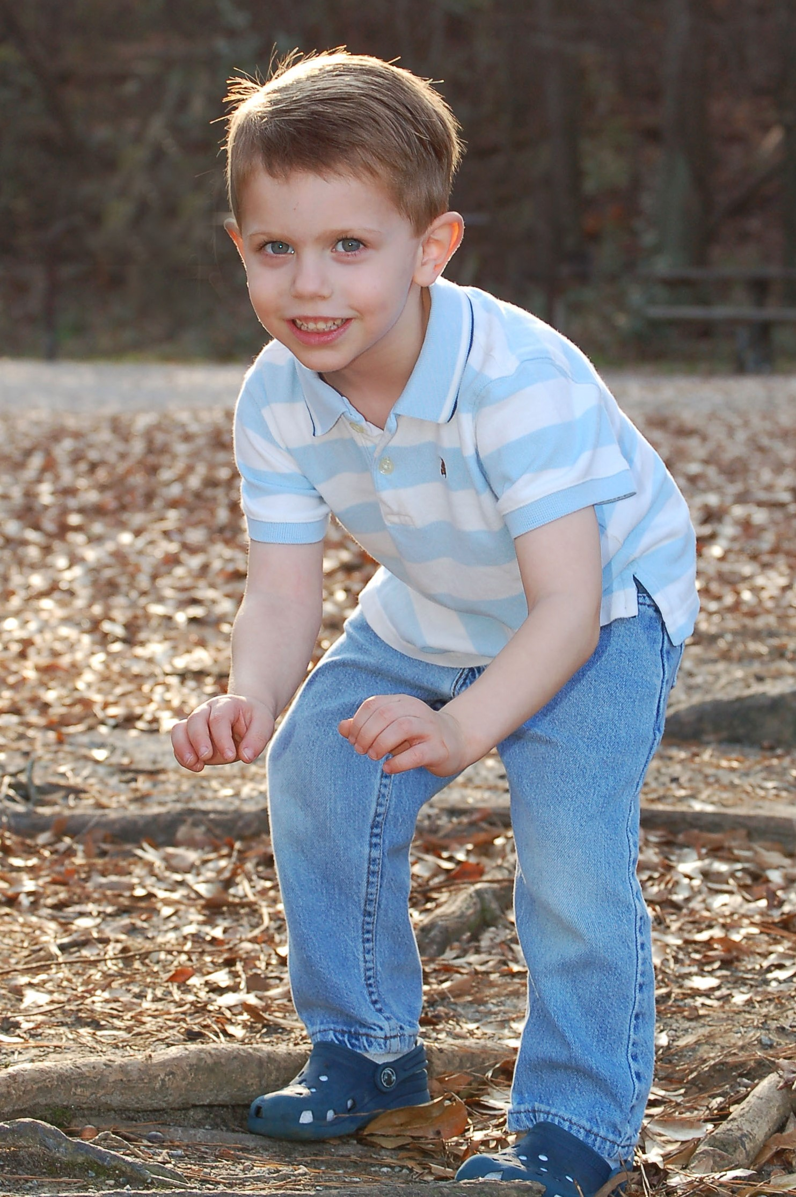
David Panone
David Panone finished his high school season as the winningest wrestler in Lassiter history. David was Lassiter's first 3x State champion finishing 1st , 3rd , 1st, and 1st each year. His final high school record was 180-14.
Some other notable stats include:
•73% bonus point wins (87% his senior year)
•350 career takedowns
•671 career back points
•3x county champion; 4x region champion
•Cadet Nationals Greco All American - 6th
•Grappler Fall Classic All American - 8th
•Knockout Christmas Classic - 4th place
David has also enjoyed being a leader on the team, helping coach his teammates on and off the mat. On most days he stays after to help with technique and regularly provides advice and counseling.
David will be attending Belmont Abbey College in Belmont, NC in the fall to further his academic and wrestling career.

