Slide 1
Lakeville north Volleyball Booster membership meeting
2019

Slide 2
AGENDA
Welcome
2018 Booster Club Executive Board
Purpose of the Lakeville North High School Volleyball Booster Club (LNHSVBBC)
Booster Organizational Chart
Roles and Responsibilities
Election: 2019 Executive Board Members
Review: 2018 Sub-Committee and 2018 nominations
Looking Ahead 2019
Key Off-Season Information
Conclusion/Questions

Slide 3
2018 LNHSVBBC EXECUTIVE BOARD
President: Jessica Wolfe
Vice President: Kari Thompson
Communications/Website: Delana Wherland
Finance Director: Amy Wheatcraft
Volunteer Director: Sarah Hornyak
Special Events Director: Mary Pat Blascziek
Tournaments Director: Heidi Winter
Concessions Director: Heidi Kolden/
Shelly Polzin

Slide 4
PURPOSE and OBJECTIVE of the LNHSVBBC
The purpose of the LNHSVBBC is to promote the sport of girls’ volleyball for the student-athletes of Lakeville North High School.
Ongoing dialogue with the LNHS Athletic Director and the LNHS volleyball coaching staff to ensure that the booster’s participation in and support of the volleyball program is at all times consistent with the highest goals and aspirations of the athletic competition among students.
The objective of the LNHSVBBC is to support the long term growth of the volleyball program and ensure that the students have the proper training, equipment and facilities in which to learn and compete.
The goals include, but are not limited to: providing financial support (financial and otherwise), to develop a sense of pride and tradition for the students, to promote and publicize the LNHS volleyball program in the community and to recognize the accomplishments of the team, the players and the coaches.

Slide 5
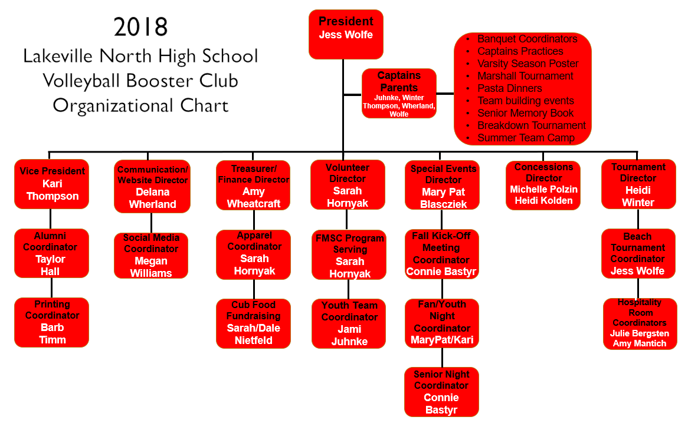
2018 ORGANIZATIONAL CHART

Slide 6
LNHSVBBC ROLES and RESPONSIBILITIES
President
Lead, guide and shape all LNHSVBBC meetings. Carry out the decisions of the general membership expressed by a majority vote of those present at vote. Carry out decisions expressed by the majority of the Executive Board. Vote only in the event there is a tie after a quorum is present. Authorized to direct the Treasurer to issued checks consistent with the budget (See Article IX). Act as the liaison between the coaching staff, school administration/Athletic Director, and the LNHSVBBC. Recommended to meet with the Head Coach & Athletic Director at the beginning of every season to discuss general business items, roles & responsibilities, new policies, etc.
Vice President
Act with the power and authority of the President in the absence of the President. Directly oversee both the Alumni and Apparel Coordinators and guide/assist the responsibilities of each. The Vice President should not be a senior parent. The VP should be willing to work alongside the President and run for the President position when vacated by the current President. The Vice President is also responsible for other duties as assigned.
Communication/Website Director
Prepare and maintain full minutes of all booster meetings. This position shall conduct and keep all correspondence of the LNHSVBBC, and perform other such duties that customarily pertain to communications. Keep and maintain the player/ parent information including addresses, phone numbers and email addresses on a spreadsheet and update all Mail Chimp data as necessary. Keep a current list of alumni player contact information. Oversee aspects of communication from the Booster Club to the membership. All communications sent on behalf of the Booster Club to the Membership are first to be cleared through the President and Head Coach prior to sending. The Communication/Website Director is also responsible for other duties as assigned.
Special Events Director
Plan and organize all special events throughout the LNHSVB season. Support, guide and direct subcommittee chairpersons dedicated specifically to the LNHSVB special events such as the Fall Kickoff, Youth/Fan Night, Senior Night, and the Banquet. The Special Events Director will assist the Captain’s Parents responsibilities as needed and other duties as assigned.

Slide 7
LNHSVBBC ROLES and RESPONSIBILITIES (CONT’D)
Finance Director
Receive, deposit and give account of the current assets of the LNHSVBBC; have charge of all funds, securities and financial records of the LNHSVBBC; maintain appropriate records; make payments for all LNHSVBBC liabilities; submit a financial statement at each monthly Board meeting; submit a fiscal year-end statement and interface with the LNHS Booster Club as appropriate. Plan and recruit subcommittee chairpersons, organize and optimize revenue stream from events such as Tournament Ticket & Concession Sales, oversee other fundraising event(s), as well as find new sources of revenue; and other duties as assigned. The Treasurer must ensure all fundraising events are approved by the LNHSVB Head Coach, the LNHSVBBC and the LNHS Activities office.
Volunteer Director
Responsible for all aspects of recruiting volunteers for all volunteer needs of the LNHSVBBC. This includes (but not limited to): establishing volunteer needs with other LNHSVBBC officers, creating a map of volunteer needs for each season, creating signup and reminder communications, and reporting the status and needs to the Executive Board on a frequent basis (as well as other duties as assigned).
Tournament Director
Oversee and organize all aspects of Tournament Operations with the guidance and cooperation of the on-site LNHSVB Head Coach. Post and maintain all visible tournament brackets, programs, signage and operations during tournament events. Oversee the Hospitality Room (Bachman Invitational only) and the LNHSVB Beach Tournament (July): distribute direction and assistance as needed.
Concessions Director
Oversee the complete operations of concessions at each tournament with the help of the on-site concession coordinators. Supervise the setup and breakdown of the concession stand; the production of all menu items; costing; shopping and delivery of the concession items. The Concession Director will pre-order all items needed the day off by local businesses (as well as other duties as assigned).

Slide 8
2019 EXECUTIVE NOMINATIONS LNHSVBBC
Position | Nominees
President | Jessica Wolfe
Vice President | Kari Thompson
Finance Director | Amy Wheatcraft
Communications/Website | Delana Wherland
Volunteer Director | Sarah Hornyak
Special Events Director | Mary Pat Blascziek
Tournament Director | Barb Timm
Concessions Director | Julie Bergsten

Slide 9
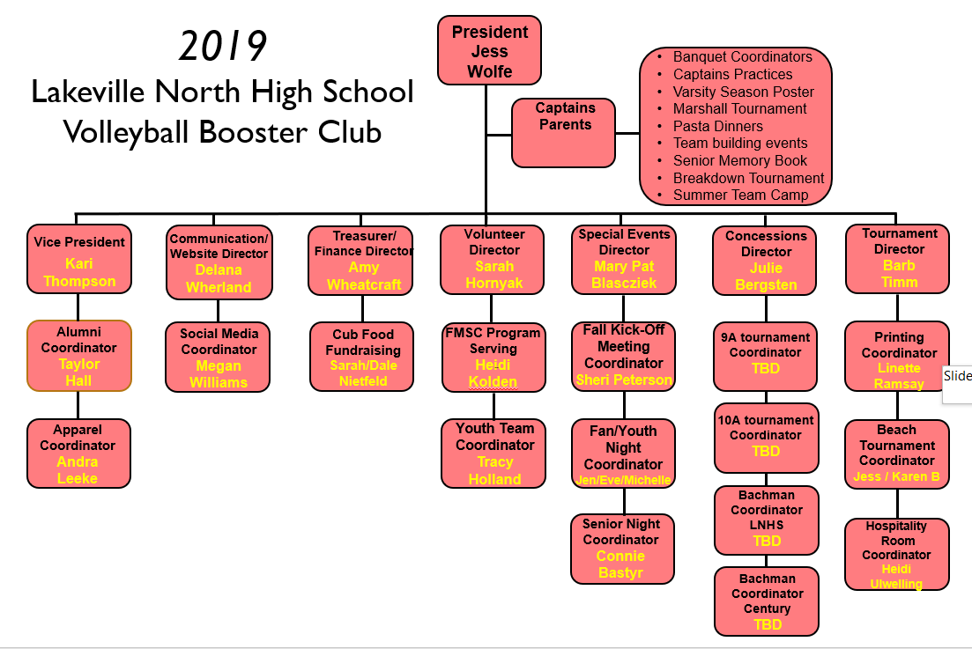
2019 ORGANIZATIONAL CHART

Slide 10
2018 EVENT COORDINATORS LNHSVBBC
Position | Volunteer
Social Media | Megan Williams
Apparel Coordinator: | Sarah Hornyak
FMSC Service Event: | Sarah Hornyak
Fall Kick-Off Meeting: | Connie Bastyr
Beach Tournament: | Jess Wolfe
Cub Food Fundraiser: | Sarah/Dale Nietfeld
Alumni Coordinator: | Taylor Hall
Printing Coordinator | Barb Timm
Position | Volunteer
Fan/Youth Night: | Mary Pat B / Kari T
Hospitality Room: | Julie B / Amy M
Senior Night: | Connie Bastyr
9A Directors: | Heidi/Megan
10A Directors: | Heidi/Jackie
Bachman-LNHS: | Heidi/Brett/Lisa
Bachman-Century: | Heidi/David
Youth Team Coordinator | Jami Juhnke

Slide 11
2019 EVENT COORDINATOR OPPORTUNITIES LNHSVBBC
Position | Volunteer
Social Media | Megan Williams
Apparel Coordinator: | Andra Leeke
FMSC Service Event: | Heidi Kolden
Fall Kick-Off Meeting:
Beach Tournament: | Jess Wolfe
Alumni Coordinator: | Taylor Hall
Fan/Youth Night:
Hospitality Room: | Heidi Ulwelling
Youth Team Coordinator:
Cub Food Fundraiser: | Dale/Sara Nietfeld
Senior Night Coordinator: | Connie Bastyr
Printing Coordinator:

Slide 12
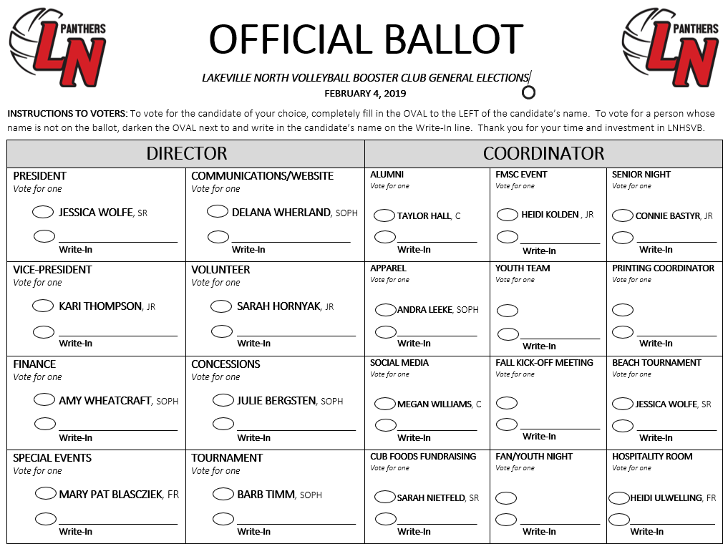

Slide 13
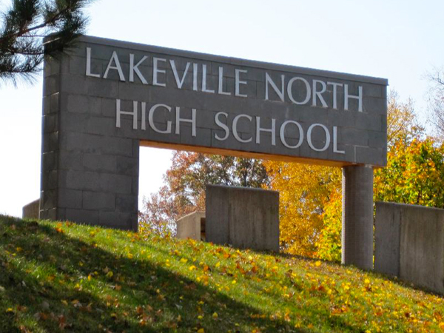
2019 BOOSTER MEETINGS When and Where
Monday, 2/4/19 from 6:30-8:00pm in Room 306
Monday, 3/4/19 from 6:30-8:00pm in Room 121
Monday, 4/8/19 from 6:30-8:00pm in Room 209A
Monday, 5/6/19 from 6:30-8:00pm in Room 121
Monday, 6/3/19 from 6:30-8:00pm in Room 121
Monday, 7/8/19 from 6:30-8:00pm in Room 121

Slide 14

LOOKING AHEAD LNHSVB

Slide 15

2019 OBJECTIVES
Organize and Simplify
Efficiency (booster-run events)
Transparency in Roles and Responsibilities (transitions)
Fundraising Reset
Fundraising
Strengthen our strengths
Examine how we do what we do and improve
Not adding but maximizing
Connection
Current: Sports Festival, in-house program, fall/winter programs, youth night, home match youth teams
‘Meet the Panthers’ Night early in 2019 season
Spring one-day school demonstration
In-Season Leadership
Varsity Captain weekly development and pre-season retreat activity
Sub-Varsity Leadership development continued growth. Organization and clarity
Examination of Growth

Slide 16

2019 KEY OFFSEASON EVENTS LNHSVB
Monday 2/4/19
Monday 3/4/19
Monday 4/8/19
Monday 5/6/19
Monday 6/3/19
Monday 7/8/19
3pm-4:15pm
Room 248
(unless otherwise announced)

Slide 17

OFFSEASON EVENTS (cont’d)
Saturday, 2/16/19
and
Sunday, 2/17/19
Hosted at:
Lakeville North High School
*Concessions
*Gate
*Site Management
VOLUNTEERS NEEDED!

Slide 18


OFFSEASON EVENTS (cont’d)
Saturday, 4/13/19
Hosted at: Lakeville North High School
*Concessions
VOLUNTEERS NEEDED!

Slide 19


2019 KEY SUMMER EVENTS LNHSVB
Begins June 10, 2019
Mon, Wed, Fri mornings
7:30am-9:00am
Hosted at: Lakeville North High School
No commitment week
6/30/19 – 7/7/19

Slide 20

SUMMER EVENTS (cont’d)
Sunday
July 14th, 2019
Hosted at:
Antlers Park, Lakeville
*Tournament Fees
*Raffle
*Bags Tournament
ALL HANDS ON DECK:
VOLUNTEERS NEEDED!

Slide 21


SUMMER EVENTS (cont’d)
Panther Youth Camp
Monday, 7/15/19 –
Thursday, 7/18
Grades K-8
Hosted at: Lakeville North High School
Panther Youth Camp
Monday, 7/22/19 –
Thursday, 725/19
Grades 9-12
Hosted at: Lakeville North High School
PARENT ATHLETE COACH (PAC) MEETING
Tuesday, July 23, 2019
5:30pm Auditorium

Slide 22


SUMMER EVENTS (cont’d)
Team Camp
Saturday, 7/27/19 –
Sunday, 7/28/19
Hosted at: Concordia University, St Paul
More info:
President Jessica Wolfe
CAPTAINS PRACTICE
Monday, 8/5/19 –
Thursday, 8/9/19
2019 LNHSVB Tryouts
Monday, August 12, 2019

Slide 23
THANK YOU for your attendance and commitment to the 2019 LNHS volleyball season

