Slide 1
Wisconsin High School Track & Field Coaches Annual Meetings
Lance Brauman
PURE Athletics
Adidas

Slide 2
100m Deep Dive

Slide 3
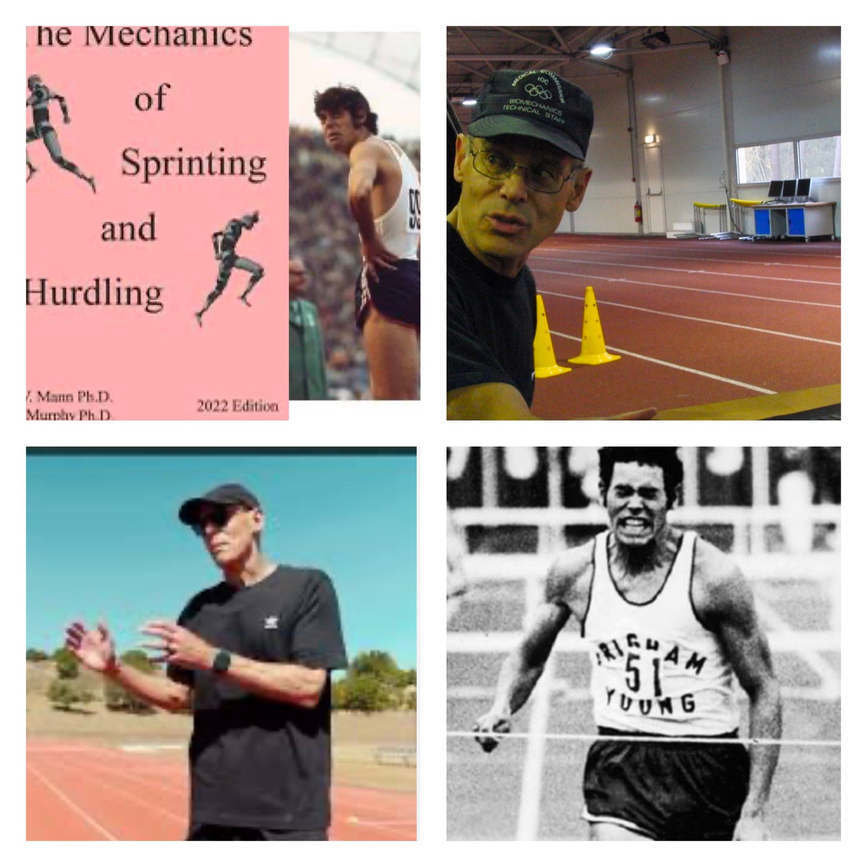
Dr Ralph Mann

Slide 4
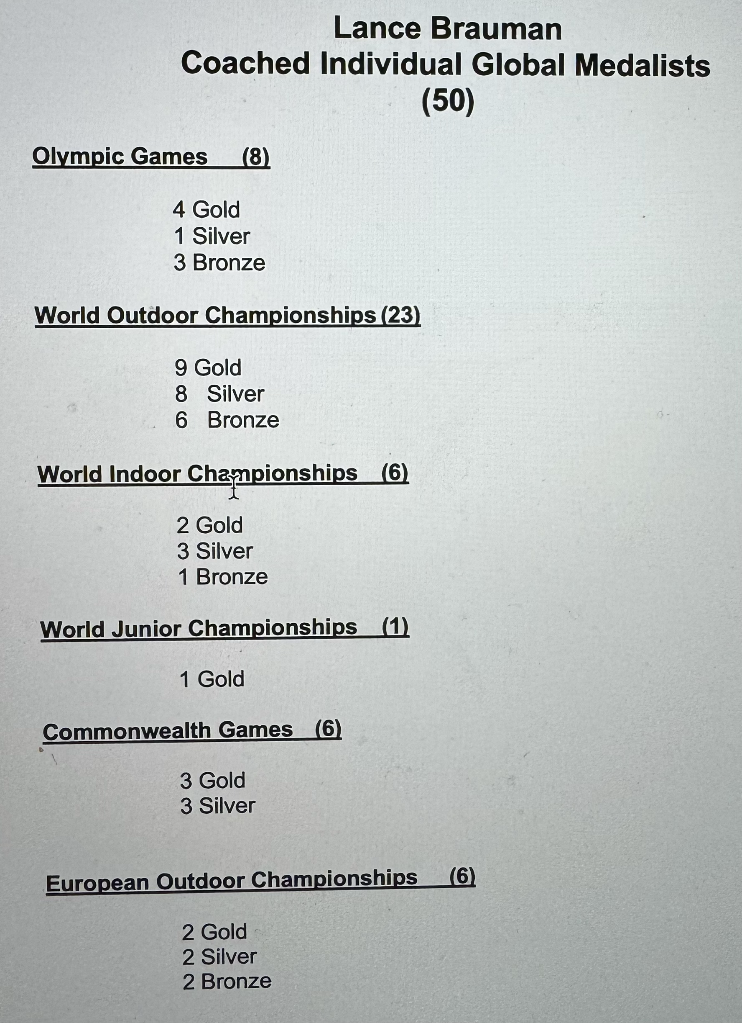

Slide 5
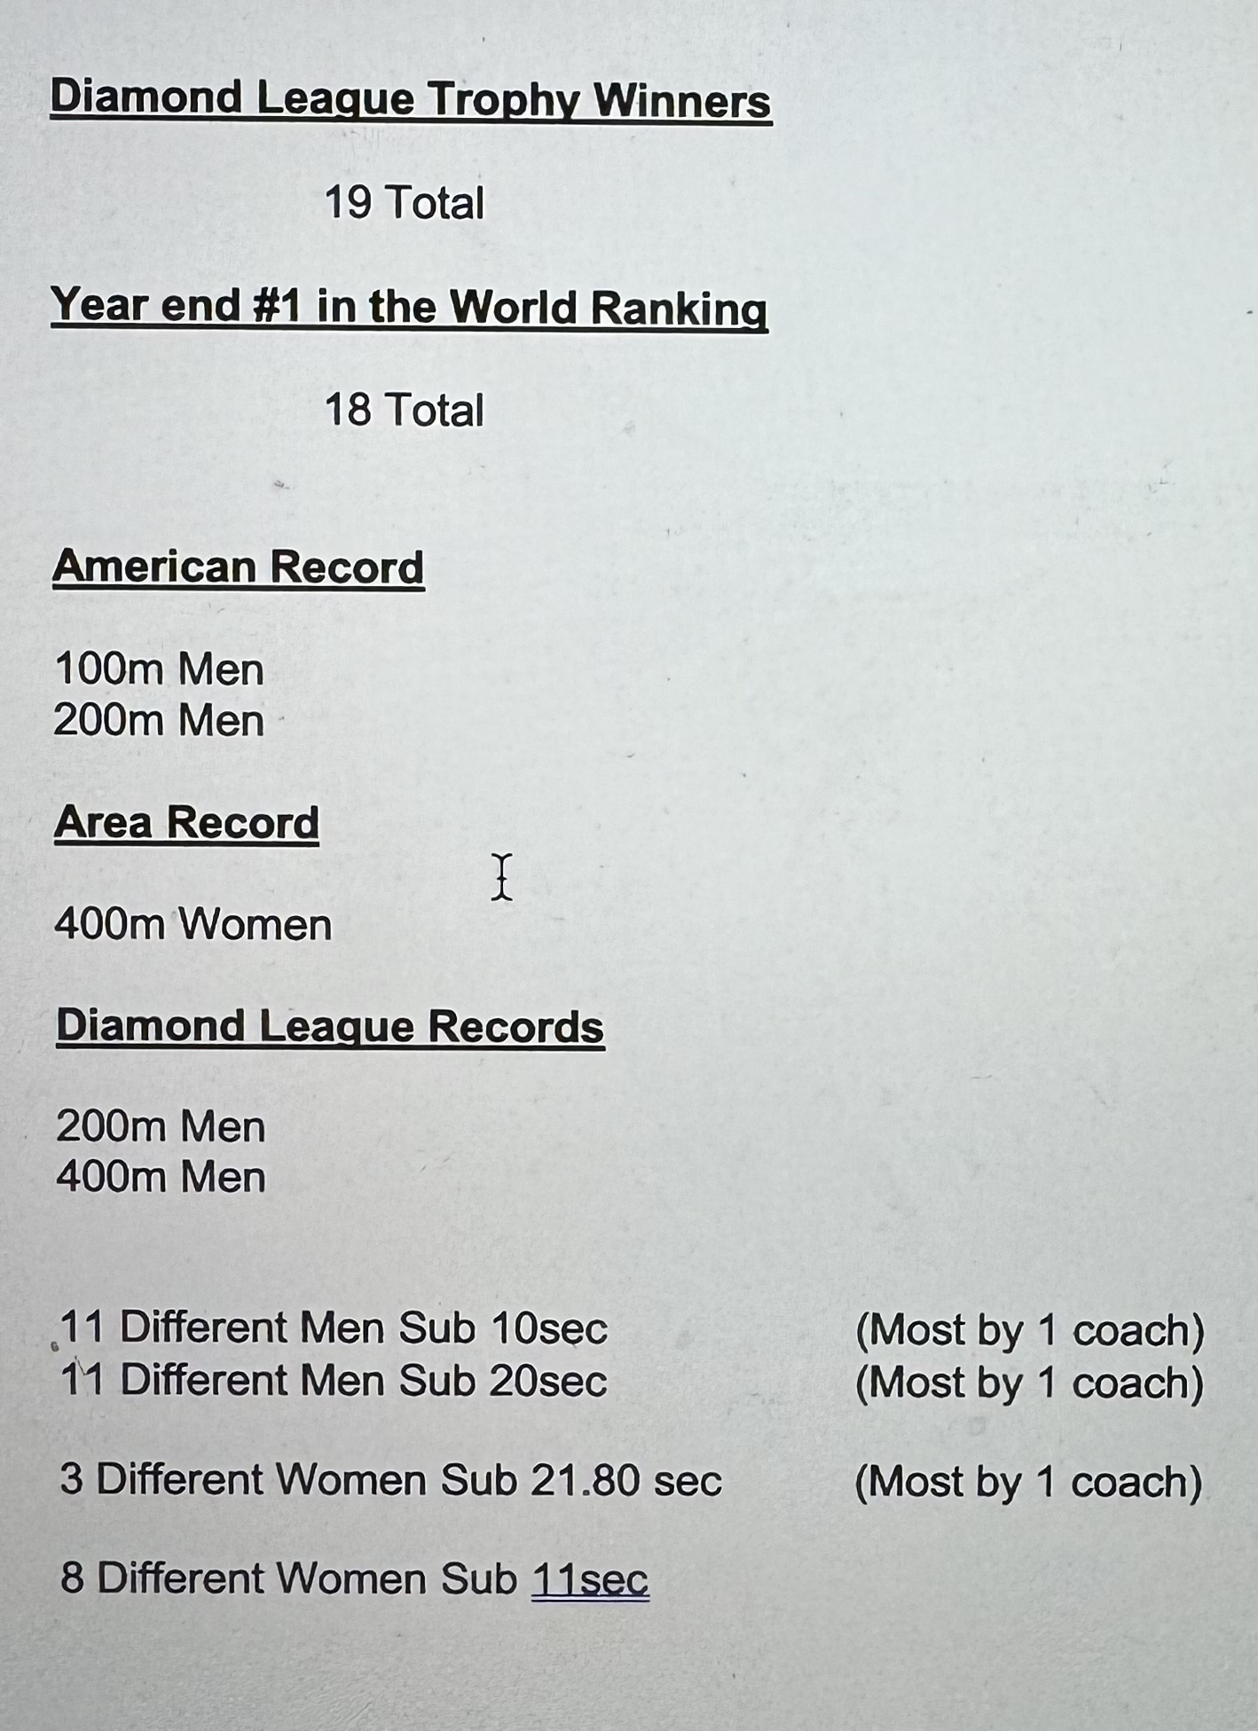

Slide 6
Men’s 100m
Sub 10.03 or Better Sub 10.00 or Better 9.90 or Better
Alonso Edward (10.01) Marvin Bracy (9.93) Nickel Ashmeade (9.90)
Gerald Phiri (10.03) Trell Kimmons (9.95) Keston Bledmon (9.86)
Aaron Armstrong (10.03) Wallace Spearmon (9.96)
Bernard Williams (10.03) Travis Padgett (9.99)
J-Mee Samuels (10.03) Jacques Harvey (9.92)
Josephus Lyles (10.01) Kendal Williams (9.93)
9.80 or Better 9.70 or Better
Noah Lyles (9.79) Tyson Gay (9.69) #2
Steve Mullings (9.80)
Men’s 200m
20.00 or Better 19.85 or Better 19.70 or Better
Curtis Mitchell (19.97) Alonso Edward (19.83) Wallace Spearmon (19.65)#9
Steve Mullings (19.98) Nickel Ashmeade (19.85)
Aaron Armstrong (19.98) Jereem Richards (19.80
Kyle Greaux (19.97)
19.60 or Better 19.50 or Better
Tyson Gay (19.58) #7 Noah Lyles (19.31) #3
Men’s 400m
45.00 or Better 44.55 or Better 44.01 or Better
Tyson Gay (44.89) Derrick Brew (44.53) Machel Cedenio (44.01)
Terry Gatson (44.93) Tony McQuay (44.24) Jereem Richards (43.78) M. Hudson-Smith (44.68)

Slide 7
Women’s 100m
11.00 or Better 10.90 or Better 10.80 or Better
Debbie Ferguson (10.97) Kelly Ann Baptiste (10.84) Tori Bowie (10.78)
Samantha Henry (11.00) Veronica Campbell-Brown (10.85)
Shaunae Miller Uibo (10.98) Shalonda Solomon (10.90)
Gina Luckenkemper (10.93)
Women’s 200m
22.34 or Better 22.20 or Better 21.80 or Better
    Debbie Ferguson (22.22) Shalonda Solomon (22.15) Shaunae Miller-Uibo(21.74)
    Kelly Ann Baptiste (22.32) Veronica Campbell (21.74) Shakima Wimbley (22.34) Tori Bowie (21.77)
    Tiffany Townsend(22.26
Women’s 400m
50.80 or Better 49.55 Or Better
Chrisann Gordon (50.66) Shakima Wimbley (49.52)
Jessica Beard (50.69)
Natasha Hastings (50.80)
Lynna Irby (50.12)
48.50 or Better
Shaunae Miller-Uibo (48.36) #5 Area Record

Slide 8
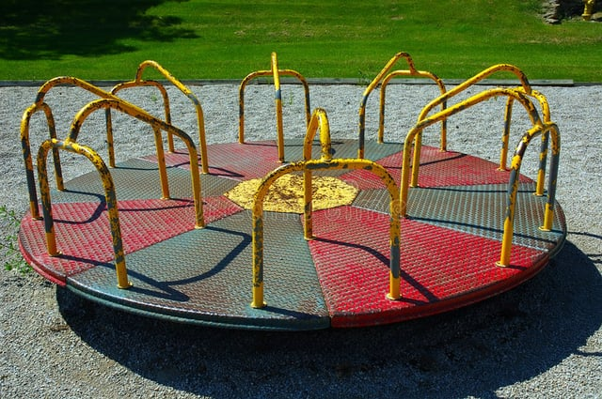

Slide 9
The 5 Phases of the 100m:
1. The Block Start. (0m-5m) Phase of highest increase of velocity.
2. The Drive Phase. (5m-25m) Emphasize the increase in (HV).
3. The Transition Phase. (25m-40m) Transition from (HF) to (VF)
4. The Maximum Velocity Phase. (40m-80m) Application of (Max VF)
5. The Maintenance Phase. (80m-100m) Rhythmic Continuation of (CNS) coordination. (Holding proper mechanics to lessen decrease of (HV).

Slide 10
Graph

Slide 11
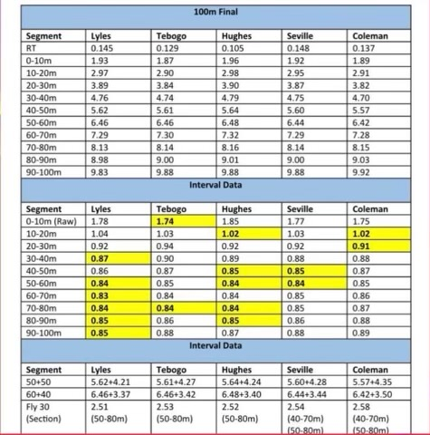

Slide 12
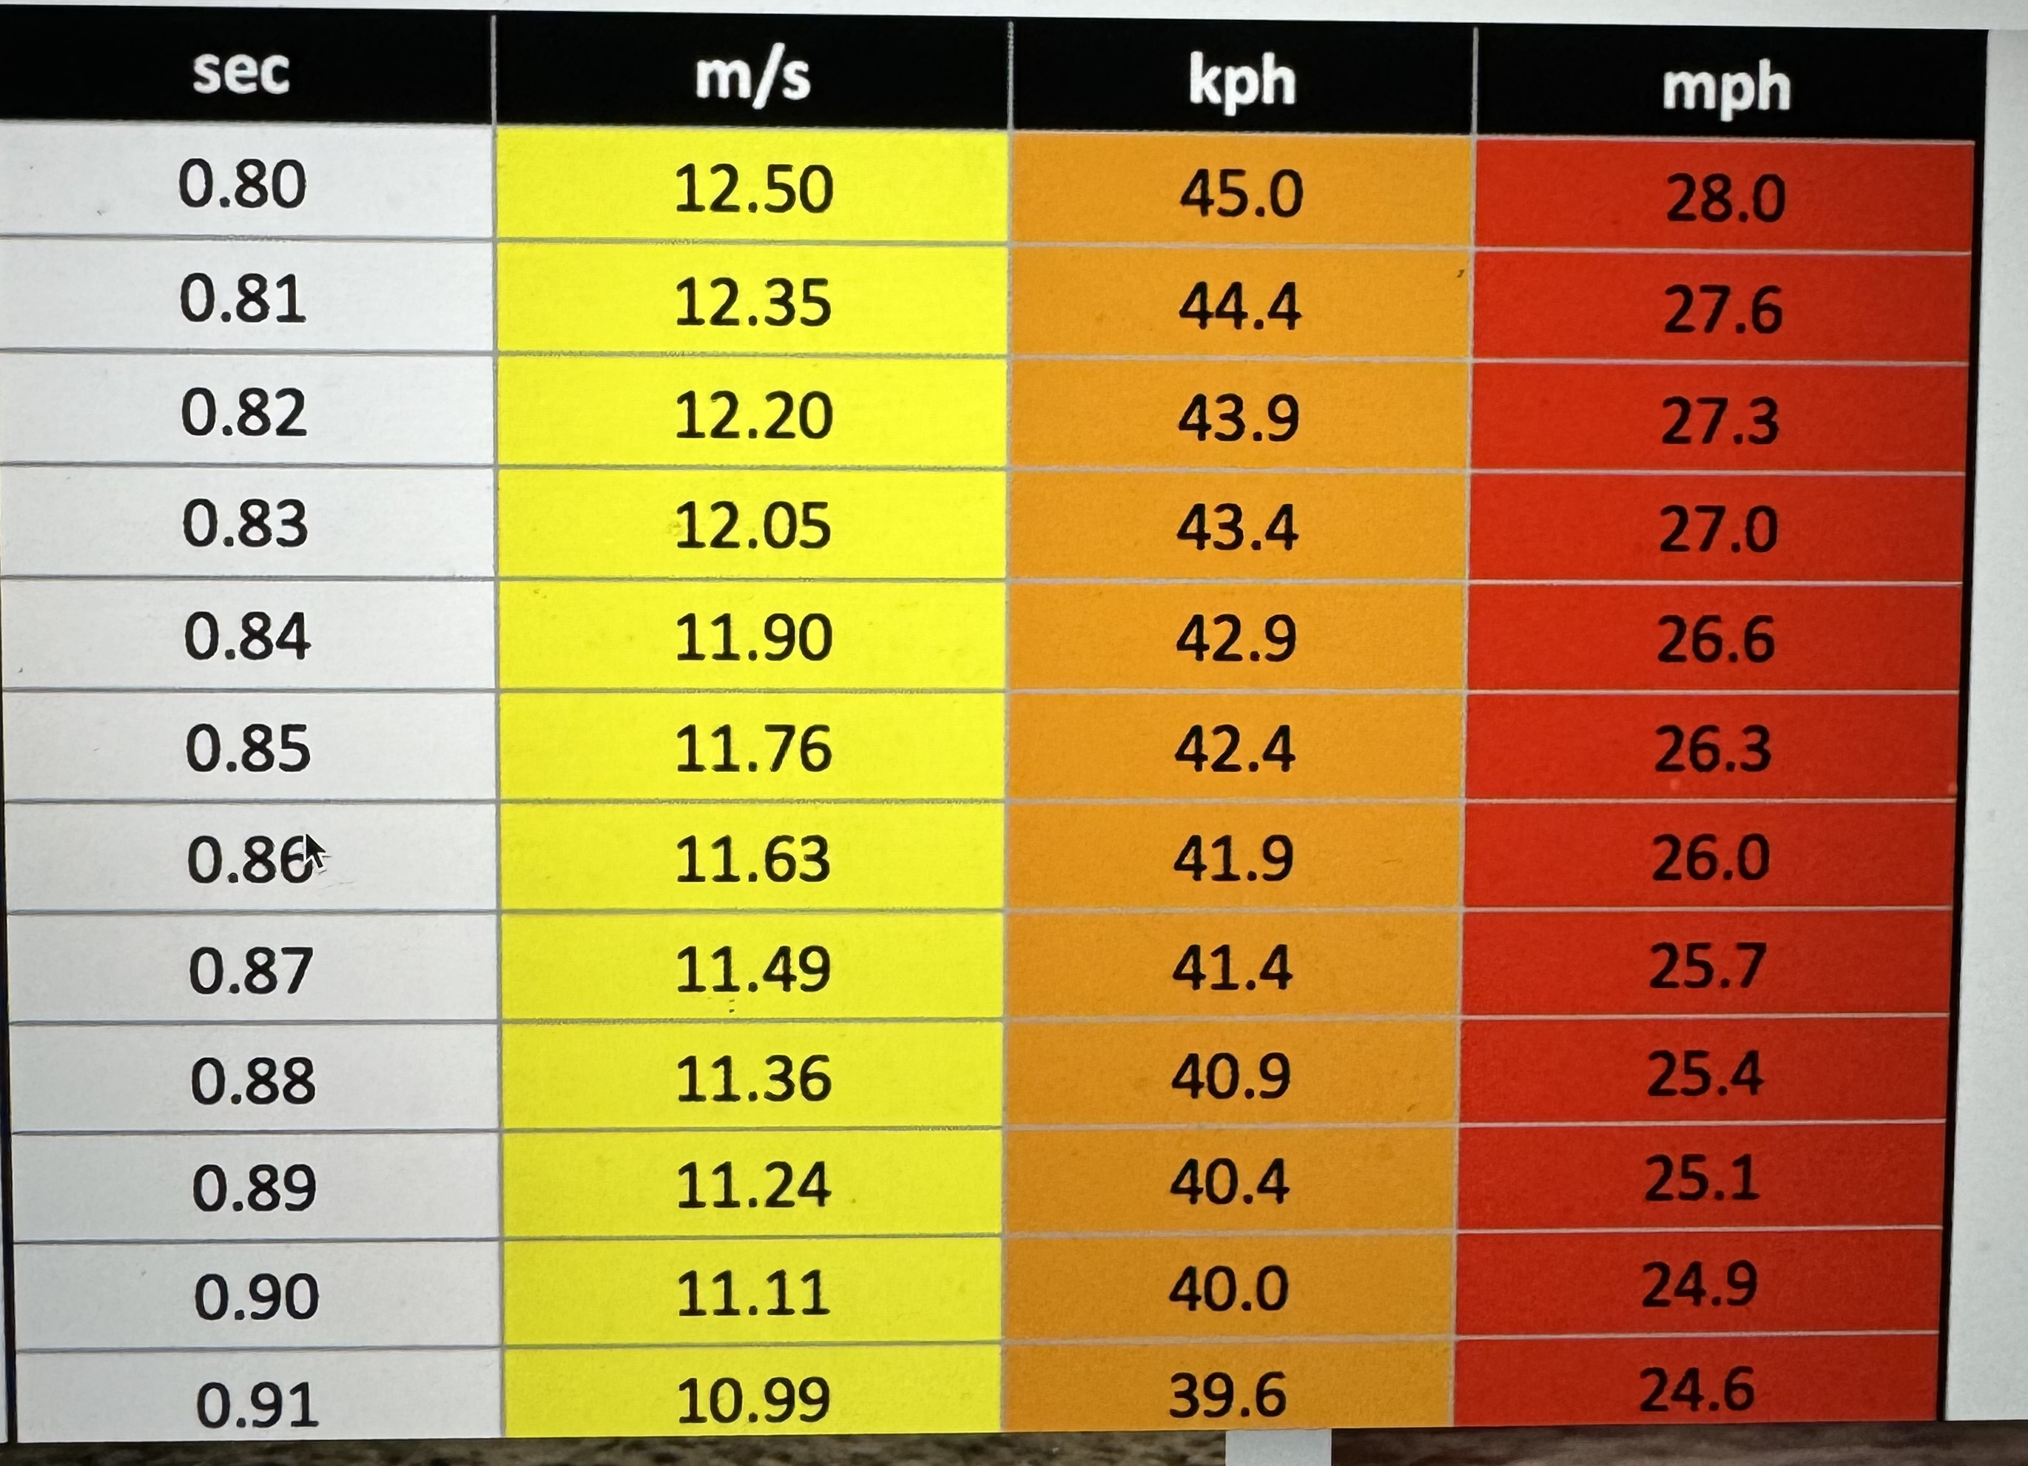

Slide 15
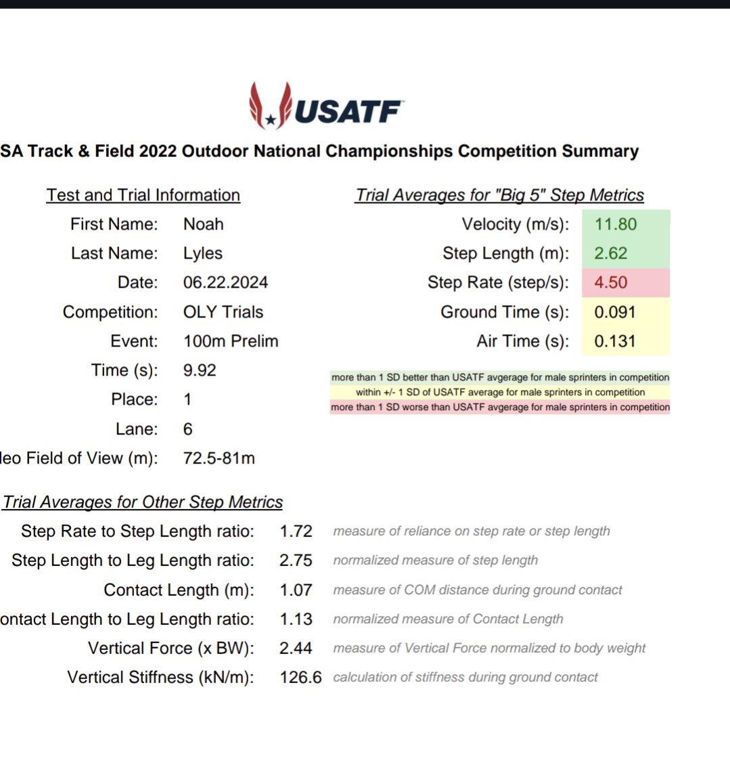

Slide 16
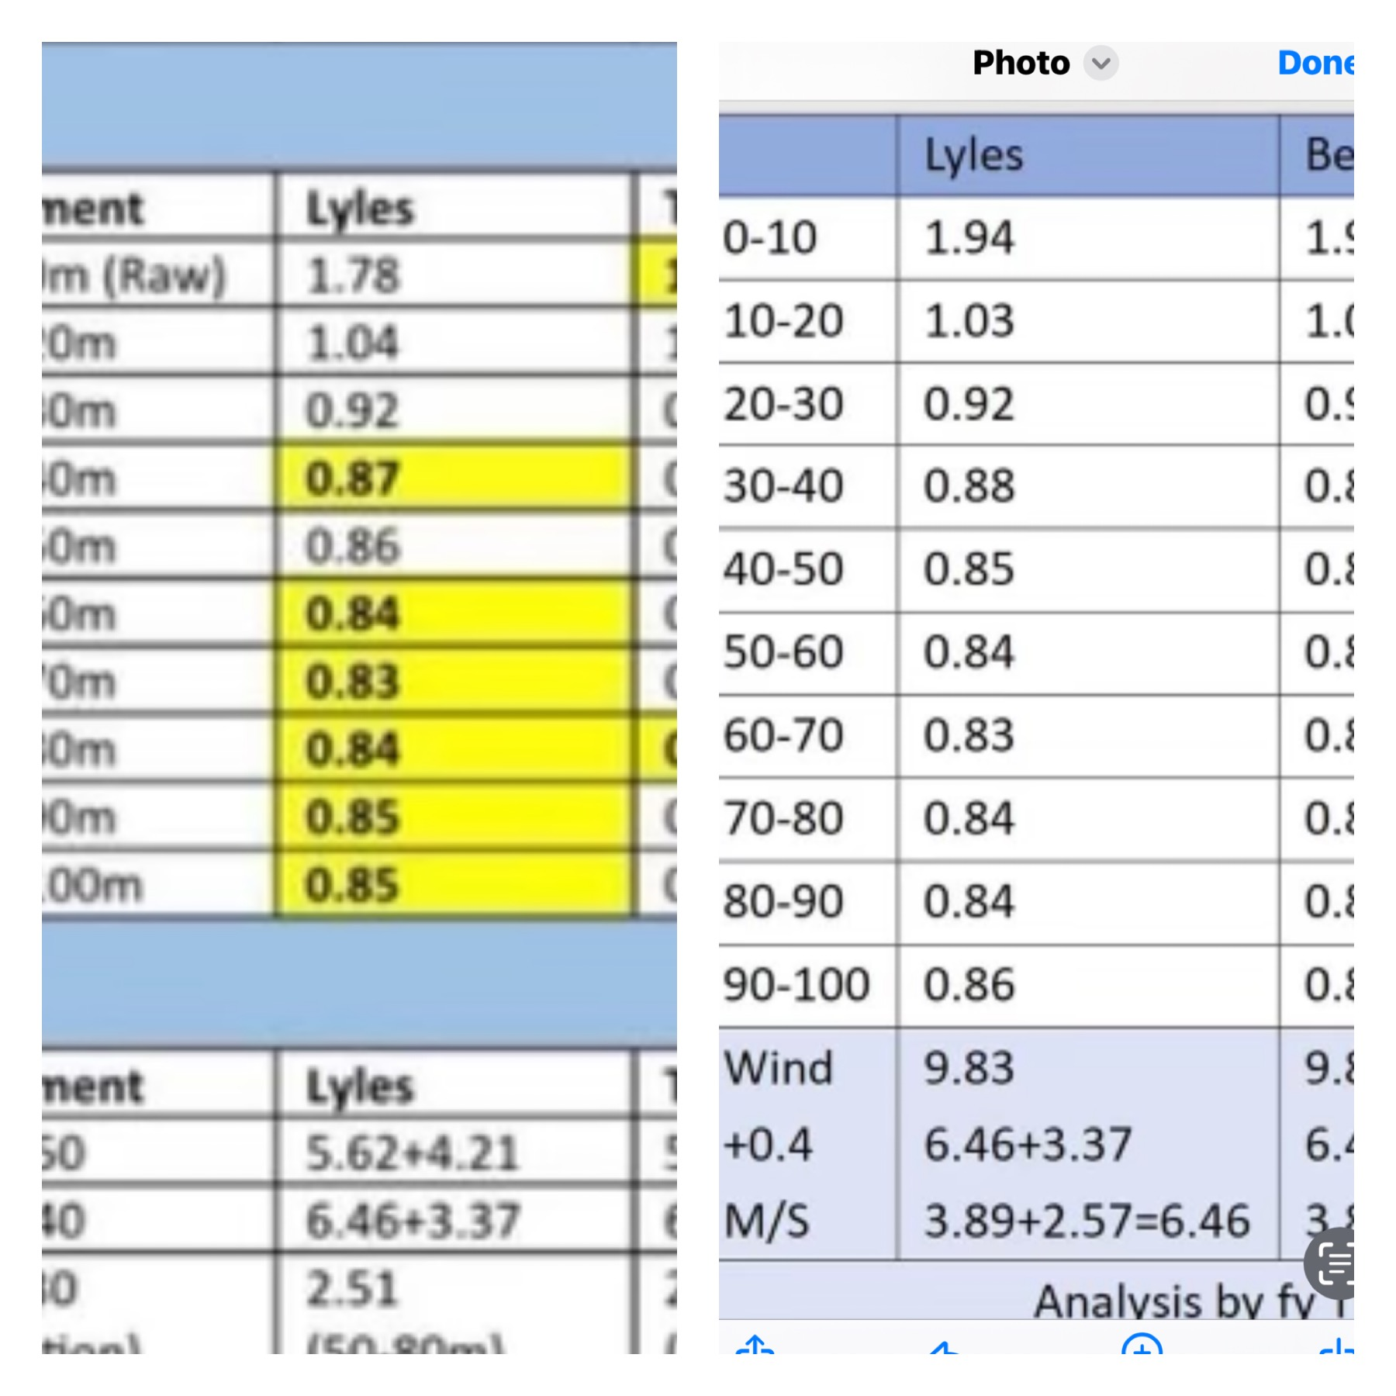

Slide 17
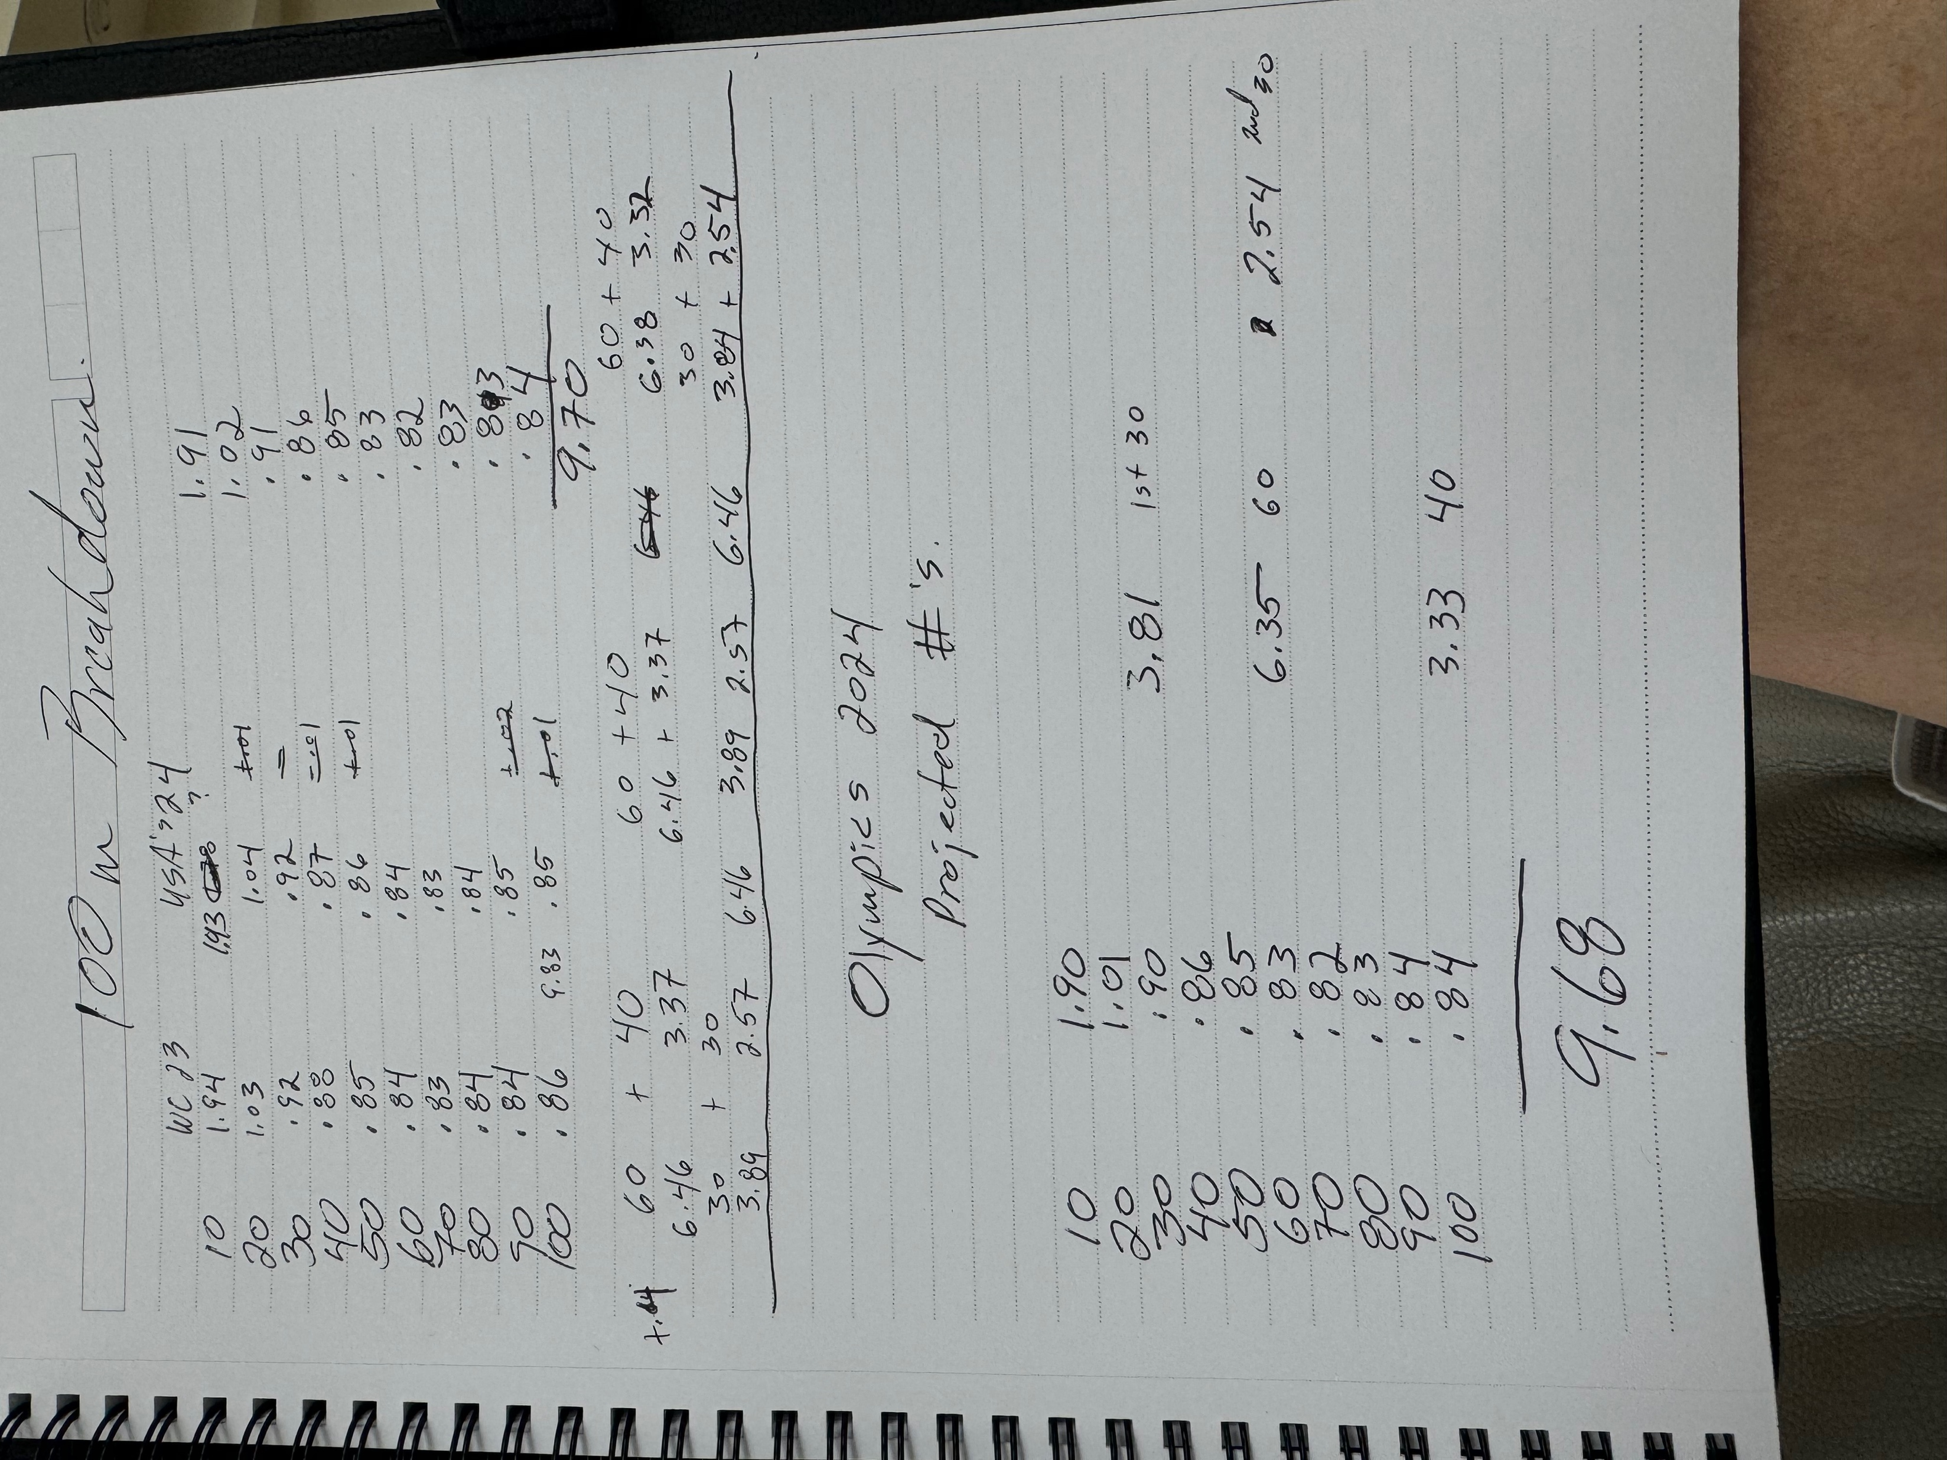
) )

Slide 18
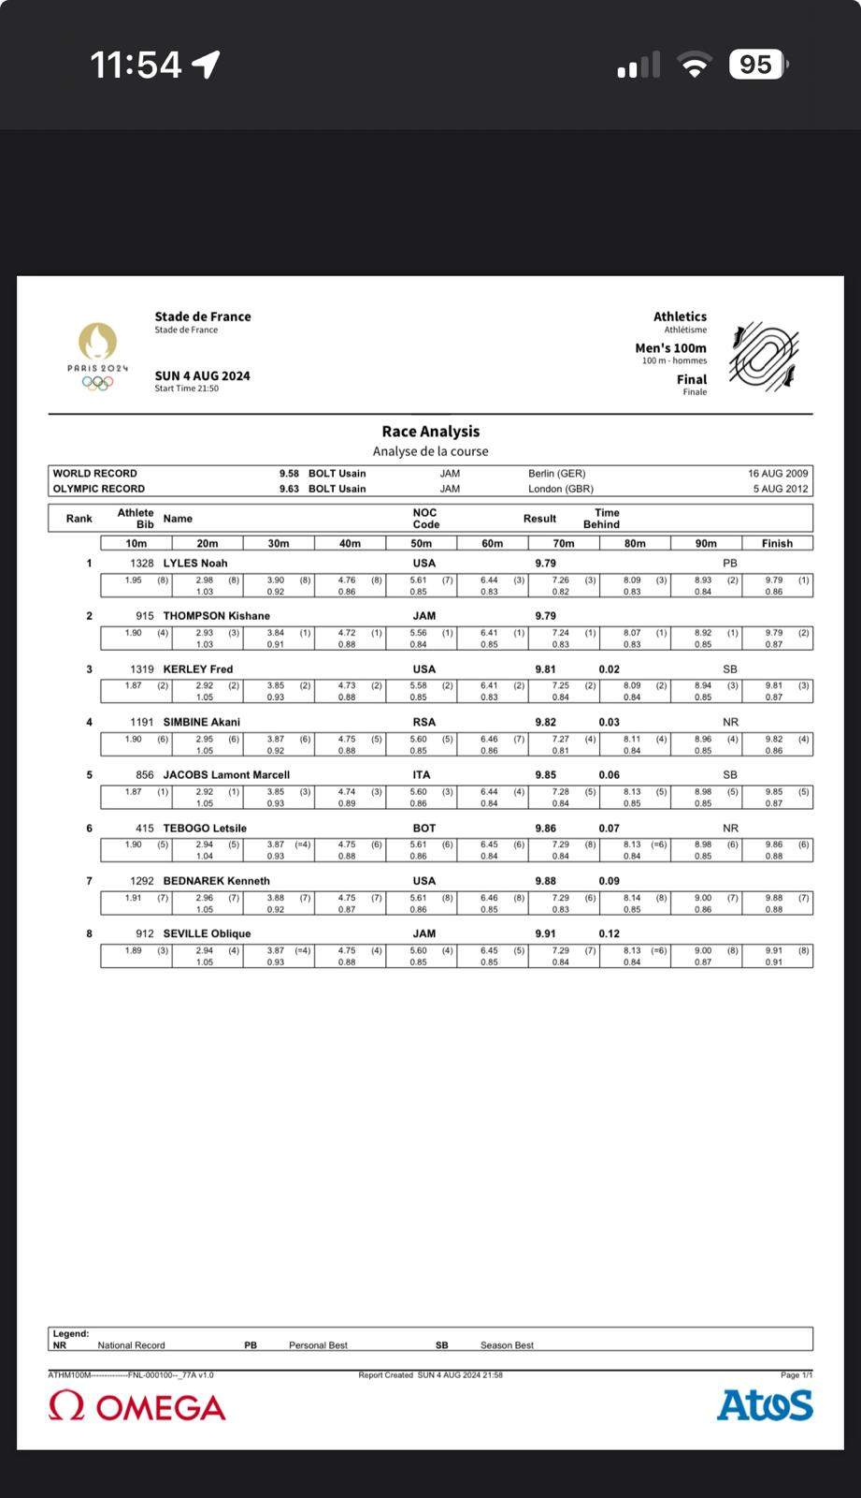

Slide 19
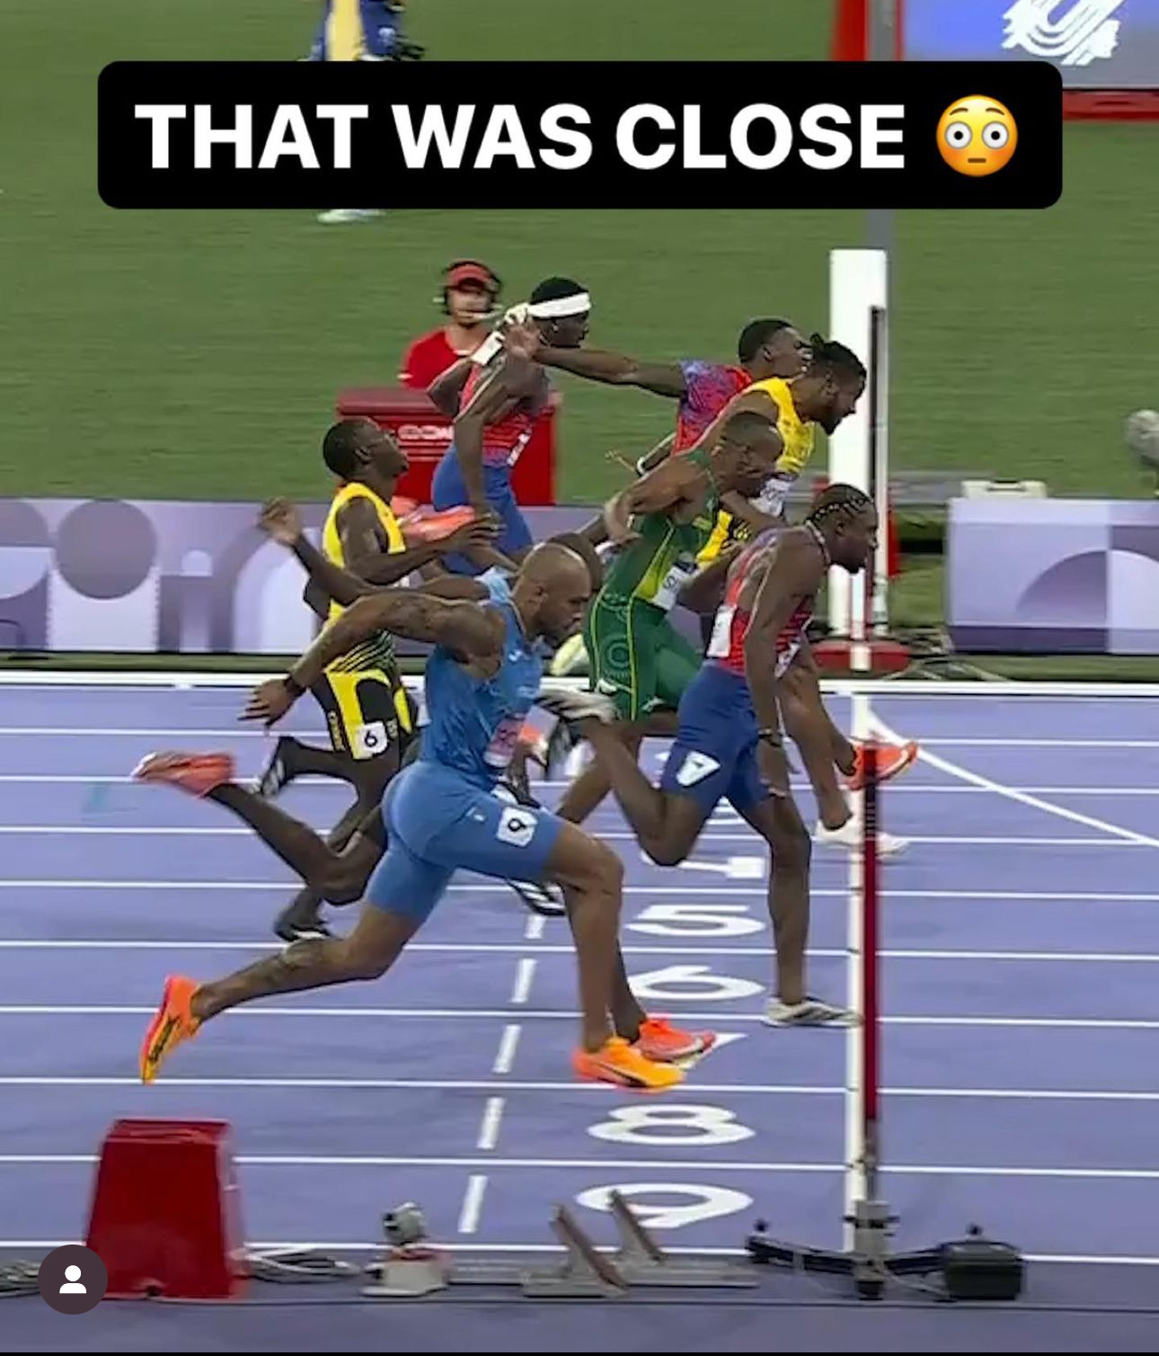

Slide 20
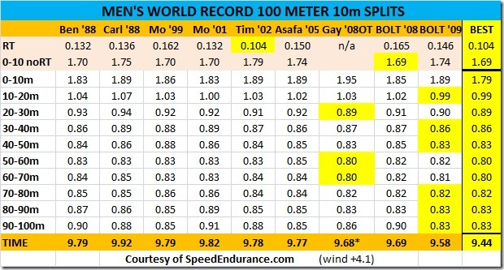

Slide 22
Thank You!

