Slide 1
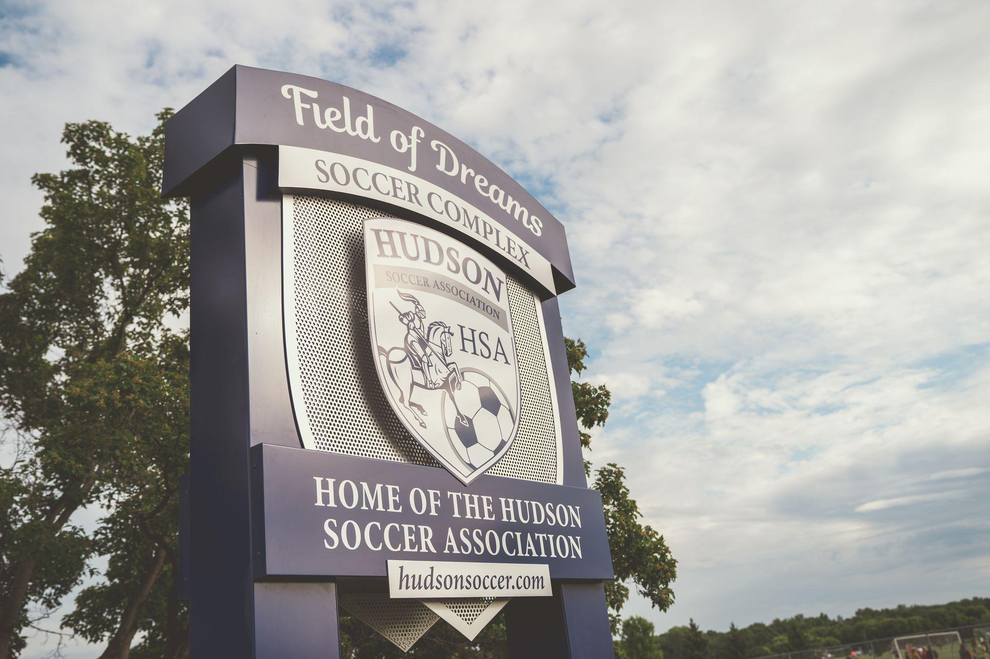
2022-2023
Annual Meeting
Monday Oct. 23rd

Slide 2


Agenda
Introductions - HSA Board & Staff
Financial Overview
2023 Home Tournament Review
Rec Program Review & Planning
WW Travel Program Review
2023 Highlights
2024 and Beyond Plans
Fundraising and Sponsorships
Re-Election of Board Positions
Questions & Discussion

Slide 3
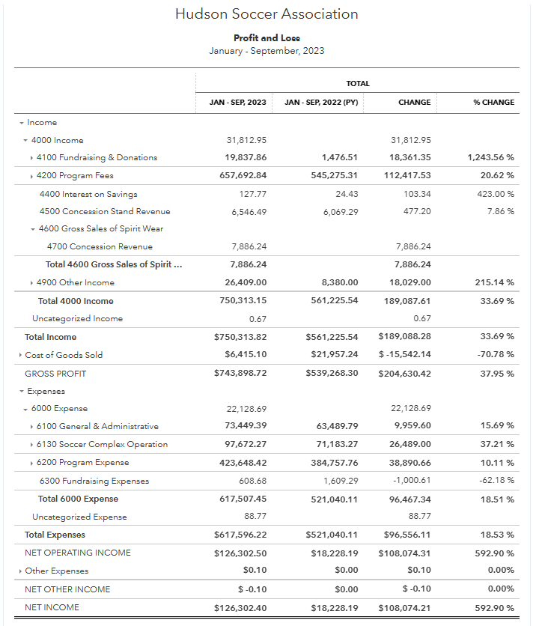
Financial Overview

Slide 4
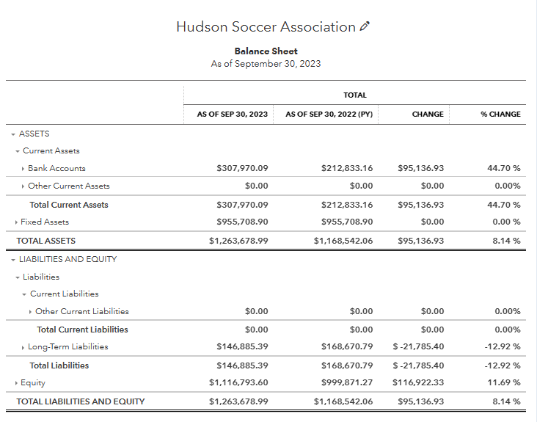
Financial Overview

Slide 5

Spring Tournament in Review
Increased Registration $50-$100
Tiered Pricing
Sunday Play Cancelled
Reduced Referee Costs
Reduced Apparel/Photo revenue
Rec Bracket Continued
Saturday Apparel sales topped 2022 total
Only 1 Complaint
No Referee Challenges
Participation (110 total teams)
Registration impacted by Late Spring
53 Girls (7 brackets, 1 Gold Level)
57 Boys/Coed (7 brackets, no Gold Level)

Slide 6

Fall Tournament in Review
Cancelled due to registration
Replaced with Rec Jamboree Friendlies
Challenges:
Limited Dates due to short fall season
Compete with Final 4 and Coulee Cup
Dual Location was a hindrance

Slide 7
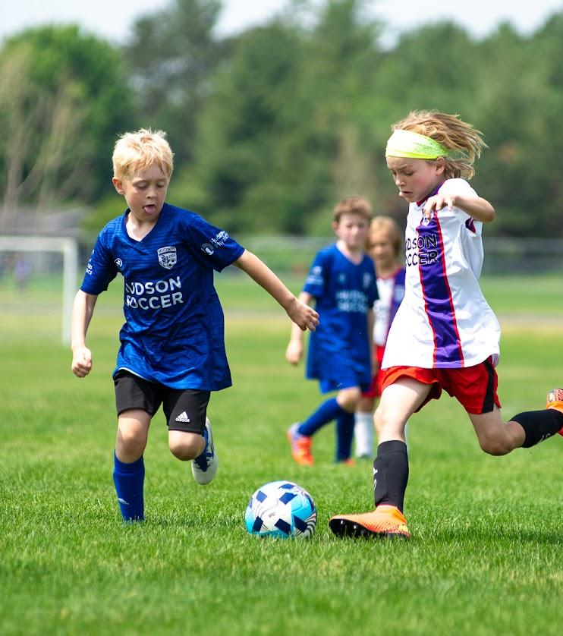
Youth Rec Program Overview
2023 Spring Rec
747 players registered
+43 over 704 Spring 2022 (+6%)
77 U4 (+14)
Lost Coaching Coordinator Week 1
Travel transition program
2014 U8 Players
HSA Coaches, extra weekday practice
Excellent retention to travel teams
Continued paid HSA Youth coaches for U4 - U8 teams

Slide 8
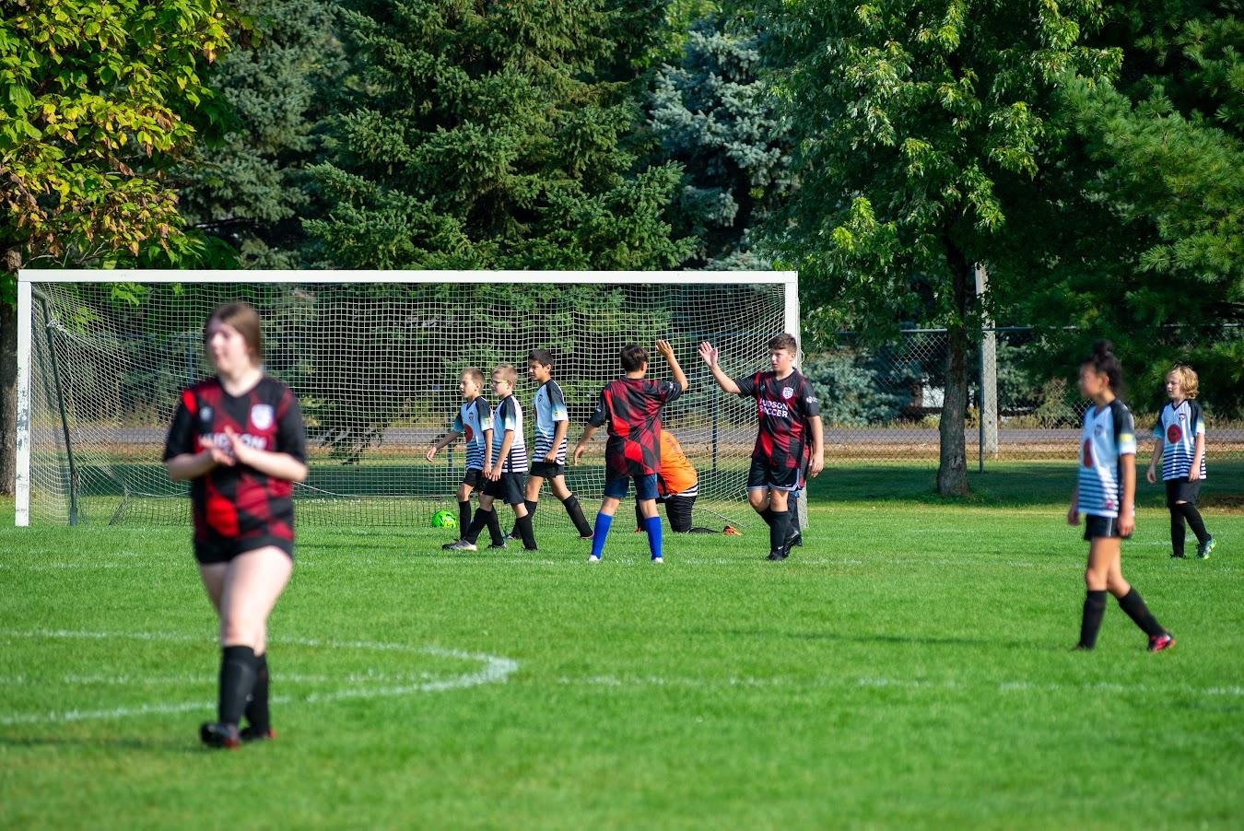
Youth Rec Program Overview
2023 Summer Rec
New Program for 2023
102 players registered
$55 per player
3 days a week:
Tues - U9/U10
Thurs - U11/I12
Sat - U13+
Used inventory of old design uniforms
Excellent parent coaches

Slide 9
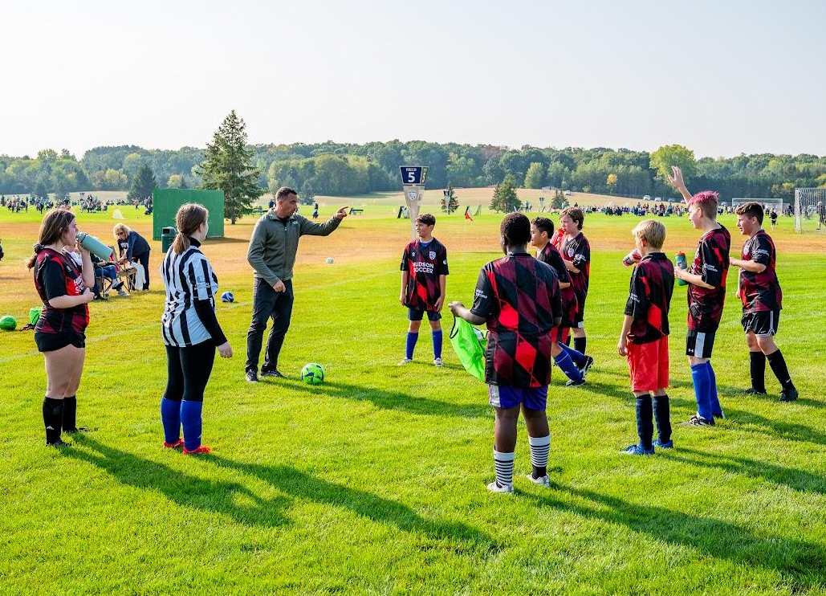
Youth Rec Program Overview
2023 Fall Rec
~600 players registered
+4% over Fall 2022
28 U4 Rec Players +1 over 2022
36 U13+ Rec Players -1 under 2022
Heather hired as Rec Coaching Coordinator
Paid Youth coaches for U4-U8
Visiting teams from other programs
Kick or Treat Rec Jamboree replaced Fall Tournament
20 visiting Rec teams U10 - U16
WW Travel teams filled brackets
Excellent Kick and Treat activities
Lessons learned

Slide 10
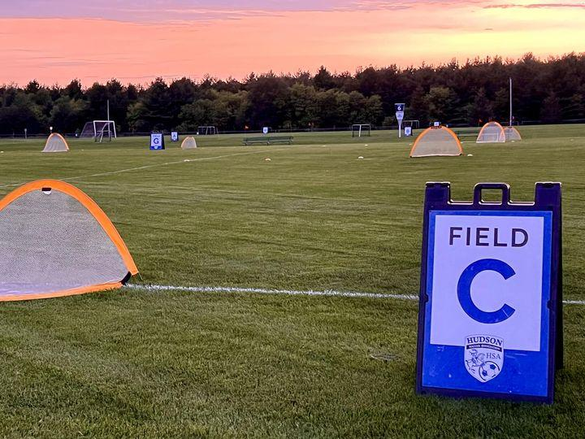
Adult Co-Ed Rec Program
Maintained 10 Adult co-ed teams in Spring and Fall (9 week sessions)
Returned to using Referees
Part time registration option
Emphasis on improving team behaviour to refs and each other
Budget to raise $10,000 for HSA operations after costs (apparel and Referees)

Slide 11
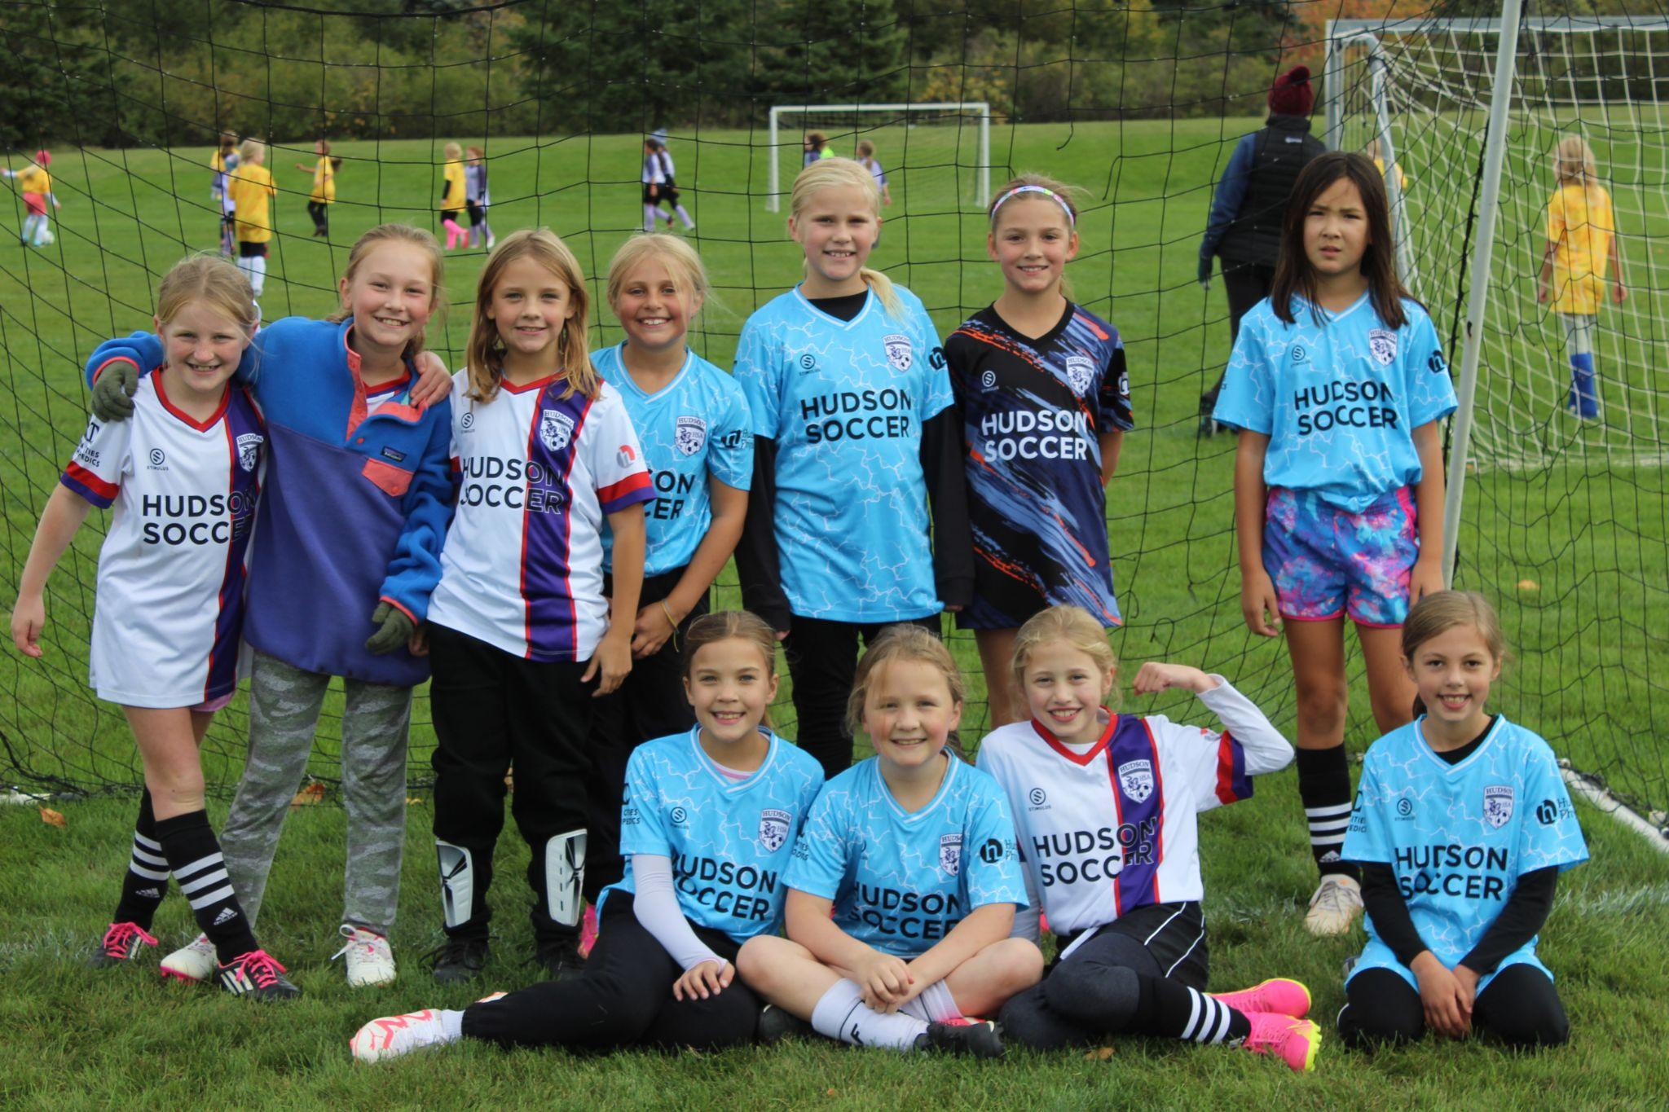
2023 Rec Program Achievements
2023 Enrollment Goals:
Spring - 2023 vs 2022 + ~7% ✔
Fall - 2023 vs 2022 + ~5% X
2023 Program Goals:
Appoint new Assistant Rec Director ✔
New shirt designs for 2023 ✔
Continue Travel Transition Program ✔
Formalize 2023 Summer Rec program ✔
Expand 2022 - 23 Winter Rec program to other age groups X
Budget to generate $100K Revenue ✔
Increase promotional activities to drive higher numbers ✔

Slide 12
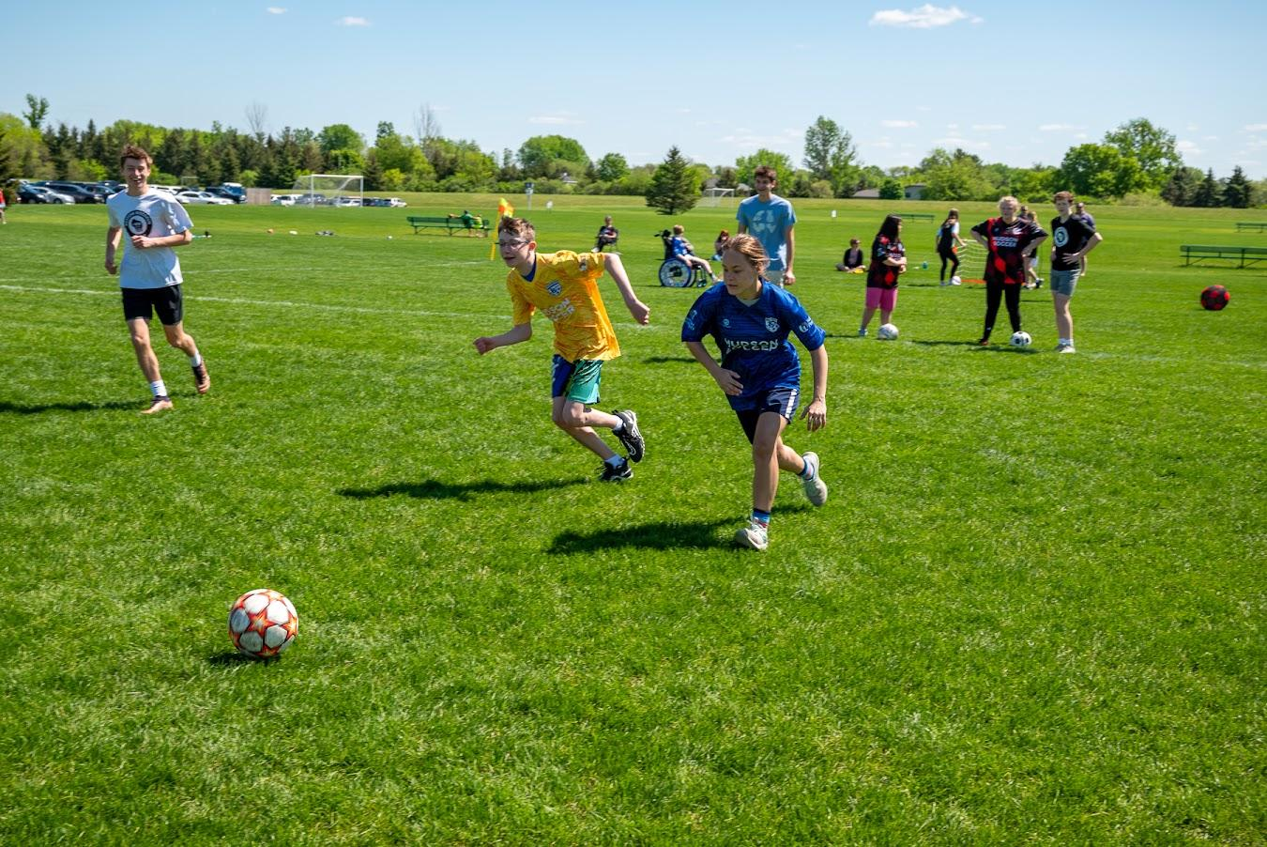
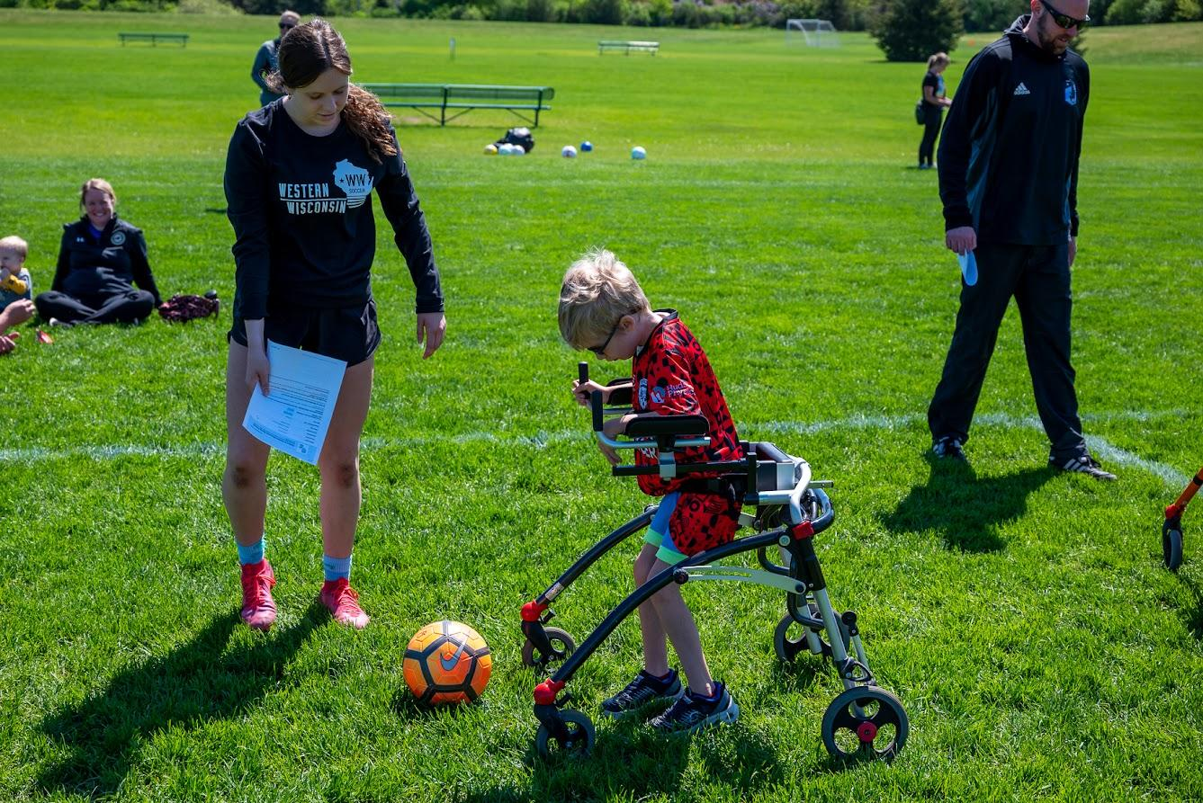
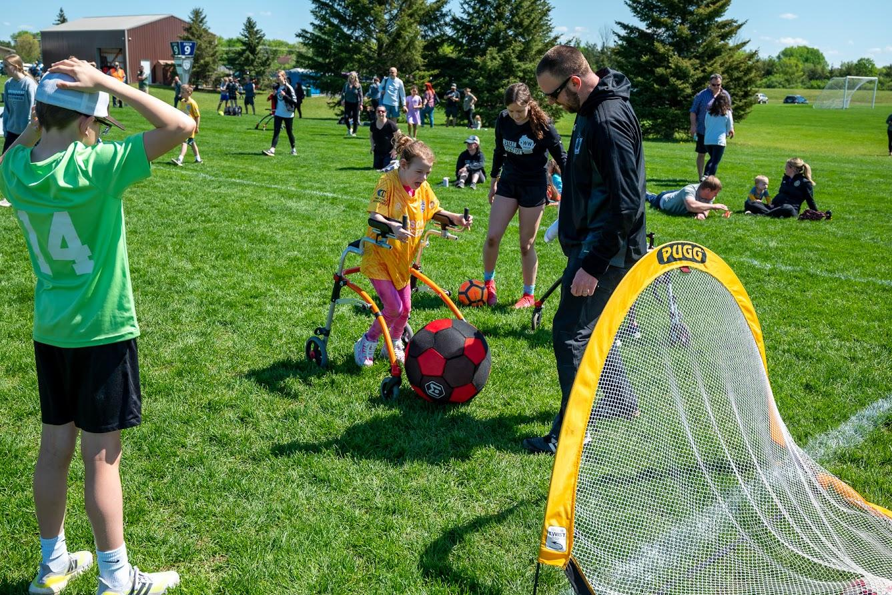
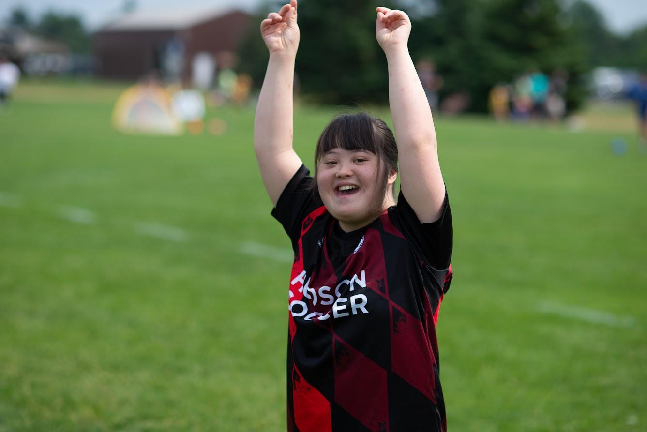
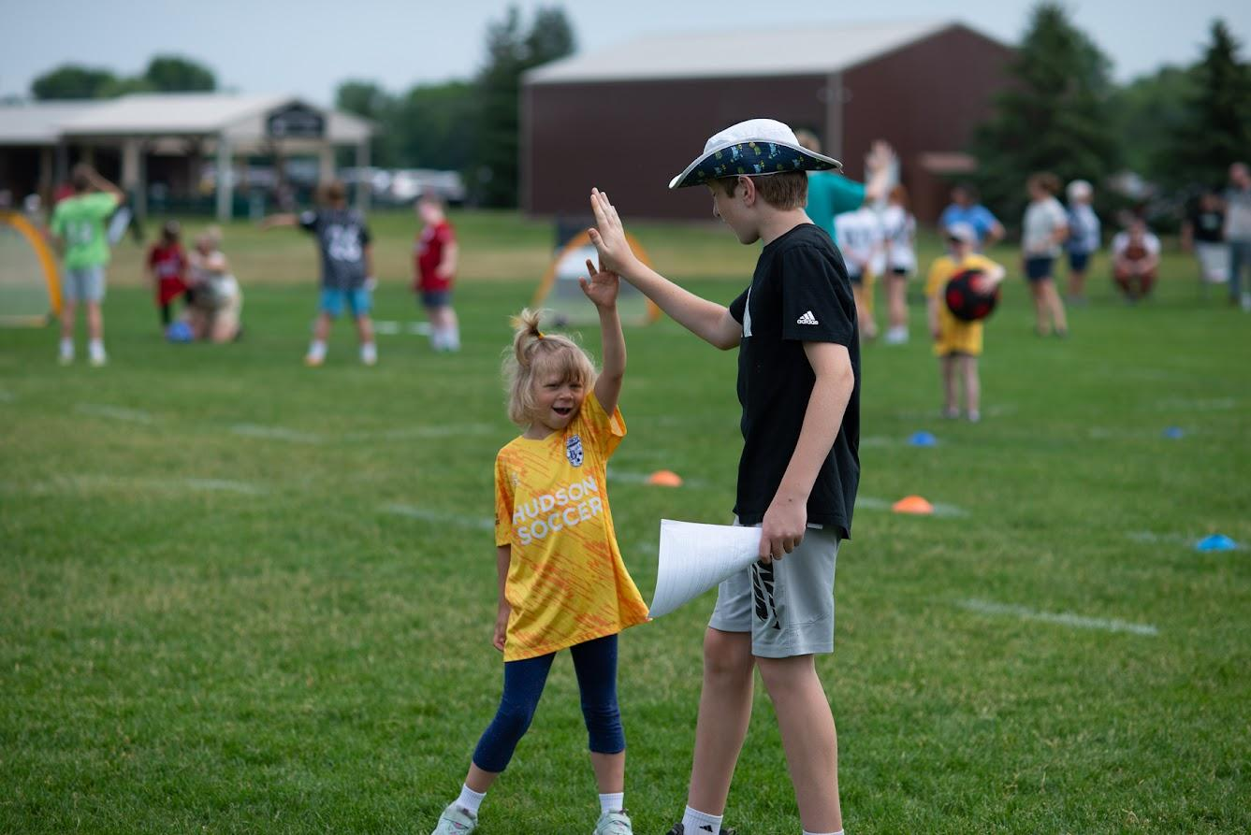
2023 Adaptive Rec
2023 Adaptive Rec: A new soccer program for different abilities
Program in line with adaptive hockey, T ball etc
Adapt soccer experience for all abilities
Spring - Three Saturday mornings during Rec
Fall - Tuesday evenings
Purchased adaptive equipment
Fabulous support from player coaches, parents, teachers
Grant support generated to make program cost neutral

Slide 13
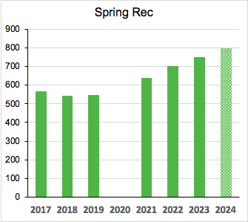
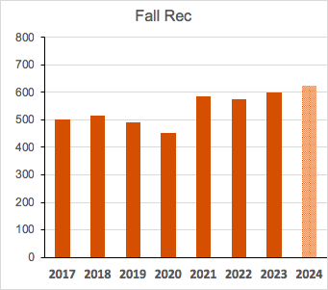
2024 Rec Program Goals
2024 Enrollment Goals:
Spring 2024 800 players (+7%)
Summer 2024 110 players (+10%)
Fall 2024 630 players (+5%)
2024 Program Goals:
Enhance Rec coaching
Expand Summer 2024 program
Continue Travel Transition Program
Increase U4 enrollment for Fall 2024
Expand U13+ opportunities
Increase opportunities to play other Rec programs
Build new competitive Rec Program for older teams
Rec Jamboree for Fall 2024??

Slide 14
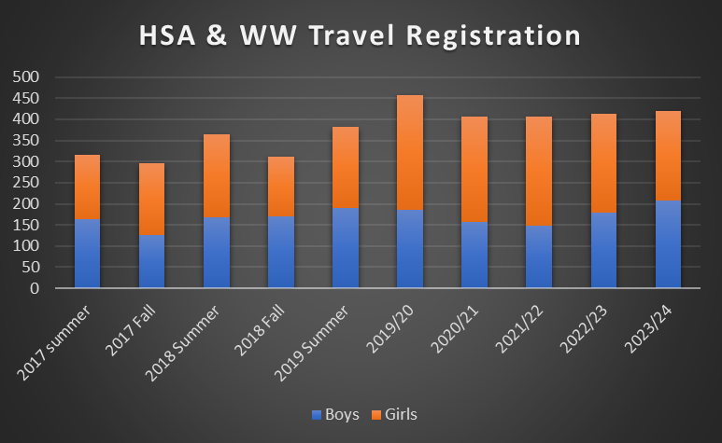
Travel Program - By the Numbers
Tryouts and Team Selection July 2023
425 Players registered for WW Soccer
+10 from 2022, steady 3-5% growth
213 Girls & 212 Boys
29 teams
14 Girls Teams
15 Boys Team (+2 from 2022)
Players from 20 different Communities
32% of players from outside of Hudson School District
Stillwater, Woodbury, Eau Claire, Chippewa Falls, Boyceville, Hammond, Hager City, Prescott, Ellsworth, Baldwin, New Richmond, and more!

Slide 15
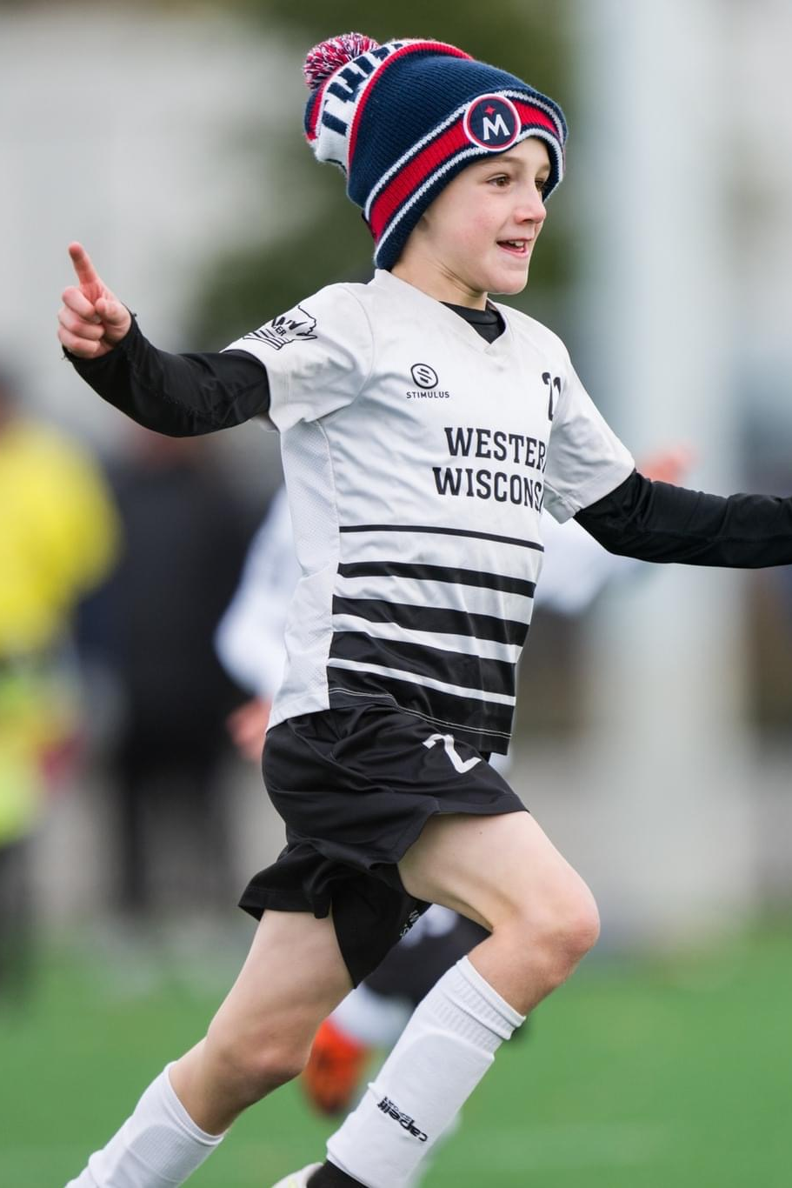
Travel Program In Review 2022/23
Goals and Results from Last Season - 2022/23
Improve the flexibility and personalization of the tournament selection process.
Introduction of the Team budget process
More autonomy for coaches, managers and teams to select events that work for them
Western Wisconsin Teams participated in tournaments throughout WI, MN, IA, KS, NE
Increase and improve our pool of Goal Keepers
Started a specific Goal Keeper Training during Winter Training. Well received by players.
Successfully field a higher competitive level team.
1st NPL team 2005 WWFC Boys
3rd Place finish in TCSL Premier
Worked through the kinks of not having winter game space.
Improve Travel Family volunteer hour contributions.
Kati reports excellent improvement in filled hours.
Additional Communication and adjustment to $ per hour.
Areas to focus on improvement for 2023/24
Payment processing for Managers
Better info/coordination on optional winter activities

Slide 16
Travel Program In Review 2023/24
Goals and Results for This Season - 2023/24
Continued improvement of the player eval process, with goal of finding soccer for all.
Moved HS girls player eval to June.
All others in late July: behind the scenes work on tryout shirt process,, player list, and team formation process.
All players found a home within WW Soccer.
Increase our presence in the higher competitive NPL league
Added 2010 WWFC Girls to NPL Premier.
Took 1st place in the Fall portion!
2005 WWFC Boys will start NPL league after HS league.
Continue to build quality coaching staff and eliminate reliance on St. Croix shared coaches.
Coaching Staff: 17.
7 New Coaches for 2023, bringing a wealth of experience and energy.
Elimination of shared coaches with St. Croix is complete.
Continued focus on improvement and communication
Pool Training, Coach mentoring, Coaching notes prior to training.
Continue Goal Keeper Training
Hired GK Coach, reserved Catalyst time.
Improve the awareness and understanding of the optional Winter competitions
Larger focus at the team manager and coaches meetings.
Winter Training is guaranteed. Most teams electing to participate in some kind of winter league, either Futsal, Salvo, or other. Not all teams will choose to do this, nor may it be developmentally appropriate for all teams.
Simplify the Budgeting and repayment process for Team Managers

Slide 17

Travel Program In Review: 2023/24 & Beyond
Highlights from Fall
TSCL Fall league went great!
Many successful teams and developmentally appropriate brackets
Players had lots of fun!
Trainings switched to consistent nights, eases burden on volunteer hours, easier to reschedule games, etc.
High School Teams
Girls participated in tournaments in Madison, La Crosse, etc.
Multiple Championships and Runner-Up Finishes.
Boys begin in November.
Winter Training
Indoor training starts Mid November and runs through mid April.
Goal is for Teams to have 1 weekday and 1 weekend training sessions at Catalyst
Girls WWFC ages 05-09 replace 1 Catalyst session with 1 St. Croix Valley Dome session.
Great opportunity to increase foot skills and technical ability!
Schedules should be added to Team Snap
Spring TCSL Season and Tournaments
TCSL starts in May
Several Teams have tournaments starting in April!

Slide 18
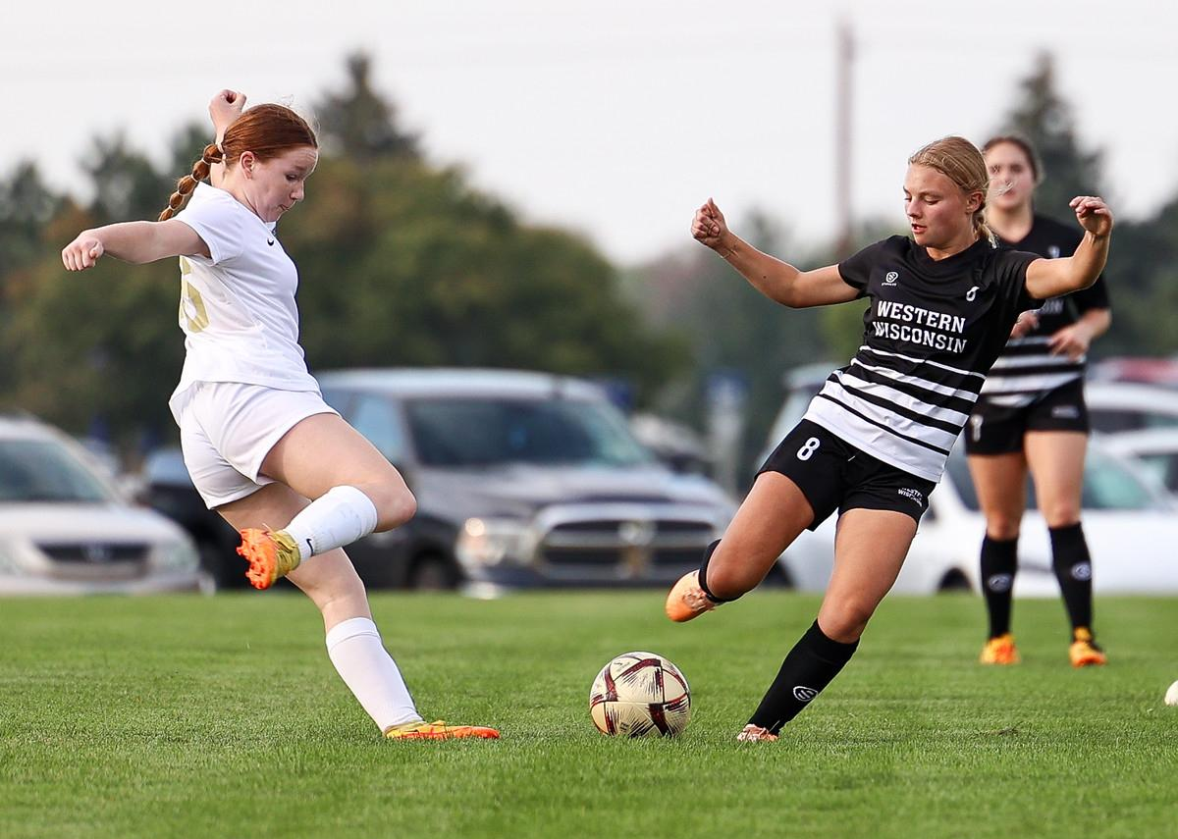
Travel Program: Challenges &
Goals for Future Improvement
Areas we still see challenges and our goals to improve:
Challenge: Winter Training Space and available time is extremely constrained
Expect some teams to share the already small catalyst space.
St. Croix Valley Dome overbooked as well, there will gaps in available training weeks for HS Girls.
Goal: Plan, fund, and build an HSA/WW Dome by Fall of 2025.
Challenge: Keeping a robust HS age program at WW.
Historically had trouble keeping players and consistent teams.
Examples: Lost HS girls to other clubs looking for “College recruitment”, older boys teams change to “tourney only.”
Goal: The improvements in coaching we make at the younger levels will drive the ability to field NPL level teams at the HS age.
Also removing shared coaches with other clubs eliminates player poaching.
05 WWFC Boys is a great example
Challenge: 8th/9th grade year is inherently difficult to manage and variable every year.
Ensuring we identify a plan to keep 8th grade players playing while their 9th grader teammates play HS soccer.
Goal: Send communication to 7th graders for what to expect coming into the 8th/9th grade transition year.
Work within the club to refine the timeline and process.

Slide 19
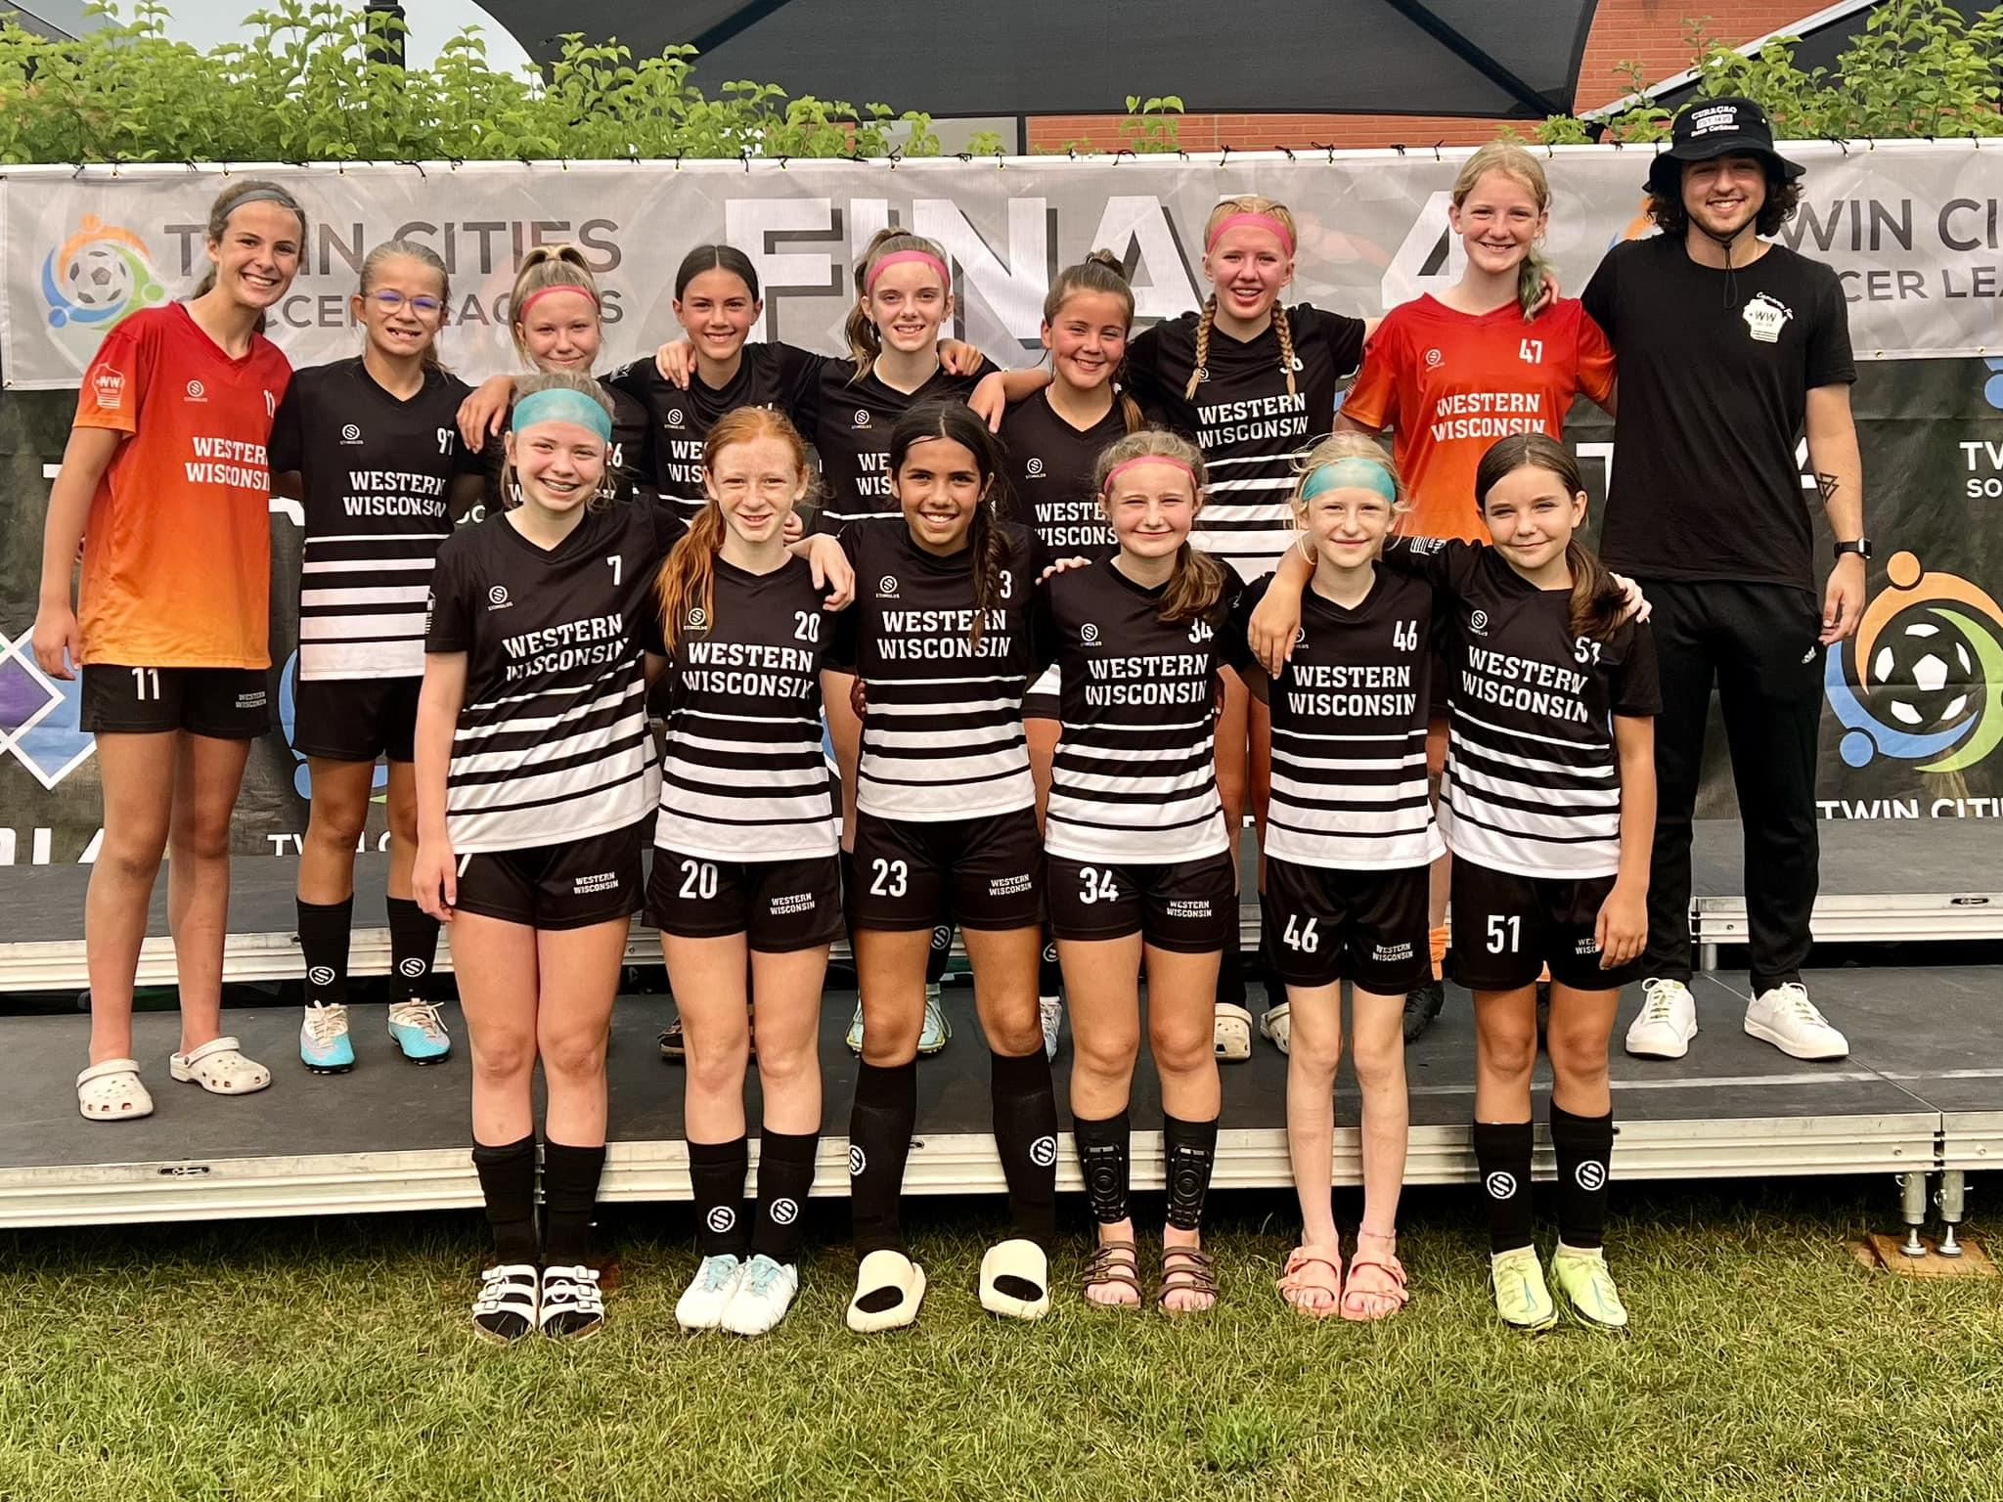
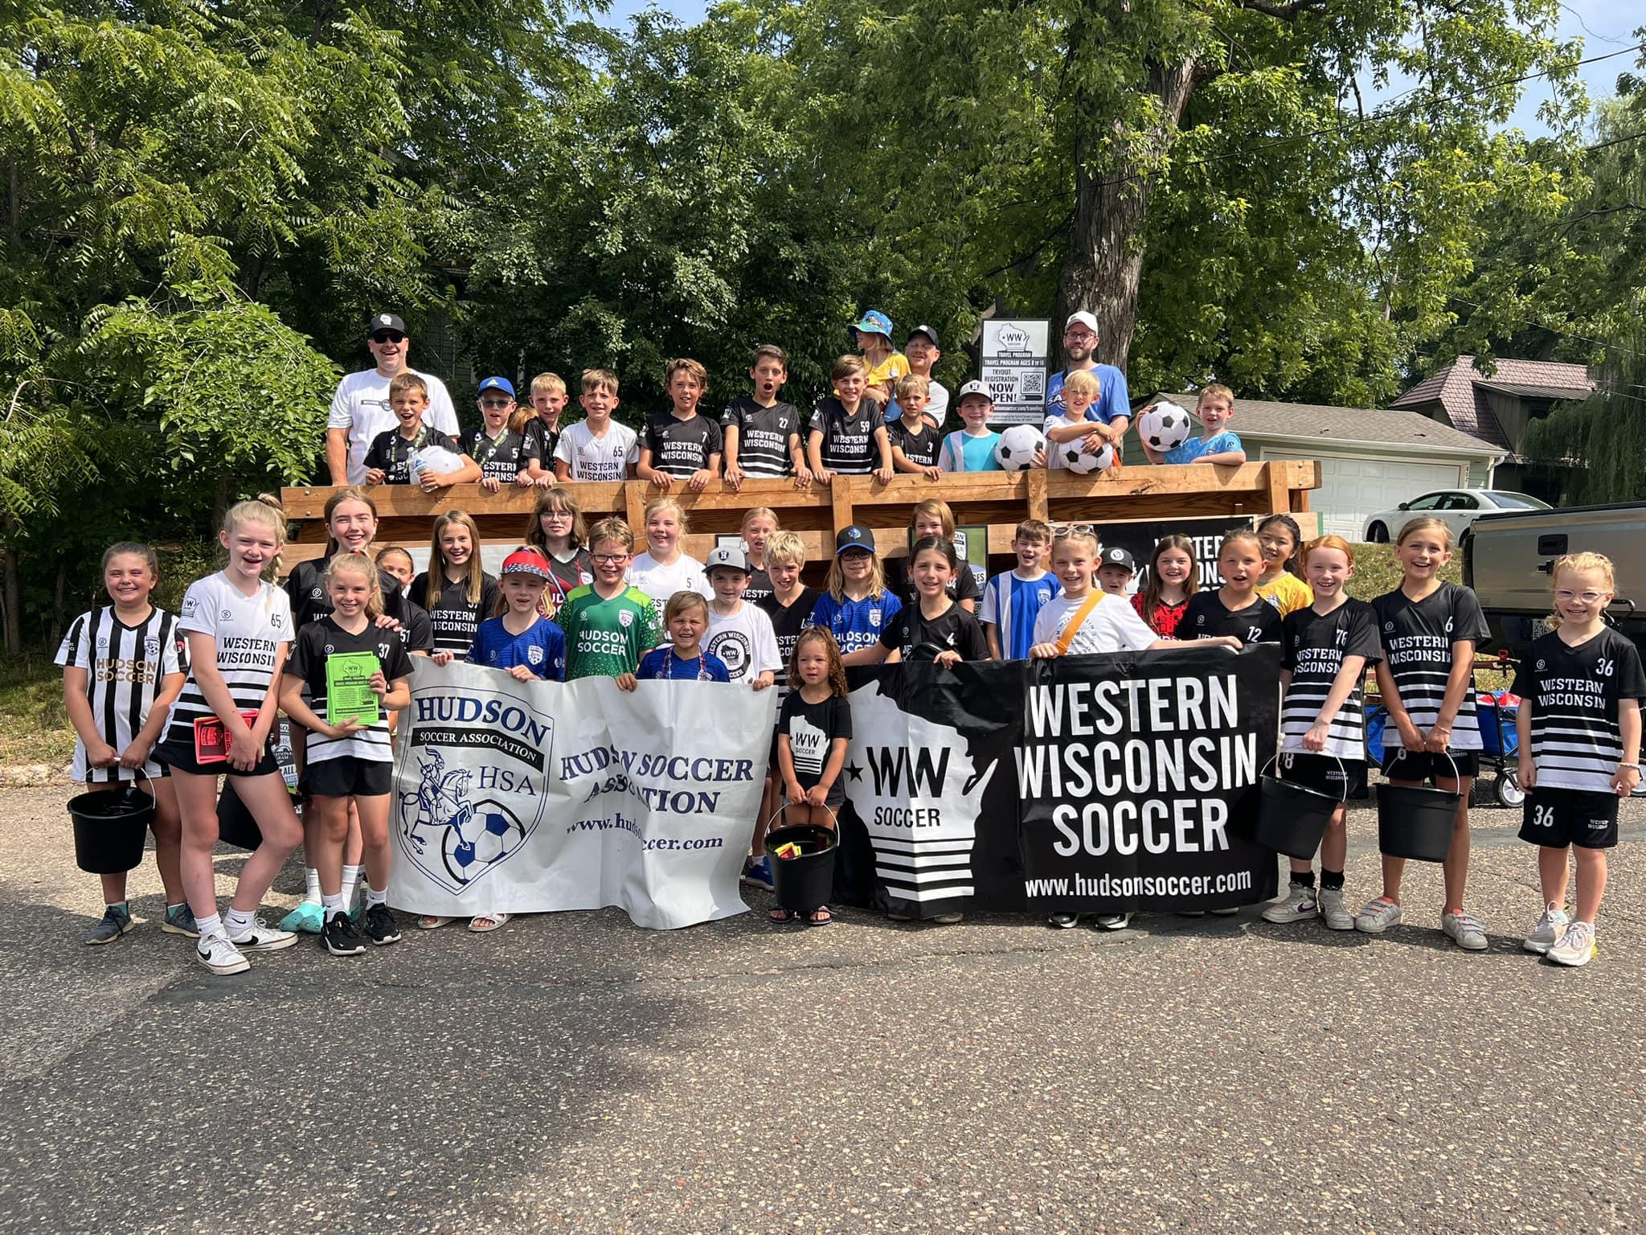
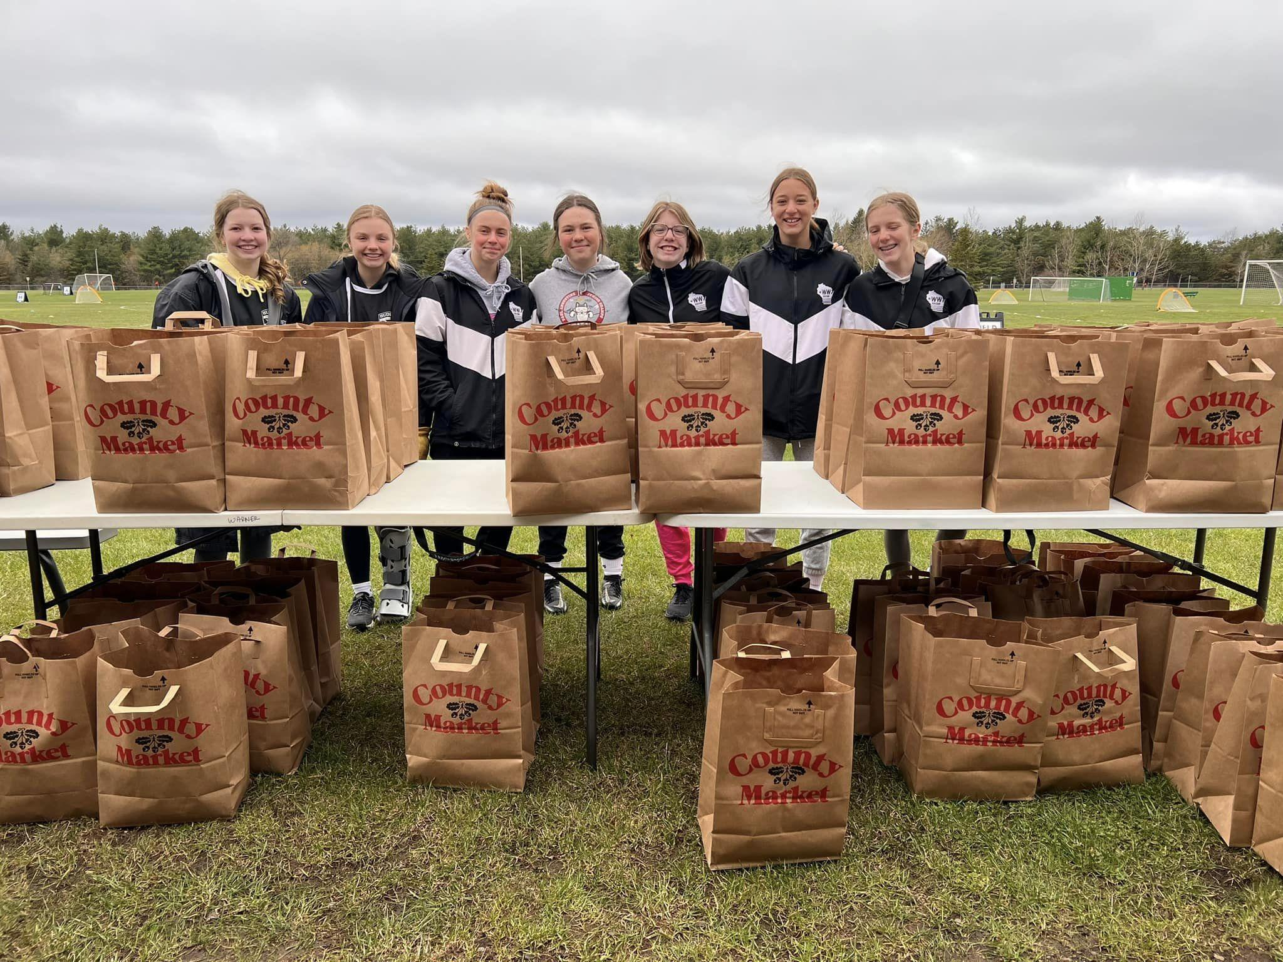
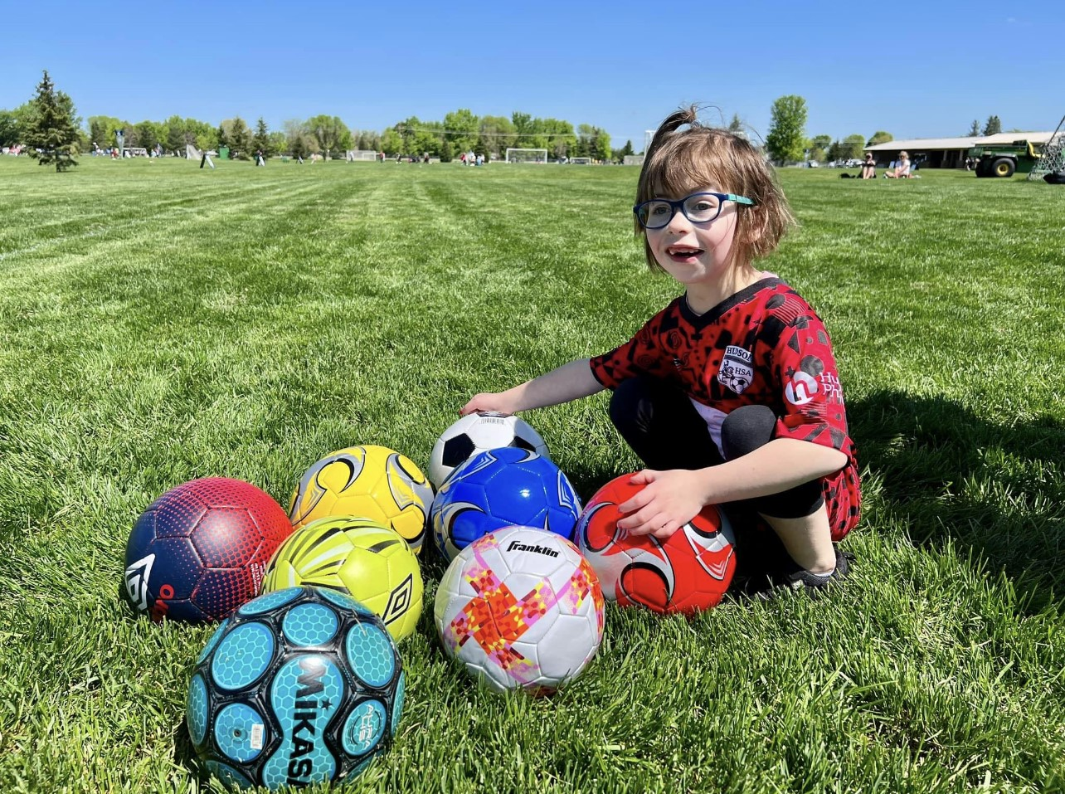
2023 Highlights
Continued program growth: increased not only numbers in programs, but the quality of the programs
Rivertown Classic
New partnership with Hudson Physicians and Twin Cities Orthopedics
Adaptive Soccer program
Kick or Treat
Players participation in parades, fundraisers, coaching, and community events

Slide 20
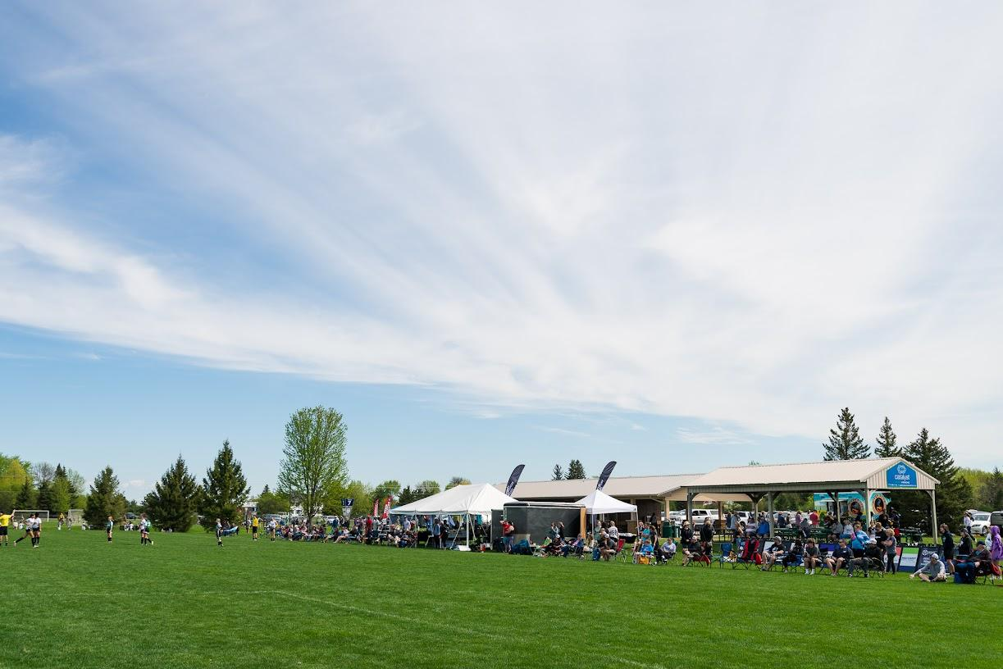
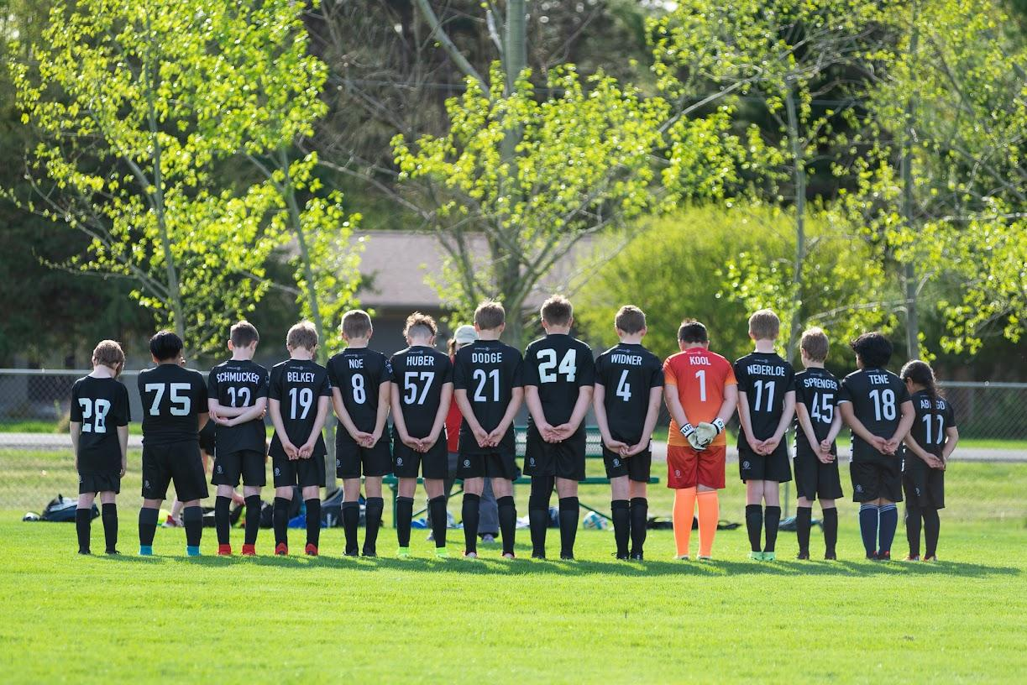
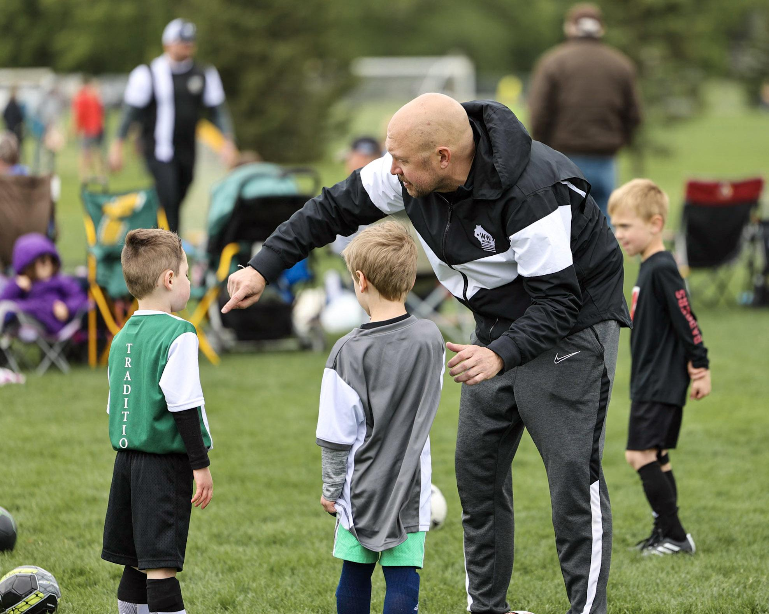
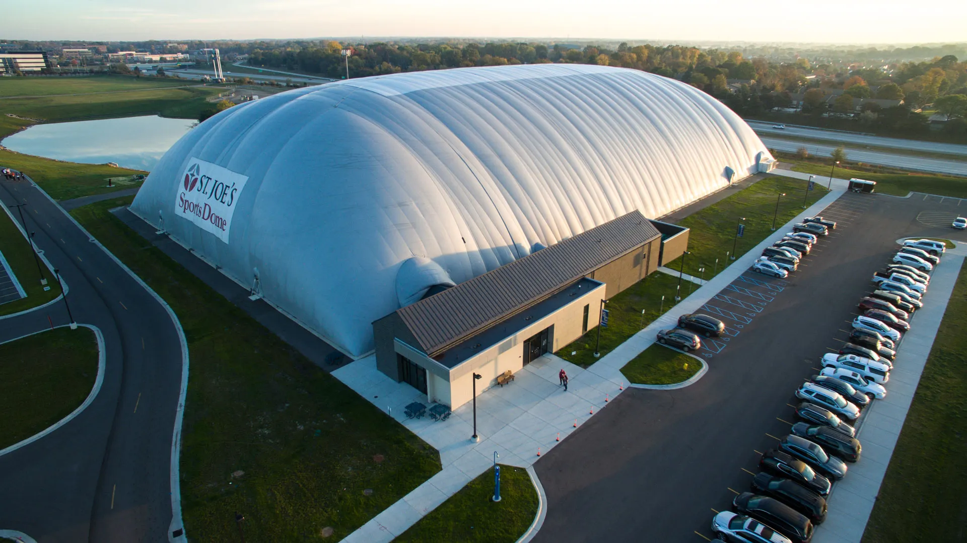
Future Plans
Modernize our Website, including more parent information and resources.
Continue to develop and grow community involvement in Western Wisconsin and Eastern Minnesota.
Continued focus on increasing the quality and quantity of available programs. One example would be to grow the Adaptive Soccer program beyond Hudson.
Review possible landscaping projects around the Main Building and Maintenance Shed along with improving security at the fields.
Finalize plans for a Hudson Soccer Association owned Indoor Training Facility and Launch a Fundraising Initiative for it
Establish a Club relationship with the Minnesota Aurora and continue the work on growing our relationship with the Minnesota United

Slide 21
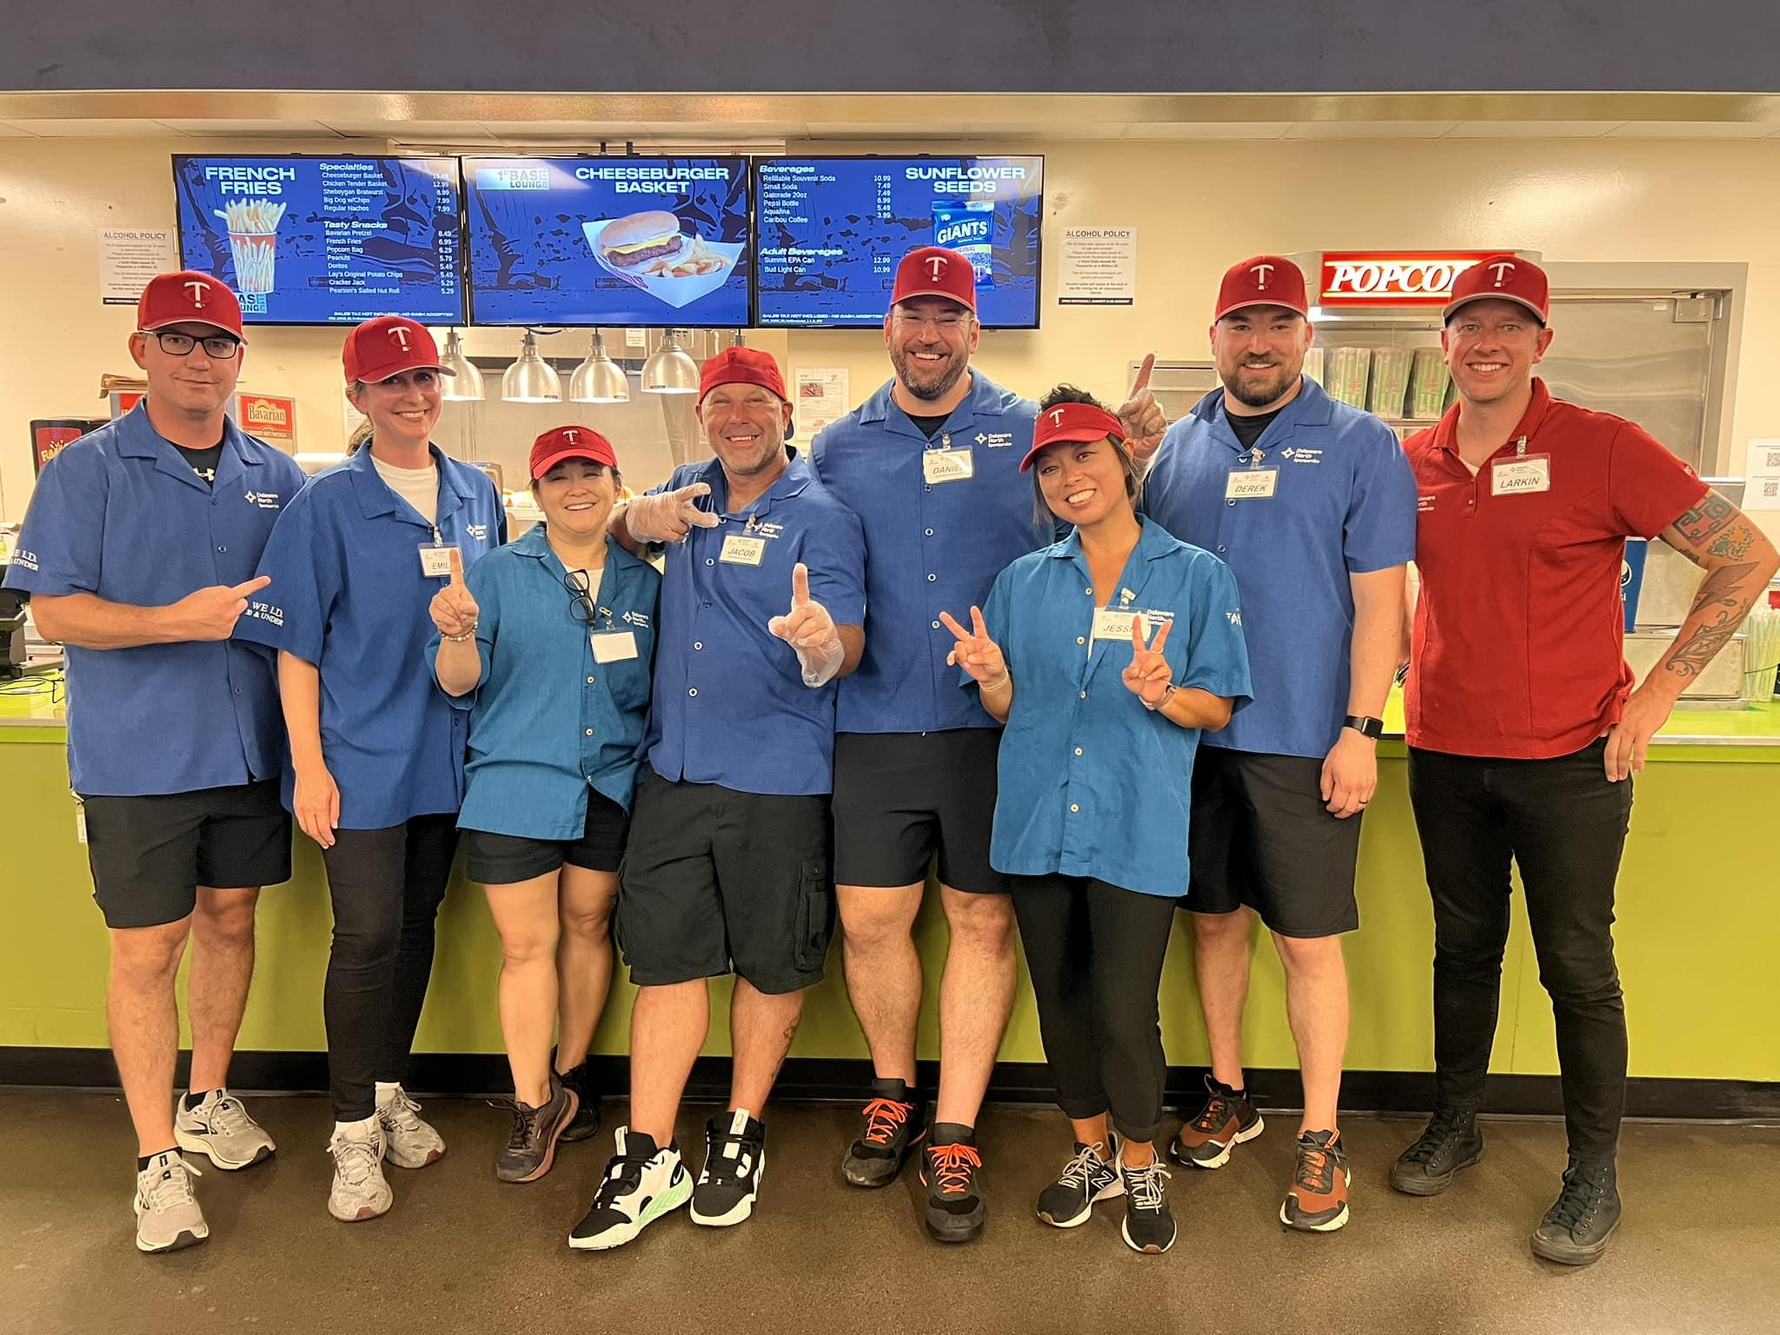
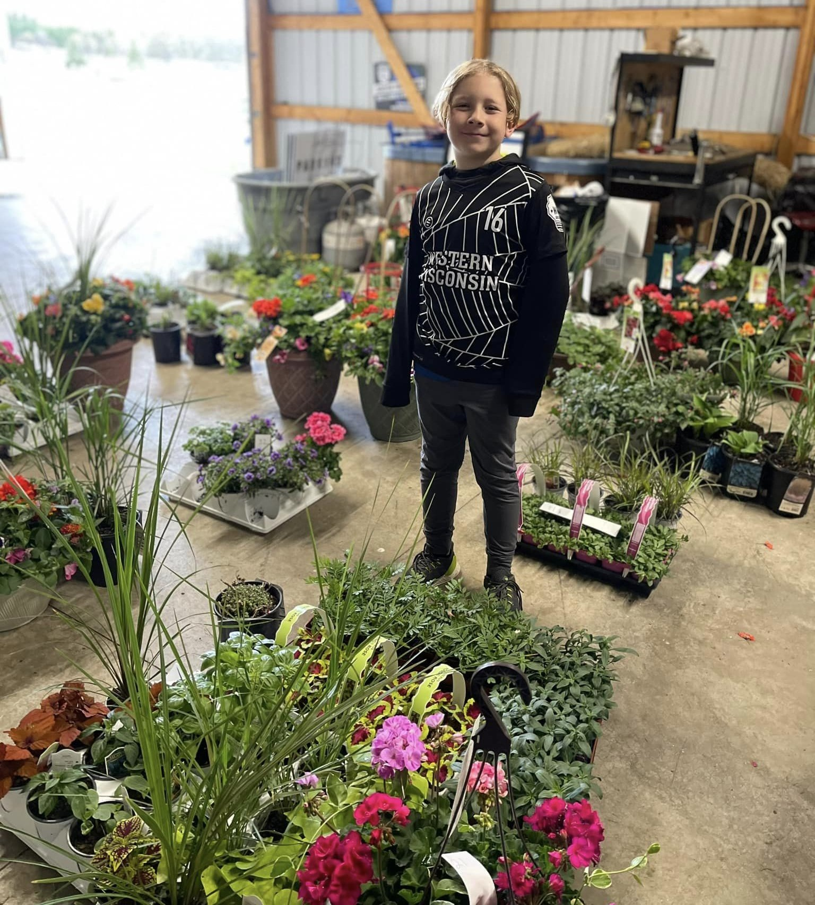
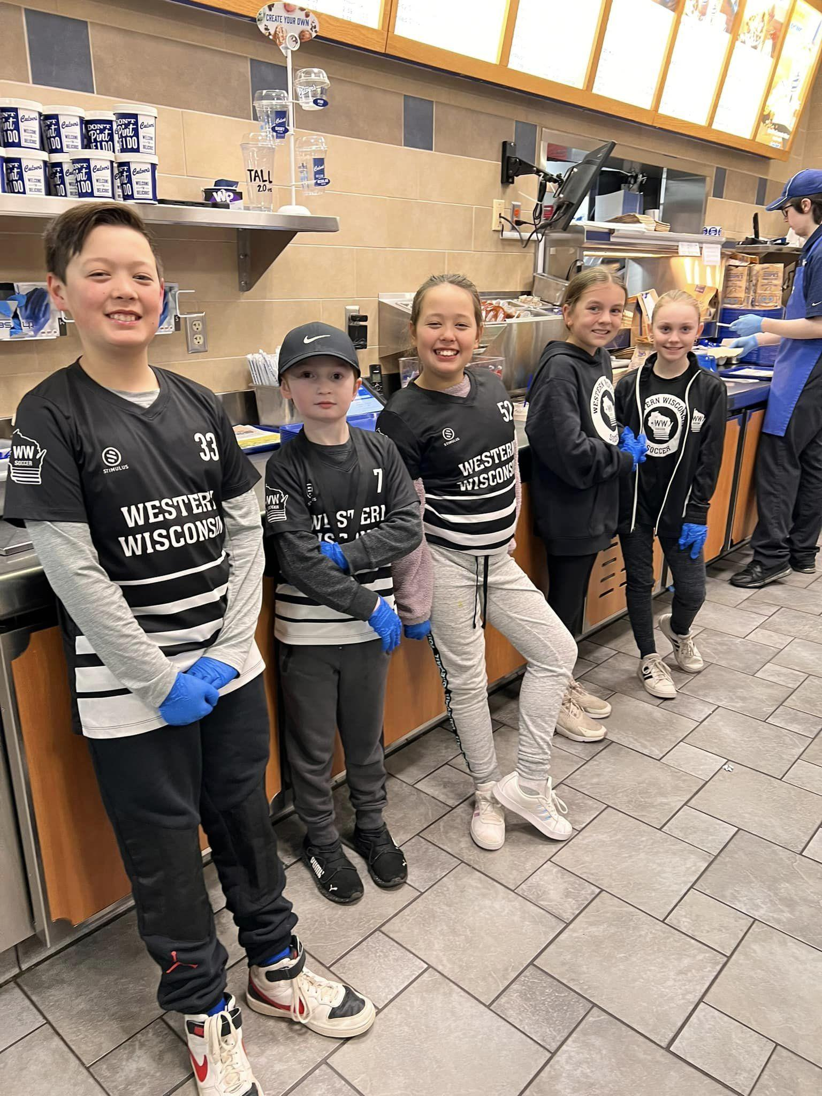
Fundraising
Fundraising helps cover scholarships, maintain complex, and assist with future indoor training costs.
Grants awarded for new equipment and adaptive program
Established relationship with Minnesota Twins to fundraise through concessions
Multiple fundraisers hosted throughout the year at area restaurants
Gertens Spring and Fall Plant Fundraisers
Weekly BINGO at Hudson Tap
End of year event at Willow River Saloon & Carbone’s
Additional funds raised by increased concession sales and volunteer buyouts

Slide 22





Sponsorships
All Field Sponsorships filled in 2023
Platinum Club Sponsor for 2023 - 2026:
Twin Cities Orthopedics and Hudson Physicians
Platinum Tournament Sponsor:
Stimulus Athletics
New Complex Sponsor Sun Control of MN/WI, assisting with signage
Five new Field Sponsors in 2023

Slide 23

Tournament Director Assistant
Open Board Positions up for election

Slide 24

Questions?

