Slide 1


NWBA Gender Eligibility Policy:
Creating a Safe & Fair Environment for All to Play, Learn, and Compete
Presented by ABC Medical
Notes:
Moderator: CLICK RECORD ;)​​
Welcome to the NWBA Webinar Series Presented by ABC Medical! We are very excited to have you participating in tonight’s session on Registering as a NWBA Team and Member!​
Before we get started tonight, I want to share a few housekeeping items:​​ ​
Everyone attending is asked to mute your audio during the presentation to reduce background noise for the presenters.​​
If you have any questions, please use the chat box. We will be monitoring this throughout the presentation, and we have time reserved at the end for Q&A.​​
If you cannot stay for the entire presentation, we will provide a recording of tonight’s session on the NWBA website.​​

Slide 2


Webinar Presented by ABC Medical
Notes:
Moderator:
Thank you to ABC Medical for being a long-time partner of the NWBA and presenting this webinar series! ABC Medical serves to provide NWBA members and more a comprehensive line of medical supplies. Thank to ABC Medical for continued support of the NWBA!

Slide 3


Presenters
Dug Jones, Secretary for the NWBA Board of Directors/Chair of Ethics & Governance Committees/Class of 2017 NWBA HOF
Chance Cochran, former Team USA Athlete, current Law & Policy Analyst for The Inclusion Playbook, Georgetown University Justice Fellow
Notes:
Moderator Doug Jones, has been involved in wheelchair basketball since 1982. He began his playing career with the North Florida Renegades where he played for 12 seasons before transitioning to the Fresno Red Rollers in 1995 and finally, the Dallas Wheelchair Mavericks in 1997. As a player, Dug was a member of six national championship teams. Once he began coaching in 2003, he won another four national championships. He was also a member, as a player, of two World Club Team Championships and held administrative roles with the USA Paralympic wheelchair basketball team in 1996 and the USA Gold Cup team in 1998. Dug was inducted into the National Wheelchair Basketball Association Hall of Fame in 2017. He served the Intercollegiate Division of the NWBA as the Divisional President from 2012 through 2021.
Chance Cochran, is an attorney and civil rights advocate. Before coming to the Inclusion Playbook, he spent time with Campaign Legal Center and the Institute for Constitutional Advocacy and Protection at Georgetown University Law Center. He is an expert on inclusive policies and transgender participation in sports. Chance is a committed activist whose involvement in LGBTQ+ causes has ranged from on-the-ground protests to authoring an amicus brief on gender identity and expression for submission to the Inter-American Court of Human Rights. A former Team USA athlete, Chance has first-hand knowledge of the transformative power of sports and believes that every person deserves to play as their authentic self.

Slide 4
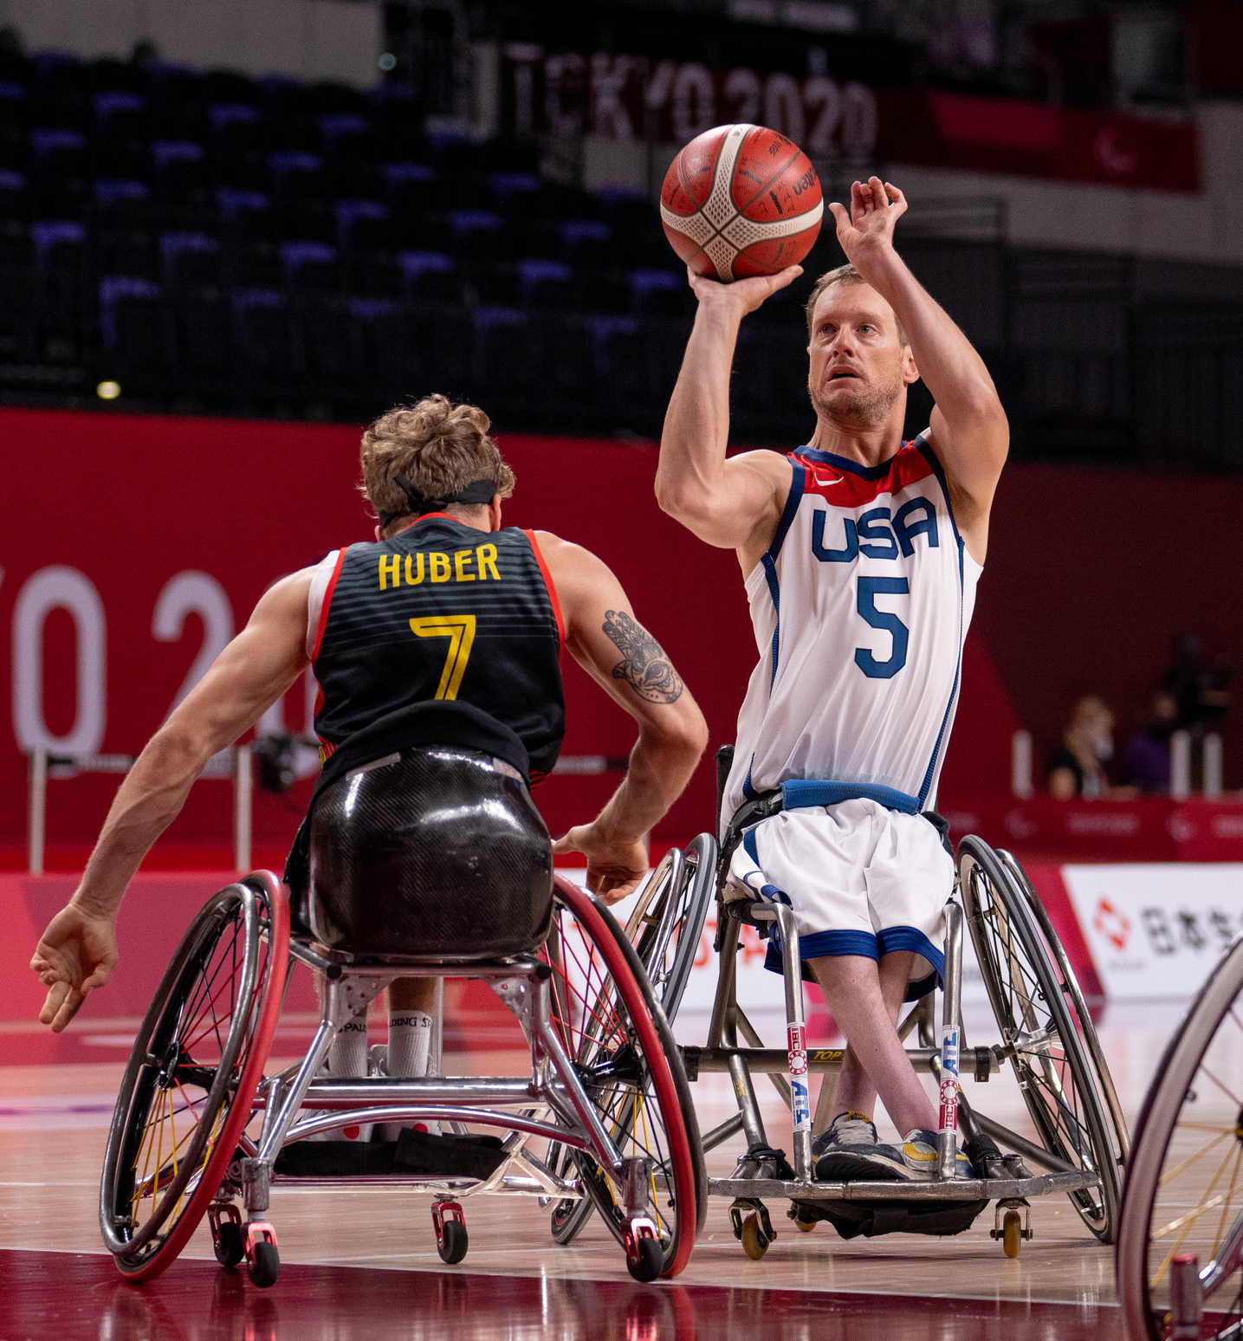
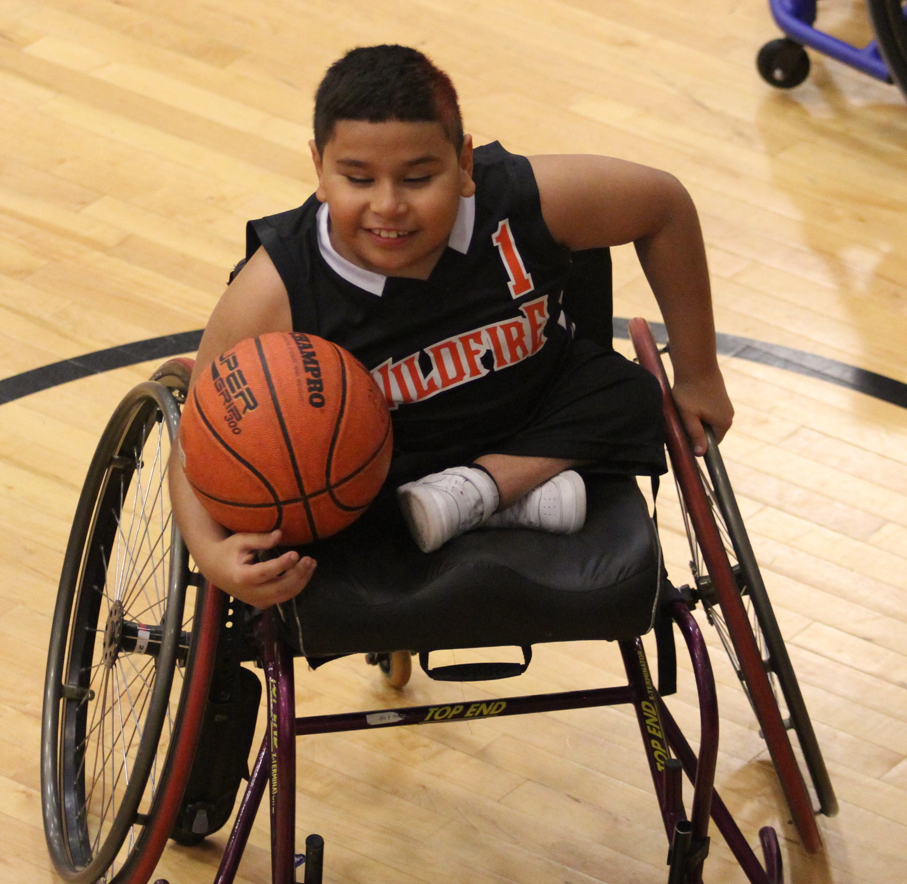
Session Objectives
This webinar is designed to help participants understand:
Education on transgender athletes
Clarity regarding landscape of participation of transgender athletes in sport
The prioritization of Diversity, Inclusion & Equity initiatives for the NWBA
Development and implementation of Gender Eligibility Policy for the NWBA
The importance of Gender Eligibility requirements for participation and good standing with the NWBA for teams and sanctioned competitions.
Notes:
Moderator

Slide 5
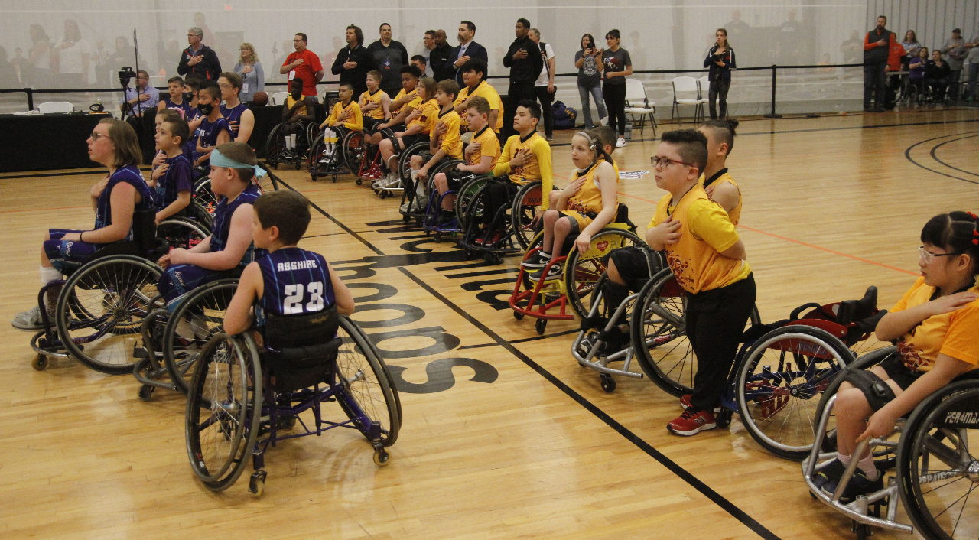
Trans 101 - Definitions
A person's Gender Identity is their internal and psychological sense of self as a man, woman, both, in-between, or neither. Only YOU can determine your gender identity.
Someone's Gender Expression is how they publicly present their gender. This can include behavior as well as outward appearance such as clothing, hair, and make-up. A person's chosen name and pronouns are also common ways of expressing gender.
Notes:
Let’s roll right into some heavy topics…

Slide 6
Trans 101 – Definitions (cont.)
A person is Transgender if their gender identity is different from the gender they were thought to be at birth.
Someone is Cisgender if their gender identity is the same as the gender they were thought to be at birth.
A Non-Binary person is someone who does not identify exclusively as a man or a woman (i.e. their identity does not easily fit into a binary understanding of gender).
Notes:
Let’s roll right into some heavy topics…

Slide 7
Common Myths/Misconceptions
Trans athletes transition for the purpose of gaining an advantage at sports
When trans girls or women compete, they "dominate"
Trans girls or women are bigger/stronger/faster than their teammates and opponents
Trans athletes aren't excluded so long as they can still play on a team, even if it's not the team that matches their gender identity
Notes:
Let’s roll right into some heavy topics…

Slide 8
Expert Consensus
What the experts are saying:
Trans youth should be allowed to play without restriction
Trans athletes have been participating at all levels of sport for decades
Trans-inclusive policies benefit all women and girls, cisgender and transgender alike
Notes:
Let’s roll right into some heavy topics…

Slide 9
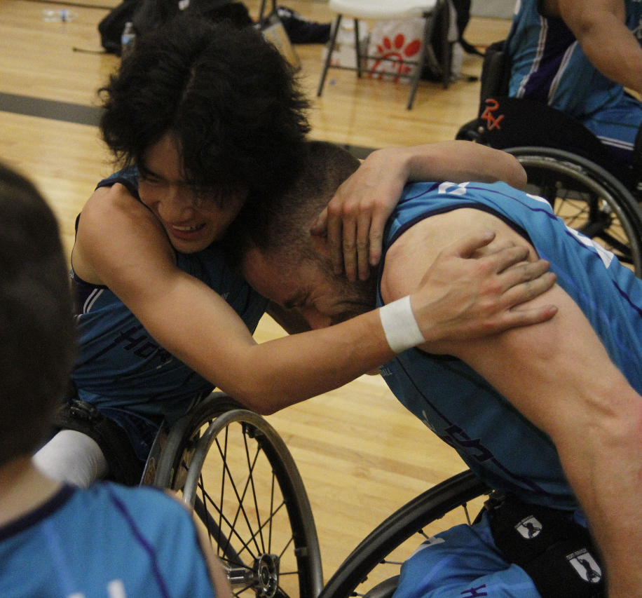

State of Play
Where does that consensus come from?
86% of trans boys and 88% of trans girls do not play a sport
41% of trans boys and 34% of trans girls report NEVER having felt safe in a locker room
82% of trans youth are not out to their coaches about their gender identity
Notes:
Let’s roll right into some heavy topics…

Slide 10
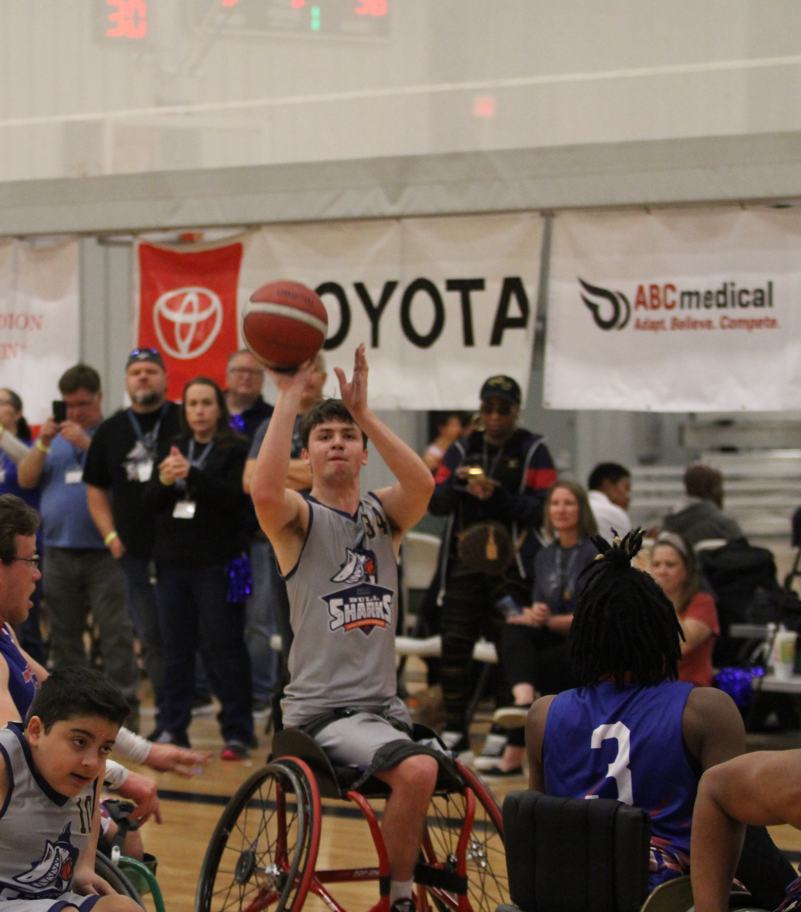
Value of sport
Why do YOU play sports?
Physical Health
Emotional Wellbeing
Sense of Team/Community
Because they're FUN
Notes:
Let’s roll right into some heavy topics…

Slide 11
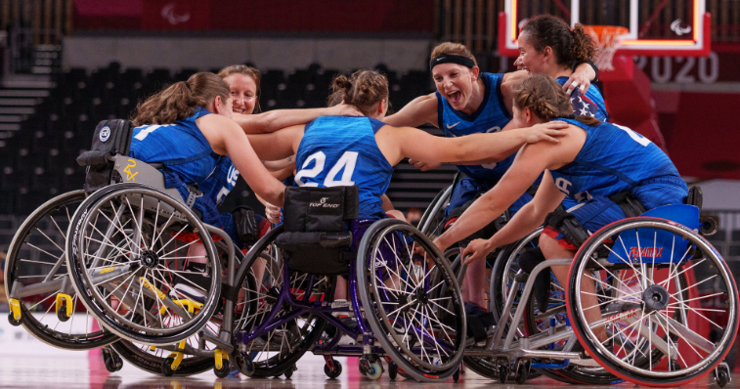
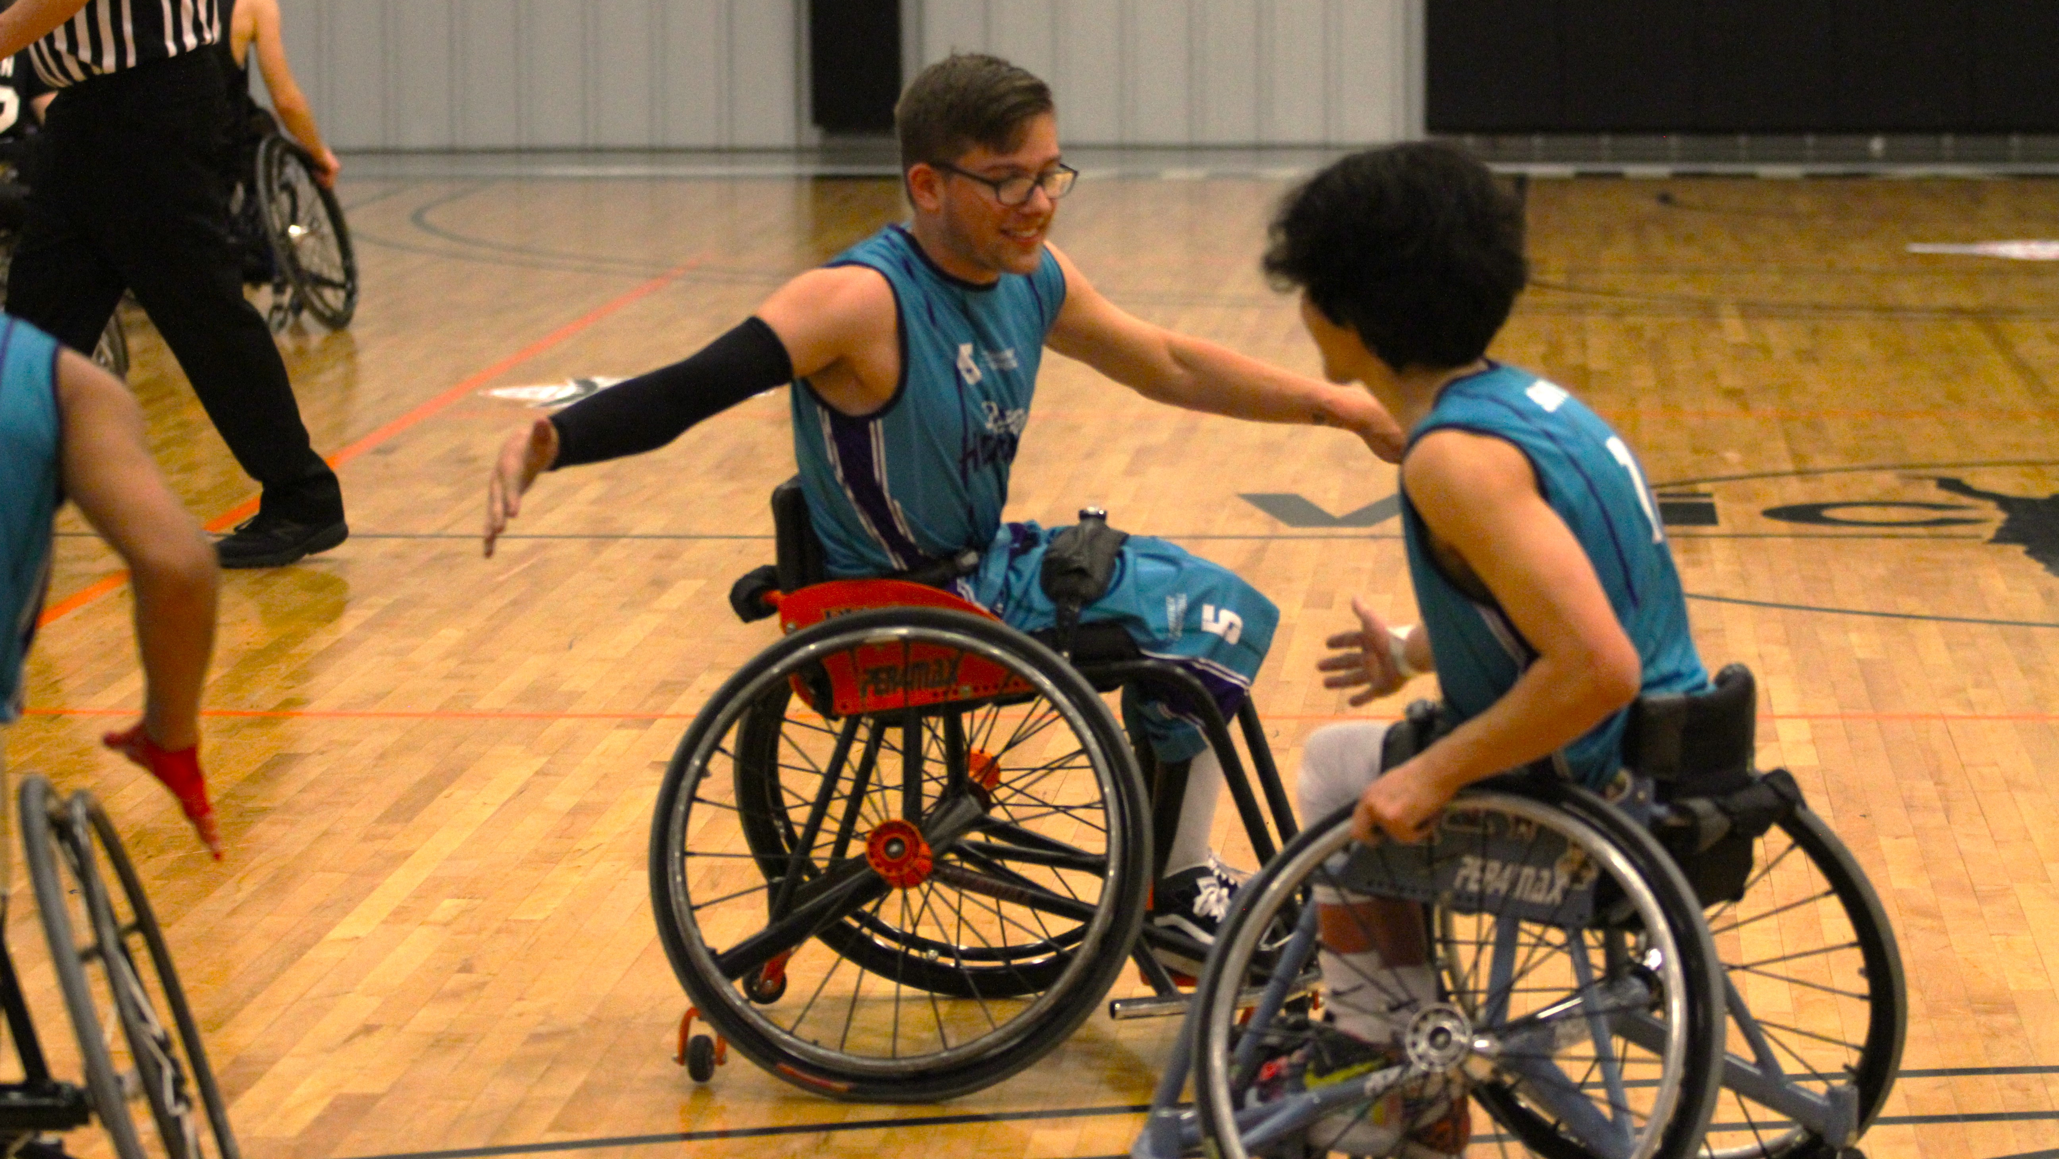
Value of sport (cont.)
Why does this matter?
LGBTQ+ people, and trans people in particular, are at far greater risk of depression, anxiety, and suicide than their straight/cisgender counterparts
Having even one accepting adult (e.g. a coach) can reduce the risk of suicide attempts by 40% among LGBTQ+ youth
Everyone deserves to be able to play the game they love with their friends
Notes:
Let’s roll right into some heavy topics…
Pass Presentation to Dug

Slide 12

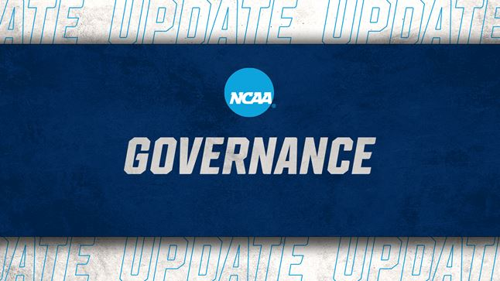
Transgender Participation Updates
November 16, 2021
International Olympic Committee (IOC) releases “Framework on Fairness, Inclusion and Non-Discrimination on the Basis of Gender Identity and Sex Variations”
No athlete should be excluded from competition on the grounds of a perceived unfair advantage, while leaving it up to sports International Federations (IF) to decide where the balance lay between inclusion and fairness.
USOPC’s response was to support development of policies from IFs and National Governing Bodies (NGBs)
January 19, 2022
NCAA announced it supports a sport-by-sport approach to transgender participation.
Notes:
DUG
Read Slide
Following a two-year consultation process with more than 250 athletes and concerned stakeholders, the International Olympic Committee (IOC) today released its new “IOC Framework on Fairness, Inclusion and Non-Discrimination on the Basis of Gender Identity and Sex Variations”.
Read Slide The NCAA Board of Governors on Wednesday voted in support of a sport-by-sport approach to transgender participation that preserves opportunity for transgender student-athletes while balancing fairness, inclusion and safety for all who compete.

Slide 13
NWBA Policy Development
Fall of 2020 NWBA leadership identified the need for a policy
NWBA’s 2021-2024 Diversity, Equity & Inclusion Action Plan submitted to USOPC for review by U.S. Congress included following objective:
“Promote an inclusive environment thru transgender athlete participation within the NWBA and sport of wheelchair basketball.”
https://www.nwba.org/diversityandinclusion
Fall of 2021 following IOC announcement – USOPC offers first cohort “NGB Trans Policy Project”
NWBA is selected among other NGBs to participate
Project Timeline Executed by NWBA Q1 & Q2 of 2022
Notes:
DUG
Fall of 2020 preliminarily stated discussions with Athlete Ally to support policy development
Fall of 2021 NWBA submits 2021-2024 Diversity, Equity & Inclusion Action Plan submitted to USOPC for review by U.S. Congress. “Promote an inclusive environment thru transgender athlete participation within the NWBA and sport of wheelchair basketball.” The initiatives include the following two items -
Create and implement a Transgender Participation Policy that is tailored to wheelchair basketball, membership and levels of play
Host educational opportunities for NWBA membership on the policy and implementation.
https://www.nwba.org/diversityandinclusion
Fall of 2021 we opted into USOPC offered funded program “NGB Trans Policy Project” to be supported by Inclusion Playbook to be educated on landscape of trans athletes and assist with developing a policy.

Slide 14
NWBA Policy Development
Policy was presented and discussed by NWBA Board of Directors on May 16, 2022
Policy presented would be implementation for the 2022-2023 NWBA Season*
Approved by the NWBA Board of Directors via email on May 27, 2022, and included in the NWBA Polices & Procedures.
https://www.nwba.org/aboutpoliciesprocedures
Policy presented during NWBA Town Hall on Wednesday, June 15
Educational session to be provided to NWBA membership in the form of this webinar.
Notes:
DUG
Policy was presented and discussed by NWBA Board of Directors on May 16, 2022
Policy presented would be implementation for the 2022-2023 NWBA Season*
Approved by the NWBA Board of Directors via email on May 27, 2022, and included in the NWBA Polices & Procedures.
https://www.nwba.org/aboutpoliciesprocedures
Policy presented during NWBA Town Hall on Wednesday, June 15 - Brandon
Educational session to be provided to NWBA membership in the form of this webinar.

Slide 15
NWBA Policy – Guiding Principles
NWBA supports diversity and inclusion in all aspects of wheelchair basketball.
The purpose of this policy is to provide guidance on gender eligibility to participate.
This policy was written with the intent to create inclusive sporting environment where people of all backgrounds can play wheelchair basketball AND allows athletes to participate on a team that is consistent with their gender identity.
NWBA’s goal is to allow all athletes access to wheelchair basketball in a healthy and respectful environment.
Notes:
DUG
The National Wheelchair Basketball Association (NWBA) supports diversity and inclusion in all aspects of wheelchair basketball. The purpose of this policy is to provide guidance on gender eligibility to participate in recreational and competitive wheelchair basketball managed and operated by the NWBA. This policy was written with the intent to create inclusive sporting environment where people of all backgrounds can contribute and play wheelchair basketball. NWBA’s goal is to allow all athletes access to wheelchair basketball in a healthy and respectful environment. This policy is based on NWBA’s belief that recreational wheelchair basketball should incorporate an inclusive policy that focuses on allowing athletes to participate on a team that is consistent with their gender identity.

Slide 16
Policy Application
This policy is applicable in all NWBA registered teams and individuals who desire to play wheelchair basketball as a participating athlete at any NWBA sanctioned events.
Any competition for NWBA divisions subject to this policy are as follows:
Adult Division I
Adult Division II
Adult Division III
Women’s Division
Junior Division – Prep
Junior Division – Varsity
Intercollegiate Division – Men’s
Intercollegiate Division – Women’s
Pilot Program Division (i.e., Military Division)
*This policy is NOT applicable to any individual who desires to participate or be considered for selection as an athlete in the NWBA High Performance Program.
Notes:
DUG
READ SLIDE
National Teams under the policies developed by International Wheelchair Basketball Federation – which will be approved/revied by the IOC

Slide 17

NWBA Policy
The vast majority of NWBA’s programs, regardless of age or competition level, are co-ed play and not restricted by gender. As such, all NWBA players are eligible to participate in all NWBA divisions regardless of gender at birth, gender identity, transgender status, gender transition status and other forms of gender expression.
An NWBA athlete must declare their preference of gender for competition and may provide their gender identity during the individual registration process for an NWBA season.
Notes:
DUG
READ SLIDE/POLICY
Only Women's Division & Intercollegiate Division – Womens' are the only gender specific divisions; all other divisions are co-ed

Slide 18

NWBA Policy - continued
Starting in 2022-23, thru Individual Registration a NWBA member will be able to provide their gender identity in a more thorough and comfortable offering.
Athletes will be asked during Individual Registration to identify their preference of gender for NWBA competition.
Any NWBA athlete may update their gender identity and gender of preference for competition at any time, however to formally and appropriately make this change the individual must submit a Change to Registration Request (New Registration Form for 2022-23) with the NWBA.
All request to changes to gender identity for competition must do so 10 days prior to any sanctioned event to allow for the change to take effect.
Notes:
DUG
Starting in 2022-23, thru Individual Registration a NWBA member will be able to provide their gender identity in a more thorough and comfortable offering.
Athletes will be asked during Individual Registration to identify their preference of gender for NWBA competition.
The “Preference of Gender Competition” will show publicly on a team’s roster for others to reference
Any NWBA athlete may update their gender identity and gender of preference for competition at any time, however to formally and appropriately make this change the individual must submit a Change to Registration Request (New Registration Form for 2022-23) with the NWBA.
All request to changes to gender identity for competition must do so at least 10 days prior to any sanctioned event to allow for the change to take effect.
In line with NWBA Policies & Procedures 4.3.1 Individual Registration

Slide 19

Implementing Policy in NWBA Season - Classification
All individuals identifying with a preference of competition gender of female will adhere to current rules for classification points for a female athlete.
Please refer to divisional guidelines and rules for information on division specific rules. Which are available at https://www.nwba.org/divisioninfo.
Notes:
DUG
All individuals identifying with a preference of competition gender of female will adhere to current rules for classification points for a female athlete.
Please refer to divisional guidelines and rules for information on division specific rules. Which are available at https://www.nwba.org/divisioninfo.

Slide 20
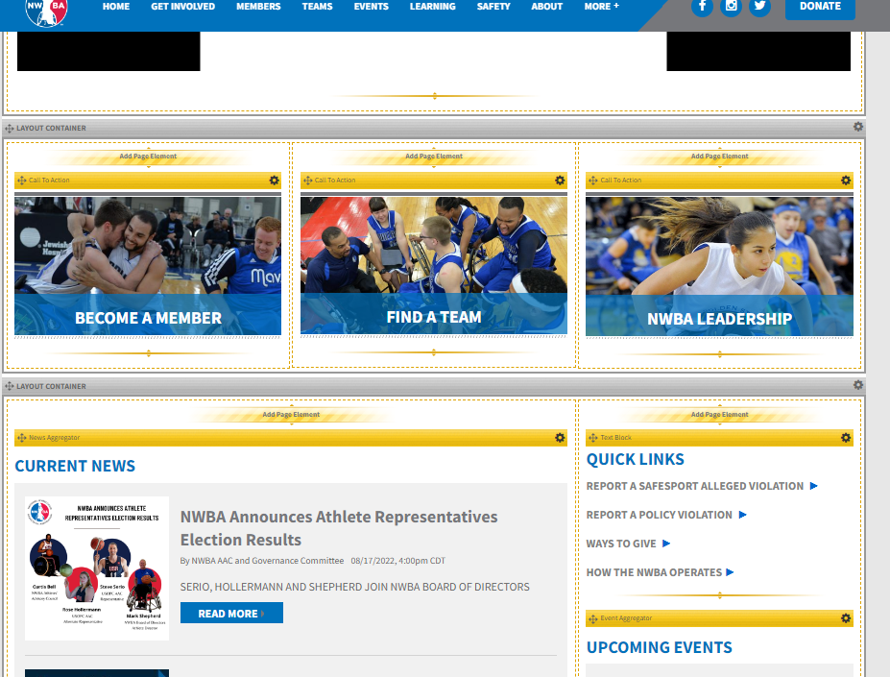
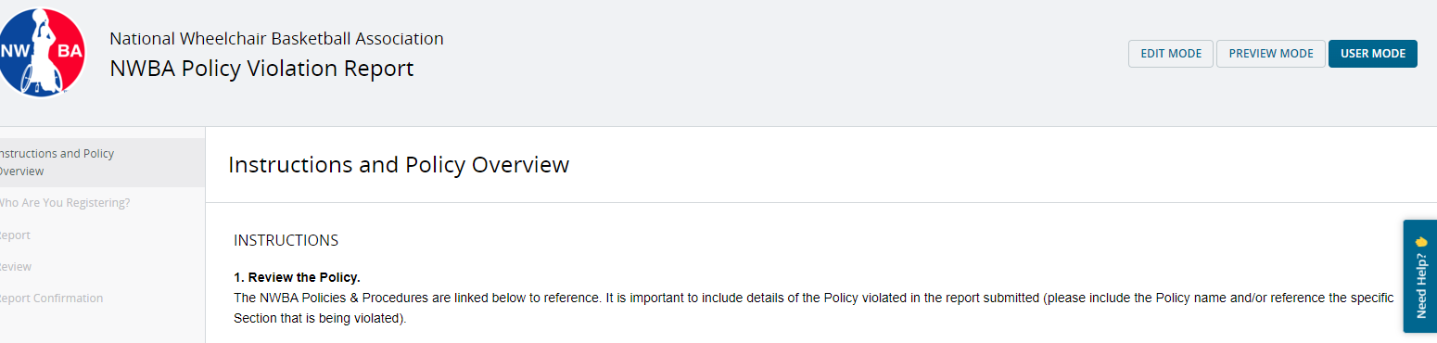
NWBA Code of Conduct and Policies
This policy was again created for the use and intent of allowing athletes to participate on a team that is consistent with their gender identity.
Any intentional misuse or abuse of this policy will be reviewed and may be recognized as an infraction of the NWBA Policies & Procedures and Code of Conduct.
This would include the unethical and impermissible behavior of pretending or falsifying gender identify or preference of gender to gain a competitive advantage.
Notes:
DUG
Read Slide
NWBA leadership does seriously consider any intentional misuse of this policy. Please discussion any concerns with divisional leadership and feel free to submit a "NWBA Policy Violation Report" if deem necessary.

Slide 21
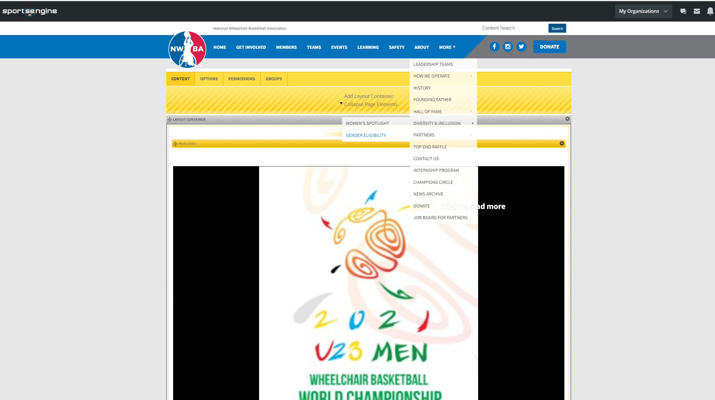
Policy & Info Availability
Notes:
DUG
We have created a webpage for this information to make it easily accessible for anyone to review. Visit the NWBA website, www.nwba.org, > hover over the about tab > scroll down to Diversity & Inclusion > then to Gender Eligibility

Slide 22
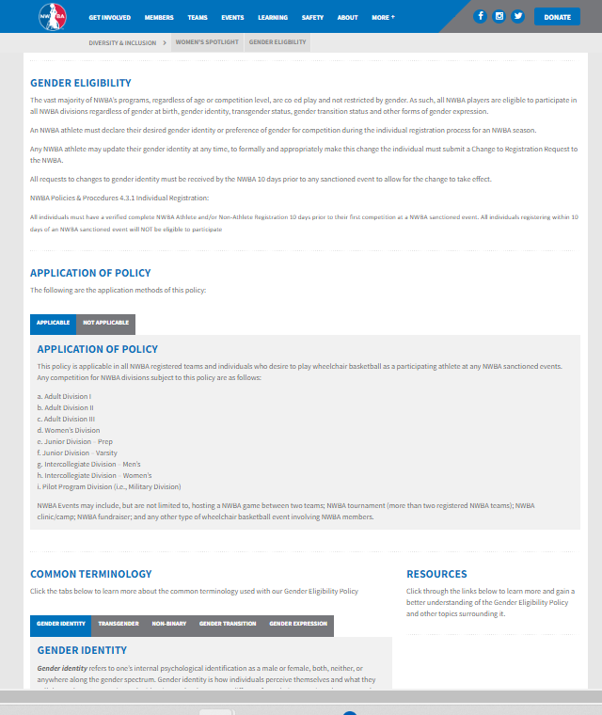
Policy & Info Availability
All information we presented today – including the policy is available at:
https://www.nwba.org/gendereligiblity

Slide 23
Questions?
Q & A

Slide 24
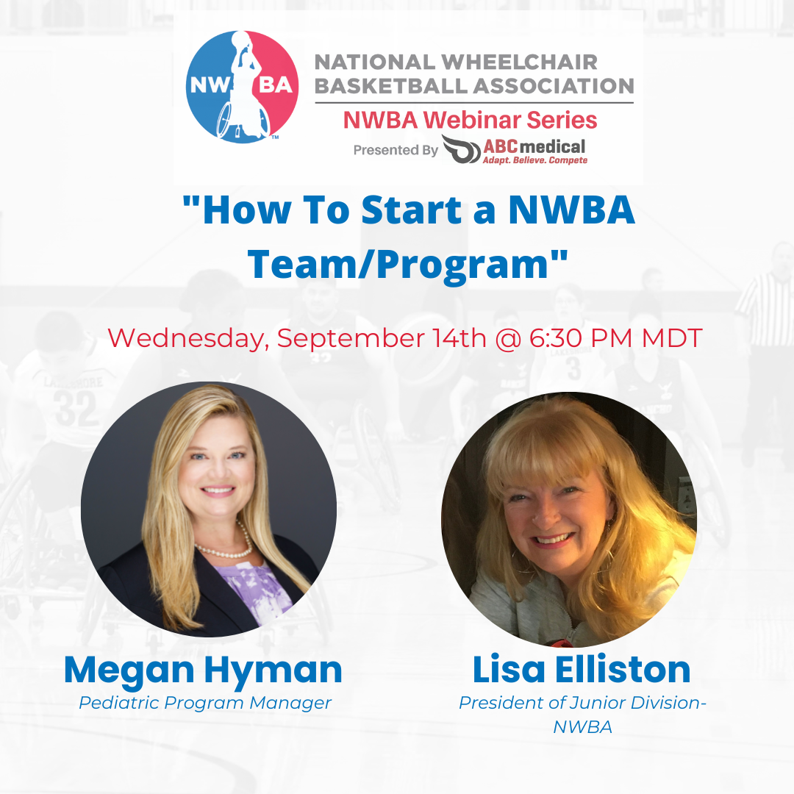
NWBA Webinar Series

