Slide 1

Dayton Juniors
Volleyball Club
Team Liaison

Slide 2

Responsibilities
Communication
  Hotel Information
  Tournament Information
Team Rosters
Warm Up Personalization
Ribbons & Snacks or Goodie Bags
Team Get-togethers
Team Meals at tournaments
Updating Program/Social Media Director of Team’s accomplishments

Slide 3
Communication - Hotels and Tournaments
Hotel Information
Pass along the booking information to your team.
Encourage your parents to make their reservations sooner rather than later.
Booking links will come from Anna Terry at StayPlayMadeSimple. anna@stayplaymadesimple.com
This is the DJRS Housing website; https://stayplaymadesimple.com/djvc-outbound-travel/
*Coaches should book their own rooms.
Tournament Information
Relay links for tournament information.
Your coach may provide you with tournament details like: play schedule, admission (if any), and if chairs are required. Forward this information to your team.
www.ovr.org
https://www.advancedeventsystems.com/#events

Slide 4

Hotel information
Teams must stay at the hotel provided by StayPlayMadeSimple. Hotel blocks are set up for all 2-3 day tournaments.
Blue/Gold teams: several of your events are Stay to Play.
12’s/White/Black/Red teams: PDC may be your only overnight tournament. No hotel needed.
Hotels are chosen by looking at a variety of criteria; proximity to the venue, cost, parking, if breakfast is served, quantity of double bed queen rooms. Sometimes the hotel that works the best, may not be the closest to the venue.
Stay to Play
To participate in the tournament the team must stay in a hotel designated by the tournament host.
Stay Play Made Simple Contact; Anna Terry; anna@stayplaymadesimple.com

Slide 5
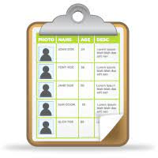
Team Rosters
Share the team roster with the parents on your team.
Team rosters will be emailed by the Season Coordinator.
Include:
Player’s Name
Player’s Number
Parent’s Names
Contact Information
(This information will be emailed to you.)

Slide 6
Warm Up personalization
Communication the option for embroidering warmups and bags.
Jackets - name
Pants - name or initials
Bag - name
Collect items and payment for personalization. There is a form to help track items.
Coordinate with vendors to have items embroidered.
Spees Apparel Works, LLC
1220 Wyoming St.
Dayton, OH 45410
937-253-7520
screen.emb@gmail.com
Twin Designs
5785 Far Hills Ave.
Dayton, OH 45429
937-732-6798
twins@twindesignembrodering.com
Nothing should be embroidered on the “butt” area of the pants.

Slide 7
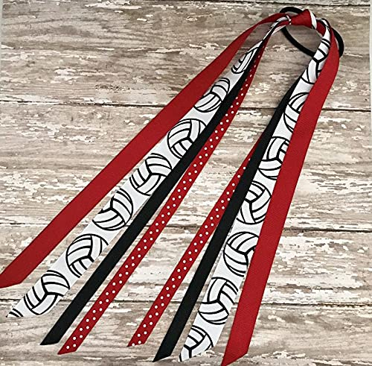
Ribbons and Snacks/Goodie bags
Optional for teams.
Some teams opt for scrunchies.
Create a sign-up sheet or schedule for players/parents to sign up to provide either ribbons, snacks, or both.
Communicate any allergies the team may have.

Slide 8
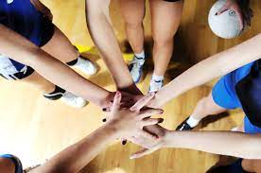
Team get-togethers
Get-togethers are highly encouraged and should be scheduled as soon as possible.
In many cases, the girls do not know each other, so a fun activity will help the girls get-to-know each other better.
Ideas:
Bowling
Dinner
Breakout Rooms
Icebreaker Games
Pizza after Practice
**Schedule lobby with Bethany; Djrssecretary@gmail.com

Slide 9

Team Meals
Make arrangements for a team meal Saturday evenings of 2-day tournaments. Regional teams can plan for a dinner or two after a 1-day tournament.
Contact local restaurants to make reservation for the team or coordinate for carryout or delivery to eat at the hotel. Make sure to check with the hotel for rules about eating in the lobby.

Slide 10
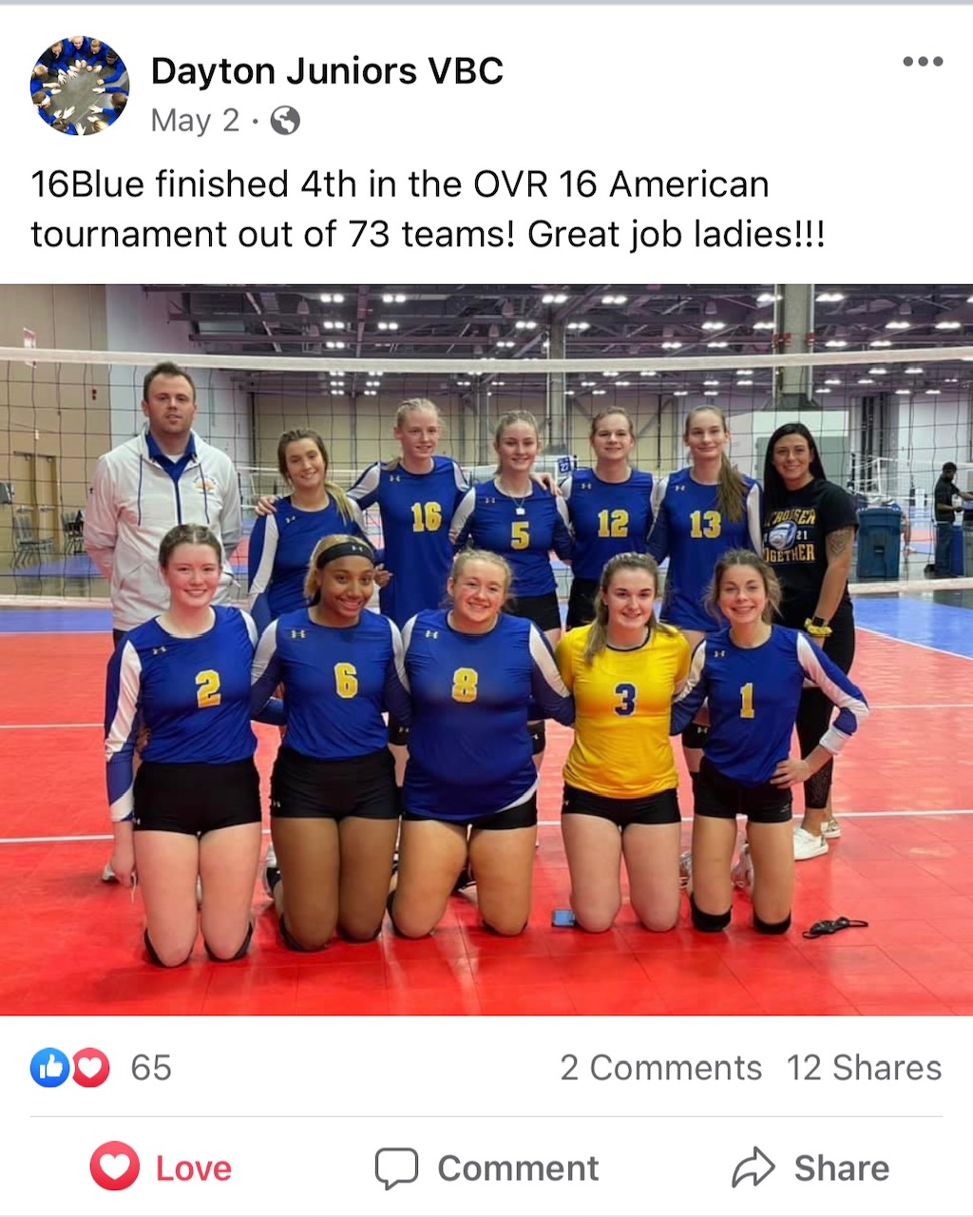
Updating program/social media director
Encourage your parents to send pictures of the players during tournaments, practices, get-togethers, results of tournament play, or articles about players to Bethany for posting on your teams’ webpage, DJRS Facebook, and Instagram.
For all Social Media posts please text Bethany Welch at 937-654-9949

Slide 11
Thank you for volunteering!
Please don’t hesitate to reach out with any questions.
Kali - Club Director djrsdirector@gmail.com or 843-540-6844

