Slide 1
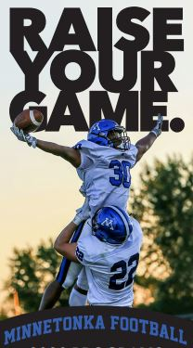

Slide 2

2020 Coaches’ Discussion
Aug 2020

Slide 3
Tonight’s Agenda
COVID - What have we done?
Return to Play Guidelines.
Responsibilities – Coaches, Parents, Players, TFA
What is needed?
Season – what changes?
Goal Tonight:
Need your feedback.
Dynamic times. Missteps will occur.

Slide 4





What Have We Done to Get Ready for ‘Return to Play’

Slide 5
What Have We Done to Get Ready for ‘Return to Play’
Started working on COVID contingencies in May.
MDH Brief (7/31), Legal Brief(8/3), & Review of Final Return to Play Guidelines
MN State High School League decision on Fall Sports.
What the 2020 Season could look like:
Discussion:
? Less games - one game a week. Practice during the week.
? Potential for Friday Night Games (no Varsity games during the fall)
? Limit Spectators and / or Keep spectators off the side lines (end zone view or bleachers)
? Each Association must execute to COVID Plan / LMAA to define the standard.
Approached by other Associations if we do not have a season. External demand.

Slide 6
Youth Football is Different Than High School Football
The kids don’t share a locker room in youth football.
The kids don’t share a bus ride to and from games. They ride to the game with Mom/Dad.
It’s easier to spread out six or seven kids on a sideline (youth) than 60 or 70 kids (varsity)
Fan base is significantly smaller than a Friday Night Varsity Game
Discussed at length with all parties.
Major Decision Factor.

Slide 7
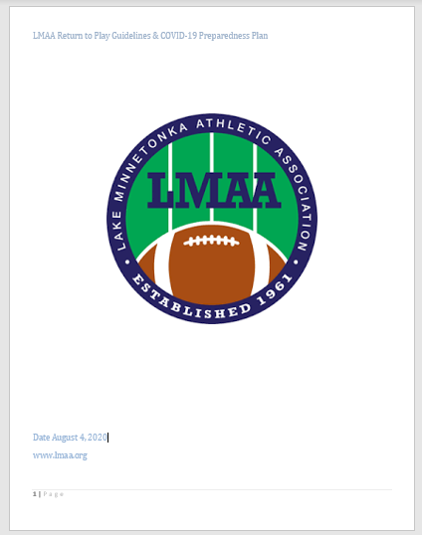
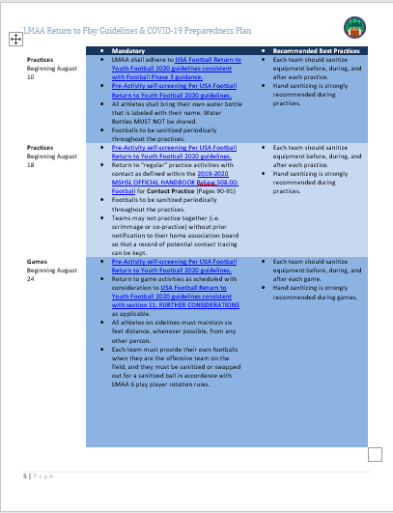
What Have We Done to Get Ready for ‘Return to Play’

Slide 8
What Have We Done to Get Ready for ‘Return to Play’
Review of the document:
What to do?
Requirements / Recommendations / Responsibilities
Responsibility resides with:
Parents
Athletes
Coaches
League / Associations
Resources
Requirements + Recommendations + Responsibility + Resources = Return

Slide 9
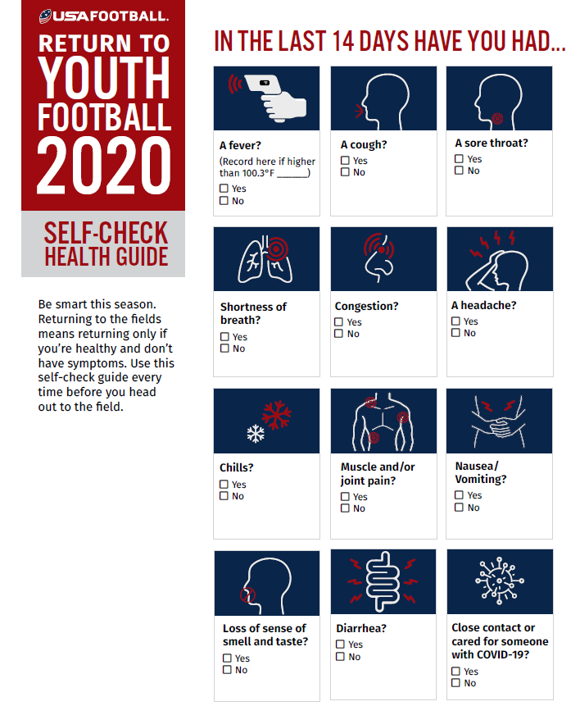
Responsibility:
What can we all do?
Understand. Playing football today is a choice.
Bottom Line – Stay Home if you are not feeling well.
Period.

Slide 10
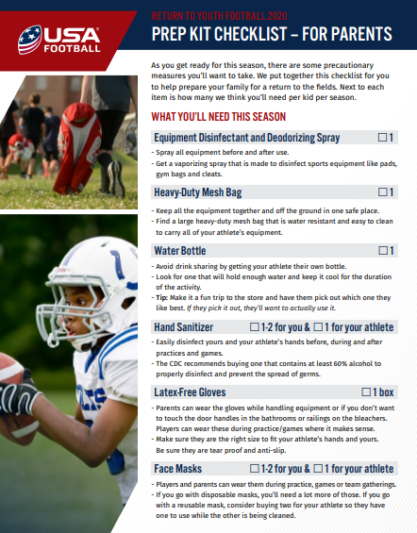
Responsibility:
What can parents do?
Visit USA Football Parent Checklist.
Label everything.
Provide their own:
Hand sanitizer
Disinfectant spray or wipes.
All equipment goes into a duffle or mesh bag before and after practice.
Players should wear football gloves if possible.
Consider face shield.

Slide 11
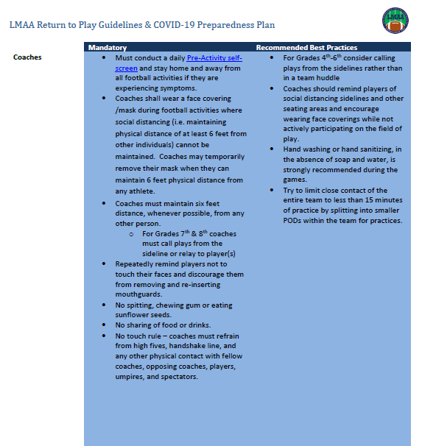
Responsibility:
Coaches
Designate one Coach to oversee COVID protocol and communication. Subject Matter Expert. (SME)
Contact Tracing
The ‘Go To’ if we have a case or the what if…
Keep athletes apart whenever possible.
Divide team in two – Blue / Black. Rotate.
Close contact = < 6ft for 15 minutes
Provide by team:
Hand sanitizer
Disinfectant spray bottle, shop towels or wipes.
Wipe down – prior to / end of practice
Wear a mask as a rule. Take off when not in close contact.
- Be Aware as Eyes Are Upon You Always -

Slide 12
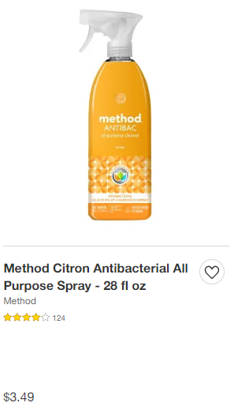
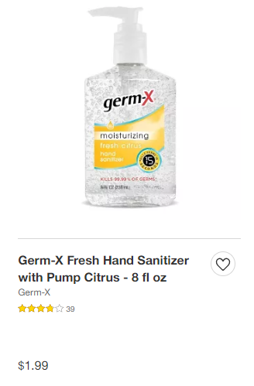
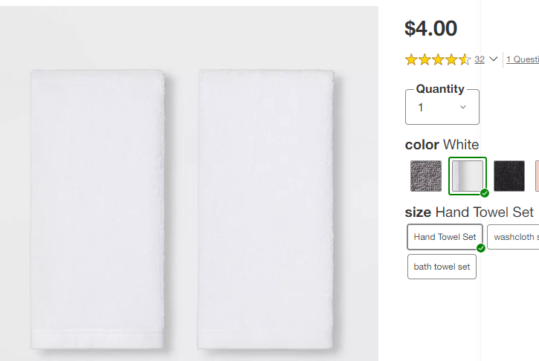
For $10 at Target – your team is covered.

Slide 13
What Happens If….
“Individuals who have had close contact to someone who tests positive are required to self-isolate for 14 days beginning from the date of exposure and immediately contact the designated individual within their “home” member LMAA association as detailed at the end of this document.
Individuals who test positive for COVID-19 infection shall immediately contact the designated individual within their “home” member LMAA association and will be required to self-isolate and avoid sports participation for a variable duration of time. Prior to returning to or attending any football activities they need to provide a note from their health care provider releasing them to full participation. THIS INCLUDES ATHLETES, COACHES, OFFICIALS, PARENTS/GUARDIANS, FANS AND SPECTATORS.
Review What to do if you’re waiting for COVID-19 test results.
See Appendix C for Definition of Close Contact and Exposure.”
Template and Documents within the Return to Play Guidelines. COVID SME Coach will be point.
An exposure of one individual on a team does not equal the ‘team is to be quarantined’.
Diligence & tracing will define other ‘close contact exposed’ individuals.

Slide 14
What The Season Will Look Like…
6 Games –
Once a Week. Saturday or Friday Night.
Lots of games on Stadium. Vets will be dual use. 80-yard fields only – no goal posts.
No make up games.
Spectators –
No fans, parents, etc. on the field.
Only allowed in the bleachers and along the rail. This includes Vets.
Considering End Zone View Only and / or One Parent per player at Badger.
Bowl Games for 7th and 8th are TBD

Slide 15

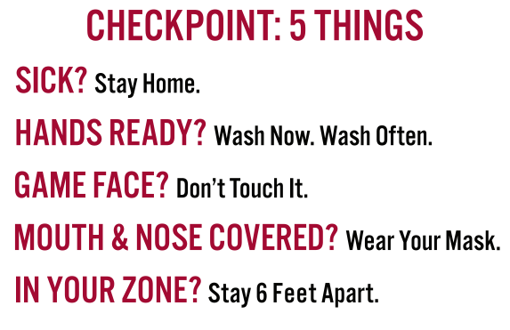


Example of signs that will be created and displayed at TFA Game Venues.

Slide 16
Questions?

