Slide 1

SHAKOPEE High School WRESTLING Parent Meeting 2025-2026
Shakopee High School
October 12, 2025

Slide 2
Agenda
Booster Club Board
Fundraising
Sponsorship
Volunteering
Coaches Corner
Registration
Communications / Info
Schedules

Slide 3
High School Wrestling Booster Club
Lee Triplett– President
Eric Wagner– Vice President
Dawn Finch– Secretary*
Chad O’Fallon– Treasurer
Val Duran – At Large
Melissa Morales– At Large
Lindsey Vanlaningham – At Large
Derek Walters– At Large*
Julia Walters – At Large*
Looking for a social media lead!!!
For email updates or questions, please email the Shakopee Wrestling alias and provide your email address:
shakohswrestling@gmail.com
*board position open at the end of this season

Slide 4
Fundraising
Why do we need to Fundraise?
Supplemental Coaching Staff – In and out of season
Wrestler Development
Out of Town Tournament Expenses– hotels, food
Travel Meals
Team Banners
Senior gifts and annual banquet
Alumni and Youth Night

Slide 5
Fundraising – 99 Pledges
2nd week of practice
Takedown Challenge
Wrestlers will a have personal pledge page to share with family, friends, and fans via text or email
Flat donation or pledge per takedown
Final day of the Challenge will be streamed live
Goal is to raise $10,000 as team
If every wrestler raises $250 we will surpass our goal!

Slide 6

Sponsorship

Slide 7
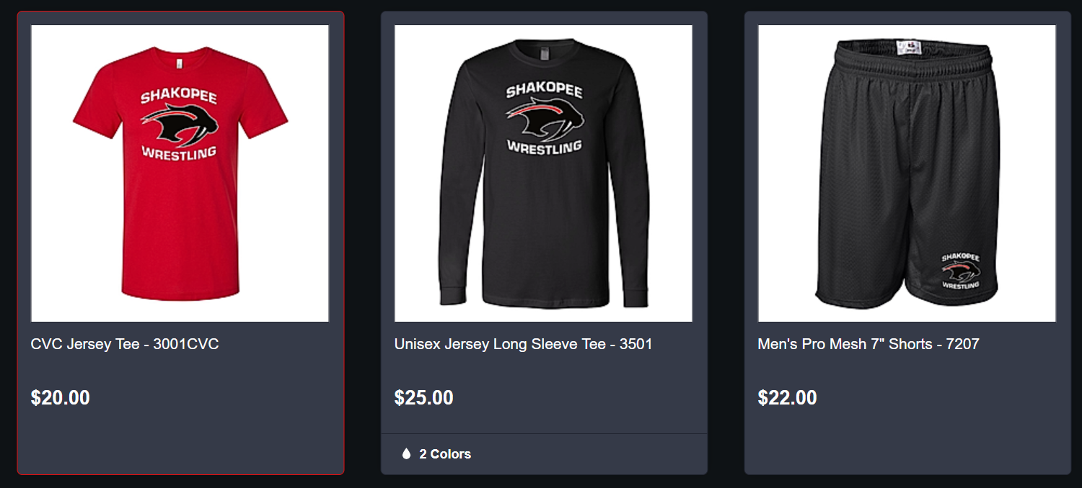
Apparel
Store will be available in the next couple days
Watch your email
If we don’t have your email, please make sure to stop outside after the meeting
Required gear:
HS/MS bundle Options
Shirt, Shorts, Sweatshirt
Shirt, Short, Sweatshirt, Joggers
Both Boys and Girls bundles (same LOGO on both)
Store will be open for one week in order to get gear prior to season
Additional store will open in Late November/Early December

Slide 8
Ways to help!
Volunteer Opportunities:
Take down cancer night, Alumni night, Senior night, and youth night
Food preparation and delivery for meets/tourneys
Lots of events to help support our wrestlers:
Sponsorship
Fundraising
Ask your employer or contractor if they are interested in supporting. Get them in touch with a member of the Booster Club Board
Consider joining the board!!
7 positions will be open following this season!
Get Social:
Facebook – facebook.com/shakopeewrestling
Twitter - Wrestling@SaberWrestle
Website – shakopeewrestling.com
Make sure you have your email in with Dawn and check your spam as our email may get blocked

Slide 9
Coaches Corner

Slide 10
Mission Statement
It is our job as wrestling coaches to help develop great young men and women who will go out and change the world for the better.
There is no other sport that teaches teens how to deal with adversity, disappointments, and develop mental and physical toughness like wrestling.

Slide 11
Coaching Staff
High School
Boys Head coach:
AVK 763-226-9675
Girls head coach:
Blane Tschida 763-496-7726
Boy Assistant Coaches: Girl Assistant coaches:
Cole Baumgartner Olivia Sackor
Nick Creamier
Max Crowe (JV Head Coach)
Alex Crowe
Zach Skattum
Matt Skattum
Rob Crowe
Aaron Murray (9th Grade Head coach)

Slide 12
Team Selection
Wrestle offs*
Every 3-4 weeks
Anyone can challenge, +3.9 pounds or less at wrestle off time
Best 2 out of 3 for first wrestle offs
*Final team selection will be made by coaches

Slide 13
Attendance Policy
SCHOOL COMES FIRST!
Two unexcused Absences allowed
3rd unexcused absence will result in removal from one event.
5th unexcused Absences will result in removal from the team.
For excused absences, wrestlers must communicate absence to Coach AVK or Coach Blane.
Examples of excused absence:
Sickness
Doctor’s visit
Extreme family emergencies
Meeting with teachers

Slide 14
Wrestler Code of Conduct
Wrestlers will be provided with paper copy of our team code of conduct handbook the first day of practice.
We will go through the code of conduct booklet throughout first week and we ask wrestlers to sign form and return it to Coach AVK.
This agreement ensures that wrestlers understand expectations for season.

Slide 15
Weight Training
Starting 11/19 - Mondays and Tuesdays from 6:45am-7:30am
Run by Coach Regan with AVK to assist
Let AVK or Captains know if a ride is needed

Slide 16
Team Nutrition
Food will be provided for wrestlers at tournaments only
For Dual meets: An uncrustable and small snack will be provided, please make sure your kids bring a healthy meal/snack for dual meets
Fundraising $ will be used towards nutrition - Additional funds may be needed pending fundraising results
We are once again putting a high emphasis on nutrition this year!

Slide 17
Skin Issues and Physicals
Avoid ongoing skin conditions!
Mandatory showers for high schoolers immediately after practice at school
Antibacterial soap prevents many skin problems
Skin checks will be done weekly at practice
If skin issue comes about, talk to coach
Physicals:
New physical on file required every 3 years
Check in at the activities office to see if you need a new one
You cannot practice until physical is turned into activities office if one is needed

Slide 18
Registration
Registration for winter athletic activities is open!!!
Shakopee High School Activities (shakopeesabers.com)
Website for School Activities Office:
https://www.shakopeesabers.com/

Slide 19
Communication
Website for information and for weekly communication to High School parents https://www.shakopeewrestling.com
In the High School section you will find a This Week tab near the top (will be updated by Sunday evening each week for Varsity/JV)
On that site you will find a Schedule tab right next to the this week tab. This is the most up to date schedule and the one used by Athletics Office. - using this schedule viewer also gives you clickable links for locations (address & a map)
Follow Shakopee High School Wrestling @SaberWrestle on Twitter and Shakopee Wrestling on Facebook for very general information

Slide 20
Key Dates- Overnight Tournaments
December 5th and 6th - Donnybrook
December 19th-20th - Christmas Tourney
January 2nd and 3rd - Rumble on the red - JV and Girls
January 2rd and 3rd - The Clash

