Slide 1

300 Hurdles For The Beginner
Jared Sanchez

Slide 2
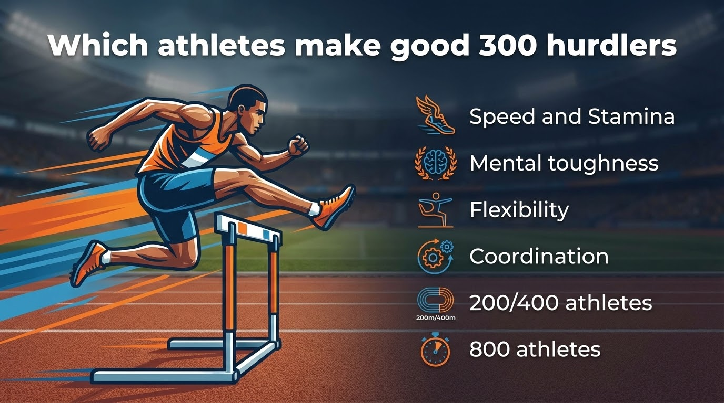

Slide 3
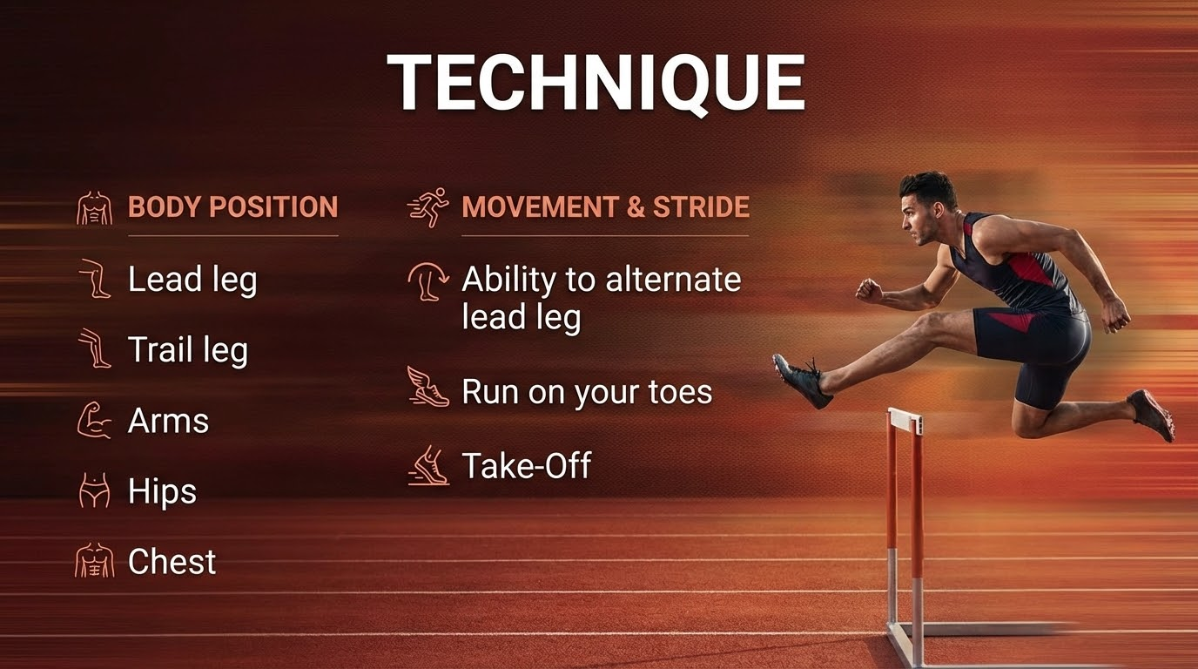

Slide 4
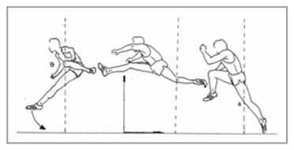

Slide 5


Slide 6
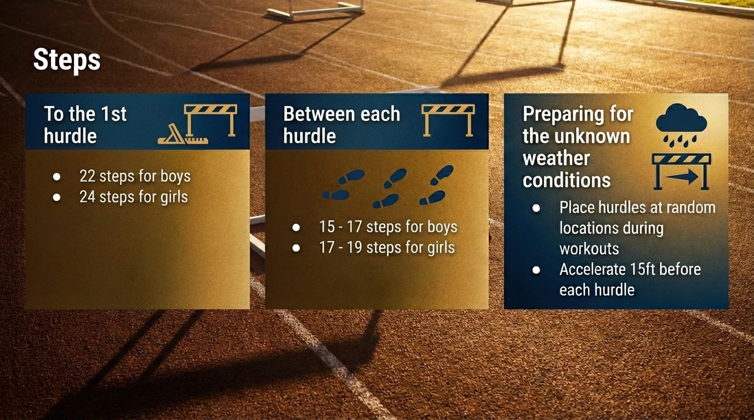

Slide 7
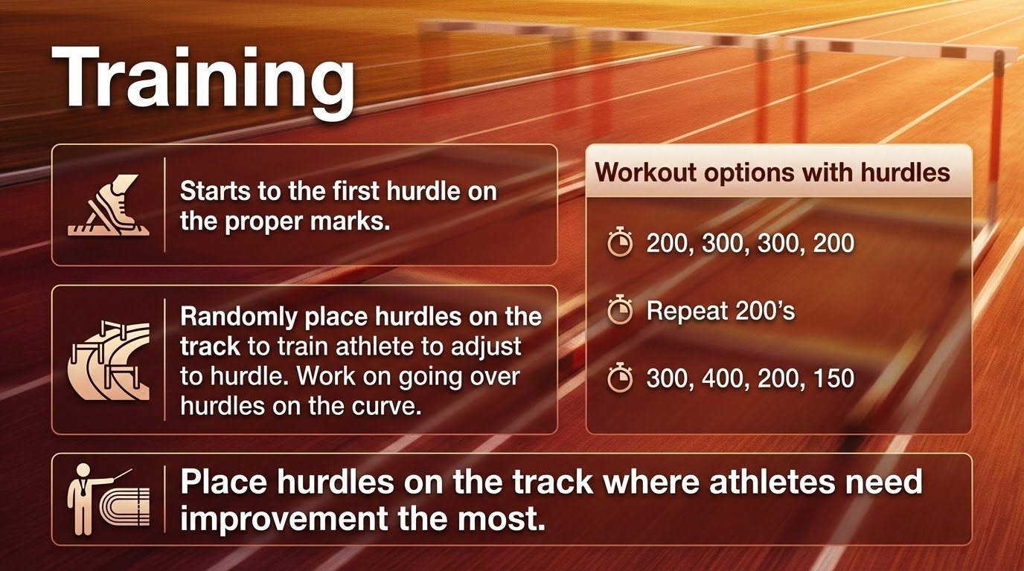

Slide 8

Contact Info
jaredsanchez1987@gmail.com

Slide 9

Open Forum

