Slide 1
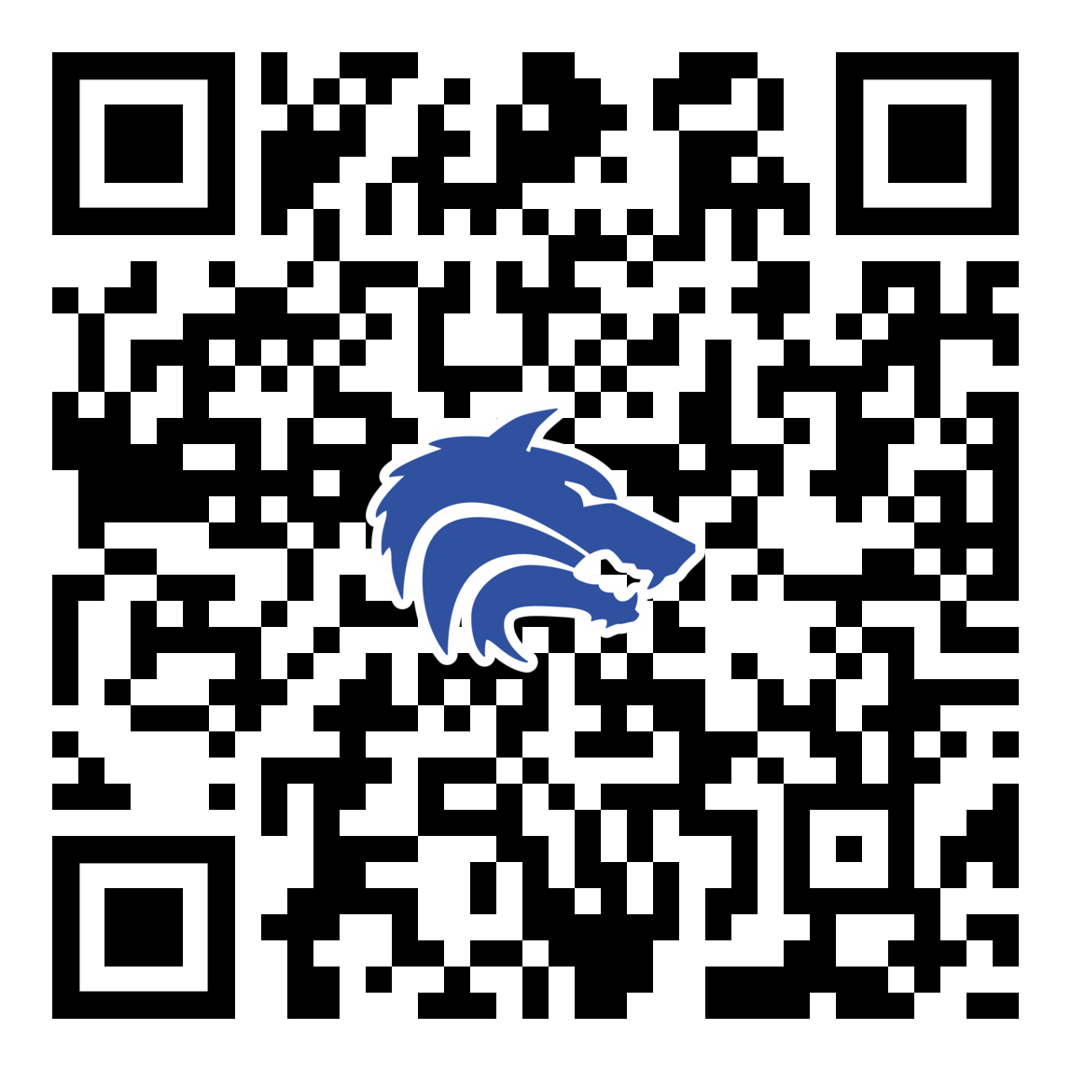
September 2023 Booster Club Meeting

Slide 2
Agenda
Approve August Meeting Minutes
Treasurer Report – Stephanie Dubner
Fall Fundraising
Coach’s Corner

Slide 3
Booster Club Votes
Approve August 2023 Meeting Minutes
JOIN THE BOOSTER CLUB
22 members already – 15 new members since August Meeting
$4,550 in membership dues!
www.planowestbaseball.org/join

Slide 4
Treasurer’s Report: September 2023
2023 – 2024 Beginning Balance:
Revenue
Booster Club Memberships
"Pack The Park" 50/50 Raffle
Total Revenue:
Expense
Reimbursement PY – check cashed
Sports Engine Website Fee
New Baseballs (11 dozen)
Misc. Equipment (iPads, cases, tripod, baseballs)
Total Expense:
$30,195.74
$4,247.00
$240.00
$4,487.00
$1,348.53
$1,299.00
$847.00
$2,321.92
$5,816.45
Ending Balance as of 9/19/2023
$28,866.29

Slide 5
Homecoming Parade
Wednesday, September 20th
Thank you Courtney Donkervoet & Joelle Novick for taking on float!
Candy donations needed!
Plan:
After practice: decorate & pizza until 5:30 pm
Make way to staging on Yeary by Brinker 5:40 pm
Parade starts at 6:30 pm (goes down Yeary and into Plano West Lot)
Pep Rally after in gym for Students
Parents please help clean up float etc.
Players wear: fall jersey/shirt, black shorts (or sweatpants) and fall team hat

Slide 6
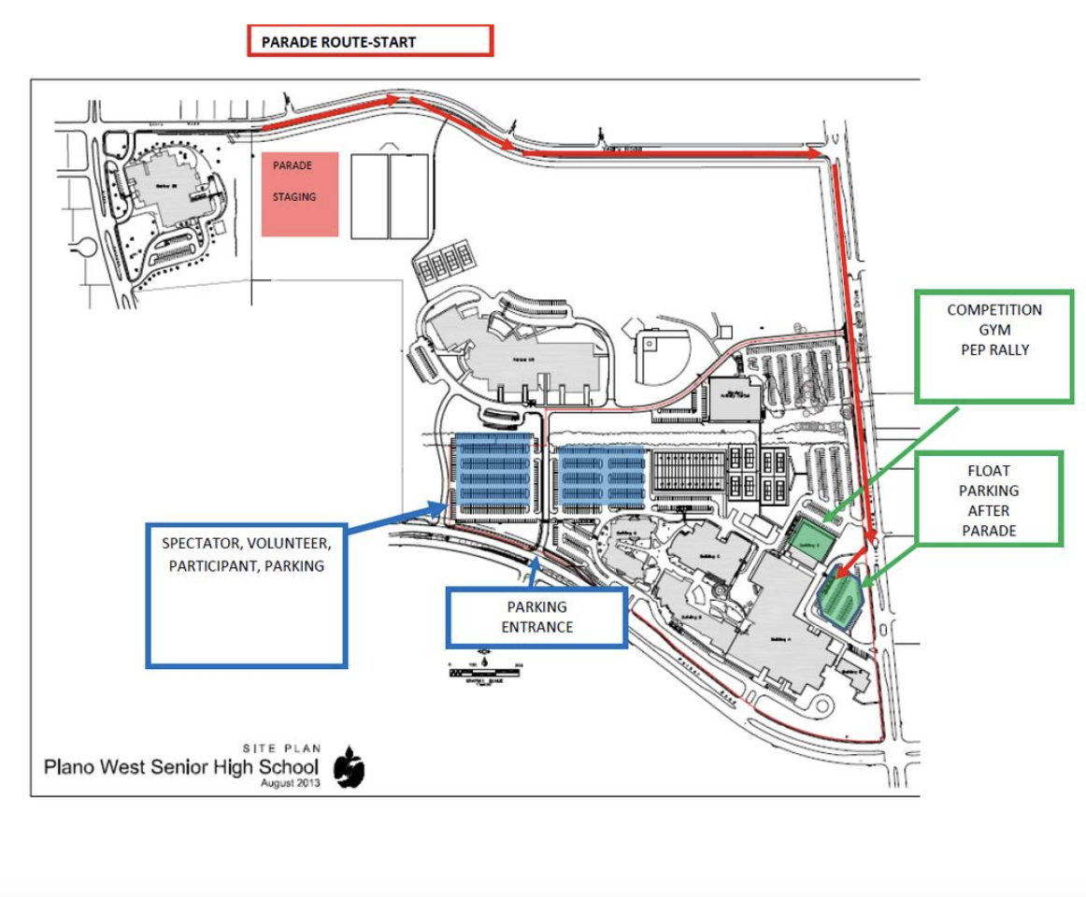
Homecoming Parade Route

Slide 7
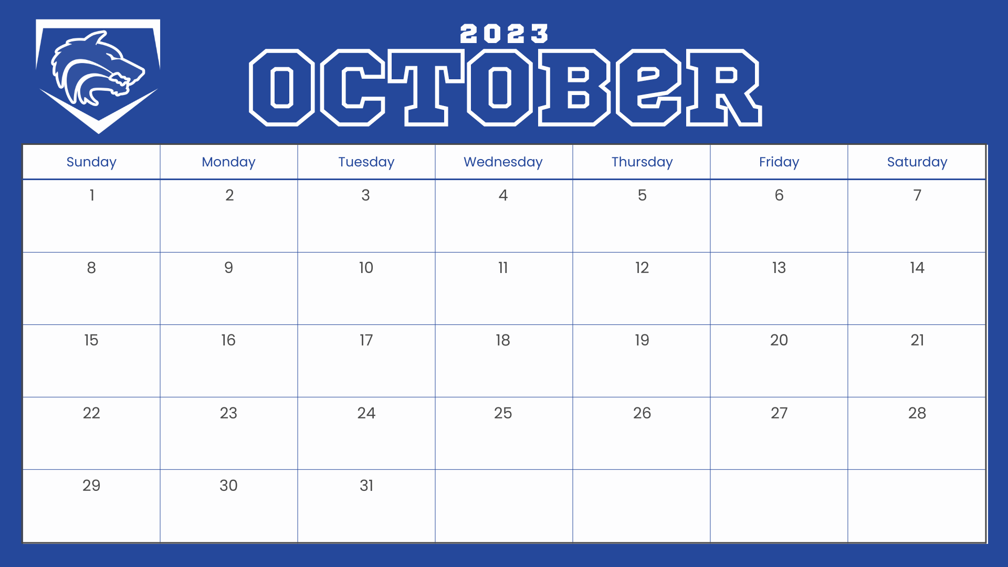
October Fundraiser
Calendar Fundraiser

Slide 8


Plano West Baseball Spirit Nights
Raising Cane's Plano West Baseball Spirit Night!
When: w/o of October 15th (exact date TBD)
Where: Coit and Spring Creek Location
Who: Anyone that comes by and mentions PW Baseball
Benefit: 15% back to Plano West Baseball!
BBQ Dinner Drive Through
When: Early November (Date TBD)
Where: PW Baseball Field Parking Lot
Who: Anyone that orders BBQ ahead of time for pickup
Benefit: % back to Plano West Baseball!

Slide 9
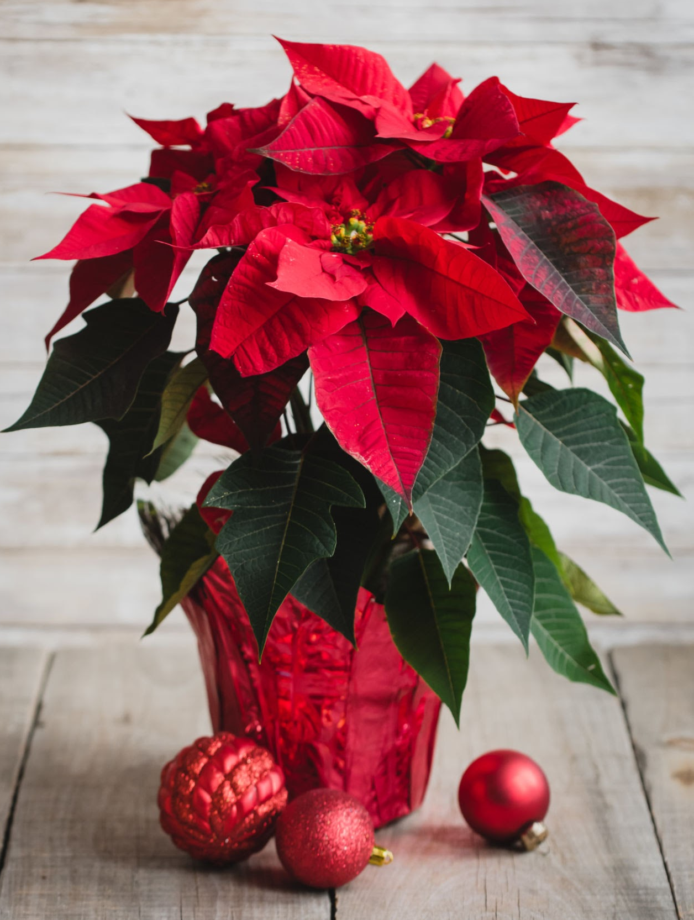
November Fundraiser
Poinsettia Fundraiser

Slide 10
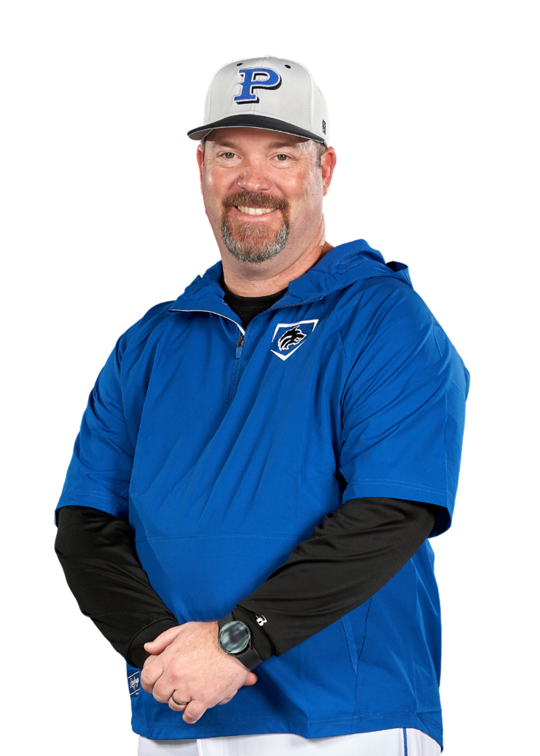
Coach’s Corner

Slide 11
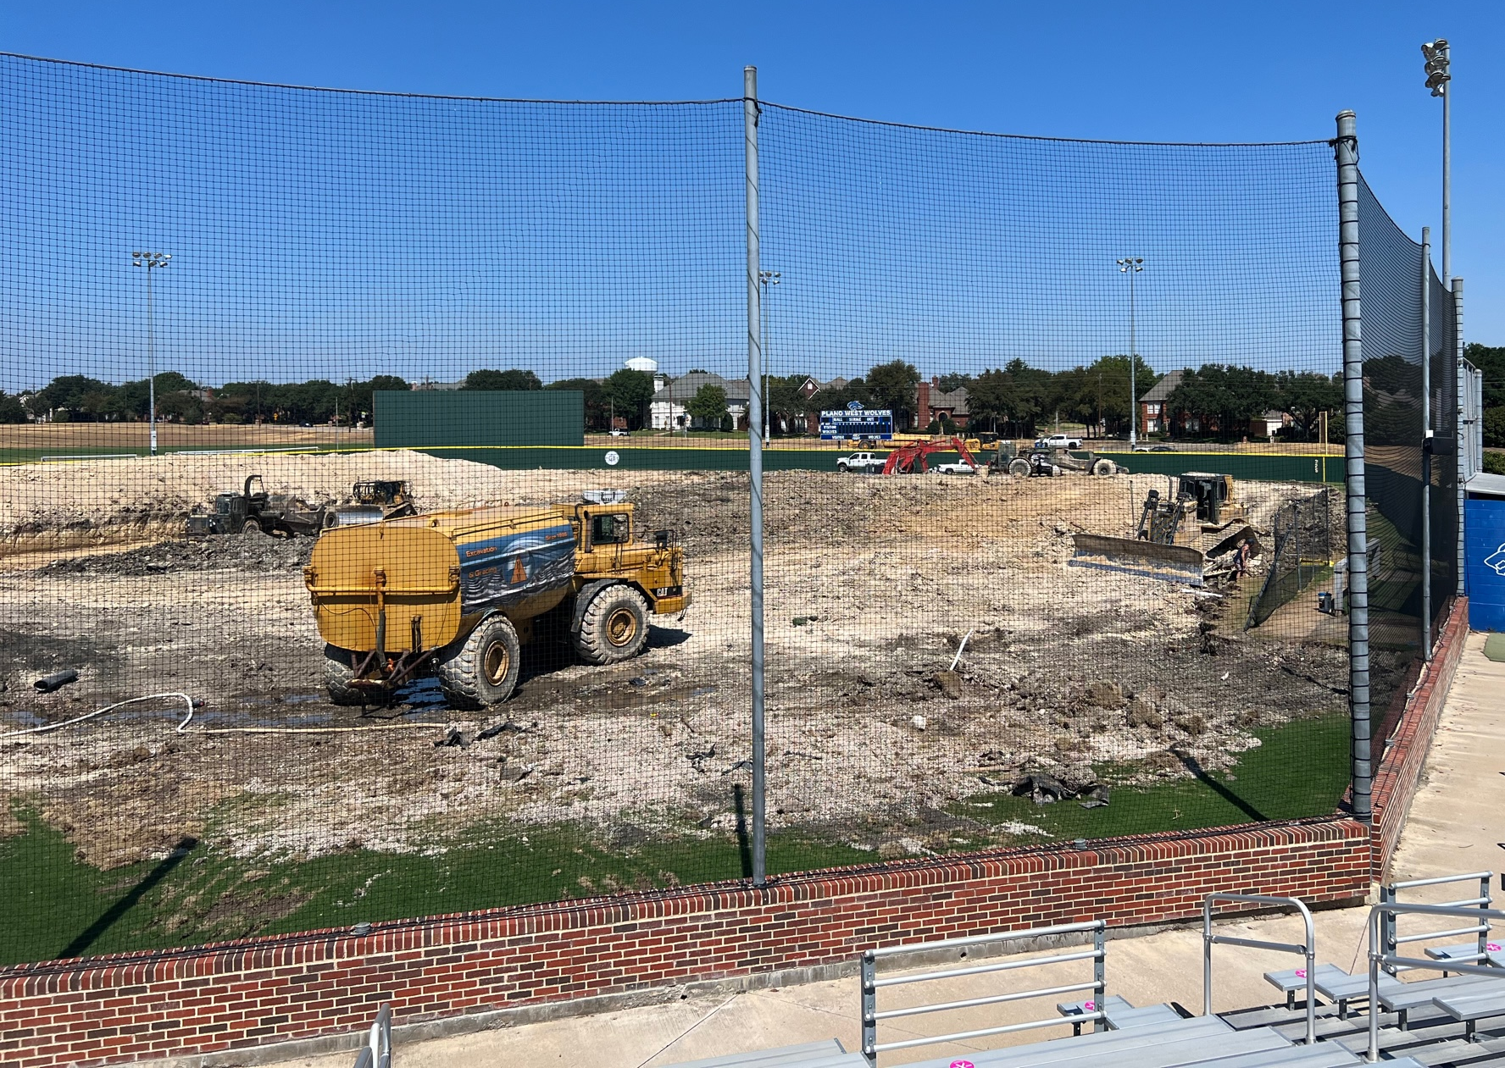
Ballpark Update

Slide 12
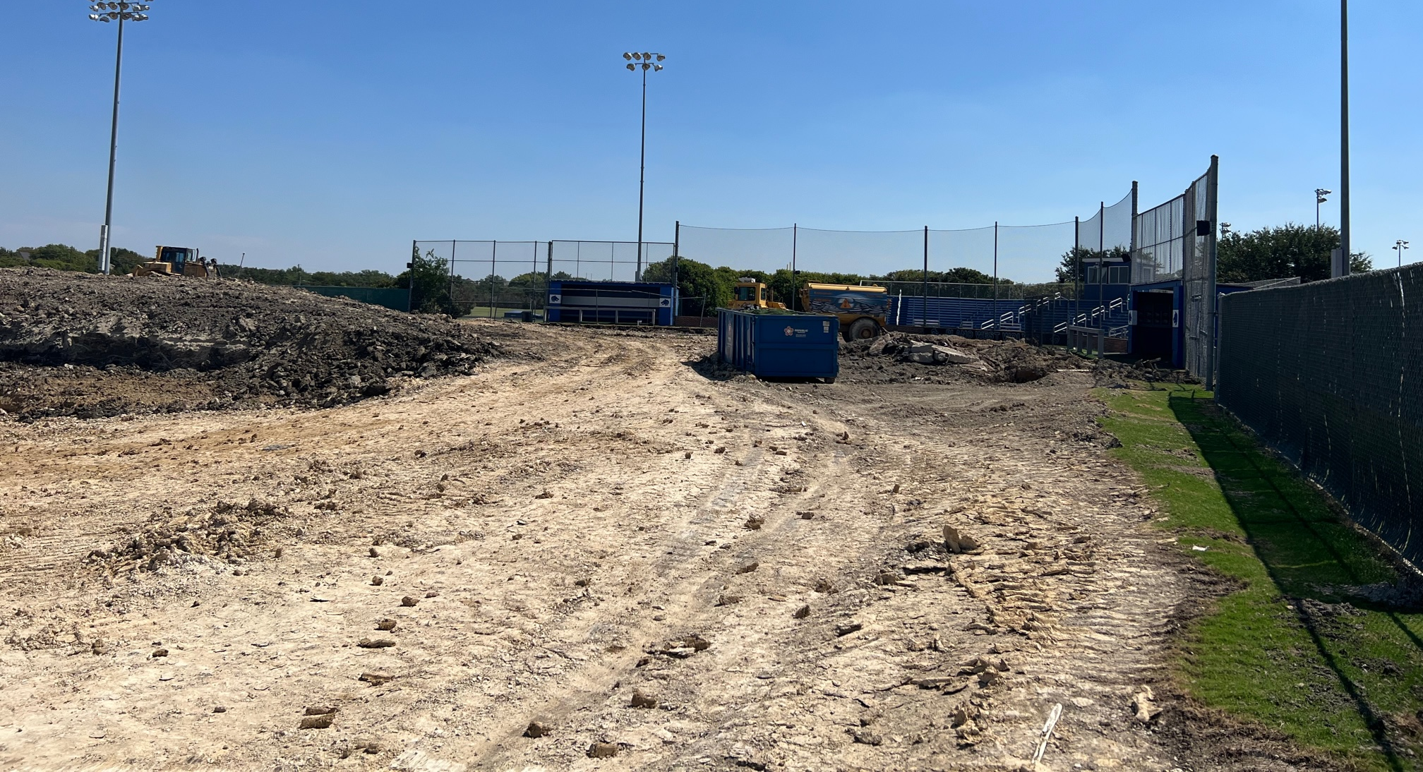
Ballpark Update

Slide 13
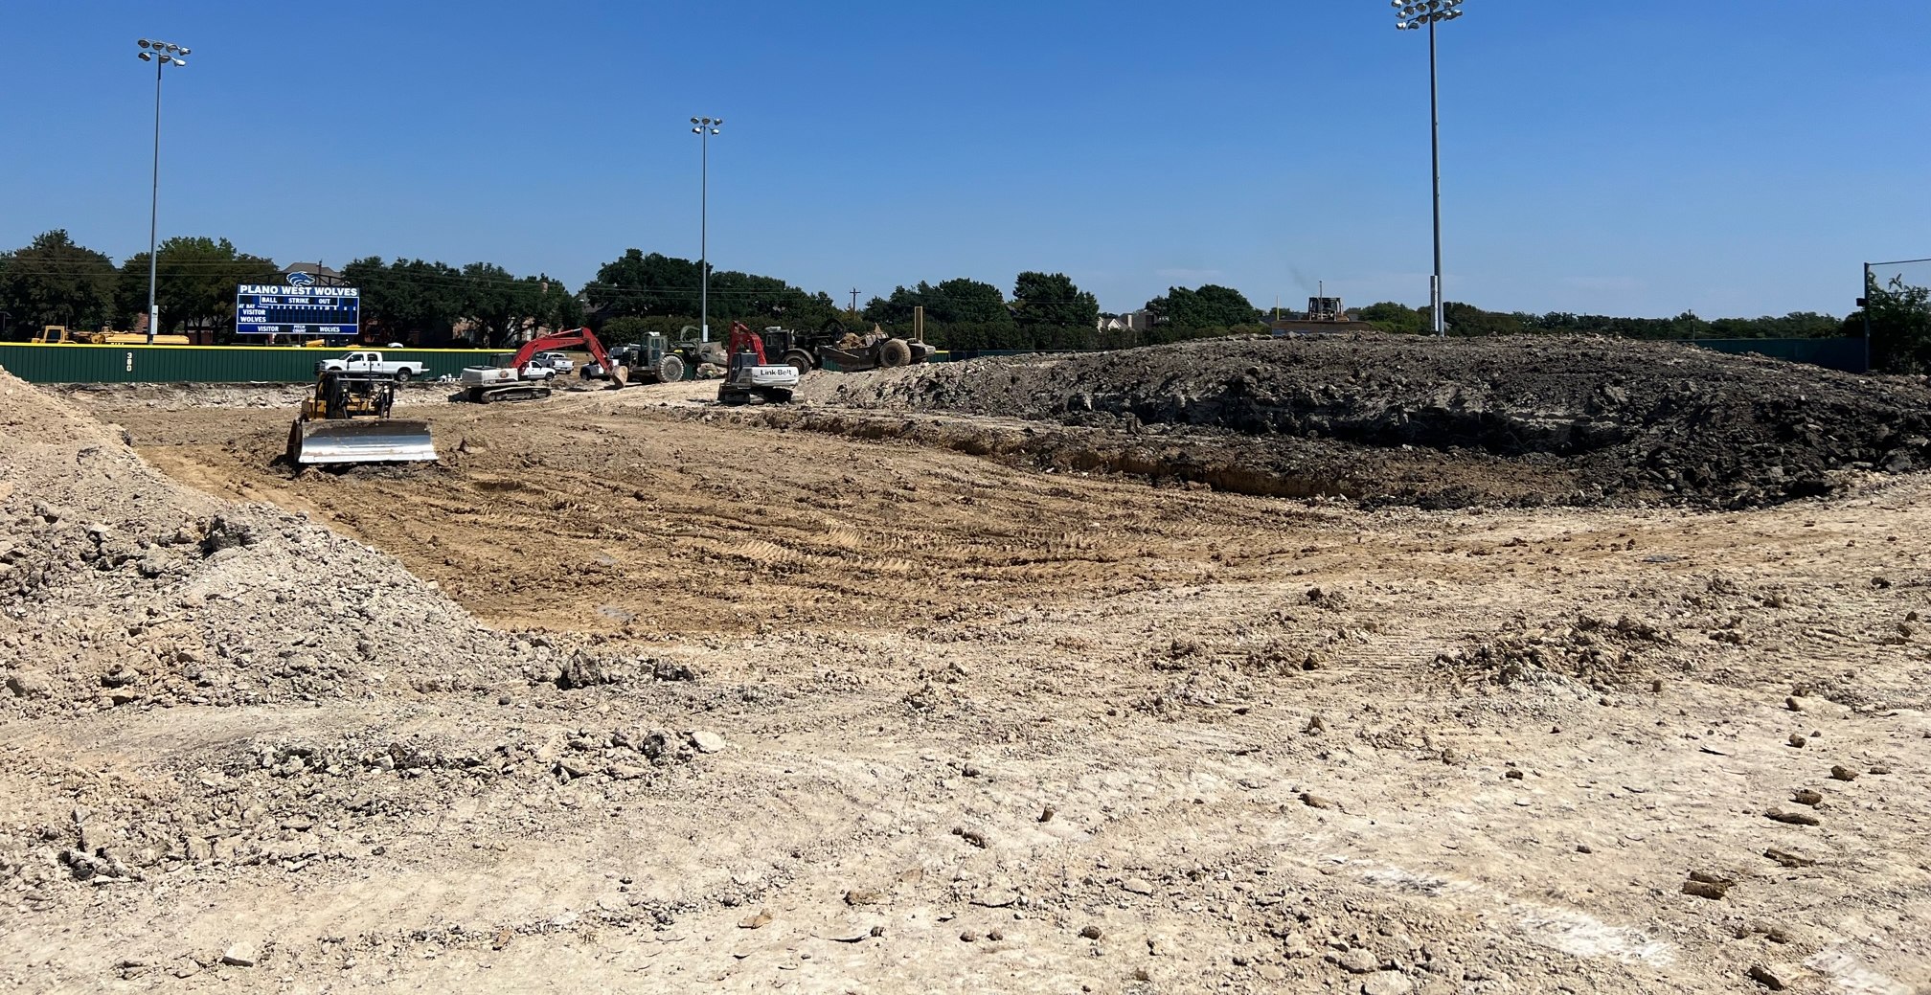
Ballpark Update

Slide 14
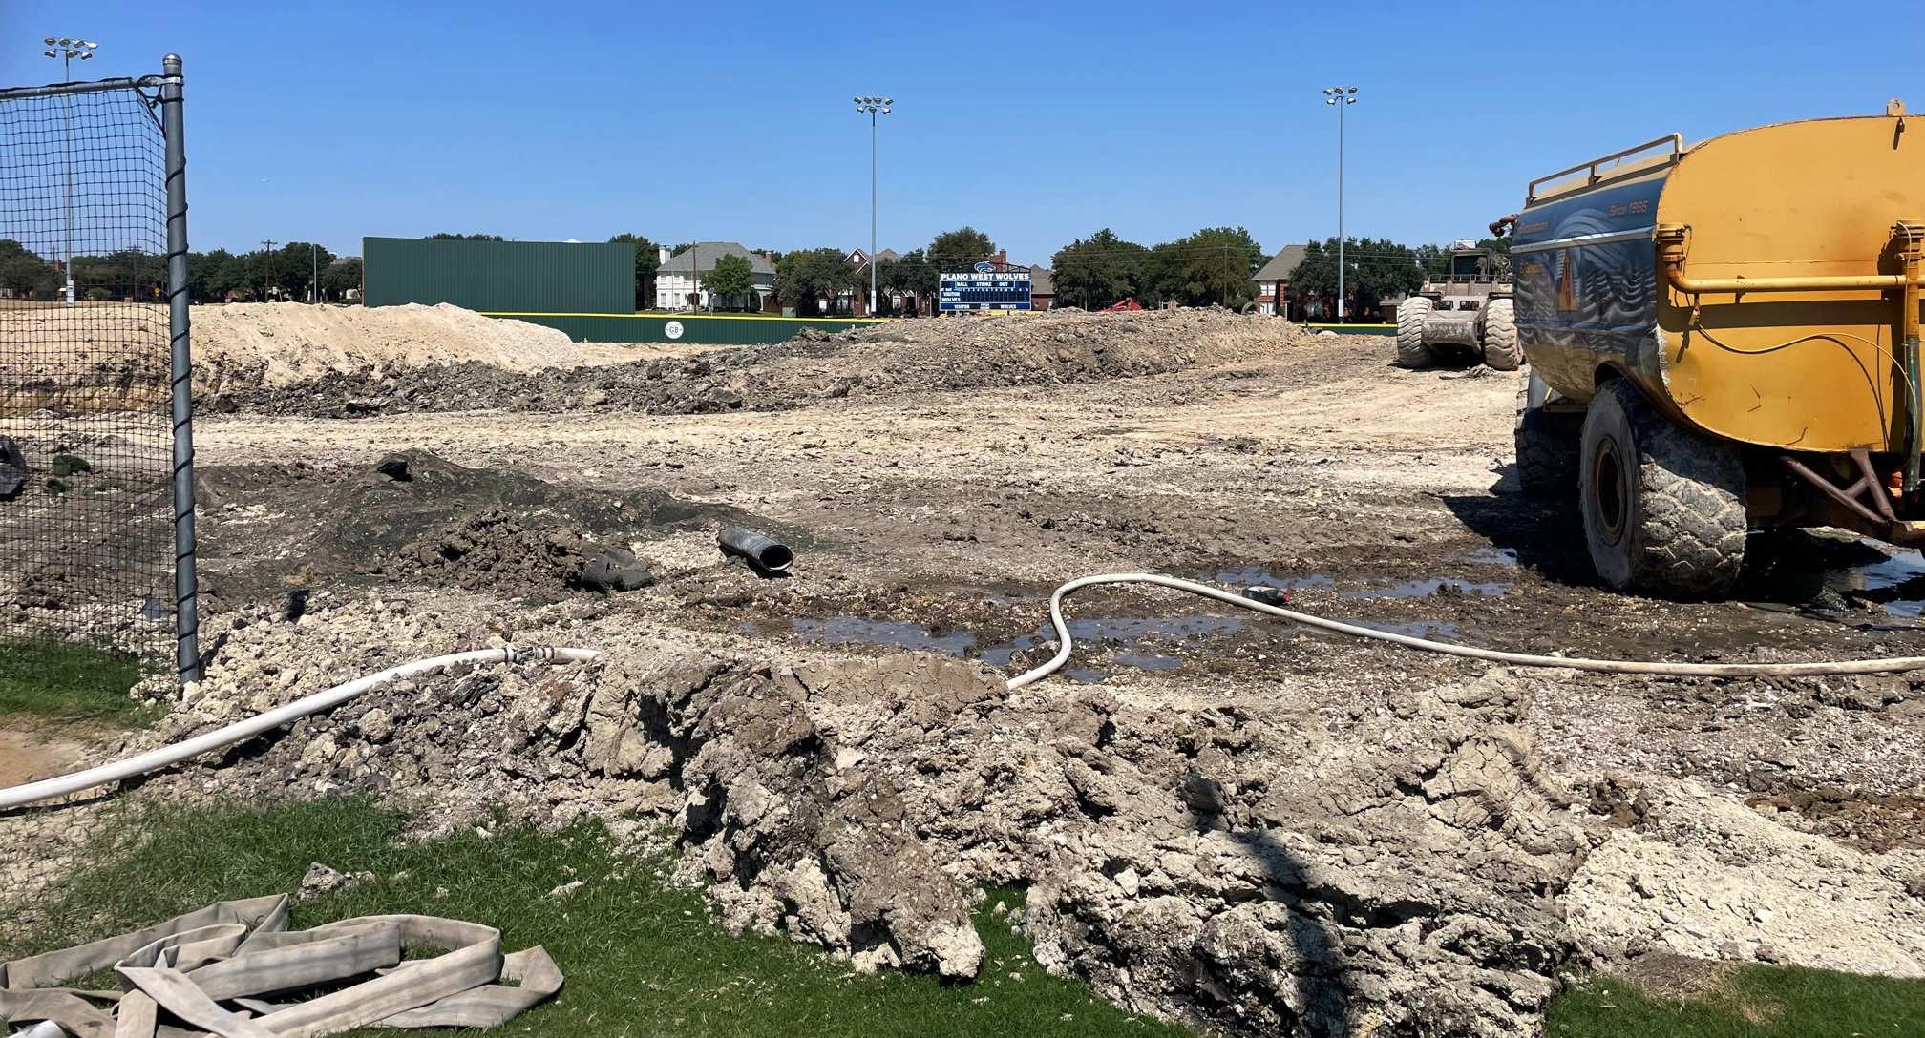
Ballpark Update

Slide 15
September 2023 Booster Club Meeting

Slide 16

SportsYou
DCMN-ZE9D

Slide 17

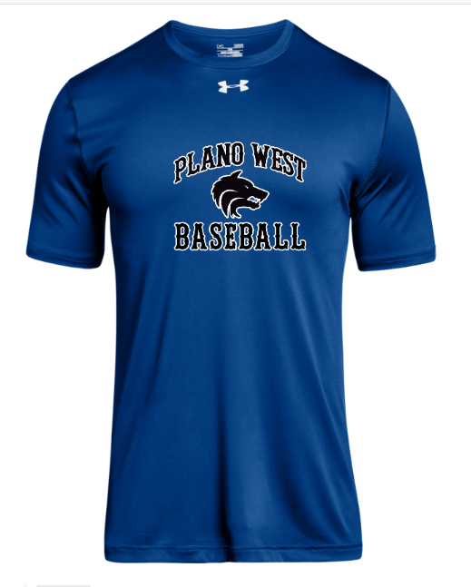
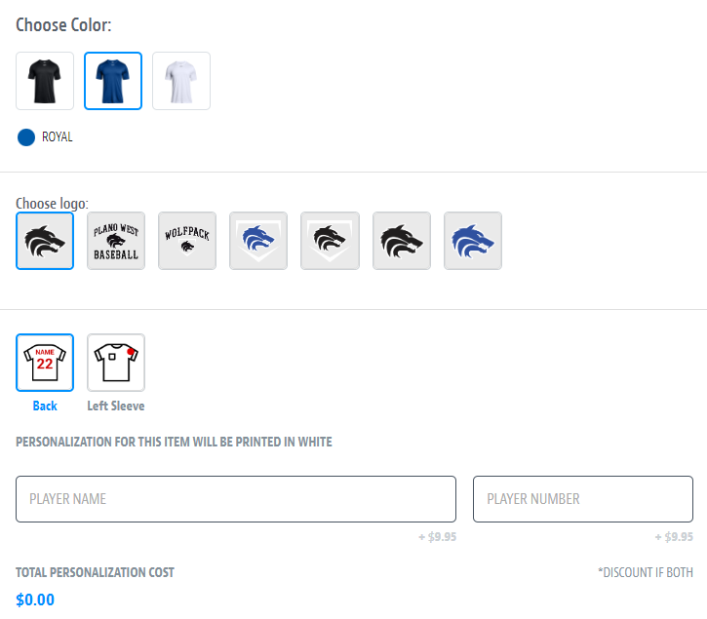
Spirit Wear – powered by SQUADLOCKER
aaaaa

Slide 18
Board Introduction
President: Jeff Paschal Preston (12)
Vice President: Julie Raecek James (12)
VP Marketing: Chris Grimes Sam (12) and Stephen (9)
Treasurer: Stephanie Dubner Matt (12)
Secretary: Erin Wasson Jack (11)

Slide 19
2023 – 2024 Booster Club Budget

Slide 20
2023 – 2024 Booster Club Budget

Slide 21
Fall Baseball Calendar
Booster Club Meetings on Website
Non-Baseball Class Tryouts – August 20
Pack @ the Park – Tuesday, September 5
Fall Ball Begins – Wednesday, September 6 (tentative)
Fundraising
Poinsettia Fundraiser Sales – October
Whiffle Ball / Cornhole Tournament – October 28 (tentative)
Other Fall Fundraisers
Baseball Alumni Game – Saturday, December 16 (tentative)

Slide 22
2023 – 2024 Booster Club Budget

