Slide 1
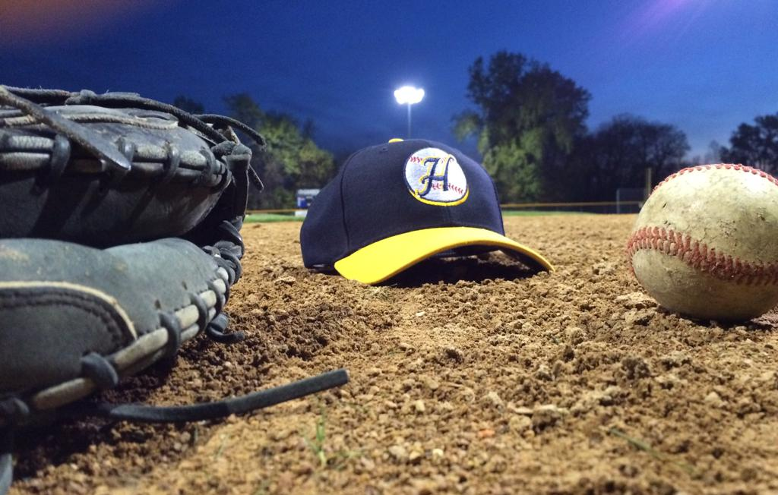
St. Paul Highland Ball
Stretch/Warmup/Agility/Strength Guidelines

Slide 2

Stretching/Warmup
*At least 15 minutes should be dedicated to stretching/body warmup prior to throwing
Body Warmup
1. Sprints
The first thing that should be done in a warmup is five to 10 short sprints that simulate the action you would see in a game. This will get the body's core temperature warmed up, and it will also increase circulation to the muscles. Start at the first base line. Sprint to second base, walk back and sprint again.
2. Forward Bends
Stand in a wide stance with your arms out to your sides and parallel to the ground. Bend forward and touch your right hand to your left foot. Come back up and then touch your left hand to your right foot. Alternate back and forth three to six times.

Slide 3
Stretching/Warmup (cont.)
3. Cat/Cow Yoga Stretch
Cat/Cow is a flow between two stretches that warms the body and brings flexibility to the spine. It stretches the back torso and neck, and stimulates and strengthens the core. Begin with your hands and knees on the floor. Make sure your knees are under your hips, and your wrists are under your shoulders. Begin in a neutral spine position, with your back flat and your abs engaged. Take a big deep inhale. On the exhale, round your spine up towards the ceiling pulling your belly button up towards your spine, engaging your abs. Tuck your chin towards your chest, and let your neck release. This is your cat-like shape. On your inhale, arch your back, let your belly relax and go loose. Lift your head and tailbone up towards the sky — without putting any unnecessary pressure on your neck. This is the Cow portion of the pose. Continue flowing back and forth from Cat Pose to Cow Pose, connecting breath to each movement — inhale for Cow Pose and exhale on Cat Pose. Repeat for at least 10 rounds, or until your spine is warmed up.

Slide 4
Stretching/Warmup (cont.)
4. Trunk Rotations
Trunk rotations are done with your feet in a wide stance and your hands extended out to your sides and parallel to the ground. Rotate your upper body to the right, then rotate it to the left. Every time you rotate, try to go a little bit further. Go back and forth three to six times.
5. Knee lifts
Knee lifts loosen up the legs and the hip flexors. To do these, stand with your feet about shoulder width apart. Lift your right foot off the ground and bring you knee up to your chest. Lower it back down and bring your left knee up. Go back and forth three to six times. You can also do these in a walking motion.
Throwing Arm Stretches
1. Shoulder Circles
With your arms at your sides, make circular motions with your shoulders. Stand with your feet shoulder-width apart without moving your arms or head. Try making circular motions forward first, and then do them the opposite way. This dynamic stretch is a good way to get started warming up and loosen your shoulders before doing baseball drills.

Slide 5
Stretching/Warmup (cont.)
2. Arm Circles
This stretch is similar to the shoulder circles. Put your arms out to your sides, and make circular motions with them. These circular motions are similar to the motion made when throwing a baseball. Start with small circles, and then gradually make the circles bigger. This stretch should be a part of every player’s baseball training.
3. Triceps Stretch
For this stretch, you can use an item such as a towel or a band to help you if your shoulders are particularly tight. Holding the towel in one hand put your arm over your back, behind your head. Grab the other end of the towel behind your back with your other hand, and gently pull to stretch the triceps of the arm that is over your head. You shouldn’t try to force the stretch, but after incorporating it into your routine, you will know that your triceps and shoulders are loose if you can interlock your fingers in this stretching position.

Slide 6
Stretching/Warmup (cont.)
4. Forearm Stretch
Pull back on the fingers of your straight arm until a mild stretch begins in the forearm muscles. Hold this stretch for about twenty seconds. Release the stretch and turn the hand 180 degrees so that your stretch arm is now positioned with the palm facing outward and the thumb pointing out to the side.
5. Chest Stretch
For this stretch, you will need a partner. Raise your arms sideways away from your body to shoulder height and turn your palms forward. Have your partner stand behind you, hold your wrists, and pull both arms back at the same time. This stretch should only last 10 seconds - going longer can put you at risk for injury.
6. Hugs
This stretch warms up your back as well as your rotator cuffs. Start by holding your arms out to your side at shoulder height. Then swing your arms across your body and hug yourself. Your hands should reach behind you and hold the back of your shoulders. Hold this position for a second and then repeat.

Slide 7

Agility
Footwork – Ladder Drills

Slide 8
Agility (cont.)
Footwork – Cone Drills

Slide 9
Agility (cont.)
Footwork – 5 Dot Drill

Slide 10
Agility (cont.)
Wave Drill (football example)

Slide 11
Agility (cont.)
Jump Rope

Slide 12
Agility (cont.)
Wall Transfer Drill

Slide 13
Agility (cont.)
Running Form Drills

Slide 14
Stengthening
Body Weight Squats
When done correctly ensure great hip and ankle ROM – Important to throwing
Requires really good core strength when done correctly and will improve core strength when done correctly
Teaches you to organize the spine which becomes very beneficial when under a load
10 Repetitions
Progress to: Feet narrow - then do the same with right foot forward then left foot forward – staggered/split stance

Slide 15
Stengthening (cont.)
Lunge Patterns
To be done correctly really engages and improves the core
Make sure the legs are strong when lunging…no wobbly legs or trunk
By adding multi plane lunging you are better preparing the body to create stability in multiplane movement patterns
10 forward lunges (each leg counts as 1 – 5 per leg)
10 backward lunges (each leg counts as 1 – 5 per leg)
Progress to other planes of movements - right lateral lunges, left lateral lunges, right forward 45 degree lunges, left forward 45 degree lunges, right backward 45 degree lunges, left backward 45 degree lunges

Slide 16
Stengthening (cont.)
Pushups
Require core stability and shoulder/scap stability to do correctly
5-10 pushups (it is ok to modify and do from knees, technique is important)

Slide 17
Stengthening (cont.)
Planks
Cores strengthening exercise
Start in a push-up position, bend elbows and rest forearms flat on the ground
Flex your stomach muscles and hold (make sure your back stays flat)
5 repetitions at 10 seconds

Slide 18
Stengthening (cont.)
Throwers 10 Exercises
Start with Exercise #1
Emphasize scapular control
Start with one set of 10 then progress

Slide 19
Stengthening (cont.)
Long Toss
If athlete is throwing with good mechanics, it is ok to let their arm dictate how far and long to throw. This does require supervision as coaches should monitor throwing mechanics. Instead of sets and reps, set a time period that the players can throw. Maybe 15 -20 minutes. If players are done early that is ok as they could be tired not strong enough to throw longer etc. But allow time for those that are able to so they can continue to develop.
Arm Health Resources:
https://www.mlb.com/pitch-smart
https://www.stopsportsinjuries.org/
https://elitebaseballperformance.com/

