Slide 1

Nutrition Fundamentals
What is Worth Focusing On

Slide 2






Tommy Jensen, MS, RD Director of Sports Nutrition University of Minnesota September 2019 - present
Previous Stops:
April 2019 – September 2019
Team Sports Dietitian
July 2018 – April 2019
Associate Director Sports Nutrition
January 2017 – September 2017
Team Sports Dietitian - Consultant
July 2014 – July 2018
Associate Director Sports Nutrition
November 2013 – February 2014
Volunteer Sports Dietitian
Disclaimer:
I have no affiliation or receive any money from companies mentioned in this presentation

Slide 3
FUNDAMENTALS TO FOCUS ON
SLEEP
ENOUGH KCALS
CONSISTENCY
VARIETY
SUPPS/SPORTS PRODUCTS

Slide 4
What Happens When you Miss Restorative Sleep – Weight & Metabolism
Likelihood of overeating increases as hunger hormone levels rise while hormones signaling you’re full decrease
Chance of GI problems and nutrition absorption issues rise.
Increased cortisol levels cultivate bad bacteria in your gut, which can lead to systemic inflammation

Slide 5
What Happens When you Miss Restorative Sleep – Energy & Resilience
Time to physical exhaustion drops
Injury rate increases
Tissue repair slows and lactic acid builds up faster
Peak muscular strength, explosiveness, and skating speeds decreases.

Slide 6
SLEEP COACHING POINTS
8-10hrs of sleep
Sleep hygiene
Temperature 65-69 degrees
Noise – white noise
Light – blackout curtains or sleep mask; peak melatonin production comes from light
Bed/wake consistency
Don’t rely on melatonin
Considerations around sleep:
Practice times
Lift times
Meal times in AM (breakfast/pre-game)
When traveling, pair w/similar sleep habits vs mentorship/seniority

Slide 7
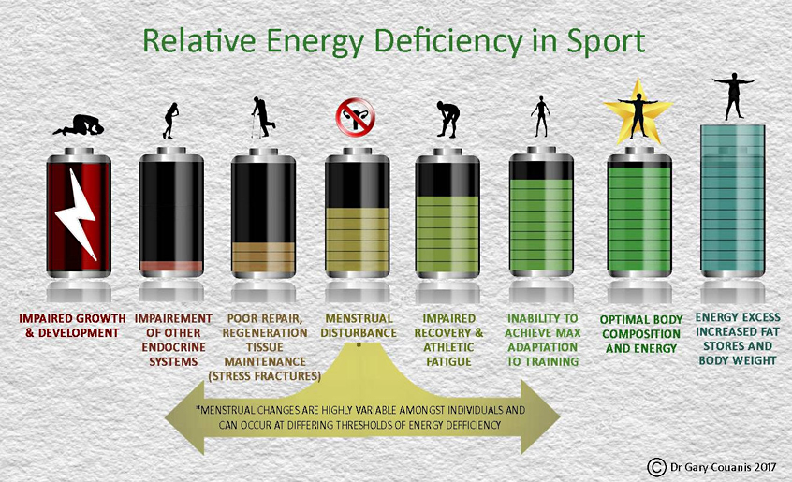
ENOUGH CALORIES
Support development, daily activity, and general health
Higher risk for under fueling d/t societal pressures & environment
Social media influences diet culture, body comparisons
RED-S risk – hormonal, metabolic, bone health, and immunity

Slide 8
CONSISTENCY COACHING POINTS
Not skipping meals
Not showing up to practice under fueled and therefore, showing up unprepared
Common to skip breakfast and/or lunch d/t class and training schedules
Skipping post-workout recovery beverage d/t misconceptions or fears
Consistent eating allows for normal hunger cues

Slide 9

VARIETY
Lack of exposure or assumptions about foods – starts at home
Micronutrient deficiencies can occur when eating same foods– lead to slower recovery from injury, increase in URTI and illness which all cost time on ice
More diverse diet = more exposure to health benefits

Slide 10

SUPPLEMENTS/SPORTS PRODUCTS

Slide 11






Reputable Brands Won’t Ruin Your Brand

Slide 12
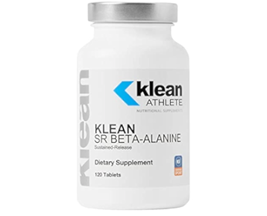
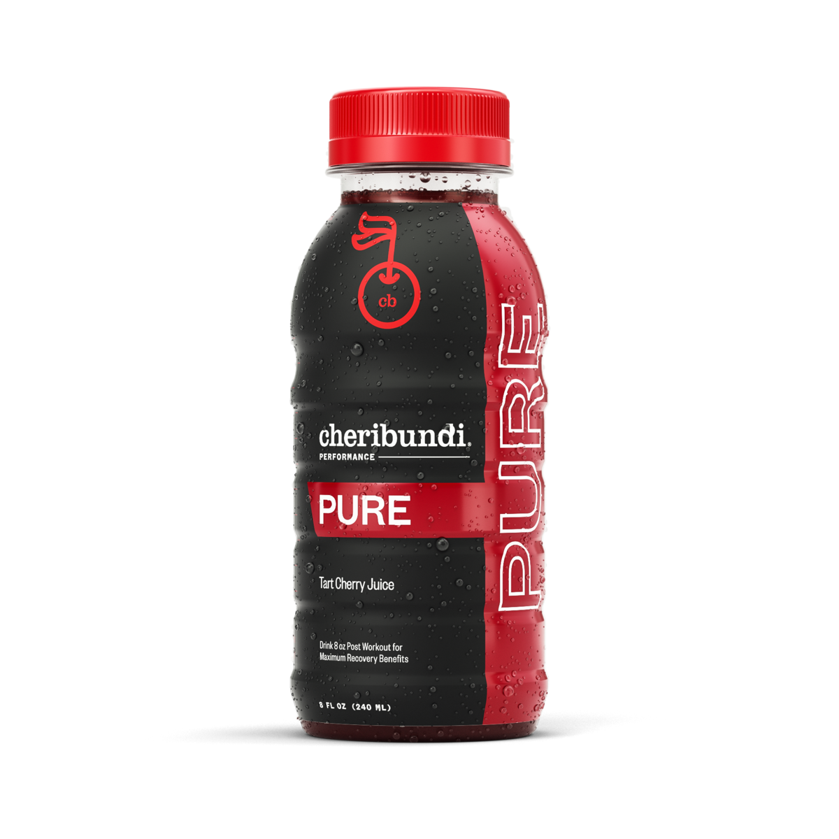
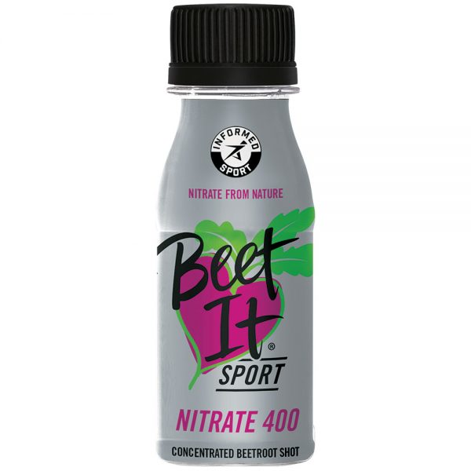

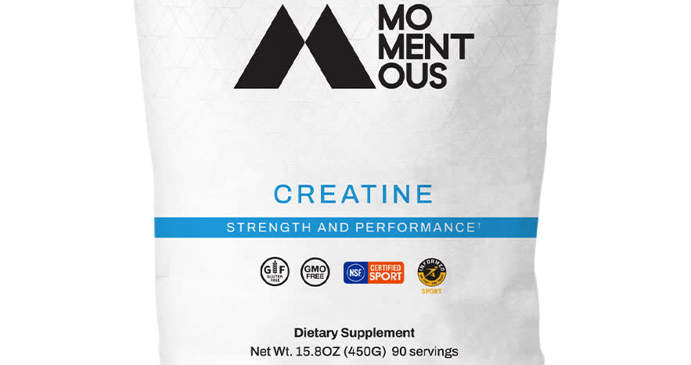
BACKED BY SCIENCE –PERFORMANCE
Tart Cherry Juice
Nitrates/Beetroot Juices
Beta-alanine
Sodium Bicarbonate
Creatine
Caffeine*
Whey Protein
*banned at 15ug/mL in urine

Slide 13

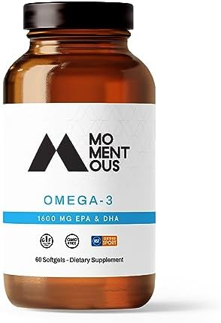
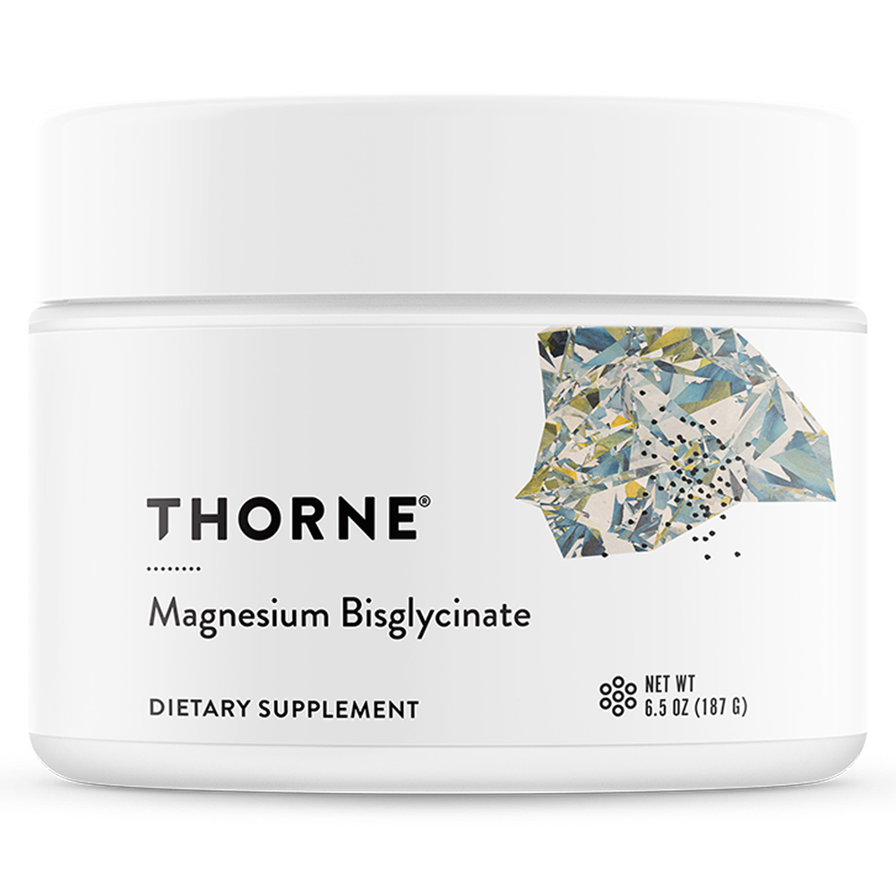
BACKED BY SCIENCE - HEALTH
Vitamin D
Fish Oil/Omega 3’s
Magnesium

Slide 14
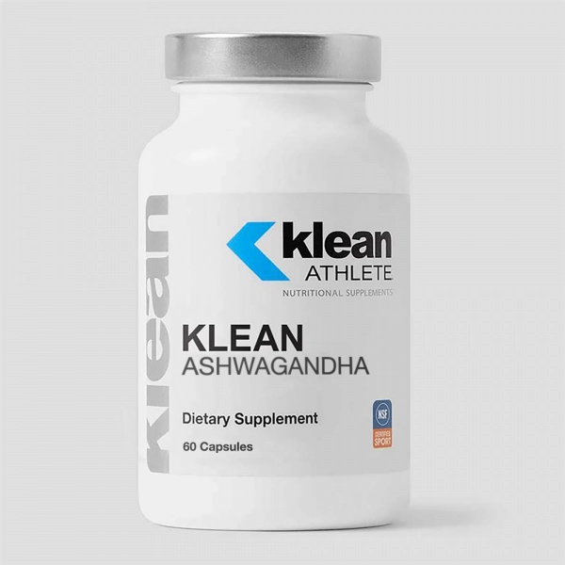
Up n Coming Products
Adaptogens & Nootropics such as Ashwagandha
Focused on mental clarity and stress relief
Popular in Eastern medicine, growing focus in the West
Studies being done for safety and efficacy
Can get from foods such as lions mane mushrooms

Slide 15
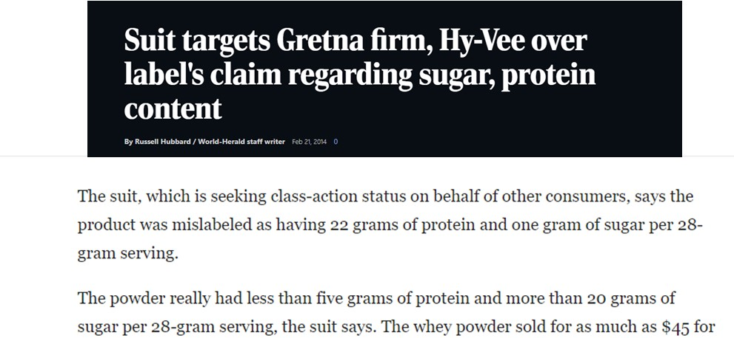
3rd Party Testing - Why So Important?
Label Matches Ingredients
Only way to feel assured you’re…
Getting what you’re paying for
What’s on the label is in the product
No banned/harmful substances

Slide 16
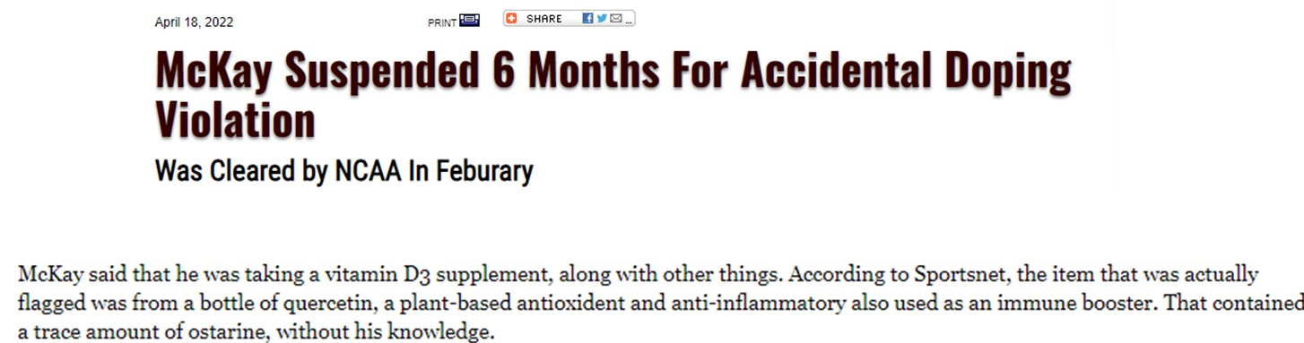
It Happens

Slide 17



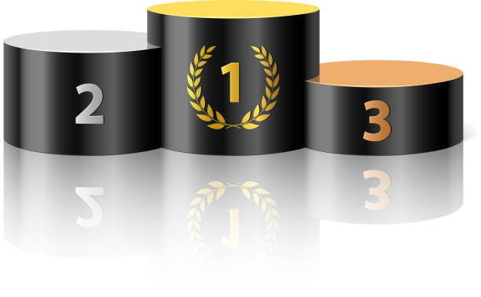
3rd Party Testing - Which One Is the Best?
NSF For Sport – 280 banned substances + herbicides, pesticides, heavy metals; requires facility to go through GMP certification process
Informed Sport – 250 banned substances
BSCG – 207 banned substances

Slide 18
COACHING TAKEAWAYS
SLEEP
AIM FOR 8-1OHRS OF UNITERRUPTED SLEEP
FOCUS ON TEMPERATURE, NOISE, LIGHT, AND CONSISTENT BEDTIME
ENOUGH CALORIES
NEEDS VARY BUT CRUCIAL TO EAT ENOUGH KCALS TO SUPPORT HEALTH, TRAINING, AND RECOVERY
CONSISTENCY
SKIPPING MEALS AND/OR SHOWING UP TO THE RINK UNDERFUELED = UNPREPARED
VARIETY
EATING A VARIETY OF FOODS & NOT THE SAME THING PROVIDES MYRIAD OF HEALTH BENEFITS THRU MICRONUTRIENTS, ANTIOXIDANTS, AND PHYTOCHEMICALS
SUPPLEMENTS/SPORTS PRODUCTS
ONLY TAKE 3RD PARTY TESTED PRODUCTS; FOLLOW THE SCIENCE NOT THE SALESPITCH
BEETROOT JUICE, TART CHERRY JUICE, WHEY PROTEIN, CREATINE, CAFFEINE, BETA-ALANINE, SODIUM BICARBONATE, FISH OILS, VITAMIN D, MAGNESIUM

