Slide 1

WELCOME TO THE 2016 HILLIARD DARBY H.B.A. CLINIC
Presented by:
Head Coach Chris Fugitt
& the Darby Staff

Slide 2
Jay Smith Asst. Varsity
Larry Wolf Asst. Varsity
Andrew Ozbolt Head JVA
Lance Kingrey Asst. JVA
Corey Carter Head JVB
Matt Chastain Asst. JVB
Brandon Longwell Heritage Head 8^{th-}
Brett Maniaci Heritage Head 7th
Billy Martin Heritage Head 7th/8th
Hilliard Darby Staff

Slide 3
Coaching Philosophy
Do you Have One?
Ideas to Think About?
Fundamentals
Developing Players
Develop Pitchers/Catchers
Don’t Label Players
Focus on Playing the game (Not Winning/Losing)
HAVE FUN PLAYING A GAME!!

Slide 4
Practice Organization
Have a Plan!
Have a Purpose (What are your goals?)
Don’t Dwell, Move on
Player Involvement, No Standing Around
Start Small and Progress (PIT)
Make Drills/Practice Competitive
Fundamentals Everyday
Game of Repetition

Slide 5
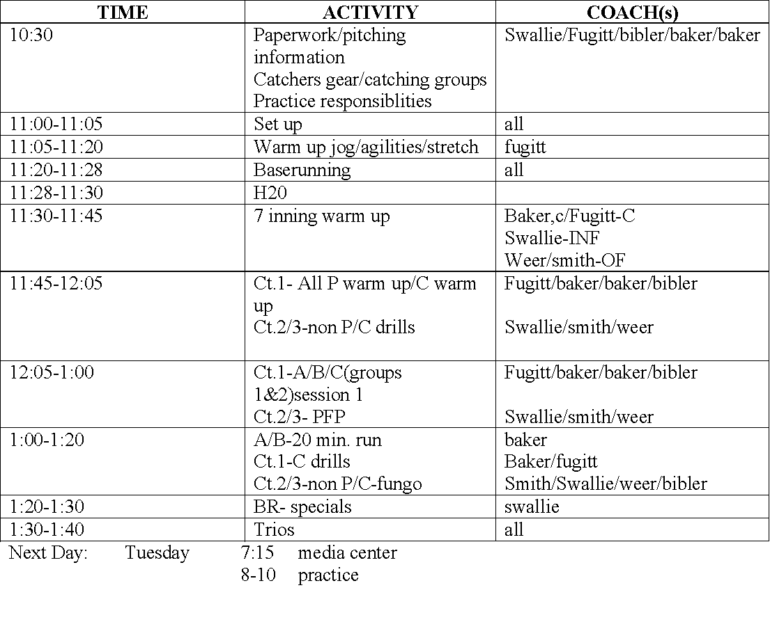
Practice Plan

Slide 6
Sample Practice Plan
6:00-6:10 warm up jog/stretch
6:10-6:25 warm up throwing
6:25-6:30 skill improvement time (PIT)
INF/OF
6:30-6:45 baserunning
6:45-7:00 INF/OF fungo
7:00-7:30 Hitting- front toss/t work (3 groups)
7:30-7:45 competition- 18
7:45 wrap up/paperwork/announcments

Slide 7
Pitching/Throwing Mechanic Drills
Chest to Chest
1. ball turn/back
2. full turn
3. finish low-shoulder to knee
Knee down
1. ball down out of glove
2. finger on top towards 2nd base
3. forearm at target

Slide 8
Pitching/Throwing Mechanics
Stride Drill
1. front foot stride/foot at 45angle
2. ball down out of glove
3. fingers on top
4. shift weight, keep feet on ground, pivot on back foot
5. finish chest over knee

Slide 9

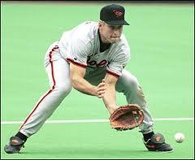
PIT

Slide 10
PIT
Stance-glove out
Pick through baseball
Flip back
-Alligator
-Chest
-Skateboard
-Fingers to sky
-4 seams
-Glove side - pivot
-Backhand - Crossover
-3 Steps each side
Drills
Short hops
Front
Glove side
Backhand
**ALWAYS FIELD WITH
A “RIGHT/LEFT”
APPROACH TO BALL
=
Fielder
=
Roller
http://www.youtube.com/watch?v=VRlTzcI1iJI

Slide 11
Triangle
Drill
= Fielder
= Roller
https://www.youtube.com/watch?v=6ydbVCF32-c
= 1st Basemen

Slide 12
Double Fungo Drill
=
Fielder
Catcher
=
Coach
=
Catcher
Catcher

Slide 13
Pre-Game Warm Up
Things to emphasize
Four Seam Grip, EVERYTIME
Throwing overtop, eliminates ball tailing
Catching ball in front of body
Calling “Mine, Mine, Mine”
Calling “Take It, Take It, Take It”
Practice during warm-ups, so it’s a habit in game
Throw with a purpose

Slide 14
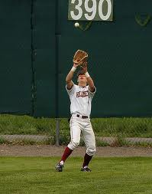
Outfield
Perfect Catch
Above shoulders
Two hands
Over Throwing Shoulder
Mine, Mine, Mine
Drill work
Short fly balls
Gain confidence

Slide 15
Outfield
Crow Hop
Gain momentum
Not running with the ball
Cutoff
Hit the cutoff and allow him to make the next play
Aim for Glove Side
Throw through Cutoffs head

Slide 16
Outfield Details
Should crow hop every throw
If an error is made, no excuses
Don’t compound errors
Don’t rush
Take the time to make a fundamentally good throw, every time
Always working on proper cut off position

Slide 17
Proper Charge and Crow Hop
http://www.baseballmastery.com/new_search_results.php?Topic=Outfield_Groundballs&Asset_id=194&Media_id=189
Things to keep in mind
This video pertains to a quick throw in
May also break down to field ball
Break down like an infielder fielding the ground ball
Drop to a knee

Slide 18
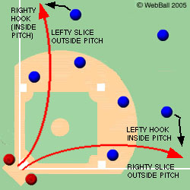
Outfield
Drop Step
Drop step direction of the ball
Open up in order to gain more ground on the ball

Slide 19
Round the Ball
Purpose
To Force momentum towards target
Allows us to get ball in quicker
Gives us the ability to field the ball in front
Frequent Errors
Too shallow of rounding
Poor Angle towards ball
Poor Drop Step

Slide 20
Outfield PIT
Drop Step Drill
Banana Curl
Ground ball
Fly Ball
Full Speed Catch (side to side)
Simple short fly ball (thrown not hit)
Ground Balls

Slide 21


Catching - Stance
Stance
Primary
Relaxed
Throwing hand limp
ankle
Secondary
Weight on balls on feet
Ride a horse
Glove hand elbow bent

Slide 22
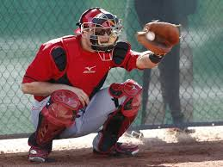
Catching - Receiving
Receiving
Cheat
Quiet body language - Make it look easy
Soft hands
Beat the ball to the spot - get behind the ball
Thumb down (safety)

Slide 23
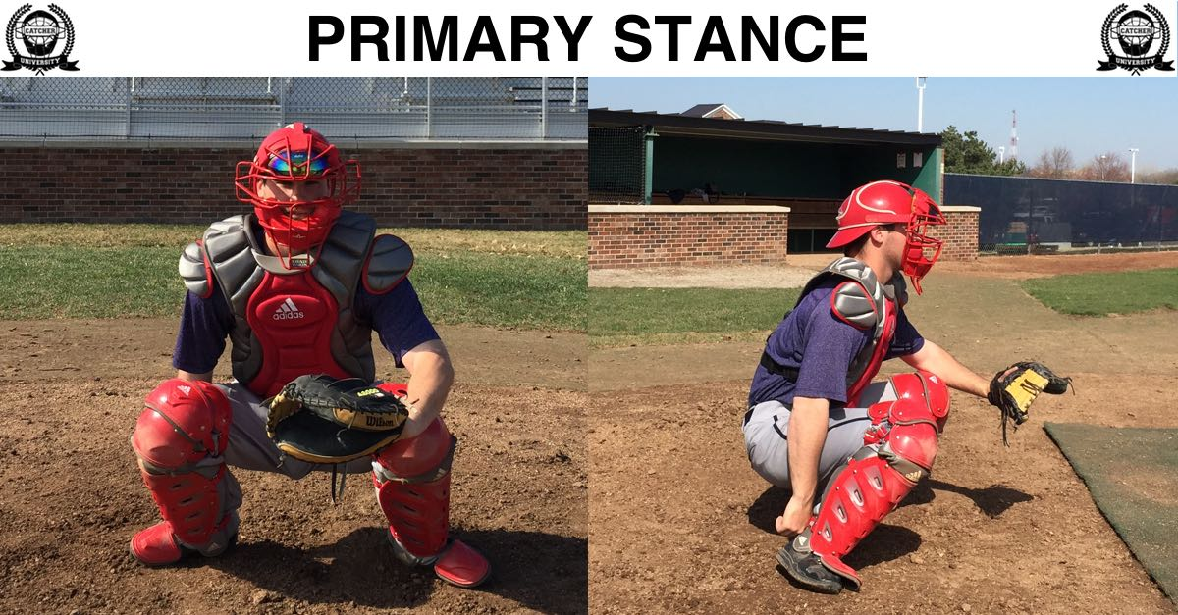
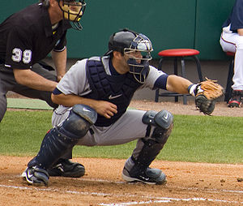
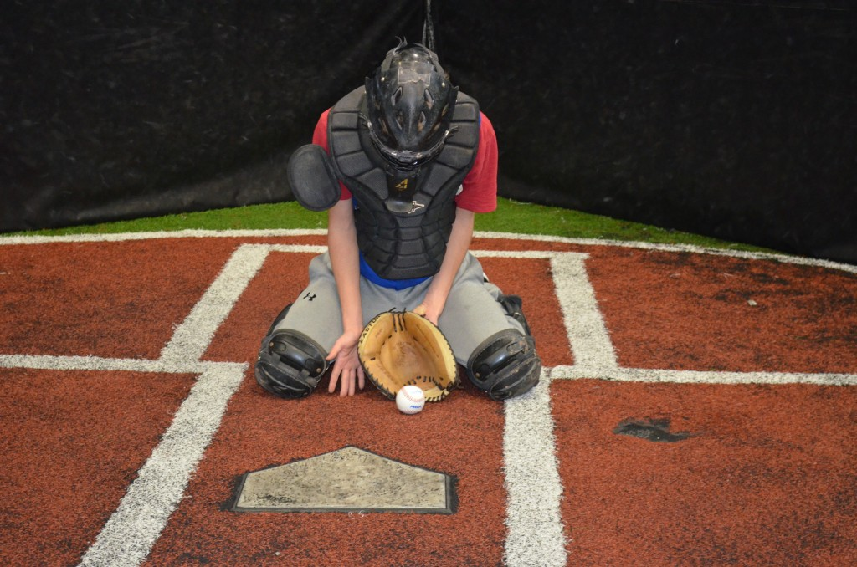
Catching Stance Drill
Have coach pretend to be pitcher.
Catchers progress though stances
Primary
Secondary receiving stances
Blocking stance
Go slowly to make sure they are in proper form at each step. As they master the drill you can pick up the pace to more game speed.

Slide 24
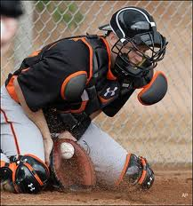
Catching - Blocking
Blocking
Gain ground on block knees forward.
Glove initiates movement.
Shoulders wide.
Make not angled too far down.
Chin down, elbows tucked,
protect 5 hole
Block ball to middle of the field

Slide 25
Drills
Soft hands - tennis ball
Ball in hand - tennis ball
Reaction Drill - tennis ball
Blocking progression - 3 steps
Show videos

Slide 26
Hitting Philosophy
Panther Hitters will always have an Athletic, Controlled approach. Solid contact 100%!
Ideas to Think About?
Fundamentals/Athletic Approach
Master ONE part at a time
Developing Confidence in all Hitters
Focus on Playing the game (Not Winning/Losing)
HAVE FUN PLAYING A GAME!!

Slide 27
Hitting Practice Organization
Have a Plan!
Have a Purpose (What are your goals?)
Start Small and Progress
Fundamental Drills Everyday
Reps, Reps, Reps
Player Involvement, No Standing Around
Combo Drills
Game of Repetition

Slide 28
Panther Hitting
Goal: Make Solid Contact Constantly
How do we work toward that goal?
Fundamentally sound
Be in control of their body
(BALANCED & Athletic)
Same approach on every pitch (Consistent)
Less is more
Create same rhythm on every pitch

Slide 29
Panther Hitting
Coach the positives!
Absolutes - STANCE
Toes facing forward
Knees inside feet
Keep weight on inside of feet
Knocking knuckles aligned & Hands shoulder high
ATHLETIC with head slightly over chest
Eyes level and on pitcher
Keep Chin on ball.
Common Problems
Weight starting back while over or outside back foot
Toes pointing out
Starting head over or tilted to side
No Rhythm
Changing levels through sequence

Slide 30
Panther Hitting
Coach the positives!
Hitting Sequence
#1 Get Strong - Balanced and Athletic
#2 Stride & Hands - Balanced and Athletic
#3 Fire (Attack the ball) - Balanced and Athletic

Slide 31
Panther Hitting
Coach the positives!
#1 Get Strong - Balanced and Athletic
Loading Spring
Load against inside back , NOT over
When?
Types/Style of Negative Loades - TEMPO, TEMPO, TEMPO
Traditional - Sink into back leg/flexing into back leg keeping until walkout
Knee Lift - Will come close to getting weight over back foot
Toe Tap - Load spring as you tap back leading into walk out
Open Stance – Will come close to getting weight over back foot
Common Problems
Weight outside back foot creating energy going up
Weight stays back over foot causing false/reverse pivot

Slide 32
Panther Hitting
Coach the positives!
#2 Stride & Hands - Balanced and Athletic
Top and Bottom need to work separately
Head centered
Body will be at 50/50 position with spring still loaded
Land centered and square
TOES MUST BE ALIGNED WHEN FRONT FOOT LANDS ON INSIDE
Common Problems at foot down
Too much weight back of center at toe down to heel plant
Too much weight forward of center at toe down to heel plant
Spacing of stride to narrow causing energy to go up

Slide 33
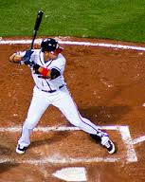
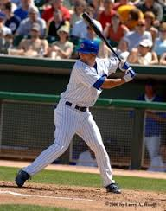
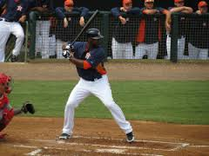
Panther Hitting
Coach the positives!
#2 Stride & Hands - Balanced and Athletic
Foot Down/Toe touch
Get attached anchored to the grown
TEMPO, TEMPO, TEMPO
Upper body should be fighting/resisting following the bottom
Keep hands over back foot
Bottom Hand loads as front foot strides
Body will be at 50/50 ATHLETIC position

Slide 34
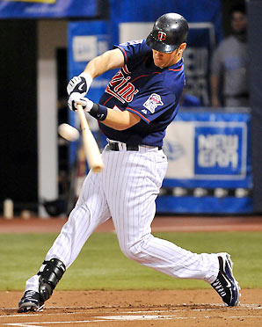
Panther Hitting
Coach the positives!
#3 FIRE (Attack the ball) Front Heel Trigger - ATHLETIC
Hands at toe touch
Hitters commitment to attach ball
Front heel down/ front toe toward plate
Backside drive/Guide-Front hand gets us to ball
Top hand will take over and finish
Common Problems with hands
Start attach with front side/heel spin
Start to push with backside early
Leaving energy/Spinning on backside
Top hand taking over early

Slide 35
Hitting-Practice Drills Don’t underestimate the importance. Not everyone needs batting practice at the same time.
Tee Drills
Front Toss
BP
Combo Drills
Hitting and Base running

Slide 36
Hitting-Practice Drills
Tee Drills - Have player approach plate/tee every rep.
Dry Run - Load to Stride
Verbal commands
Get Strong, Stride & Hands
Fire
Regular Tee Work
Verbal commands
Get Strong, Stride & Hands, Fire
Happy Gilmore
From regular stance take step back with front and back foot
Step with back foot - Get Strong
Stride & Hands
Fire
Trigger-Heel/Knee
Verbal commands
Get Strong, Stride & Hands
Fire

Slide 37
Hitting-Practice Drills
Tee Drills
#1 Dry Run - Load to Stride - x5
#2 Regular Tee Work - x5
#3 Dry Run - Load to Stride - x5
#4 Regular Tee Work - x5
#1 Regular Tee Work - x5
#2 Happy Gilmore- x5
#3 Regular Tee Work - x5
#4Happy Gilmore - x5
#1 Regular Tee Work - x5
#2 Heel-Knee- x5
#3 Regular Tee Work - x5
#4Heel-Knee - x5

Slide 38
Hitting/Fielding-Practice
=
Fielder
=
Tee/Hitter
Any variety of drills: Tee, Soft Toss or BP

Slide 39
Hitting/Base Running -Practice
=
Runner
=
Fielder
=
Tee/Hitter

Slide 40
“18”
Catch 18 fly balls
Field 18 ground balls
Make 18 good throws
Throw 18 balls into a bucket

Slide 41
Questions/Answers
What can we do to help?
Coaches & Players are encouraged to come to our games.

Slide 42
Panther Summer Baseball Camp
June 13-15, 2016
Hilliard Municipal Park
9am-12noon
Forms: www.hilliarddarbybaseball.com

