Slide 1

PAC Meeting
Tuesday, July 23, 2019
Lakeville North
Panther volleyball

Slide 2

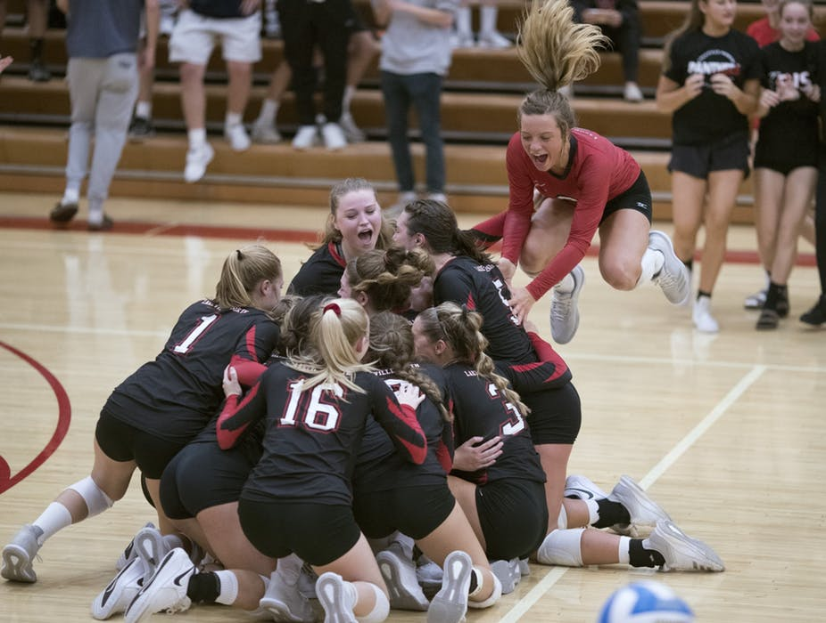


Slide 3
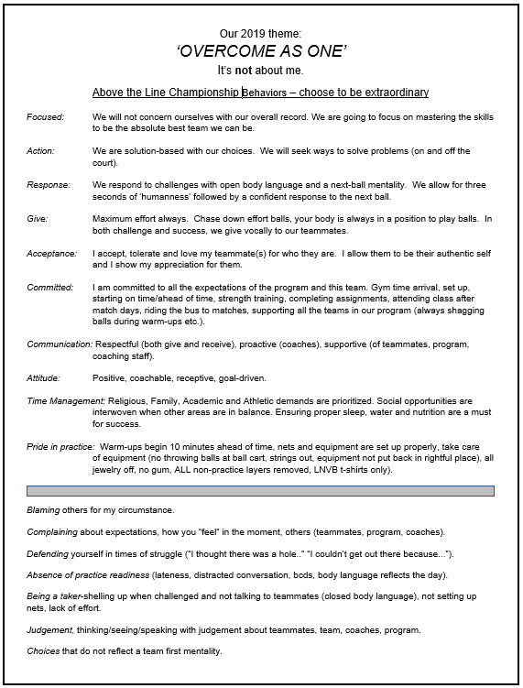

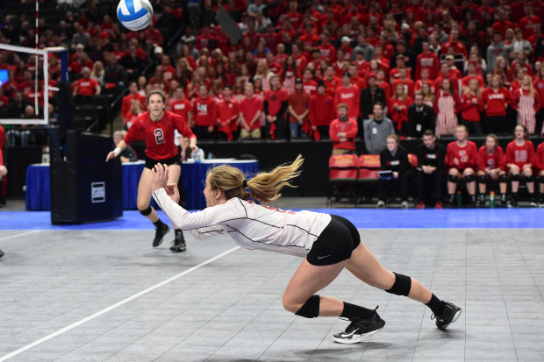
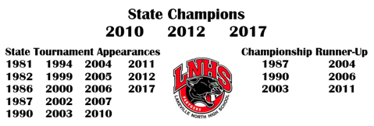
Lakeville North High School Volleyball program

Slide 4
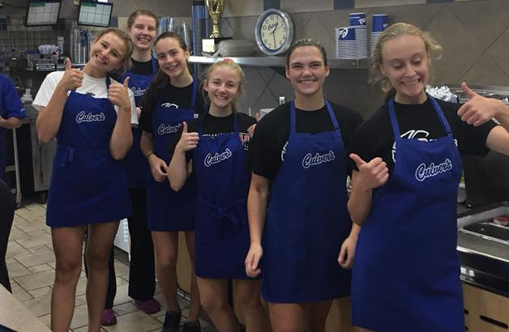
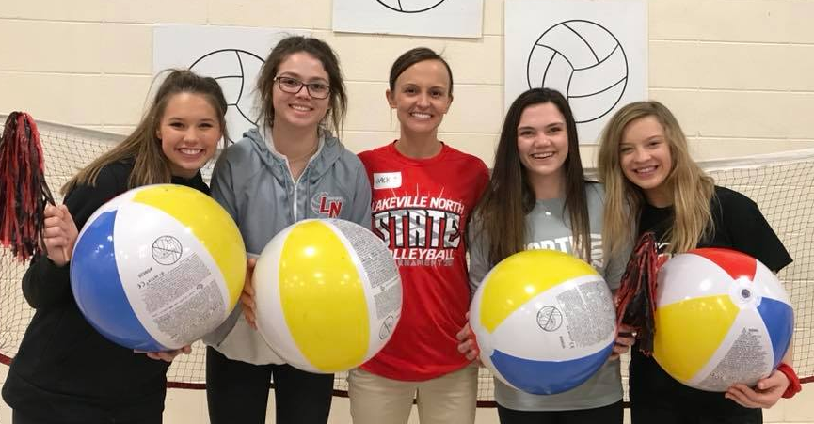
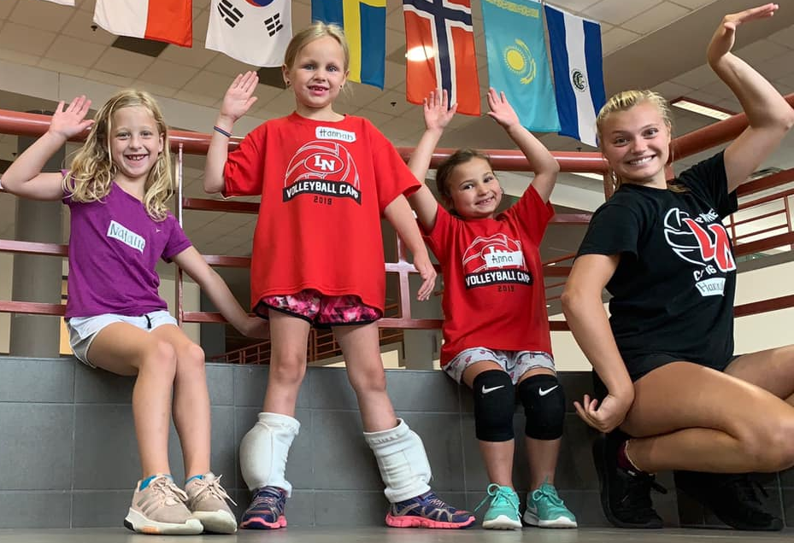
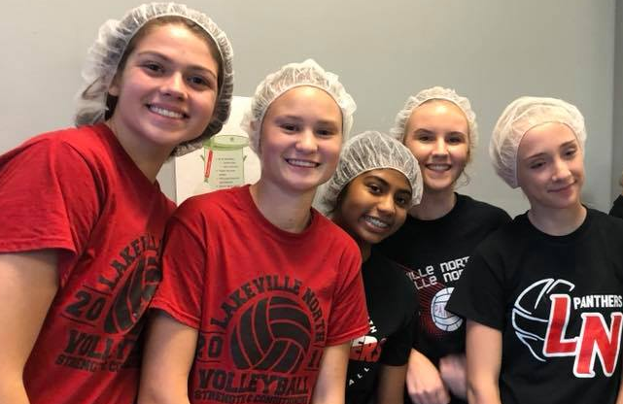
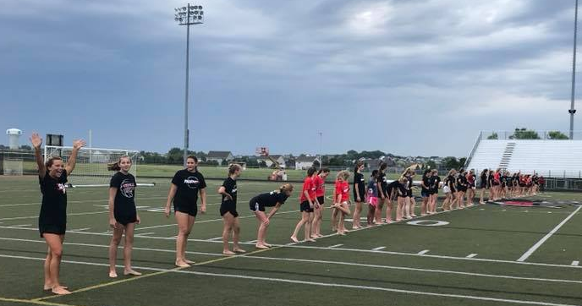
examples of this culture in action….

Slide 5

An on-court example of this culture in action….
Pssst…watch the bench…

Slide 6
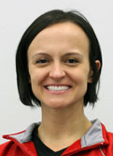
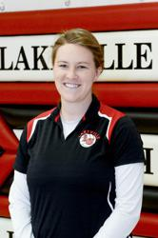
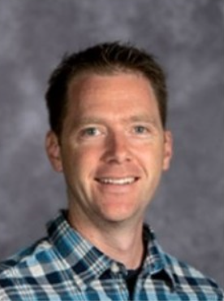
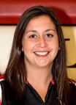
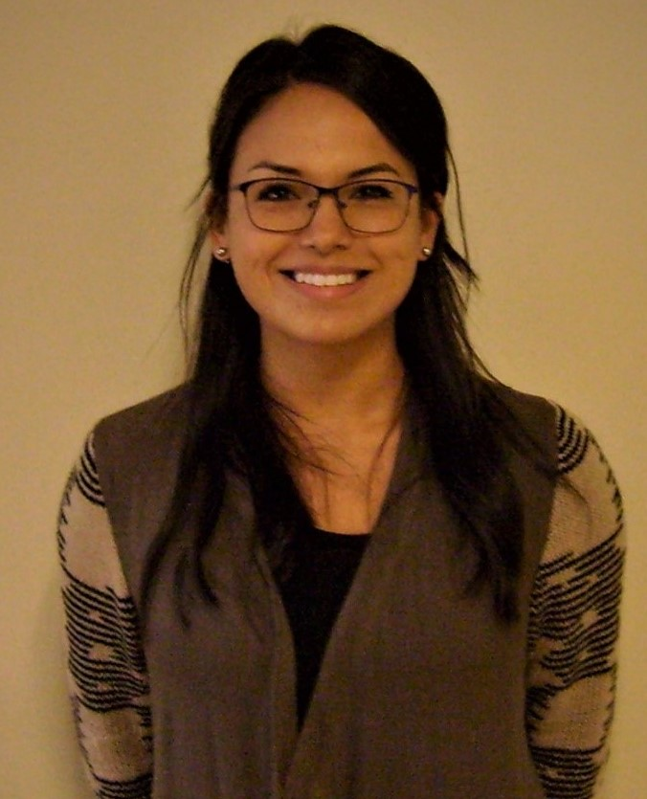
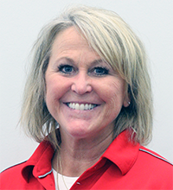
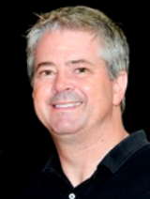
Panther coaching staff
 | Jackie Richter | Head Varsity | 612-597-5328 | Jackie.Richter@isd194.org
 | Taylor Hall | Asst Varsity | 612-599-1996 | Taylor.a.hall6@gmail.com
 | David Laufenburger | Asst V/JV | 612-325-9496 | lauf4858@isd194.org
 | Megan Williams | Head JV | 651-235-8330 | megankathleenw@gmail.com
 | Tina Nelson | Head 10A | 218-750-7071 | nels7206@d.umn.edu
 | Bonnie Sperbeck | Head 9A | 952-212-3377 | sper2267@isd194.org
 | Brett Johnson | Head 9B | 952-212-3205 | brettjohnson@edinarealty.com

Slide 7
C a l e n d a r
Sunday | Monday | Tuesday | Wednesday | Thursday | Friday | Saturday
 | 7/22 ETS 7:30-8:30am HS Camp 9-3pm | 7/23 PAC Meeting HS Camp 9-3pm | 7/24 ETS 7:30-8:30am HS Camp 9-3pm | 7/25 HS Camp 9-3pm | 7/26 ETS 7:30-9:30am | 7/27 Concordia Team Camp for returning V/JV players
7/28 Concordia Team Camp for returning V/JV players | 7/29 ETS 7:30-9:30am | 7/30 | 7/31 ETS 7:30-9:30am | 8/1 | 8/2 ETS 7:30-9:30am | 8/3 Breakdown Summer Elite Tournament (returning V/JV)
8/4 | 8/5 ETS 7:30-9:30am Captains Practice 1-4pm McGuire MS (9th-12th grade) | 8/6 Captains Practice 1-4pm McGuire MS (9th-12th grade) | 8/7 ETS 7:30-9:30am Captains Practice 1-4pm McGuire MS (9th-12th grade) | 8/8Activities Fair 6pm Captains Practice 9am-12pm Antlers Park (9th-12th grade) | 8/9 ETS 7:30-9:30am | 8/10
8/11 | 8/12 Tryouts: 9-12pm & 1-3pm: returning + 10th-12th 1-4pm: All incoming 7th-9th grades | 8/13 Tryouts: 9-12pm & 1-3pm: returning + 10th-12th 1-4pm: All incoming 7th-9th grades | 8/14 Panther Prep Tryouts: 9-12pm & 1-3pm: returning + 10th-12th 9am-12pm: All incoming 7th-9th grades | 8/15 Tryouts: 9-12pm & 1-3pm: returning + 10th-12th 1-4pm: All incoming 7th-9th grades | 8/16 Program Pics Tryouts: (V) 9-12, 1-3 (JV) 9-12 (10A) 9-12 (9A) 1-4 (9B) 1-4 | 8/17 V/JV Home Scrimmage 9-12pm Fall Kick-Off Meeting (all) 12pm-3pm

Slide 8
Additional dates to add to your calendar:
Eligibility Meeting for ALL parents and Athletic Director, Mike Zweber
  Monday, August 26. Schedule found at: www.lnhspanthers.com
Eligibility Meeting for ALL fall athletes and Athletic Director, Mike Zweber
  Tuesday, August 27 at 1:00pm in the Auditorium

Slide 9
Captains practices
Sunday | Monday | Tuesday | Wednesday | Thursday | Friday | Saturday
4 | 5 ETS 7:30-9;30 1:00-4:00pm McGuire MS | 6 1:00-4:00pm McGuire MS | 7 ETS 7:30-9;30 1:00-4:00pm McGuire MS | 8 9:00am-12pm Antler’s Park | 9 ETS 7:30-9;30 | 10
Details
Open to all incoming 9th graders and interested players grades 10-12 in trying out for the fall program.
Optional Practices led by our
2019 Panther Varsity Leadership.
Intention is to connect within the program;
share and ask questions about tryouts/season/program; participate in drills designed to reflect both fun and purpose; build cohesion and preparation for the
fall 2019 season.

Slide 10
Tryouts
Eligibility Requirements:
  Updated Physical (every 3 years)
  Online Registration
  Fall Activities Fee $300
  (refund issued if needed)
Information Distributed:
  Fall Kick-Off Meeting Flyer/Payment
  Feed My Starving Children Event Flyer
  Team Photo Form
  Apparel information sheet
  V/JV Scrimmage info
Lines of Communication (tryouts):
  Athlete led, Athlete first. Always.
  Parent emails/phone calls are not encouraged.
Attendance:
  is mandatory to ensure a fair and accurate evaluation of abilities with peers.
Reminders:
On the court at least 10’ prior to scheduled start.
Wear black (LN) t-shirt daily. NO CLUB SHIRTS or tank tops.
New partner for warm-ups.
Team placements will be distributed Thursday
(unless more time is needed for decision-making).
Parent Meeting with AD Mike Zweber on Monday, 8/26

Slide 11
“Impact Placement”
The intention of the Lakeville North volleyball coaching staff is to organize athletes on teams in which:
1) They will have the most impact;
2) Their teammates and competition will raise their level of performance;
3) They have the best opportunity to achieve team and individual success;
4) Support the future vision for that player.
Volleyball is a complicated, skill specific and positional based sport.
To compile the potential for a successful team, every level is in need of a specific number of people to fill each specific role. There is no perfect number of players for each team. Our sport is defined by position and number. What is important, is that the player possess the necessary skill level to compete on the team of which they have been selected for.

Slide 12

“impact placement”
Team assignment is an accumulation of:
  Individual skill level;
  Team skill level;
  Position-specific based needs;
  Intangible quality contribution:
    Work ethic
    Team mentality
    Leadership qualities
    Commitment-immediate/future
    Coachability
    Receptiveness to change
    Discipline
    Above and beyond;
  Communication;
  Volleyball IQ
-A unified effort and commitment by the LNHS volleyball coaching staff to ensure that every athlete placement creates the highest level of success, challenge, team and court time impact.
-Impact placement does not grandfather athletes.
-Team assignment does not grant a younger athlete higher placement when a younger athlete’s skill level is equal to or less than the older athlete.
-Impact placement is directly guided by the future vision of the head coach to target what present team assignment will support the most successful path to the highest level of team assignment in the future.
- Impact placement aims to coordinate teams in which the experience aids in person growth (mentally and physically) for the season to inspire continued personal growth after the fall season (requires athletes' active participation).

Slide 13
Team Assignments
Varsity: Participation as a member of the varsity squad is open to all players 7th – 12th grades. Match time is not guaranteed at the varsity level. Although match time is not guaranteed, it is the intention of the head coach to identify each players role and allow that impact to present itself throughout the season (under the assumption that attendance, academic, effort, coach-ability and commitment have been positively exerted consistently throughout the season).
Junior Varsity: Participation as a member of the JV squad is open to all players 7th – 11th grades. Although match time is not guaranteed, it is the intention of the head coach to identify each players role and allow that impact to present itself in the majority of matches (under the assumption that attendance, academic, effort, coach-ability and commitment have been consistent).

Slide 14
10A: Participation as a member of the 10A squad is open to all 10th graders; unless numbers or critical positions are not covered. Although play time may not be evenly distributed, it can be expected that every member of the team will be provided with an opportunity to impact every match (under the assumption that attendance, academic, effort, coach-ability and commitment have been consistent).
9A: Participation as a member of the 9A squad is open to all players 7th – 9th grades. All members can expect to be provided with an opportunity to impact every match (under the assumption that attendance, academic, effort, coach-ability, and commitment have been consistent).
9B: Participation as a member of the 9B squad is open to all 9th graders; unless numbers or critical positions are not covered. All members can expect to be provided with an opportunity to impact every match (under the assumption that attendance, academic, effort, coach-ability, and commitment have been consistent).

Slide 15
Tryout truths and LNHSVB realities
We expect that your daughter is ready and willing to give her best effort, attitude and commitment.
We expect that your daughter will experience failure in some form.
You can expect that your daughter will move court to court and is encouraged not to make assumptions.
You can expect your daughter to complete daily physical testing of strength, quickness and stamina.
There is no pre-set number for each team. Team rosters are determined by the principles driving LNHSVB impact placement.
We expect that when your daughter's tryout evaluation is distributed, received and read that she take the time to communicate with the coaching staff thereafter if she has questions.
You can expect that players within all teams are expected to support one another on game nights. That the coaches will encourage this development in your daughter's time-management abilities.
You can expect that attendance is very important and impacts court time throughout the season. That the coaches will encourage this development in your daughter’s level of commitment .
You can expect a strong, sturdy and self-run program where your daughters' team will be responsible for managing another team’s home tournament during the season.

Slide 16
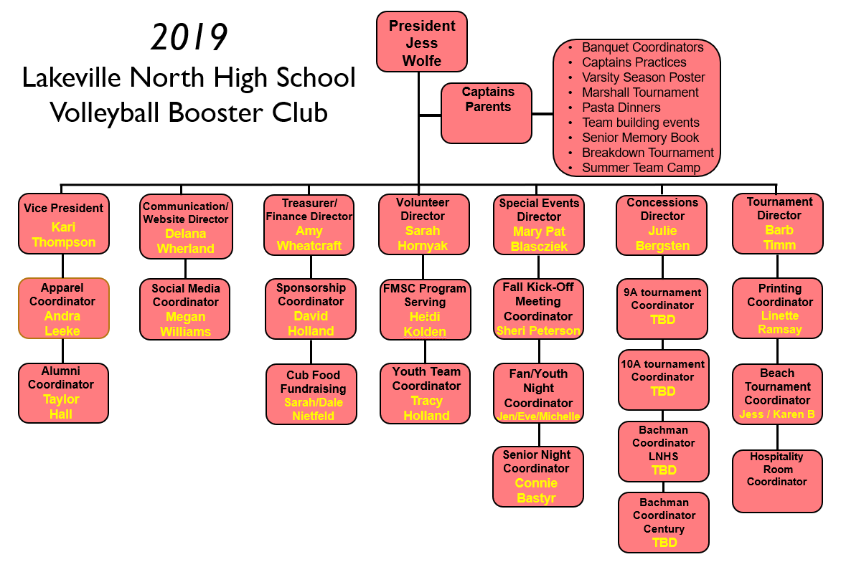
LNHSVB Booster Board
Connect with president
Jessica Wolfe
bjwolfes@frontiernet.net
or
VP Kari Thompson
skthompson6@charter.net
for booster club inquiries and information

Slide 17

Overcome As One
Panthers Volleyball
2019

Slide 18

Questions?

