Slide 1
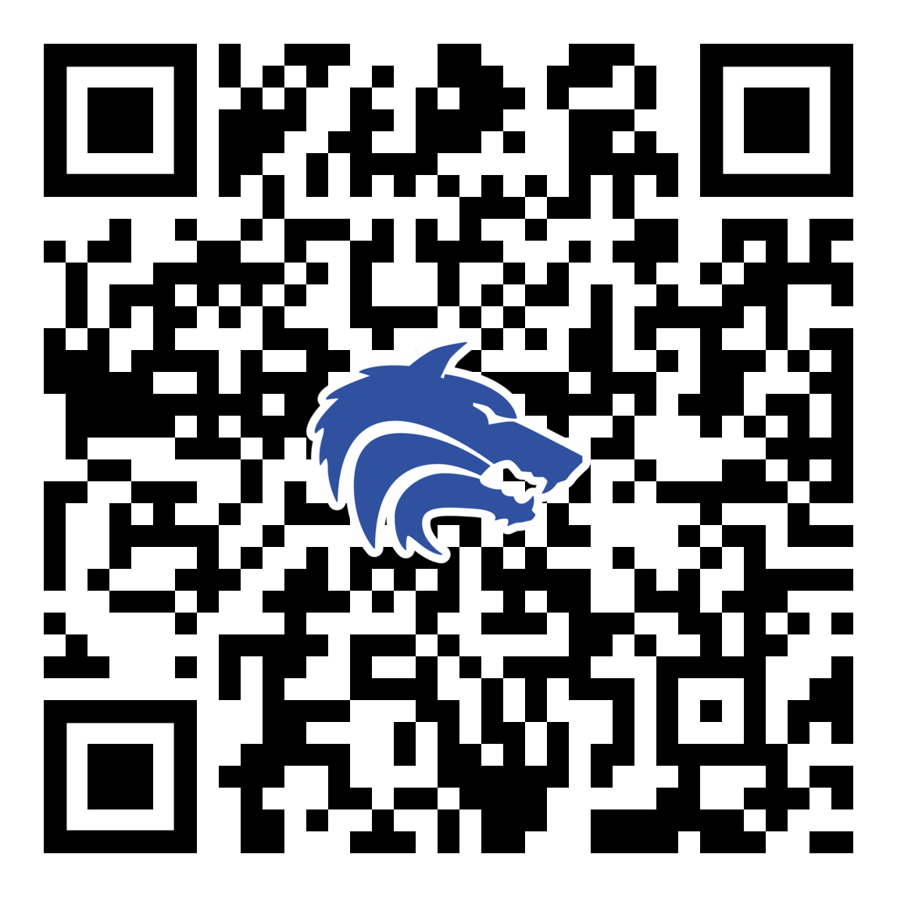
January 2022 Booster Club Meeting

Slide 2


Slide 3
Agenda
Approve December Meeting Minutes
Treasurer Report
Spring Calendar
Sponsorship Saturday
Coach’s Corner

Slide 4

SportsYou
DCMN-ZE9D

Slide 5
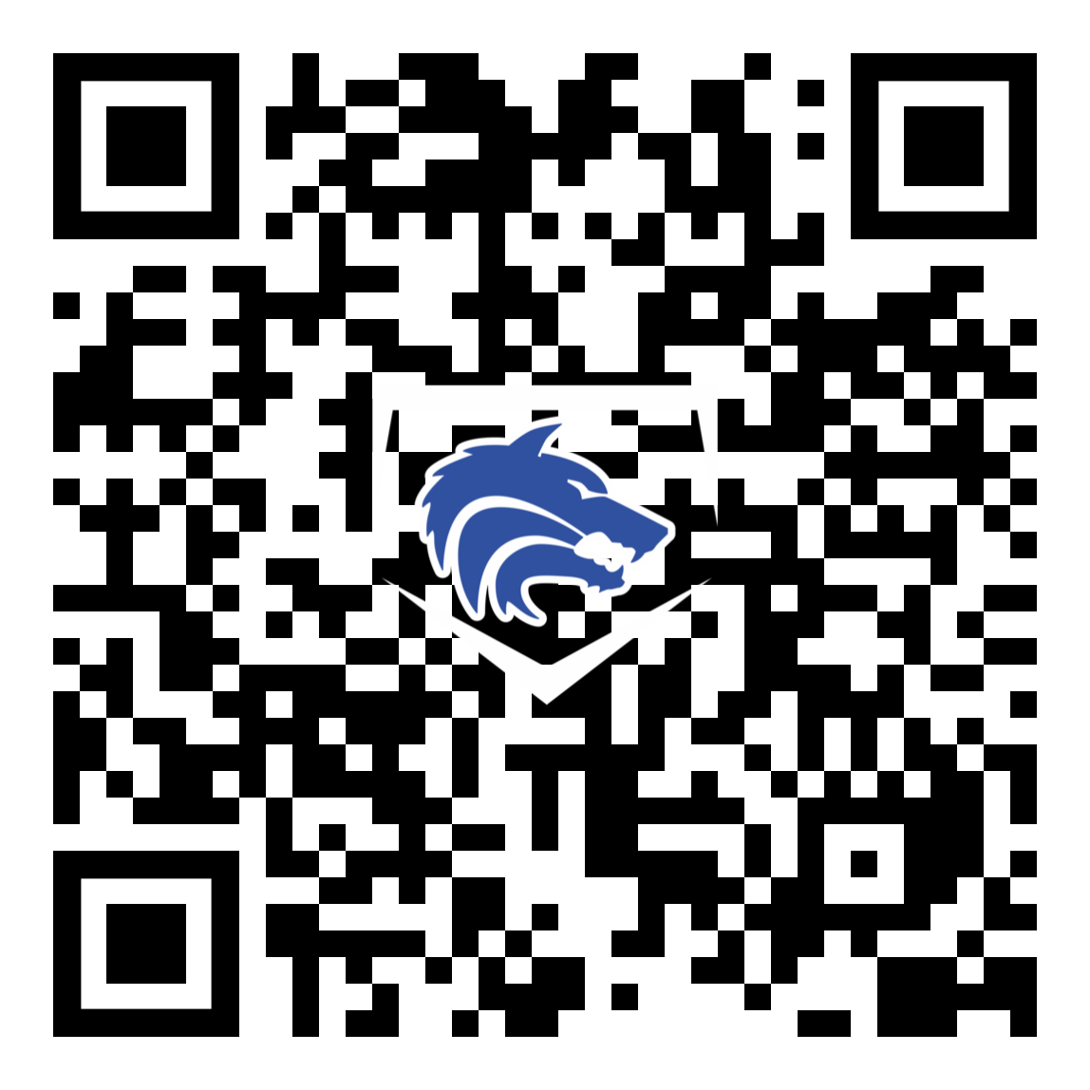
Booster Club Votes
Approve December Board Meeting Minutes
JOIN THE BOOSTER CLUB
21 Member Families
3 new since last meeting

Slide 6
Treasurer’s Report: 12/11/2022 – 1/8/2023
Our Beginning Balance: $25,313.69
New Income: $ 2,195.42
$ 2,195.42 Golf (Paypal account transfer)
New Expenses: $ 0.00
Current Balance $27,509.11

Slide 7


Spring Baseball Prep
January 14: Work Day
January 20: Blue / White Scrimmage (Varsity & JV)
January 21: Sponsorship Saturday
January 28: Media Day AND Work Day
February 4: Work Day*; 1st scrimmages
February 21: First Pitch Dinner
April 30: End of Season Banquet

Slide 8
Varsity Theme Nights
Friday March 17 Wolfpack Night – BLUE OUT
Tuesday March 21 Teacher Appreciation Night
Tuesday March 28 PSA Night
Thursday April 6 Autism Awareness / Special Needs
Tuesday April 11 PJ’s Night
Friday April 21 Feeder School Night
Tuesday April 25 SENIOR NIGHT

Slide 9
Vounteers Needed
1st Pitch Dinner Committee
Concessions Coordinator
- Expectation – at least 1 parent of each player volunteer 1 time!
Game Day Meal Coordinator for each team
Theme Night Task Force
Scoreboard and Gamechanger Volunteers for each team
JV & JV2 announcers needed

Slide 10
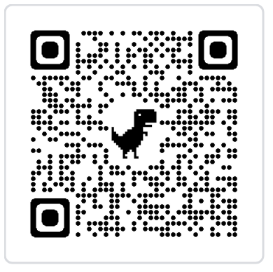
Sponsor Saturday – January 21st
Need Volunteers
3-4 players per group, 1 parent per group
Visit local businesses to promote Plano West Baseball
MINIMUM - 8 Parent Volunteers Required:

Slide 11
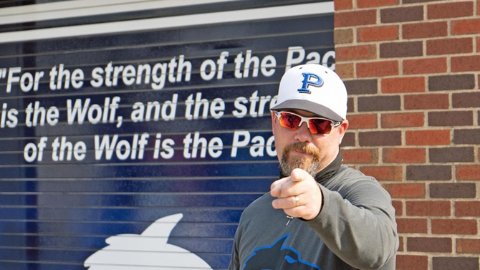
Coach’s Corner

Slide 12
January 2022 Booster Club Meeting

