Slide 1
OVA Club Operations Survey
July 2023

Slide 2
OBJECTIVE
The objective of this research is to gain an initial understanding of the challenges and opportunities for OVA to support club operations.
OVA is committed to continuous improvement and supporting its member clubs.
OVA’s mandate to grow volleyball in Ontario can only happen through the club system.
To support growth in the volume and quality of club programs, the OVA must first listen, understand and empathize with the experiences of clubs across the province.
This activity is only SMALL STEP #1 towards a positive, mutually productive relationship with club executives.
Engage in active conversations to address small issues before they become big issues.

Slide 3
OVERVIEW
April and May 2023
Online survey – open ended questions allowing for free-form responses
Target audience: Club executive and technical directors.
3 key questions:
How might the OVA better support your club operations in PREPARATION for the competitive season?
How might the OVA better support your club operations DURING the competitive season?
How might the OVA better support your club operations as you CLOSE the competitive season?
Quick and to the point, start the dialogue

Slide 4
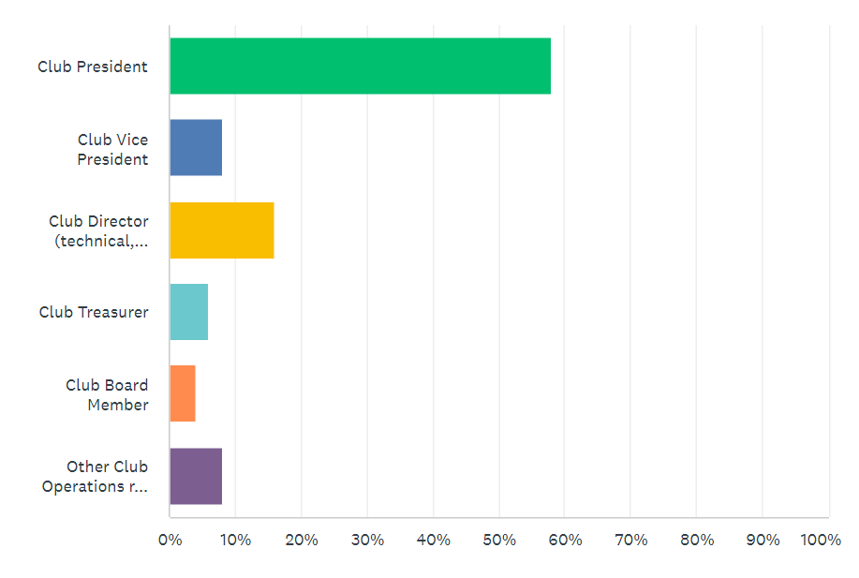
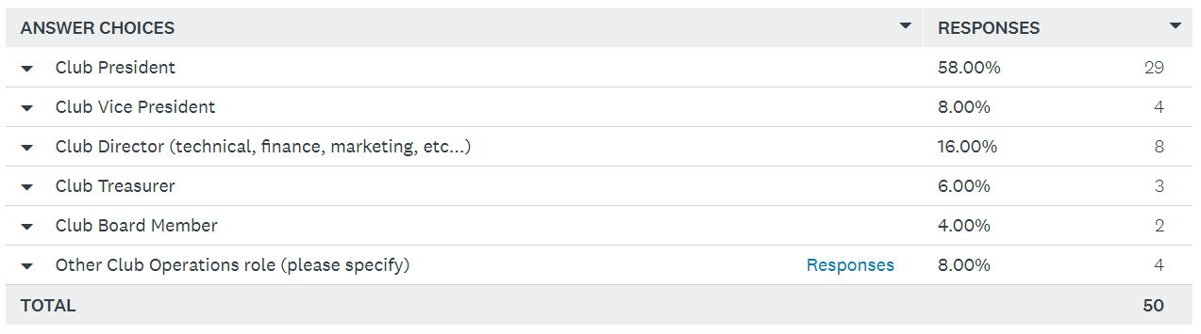
Who Responded?

Slide 5
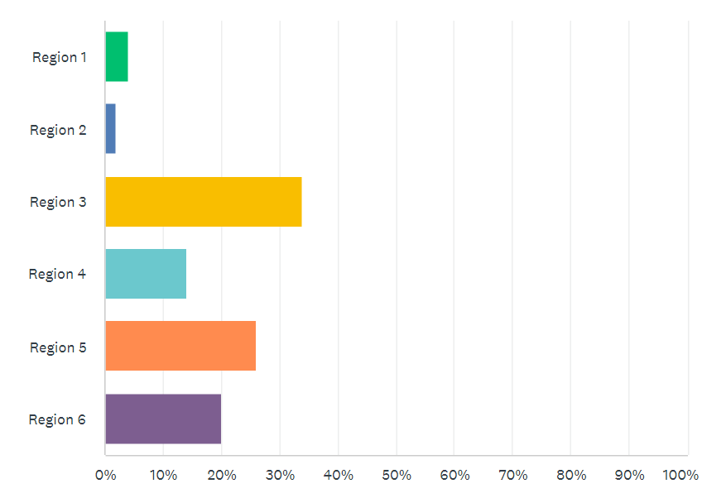
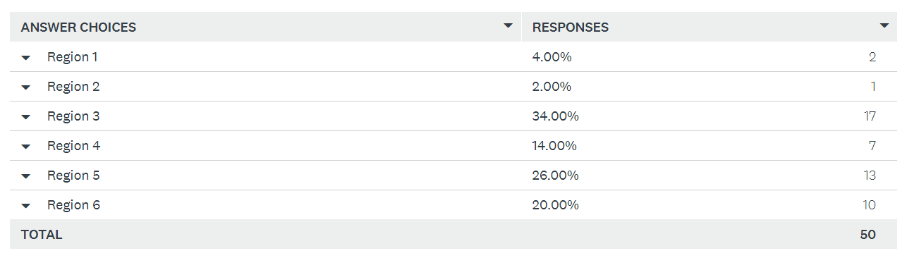
Regional Breakdown

Slide 6
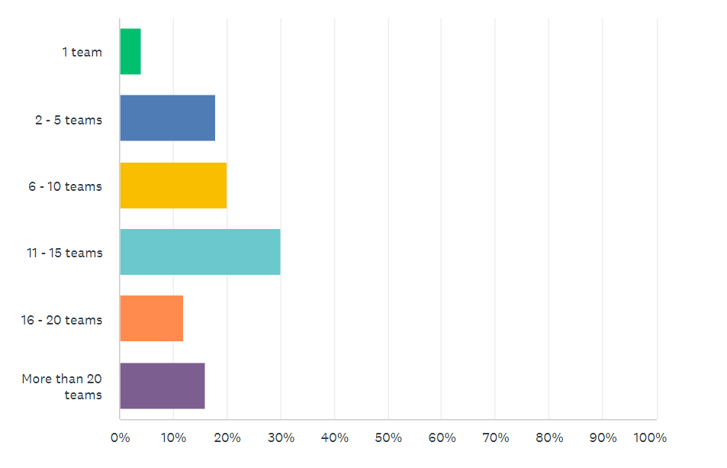
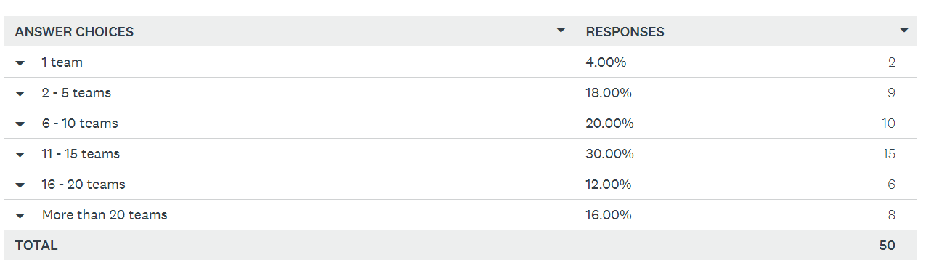
Club Size

Slide 7
3 Key Questions
How might the OVA better support your club operations in PREPARATION for the competitive season?
How might the OVA better support your club operations DURING the competitive season?
How might the OVA better support your club operations as you CLOSE the competitive season?

Slide 9
Overall Comments

Slide 10
Overall Comments

Slide 11
Competitions
Listen to your membership. a small percentage of clubs participate in 4vs 4. The 6 on 6 competition is a mess with u11 to U14 teams competing….
Realignment of season start would be tremendously helpful in creating greater time for development by having competition start in January
Get rid of 9 on 3. The day is too long and for some teams there is way too much time between playoff matches. Not every team needs to make the playoffs.
Make the first two events non-seeding and without medals. This will allow better match development of all players.
DO NOT allow teams to play out of their age category. I’m really not sure how this helps with the philosophy of LTD. I understand that lower teams need a challenge but at what expense. The expense of the older teams. How do you think a 16u team feels when they are beat by a 14u team. Not good for mental health or self esteem. As well, not 1 18u team won a gold medal in any of the tournaments one of our 18u teams were in all season. They were all won by younger teams.
Don’t group/assign every tournament geographically. Our lower ranked teams play the same teams every tournament. They are willing to travel.
Run multi day events that can host multiple age groups at a single venue.
There is no longer an end to the season, and this is leading to coach and volunteer burnout
Never host a provincial championship downtown Toronto again. There is very little positive to this mass collection of teams in the most congested city in Canada.
Provincials in Toronto were well run - loved the atmosphere. There are many things the OVA does well.
I believe a volleyball festival would be imperative mid-season, allowing teams to be re-ranked for the remainder of the season. We found teams sitting up at the top, finishing always in 5-7th, taking higher points than those trying to climb and gaining fewer points finishing second.
maybe you should consider offer age category tournaments as well as open tournaments (these tournaments could be for whatever age group would like to join).
Find a way to ease the conflicts of playing : 1) Rep Club VB 2) School VB 3) HP VB

Slide 12
Interaction with Clubs
More direct correspondence from ova via email
Communication targeted to club directors, with upcoming season updates, critical dates, key changes and pricing schedule/changes.Resources for best practices in operating a club
Club presidents should get a 1 on 1 with an ova executive each season to discuss how the OVA can help them do more and provide more opportunity for players
More availability on the phone. Many of the ova staff are hard to get by phone and some don’t return calls
When roles within the ova change clear direction provided to clubs as to whom the contact is for different things. Example - insurance coverage - contact for this position changed during the season and no update of whom took over was provided to club contacts
Who makes decisions? A committee? who's on this Committee. When asking for rational about decisions its always some one else making a decision but who? Transparency ?
Send us a list of all proposed rule changes for the upcoming season so we can applaud the good choices and argue the bad decisions.

Slide 13
Club Resources
Lessons learned webinars
Provide the travel subsidy form electronically to each club rather than having us "find" it
Check lists for wrapping up the season. How to complete financials etc.
Sample evaluation forms we can use.
Having a clearly laid out calendar for upcoming reg dates, offer dates, tryout schedules for next season
Helping coaches to have a seasonal practice plan with drills for early, mid and late season.
Provide LineUp Sheets in the OVA Championships Team bag for the coaches to ensure each coach has their own sheets / add the Triple Ball card to those teams playing Triple Ball to help with scoring
ONCA template and sample constitution.
Workshops/education for club management and best practices. I enjoyed the series that was shared this year and feel it is beneficial for clubs as we grow.

Slide 14
Rules
Please change the age groups for ECI. We need ages to matter this idea that skill matters more then age is crazy. At the young age very few can over hand and get above the net and you are mixing them with players who have a height and weight advantage because they are 2-4 years older than them. That is not fair to the young 10 and 11 year olds trying to start their carrier.
Not having medals for the younger age groups in early tournaments is not ok. This is rep and even house leaguers get medals but our rep players of the same age don’t.
The fair play rule needs to go - trust clubs to play athletes fairly. The result of the fair play rule is small team rosters (8 players) or some teams who fake injuries so they don’t have to play particular players etc. removing fair play allows teams to take more players (12) and develop more athletes. There is nothing worse than a player in tears that coaches can’t take out to give a break etc. I’ve seen this so many times and these players usually end up quitting.
I disagree with allowing University athlete being able to participate in the OVA. It creates a disproportionate advantage to clubs who are situated in areas with universities. Those athletes if of interest to the OVA can be trained in TeamO programming.
I believe the league should just one standard ball that will help the kids rather than compensating them for softer balls then when they move up another ball is shown to them, which now it's another time spent to teach the basic fundamental of volleyball.

Slide 15
Overall Comments
Not relevant “DURING” or “POST” phase so quantity is significant

Slide 16
Overall Comments
Adding “Tryouts” + “Tryout Window” + “Re-sign”

Slide 17
Tryouts, Tryout Window, Re-Signing
Once again the entire signing process is wrong , rushed and contrary to stated opinion puts way too much pressure on Athletes, parents and coaches.
There is so much recruiting in the OVA now and the OVA turns a blind eye to it. Development suffers as a number of teams pluck top players from other teams to form all star teams. This is the way of the OVA now. You dont have to develop kids just recruit them from other teams with promises of trips to states and showcasing athletes etc which a number of parents like. Instead of Coach of the year how about recruiter of the year ? This is spreading to the younger kids age groups but rampant in 16, 17 18. I know it's difficult for OVA to navigate but it's the elephant in the room . it's everywhere . last year at u14 high performance our athletes were hounded by some coaches there and volunteers about joining there clubs. I believe this happens a lot more the people think but have personal statements form athletes and parents of other clubs approaching , emailing , Instagram and even calling before the current season is even over. I guess it's the world we live in . I thought Hockey was bad this way, but volleyball's many of these flaws . How about having an open forum to discuss these issues. Most of us know they exist.
open up the tryout window so that teams can be assembled in August and clubs can plan their gym requests based on the number of teams they have, not book a bunch of gyms then potentially have to cancel gym space.
Tryout window timing is not fair to everyone. Should start a week later when everyone can get gyms. This has been mentioned numerous times, but no one seems to want to change things.
Remove tryout window and other restrictions they have placed on clubs which could exceed their jurisdiction

Slide 18
Observations from an outsider
Major themes emerge:
Competitions are a big deal - what is best in class here? Nationally? Internationally?
Many Club Resources exist, but clubs cannot find it! – website fix?
Interaction with clubs – social media and website is broadcast. They want unicast!
Minor themes:
review impact of tryout window – What problem is it trying to solve? How is it doing?
Fix ECI – What problem is it trying to solve? How is it doing?
Discuss recruiting openly
Team O/HPC out of season
Next Steps
Share this deck, or a summary of, with club executives – they want interaction, not just take.
Identify what you can fix, fix it, communicate it and measure its impact.
Keep actively inquiring. Don’t let this be a one-shot event.

