Slide 1
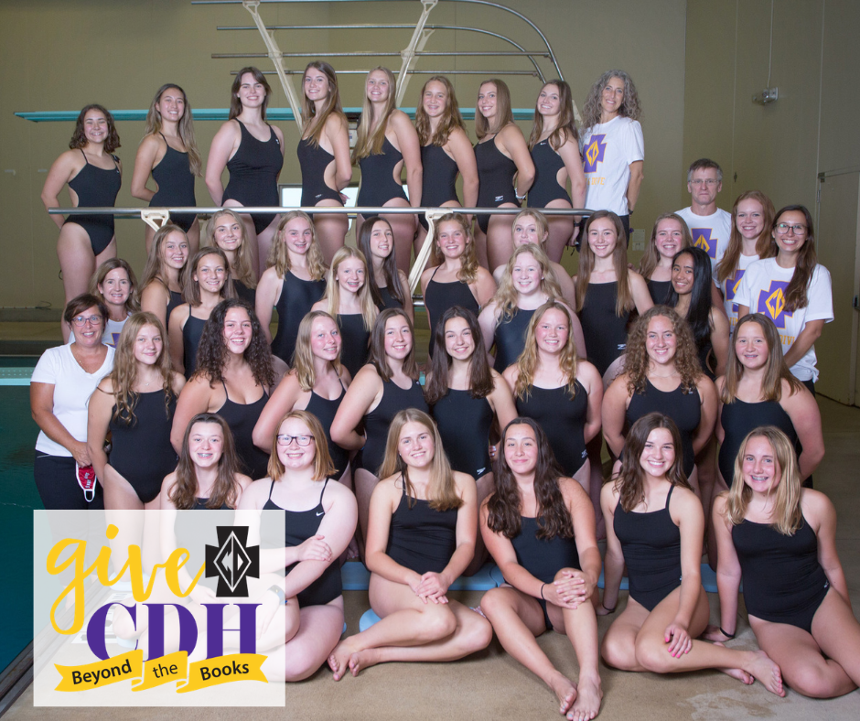
Cretin-Derham Hall
Girls Swimming and Diving 2021
Notes:
Girls
Swimming and Diving
2021

Slide 2
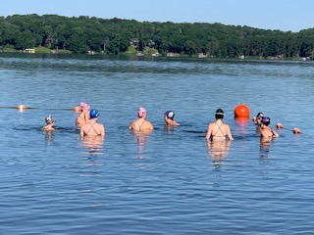
CDH Girls Swimming and Diving
CDH Swimmer and Diver Qualities:
Courage
Perseverance
Confidence
Motivation
Self Discipline
Enthusiasm
Optimism
Empathy
Integrity
Respect
Teamwork
And much more. . .

Slide 3

Coaching Staff
Lisa Thomas – Head Coach lthomas@c-dh.org
Katie Magnuson ’88 – Diving Coach kmagnuson@c-dh.org
David Reeder – Asst. Coach
Katie Reeder ’89 – Asst. Coach
Katie Conners – Asst. Coach
Erin Goodson ‘14 – Asst. Coach
Ryan Bonikoske – Strength and Conditioning
  Training Haus Coach

Slide 4

Communication
Website, Calendar, Google Classroom, and Twitter (@RaidersSwimDive)
Emails from me and Captain’s Parents
If there are questions, please have your daughter speak with me directly.
If necessary. . . A swimmer/diver, parent(s), & coach meeting
If necessary. . .Parent(s), Coach, & A.D.

Slide 5

Coaching Philosophy
We coach to create an empathetic and positive environment that inspires student-athletes to find the courage and perseverance to train, compete, and grow into young women who make a positive impact in our world.

Slide 6
Team Culture
Swimming and diving are lifelong sports and should be fun. If we do this right, we should all look at swimming and diving as an opportunity to work hard at something we enjoy and be a respectful and motivating teammates to others. We want this team to feel like a family of athletes who can rely on one another for support, enthusiasm and guidance both in and out of the pool.
Our hope, is swimming and diving at CDH becomes a building block to helping our athletes become amazing people of integrity and positive members of our community.

Slide 7
Team Expectations
Show integrity, respect and empathy for others
Persevere, be disciplined, and work to find courage and confidence in all that you do in and out of the pool.
All grades must be at least a C, or better, in order to participate in meets at mid-tri 1 and end of tri. 1. Coaches check grades.
Be on time.
Be Respectful of the facilities we use.
Listen when a coach is talking.
Have all of your equipment at practice.
Take care of yourself! Hydrate, rest, eat healthy, be positive, etc.
We expect that you will be at all practices.
Communication is important.
Coaches are committed to fostering a supportive environment that supports you and allows you to thrive.
As Coaches, Swimmers and Divers, we will all follow these expectations.
Be wise and intentional about your time outside of the pool and in.

Slide 8
Attendance Policy
You have made a commitment to the swimming and diving team.
  If the team is practicing, attending a meet or doing any other team activity, each team member is expected to be in attendance.
  You must be at 80% of all practices to swim in a meet.
  You must be at school the day of a meet to compete.
  The coaching staff must be notified prior to all absences.
  Coach Thomas’s cell: 651-269-0130

Slide 9
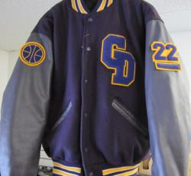
Lettering Policy
Positive Attitude: you represent CDH at all times. -Demonstrate CDH Values.
Grades must be at least C or higher at mid-tri 1 in all classes.
Practice attendance 90% – no unexcused
Meet participation 90% – no unexcused
No suspensions from school
No Chemical Violations
Coaches discretion
Section Team will letter if all other lettering criteria is met.
  Section Team will be determined by times lettering criteria.
Swimmers may swim both varsity and jv events depending on times, team size, meet, and line up.

Slide 10


Team Website http://www.cdhraiders.org
  Schedule: Google Calendar
  Elsmore Aquatics Link for suits, gear, and team jacket.
  Spirit Wear Link
  Photo ordering
  News
  Contact Information for coaches and captain parents.
  Pasta Party sign up and details.
  Open Water Events.
  Social Events

Slide 11
Team Calendar
Please add the calendar from the webpage:
  Practice dates, times, and locations
  Team Pictures
  Team Outings
  Meets
  Pasta Parties
  End of Season Banquet

Slide 12
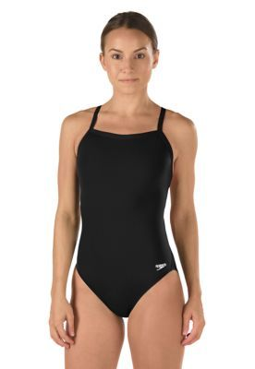
Team Suits & Gear
All Swimmers and Divers need a black suit for competition. Any all-black suit will work.
All Swimmers and Divers need a warm up jacket for meets. Any CDH Swim and Dive deck jacket or sweatshirt will do.
All Swimmers need a gear bag with snorkle, pull bouy, kickboard, flippers, and paddles.
All suits, gear and jacket can be found at the Elsmore link on our website or the spirit wear link on the website.
We will hand out caps at the first practice!

Slide 13

Spirit Wear
All spirit wear can be viewed on the website www.cdhraiders.org
and ordered through Katie Magnuson. kmagnuson@c-dh.org
All orders are due between now and by August 1st .

Slide 14
2020-2021 Leadership Team
Captains:
Leah Hausmann ’22
Saela Schwab ’22
Grace Wethington ’22
Seniors:
Leah Hausmann
Sophia Heer
Natasha Krieger
Valerie Krinke
Sophia Najarian
Annabelle Pritchard
Saela Schwab
Grace Wethington
We look to our seniors for guidance, positive modeling, support, and fun.
Thank you seniors for persevering into your 4th year and leading by example!

Slide 15
Covid: Please me mindful of change.
Please have athletes stay home when not feeling well and be mindful.
If a swimmer or diver gets covid during our season, they will need to complete a 7 day back to play program with our athletic trainer before returning to the practice or meets.
Masks – Masks may have to be worn depending on the facility we swim at.
If non-vaccinated athlete is exposed to covid: 14 day quarantine will take effect from the date of exposure.
Capacity and Distancing – Depends on the facility
Meet attendance – Meets for now, are all open to spectators. Each facility we swim at may have different guidelines as the season begins an fall starts.
Live Streaming – Most teams plan to continue live-streaming meets. This information will come out in the weekly email about each meet so you can plan to attend from home or in person.

Slide 16
NOTES:

