Slide 1
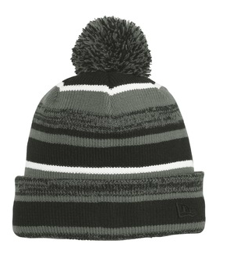

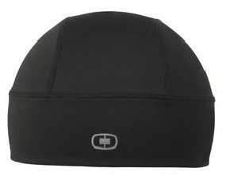

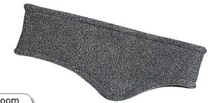
Shown for logo placement only
OGIO Endurance Fulcrum Beanie
OE652
Blacktop
New ERA Sideline Beanie
NE902
Black/Graphite
Port Authority R-TEX
Stretch Fleece Headband
C910
Midnight Heather

Slide 2
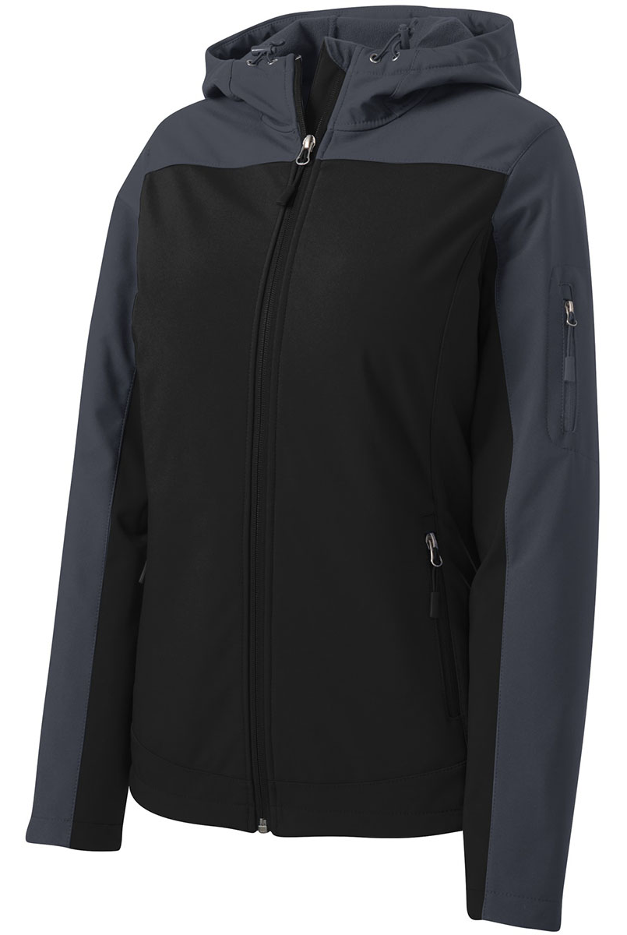
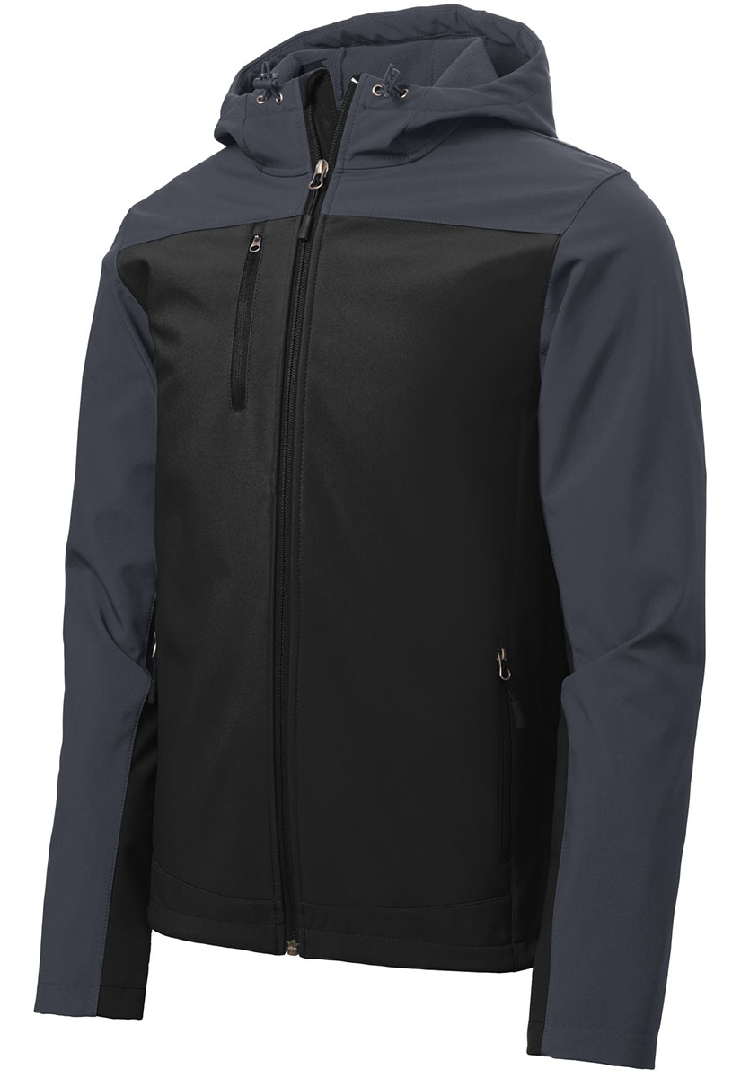

Port Authority
Hooded Core Soft Shell Jacket
L335 (Ladies)
Black/Battleship Grey
Port Authority
Hooded Core Soft Shell Jacket
J335
Black/Battleship Grey

Slide 3
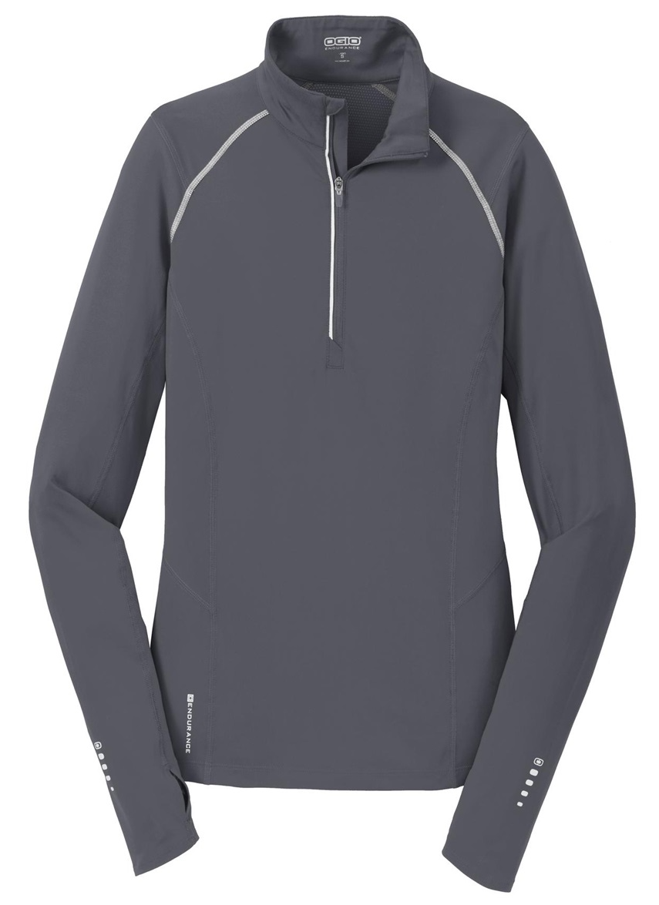
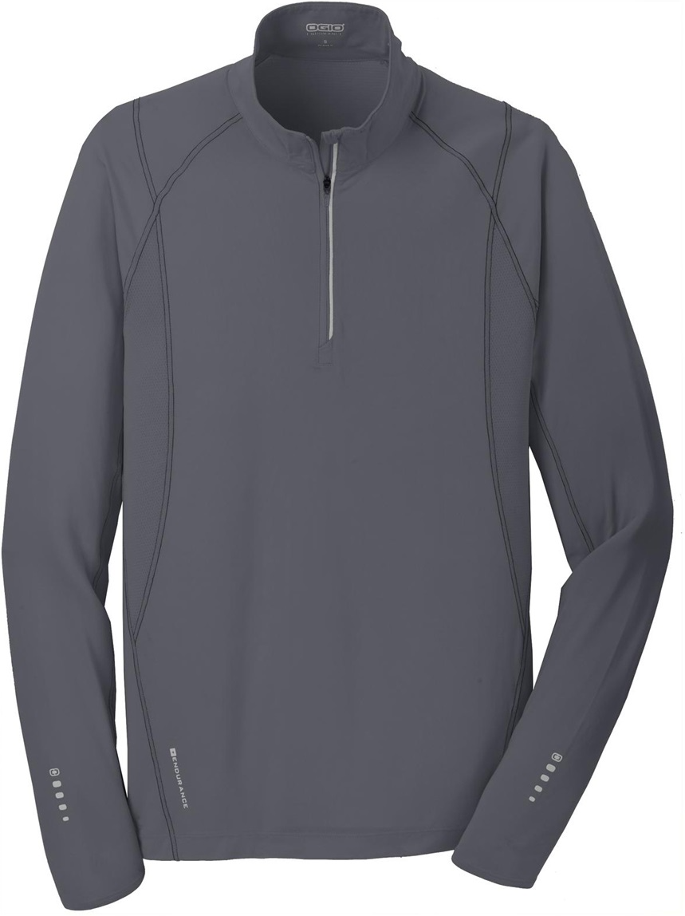

OGIO Endurance Nexus ¼-zip
LOE335
Gear Gray
OGIO Endurance Nexus ¼-zip
OE335
Gear Gray

