Slide 1

Comeback from covid
#morethanaclub

Slide 2
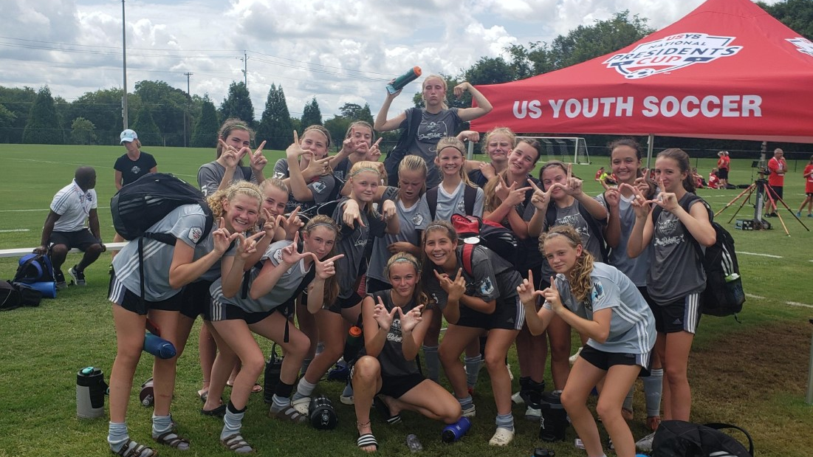
AGENDA
Club Update
Plans for rest of 19-20 Season
Plans for 2020-21 Season

Slide 3
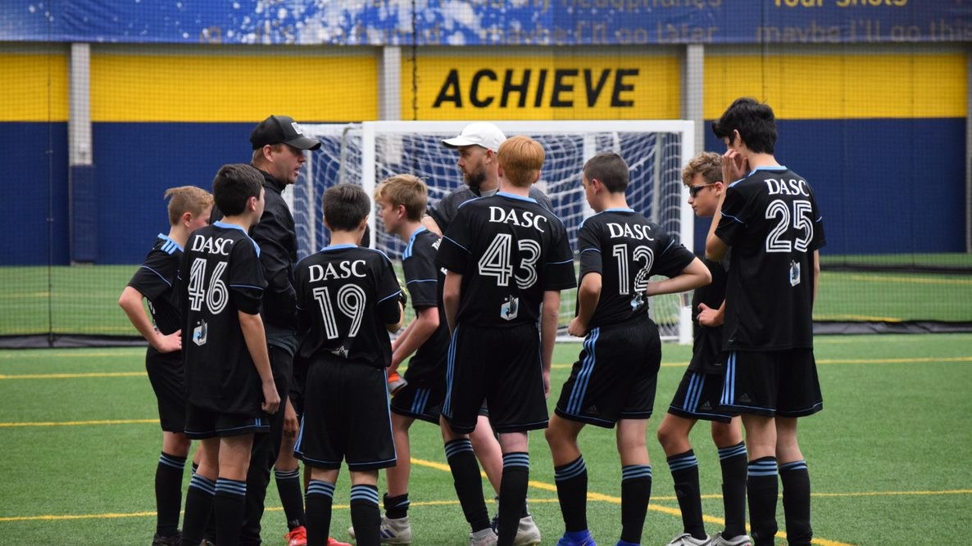
Club Update
Due to solid financial planning over the last few years, we were able to be able to absorb the immediate financial impact of COVID.
We were able to offer full recreational refunds.
True longer-term cost will be known in 1 year when we see what our number of players looks like.

Slide 4
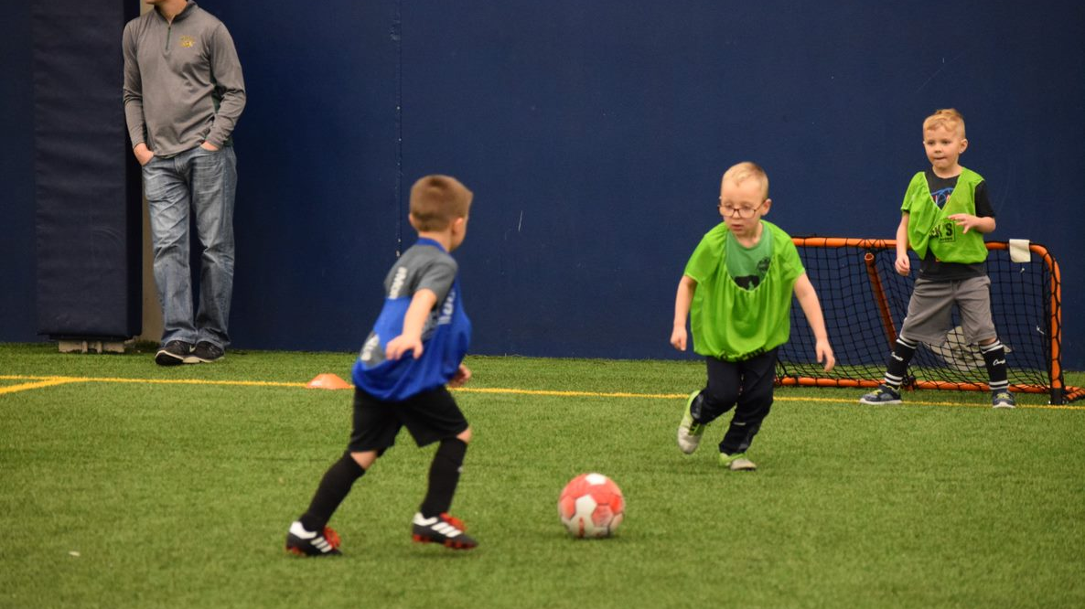
Remainder of 19-20 season
Pop & Play Events
In Public Parks
Events in June & July
DASC Pre-Season Camp
July 28-31
https://www.dakotaalliancesoccer.com/dasccamp

Slide 5
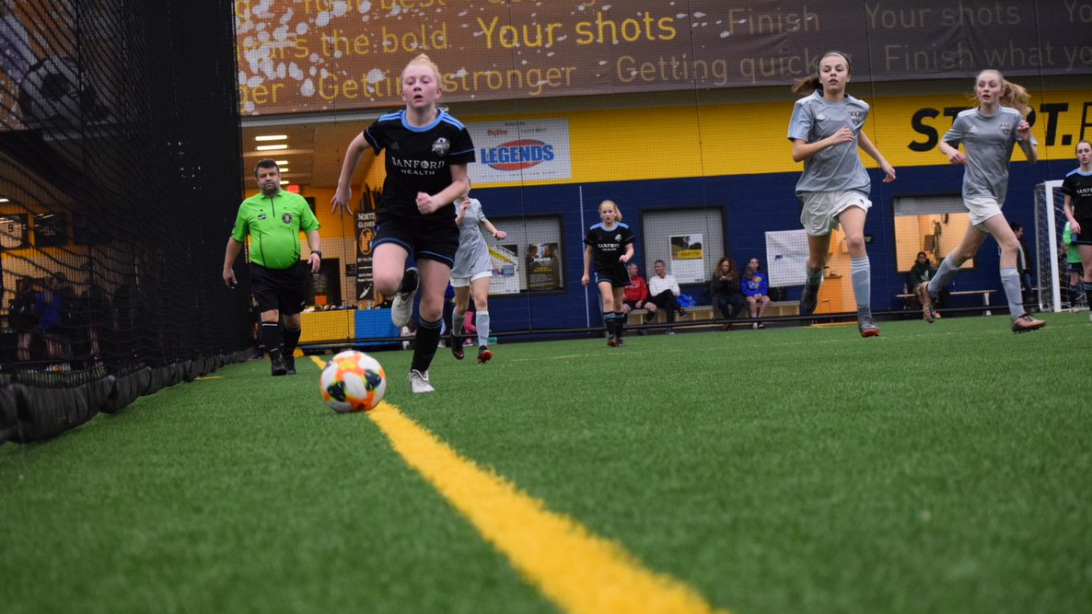
2020-2021 Season
Registration
OPENS MAY 25th
Guaranteed placement deadline June 26th
Season Dates:
August 31st – October 24th
Coach Recruitment
Fee assistance available
Jr. Academy/Academy/ Competitive Tryouts

Slide 6
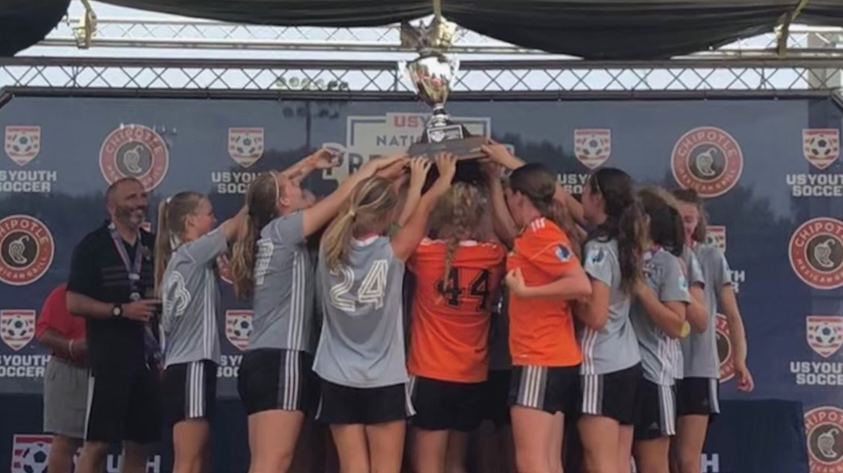
Thank you for your time
Website: www.dakotaalliancesoccer.com
Phone: 605-332-5911
Kelli Herman
Recreational Soccer Director
kellih@dakotaalliancesoccer.com
Frank Gurnick
Director of Soccer Operations
frankg@dakotaalliancesoccer.com
James Oppenheimer
Business Operations Manager
james@dakotaalliancesoccer.com

