Slide 1
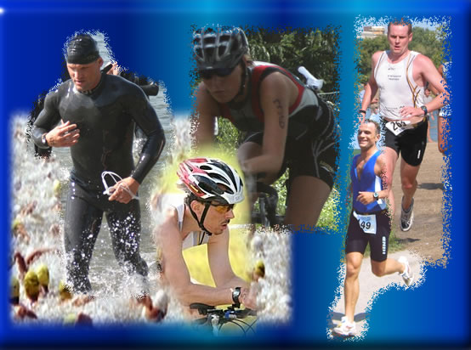
Sports Nutrition
The RD Perspective
Dee Dee Francis, MS RD CDE
St Francis Regional Medical Center
(adapted from talk by Carrie Peterson,
consultant)
Carrie Peterson MS, RD, LD, CSSD
cmpeters@umn.edu

Slide 2
Completing the Puzzle
Training
Rest/Recovery
Supplementation
Medical Treatment
Diet/Nutrition
Notes:
Diet/nutrition is very important piece to puzzle of performance and is often ignored.

Slide 3
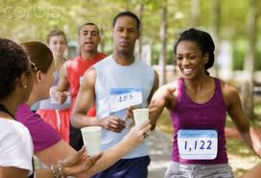
Goals of Sports Nutrition
1. Sustain Training
2. Promote Recovery
3. Provide Hydration
Appropriate foods and fluid choices can enhance adaptations to training.

Slide 4
Calorie Needs Vary
15 year old volleyball player (about 125#)
2280-2520 kcal/day
15 year old swimmer or runner (about 125#)
2725-3400 kcal/day
Notes:
Don’t need to necessarily need to count calories—might think about athlete who is losing too much weight to think about calorie intake.

Slide 5
Lohman Equation
Specific for Athletic Populations
(9 x wt in kg) + (11.7 x ht in cm) – 857 = RMR
Weight in # divided by 2.2=kg
Height inches x 2.54 = cm
(9 x 57) + (11.7 x 178) – 857 = 1738 x 1.6 – 2.0
Then,
RMR x activity level factor 1.6-2.0

Slide 6
Calorie Needs
Calories/# 120# 160# 240#
LOW - sedentary 1560- 1800 2080-2400 3120-3600
ACTVE (30-60min) 1920-2160 2560-2880 3840-4320
MODERATE (1-1.5hr) 2280-2520 3040-3360 4560-5040
HIGH (1.5-2hr) 2640-2880 3520-3840 5280-5760
VERY HIGH (2-3hr) 3000-3600 4000-4800 6000-7200
Notes:
For some of these athletes at very high level activity level—eating will be a chore.

Slide 7
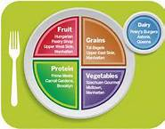
Calories
It is critical for athletes to consume sufficient calories on a daily basis to supply the energy for daily training and competition.
The difference between endurance athletes and others is in the quantity of food consumed, not the macronutrient composition.

Slide 8
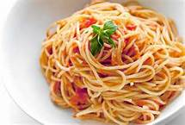
Carbohydrate Fuel Muscle
Carbohydrate is predominate energy source for training.
Stored as glycogen in muscles, it is the fuel used to supply energy for short, intense bursts of power.
The harder and longer you work, the more glycogen your muscles require.

Slide 9
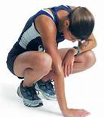
Inadequate Carbs…
General lack of energy
Muscle fatigue and breakdown
Confused thinking and lack of concentration.
Inability to work at a higher intensity for a longer period of time.

Slide 10
Carbohydrates = FUEL
Carbohydrate Needs:
30 minutes moderate exercise: 4-6 gm/kg (1.8-2.7 gm/#)
1 hour intense training/day: 7gm/kg (3gm/#)
1-2 hours intense training/day: 8-9 gm/kg (3.5-4gm/#)
2-4 hours intense training/day 9-10gm/kg (4-4.5 gm/#)
150-lb Mom who does
Aerobics classes:
300 gm/day
125 lb female athlete with intense training:
About 500 gm/day
Notes:
Many low CHO diets—CHO very important source of fuel for athletes

Slide 11
Protein
Role in Exercise
Muscle growth and repair
Aids in repair/recovery following muscle damage.
Not an Energy Source
Supplies 5% of fuel when glycogen stores are high
Supplies 10% of fuel when glycogen stores are low

Slide 12
How Much Protein?
Endurance athletes: 1.2-1.4 gm/kg/day
(125# female swimmer 68-80 grams/day)
Strength athletes 1.6-1.7 gm/kg/day
The precise amount is controversial
Increased need is caused by frequent elevated muscle protein synthesis following workouts
The more experienced a resistance trained athlete is, the less protein they appear to need vs a new lifter.

Slide 13
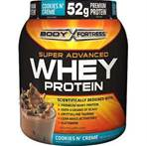
Biggest Myths about Protein
More is better
Still need carbs as energy source
Needs are higher in athletes than general population
Max amount 2 grams/kg
Supplementation is necessary
You can get enough from foods.
Think about supplements in kids who eat little meat/dairy products

Slide 14
Food Sources of Protein
1 cup milk = 8 grams
3 oz lean meat = 21 grams
Greek yogurt = 15 grams
1 egg = 7 grams
1 oz cheese or ¼ cup cottage cheese = 7 grams
2 T peanut butter = 8 grams
23 almonds = 6 grams

Slide 15
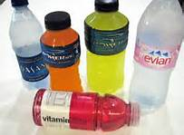
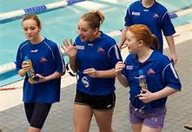
Hydration and Importance
95% of muscle cramps are due to dehydration!
Very often cause of poor performance!
Notes:
Think about average day of kid in school. Get up maybe have 1 cup milk or juice, 1 cup milk at lunch then 2 ½ hour swim practice. If they are not drinking during practice will be dehydrated.
Swimmers are sweating in the pool.

Slide 16
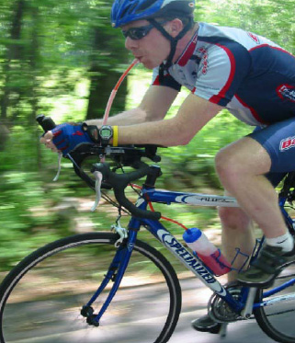
Hydration
Don’t rely on thirst
Already 1-2% dehydrated
1% loss of body weight=decreased performance
1 Liter loss = 2.2# body weight
Heart rate increases 8 beats per minute
Cardiac output decreases by 1 Liter per minute
Drink before, during & after
2 hrs before 14-24 oz
20-36 oz/hr (5-12 oz / 15 mins.)
Drink 24oz / # lost (weigh self before and after)
Water is fine for <1 hr; sport drinks > 1 hr

Slide 17
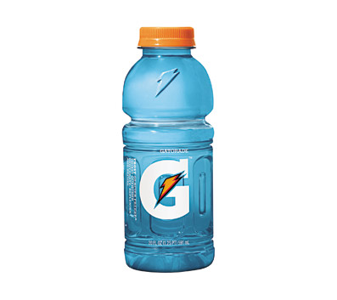
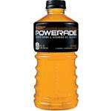
Sports Drinks?
Think of the 3H rule-hard, hot, hour
Replaces fluids better-athletes drink more because they taste better.
Provides carbohydrate source
Provides electrolytes to replace losses and drive thirst.
Combination of CHO/electrolytes is absorbed faster than water alone.
Notes:
Sports drinks go back to 1965 university of FL researchers developed to replace water and electrolyte loss during intense practices and heat.

Slide 18
What about Vitamins
Athletes at greatest risk:
Energy restrictors
Those who eat foods with low nutrient density
Calcium, Vitamin D and Iron
Athletes who train in northern latitudes or who train indoors may benefit from Vitamin D supplement
Omega 3 FA-some anti-inflammatory affects
Notes:
Many young women fail to get adequate calcium—vitamin D almost always low in northern climates. Especially problems in non-milk drinkers or girls who consume too much pop—even diet pop.

Slide 19
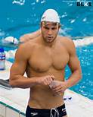
Carbohydrate Guidelines
Pre-event → 1-2 g/kg 1-2 hrs prior or 4-5 g/kg 3-4 hrs prior
1.5 cups pasta with sauce = 75 grams
1 cups milk = 12 grams
Grated Cheese
12 inch sub = 90 grams
Chocolate milk = 30 grams
Notes:
Many kids with school then sporting events need snack or small meal about 4:00/4:30
Pasta meal with about 75-150 grams CHO (tended more on upper end)
2 cups pasta, 1 cup milk, grated cheese, veggies

Slide 20
Carbohydrate Guidelines
Pre-event → 1-2 g/kg 1-2 hrs prior or 4-5 g/kg 3-4 hrs prior
During →30-60 g/hr or .5-1.0 g/kg/hr
Max CHO that can be oxidized during exercise from a single CHO source (eg: glucose) is 1g/min or 60g/hour (transporter becomes saturated)
Research 1.8-2.4 g CHO from a MIXTURE of CHO can increase CHO oxidation to 100g/hour
1 g/min later in exercise
Sports drink!

Slide 21
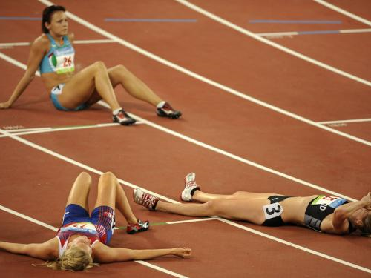
Refueling after Exercise
Consume post-exercise snack (within 30 min) 1.0-1.5 g CHO/kg
Meal within 2 hours after training (low fat)
After 2 hours enzymes that pack away glycogen are decreased.
Hydration: 16-20 oz water or sports drink for every # lost.

Slide 22
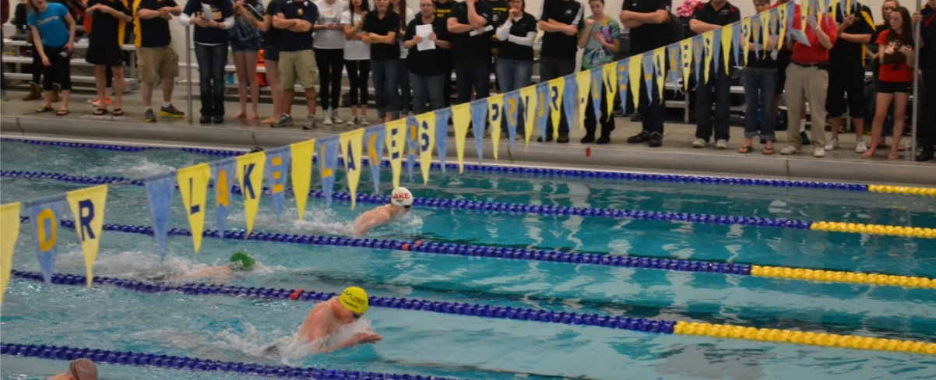
125# Swimmer example
Breakfast: pm snack
1.5 cup cereal with 1 banana Granola bar or Clif Bar
1 cup skim milk (plus fruit if needed)
1 cup juice Dinner: 3 oz lean meat
Lunch: 1.5 cups rice or potatoes
1 peanut butter sandwich 1 fruit
¼ cup almonds 1 cup green beans
1 servings chips Protein Shake if needed
1 apple (or 2 cups milk)
2 Carrots Snack:
Choc chip cookies??? Cheese and crackers
Notes:
Total above: 90 grams protein, 450 grams CHO, 2700 kcal.

Slide 23
HELPFUL RESOURCES
WWW.ACSM.ORG
AMERICAN COLLEGE OF SPORTS MEDICINE
WWW.NATA.ORG
NATIONAL ATHELTIC TRAINERS’ ASSOCIATION
WWW.GSSI.ORG
GATORADE SPORTS SCIENCE INSTITUTE
http://www.usaswimming.org
Notes:
Nutrition center at USA swimming website under tips and training.

Slide 24
Take Away Messages
Good nutrition is important for athletic performance. It is often ignored.
Think about protein supplements for those athletes who are not big meat/dairy eaters
Eating probably will be a chore for swimmers
Dehydration is often cause of poor performance
Calcium is important in young athletes

