Slide 1

All Aboard: A Parent’s
Introduction to Crew
ADMIT ONE
All Aboard
2nd Thursday each month
7:30-8:30 pm
DEPARTURE:
2nd Thursday each month
SEAT ASSIGNMENT:
meet.google.com/yix-nfqb-hib
SEAT CLASS: Parent
Langley Crew Booster Club
Notes:
Thank you for taking time out of your evening to join us
We won’t be recording this evening, but we will post the slide deck, including the Q&A on the website’s All Aboard page
Just like last month, if you have a question, please type it in the Chat.
All the questions are being noted and we’ll add them to the slide deck before we post it on the website.
Please mute yourself during the presentation, but feel free to unmute once we go to Q&A
This evening, we’ll be talking about:
A few little things
Regattas, Regattas, Regattas

Slide 2

A Few Little Things First
GroupMe Chats
Join the Parents GroupMe chat if you haven’t already. Links are on the website, on the Stay Informed page
Once you join, post #stay to keep the platform from dropping you after each post. Don’t forget the hashtag!
USRowing
Don’t forget to join USRowing! Your child must be a member before they can race. When registering, identify your club as Langley Crew Booster Club and enter our club code: BH9VS (case-sensitive – use all caps). This identifies your athlete as a member of Langley Crew and able to race for us. If you’ve already registered, check the membership and add us if necessary!
VASRA Google Group
Join VASRA’s Google group to get regatta results. Links and info are on the website, on the Stay Informed page
Notes:
GroupMe
Coach Kevin posts boat lineups and times on Fridays, so make sure you’ve joined.
Don’t forget to post #stay. Don’t forget the hashtag. For some reason known only to GroupMe, this is important.
US Rowing
Your child has to be a current member to race and they have to be affiliated with us.
Make sure you identify Langley Booster Club as your club and enter our club code.
The club code is case-sensitive, so use all caps
If you’re not sure, go to USRowing and check your membership profile – you should see us listed
VASRA Google Group
No longer using Twitter to post race results
You will need to ask to join the Google Group
Instructions are on the Stay Informed page of the website

Slide 3
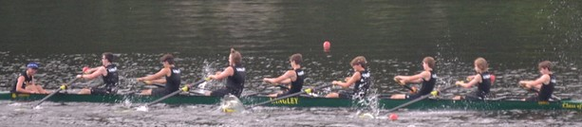
Your Child’s Experience of the Regatta
They should arrive at the park 2 hours before their race time. They should already be wearing their uniform. They should have sunscreen, a water bottle, their tech shirt, and a jacket. Many of the kids also bring a blanket or throw for the early regattas, when it’s a bit chilly in the mornings.
Once you drop them off, they will walk down to our hospitality tent by the boathouse and check in with the captains and coaches. They will hang out there until time to get ready to race, meet with their boatmates and coach, go over the race plan, and warm up on the ergs.
Notes:
They need to be there 2 hours early, already in uniform.
Everyone in the boat must be dressed exactly alike, so if one person forgets their tech shirt on a cold day, the other 4 or 8 must take theirs off as well, so they will all be cold!
They’ll meet with their coaches, warm up, and hang out at the team tent until time to row. We provide healthy snacks and drinks at the tent.

Slide 4
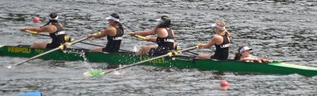
About 30 minutes before their race starts, they will launch their boat and row down the outside of the course to the starting point. Once there, they will position the boat in their assigned lane and wait for the starter to signal “Go.” They will row their hearts out for the next 1500 meters, approximately 6 minutes, to the finish line.
Once the race is completed, they will row back to the recovery dock, pull the boat out of the water, and go back to the team tent. They will cool down, grab a snack, and meet again with the coach. Whether they are expected to stay for the rest of the day to support their teammates or can leave after their race depends on their coach. Once they have the “all clear” to leave, they should text you to come pick them up, with the understanding that it will take you about 45 minutes to an hour to get from the grandstand to the parking lot, get the car, then get to the pickup point in Lot C.
Notes:
30 minutes before the race, they row down to the starting line and get in position
Once they win the race, they go back to the dock, put the boat away and go back to the tent
The coach will let them know when they can leave – some want them to stay to cheer on the team, others don’t.
It will take you about an hour to pick them up – you have to go back to South County to get the car and then back to Lot C.
Alternately, meet them at Lot C and go together to South County, but that takes up room in the bus, making the lines long

Slide 5
Your Experience of the Regatta
Before you leave home, you will make sure your student has sunscreen, a water bottle, their tech shirt and a jacket, and is wearing their uniform. Pack for yourself a printout of the heat sheet, sunscreen, a water bottle, binoculars, hand sanitizer, a hat, a padded seat or collapsible chair, small bills for concessions, snacks in case the concession stand runs out, and maybe a blanket for the early regattas.
You will be wearing comfortable walking shoes and be dressed in layers.
You will not bring the family pet. Regattas are not pet-friendly.
You will drop off your athlete and any other passengers (with all the belongings) at Lot C about 2 hours before your child’s scheduled race. Your student will walk down to the boathouse while your passengers schlump your belongings to the grandstand.
You will drive to South County High School to park. You will then get in line for the parking lot bus ($15 cash, roundtrip). The bus will drop you off at Lot C, where you will either hike to the grandstand or get in line for the grandstand van ($5 one way, cash).
Notes:
Make sure you have something soft to sit on – the grandstand is concrete
Once you drop everyone off, go to South County to park
Bring CASH – the parking lot bus is $15 round trip per person, the grandstand van is $5 each way, and everything is CASH ONLY, including the concession stand
Wear shoes you can hike in. Even from the grandstand van, there’s a bit of a hike to the grandstands themselves. Pretty sandals, flip-flops and heels are simply not practical, and you will regret it
NO PETS.

Slide 6
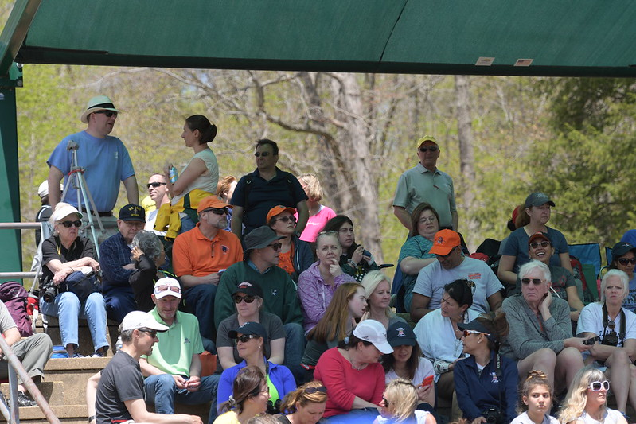
At the grandstand area, you will find a concession stand, bathrooms (not portapotties), and the grandstand itself. The Langley parents sit in the upper left corner as you reach the grandstand. We try to be in the shade, and all sit together.
You’ll track when Langley boats are racing, and in which lane, using your heat sheet, and cheer them on. With your binoculars, you’ll be able to see them from about halfway down the racecourse, and the finish line is right in front of us.
Once the regatta is over, you’ll make your way back to your car, come back and pick up your passengers, and go home. Your kids will be still keyed up after the race, but by the time they get home they will be tired and hungry. Don’t be surprised if there’s a nap soon after.
Notes:
Once you get to the grandstand, come sit with us. We’re in the upper left corner as you reach the grandstand.
Do not forget the binoculars – it’s much more exciting when you can see them clearly and pick out where the Langley boat is. Also, the start line is pretty far away.

Slide 7
Yes, But What Do I Actually DO?
Getting There
Timing
When your student needs to be there:
They need to check in at the boathouse two hours before their scheduled race
The coaches will tell them on Thursday or Friday what time they need to be there on Saturday.
ASK YOUR KIDS ON FRIDAY WHAT TIME. They know. Make them tell you. If they don’t remember, make them check. It’s in their group chat.
How long it will take you to get to the grandstand depends on how long the wait for a parking shuttle bus takes. Allow at least 45 minutes to go from the South County parking lot to the grandstand:
5 minutes to load the bus at SCHS
15 minutes to travel from SCHS to Lot C
5 minutes to unload the bus at Lot C
15-20 minutes to walk from Lot C to the grandstand or 10 minutes to ride the grandstand van
Notes:
The kids KNOW what time they race, earlier than you will. The coaches will tell them, usually before VASRA releases the heat sheets. They know which boat they’re in and what time they’ll race.
If they say they don’t know on Friday, make them look it up on the chat. It’s there.
Coach Kevin will post the lineups and times on Friday or Saturday
Most of our boats will be in the morning. Get there early to avoid the worst of the traffic and shuttle bus lines.
We’ve found that it’s best to just accept that you’re going to be at the park most of the day.
Not counting wait time for the bus, it’s 45 minutes from the parking lot to the grandstand. If you drop the kids off at 7 or 8, you should be at the grandstand in about an hour, which has you there for the first race!
There are 4 races where we cannot park at South County, so we will be parking at the Lake Ridge Kiss & Ride
There are dates and maps in the Survival Guide we’re handing out on Saturday and on the website

Slide 8
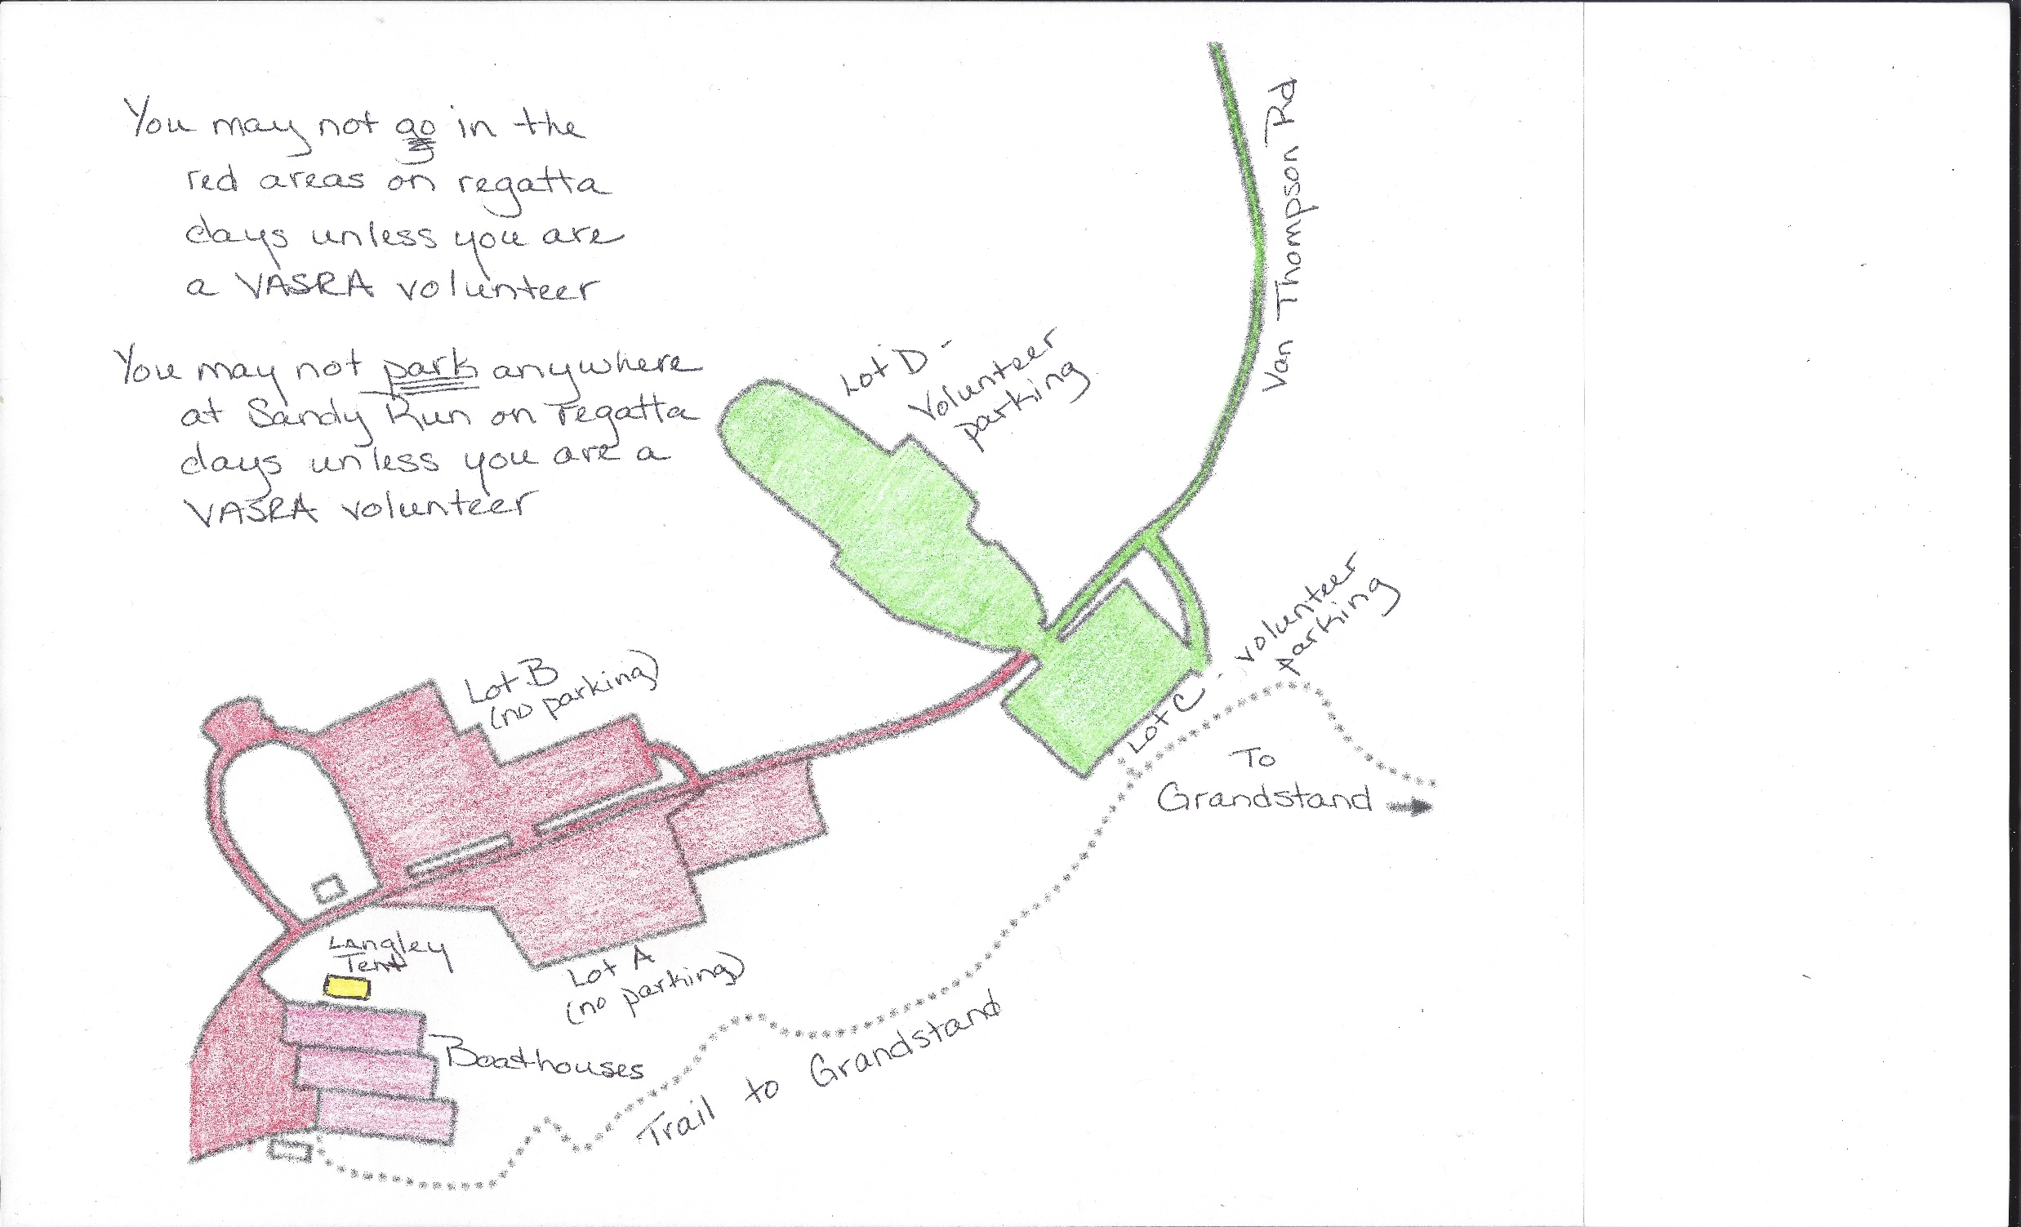
Parking
Unless you are volunteering for VASRA, you can’t park at Sandy Run on regatta days
Once your child and passengers are dropped off, go to South County HS to park, then take the parking shuttle bus to Lot C.
VASRA strongly recommends dropping all passengers off at Lot C before going on to South County, as this will reduce the number of people waiting for the parking lot bus, thereby reducing wait times for the bus.
Notes:
Park access is strictly limited on regatta days.
Only volunteers can park at Sandy Run, and only in the furthest parking lots.
Unless you are volunteering for VASRA, you cannot be past the dropoff point. No spectators in the red area. You cannot visit your kid before or after the race.
These maps will be available at the Regatta Kickoff Event Saturday night. They’ll also be on the website

Slide 9
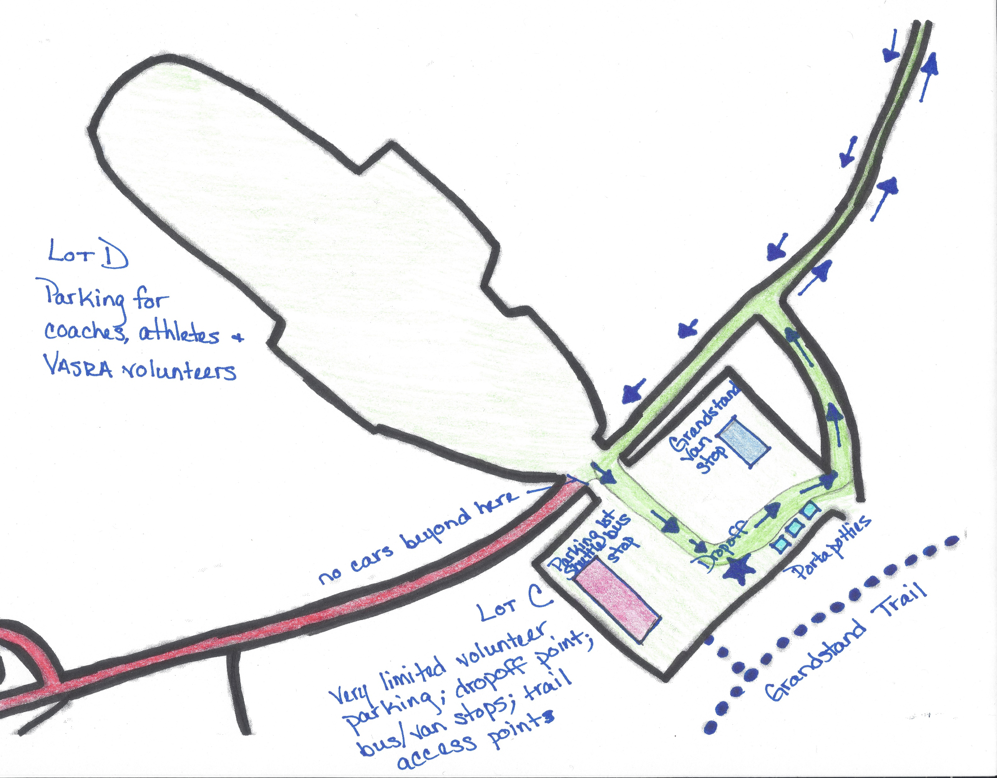
Dropoff
You should drop off your student at the Lot C drop-off point about 10 minutes before they need to check in, to give them time to walk down to the boathouse.
You should also drop off any other passengers, and anything you’re bringing with you, at Lot C, with only one person going on to the parking lot
Notes:
Notice that pretty much everything happens in Lot C
Both shuttle stops, dropoff point, and access to the grandstand trail are in Lot C
Drop off everyone but the driver here, then only the driver has to take the parking lot bus – shorter lines for everyone

Slide 10
Shuttles
There are two shuttles, one to take you back and forth from the parking at South County to Lot C, one to take you back and forth from Lot C to the Grandstand area. To avoid confusion, we will call them the parking lot bus and the grandstand van. Both shuttles run continuously from 1 hour before the races begin to 1 hour after the races end.
Parking lot bus –
  Allow at least 25 minutes to get to the park
    Takes about 5 minutes to load and unload
    Takes about 15 minutes to travel from SCHS to Lot C
    Takes about 5 minutes to load and unload
  The wait gets longer as the day goes on. We highly recommend going immediately to the parking lot after you drop off your passengers.
  $15 fee per person, payable at SCHS, covers one round trip – CASH ONLY
Grandstand van –
  Allow at least 10 minutes for the van to load, travel, and unload
  The vans are smaller vans, like the rental car shuttles at the airport, carrying about 15 people at a time.
Notes:
Regattas are cash only
We’re calling the shuttle from South County to Lot C the parking lot bus
We’re calling the shuttle from Lot C to the grandstand the Grandstand Van
Both run from 1 hr before to 1 hr after the races
It takes about the same amount of time whether we’re using South County or the Kiss & Ride lot for parking
Parking lot bus holds about 30 people
Grandstand van a van that holds about 15 people

Slide 11
At the Grandstand
What to bring
Sunscreen
Blanket for the early regattas (optional)
Water bottle
Jacket
Binoculars
Hand sanitizer
Snacks (concessions sometimes run out)
Hat
Padded seat or collapsible chair
Small bills for concessions and shuttles
How to get there
From the South County parking lot bus drop-off in Lot C, you can walk to the grandstand, or you can board the grandstand shuttle van, which will drive you nearly to the grandstands.
If you are walking, head to the Pedestrian Trail at the back of the lot. Once on the trail you will walk a few hundred yards to a “T” intersection. Take a left to the grandstand and follow the crowd. The path is well-marked and relatively smooth, but is hilly, unpaved, and a 15–20-minute walk. Wear footwear appropriate for hiking.
The grandstand van costs $5 one way and is CASH ONLY. It drops you off at the top of a hill a few hundred yards from the grandstand.
Where to sit
We sit in the shaded area at the top left corner of the grandstand.
Notes:
Definitely bring all these things, but don’t pack for the beach. There’s really no room for a lot of stuff on either shuttle, and not a lot of room at the grandstand.
We recommend only bringing the essentials listed for your first regatta, to give you a sense of what you want to bring with you from then on.
The line for the grandstand van can be prohibitive, and you could end up getting there faster if you walked – it only holds 15 people and moves slow.
You still have a little hike even if you take the van – it doesn’t drop you off exactly at the grandstand area – and there’s a hill
Once you get there, come find us. We’re in the top left corner.

Slide 12
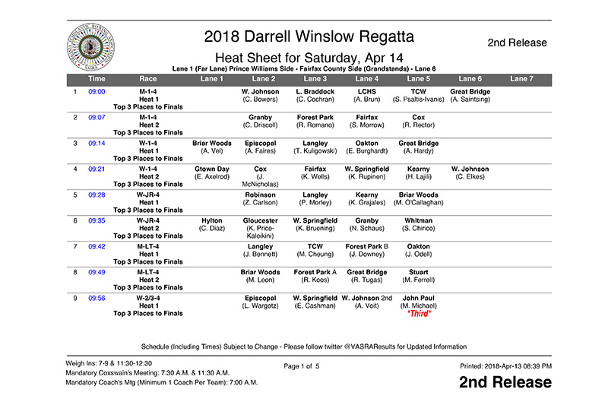
Races
The coaches provide VASRA which boats will be racing on Wednesdays. VASRA takes that information and creates the race schedule, called a “heat sheet.” The students are notified either Thursday or Friday whether they’re racing and what boat they are in. The heat sheets are posted on the VASRA website home page Thursday evening or Friday morning.
Notes:
So, you’ve dropped off the passengers, parked the car, and made your way to the Langley section of the grandstand. It’s time for the races! How do you figure out what’s happening?
The heat sheets are available to all, and we highly recommend downloading and printing the heat sheet and highlighting the Langley races.
Doublecheck the heat sheet Saturday morning, just to make sure there haven’t been any changes. It happens.

Slide 13
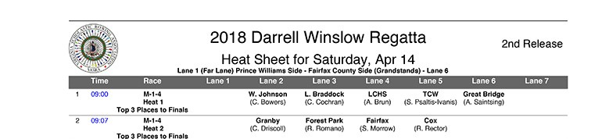
How to read the heat sheets
The heat sheets are self-explanatory, except for the hieroglyphics under the Race column.
The first column, which has no header, tells you which race it is
The second column, Time, tells you what time the race is scheduled to start
The third column, race, will be described on the next slide
The remainder of the heat sheet tells you which schools are racing and which lane they’re in
Notes:
Reading them is pretty easy, except for one column
The 1 tells you which race it is – the first one of the day
Time says what time it’s scheduled to start
Race is a foreign language we’re about to learn
Lanes are assigned starting with Lanes 3 and 4 and work out on either side from there. That’s why there’s nobody in Lane 1 in the Race 1 and no one in Lane 1 or 6 in Race 2

Slide 14
Race Column
The format is Gender-Ranking-Number of Rowers,
The first character tells you if it’s a Men’s or Women’s boat
The second character tells you the boat’s rank, or category. A number there means it’s a Varsity boat. You will also see other rankings in that space:
  V. Varsity. No age limit. Identified by the boat’s ranking in terms of speed
      JR. Nobody in the boat can be a Senior or older than 17.
      N. Novice. All the rowers must be in their first year of rowing, but do not have to be freshmen.
      FR. Freshman. All rowers in the boat must be in the 9th grade.
    The third character tells you how many rowers (not counting coxes) are in the boat
Notes:
So, let’s go a little deeper into the mystery part of the race category – the Race column’s first row
Forget the standard athletics categories of freshman, JV, and Varsity – rowing doesn’t use those
The first character is gender
The second character tells you what category, or rank within a category, the boat is.
If the boat is Varsity, it will just have the number
1 means the first boat of that category for that school. It’s the fastest boat for the school in that category.
2 means it’s the 2nd fastest boat, and so on.
The third character tells you how many rowers (not counting the coxswain) are in the boat; essentially, the number of oars
We will have multiple boats in the same category, because of our size.
The categories mean the kids compete against other boats of similar experience and skill, to give everyone the best chance of winning. No one wants a bunch of novices going up against an 8 full of Seniors who’ve all been rowing for 4 years.

Slide 15
The next row under Race tells you what heat this is. There are 6 lanes in the course, but the outside lane can be used as Lane 7. If more than 7 boats are entered in any one category (men’s 4 sweeps, for instance), there will be two heats.
The third and last row under Race tells you what happens in the heat. If there are only 2 heats, the top 3 boats in each heat will race in the final. If there are 3 heats, the top 2 boats in each heat will advance to the final.
Notes:
The next row under Race tells you if there are heats.
There are 6 lanes in the course
If there are 7 boats in a category, VASRA may assign the area outside Lane 6 as a lane to have all the boats row at once, like the shoulder on 66 is a travel lane at rush hour
If there are more than 7 boats in a category, they will do heats – as many as necessary to have all the boats racing
The last row tells you which boats from each heat will compete in a final to see who wins
Don’t worry too much about any of this. You’ll get it after the first regatta, and there will be someone in the grandstands who can help you

Slide 16
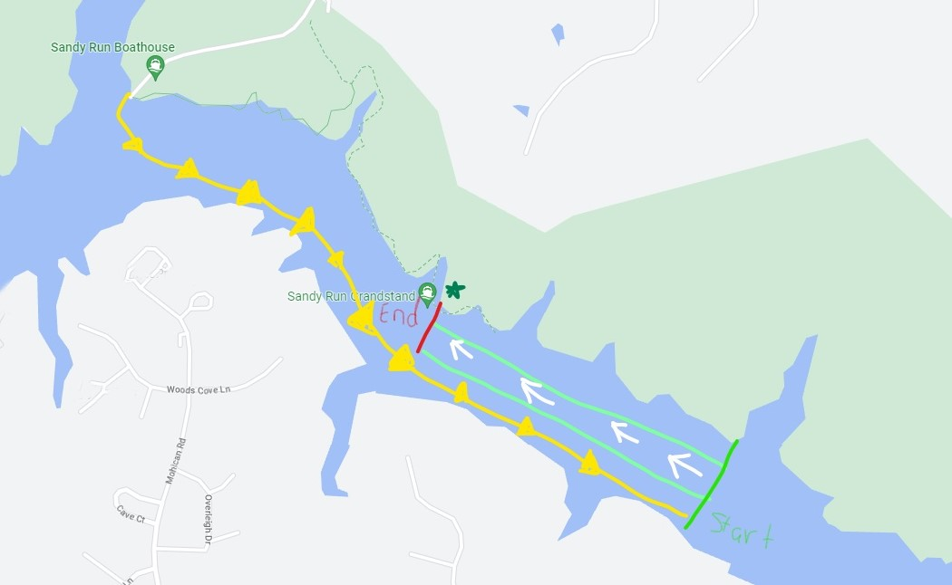
Racecourse
Notes:
So where are the grandstands and how does the race go?
The dotted lines are the trails to the grandstand
The star is the grandstand
The yellow line is the kids rowing from the dock to the start – at the medium green line
The light green is the racecourse. Lane 7 would be on the grandstand side of that top line
The white arrows is the direction they race
The red line is the finish line.

Slide 17
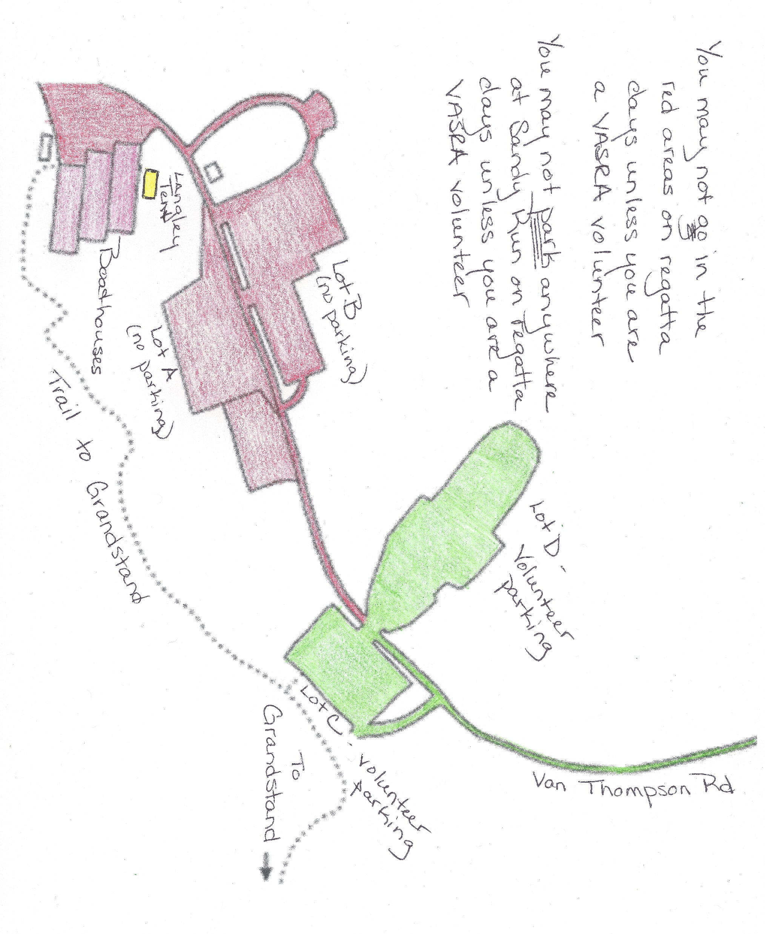
Volunteering
If you are volunteering at the regatta:
You get to park in Lot D rather than go to South County
You MUST sign in at the volunteer signup tent in the boathouse area ONE HOUR in advance of your shift, unless it’s before 7 am
If you are volunteering at the grandstand concession stand, you can sign in there instead, but still ONE HOUR in advance of your shift, unless it’s before 7 am
Failure to sign in, even if you work your shift, will be counted as not fulfilling our obligation, and Langley Crew will be fined
Children are not allowed to accompany you to any assignment, due to insurance requirements
Notes:
You get to park in Lot D (who say’s good deeds aren’t rewarded?)
You have to sign in for your position ONE hour before your shift starts
If you don’t sign in, we get fined, even if you did the shift
If your shift starts before 7 am, just show up at the start time
If you are working the grandstand concession, you can sign in there instead of at the volunteer tent, but still 1 hour early

Slide 18
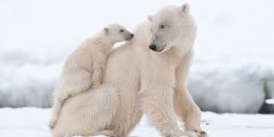
Polar Bear Regatta
March 18, races start at 9 am
We will likely race 6 boats - 3 Men’s 8s and 3 Women’s 8s
Many of our parents have never been to a regatta before –
The Polar Bear’s historically low attendance gives us a unique opportunity for a “dry run” on how to navigate a regatta!
The coaches would like all rowers – rowing in the race or not – to attend the regatta. This way, new rowers learn the details of the regattas (including making the inevitable first-timer mistakes) when it doesn’t impact race results. They will learn what’s expected on regatta days, and how the logistics work for them. Team members will meet at the boathouse, and non-racers will likely have an erg workout to do in the morning.
Parents will meet at the grandstand. You’ll have a chance to try out these logistics we just went over, when being late doesn’t impact your athlete being able to race or you being able to see it. It will also reduce your stress and anxiety level the next week, when your child is rowing.
Notes:
The Polar Bear is the first of the season, reserved for non-freshmen rowers.
Novice rowers may participate, as long as they aren’t freshman, but it’s unusual.
Because of this, it’s the least-attended of the regattas
We have 127 kids on the roster. 48 are new to rowing this season – that’s 37%
We’re going to take full advantage of Polar Bear’s low attendance to do a dry run for regattas and how they work.
Gather up your kids and your carpools and come down to Sandy Run. Don’t drop them and head to Starbucks – stay for the regatta.
This way, everyone learns how it works and what to do – and not to do – when it doesn’t really matter in terms of your child’s race.
Plan on a fun day next Saturday, and we hope to see you at the Grandstand!!!
Don’t forget to come to the Regatta kickoff dinner on Saturday. Low key, informal, and it’s the only place you can get every single question you have about regattas answered by the kids and parents who’ve done this before, all while enjoying a lovely potluck dinner. Don’t forget to sign up for the potluck!

Slide 19
QUESTIONS???

Slide 20
Volunteering:
Q: How do they know you're a VASRA volunteer so they’ll know you can park at Sandy Run?
A: You’ll tell them at the checkpoint.
Q: Is there a meet up/check in point for VASRA volunteers?
A: Yes, there is a volunteer headquarters. The tent is set up by the VASRA HQ buildings, just a little further down towards the water from the boathouses. They are the last group of buildings, on the right
Q: Where do you sign up for a shift for the VASRA volunteering?
A: You can sign up in the Signup Genius. If you log in to your account and go to signups you’ve been invited to, you’ll see one called “Off to the Races.” It’s pretty full right now but keep checking – people always need to drop or switch as things come up during the season.
USRowing
Q: For USRowing, which membership should I select? Basic or Championship membership?
A: Select Basic.

Slide 21
Shuttle
Q: I remember that there was a shuttle drop off for handicap/elderly folks closer to the grandstands? Will the same shuttle go down there?
A: This is a different shuttle, one that’s run by the park. It’s called a Gator. If you have someone with mobility issues, you need to get in touch with the Sandy Run park office to arrange transportation. They’re happy to do it, but it’s helpful if you arrange it ahead of Saturday. Check with the Fairfax County Park Authority for contact info for Sandy Run.
Q: Does the roundtrip price includes the parking lot shuttle and grandstand van?
A: No. The parking lot shuttle is $15 round trip – from the parking lot to Lot C and back – and is paid in full when boarding at the parking lot. You do not pay when boarding at Lot C to go back to the parking lot. The Grandstand Van is $5 one way, and is paid at each leg. The total for one person to take both shuttles from parking lot to grandstand and back is $25, payable in three “installments.”

