Slide 1

All Aboard: A Parent’s
Introduction to Crew
ADMIT ONE
All Aboard
2nd Thursday each month
7:30-8:30 pm
DEPARTURE:
2nd Thursday each month
SEAT ASSIGNMENT:
meet.google.com/yix-nfqb-hib
SEAT CLASS: Parent
Langley Crew Booster Club
Notes:
Thank you for taking time out of your evening to join us
We won’t be recording this evening, but we will post the slide deck, including the Q&A on the website’s All Aboard page
As a side note, we’ve added a Website Directory, with links to subpages, to make it easier to find the information you’re looking for
Just like last month, if you have a question, please type it in the Chat.
All the questions are being noted and we’ll add them to the slide deck before we post it on the website.
Please mute yourself during the presentation, but feel free to unmute once we go to Q&A
This evening, we’ll be talking about:
Away trips
Setting up for next year

Slide 2

Away Trips
Manny Flicks – Philly 4/24
Men’s and Women’s 1st and 2nd Varsity and Freshmen will be going up for the day
Men will compete in the morning and women in the afternoon. LCBC is not providing transportation, meals, etc. The rest of the team will compete in Occoquan on 4/23.
Stotesbury Cup Regatta – Philly 5/19-21
We leave after school on Thursday, May 19. On Friday, the kids will compete in time trials to try to advance to the next round. Semifinals are on Saturday morning, with finals on Saturday afternoon. After the finals, we come back home, so we’ll be back late Saturday.
For those going, we have booked a block of rooms, made catering arrangements for our meals, and have booked transportation for the coaches, athletes, and chaperones. This is not included in the registration fees – parents will need to pay to participate.
National Championship – Camden, NJ 5/28
Nationals is only for those boats that won a state championship. Because fewer boats go, we don’t book rooms, meals or transportation – we really don’t have any idea how many kids are going until too late to do any of those things.
Notes:
Manny Flicks
For the Manny Flicks event, we will bring the large tent and providing snacks for the kids, like at the Occoquan regattas. We hope to have a final decision on alternates tomorrow or Saturday
I’ll be sending out detailed information this weekend for those who are going up. Putting that together is my chore for tomorrow.
Stotes
We do not know yet which boats are going to Stotesbury and won’t until a little later. Manny Flicks is at the same place as Stotes, so we’re looking at it as a dry run.
We need a chaperone for every 6 students, so we will need parents to volunteer for that.
Nationals
Memorial Day weekend in Camden
Only the boats that win States will go
We won’t know until 5/7 or 5/14 who goes
Providing tent or snacks depends on how many boats go

Slide 3
Planning for Next Year – Board Members
Board Positions Graduating Out
Treasurer (1 of 2)
Photographer (1 of 1)
Board Positions of Rising Seniors
President (2 of 2)
Coach Liaison (1 of 1)
Secretary (2 of 2)
Equipment (2 of 2)
Volunteer Coordinator (1 of 1)
Website (2 of 2)
Membership Administrator (1 of 1)
VASRA LOC (1 of 1)
Apparel (2 of 2)
Launch Operations (3 of 3)
Ways and Means (1 of 2)
Recruitment (1 of 2)
Events (2 of 4)
Notes:
It seems way too early to talk about next season, but we’re already halfway through the regattas. We have the first weekend of States in 3 weeks, and Stotesbury the weekend after that. The season will be over for most of our rowers on May 21.
We have 2 Board members graduating out. A lot of our other Board members are juniors, so we’ve got a big turnover coming and we need to prepare.
We have 38 Board positions; all but 7 are held by parents of juniors and seniors
We need people to sign up to be Board members for next year, so that we can start training you for these positions before the parents of juniors graduate out.
Let’s take a quick look at each position’s duties and time demands

Slide 4
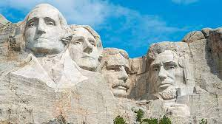

Board Jobs:
President
  Oversees activities of each committee
  Liaison between school and Booster Club
  Monitor emails
Training/Logistics/Coach Liaison
  Reviews, renews and signs coaching contracts
  Liaison between parents and coaches
              Recruitment
                Promote Langley Crew to 8th graders and Langley students
                Supervise Learn to Row preparations, including swim tests
                Supervise Club Day, Orientation and other events for new Langley students
Notes:
President: We have one person agreeing to be a President-Elect for next year, learning the position while doing another Board role. Ideally, we would like to have a second President-Elect for next year as well. The President position is not as scary, or as busy, as it has been this year. Between COVID and last year’s graduations, wee had several Board members new to both crew and the Board this year, so Tine and I took on portions of those roles. Now that those people have some experience, we will be transitioning that extra stuff back for next year, so the President position will be less demanding next year. Thank God. I’m old and tired.
Coach Liaison is year-round, but only sporadically busy. The most hectic time is the beginning of the year, when coaches’ contracts are renewed.
Recruiting is time-consuming in short bursts – the fall is busy with Freshman and New Student Orientations in August, and getting things ready for Learn to Row. In the spring, you have Club Day for LHS students, at Langley, and the Activities Fair for 8th graders in March.

Slide 5


Treasurer
  Monitor club finances
  Develop club budget and performance against the budget
  Pay bills
Secretary
  Board meetings – take minutes, schedule meetings, book meeting venues
  Monitor insurance renewals and payments
  Complete and track paperwork necessary for out-of-town trips
Membership
  Create and monitor Sports Engine registrations
  Liaise with LHS Athletics Office and parents to ensure each team member meets registration requirements
Ways and Means
  Organize and supervise Tag Day
  Seek and evaluate other means of fundraising
Notes:
Treasurer is pretty self-explanatory – pay bills, watch the budget, tell us what we can spend. It’s not all that time-consuming if you have experience. Busy in the fall, setting the budget, sporadic time demands throughout the year.
Secretary is also pretty standard. Monthly demands for the Board meetings, and sporadic requirements throughout the year
Membership Chairpersons are pretty busy in October through February, when crew registration is open. Weekly, you will need to make sure that those who have registered have dotted all the Is and crossed all the Ts. It’s mostly an exercise in managing a tracking spreadsheet and downloading information from SportsEngine and from Beth Longo, and answering registration questions from Treasurers, Presidents, Bus Coordinators and Volunteer Coordinators. It does not take vast computer skill, just willingness to learn how to manipulate SportsEngine
Ways and Means is fundraising. It is busy sporadically, particularly from early December until early February, prepping for Tag Day.

Slide 6
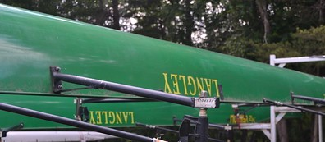
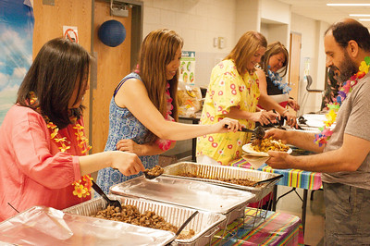
Equipment
  Maintain inventory of all Langley Crew equipment, at the boathouse and the shed
  Maintain inventory of replacement parts for all equipment
  Perform maintenance on all equipment where possible, outsource when necessary
Volunteer Coordinator
  Create and monitor Signup Geniuses for activities as requested
  Notify requestor of signup status
  Monitor family volunteer status
Communications
  Create and send newsletters
  Manage social media sites
  Manage distribution lists
Events
  Event planning for team dinners and meetings
  Food tent setup and supply for regattas
Notes:
Equipment Chairs is year-round, and busy once practices start. Winterizing equipment after Learn to Row, keeping ergs working during winter training, keeping boats and launches on the water during spring and fall. Many of the coaches are also handy in this way, so it’s not all on you. It is one of the more time-consuming, but essential. Ideally, at least one of the chairs will be handy at tinkering and at least one will be good at organization and record-keeping.
Volunteer Coordinator is busy all season, but none of the tasks take very long, no more than an hour. You could assume a couple of hours a week, at the most
Communications is busy during the season and requires some basic computer skill and some writing ability. It’s also helpful to have social media management knowledge. Ideally, we’d have two people for this, to backstop each other.
Events Coordinator is pretty self-explanatory. It’s pretty time-consuming, as they are involved in everything we do as a group. That’s why this group is pretty big. Right now, we have 4 coordinators, and they rotate who’s prime for events. That way, it’s not overwhelming for any one person. Each event is time-consuming if you’re the point, but less so if you’re backup.

Slide 7
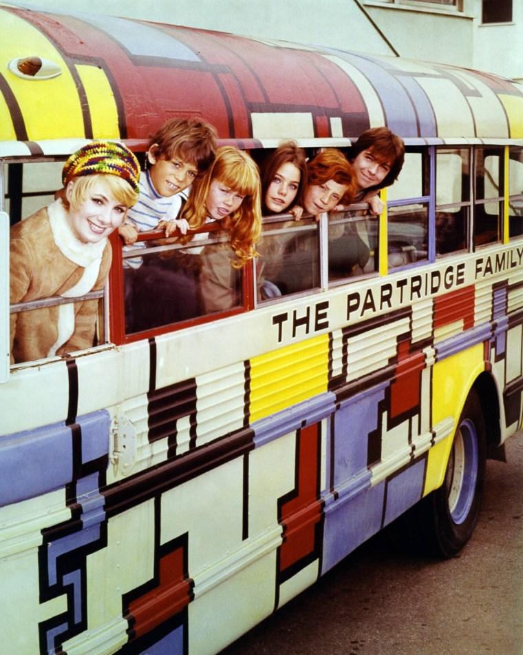
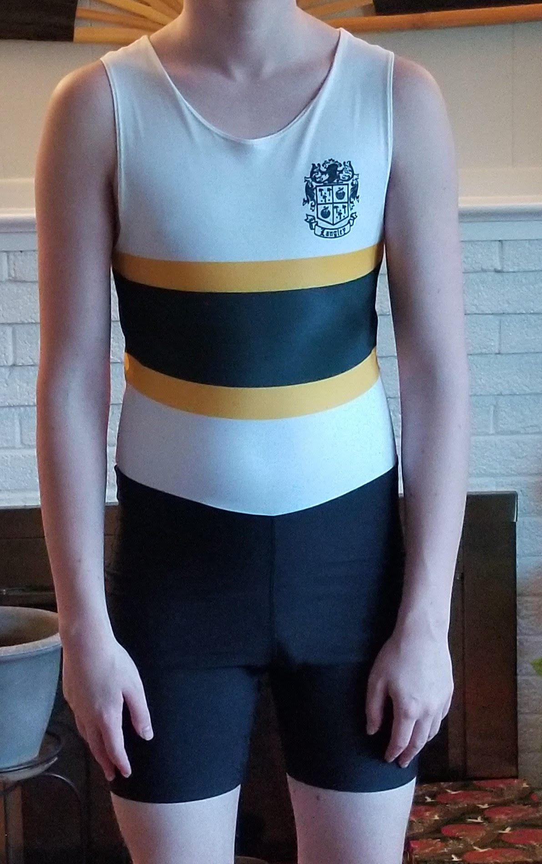
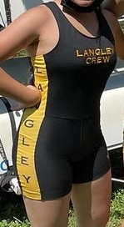
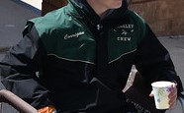
Bus Transportation
  Initiate and track chaperone certification applications
  Liaise with bus company
Website
  Update website information
  Create new content as needed
Membership Administrator
  Create new SportsEngine registration forms
VASRA Contact
  Liaison between Booster Club and VASRA
  Monitor shuttle van helpers during regattas
Apparel
    Develop, order and sell crew team merchandise
    Order new uniforms
Notes:
Bus Coordinator is very important and, with the current chaperone certification process, really needs to be two people. Certification monitoring is essentially getting info from Membership and passing it on to Langley, who is certified and who is not. Bus company liaison is busy at the beginning of the year, setting up the contract with the bus company, then quiet until February. At that point, there is activity every day, but for a few minutes, to make sure that the buses run smoothly.
Website coordinators need basic computer knowledge. If I can do it, you can. If you’ve ever used HTML, XML, or WML, you can do this. Busy sporadically, rarely takes longer than 30 minutes to make updates.
VASRA Contact attends VASRA meetings once a month and LCBC meetings once a month. During regatta season, you will monitor the volunteers working our assignment, usually the grandstand van
Apparel is very busy when ordering uniforms, and sporadically in spring and fall to open the stores for crew swag. It’s pretty time-consuming during these periods, with a lot of email discussion with vendors and monitoring distribution of merchandise.

Slide 8
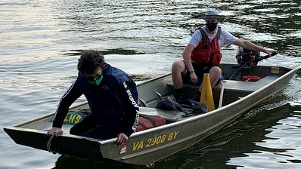


Launch Driver Operations
  Train new drivers
  Ensure team has enough drivers to fill VASRA obligations
  Work with equipment manager to ensure launches are in working order
Videographer
  Take video of team events, such as Ergathon, and practices
  Take video of regatta races
  Maintain team YouTube channel, adding video as completed
  Support Events and Recruitment team with videos of team for various events
Photographer
  Take photos of team and volunteers at practices, regattas, and events
  Organize photos and post on team Flickr account
Notes:
Launch Operations is busy sporadically. A few weekends in the fall, a few in the spring, and possibly some time during regatta season
Videographer is busy during the regattas and practices, sporadically. Regattas are all day, of course, but random videos of practices at your discretion. If you’re at all inclined, turning the raw video into presentation videos for recruiting events and dinners would be ideal. Doesn’t have to be Oscar-worthy. If I can figure out how to post to YouTube, you can too.
Photographer – same thing as videographer, with photos.

Slide 9
FEEDBACK
This is the first year we’ve done All Aboard and would really like your feedback.
Have you ever downloaded the slides?
Have you heard other people mention it?
What is the general feeling about it – waste of time or helpful?
How would you change it?
What can we do to get people more engaged with it?
What else could you tell us about your experience with All Aboard?
Please email any comments, constructive criticism, suggestions, etc to langleyrowing@gmail.com
THANKS!!

Slide 10
QUESTIONS???

Slide 11
Q: How do we find out who is going to which competitions? Did coaches post the lists on Langley Crew web page?
A: We will notify you via email. For the April 24 regatta in Philly, we sent out three emails to parents on Monday, April 11 – one stating their child is going to Philly, one stating their child is an alternate and may go to Philly, and one stating their child would be staying to compete on Saturday. Students going to the Stotesbury regatta in late May will be notified the same way – we’ll send you an email with information.
Q: If they are going to Philly on Sunday do they have to be at the races on Saturday the day before? Trying to plan when we are leaving.
A: No, if they are going to Philly on April 24, they don’t have to attend the April 23 regatta. They can attend as spectators if they want, of course, but they don’t have to be there for team support.

Slide 12
Q: Do the kids know who's going to Philly?
A: Yes, they were notified on Monday
Q: Do you have hotel/parking recommendations for Philly regattas?
A: We’re working on an information packet with parking information, but if you are looking at hotels, the regatta site is very close to the Philadelphia Art Museum, where the Rocky statue is. Search based on that landmark. New Jersey is a viable option, as well.
Parent Comment: Quite a few of us have booked the Hilton Philadelphia City Avenue which was a good price. Some are extremely pricey - book soon!

