Slide 1
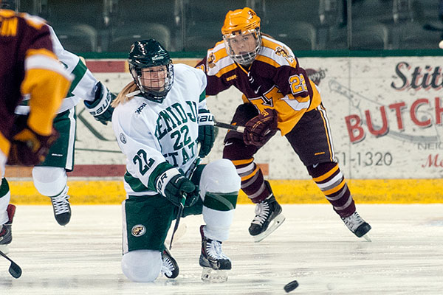
BEMIDJI STATE HOCKEY
Defensive Zone Play: “D Zone Coverage”
By: Shane Veenker

Slide 2
D Zone Coverage-Eliminate opposition scoring chances
Wear our opponents down mentally/physically
Tough to play against without taking penalties(SMOTHERING)
Layering/Swarming(Push & Pin) & Scooping
Corner Containment
Get the puck stopped
Stick on Puck
Puck Battle- create separation and make a play
Boxing out the front of the net
C Stay between the puck and the net
Don’t Panic

Slide 3
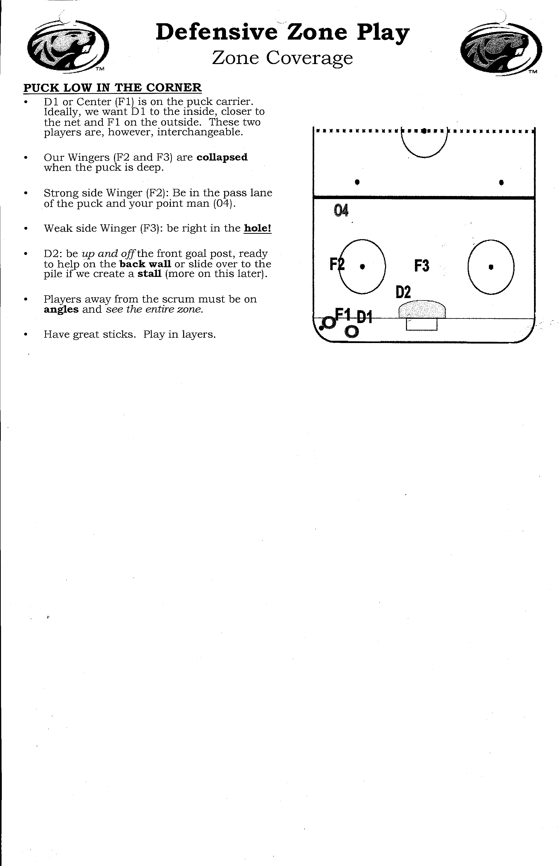

Slide 4
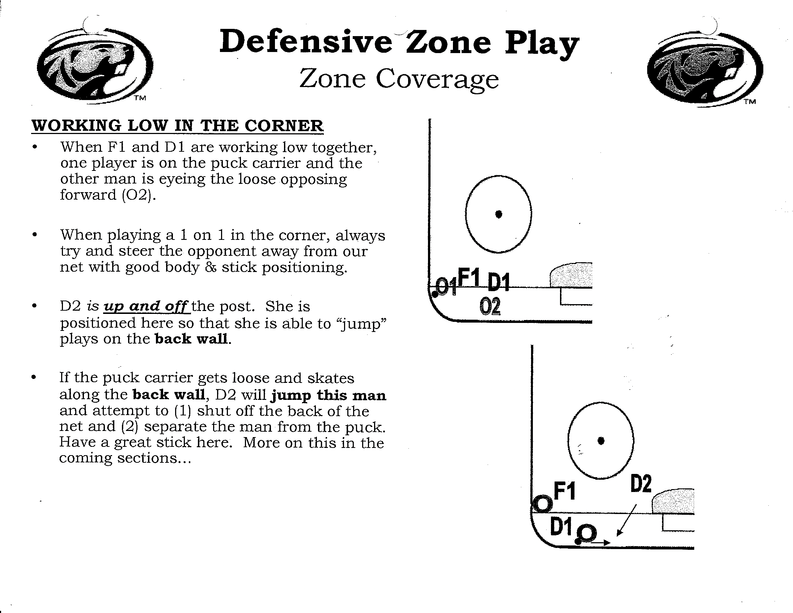

Slide 5
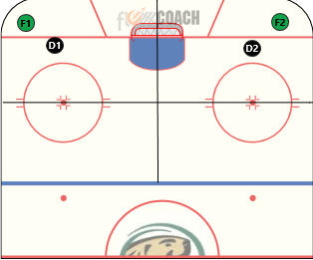
D Zone Drill: 10 sec corner contain 1 on 1’s
Setup: 1 Offensive Forward in both corners. 1 defencemen/low forward in each corner.
1st w Offensive forward skates up and down the wall staying in their quadrant. 2nd w after 10 seconds offensive forward can try and score staying in their quadrant. Also 2nd w other corner begins corner contain and after 10 seconds that offensive forward can try and score staying in their quadrant.
Note: It is important that D take an angle that will keep the puck and the player in the corner if possible. Deny the back of the net. Get the puck stopped.

Slide 6
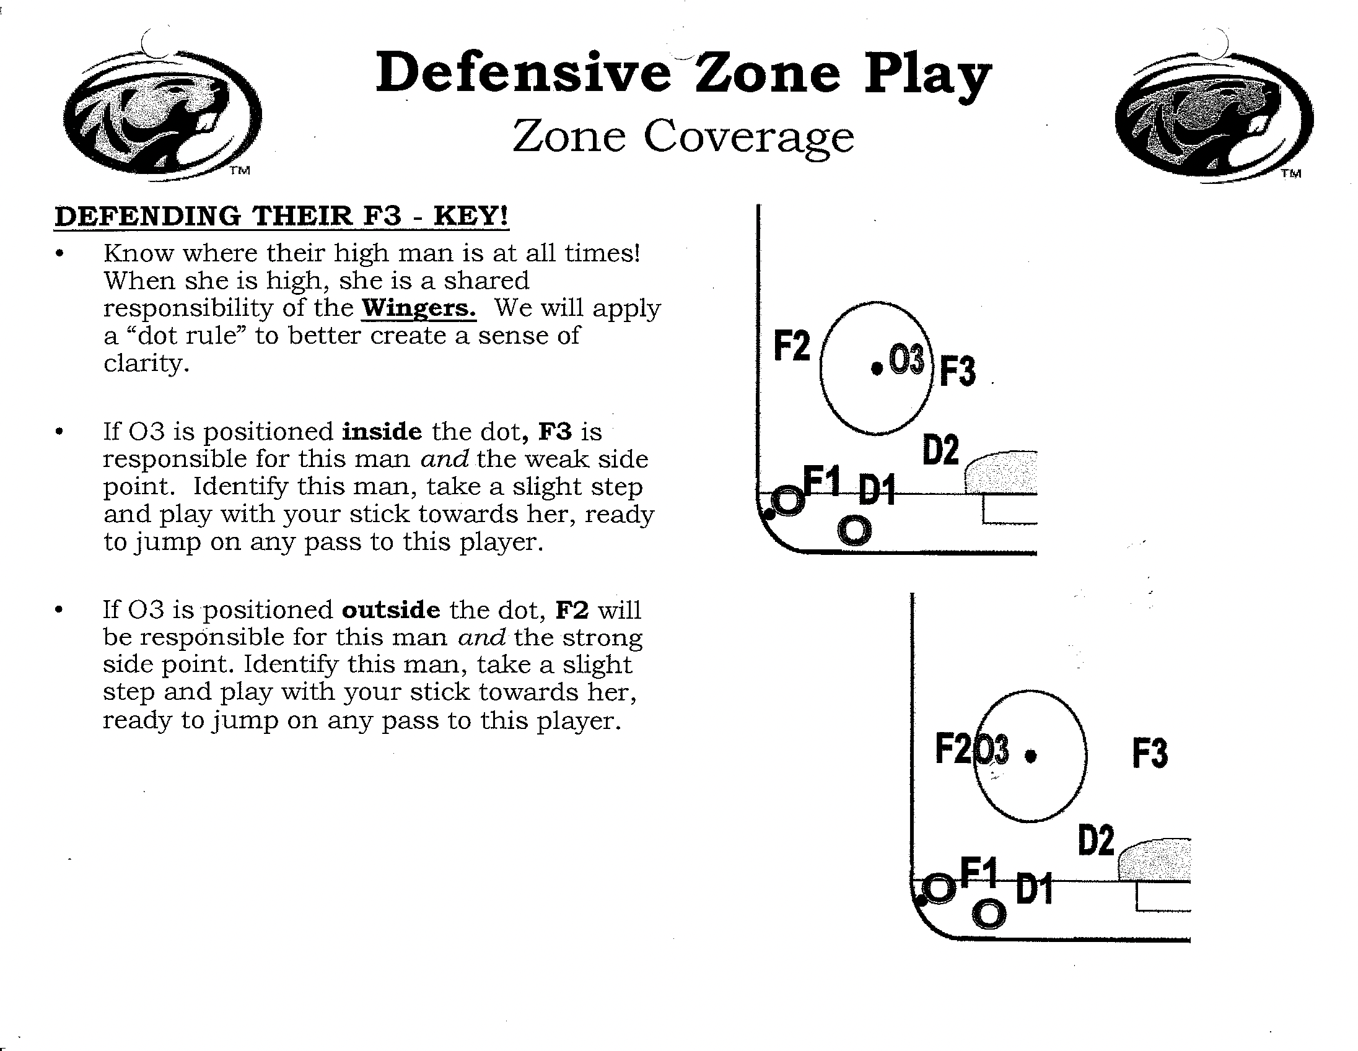

Slide 7
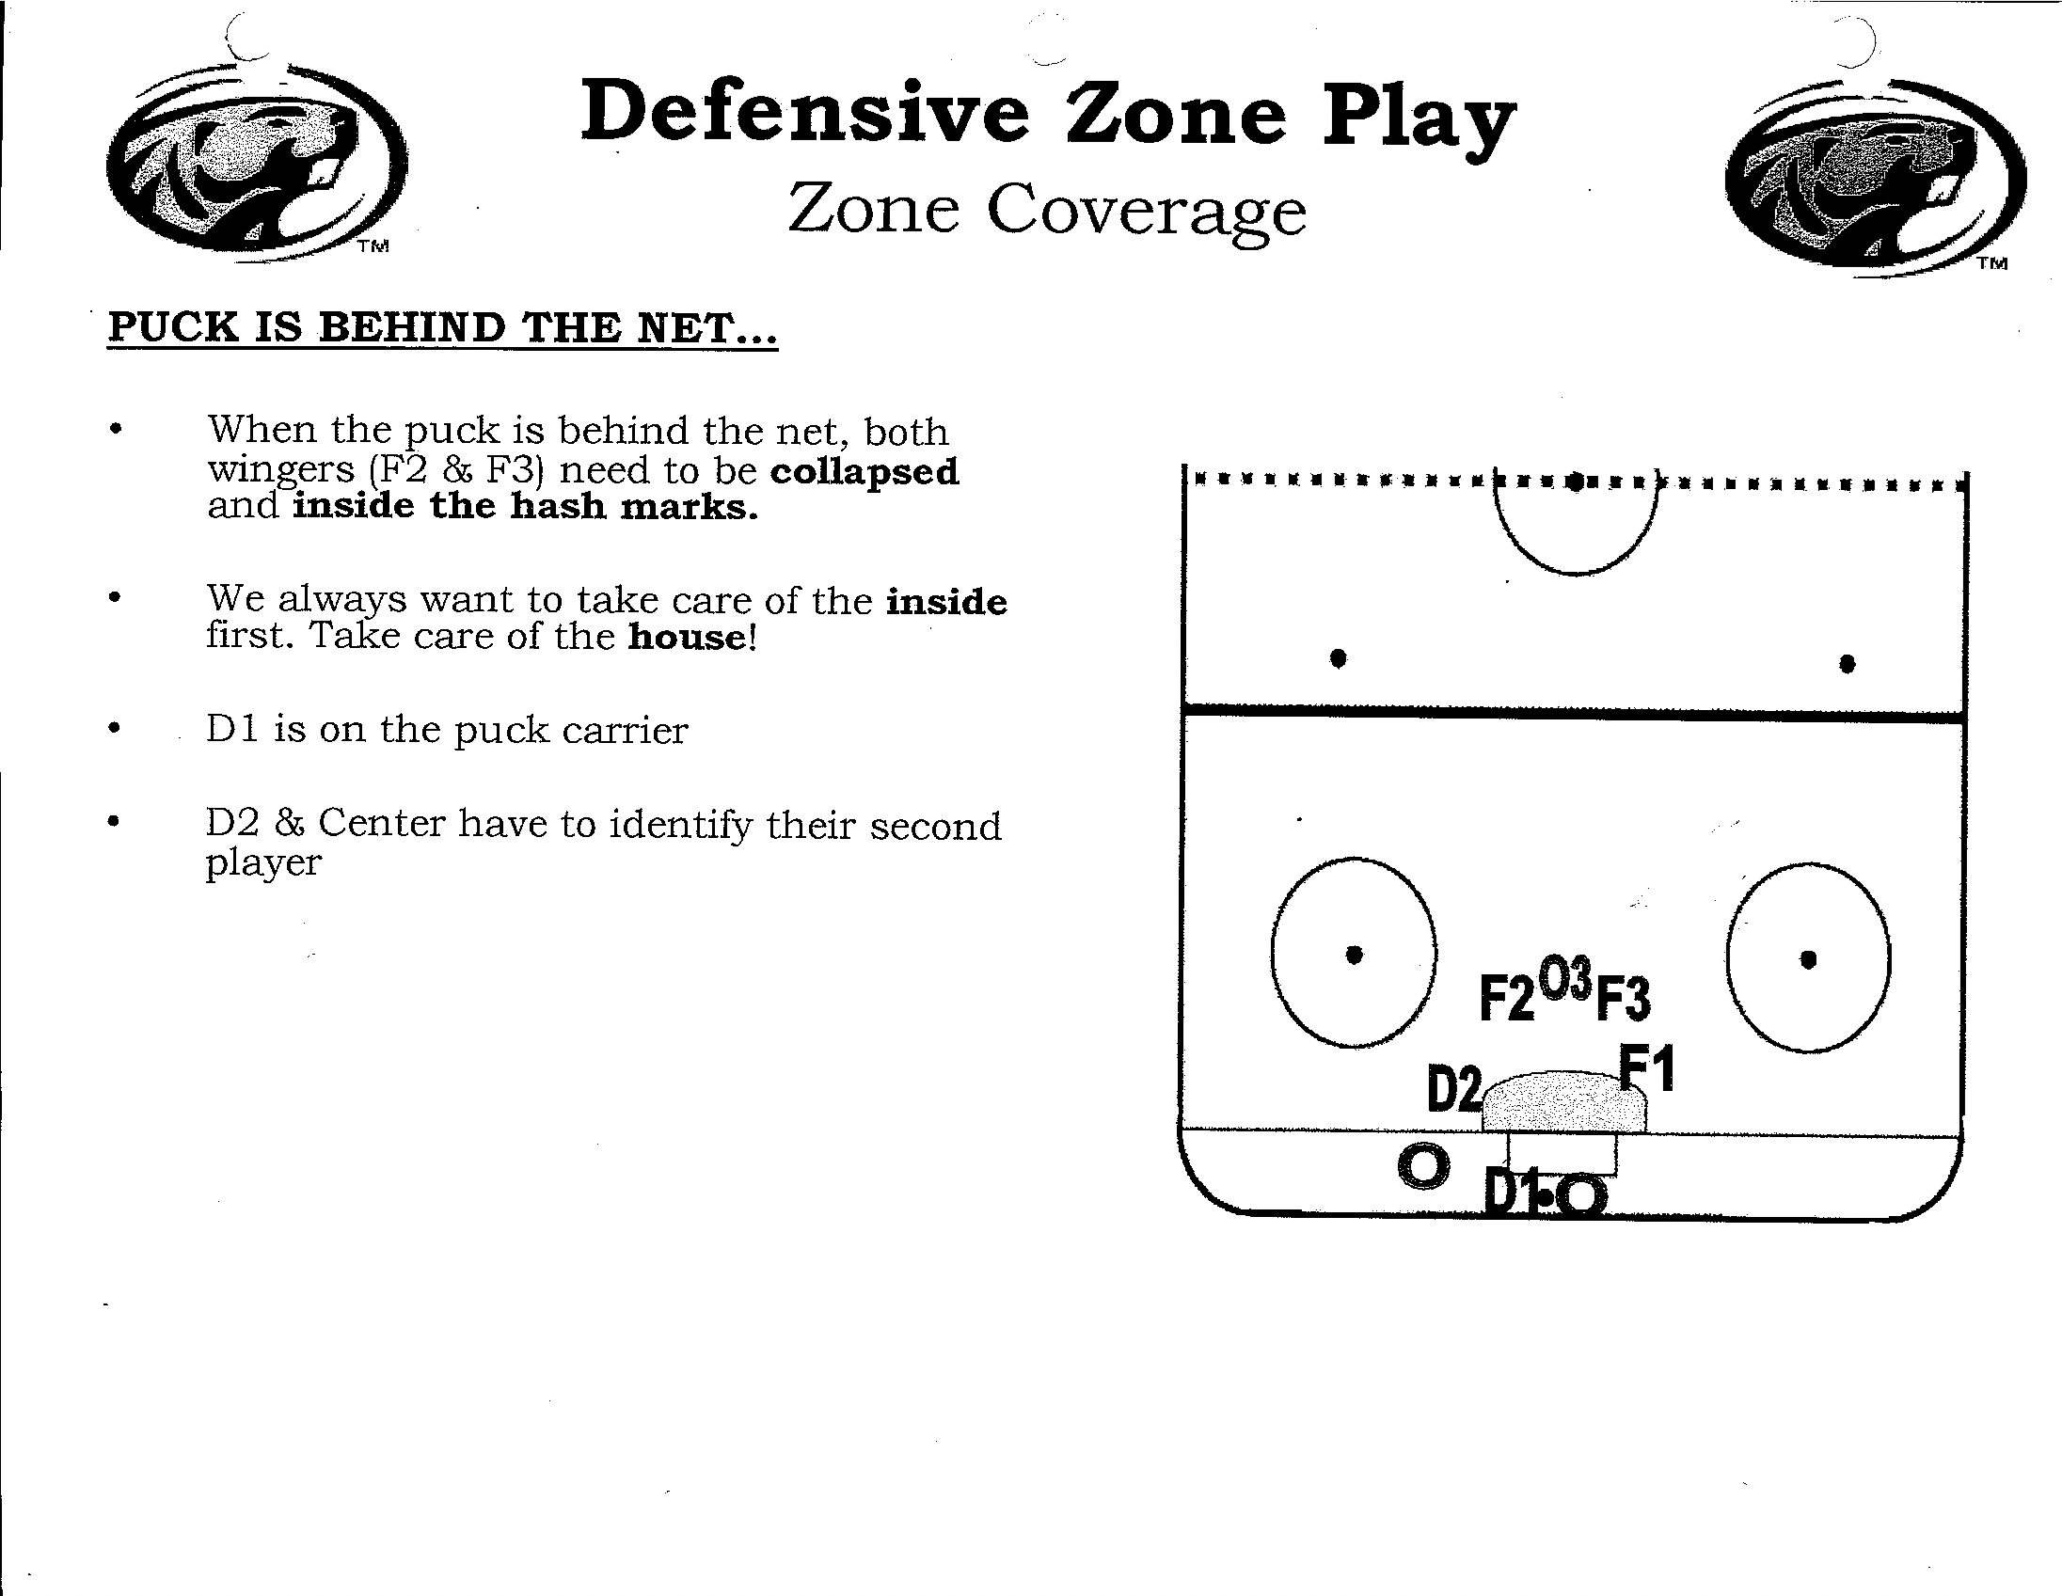

Slide 8
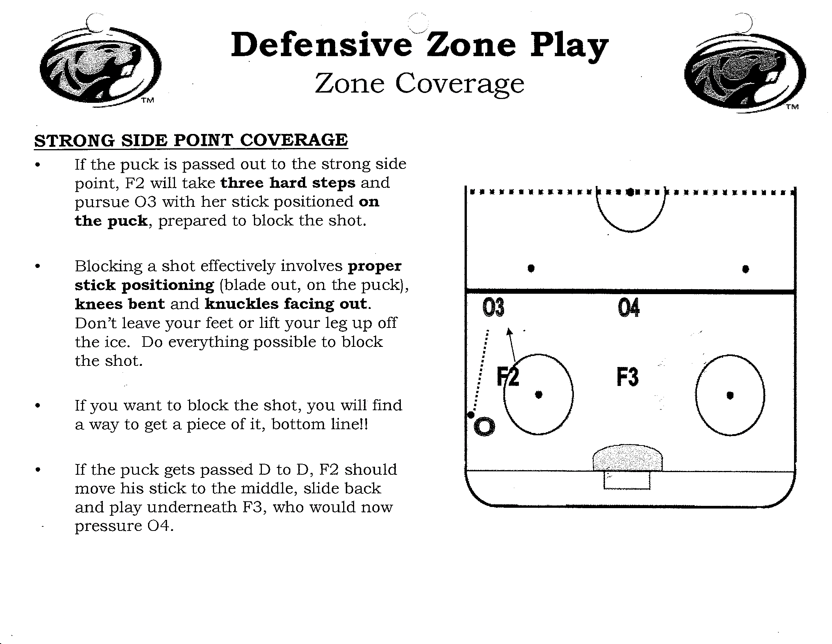

Slide 9
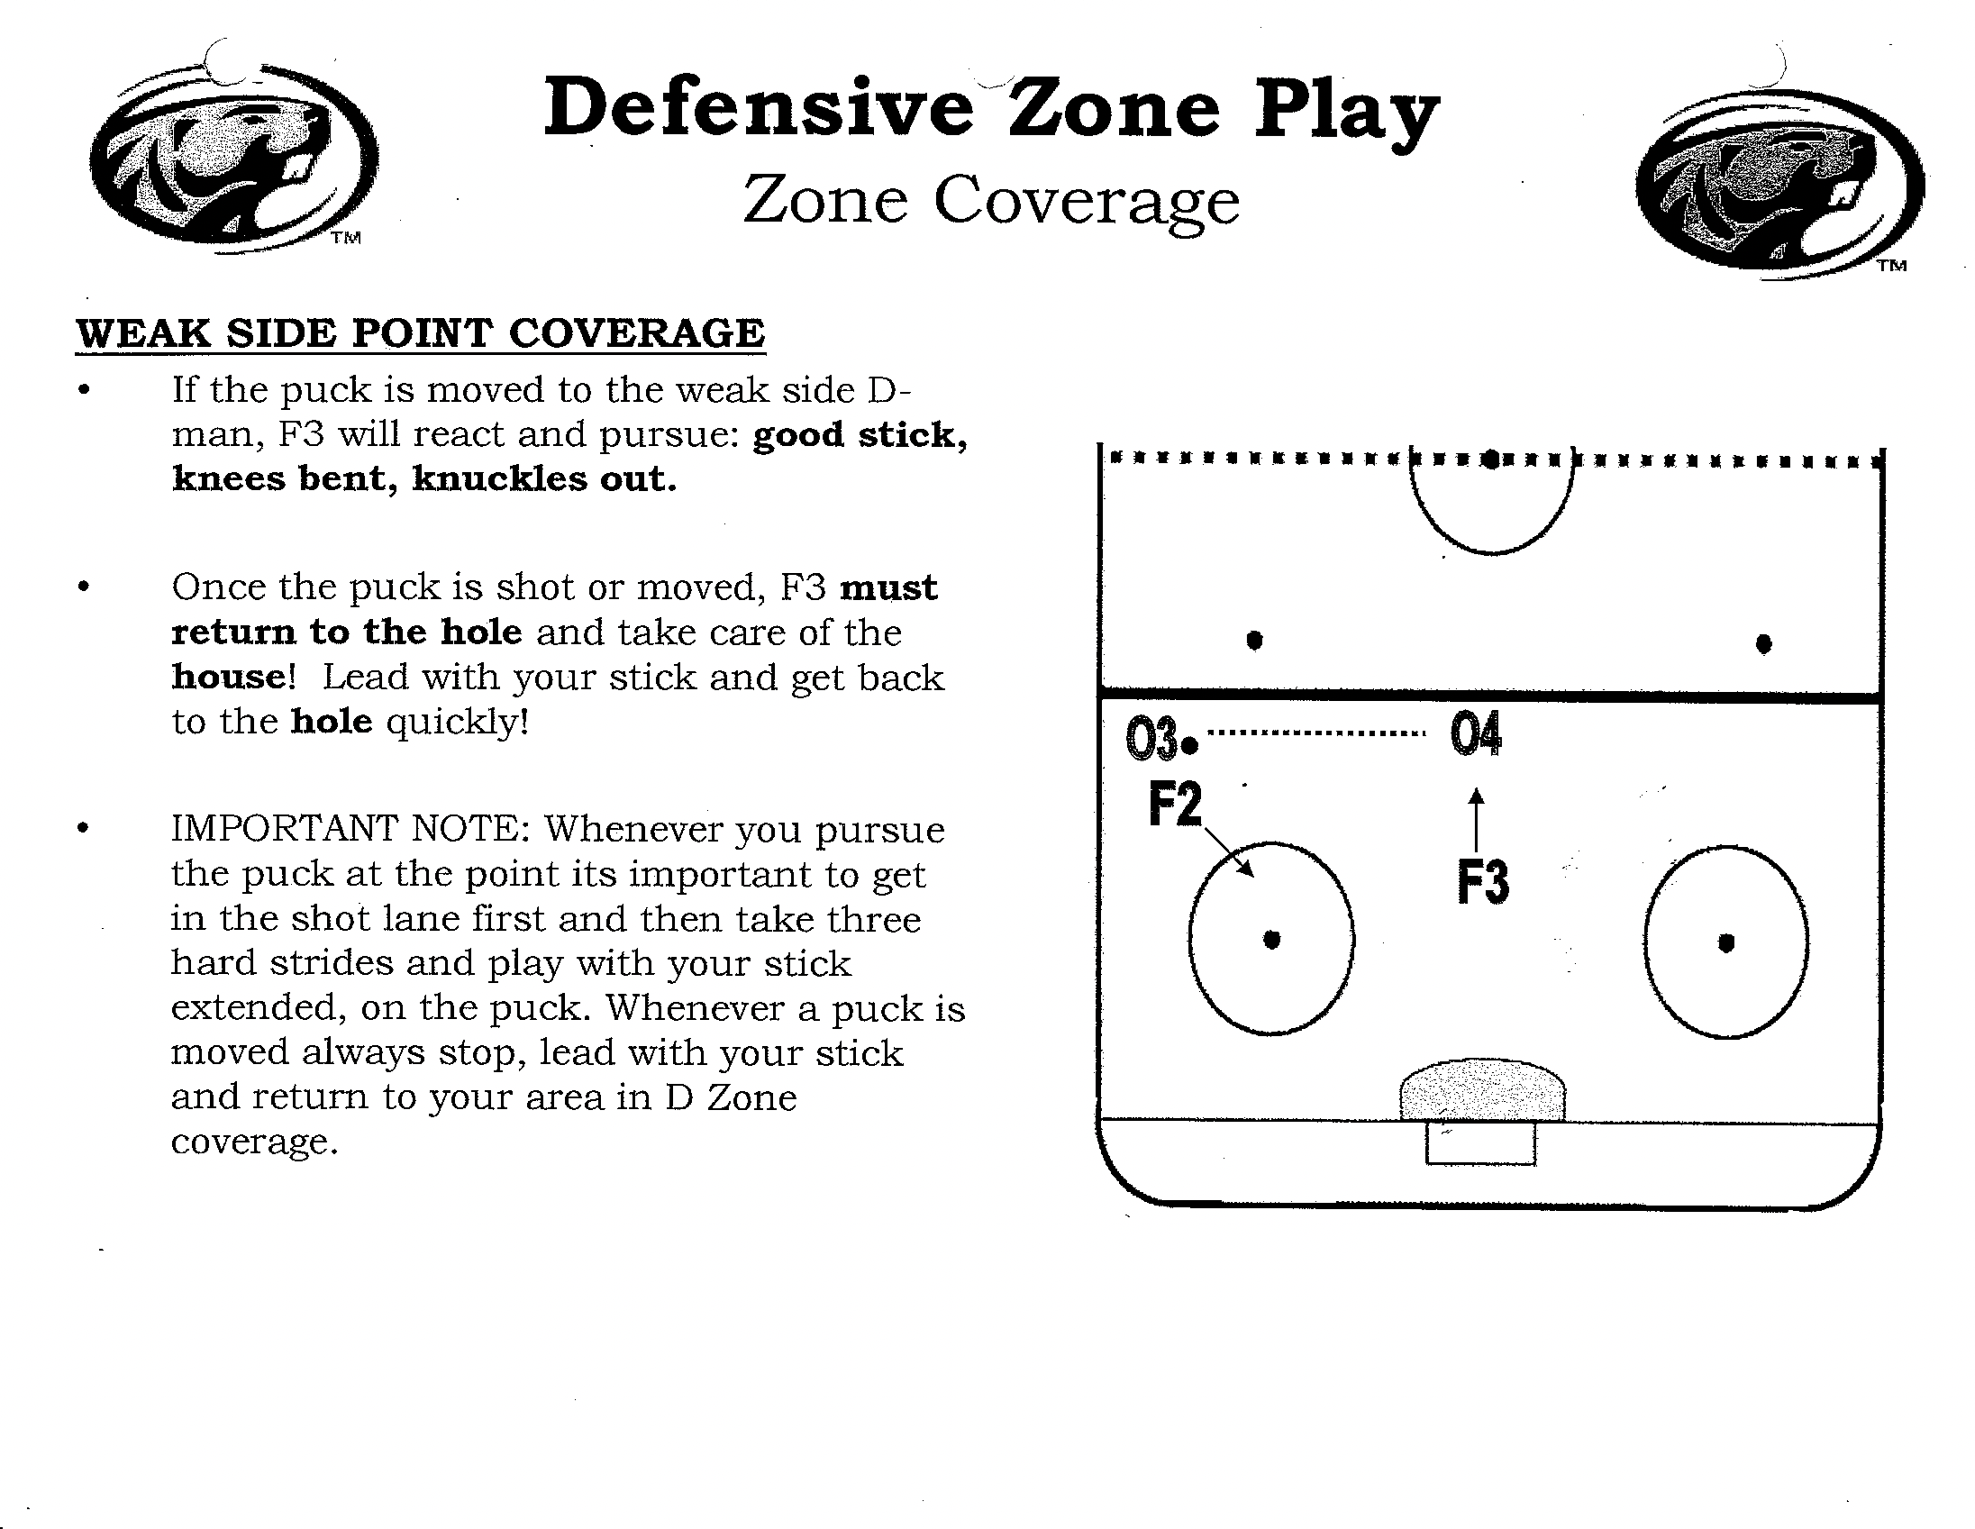

Slide 10
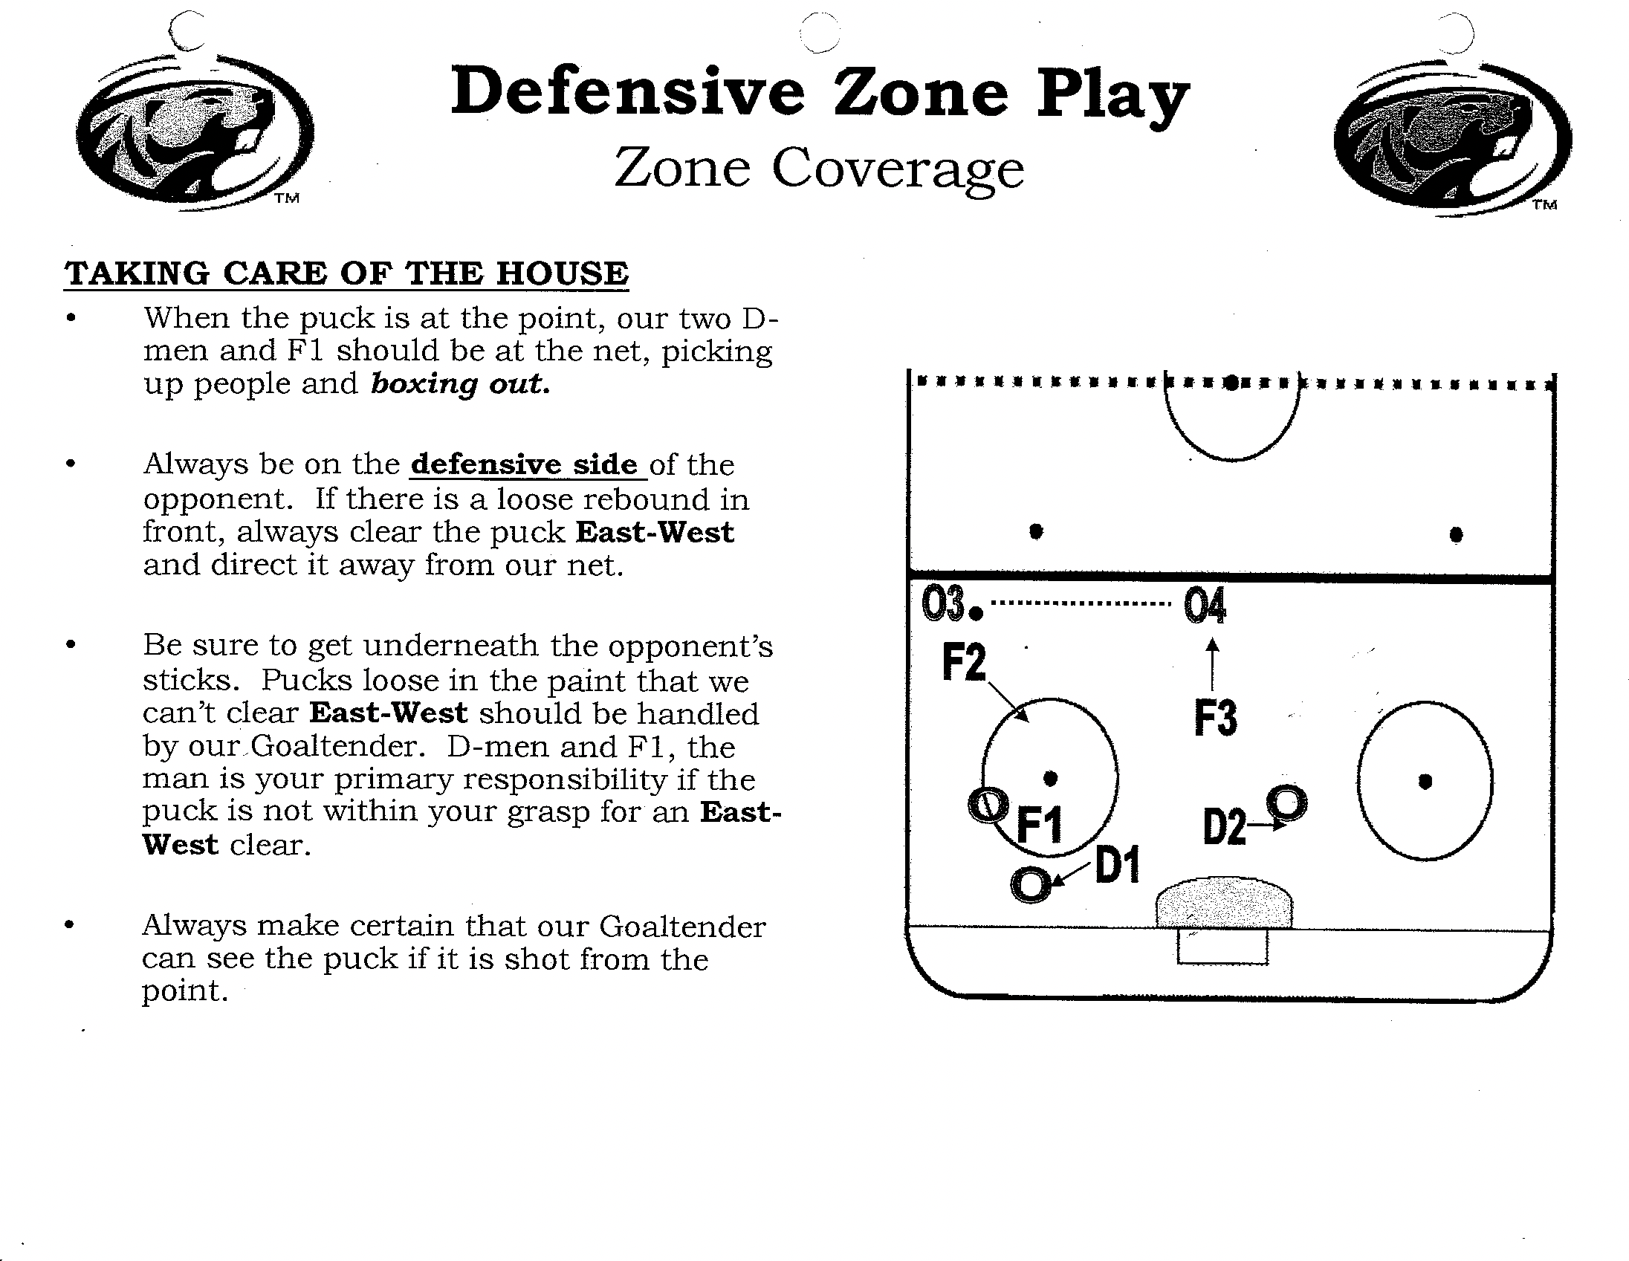

Slide 11
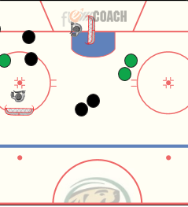
D Zone Drill: BSU 2 v 2
BSU 2v2
Coach starts drill with dump into corner for possession.
Red & Black play out 2v2 in confined space looking to score on opposing goalie.
Players in line keep puck in play.
On goals – coach spots scoring team another puck.
Concepts:
Wall play (offensively & defensively)
Getting the puck off the wall and into scoring area (“Home Plate”)
Keep puck moving – avoid stops on pucks.

Slide 12
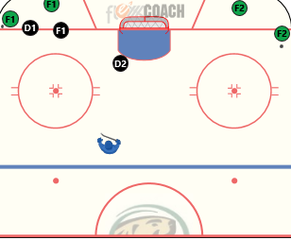
D Zone Drill: 2 v 3 Out of Corner
Setup: 2 Offensive Forwards in both corners. 2 Defencemen and 1 Low Forward.
1st w 2 Offensive Forwards start cycle game and also trying to score staying in their quadrant(Below the tops of the circles) 2 Defencemen and 1 Low Forward Shut things down and transition puck to C at top of circles. 2nd w 2 Defencemen and 1 Low Forward switch sides. Next 2 Offensive Forwards cant begin until D2 has reached the far post. Again shut things down and transition puck to C at top of circles.
Note: Puck pressure is important. Close quick on puck carrier. D Side positioning. Look to swarm/scoop when opportunity. Give puck a net/wall call.

Slide 13
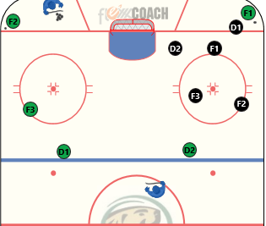
D Zone Drill: CAPS D Zone Progression
Setup: 1 Offensive F in one corner with puck v a unit of 2 D and 3 F’s. C with 3 pucks in hand in opposite corner with 2 Offensive F and 2 Offensive D.
1st w 1 v 5. 5 Defenders/swarm/scoop shut things down and transition puck to C
2nd w C with pucks waits for 5 defenders to switch sides and then drops puck for a 3 v 5 defenders shut things down and transition puck to C
3rd w C with puck has 5 defenders close back down and C throws a rimmed puck to the weak side and play out 5 v 5 until defenders transition puck to C D2 looks for chance to out# and release from net
4th w C with puck has 5 defenders close back down and Coach gives puck to offensive F who executes a high scissor/interchange with offensive D play out 5 v 5 until defenders transition puck to C
Note: Stick on hips. Pinning. Tight but not to Tight. Communication is Key! Be ready to block shots! Sticks on the ice and active. Defending their F3. Point F v high scissor go with offensive player going up. D1 stay with Offensive D coming down.

Slide 14
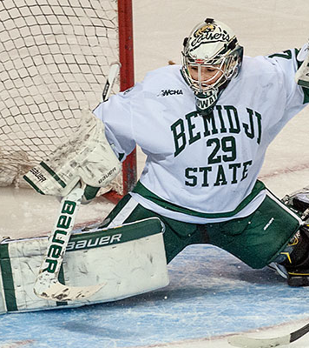
Notes, etc……
THE X-FACTOR ABOVE EVERYTHING ELSE = GREAT GOALTENDING

