Slide 1

FSJ BOARD OF DIRECTORS
Brian Cross– Director
Sarah Edwards – Treasurer
Andrea Tharnish – Bookkeeper
Kimberly Holman - Secretary
Whitney Adams – VP Club Development
Allen McFerran - VP Fundraising
Bill McCain- VP At Large
Tanisha Guy- VP At Large
Payton Northington - VP At Large
Howell Schmidt - VP At Large

Slide 2
Additional Positions
Jenn Douglas - Administrator/Registrar/Club Management
Tanisha Guy– Concession Coordinator
Kim Brown – Volunteer Coordinator
Elizabeth Voris – Hospitality Coordinator
Kimberly Holman – Uniform Coordinator
Lee Dewey - Tournament Coordinator
Bill McCain - Building Management

Slide 3
FSJ COACHES 2024-2025
FSJ 10 - Macie Grams
FSJ 11 Regional Plus - Lee Dewey
FSJ 11 Regional Nicole Rensink
FSJ 12 National - Taylor Pate
FSJ 12 Regional Plus - Ro Champlin
FSJ 12 Regional - Emily Bass
FSJ 13 Elite - Payton Northington / Paola Fragalle
FSJ 13 National - Liyah Smith
FSJ 13 Regional Plus - Hannah Holland
FSJ 13 or 14 Regional - Mackenzie Mendenhall

Slide 4
FSJ COACHES 2024-2025
FSJ 14 Elite - Tanisha Guy / Tyler Clunn
FSJ 14 National - WR Douglas / Jenn
FSJ 14 Regional Plus - Madi Taylor
FSJ 15 Elite - Mallory Moreton / Brooke Rifkin
FSJ 15 National - Jovan Garcia
FSJ 15 Regional Plus - Wesley Farber
FSJ 16 Elite - Whitney Adams / Felicity Suggs
FSJ 16 National - Nyia Anderson / Jillian Olienyk
FSJ 17 Elite - Josh Stark / Laci Gratkowski
FSJ 17 National - Amanda Haulmark
FSJ 18 - Drew Waack / Gracie Atchison

Slide 5
Coaching Qualifications
All FSJ coaches are required to:
Undergo a background check annually
Safe Sport certified annually
Be a registered member with USA Volleyball and Delta
Region
Complete the USAV IMPACT Certification Training Program
Be approved by the FSJ Board of Directors

Slide 6
Minors are not allowed to coach
The Delta Region does not allow minors to act as team coaches due to the liability of having minors supervise other minors. Background screenings are not available until the age of 18. If you will turn 18 soon, you can register as a team manager and then convert to a coach membership (no charge except for the background screening) at your 18th birthday.

Slide 7
FSJ Website
All pertinent information can be found on our website including Payment Schedule, Bylaws, Forms, Fundraising, etc.
www.fortsmithjuniors.com

Slide 8
SAFESPORT EDUCATION AND TRAINING
FOR PARENTS To keep children safe from abuse in their sport activities, your child’s sport Organization has implemented the Minor Athlete Abuse Prevention Policies (MAAPP). These policies are required for Organizations affiliated with the Olympic and Paralympic Movement. The MAAPP outlines training requirements and limits one-on-one interactions between Adult Participants and Minor Athletes. Adult Participants who have regular contact with or authority over Minor Athletes include coaches, athletic trainers, and officials. The MAAPP applies to all interactions related to your child’s participation in a sport within the Olympic and Paralympic Movement, including practices and competitions as well as events such as fundraisers, team meals, and celebrations.
BE AWARE OF THESE MAAPP POLICIES ORIENTED TOWARD KEEPING KIDS SAFE:
1. One-on-one interactions between Adult Participants and Minor Athletes must be observable and interruptible.
2. Your consent is required for your child’s participation in individual training sessions, athletic training modalities, meetings with health professionals, transportation, and lodging. The Organization must provide you with consent forms.
3. You must be allowed to watch your child’s individual training sessions.
4. A second Adult Participant must be in the room during all massages, rubdowns, and other athletic training modalities—for which your child must be fully or partially clothed, with private body parts covered.
5. Your child must have access to a semi-private or private changing area, and locker rooms and changing areas must be monitored.

Slide 9
SAFESPORT EDUCATION AND TRAINING
6. Adult Participants must never shower with your child, unless they are close-in-age peer athletes or it is a pre/post activity rinse where everyone is wearing swimwear. You can request that your child not change or shower with close-in-age adult peer athletes.
7. You, another adult family member, or another Adult Participant must be included on all electronic communications (including texts, emails, and social media).
8. One-on-one interaction policies apply during organization-sponsored transportation and lodging.
9. Limited exceptions to some policies (related to youth close in age to peer adult athletes, Personal Care Assistants, and out-of-sport dual relationships) are detailed in the full MAAPP document. We encourage you and your child to take the Center’s free, age-appropriate online trainings, and to report any concern about abuse or misconduct to the U.S. Center for SafeSport or your organization.
SAFE SPORT WILL BE DISCUSSED MORE AFTER TEAMS ARE FORMED IN FIRST PARENT MEETING

Slide 10
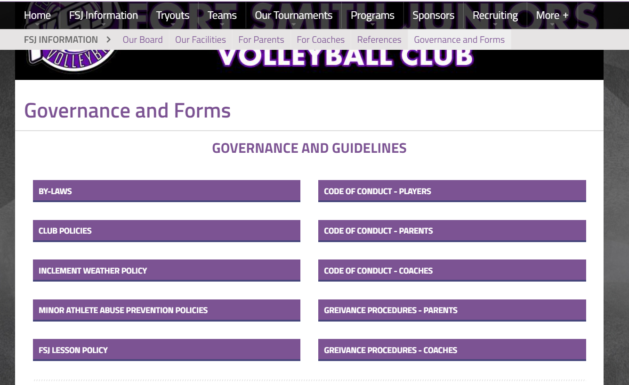
FSJ Info > Resources

Slide 11
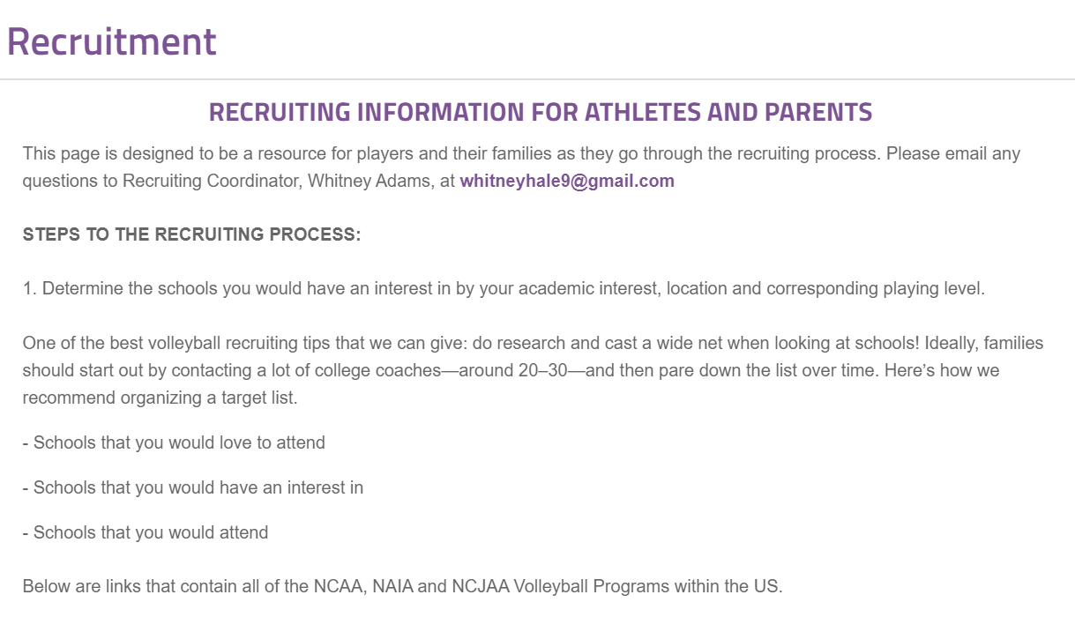
Recruiting > FSJ Website

Slide 12
Junior Player Membership Cost
All Payments Done Online Only
Regular Girl’s Junior Membership-$53.00: Full season junior female player membership for both indoor and outdoor participation and eligible for all national level events
Regular Girl’s (18s) Junior Membership-$53.00 Full season junior player membership for those who are 18 or will turn 18 by 8/31/25 or 19 and in the 12th grade. Includes both indoor and outdoor participation and eligible for all national level events. SafeSport training must be completed prior to being eligible to participate.
The Delta Region no longer offers a Tryout membership, since 95% of the players who register end up on a team. If you purchase a full-season membership and do not end up on a team, you may apply for a refund minus the $10 tryout fee from DELTA REGION.
FSJ tryout registration fee $35.00 :
FSJ tryout registration fee is non-refundable. ALL PAYMENTS ONLINE ONLY
FORTSMITHJUNIORS.COM (all payments online) TRYOUTS TAB

Slide 13
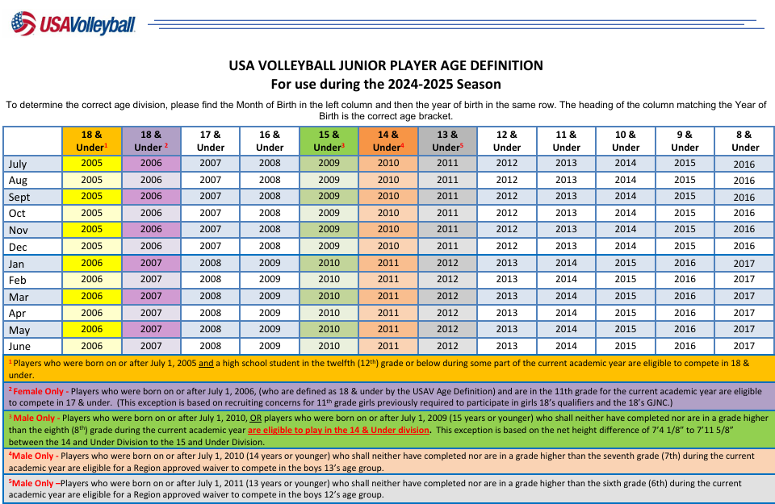
NEW USAV AGE DEFINITION

Slide 14
    FSJ TRYOUT REGISTRATIONS ARE DONE ONLINE ONLY !
    (1st step) Register with USAV/DELTA
    pay $53 membership fee
    2024-2025
    (2nd step) Register with FSJ pay $35 tryout fee
    (NO REFUNDS)
    You must have USAV ID number for this registration
    USAV ID NUMBER is given to your player after he/she are registered with USAV/DELTA in sportsengine.
USAV Medical Release Form
MUST BE PRINTED AND BROUGHT WITH YOU (guardian email address printed on top of page)

Slide 15
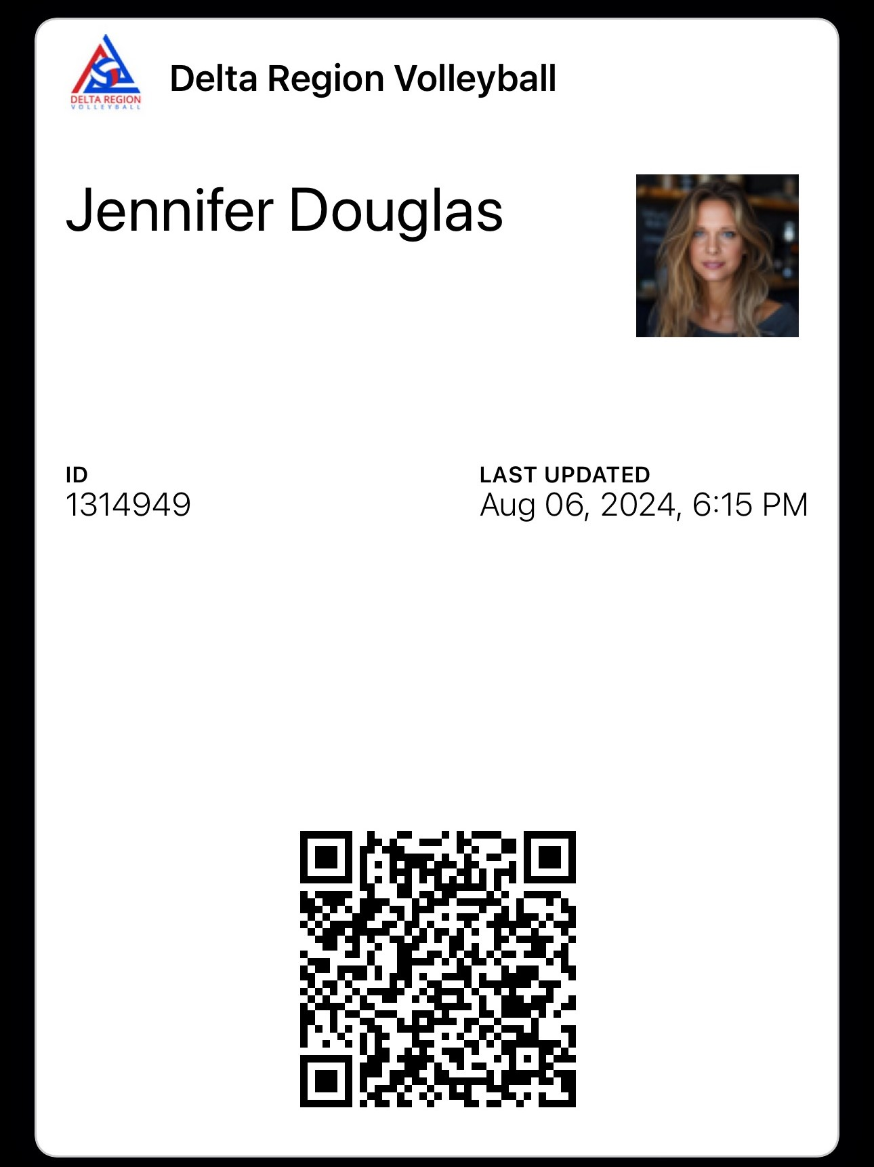
    USAV membership card can be printed or shown digital on your phone
    EXAMPLE OF DIGITAL (LAST UPDATED DATE MUST BE 2024
    ID NUMBER IS WHAT YOU NEED TO FINISH FSJ TRYOUT REGISTRATION

Slide 16
TRYOUTS
    Tryouts does not guarantee a placement on a competitive team
PLEASE make sure when you check in you give the correct spelling of PLAYERS NAME and PLAYERS DATE OF BIRTH
Bring your own water bottle, wear a t-shirt, and volleyball attire
No jerseys from previous years
All girls will wear pinnies that FSJ provides
Spectators will NOT be allowed in the building during tryout. All parents will be asked to leave after helping their
child with check in

Slide 17
Registration Questions?
If you have any questions about registration please contact:
Jenn Douglas - FSJ Registrar
Email: Jennd0718@gmail.com
Phone: 479-883-8570
Text preferred or leave a message if you call
or
Andrea Tharnish (FSJ Bookkeeper)
Andrea.Tharnish@BMS.com
If you start the registration process and there is an issue with SportsEngine, please click the “help” button in SportsEngine and wait for their response

Slide 18
Fundraising Opportunities VP Fundraising ALLEN McFERRAN
Sponsorships:
  30% of sponsorship sells go to player fees
  80% banners for the
    BATF go to player fees.
Visit: fortsmithjuniors.com/fundraising
Questions? Contact Allen by email at allenmcferran@gmail.com

Slide 19
Fundraising Opportunities
VP Fundraising ALLEN McFERRAN
Website Ads $100 – $300
FSJ Banners $200
Completed Ad form, Ad and money must be turned in together
Logo + Web Link: $300
Logo Sponsor: $100
80% of all sales will be applied to player accounts and credit accounts
Questions? Contact Allen by email at allenmcferran@gmail.com

Slide 20
Scholarship Sponsor Platinum $5,000
Court Sponsorship $5000.00
Club Sponsorship Gold $3,000
Battle at the Fort Sponsor $2500
Player Practice Shirt Silver $2,000
Player Practice Shirt Sleeve $1000
Club Sponsorship Bronze Level $1000
Club Sponsorship $500
FSJ Program Ads
FSJ Web Ads
FSJ Banners
More information is provided at fortsmithjuniors.com/fundraising
Sponsorships Levels

Slide 21
Thank You to the Following Sponsors
MERCY HOSPITAL
FIRST NATIONAL BANK OF FORT SMITH
ARVEST BANK
HARRY ROBINSON
MIDAS
PREMIER PEDIATRICS

Slide 22
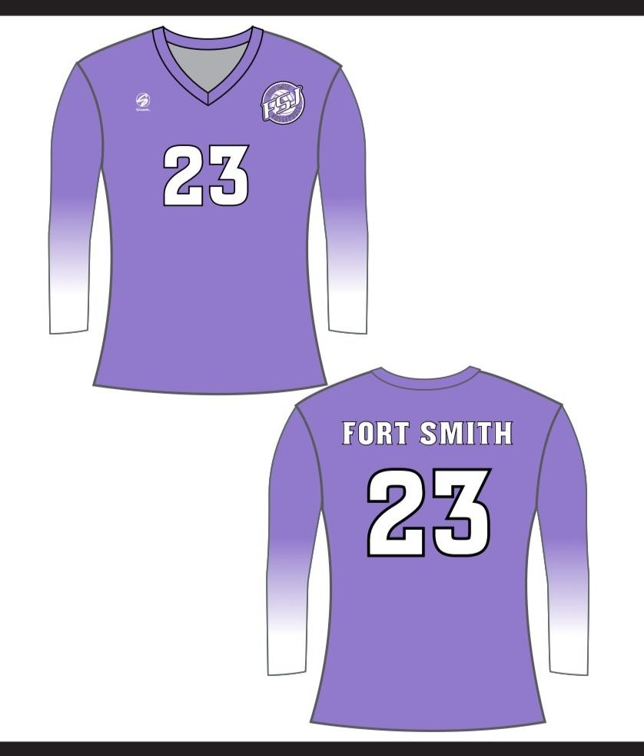
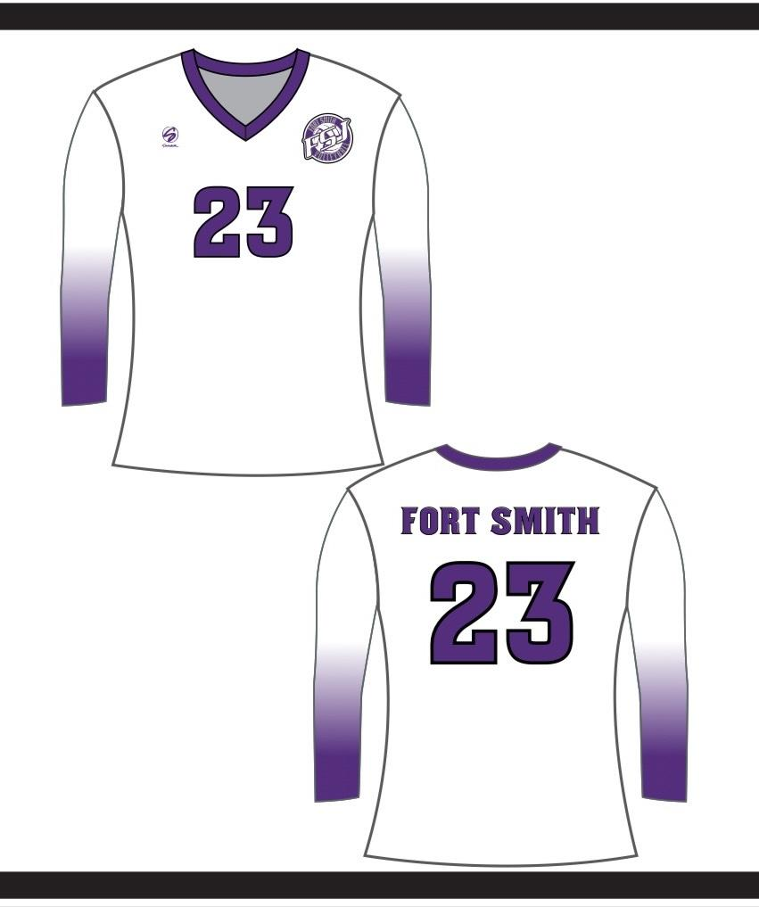
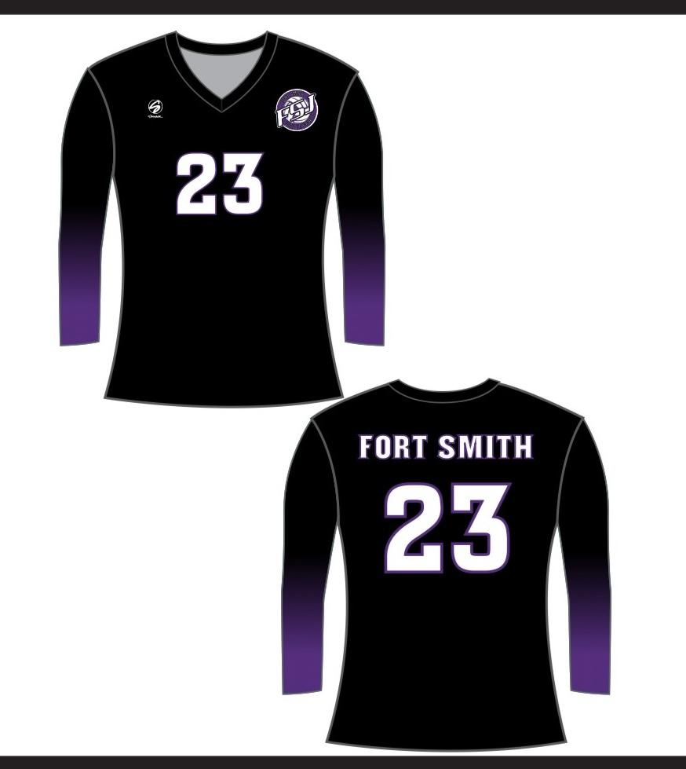
Uniforms - Kimberly Holman
Jerseys are paid separately from player fees
Uniforms are paid for at fitting
  Cost $40 each=Total $120: Cash, Check, or Venmo
    Venmo Info: @FSJVB ($5 fee will need to be added to payment)
All Teams: Purple, White, & Black Jerseys
Uniform Fitting Day: November 10th (12:30 pm to 7 pm)
Questions concerning uniforms please contact:
kgholman1981@gmail.com

Slide 23
Sarah Edwards - Treasurer
Andrea Tharnish - Bookkeeper
Sarah will be in charge of overall financial oversight of the Club
  Contact at Treasurerfortsmithjuniors@gmail.com
Andrea will be in charge of Player Accounts, Payments and Refunds
  Contact at Andrea.Tharnish@BMS.com

Slide 24
Player Fees 2024-2025
2024-2025 Player Fees | Payments due by 15th of the month
AGE | Uniforms | Due upon Bid Acceptance | Dec | Jan | Feb | Mar | FSJ Fees
10's | not included | 300 | 200 | 200 | 200 |  | $900.00
11-1 | not included | 300 | 250 | 225 | 225 |  | $1,000.00
11-2 | not included | 300 | 200 | 200 | 200 |  | $900.00
12-2 and 12-3 | not included | 300 | 250 | 225 | 225 |  | $1,000.00
13-3/14-3/15-3/13-4/14-4 | not included | 300 | 250 | 250 | 250 |  | $1,050.00
Elite 13-1/14-1/15-1/16-1/17-1 | not included | 400 | 340 | 340 | 335 | 335 | $1,750.00
National 12-1/13-2/14-2/15-2/16-2/17-2 | not included | 365 | 275 | 270 | 270 | 270 | $1,450.00
18-1 | not included | 400 | 325 | 325 | 300 |  | $1,350.00

Slide 25
Player’s Account
Sports Engine is used to process automatic player payments. You will be required to set-up a Sports Engine account to be able to register for tryouts.
Online account must be established by parent or guardian for the player(s). It is required for your daughter to play volleyball at FSJ. There are no exceptions.
Sports Engine requires automatic payment processing. NO EXCEPTIONS! You can pay your balance in full or sign up for automatic payments.
FIRST PAYMENT IS DUE UP0N TEAM ACCEPTANCE online (within 48 hours after teams are posted)
  NO EXCEPTIONS!
Payments are due on the 15th of each month after that and the card or bank account on file will be charged automatically. You can change the type of credit card or bank account that is on file at anytime during the season by logging into your SportsEngine account.

Slide 26
Player’s Account (cont’d)
The club is working with SportsEngine to determine a process to apply fundraising and other credits during the season. There is a possibility that checks will be sent so make sure your home address is updated in your sports engine account.
Please keep in mind that fundraising efforts can not exceed the fees charged to the player from FSJ.
Do not withhold payment while waiting for fundraising credits to be applied to your account.
Payments will be automatically deducted from the credit card or bank account on file. If payment is declined, there may be an additional administrative charge. You will also be contacted to bring the account current by the FSJ Bookkeeper.
If payments are not made and you fall behind the payment schedule by two (2) payments, the coach of your team will be instructed to withhold playing and/or practice time.

Slide 27
Reduced Fee\Scholarships
Club sets aside $5,000 annually to assist families with fees
Max of 50% of player fees reduced
First payment is still made and in full at team acceptance, then remaining payments may be reduced based on scholarship amount, then player portion of fees are to be paid monthly by the parent
The program is based on financial need, not athletic ability
Previous calendar year tax return required (no exceptions)
First come first serve basis – The program is now open for applications
Confidential – only 4 board members will see the applications
More information on the website under FSJ Info\For Parents\Scholarships
How to submit? treasurerfortsmithjuniors@gmail.com

Slide 28
Battle at the Fort - Work Credit
If player parents (or player representatives) help with SET UP and/or TEAR DOWN at the Battle at the Fort tournament, the player will receive a credit. This credit is only provided if you sign in and sign out during the required work time and fulfill your shift. It is recorded and verified before the credit is provided by the bookkeeper.
*One credit per each person that works each shift*
Work Credits Available:
$50 credit for working SET UP
$50 credit for working TEAR DOWN

Slide 29
Battle at the Fort - Work Credit
Shift Options: Set up at Convention Center or FSJ facility
Tear down at Convention Center or FSJ Facility
Workers have to be scheduled and documented (sign in/out sheet completed). Credit shifts are 4 hour shifts (9am-1pm) and (12pm - 4pm)
Note: Every player is required to have a parent or family member work a shift during the BAF the opposite weekend the team plays which is not part of the credit.
Work Options: Court Monitor, Ticket Table, Hospitality, Concession, Clean up crew at FSJ

Slide 30
FSJ Tournaments
Battle at the Fort
January 25-26, 2025 for 11s-14s
February 1-2, 2025 for 15s-18s
All FSJ Teams Play
Mandatory: Every player is required to have a parent/guardian or family member work a shift during the BAF the opposite weekend the team plays which is not part of the credit. Court Monitor, Ticket Table, Hospitality Clean up crew at FSJ and Concession.

Slide 31
FSJ Tournaments
Border Town Brawl
January 4th - Ages 11’s,12’s &13’s
January 5th - Ages 14’s & 15’s
Non-National teams (unless playing up in age)
Mandatory: Every player is required to have a parent/guardian or family member work a shift during the Border Town Brawl the opposite day the team plays which is not part of the credit.
Court Monitor, Ticket Table, Hospitality Clean up crew at FSJ and Concession.

Slide 32
TOURNAMENT SCHEDULES
Elite Teams 13’s–17’s - 1s teams
6 - 7 Tournaments
2 National Qualifiers
1 Delta Region Bid Qualifier
1 Pre National Tournament
National Tournament (if qualify for Nationals)
National Teams 12 Nationals and 13–17’s - 2’s teams
6 - 7 Tournaments
1 National Qualifier
1 Delta Region Bid Qualifier
1 Pre National Tournament
National Tournament (if qualify for Nationals)
Elite and National teams travel to OKC, Dallas, Kansas City, St.Louis, Tennessee, Tulsa, and etc…..
Waivered players can not be placed on a Elite or National Team

Slide 33
TOURNAMENT SCHEDULES
Regional Plus Teams: 12s-15s
6 - 7 Tournaments
Regional Teams : 12s-14s
6 - 7 Tournaments
Youth Teams : 10’s,11-1 and 11-2
6 - 7 Tournaments
10-15 Regional Plus and Regional Teams
will usually travel to Fayetteville, Springdale, Rogers, Tulsa, Little Rock, Benton, Cabot or Russellville
(try to stay under a 4 hours drive)

Slide 34
PRACTICE SCHEDULES
Mondays and Thursdays
10s, 11s, 12s 5:30pm - 7:30pm
16s, 17s, 18s 7:30pm - 9:30pm
Tuesdays and Wednesdays
13s, 14s, 15s
5:30pm - 7:30pm
7:30pm - 9:30pm
We will work with school commitments with prior notice
Teams may practice at other venues if can make arrangements

Slide 35
PRACTICE AND TOURNAMENT SCHEDULE ATTENDANCE COMMITMENT LEVEL
REGIONAL- HIGH - attendance is expected at most practice and all tournaments. we will work with school commitments with prior notice
REGIONAL PLUS - HIGHER - attendance is expected at most practice and all tournaments. We will work with school commitments with prior notice.
NATIONAL - VERY HIGH - attendance is expected at all practices and all tournaments. We will work with school commitments with prior notice.
ELITE - HIGHEST - attendance is expected at all practice and all tournaments. we will work with school commitments with prior notice.
NATIONAL AND ELITE TEAMS WILL COMPETE AT USAV NATIONALS

Slide 36
Player Development
Factors that determine playing time:
  Level of team
  Situation in game
  Pool play or bracket
  3rd set tie-breaker
  Performance/Behavior in practice
  Position of player
“You are paying for practice time”

Slide 37
FSJ WINTER LEAGUE
For kids and families that aren’t able to commit to
traditional FSJ teams due to travel, time, cost or other
activities. Also, provided for players when space is not available on travel team.
  -Mid January to March (tentatively)
  -Friday nights 6:00 to 8:00pm
  -Skills, Drills, Scrimmages
  2024 Winter League Coordinator
  (Assistant Coach UAFS)

Slide 38
FSJ WINTER LEAGUE
No tryout
No travel
$250 Player Fees
$53.00 USAV/Delta Registration
  -Payment 1 due January ($125)
  -Payment 2 due February ($125)

Slide 39
Little Spikers
Purpose: To introduce the game of VB to younger players, teach fundamental skills and basic concepts of the game
USAV Registration: All Little Spikers must be registered on USAV - Players aged 8 or below are free
Ages: 6 – 8 years old
Practices: Once a week 3:30pm – 4:30pm for 5 weeks
Cost: $60 - Free USAV registration (8 and under)
Contact: More information will be posted on our website

Slide 40
Upcoming Timeline
1) Tryouts: October/November
2) Team Offer: Accept or decline offer no later than 48 hours after posted on website
3) FSJ Day: November 10
4) Practices Begin: November
5) Tournaments begin: January
6) Tournaments end:
Regional Plus and Regional -April
Elite and National - May and July

Slide 41
Who do I contact if I have questions?
A complete list of board members is listed on the FSJ website - fortsmithjuniors.com
For general questions regarding FSJ:
find the “Ask the Director” graphic on the home page of our website
post questions on FSJ Facebook Messenger
Contact Jenn Douglas or Whitney Adams

Slide 42
FSJ - Fort Smith Juniors Volleyball Store
·
Our FSJ store is open! Start getting ready for club season with new shirts, sweatshirts, backpacks and other FSJ accessories.
https://www.fsjstore.vip

Slide 43
FSJ DAY
SUNDAY, NOVEMBER 10th
12:30pm - 7pm
Uniform Fittings
Mandatory Team Meetings
Team Meetings timeline TBA Check Fortsmithjuniors.com

Slide 44


