Slide 1
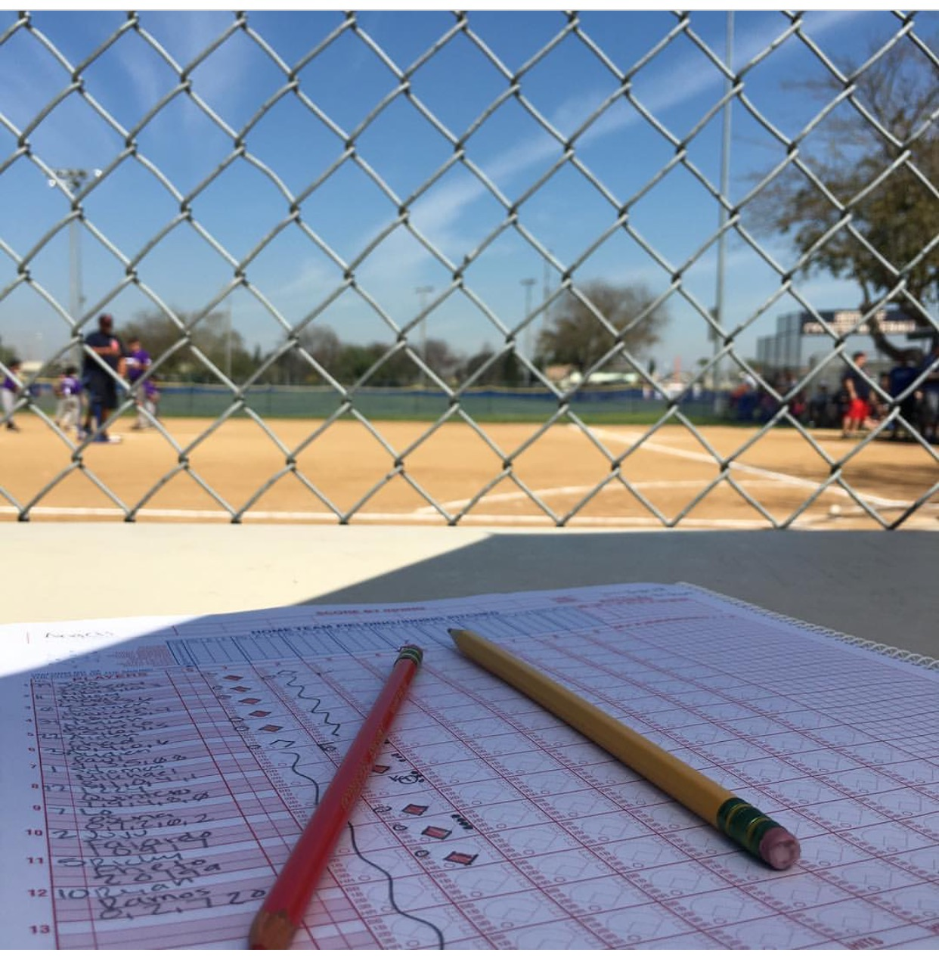

Scorekeeping
Training

Slide 2
About Official Scorers
Keep our pitchers safe from overuse injuries
Record the progress of the game including balls, strikes, runs, outs, etc. as called by the umpires

Slide 3
About Official Scorers
Home Team responsibilities:
The official scorebook for game
Verifying/signing the pitcher eligibility forms
Visitor Team responsibilities:
Tracking pitches in Game Day Pitch log
Updating the pitcher eligibility form
Updating the score board

Slide 4
Scoring Goals
Your goal is to accurately record what happens during the game.
Strive to be Consistent!
Follow the proper Score Keeper etiquette
Remain objective in the score booth ( No cheering or coaching)
Keep distractions to a minimum ( cell phones in vibration mode )
Only those persons scoring are allowed in the scoring booth

Slide 5
Official Scorekeeping Focus
Be a “PRO”
Pitches
Accurately track Balls, Strikes, Foul Balls
Runs
Follow hitters and runners as they get on base and advance around the bases
Outs
Keep the Defense aware of how many outs they need to move to next half inning

Slide 6
Lineup Cards
The Lineup card is used in baseball to record the full lineup of a team. In addition to the batting order listed in the lineup card, player’s positions are listed.
Each team MUST provide a lineup card to:
Scorekeeper
Umpire
Opposing Manager

Slide 7
Line Up Card Requirements
Team name and Game Date
Every player, including absent and injured players are on the line up card
Player’s complete last name followed by a comma and complete first name
Example: Robinson, Jackie
Players uniform number
Positions for each player listed
“X” if players are not starting in the field

Slide 8
Scoring Book Setup Prior to game (1 of 2)
The Home Team score keeper is responsible for the official book.
Print your name in the scorer field located in the top left hand corner
List VISITORS first and Home team second in the book, as this is the order in which they will bat during the game
Enter the date and day of the game where indicated
Enter Players Uniform Number, Last name, First Initial and position number in the score book. (Use the lineup card provided by manager)

Slide 9
Scoring Book Setup Prior to game (2 of 2)
Enter absent and injured players uniform number, last name, and first initial at the bottom of the lineup in the scorebook
Enter the opposing pitchers last name in the box designated “Pitcher”. Also enter the staring pitchers Number in the blank space directly above the score blocks for inning 1.
Note: The lineup should be recorded, in the official scorebook, in INK. The rest of the book may be entered in pencil.

Slide 10
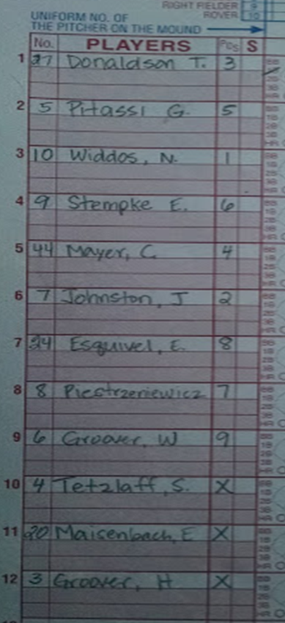
Sample Score Book Lineup
This is a scorebook lineup from an actual game in the past.

Slide 11
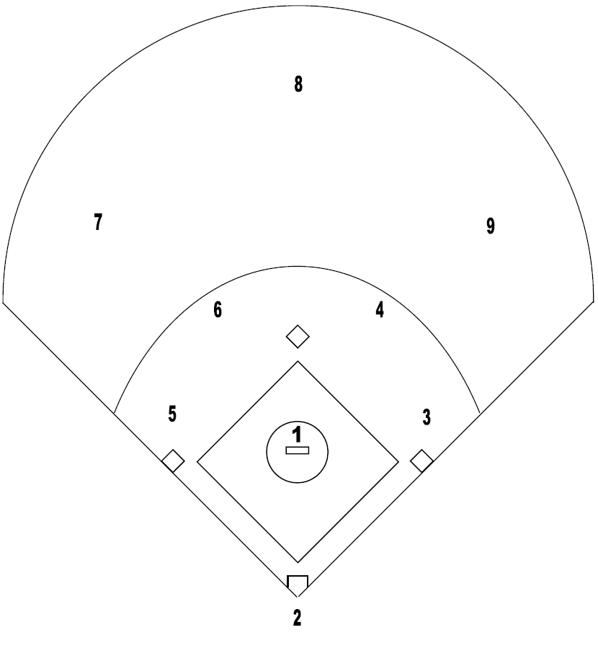
Positions Pinto, Mustang, Bronco
#1 Pitcher
#2 Catcher
#3 First Baseman
#4 Second Baseman
#5 Third Baseman
#6 Shortstop
#7 Left Field
#8 Center Field
#9 Right Field

Slide 12
Game Day Set up
Both the Home and Visiting Teams are responsible for maintaining the official score book, score board, Game Day Pitch Log and completing the Pitcher Eligibility Tracking Form for a Scheduled Game.

Slide 13
Score Keeping Box Contents
All scorekeeping supplies are stored in the score keeping totes. These totes can be located in the CYB shed, behind the Pinto field at Oak Knoll park. CYB Head Score Keeper and Team Managers have a key to the CYB shed.
COVID 19 Safety Guidance
Official Score Book
Official Pitcher Eligibility Tracking forms
Game Day Pitch Logs
Pencil box with regular and red pencils, pens, .etc
Remote for Score Board
Folder with Local League Rules, Scorekeeping Guide, Training Presentation
4-Dial Umpire Indicator
Extra Line up Cards ( Just in case a team does not have one )
Disinfectant wipes and Hand Sanitizer
First Aid Kit
Extra Batteries
COVID 19 Banners

Slide 14
COVID-19 Safety
Limit 2 persons in Score Booth sitting at least 3 feet away (marked via tape)
Please wipe writing utensils with alcohol wipes after game usage
You can bring your own writing utensils (pen and pencil)
Score keepers use hand sanitizer before and during the game
Scorekeepers wear masks
No eating is allowed in the score booth

Slide 15
COVID 19 Banners
Clip to Fence
Place Banners at locations in following slides.

Slide 16
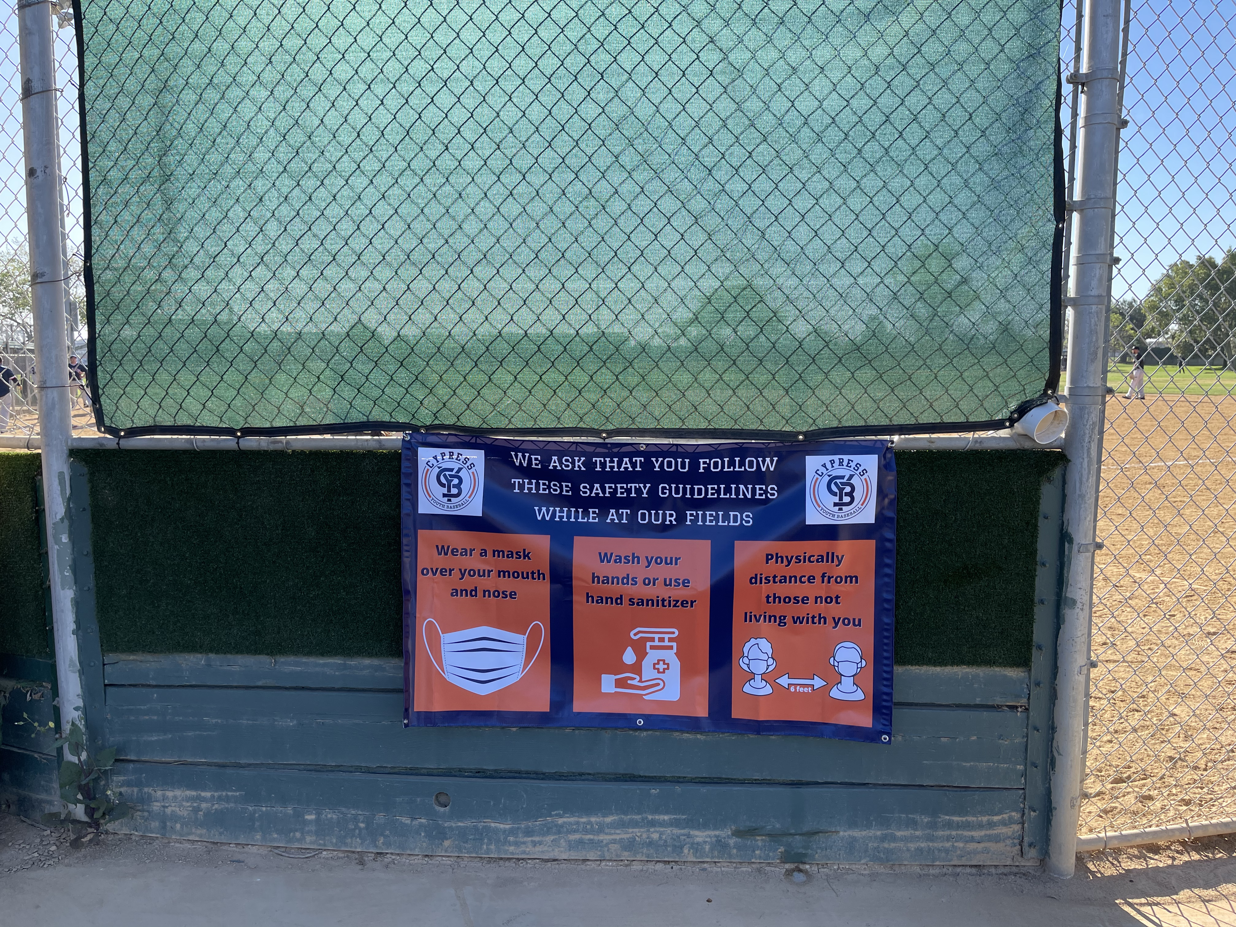
COVID 19 Banner - Pinto
1st Base side of Score Booth

Slide 17
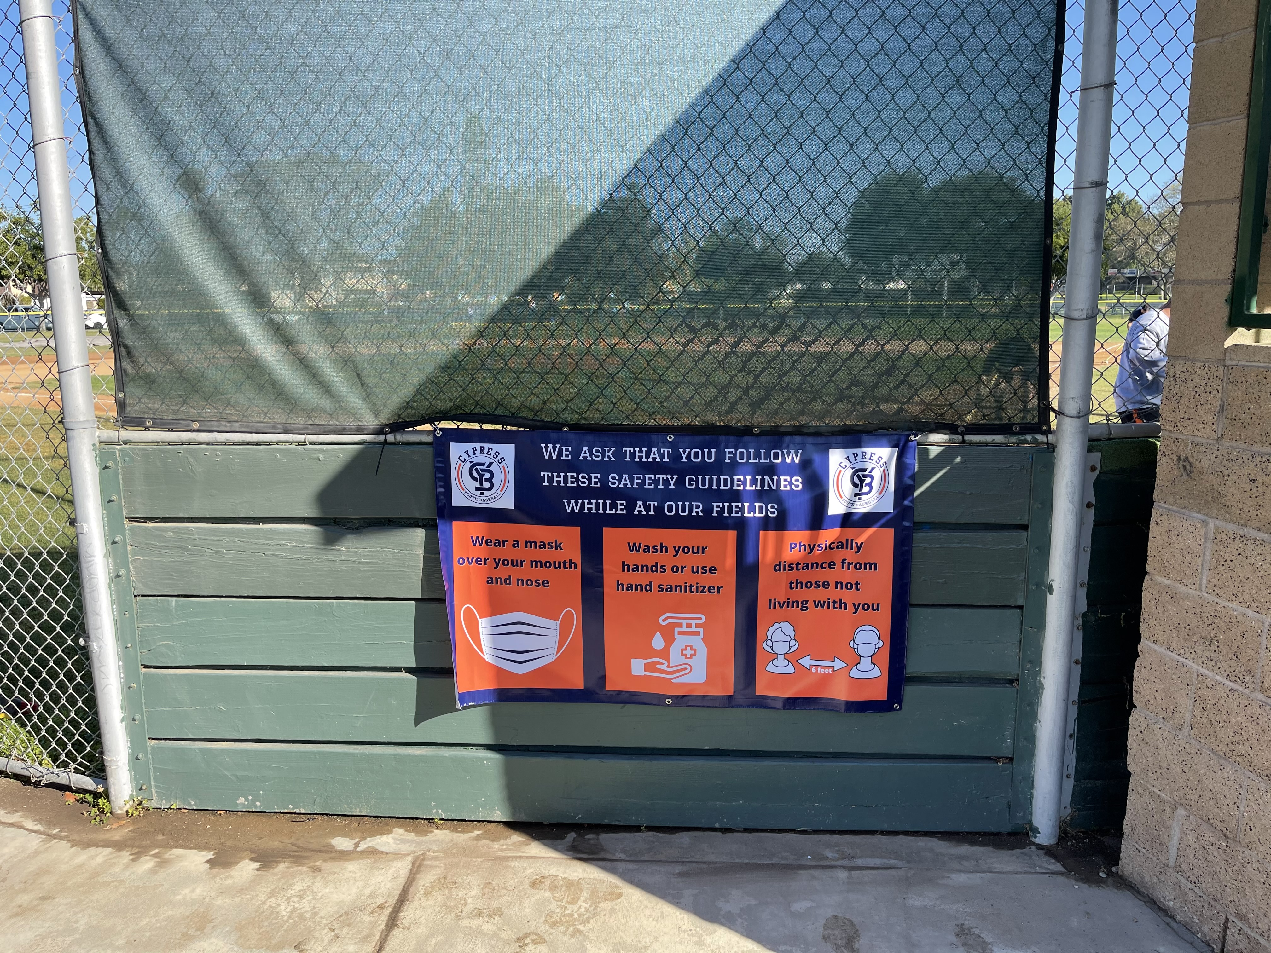
COVID 19 Banner - Bronco
3rd Base side of Score Booth

Slide 18
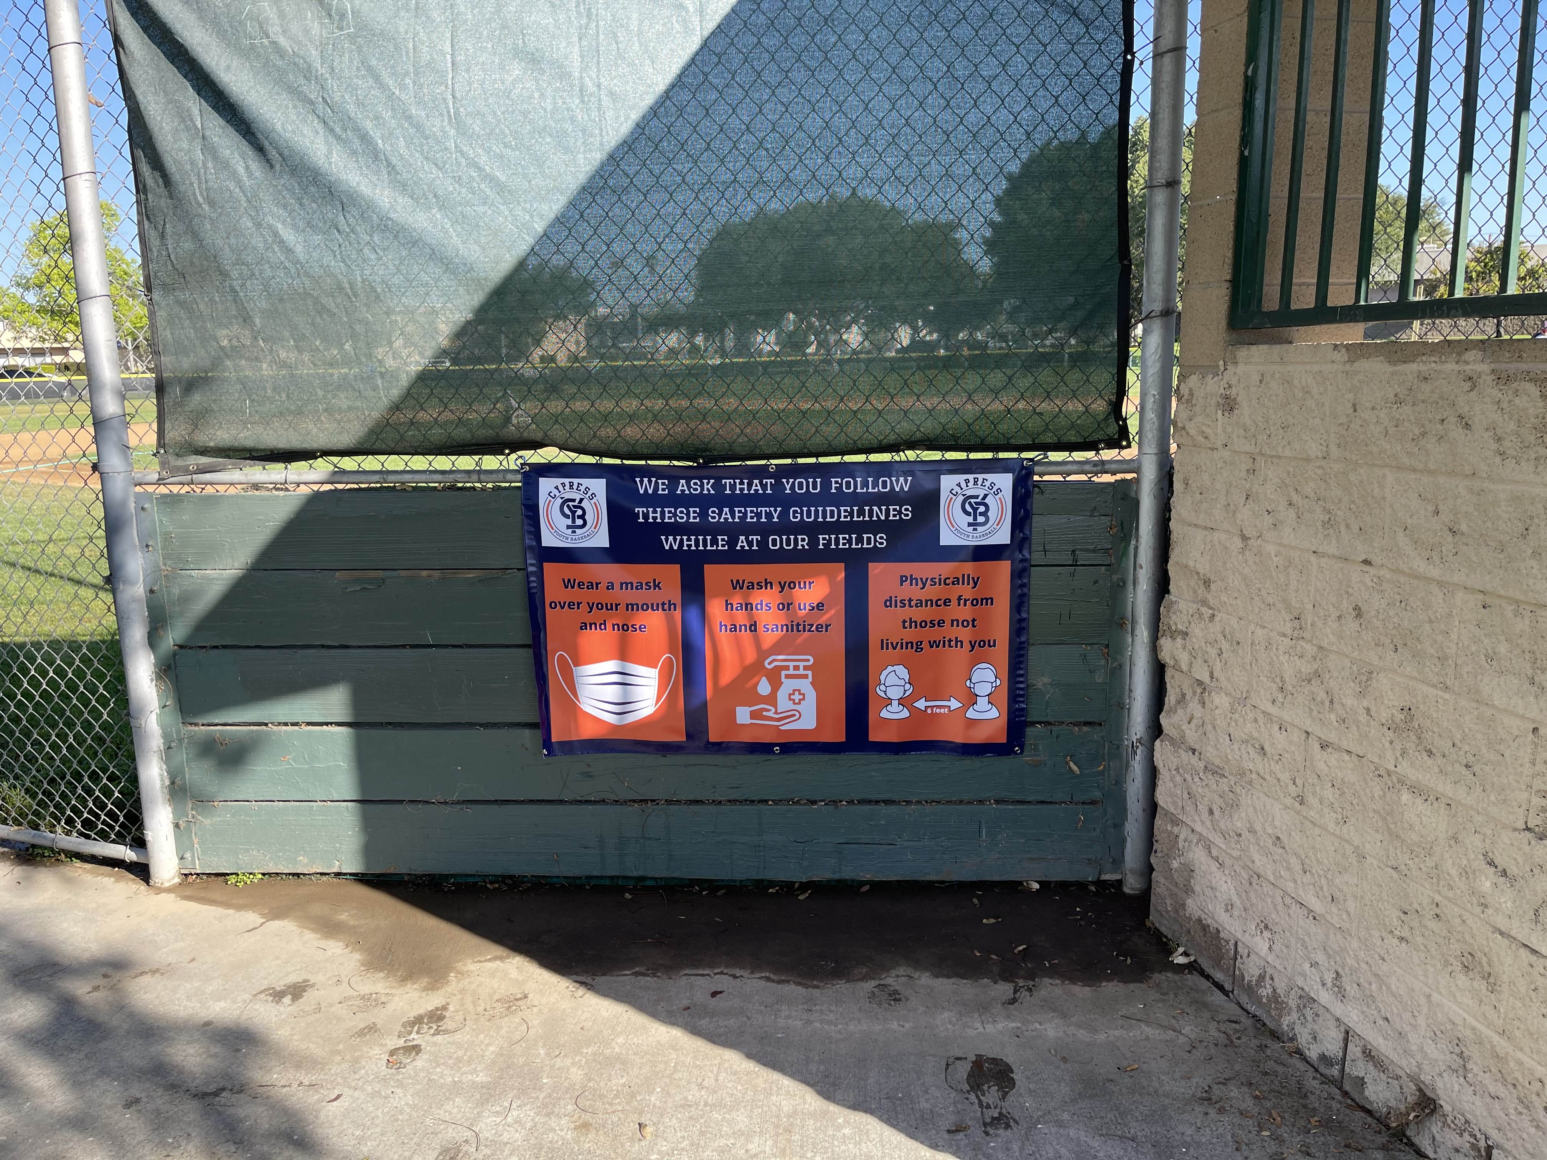
COVID 19 Banner - Mustang
3rd Base side of Score Booth

Slide 19
Setting Up
Arrive at the game site at least 45 minutes prior to the game time.
Home team is responsible for obtaining the score keepers tote and the chairs marked for your division from the CYP Shed. If your game is not the First Game of the day, the tote should be in the score booth.
Obtain Lineup Cards and Pitcher Eligibility Tracking Form from each team at least 15 minutes prior to the game start time.

Slide 20
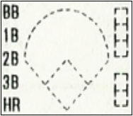
Scorebook Core Component – Score Blocks
The score blocks, located in the pages of the official scorebook will help us track the following:
Balls and Strikes
How a batter reached bases
A base runner’s progress around the bases
How an out was made

Slide 21
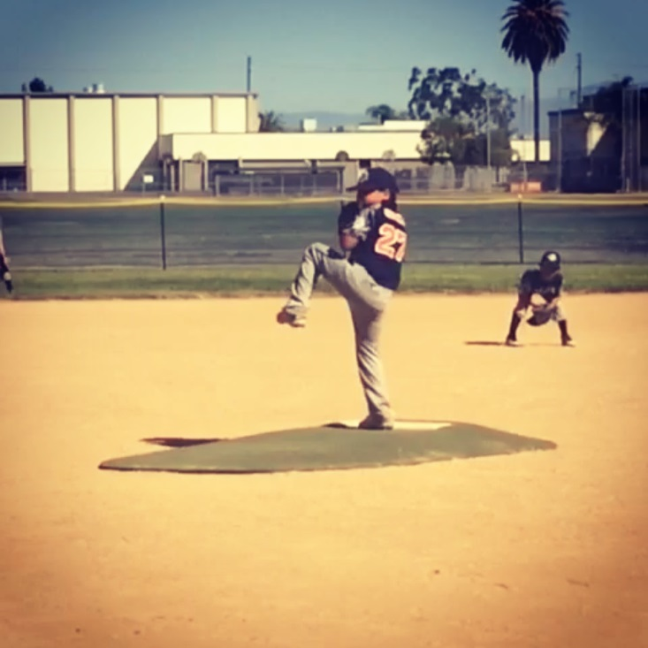
How to Record Pitches

Slide 22
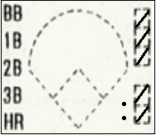
Tracking Pitches
Slash out one square within the score block for each pitch thrown.
If a ball is thrown, then slash out one of the three squares located in the top right hand corner of the score block beginning with the top most square
If a strike is thrown, then slash out one of the two squares located in the bottom right hand scorner of the score block beginning with the top most square
Note: If a batter already has two strikes and continues to foul off pitches you must track each additional pitch by placing a dot next to the square designated for strikes.

Slide 23
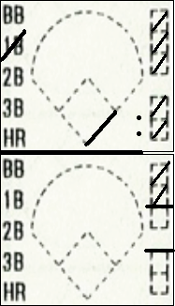
Pitching Change
After a batter has completed their at bat:
Draw a line under the score block for the last batter faced by the old pitcher.
Record this inning’s pitch count, for the old pitcher, in the blank space located at the end of the inning column.
Enter the new pitcher’s number in the blank space directly above the score blocks for the inning they will start pitching in.

Slide 24
Pitching Change
In the middle of an at Bat:
Draw a line, ¾ of the way, under the score block for the last complete batter faced by the old pitcher.
Draw a line under the square for the last ball thrown by the old pitcher.
Draw a line under the square for the last strike thrown by the old pitcher.
Record this inning’s pitch count, for the old pitcher, in the open space located at the bottom of the inning column.
Enter the new pitcher’s number in the blank space directly above the score blocks for the inning they will start pitching in.

Slide 25
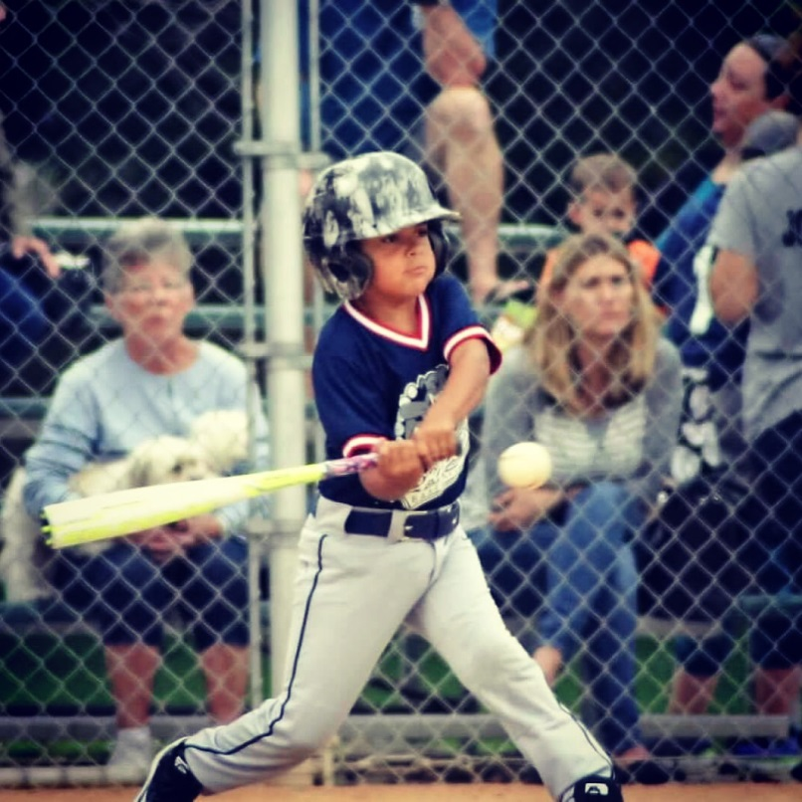
How to Record player Reaching Bases

Slide 26
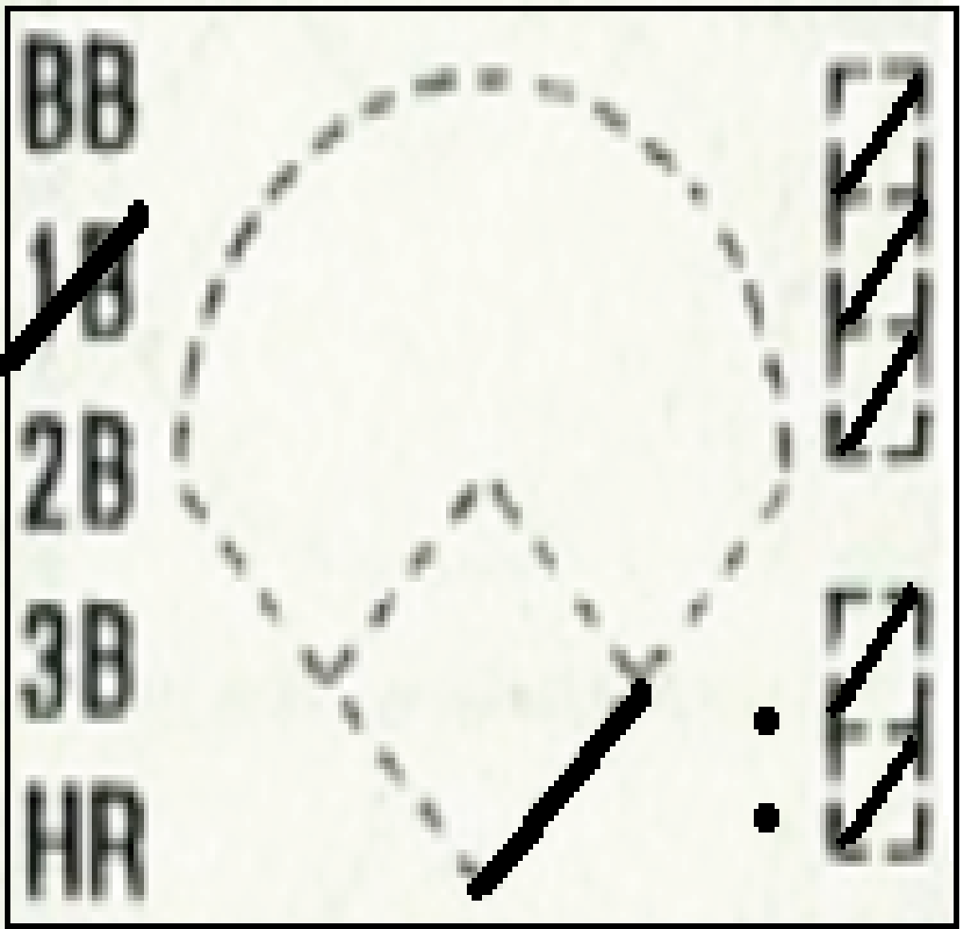
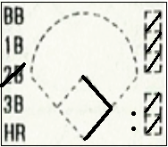
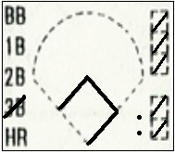
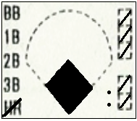
Symbols for Play | Description | Score Block
1B | A single (1B) is awarded to the batter if they hit a fair ball that advances them to first base safely and advancing is not the result of a fielder’s choice or an error. A single is recorded by slashing through the 1B symbol on the left side of the score block.
2B | A double (2B) is awarded to the batter if they hit a fair ball that advances them to second base safely and advancing is not the result of a fielder’s choice or an error. A double is recorded by slashing through the 2B symbol on the left side of the score block.
3B | A triple (3B) is awarded to the batter if they hit a fair ball that advances them to third base safely and advancing is not the result of a fielder’s choice or an error. A triple is recorded by slashing through the 3B symbol on the left side of the score block.
HR | A home run (HR) is awarded to the batter if they hit a fair ball that advances them home safely and advancing is not the result of a fielder’s choice or an error. A home run is recorded by slashing through the HR symbol on the left side of the score block.
1B
2B
3B
HR

Slide 27
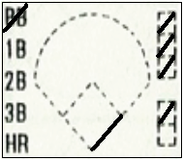
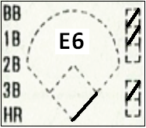
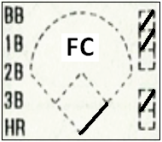
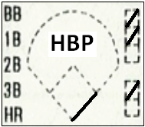
Symbols for Play | Description | Score Block
BB | A base on balls (BB) is credited to a batter when a batter receives four pitches that the umpire calls balls. A base on balls is recorded by slashing through the BB symbol on the left side of the score block.
E | An error (E) is the act of a fielder misplaying a ball in a manner that allows a batter or runner to reach base when such an advance would have been prevented given ordinary effort by the fielder. An error is recorded by writing “E”, followed by the position number of the fielder who made the error, directly above the dotted diamond in the score block.
FC | A fielder's choice (FC) is when the batter reaches base due to the defense's attempt to put out another runner. Fielder’s choice is recorded by writing “FC” directly above the dotted diamond in the score block.
HBP | Hit by pitch (HBP) is a batter or his equipment (other than his bat) being hit in some part of his body by a pitch. A hit by pitch is recorded by writing “HBP” directly above the dotted diamond in the score block.
BB

Slide 28
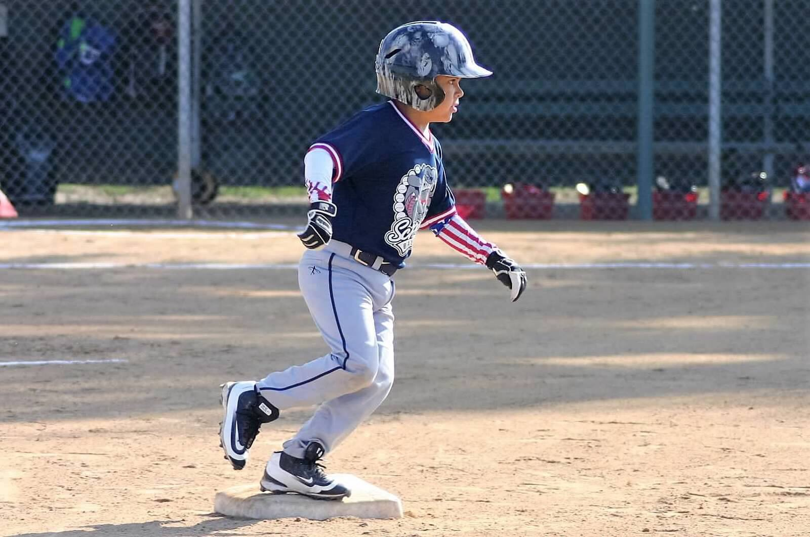
How to Record a Runner’s Advancement
When a Batter reaches base, you will track their progress around the base by drawing a line connecting the dots of the diamond and filling in the diamond when a run scores.

Slide 29
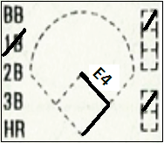
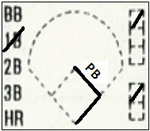
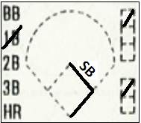
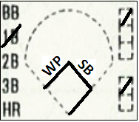
Symbols for Play | Description | Score Block
E | An error (E) is the act of a fielder misplaying a ball in a manner that allows a batter or runner to reach base when such an advance would have been prevented given ordinary effort by the fielder. An error is recorded by writing “E”, followed by the position number of the fielder who made the error, on the advancement line from the base the runner started at to the base the runner advanced to.
PB | A passed ball (PB) is when the catcher fails to hold or control a pitched ball that, with ordinary effort, should have been maintained under his control. When a runner advances on a passed ball, it should be recorded by writing “PB”, followed by the position number of the catcher, on the advancement line from the base the runner started at to the base the runner advanced to.
SB | A stolen base (SB) occurs when a runner successfully advances to the next base while the pitcher is delivering the ball to home plate. A stolen base is recorded by writing “SB” on the advancement line from the base the runner started at to the base the runner advanced to.
WP | A wild pitch (WP) is scored when a pitch is too high, too short, or too wide of home plate for the catcher to control with ordinary effort. A wild pitch is recorded by writing “WP” on the advancement line from the base the runner started at to the base the runner advanced to.
B | A balk is an illegal pitching action in baseball an announced by the umpire. A balk is required by writing “B” on the advancement line from the base the runner started at to the base the runner advanced to.
B
SB

Slide 30
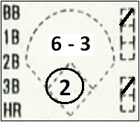
How to Record put Outs
When an out is made, the player who is put out is marked in the scorebook with the out number circled

Slide 31
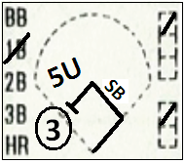
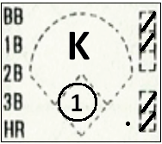
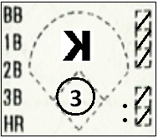
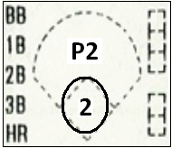
Symbols for Play | Description | Score Block
Groundout | A ground out is when a batted ball hits the ground in fair territory and the defense is able to gain possession of the ball and throw to a base before the batter-runner or runner arrives. To score a ground out, record the position number of the player who fielded the ball and the position number of the player who caught the ball for the put out directly above the dotted diamond.
Unassisted play | An unassisted play occurs when a defensive player makes the putout by himself without any teammates touching the ball. To score an unassisted play, record the position number of the player who fielded the ball and putout the batter runner or runner, followed by a “U”, outside of the dotted diamond.
Strikeout Swinging | A strikeout occurs when a batter receives three strikes during his time at bat. A regular “K” is used when the batter swings at the third strike.
Strikeout Looking | A strikeout occurs when a batter receives three strikes during his time at bat. A backwards “K” is used when the batter looks at the third strike.
Pop out | A pop-up is a ball that goes very high while not traveling very far. Pop outs are typically caught in the infield. To score a pop out, record a “P” followed by the position number of the player who caught the pop up, directly above the dotted diamond.

Slide 32
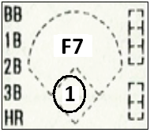
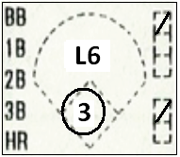
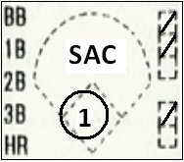
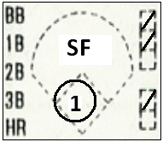
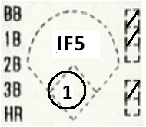
Put Out | Description | Score Block
Fly out | A fly ball is a ball that is hit in the air, usually very high. Fly outs are typically caught in the outfield. To score a fly out, record an “F” followed by the position number of the player who caught the fly ball, directly above the dotted diamond.
Line out | A line drive is a ball sharply hit and on a level trajectory. To score a line out, record an “L” followed by the position number of the player who caught the line drive, directly above the dotted diamond.
Sacrifice Bunt | A sacrifice bunt is a batter's act of deliberately bunting the ball to allow a runner on base to advance to another base. To score a sacrifice bunt, record “SAC”, directly above the dotted diamond.
Sacrifice Fly | A sacrifice fly is a fly ball that satisfies four criteria: There are fewer than two outs, the ball is hit to the outfield, the batter is put out because a fielder catches the ball and a runner who is already on base advances on the play. To score a sacrifice fly, record “SF”, directly above the dotted diamond.
Infield Fly | When there are fewer than two outs, and there are runners at first and second base, or the bases are loaded and a fly ball is in fair play, and in the umpire's judgment it is catchable by an infielder with ordinary effort, the umpire shall call "infield fly", and the batter will be out regardless of whether the ball is actually caught. To score an infield fly, record “IF”, followed by the position number of the player closest to the pop-up, directly above the dotted diamond.

Slide 33
Uncommon Plays
Play | Description | Score Block
Dropped third strike and batter is out (force play) | In Mustang & Bronco, the batter may advance to 1st base if catcher does not catch the ball cleanly. (1st base cannot be occupied, if so, the batter is out, except when there are 2 outs in the inning) Mark appropriate strikeout (looking/swinging) and who touched the ball to make the play
Dropped third strike and batter is safe | In Mustang & Bronco, the batter may advance to 1st base if catcher does not catch the ball cleanly. (1st base cannot be occupied, if so, batter is out, except when there are 2 outs in the inning) Mark appropriate strikeout (looking/swinging) and draw line to 1st base (or to the base they advanced to). Mark “E” for either P or C. This is up to scorekeepers discretion
Pickoff attempt and runner is out | A pitcher (or catcher) can try to pickoff a runner on the bases. A pickoff is an act by a pitcher (or catcher), throwing a live ball to a fielder so that the fielder can tag out a baserunner who is either leading off or about to begin stealing the next base. Mark the runner as not advancing to the next base and identify the thrower of the ball and those who touched the ball to get runner out.
Pickoff attempt and runner advances to next base | When a pitcher (or catcher) attempts a pick off attempt and an error allows baserunner to advance a base (or multiple bases) Mark the runner as advancing to appropriate base and identify who made the error to allow baserunner to advance
2-3
K
1
K
E2
1-3-6
2
E1
E1

Slide 34
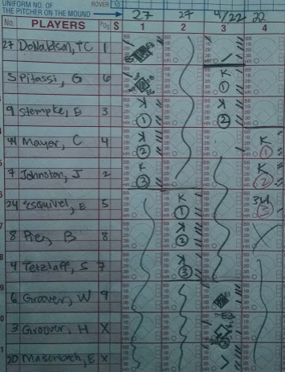
How to Fill in Score Book
Typically, you should rest your pencil on the block of the current batter. After a play, you mark the plays starting with the batter’s block and move up the scorebook to mark the players on base.
Tips:
Watch the whole play before you mark the book.
Take a survey of the field to make sure that who you have on base matches what is actually happening.
If possible use red pencil when outs are made
Do your best…but understand these scorebooks are not going to Cooperstown.

Slide 35
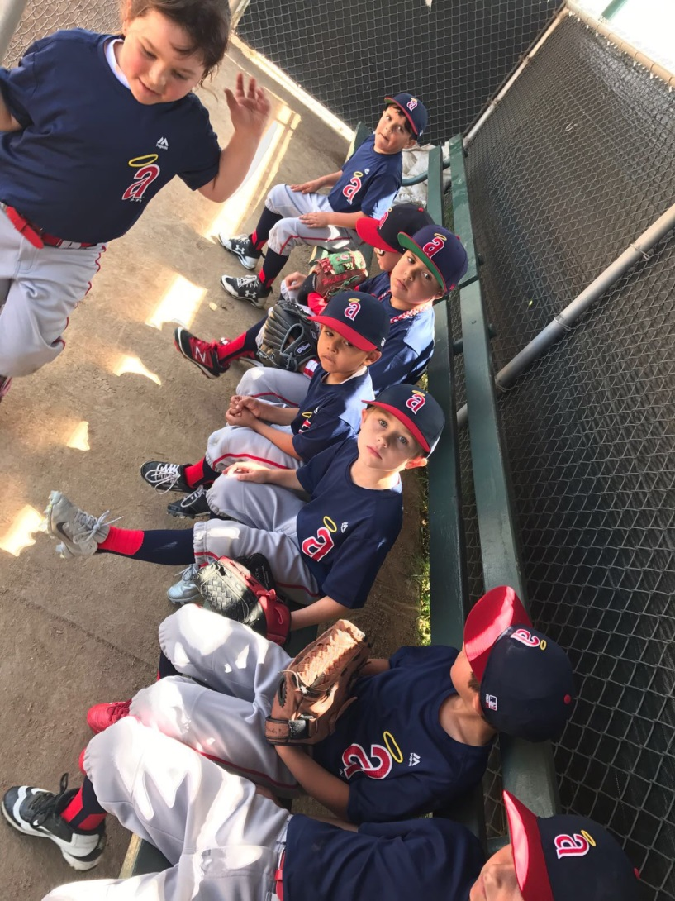
Defensive Changes

Slide 36
How to Record Defensive Changes
The starting defensive players will have the position number written in the box to the right of their name
Using the space below each batter, position changes should be noted as shown below. The first number will be the new position and the second number will be the inning the change was made ( position/inning).
For a player who was not apart of the starting lineup, the position will be noted in the position box the same position changes are noted for starting players.
Note: All players must have at least the following minimum innings played in the field per game. For the Bronco division a minimum of 3 innings per player and for Mustang/Pinto a minimum of 2 innings per player.
27 | Kemp, M | 7
 | 6/3, 8/5
16 | Ethier, A | 9
 | 5/4
33 | Van Slyke, S | X
 | 2/2

Slide 37
End of Each Inning
Scoring at the end of each inning
Pitch Count- Add the total pitches for the current pitcher in the current inning and enter that number in the open space located at the bottom of the inning column. Compare with the person tracking in the Pitching Log. To test on slide 28, there were 18 pitches in the first inning.
Hits- Add the total number of hits for the current inning and enter that number in the “Hits” box located at the end of each inning column.
LOB: Left on Base- add the total number of runners that were left on base and did not score in the current inning and enter that number in the “LOB” box located at the end of the inning column.
“X” out the next batter in the lineup and draw a line to mark out the other boxes. This will help you start in the right place in the next inning.
What if they bat through the lineup? You keep tracking the action in the next column. Just go across the top and cross out the inning number and replace it with the current one in subsequent innings. With so many players on each team, this should be pretty rare.

Slide 38
Pitcher Eligibility and Pitch Tracking
Pitcher Eligibility (changed in 2018)
Pitcher eligibility has a resting schedule based only on pitch count
The limits are on the Game Day Pitch Log.
Accurate recording is important from a safety and competitiveness standpoint.
Game Day Pitch Logs: blank forms are in the binder in the tote.
Pitch Log has recommended way of logging pitches
Every pitch gets a slash.
On the last pitch of that at bat, turn the slash to an X.
On the last pitch of that inning, make a circle around the X. This helps you to count by batter and inning. Especially helps when there are discrepancies.

Slide 39
Pitcher Eligibility Tracking Form
A form has to be completed for EACH Team. They will use the same form game to game.
Complete an entry, on each team’s form for each pitcher that entered the pitching position in the game. Use the game Day Pitch Log for the reference. Best to update at each pitching change.
Enter the next day a pitcher can pitch based on the rest requirements on the pitch log. For instance, if a player pitches 36 pitches and requires two days of rest: count tomorrow and the day after as rest days. The date after that is when they are eligible to pitch.
Sign your name for each entry. Either score keeper can sign.
Have opposing Managers sign each of the forms
Note: The Pitcher eligibility Tracking Form is ONLY Valid when signed by the Official Scorer and both opposing managers

Slide 40
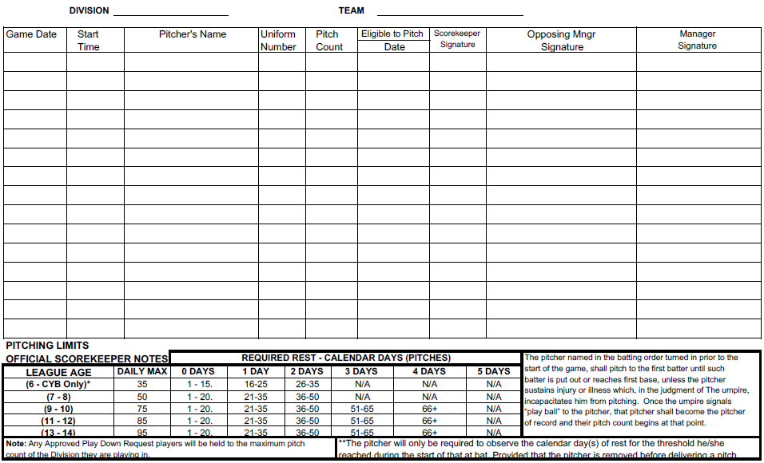
Pitcher Eligibility Tracking Form

Slide 41
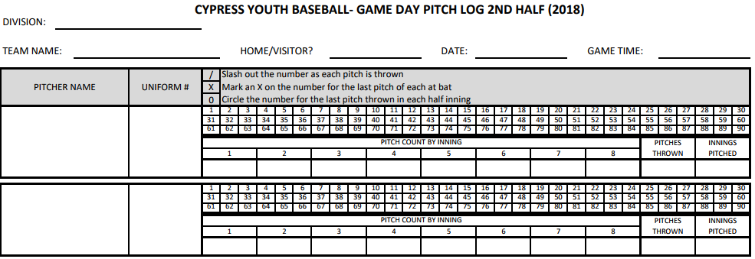
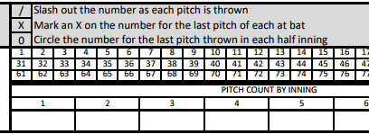
Game Day Pitch Log
Game Day Pitch Logs will be maintained for pitching eligibility verification. Place the Game Day Pitch Log in the Score Keeping Binder after Each Game.

Slide 42
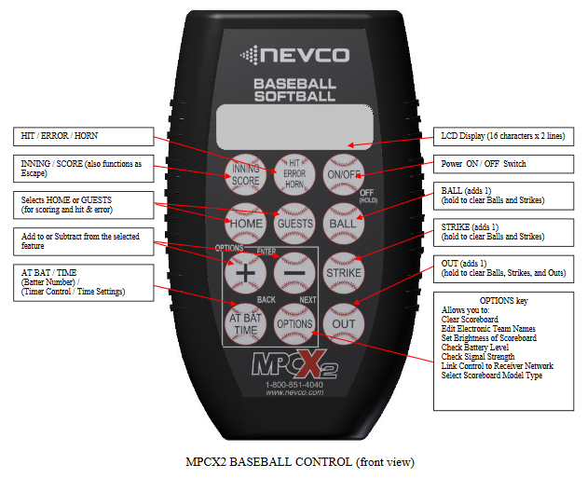
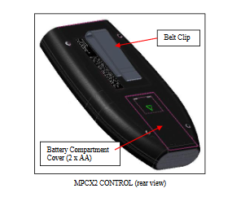
Scoreboard – Visiting Team Bronco/Mustang

Slide 43
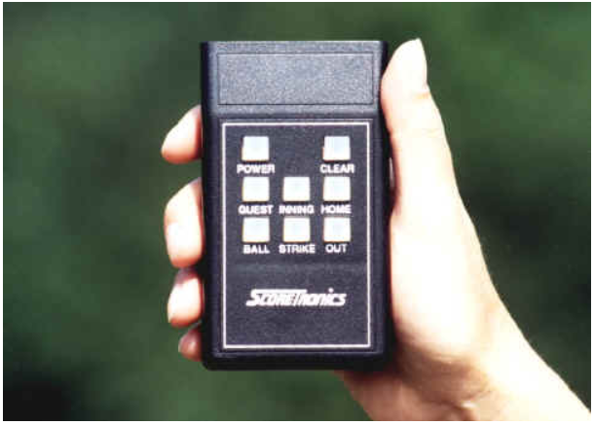
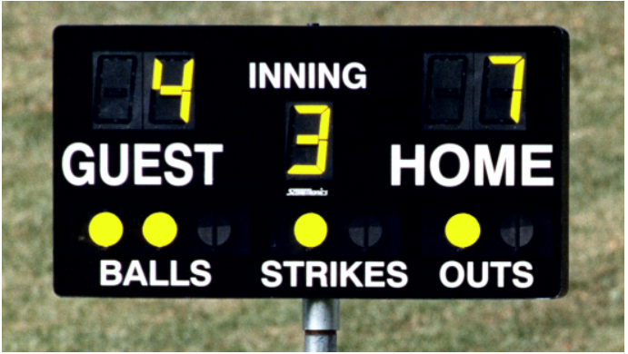
Scoreboard – Visiting Team Pinto
On/Off Button

Slide 44
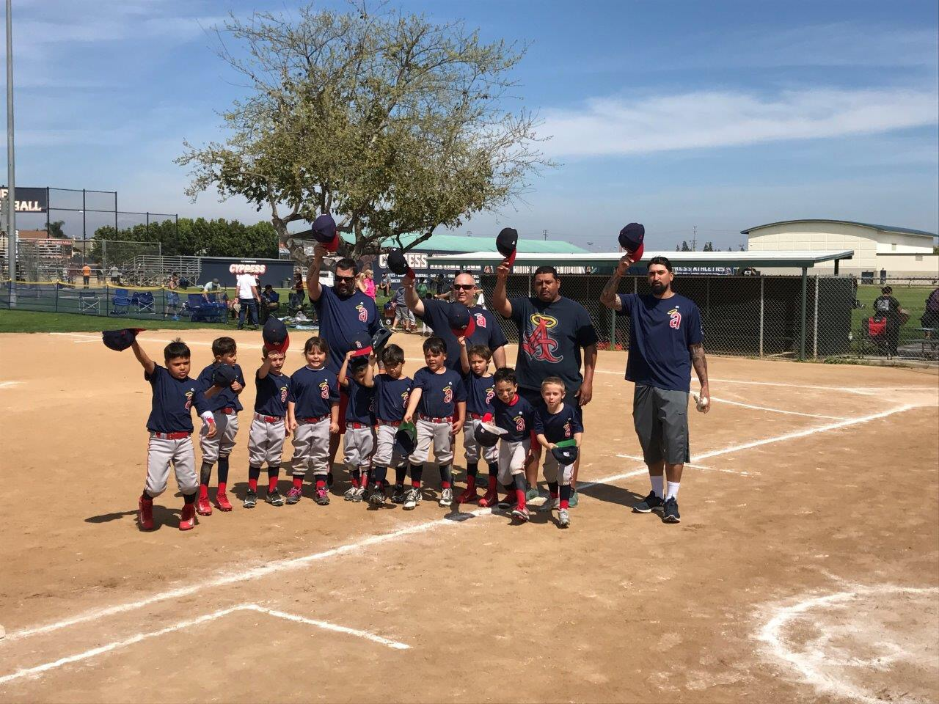
Post Game Check List

Slide 45
Post Game Checklist – Home
At the end of the game, write the final score on the pages of the scoring book in BIG Numbers with the winning team’s name written underneath it. Circle this Entry
The score book needs four signatures: home team manager, visitor manager, umpire, and official scorekeeper.

Slide 46
Post Game Checklist – Visiting
Fill out the Pitcher Eligibility Tracking Form with using information from Game Day Pitch Log
The Pitcher Eligibility Tracking form needs three signatures: home team manager, visitor manager, and scorekeeper.
NOTE:
0 days is next day
1 day is day after next
2 days is 2 days after next
3 days is 3 days after next
4 days is 4 days after next

Slide 47
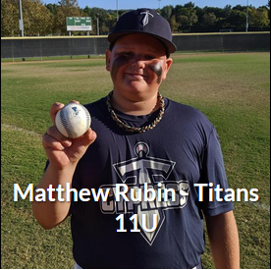
Post Game (2022)
Scoring Tote
If you scored the LAST game of the Day, please wipe down scoreboard remote, writing utensils, and microphone with disinfectant wipes, and place all scoring items and banners in the scoring tote and store in the CYB Shed. The Visiting team is in charge of returning the scoring tote and chairs to the shed. Be sure to lock the scoring booth.
Game Scores
The Home Team is responsible for reporting game scores within 24 hrs of the completion of the game. Home team managers in charge of
notifying Head Scorekeeper
** If there was an over the fence home run please list
the Players Name, Team Name, Division and picture of
the player for the Website. ** EXAMPLE →

Slide 48
Additional Resources

Slide 49
Practice Scoring Sheets
Print out to object to practice with
Pitch Count Tracking Sheet to practice with

Slide 50
Practice Scoring YouTube Links
2018 Pony League World Series Championship Game
https://youtu.be/pATHwhJs8aY
2018 Pony League World Series GM #16
https://youtu.be/aCVfL5JVxzA
Little League Baseball 2019
https://youtu.be/AinFzuBU23Y

Slide 51
Thank you for Coming
If you have any questions, the best way to reach me is by email: scorekeeper@cypressyouthbaseball.org
Remember we are all Volunteers and Human so please if you have QUESTIONS just ask.

