Slide 1

WYFH Coaches & Cocktails 2025
Welcome to WYFH Coaches & Cocktails

Slide 2

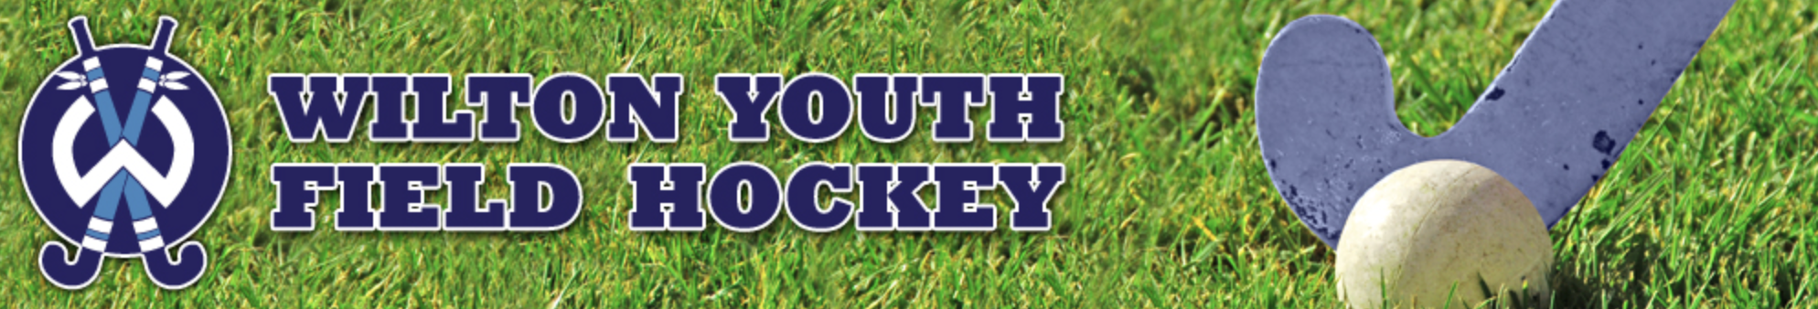
WYFH Coaches & Cocktails 2025
Program Philosophy
Wilton Youth Field Hockey develops youth players, grades K-8, into competitive, well-rounded athletes, while promoting respect, sportsmanship and a love for the sport of field hockey.
The Wilton Youth Field Hockey Program is a developmental program focused on providing age-appropriate training and competitive play that enables girls to grow to their fullest potential and providing them with the guidance to evolve as a player and a ‘Warrior’.

Slide 3
Coach Bios
Matt Ariniello – Varsity Coach Immaculate HS, Club Field Hockey Coaching Experience, WYFH for 7 years
Leon Kerr Sr. - Wilton High School Varsity Coach, Club Coach and International Player
Chandra Ring- Wilton High School Junior Varsity Coach, Former President WYFH
Leon Kerr Jr. - Assistant Coach at Wilton HS and International Player
Richard Wisdom - Jamaican National Player, Club Coach, National Coach and current High School Umpire
Shannon Horosky - Former HS player, Varsity Coach Immaculate HS and Club Coach
Ella Christ - Former Youth Player and Wilton HS Field Hockey Alumni
Caroline De Angelis- Former Wilton HS Player, Youth Alumni and Club Player
Robin Clasby - Played for over 10 years - coached for 3 years, Wilton HS Alumni
Jodene Weir - International Player, Coach and current High School and International Umpire
Coaching Director – Matt Ariniello
7th/8th Blue - Matt Ariniello and Leon Kerr Sr.
7th/8th White - Leon Kerr Jr. and Richard Wisdom
5th - Richard Wisdom and Matt Ariniello
6th - Shannon Horosky and Ella Christ
5th/6th - Caroline Deangelis and Robin Clasby
3rd/4th – Jodene Weir

Slide 4
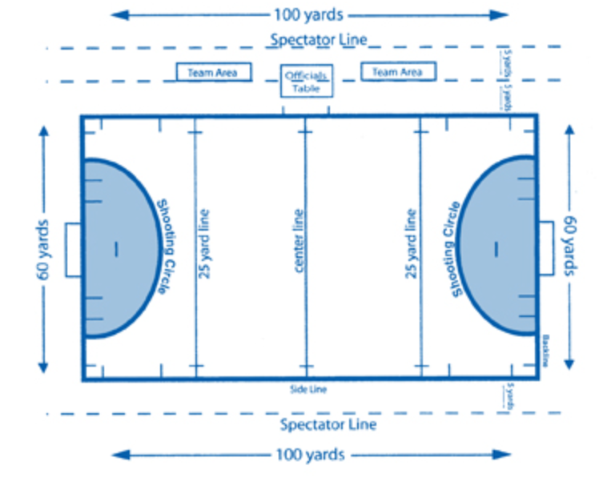
WYFH Coaches & Cocktails 2025
The Basics

Slide 5
WYFH Coaches & Cocktails 2025
The Field
Center Line: The line in the center of the field that divides the field in half, running from sideline to sideline.
25-yard line: The line on both sides of the field 25-yards in from the endline running from one sideline to the other.
Circle: The area of the field surrounding the goal that a player or a player the scorer deflects the ball off of must be in in order to score
Penalty Stroke Line: This is where a penalty stroke is taken from (covered later)
Substitution Area: When someone needs a substitute they must wait until the play is over. In the meantime, the relief player is waiting in the are until they get to sub in. The player coming off must be off the field before the new player can come onto the field.

Slide 6
WYFH Coaches & Cocktails 2025
Wilton System
2 Forwards: play high to stretch the field. Create scoring opportunities.
3 Attacking midfielders: attack the goal and spreading field, creating width. Create scoring opportunities.
2 Defensive midfielders: support attacking mids, move ball outside and up the field, active defenders.
3 Backs: support on attack, get ball back to our team on offense and transfer ball across the field.
1 Goalie: defend the goal; constant communication with teammates

Slide 7
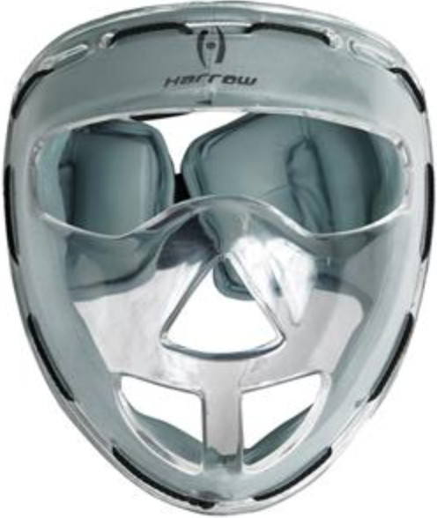
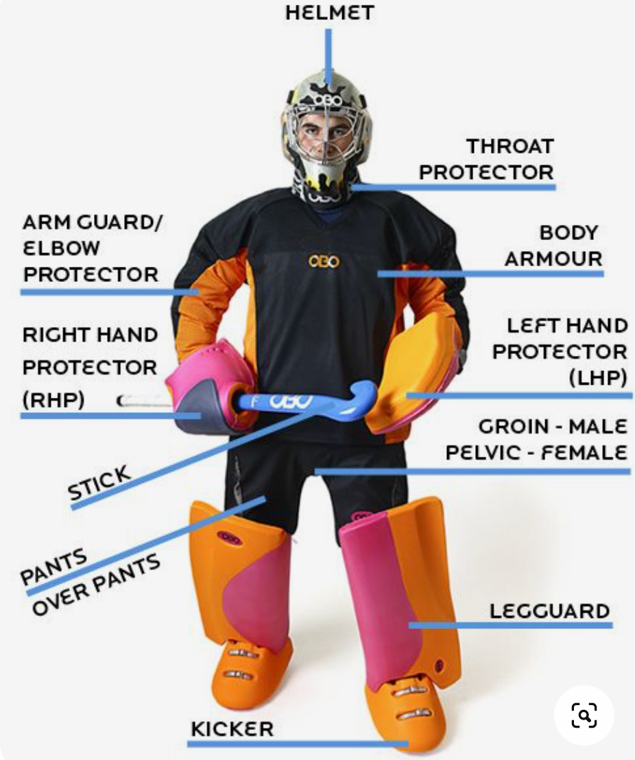
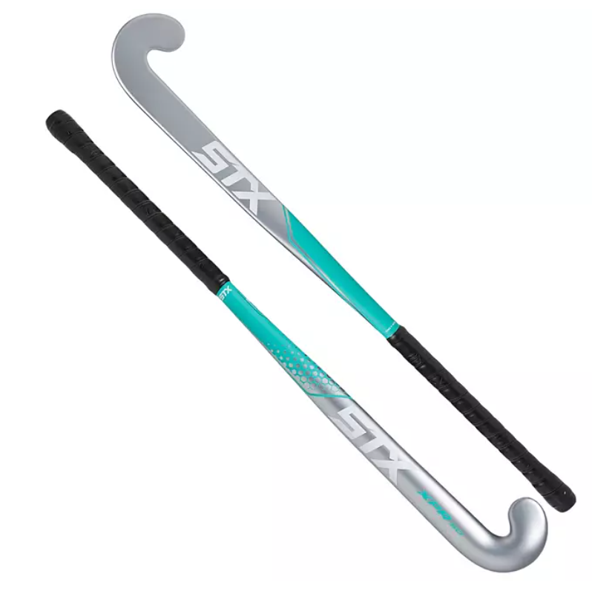
WYFH Coaches & Cocktails 2025
Equipment
Field Player:
Stick
Shin guards
Mouthguard
Corner Masks
Optional: Glove

Slide 8
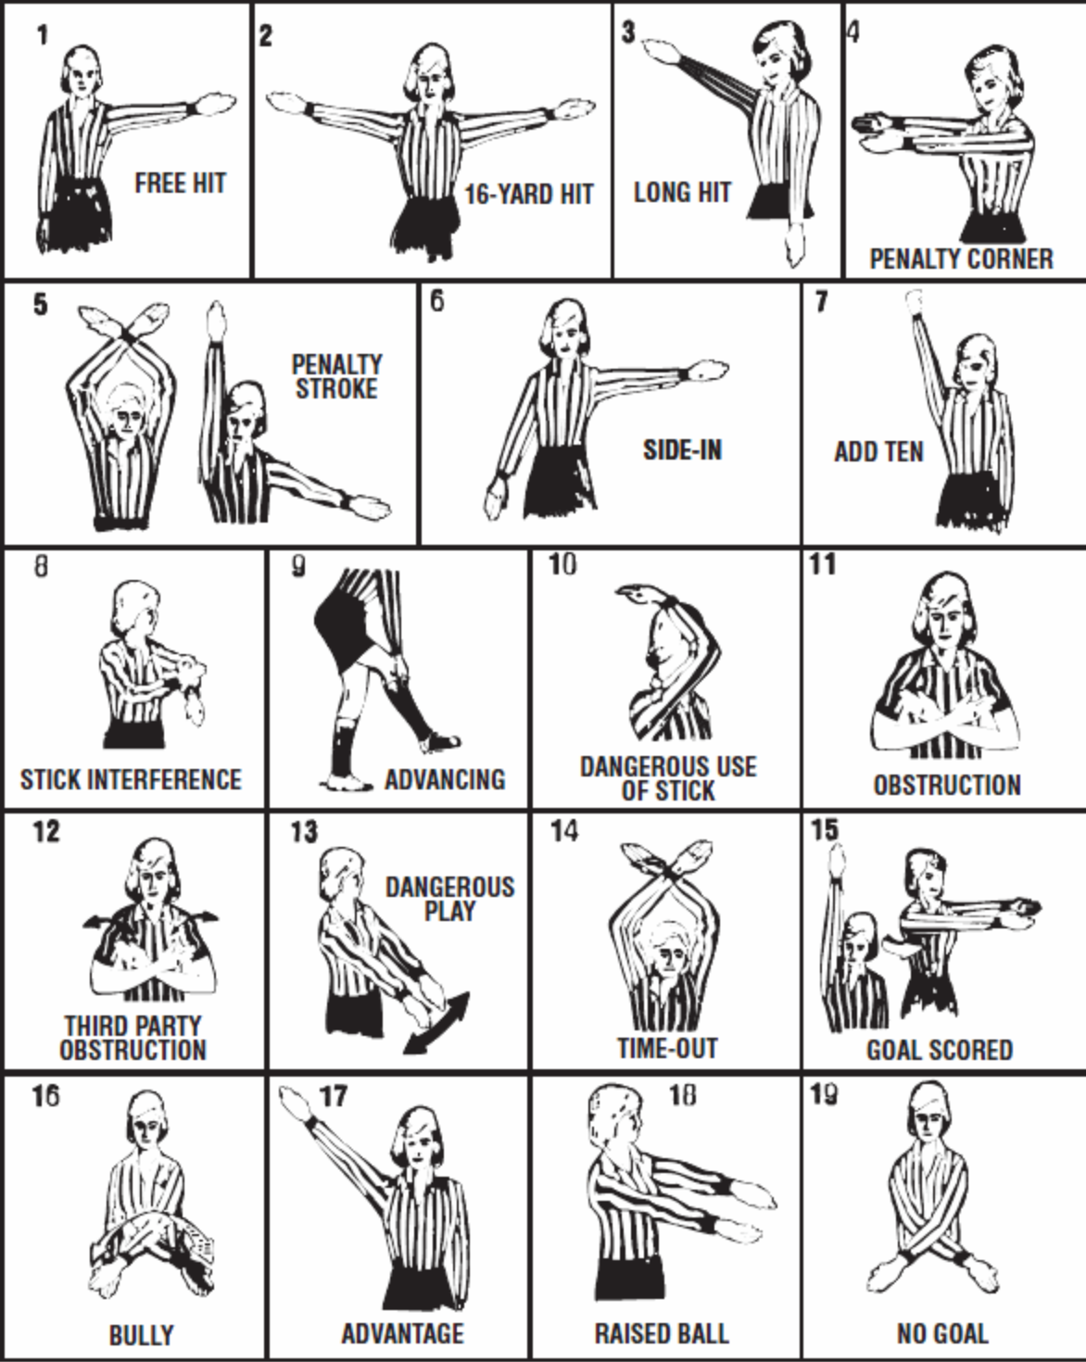
WYFH Coaches & Cocktails 2025
Referee Hand Signals

Slide 9
WYFH Coaches & Cocktails 2025
Positions
There are 11 players on the field for a field hockey game. At younger ages, we play a modified field with 7 v 7 games. Overtime is also 7 v 7.
Positions can include variations of the following:
Forward: spend most of their time between midfield and opponents endline. Typically have the most scoring opportunities.
Midfielders (Attacking mid; Defensive mid): They run the field, playing both offense and defense. Responsible for spreading the field, transitioning the ball from one side of the field to the other and getting the ball to forwards.
Defenders: Primary role is to play defense, clearing the ball out of the defensive zone and transitioning from one side of the field to the other.
Goalie: Prevent the other team from scoring.

Slide 10
WYFH Coaches & Cocktails 2025
Basic Rules
Players can only use flat side of their stick to play the ball
All goals must be scored inside the team’s offensive circle
Players can self start the ball after a whistle. This means they can dribble to restart action. They can also pass the ball.
After an penalty by your team, players must get back 5 yards from the restart, or cannot play the ball until it has moved 5 yards.

Slide 11
WYFH Coaches & Cocktails 2025
Common Fouls
Using the stick in an intimidating or uncontrolled manner, which can result in dangerous play.
Stick interference.The player should attempt to play the ball -- not hit, hook, hold, or interfere with an opponent’s stick.
Undercutting, or raising the ball dangerously.
Charging, pushing, tripping, or personally handling an opponent.
Deliberately hitting the ball into an opponent.
Hacking (aka stick obstruction): Hitting the opponent’s stick instead of the ball

Slide 12
WYFH Coaches & Cocktails 2025
Common Fouls
Advancing A foul in which a player pushes, shoves, or advances the ball in anyway, using their body, hands, or feet rather than their stick. Note: the goalkeeper may stop the ball with her body.
No feet Field players may not play the ball with their feet. If the ball accidentally hits the feet and the player gains no benefit from the contact, then the contact is usually not penalized.
Play without a stick.
Green, Yellow and Red Cards: Cards are used for misconduct violations.
Green is used for warnings. You are removed for 2 minutes.
Yellow is used to remove a player from the game for 5 to 10 minutes.
Red ejects the player from the game and the following game.

Slide 13
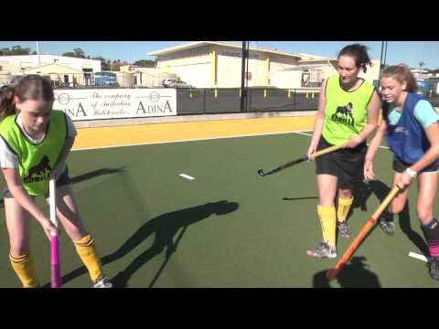
WYFH Coaches & Cocktails 2025
Common Fouls: Third Party
Third Party:
Players must not obstruct an opponent who is attempting to play the ball. A player who runs in front of or blocks an opponent to stop them legitimately playing or attempting to play the ball is obstructing (this is third party or shadow obstruction)

Slide 14
WYFH Coaches & Cocktails 2025
Penalty Corner (Short Corner)
When the defending team fouls in the circle, or if the defenders send the ball over the end line intentionally, a penalty corner will be awarded to the attacking team. A corner can also be awarded for fouls inside the 25 at the referee’s discretion.
Five defenders (including goalkeeper) shall be behind their backline. Defenders often line up in the goal cage but are not required to. The rest of the defending team shall be behind the centerline (50 yard line).
One member of the attacking team shall insert the ball from a spot on the end line 10 yards from the goal post with at least one foot completely outside of the field of play. The rest of the attack must be outside the shooting circle until the ball is inserted. The ball must leave the circle before a shot is taken. If the initial shot on goal is a hit, the ball go higher than 18 inches (which is the height of the board in the back of the goal). After the initial shot, the attacking team may flick the ball towards the goal in a controlled manner. If the first shot is a drag flick, then the ball can cross the goal line at any height, as long as it is not a dangerous play.
If time expires as a penalty corner is in progress, it gets played to completion (goal scored, ball is played over the endline and another penalty corner is not awarded, defending team is awarded a free hit, or the ball travels more than 5 metres outside the circle.)

Slide 15
WYFH Coaches & Cocktails 2025
WHS Alumni:
Where they Play(ed) in College
Current WHS players committed to the process:
Clara Fielden, Davidson
Current WHS Alumni playing in college:
Mary Sylvester, Bucknell
Bridget Grosso, Trinity
Natasha Ring, Bryn Mawr
Hannah Fitzgerald, Franklin & Marshall
Riley Fitzgerald, Georgetown
Charlotte Casiraghi, Harvard
Nola Ryder, Lehigh
Sampling of Colleges Alumni have played for:
University of North Carolina
Syracuse
University of Richmond
Dartmouth
Gettysburg
Colby
Colgate
Dickinson
UPenn
Drexel
Brown
Boston College
Boston University

Slide 16
WYFH Coaches & Cocktails 2025
Additional Resources
USA Field Hockey / Field Hockey 101
USA Field Hockey / Field Hockey Facts
NFHCA New Coaches Toolkit
USFHA ADM Model WYFH uses the ADM Model at the youngest levels
How to Play Field Hockey for Beginners (Part 1)
How to Play Field Hockey for Beginners (Part 2)
How to Play Field Hockey for Beginners (Part 3)

