Slide 1

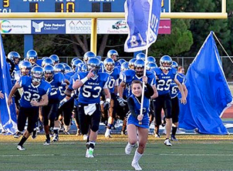
DAVIS JUNIOR BLUE DEVIL FOOTBALL & CHEER
FAMILY INFORMATION NIGHT

Slide 2
Meet our Board of Directors!
President: Chris Williams Williams.chris07@gmail.com
VP: Nina Nero nynero83@hotmail.com
Treasurer: OPEN (contact Paul Hasson paul.hasson@yahoo.com)
Equipment: OPEN
Snack Shack: Amanda Millican mandymilli08@icloud.com
Registrar, Secretary & Volunteering: Kassandra (KC) Salas Ksalas_17@yahoo.com
Coach Liaison: Gregg Herrington Gregg@yackzangroup.com
Fundraising / Boosters : Lisa Herrington lherrington@gmail.com
Cheer & Events Coordinator: Chelsea Treseder Chelseatreseder@gmail.com
Want to get involved? Chat with any of our board members for more information. We need you!

Slide 3
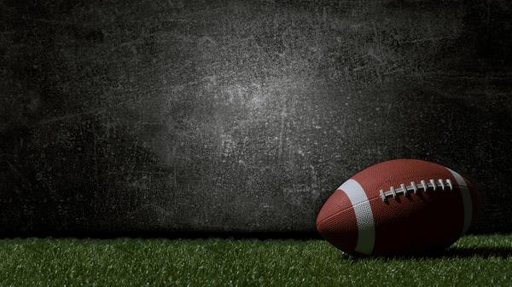
Davis Tackle Football 2025
The Davis Jr. Blue Devils (DJBD) football program is dedicated to the athletic and academic development of our student athletes through teaching the fundamentals of football. We promote character building, self-discipline, honor, integrity and sportsmanship towards our teammates, the Davis community and our fellow competitors. We work closely with and are the direct feeder program to Davis High School football.
COMMIT COMPETE COMPLETE

Slide 4

3 Divisions make up our DJBD Family:
PeeWees (9 & Under)
Jr. Midgets (11 & under)
Midgets (13 & under and/or 8th Grade Age as of July 1st, 2025 *)
(monitored weekly): Age & weight Exceptions
Older lighter 5 per team
  Midgets 13u (14 y/o 9th grader): 135 lb & under
  Jr. Midgets 11u (or age 12): 110 lb & under
  PeeWees 9u (or age 10): 85 lb & under
x-men: 5 per team
  Midgets – 185 lbs
  Jr Midgets – 160 lbs
  Pee Wee -135lbs

Slide 5
COACHING STAFF 2025
9u: Head Coach Kenny Chiccoine (“sha-quin”)
    Assistant Coach: Gregg Herrington
11u: Head Coach Chris Williams
    Assistant coach Cal Incendy
13u: Head Coach Ross Schnitzler
    Assistant Coach Ryan McMillan
DJBD Safety Plan
  Coaches Clinics / USA Heads up training course
  Shift in practice philosophy
  Increase use of tackling / blocking bags / Shadowman / tubes
  Yearly helmet recertification, Continuous new helmet purchase
    Want to purchase own helmet? $400 – please See Chris Williams
  Need Asst. coaches at all levels, 1:5 ratio. Yes, you can do this. We’ll help train you.

Slide 6
DATES TO REMEMBER
Games time are Generally:
Peewee 10am
Jr Midgets 12pm
Midgets 2pm (TBD depending on the team*)
ISAC:
Woodland Christian
Dixon
Vacaville Christian
Arbuckle
Esparto
East Nicolaus
Davis
Rio Vista
Winters
Williams (New)
Davis home games are typically: 10am, 12pm, 2pm (if no MM team)
Equipment Distribution #1 Sunday July 27th
  9u: 10am , 11u: 11am, 13u: 12pm
  Davis Mini Storage
  975 Olive Drive ste B, Davis CA
Equipment Distribution #2 Sunday August 3rd
  6pm – Same location
Fall FREE Football Camp : TBD
Fall Practices Commence 8/4 Mon – Friday 5-7pm
When school starts: Tues – Thurs practices
2025 Jamboree @ East Nic 8/23 Schedule TBD

Slide 7

2025 SEASON SCHEDULE
8/23 – Jamboree @ East Nicolas
9/6- Arbuckle @ Davis
9/13- Winters @ Davis
9/20- Davis @ Williams
9/27 – Davis @ Woodland Christian
10/4- Vacaville Christian @ Davis
10/11- Davis @ Esparto
10/18- Dixon @ Davis
10/25- Rio Vista @ Davis
11/1- Davis @ East Nic
11/8 *Playoffs*
11/15 *Superbowl*

Slide 8
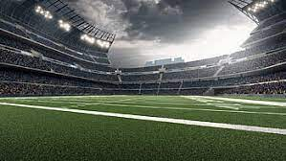
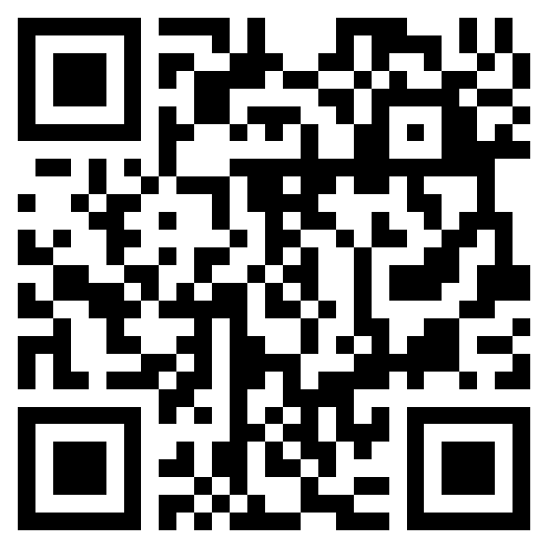
REGISTRATION
* Regular: April 16 th - June 15th : $225.00
* Late: June 16th – Jamboree, $300.00
* Payment Plans Available (Initial payment of $75.00 then 3 equal payments May 15, June 15, July 15
Includes all equipment rental (except cleats and mouthguard)
***Players can keep their personalized jerseys***

Slide 9
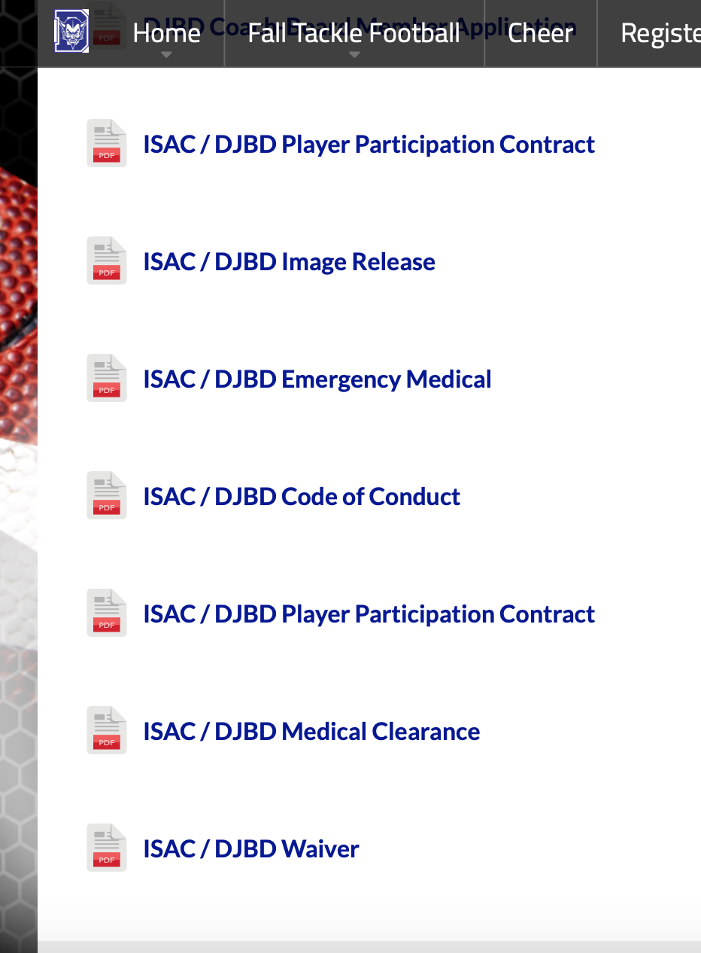
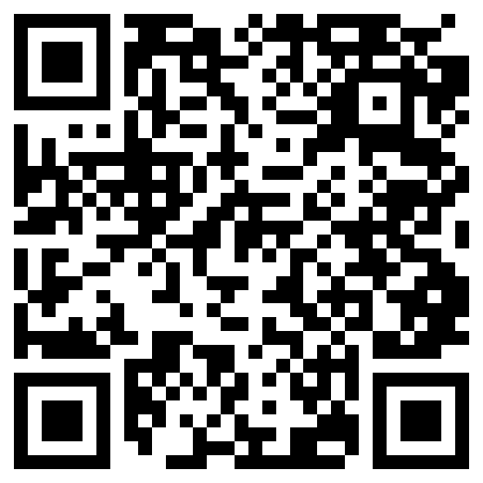
REQUIREMENTS:
1. Register player / coach www.juniorbluedevils.com
2. ISAC Code of Conduct
3. ISAC Waiver
4. Proof of age (birth certificate ONLY)
5. ISAC Physical after 1/1/ 25: Signed, dated and stamped
6. ISAC Photo Release
7.Participation contract
Tackle Forms Page

Slide 10

June 7th 8am – 11am walk-ins $20 donation
Please arrive early as it will get busy!

Slide 11
EQUIPMENT
What Does Jr. Blue Devils provide?
Helmet w/ chin strap
Shoulder Pads
Pants
Jersey
Sports Bag
What are families responsible for?
Cleats
Socks
Mouthguard
Gloves (Optional)
Returning all equipment: Last game (hopefully at the superbowl)
Helmet Information
Reconditioning
  Reconditioning includes taking the helmets completely apart, inspecting them, cleaning them, and putting them back together after replacing any parts that are needed.
If you would like to buy your own new helmet:
  contact Chris Williams
  $400
  DJBD will buy it back for ½ price when athlete ages out of program.

Slide 12
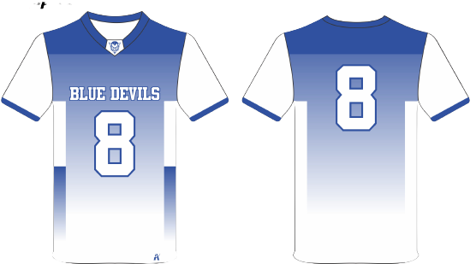
EQUIPMENT DISTRIBUTION
Equipment Distribution
Families meet at storage facility to pick up equipment, confirm sizing, player card picture
Players will receive Bags, Helmets, Pants, Shoulder Pads
Jerseys will available at a later date
We need 3-4 parents to help with sizing and the distribution of equipment
Equipment Distribution #1 Sunday July 27th
  9u: 10am , 11u: 11am, 13u: 12pm
  Davis Mini Storage
  975 Olive Drive ste B, Davis CA
Equipment Distribution #2 Sunday August 3rd
  6pm – Same location
Reminder: No paperwork, No equipment. Not registered, no equipment.

Slide 13
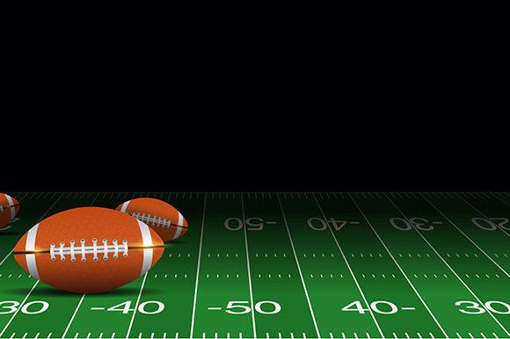
VOLUNTEERING!
Volunteer Coordinator Kassandra (KC Salas)
Ksalas_17@yahoo.com 5303123123
- DJBD is run by ALL Volunteers as a Non –Profit Organization
6 Hours of MANDATORY Volunteer hour ( 3: 2 hour shifts) 2 hours completed by week 5.
Volunteer Jobs : -------→
We use DIBS for volunteer sign ups! (Examples on next slide)
Our organization depends on everyone working together
Gate / Tickets
Field Set Up
Shack Shack
Field Closers
Score Board
Announcer
MPR
Chain Crew
Videographers
Weigh Master
Field Monitor (Home Games)

Slide 14
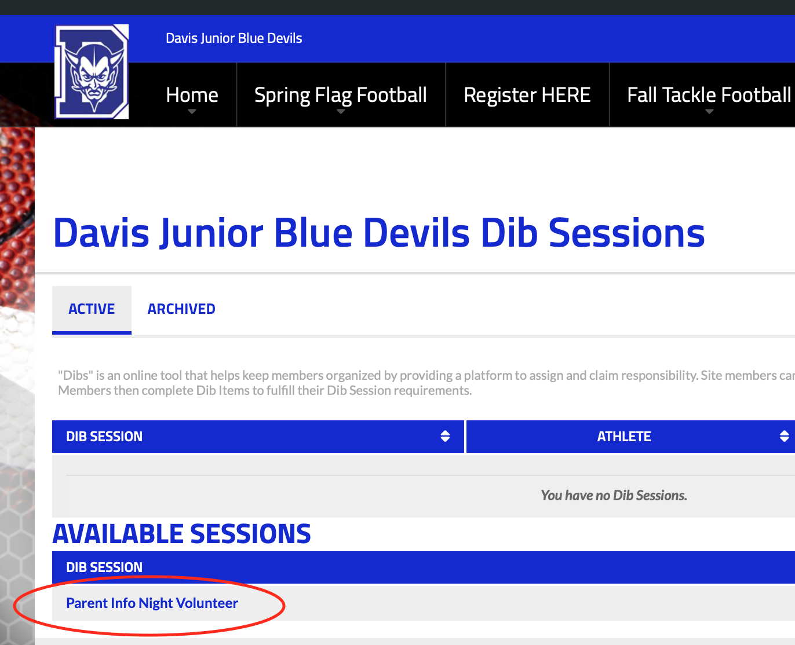
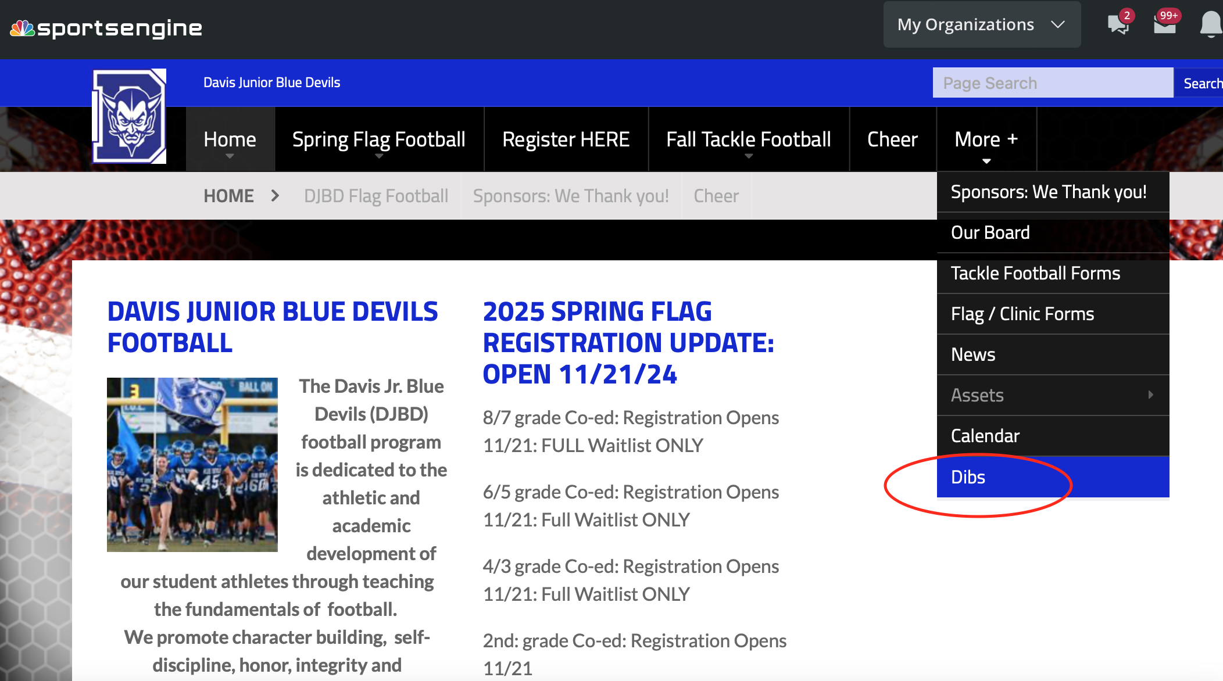
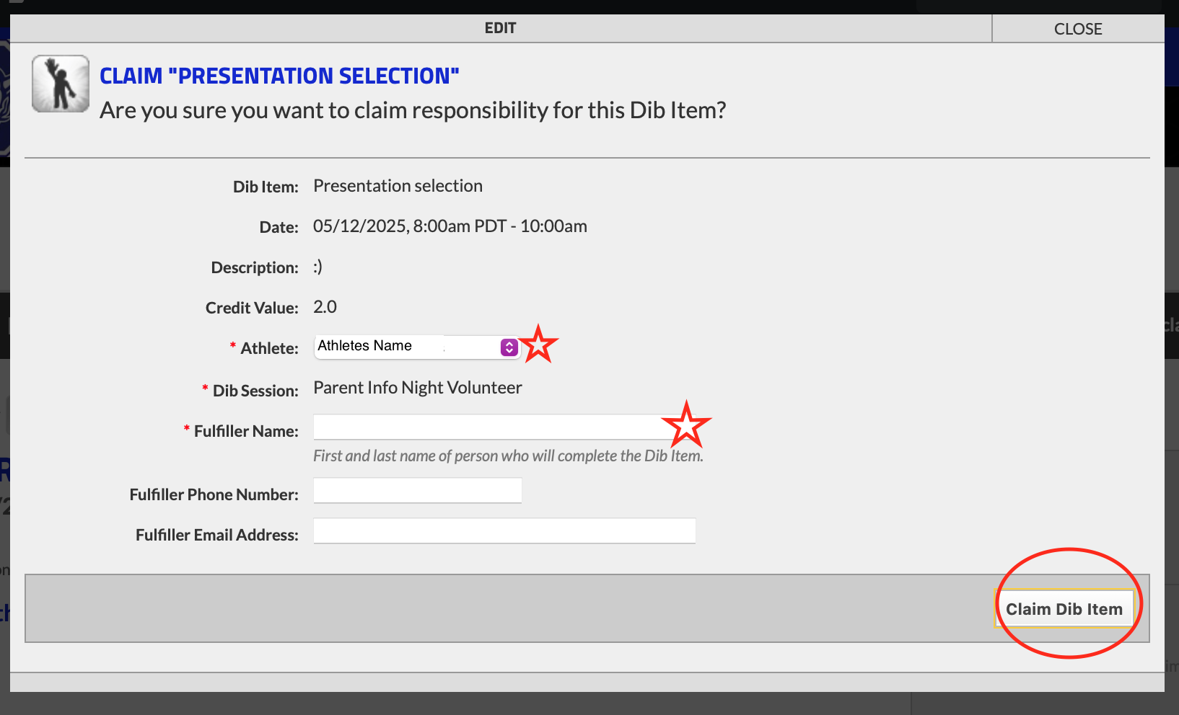
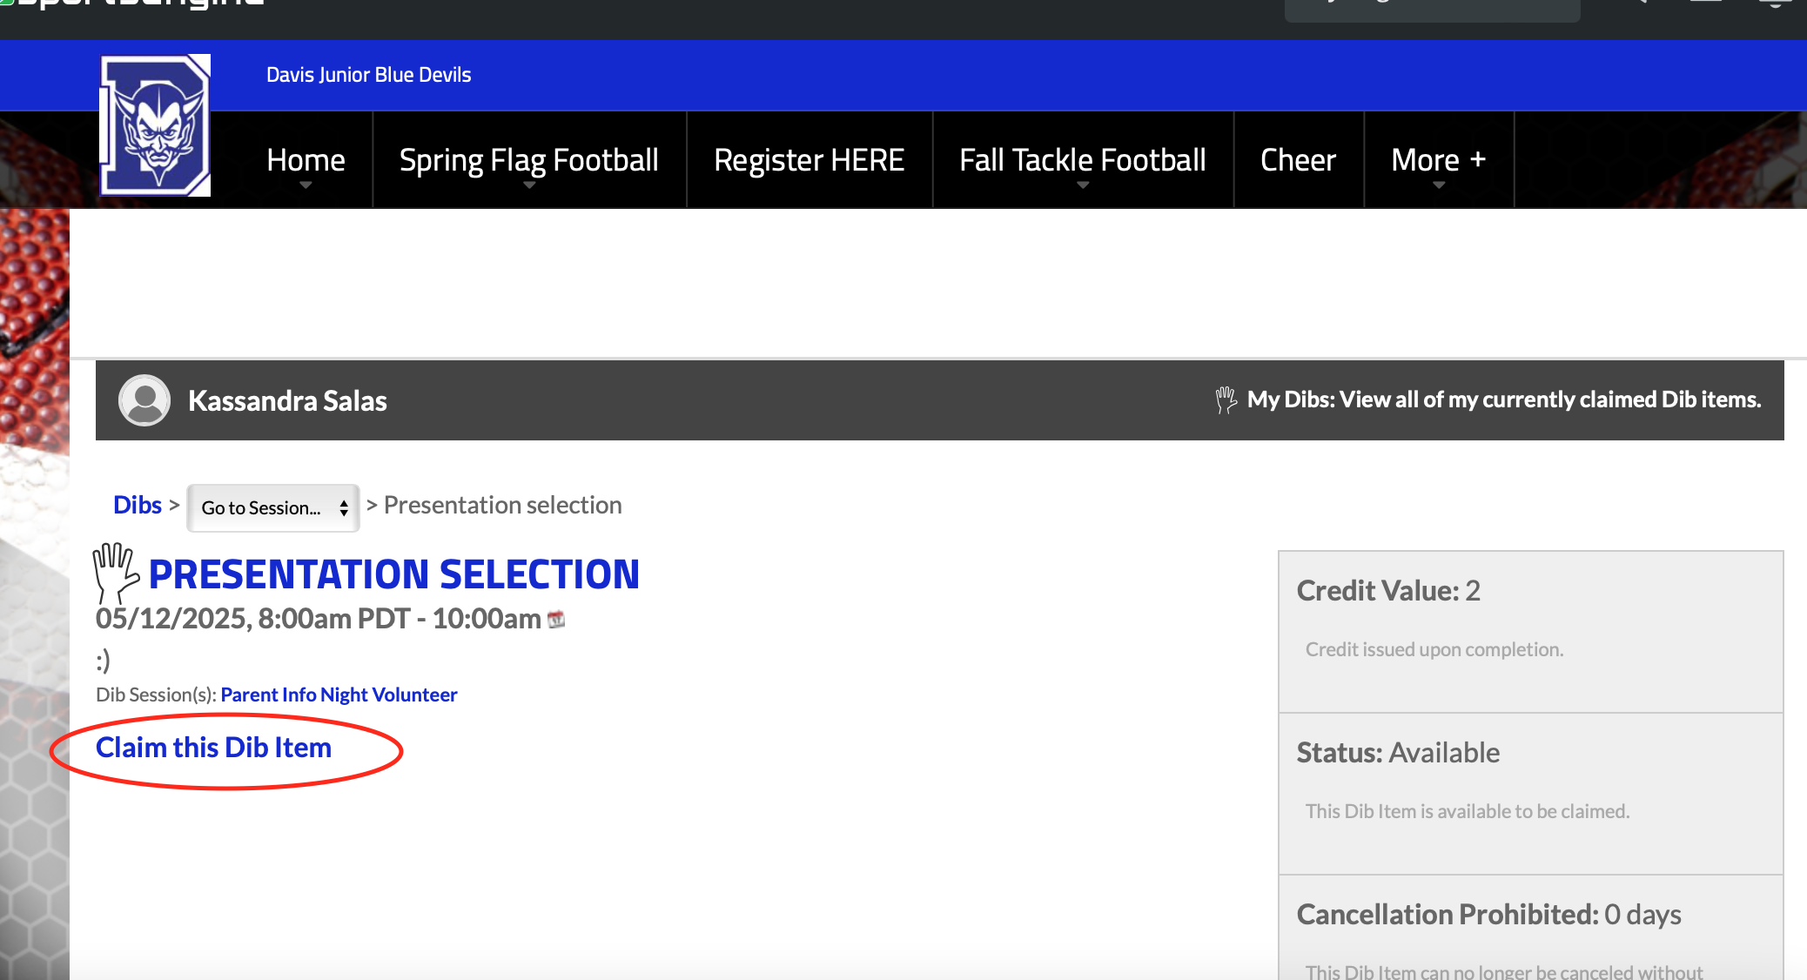
3
1
4
2

Slide 15
QUESTIONS?
LET’S GO BLUE DEVILS!!
Don’t forget to register here!

