Slide 1
December 2023 Booster Club Meeting

Slide 2

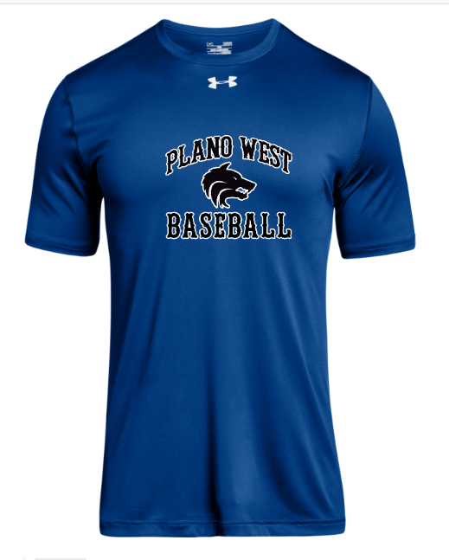
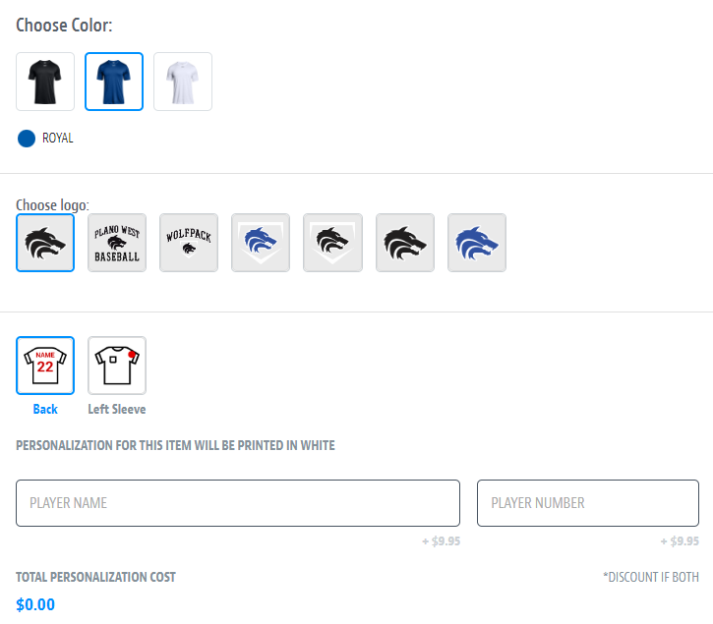
Spirit Wear – powered by SQUADLOCKER
aaaaa

Slide 3
Agenda
Approve October Meeting Minutes
Treasurer Report – Stephanie Dubner
Fall Recap
Ballpark Upgrades
Sponsors
Spring Calendar
Committees
Coach’s Corner

Slide 4
Booster Club Votes
Approve October 2023 Meeting Minutes
JOIN THE BOOSTER CLUB
  26 members (we had 37 member families in 2022-2023 school year)
  $5,150 in membership dues! ($500 increase from prior meeting)
www.planowestbaseball.org/join

Slide 5
Treasurer’s Report: December 2023
  $29,502.26
Beginning Balance as of 10/14/23:
Revenue
Booster Club Memberships
Poinsettia Sales
"Buy A Date" Calendar Fundraiser
Total Revenue:
Expense
Poinsettias
New Baseball Duffle Bags, Baseballs
New White Nike Home Uniforms
Total Expense:
$482.00
$4,221.62
$2,037.33
$6,740.95
$1,731.13
$1,982.92
$2,380.00
$6,094.05
Ending Balance as of 12/10/23:
$30,149.16*
*Includes $404.23 of PY uncashed reimbursement checks written to PWBBC members

Slide 6
Fall Baseball Recap
Pack @ the Park
5 / 6 Fall Ball Games
Fundraising
  Pick-a-day Fundraiser ($3,884 raised)
  Poinsettia Fundraiser Sales ($2,490 raised)
  Spirit Night at Raising Canes
Baseball field under construction!

Slide 7
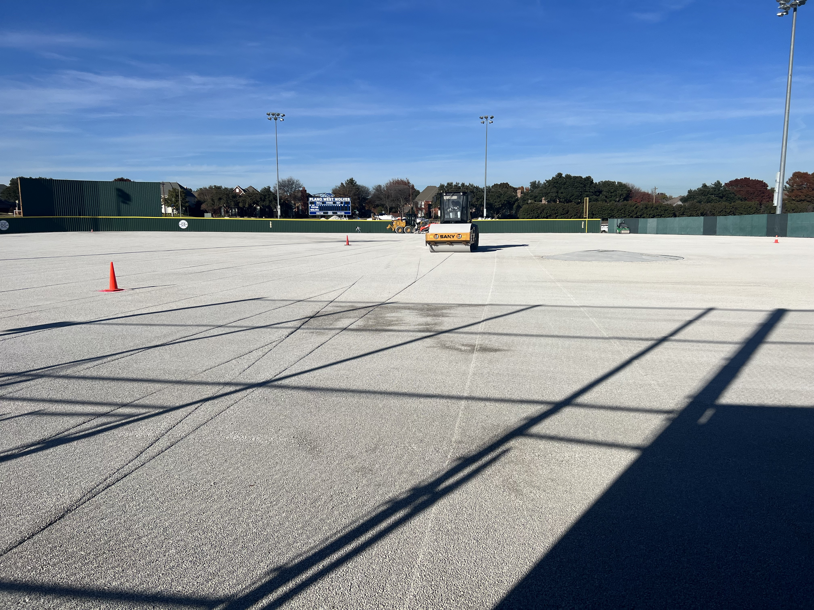
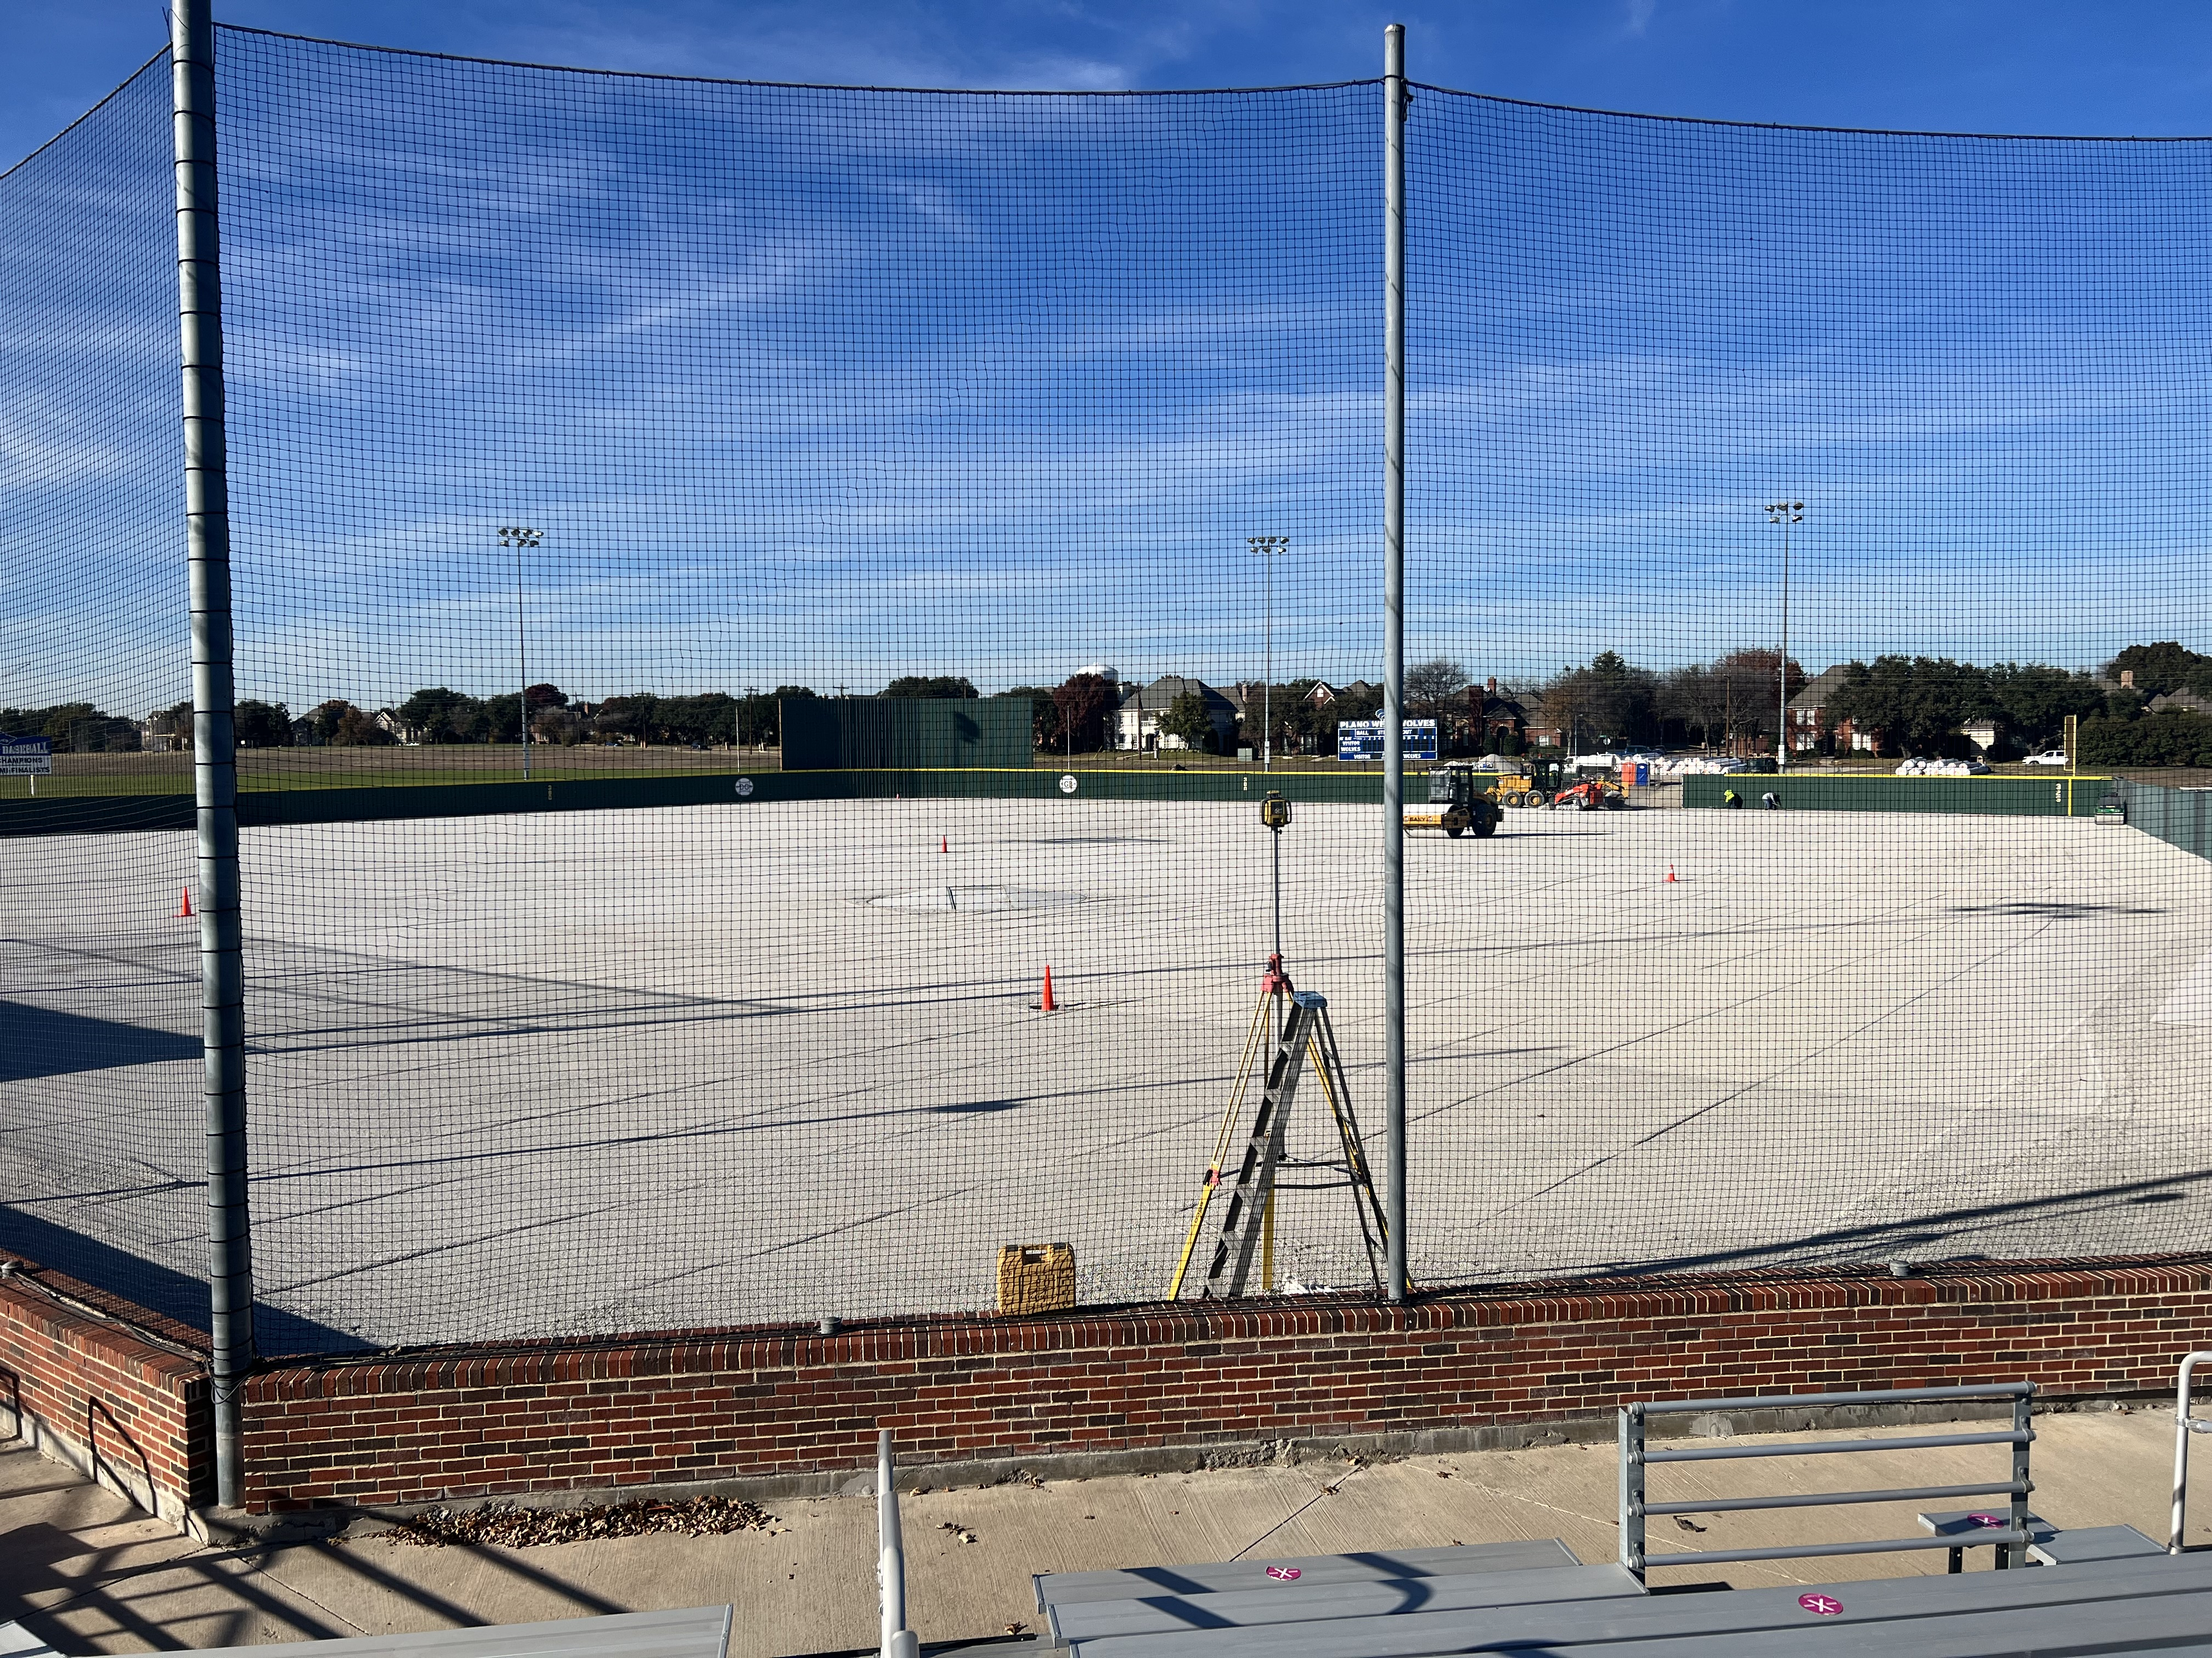
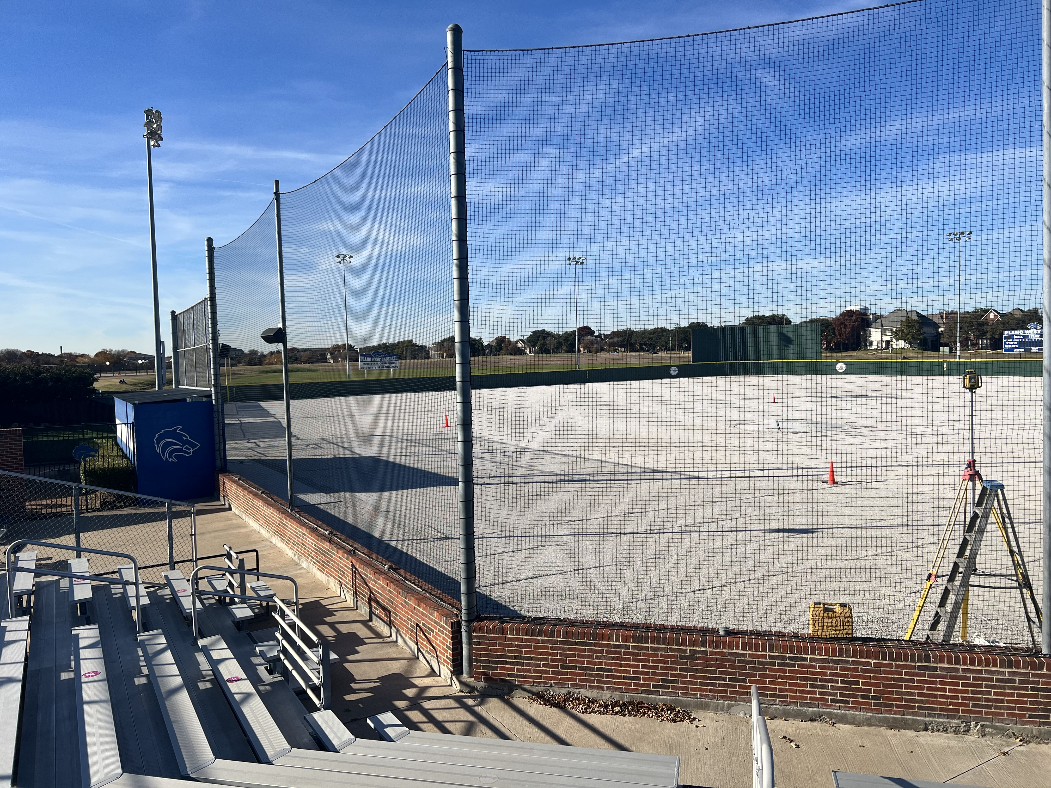
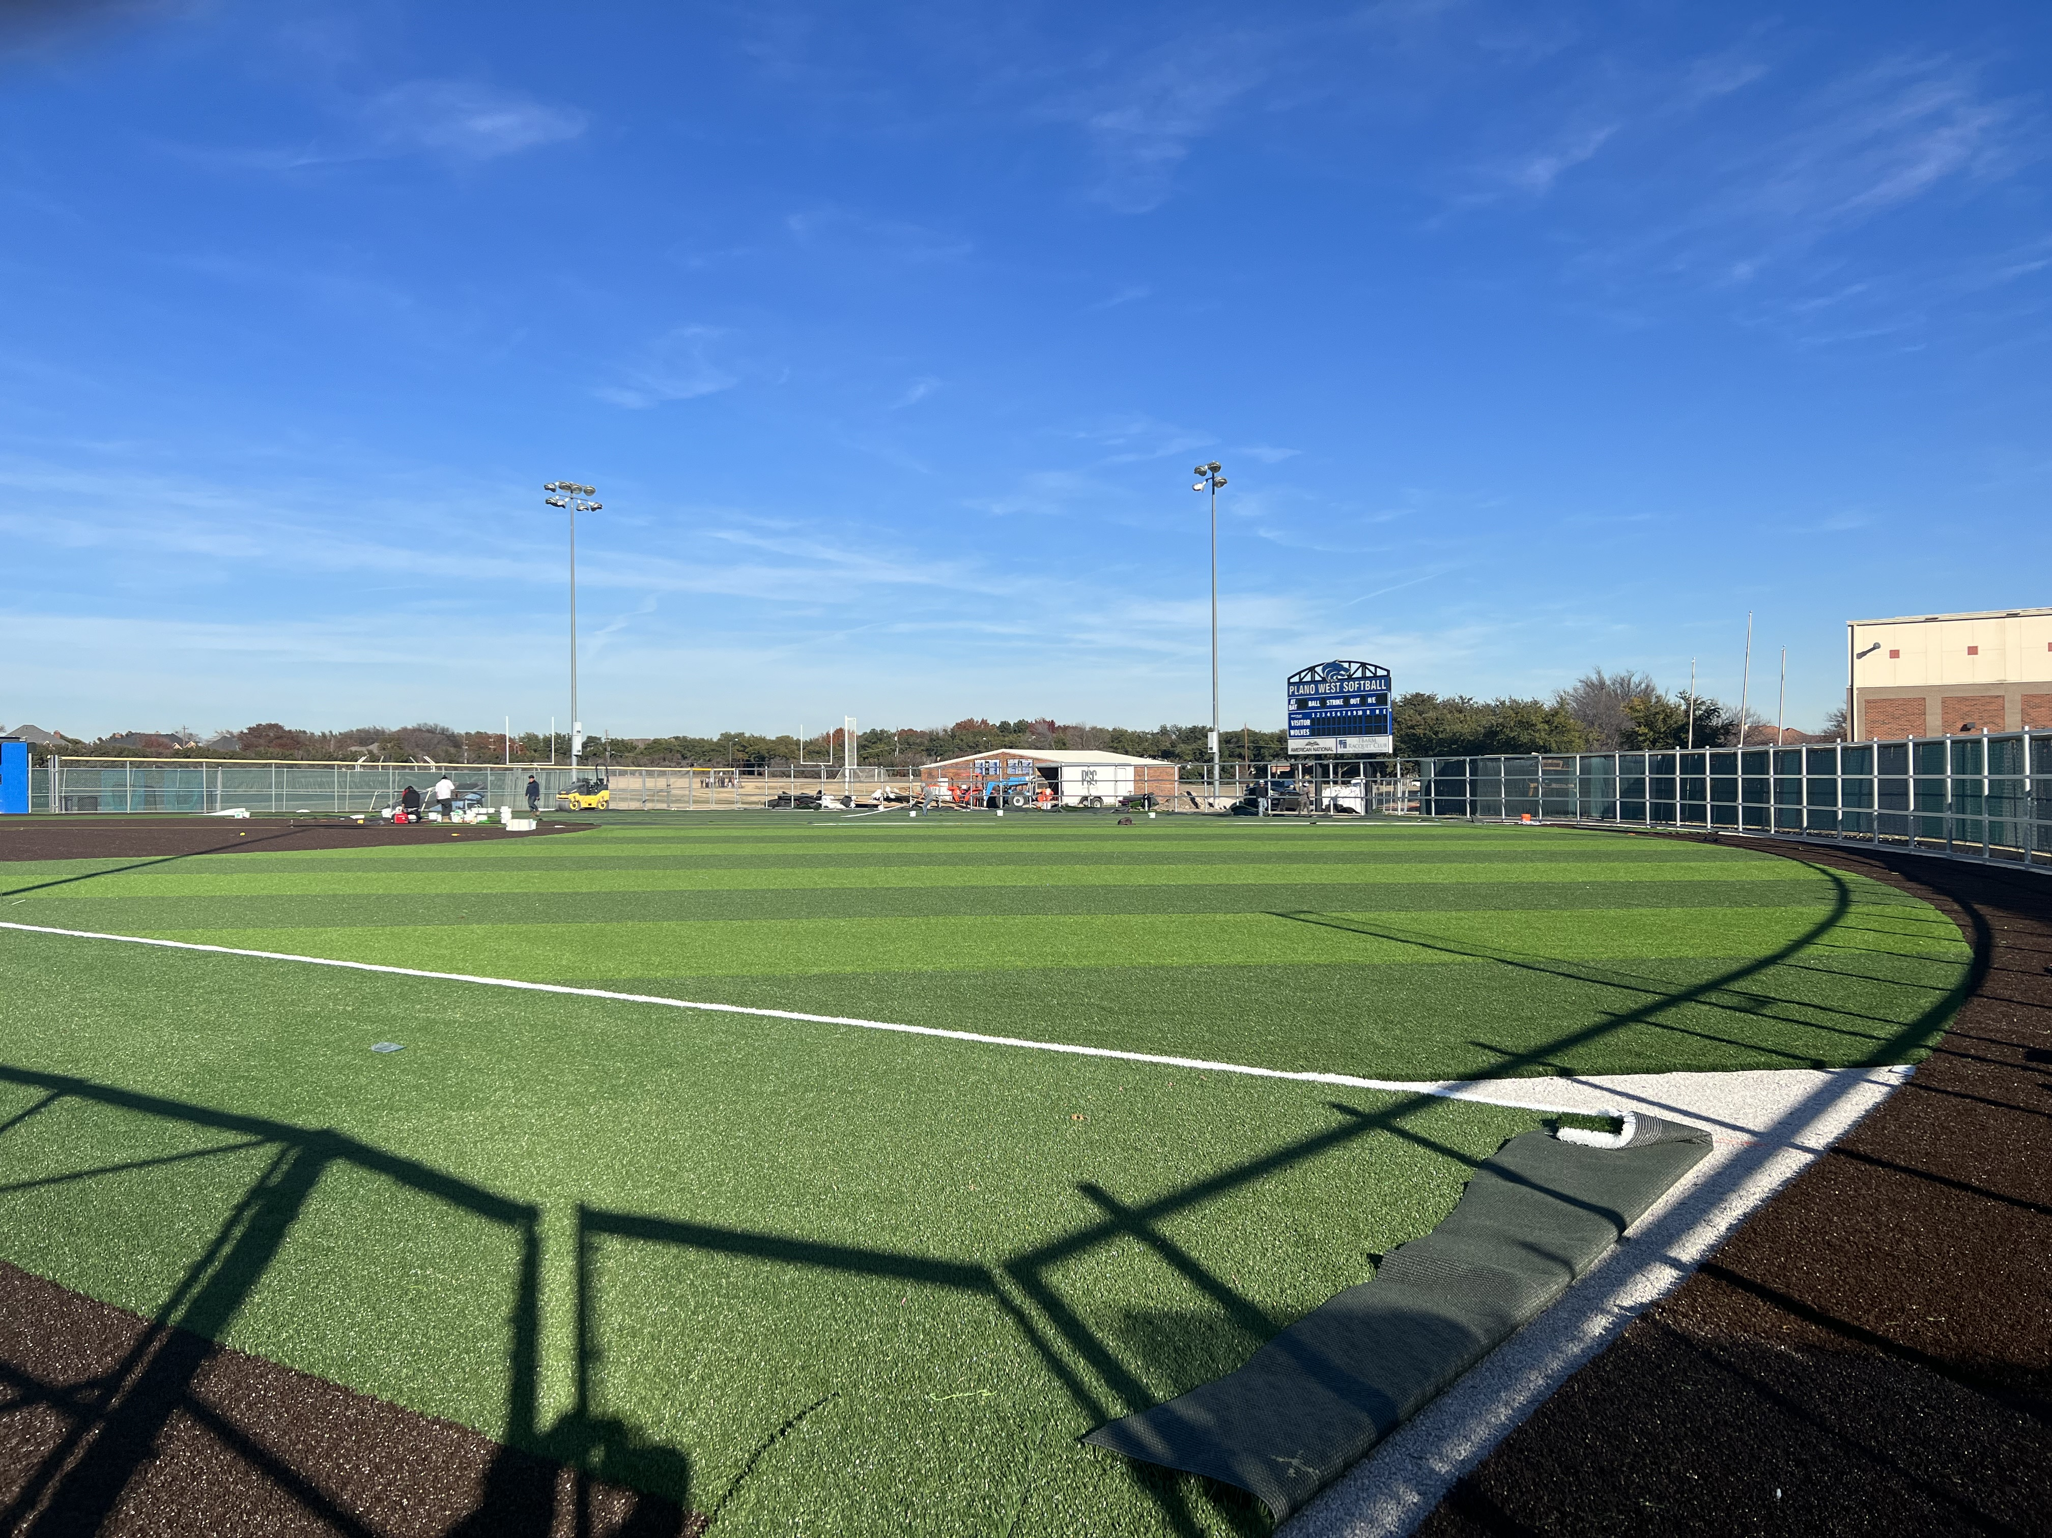
Ballpark Turf
Softball Field

Slide 8
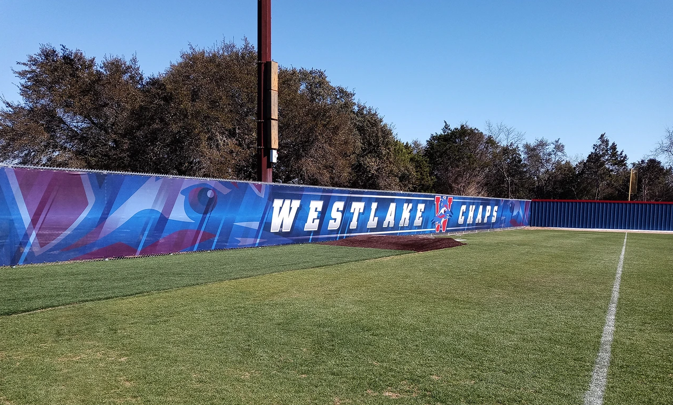
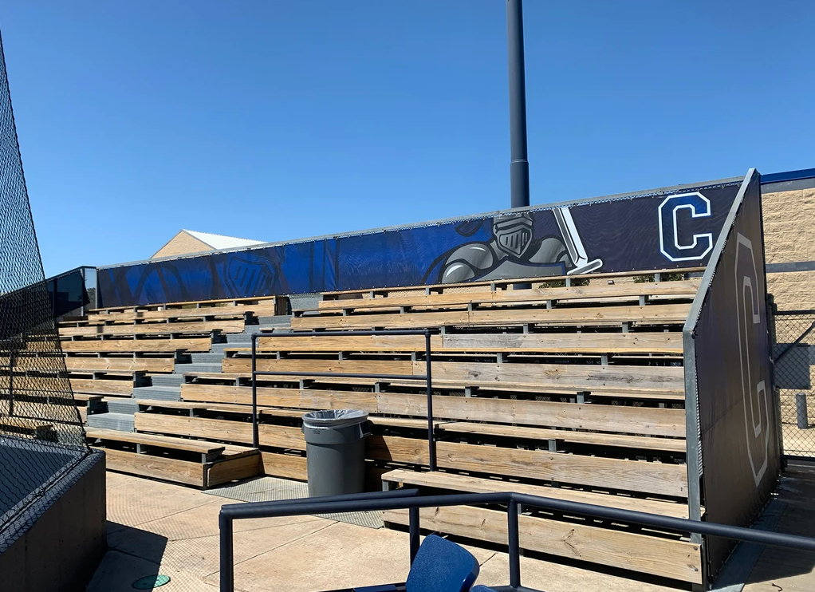
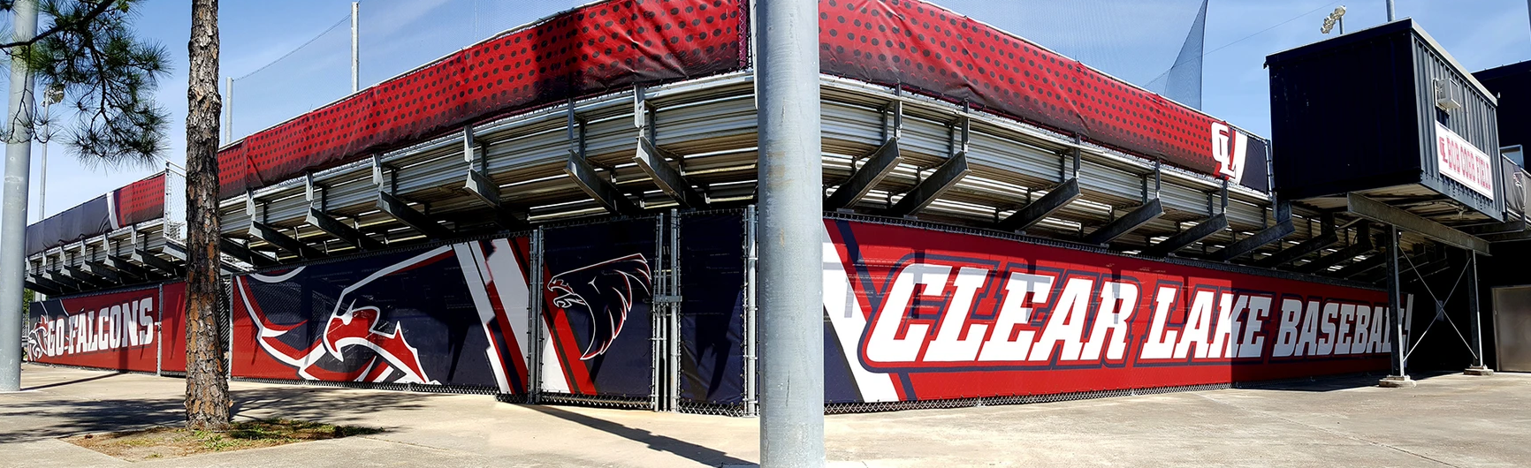

Ballpark Branding Upgrades

Slide 9
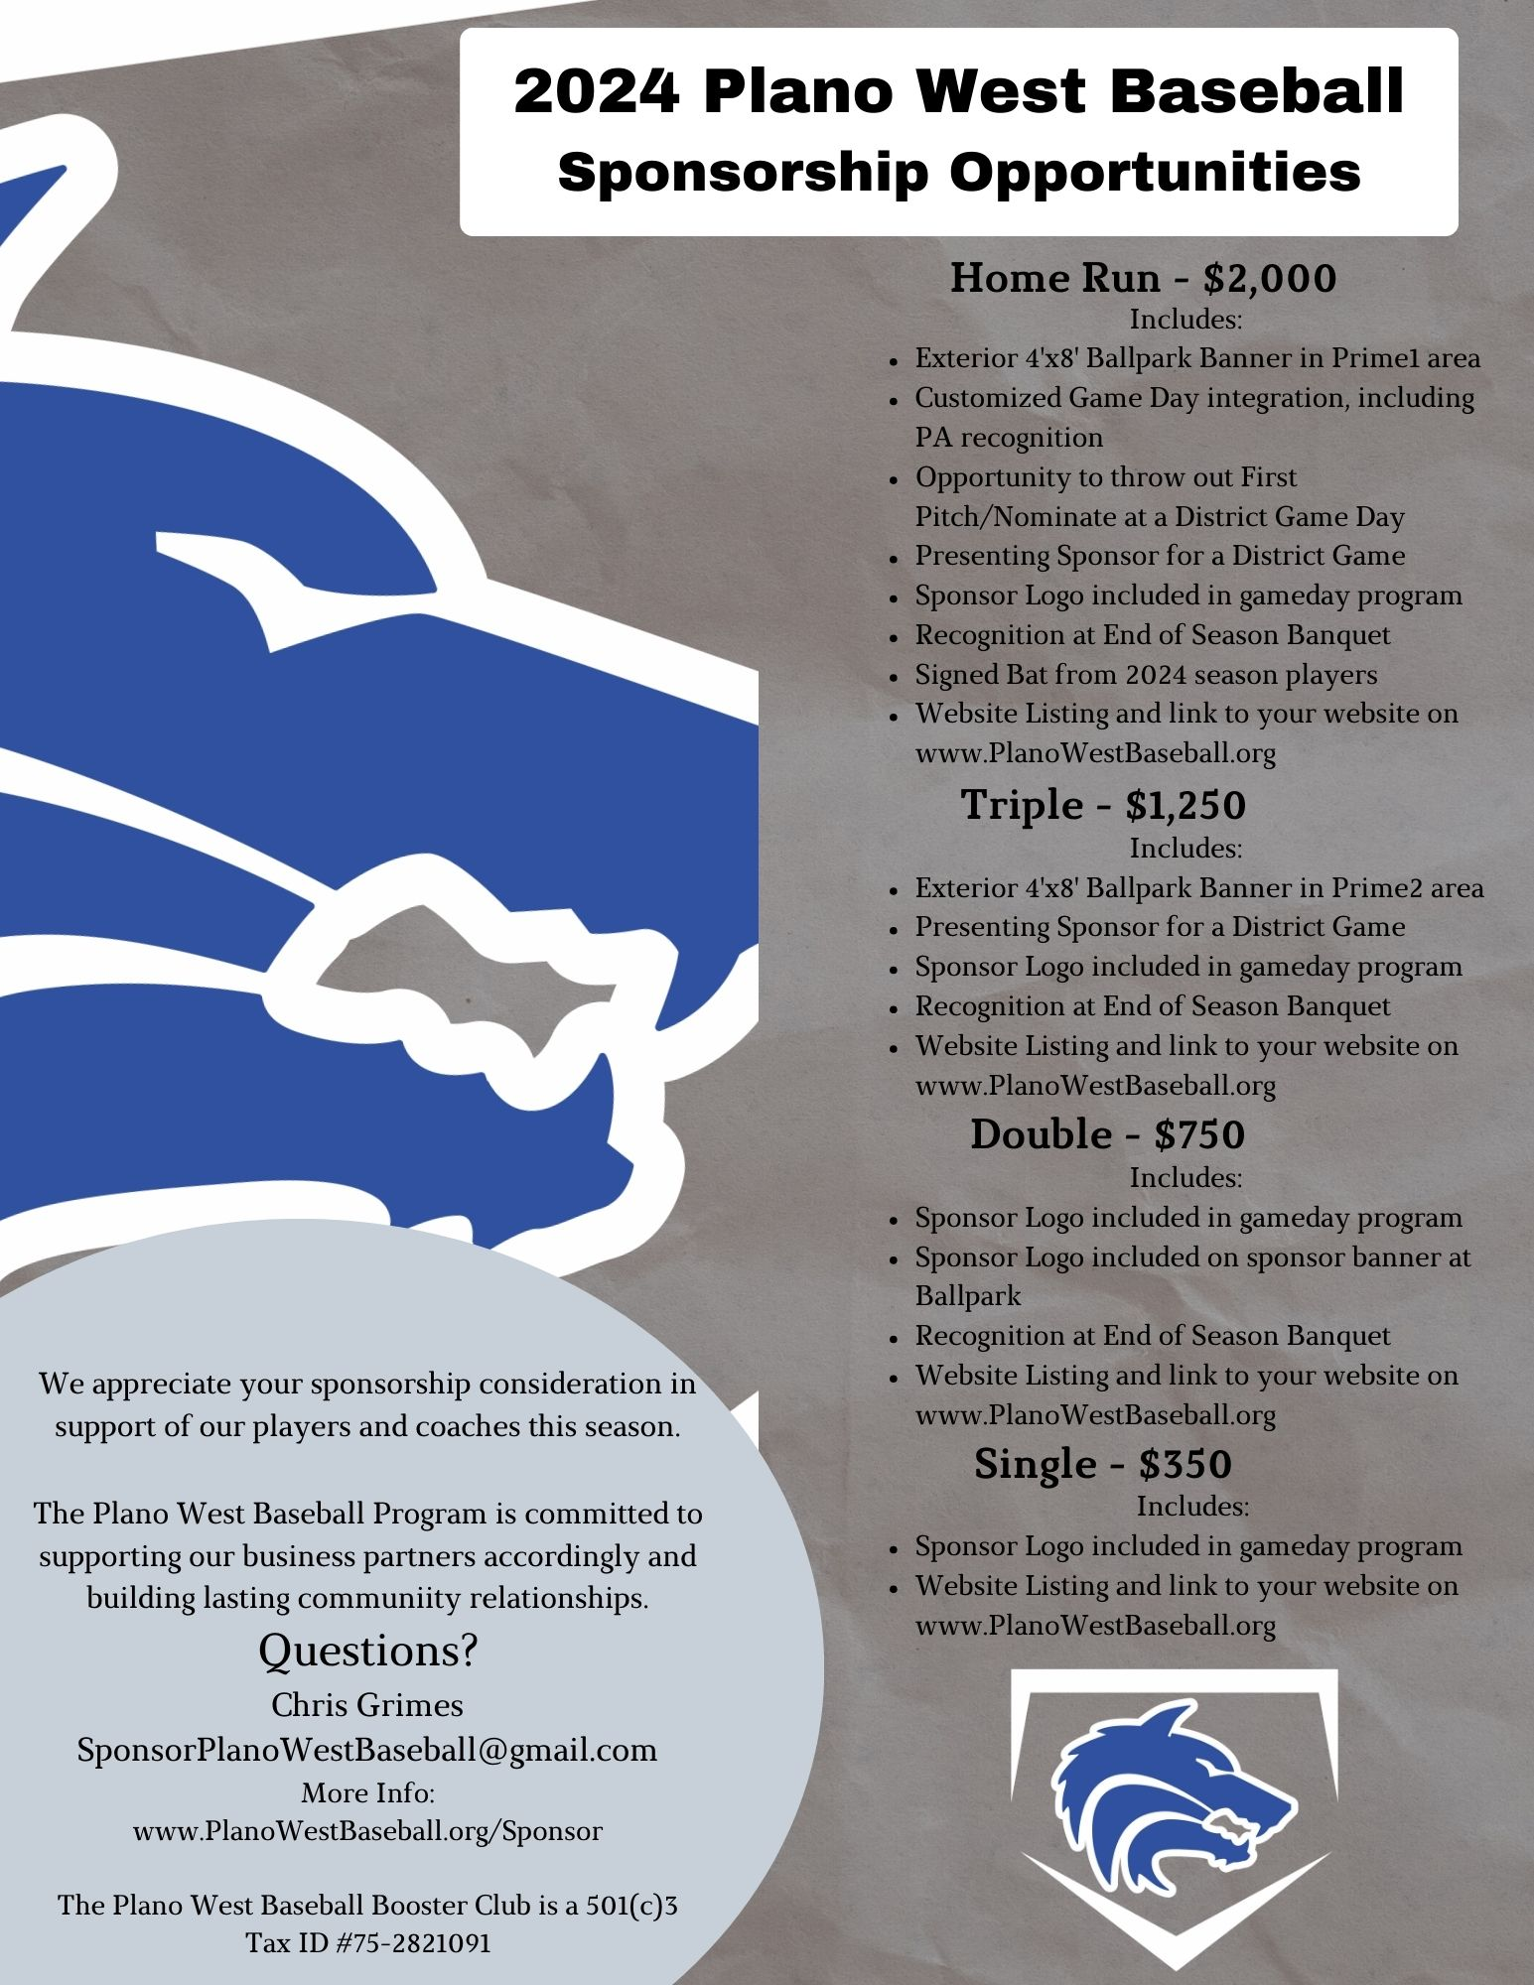
Sponsorships
Sponsor Day Sat – 1/20 @ 12:00
  Should last 1.5 - 2 Hours
Sponsorship Committee
  2-3 Volunteers needed for contacting potential sponsors
Sponsorship Ideas from Parents
  Restaurants, Gyms, Ins. Agents, Car Dealers, PSA, Realtors, Baseball Clubs
Team Picture/Calendar
  Leave behind or give to sponsors as soon as possible after Media Day

Slide 10
Spring Calendar
Sat – 1/13: Field Work Day @ 9:00 AM
Fri – 1/19: Blue / White Scrimmage @ 4:30 PM
Sat – 1/20: Non-Baseball Class Tryouts
Sat – 1/20: Field Work Day @ 9:00 AM ; Sponsor Saturday @ Noon
Sat – 1/27: Media Day (Families Invited) @ 9:00 AM
Sat – 1/27: Packfunding Kickoff
Sat – 2/3: Scrimmages Begin
Wed – 2/21: 1st Pitch Dinner @ 6:30 PM (players wear jeans & jersey)
Thur – 2/22: Season Begins (tournaments all 3 teams)
Wed – 3/13: District Games begin w/ Varsity hosting Plano Senior High
Fri – May 3: Playoffs Begin
Sun – May 5: Baseball Banquet (Collin College – Frisco Campus)

Slide 11
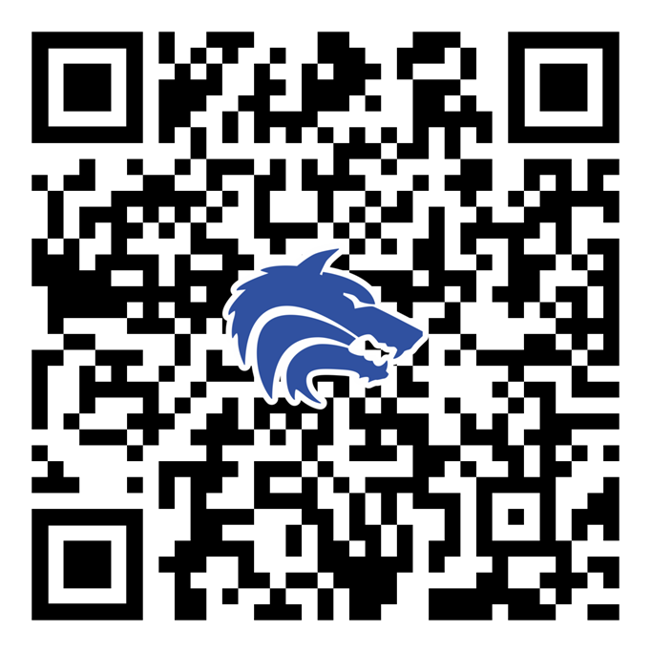
Committees / Task Needs
Sponsorship
Concessions
First Pitch Dinner
Gameday Program
Teacher Appreciation Night
Senior Night
End of Season Banquet

Slide 12
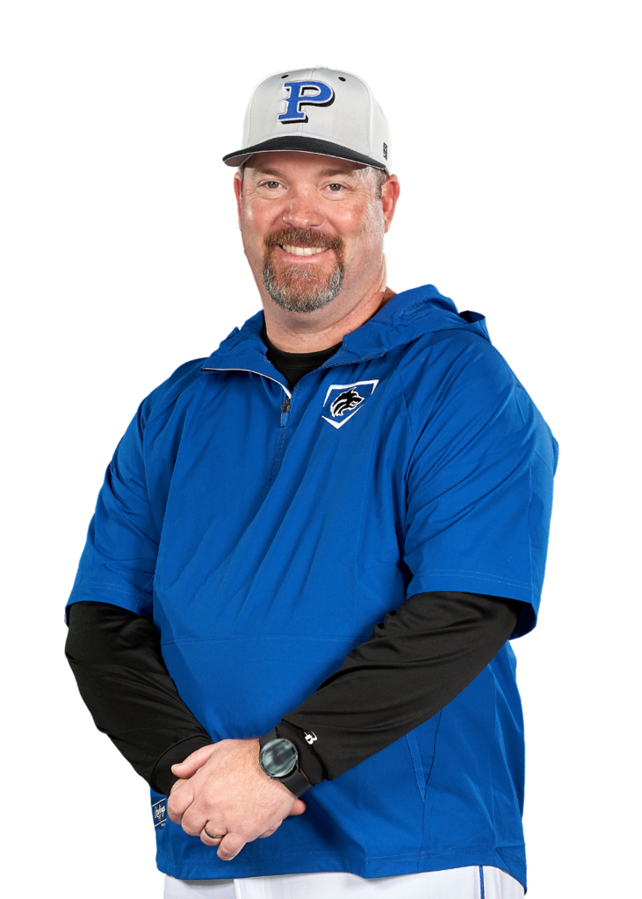
Coach’s Corner

Slide 13

December 2023 Booster Club Meeting

Slide 14

SportsYou
DCMN-ZE9D

Slide 15
Board Introduction
President: Jeff Paschal Preston (12)
Vice President: Julie Raecek James (12)
VP Marketing: Chris Grimes Sam (12) and Stephen (9)
Treasurer: Stephanie Dubner Matt (12)
Secretary: Erin Wasson Jack (11)

Slide 16
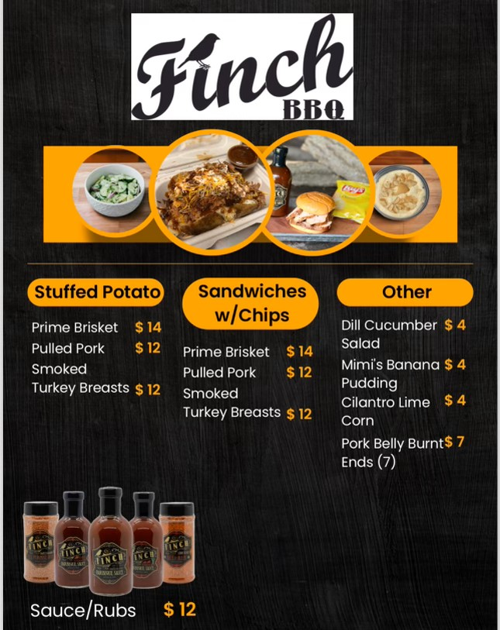
Plano West Baseball Spirit Nights
BBQ Dinner Drive Through
When: Thursday, November 9th
Where: PW Baseball Field Parking Lot
Who: Anyone that orders BBQ ahead of time for pickup
Benefit: 20% back to Plano West Baseball!

Slide 17
2023 – 2024 Booster Club Budget

Slide 18
2023 – 2024 Booster Club Budget

Slide 19
2023 – 2024 Booster Club Budget

Slide 20

Plano West Baseball Spirit Nights
Plano West Baseball Spirit Night!
When: Monday, October 23rd
Where: Coit and Spring Creek Location
Who: Anyone that mentions PW Baseball
Time: 5:00 p.m. - 10:00 p.m.
Benefit: 15% back to Plano West Baseball!

Slide 21
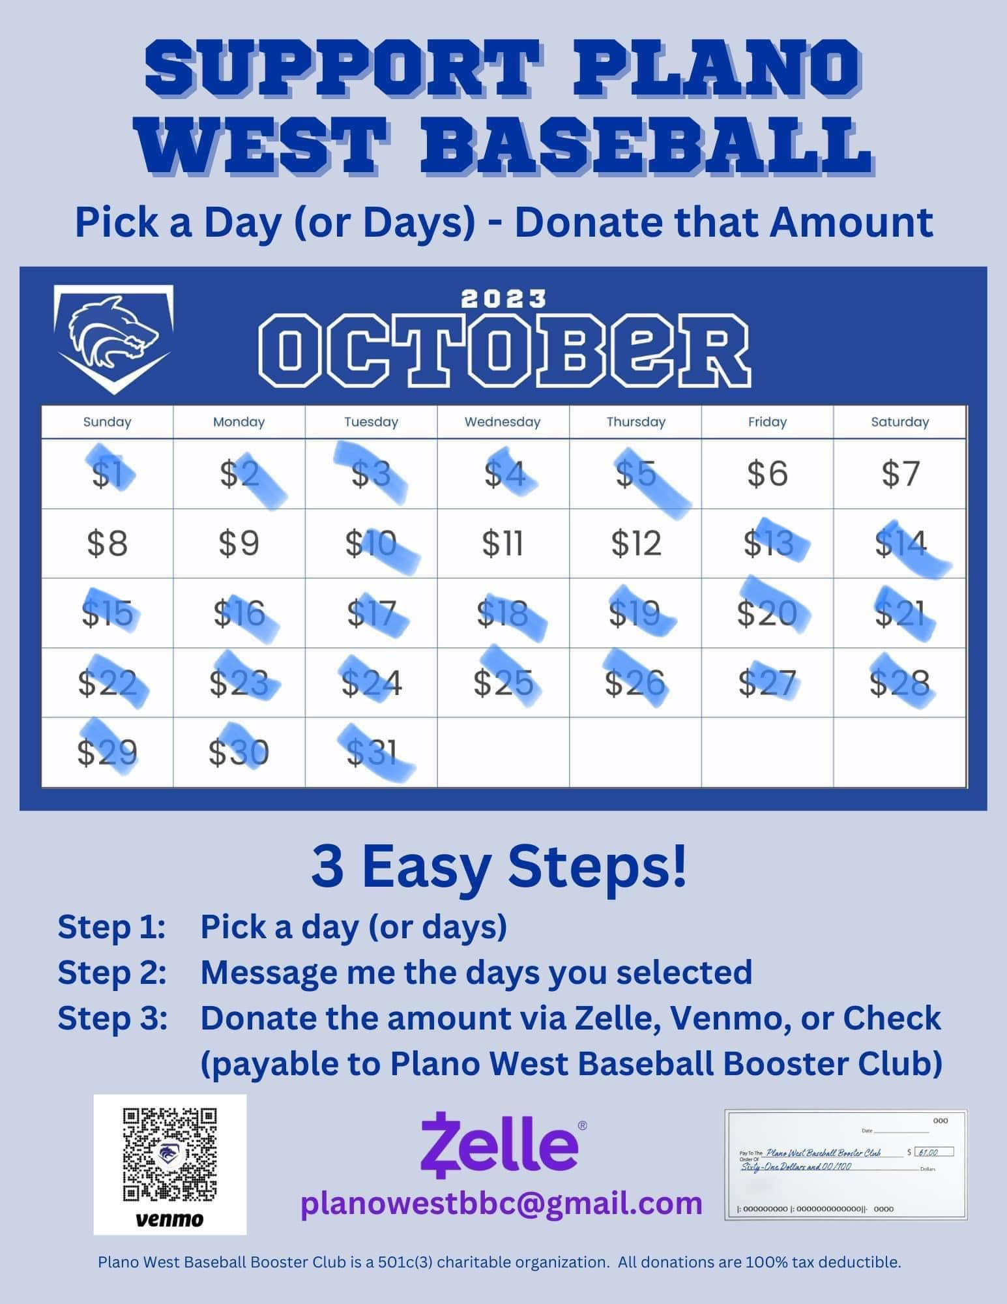
October Fundraiser
Calendar Fundraiser - $3,884 raised

Slide 22
Homecoming Parade
Wednesday, September 20th
Thank you Courtney Donkervoet & Joelle Novick for taking on float!
Candy donations needed!
Plan:
  After practice: decorate & pizza until 5:30 pm
  Make way to staging on Yeary by Brinker 5:40 pm
  Parade starts at 6:30 pm (goes down Yeary and into Plano West Lot)
  Pep Rally after in gym for Students
  Parents please help clean up float etc.
Players wear: fall jersey/shirt, black shorts (or sweatpants) and fall team hat

Slide 23
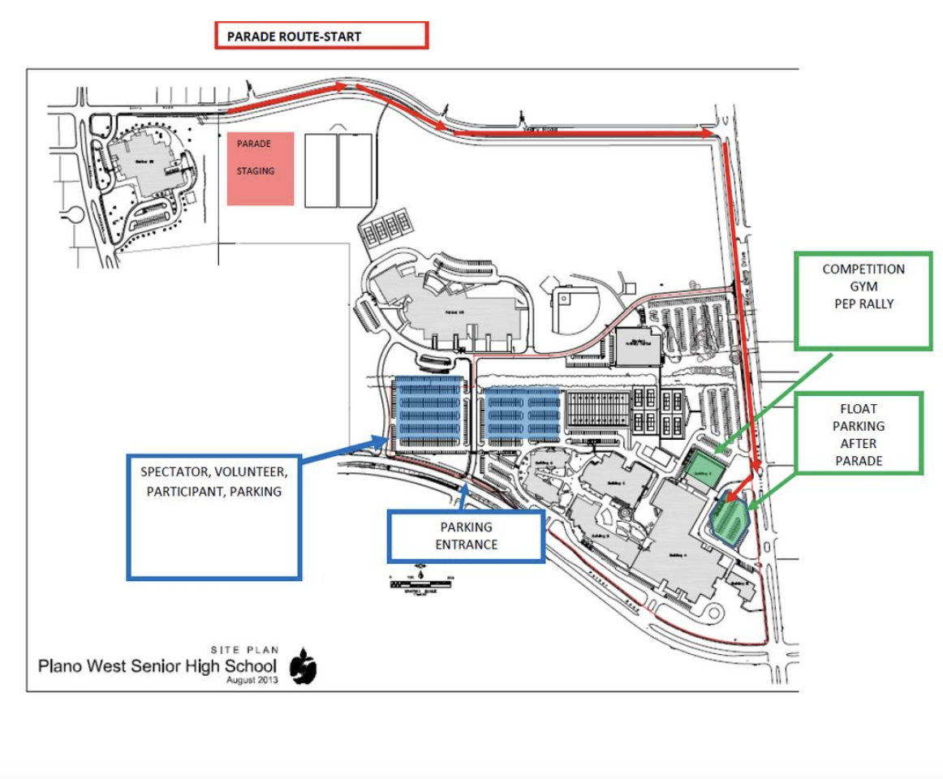
Homecoming Parade Route

Slide 24

November Fundraiser
Poinsettia Fundraiser
Working with Website provider to have all orders go through website.
Look for ordering link soon!

Slide 25
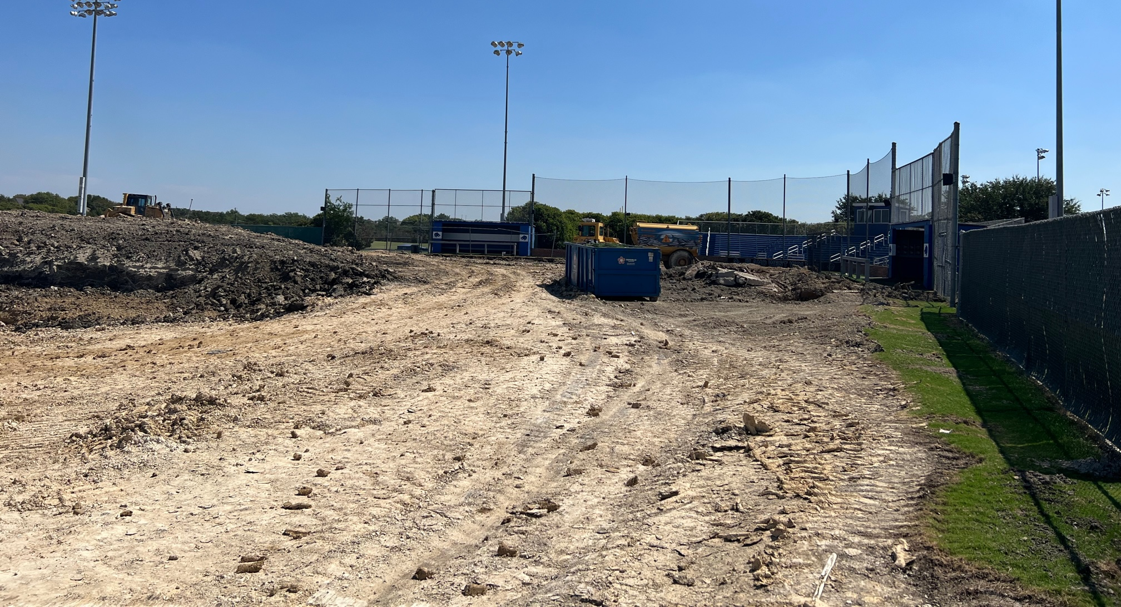
Ballpark Update

Slide 26
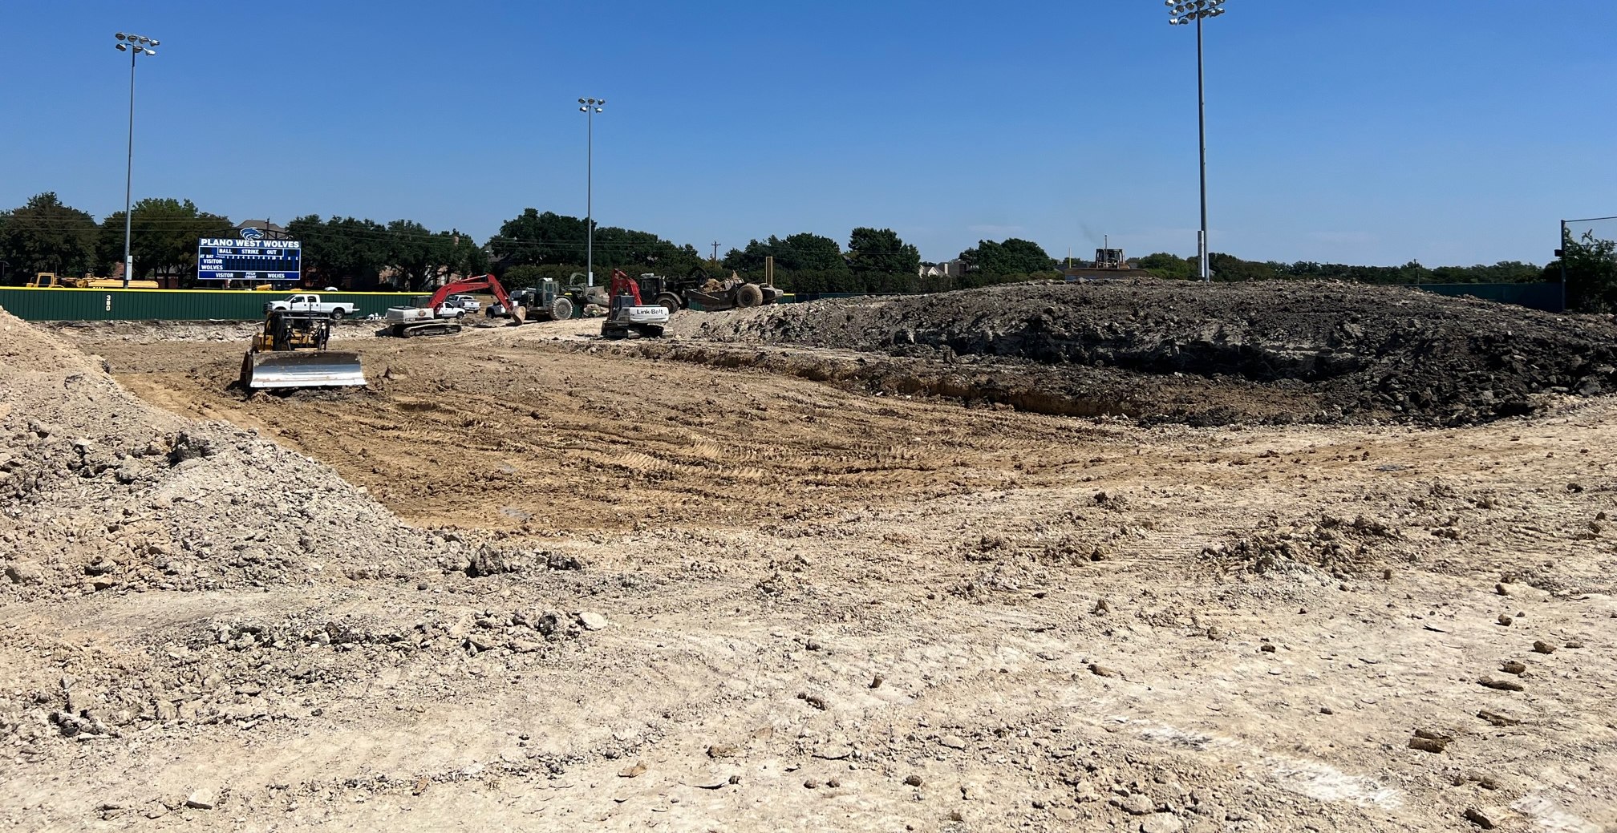
Ballpark Update

Slide 27
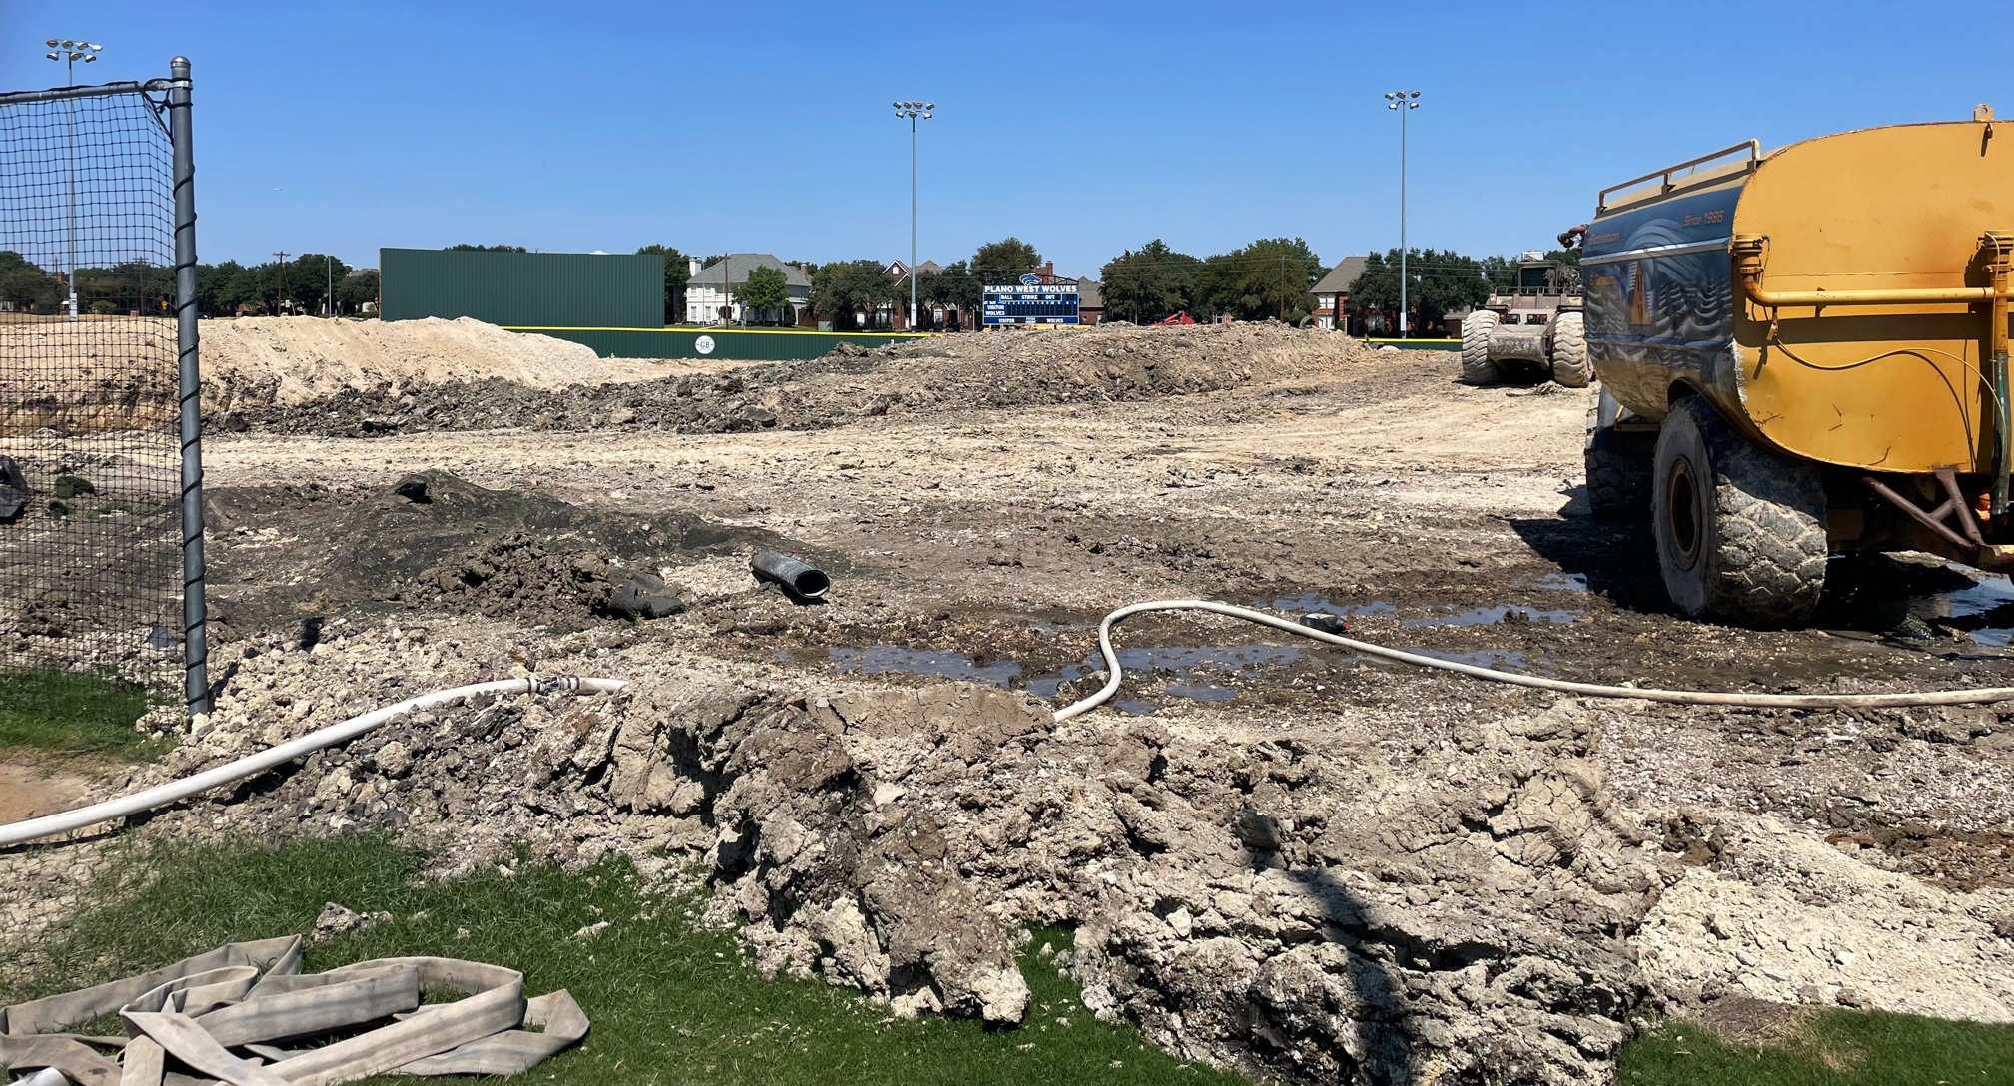
Ballpark Update

Slide 28
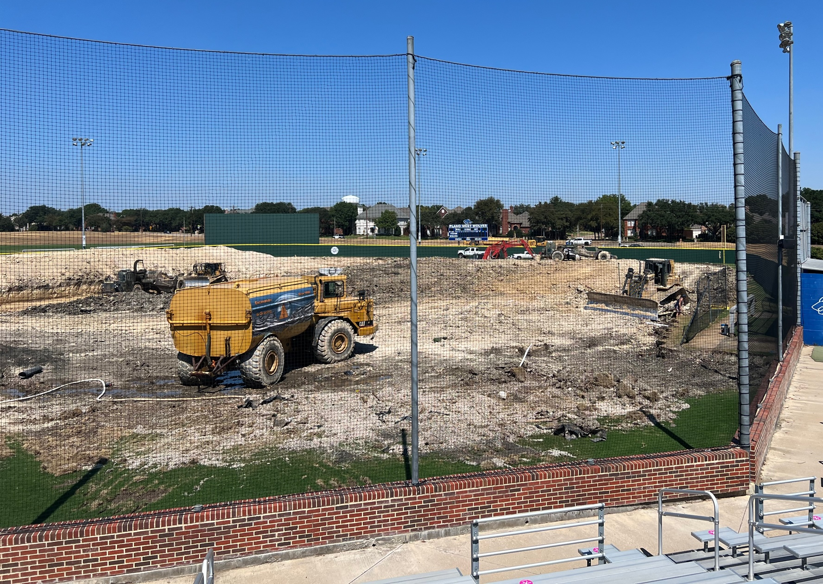
Ballpark Update

