Slide 1
College Planning 101
West Linn High School
Sydney Montgomery, Boise State University
Hunter Denson, The University of Alabama

Slide 2
BUZZWORDS
Have you ever heard these terms and though “what does that mean”?
Student to Faculty Ratio
Acceptance Rate
Retention Rate
Renewable Scholarships
FAFSA
Merit Based Scholarships vs Private Scholarships
Superscore
For Profit vs Not for Profit Options

Slide 3
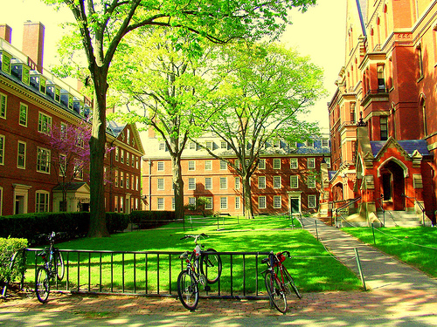
STARTING THE COLLEGE SEARCH
Academics
Location and Size
Student to Faculty Ratio
Student Life
Campus Visit
Application Process
Cost of Attendance
Scholarships/WUE

Slide 4
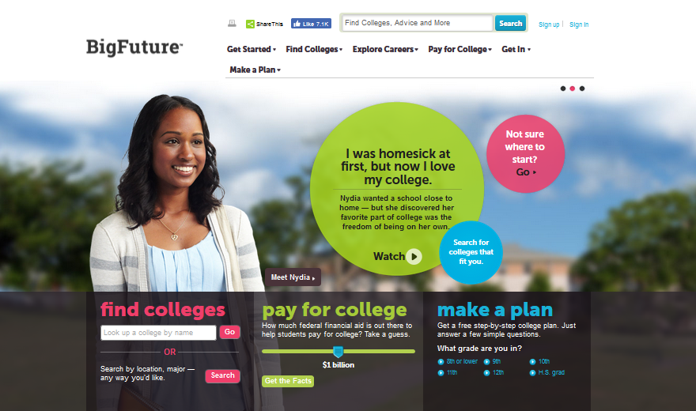
FINDING THE RIGHT SCHOOLS FOR YOU
https://bigfuture.collegeboard.org/

Slide 5
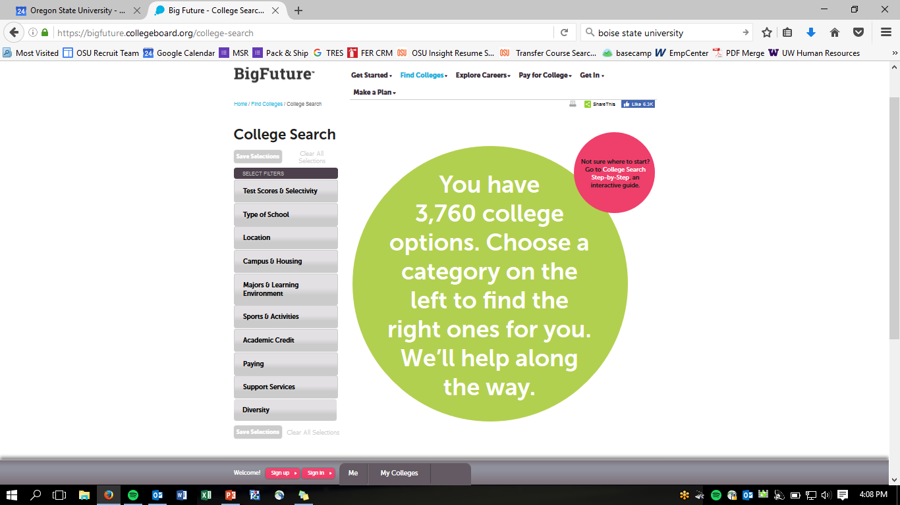

Slide 6
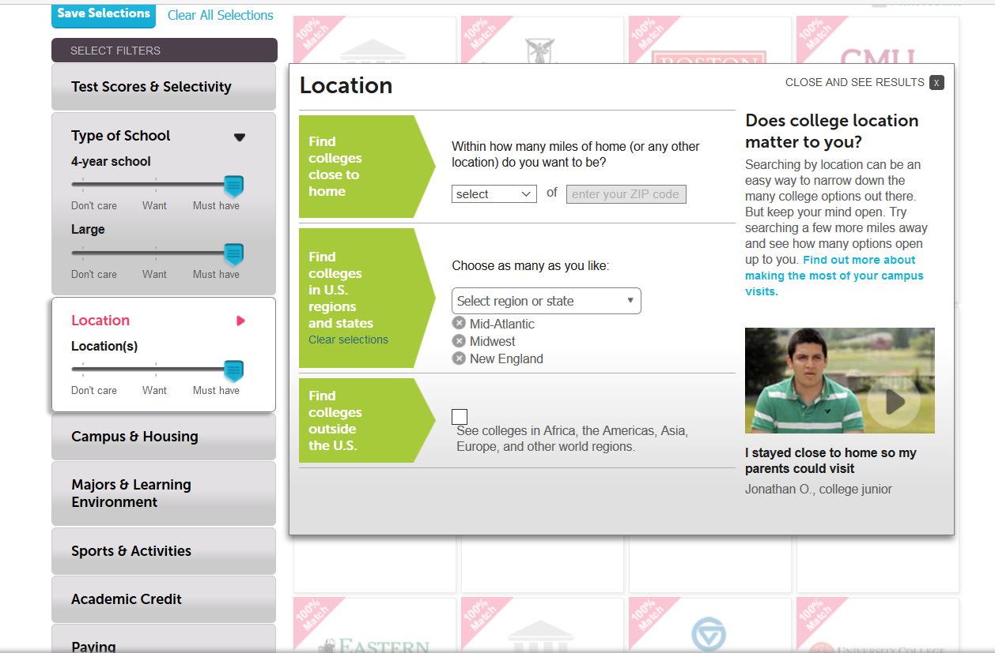

Slide 7




LARGE SCHOOLS
Arizona State University Student Population: 72,072
The University of Alabama Student Population: 38,000
Oregon State University Student Population: 32,598
Boise State University Student Population: 23,873

Slide 8




MEDIUM AND SMALL SCHOOLS
University of Idaho
Student population: 12,338
University of Montana
Student Population: 11, 865
Eastern Oregon University
Student population: 3,488
Carroll College (Montana)
Student population: 1,430

Slide 9

SELECTING WHERE YOU WILL APPLY
Safety School - Above average applicant; within budget
Good Match - Schools that meet your “College Fit Checklist” and you meet their minimum admission requirements
Reach School - Less likely of being accepted; out of budget

Slide 10

Visiting Campus
Get your feet on the ground
Take in the atmosphere
Overall community feel
Ask your tour guide about their experience
Meet with academic areas of interest
University Open House Events
Can you visit multiple schools on one trip?

Slide 11

What Really Matters to Colleges?
GPA (Especially grades earned in academic courses)
Test scores (SAT or ACT)
-----------------------------------------------
Resume Builders (Community Service, Clubs, Religious Organizations, Athletics, etc)
Essay (Grammar really does matter)
Letters of Recommendation
Enthusiasm for Institution
Perseverance to overcome adversity
Secret? There is no magic formula

Slide 12


Types of Applications
Common Application: 700 Colleges, 1 Application.
Coalition Application: 90 Institutions, 1 Application. Members focused on Access, Affordability and Success
University Application: Applications that are specific to that particular institution

Slide 13
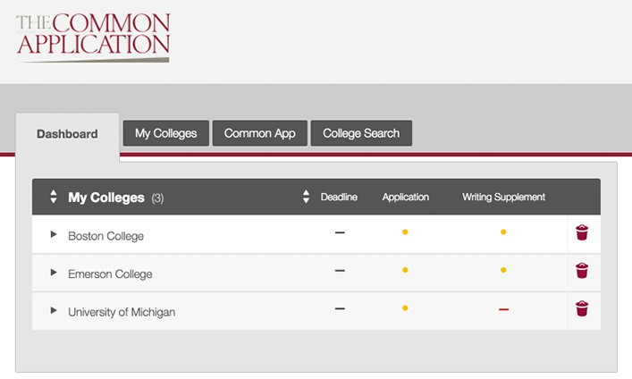

Slide 14
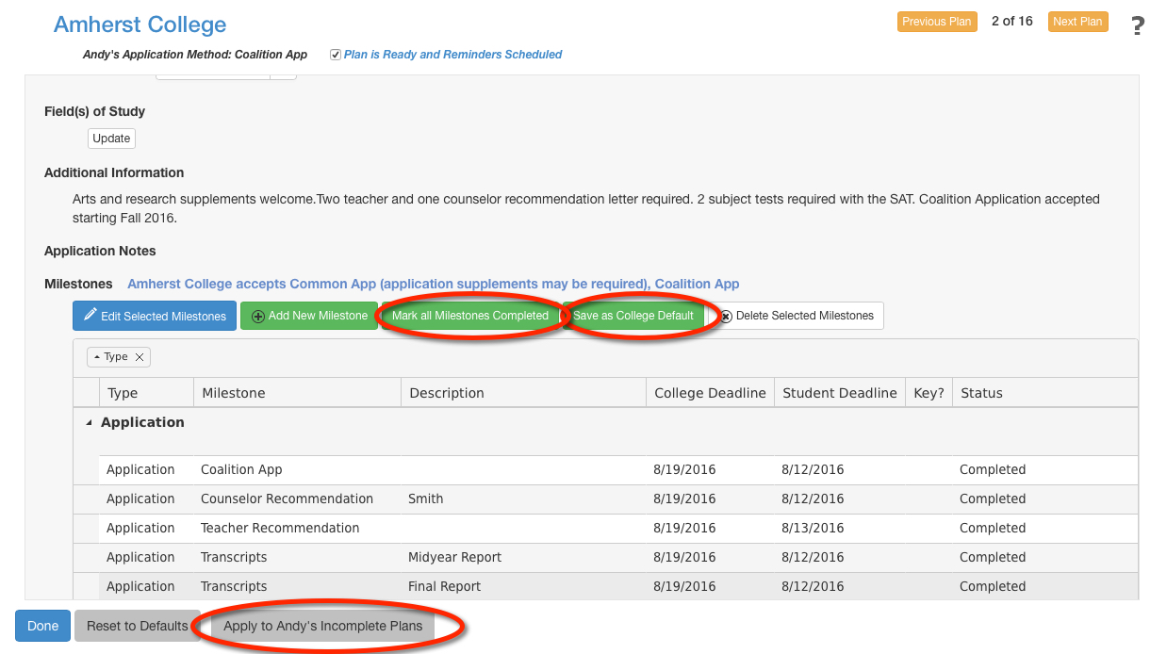

Slide 15
Types of Admission Deadlines
Be aware of Application Options
Early Decision*-Binding.
You can anticipate to receive your admission decision earlier (EX: Georgetown)
Early Action*-Not binding. Typically EA applicants are more competitive than usual applicants (EX: MIT)
Regular Decision/Rolling Admission- Apply to multiple colleges and then select by May 1st.
*Due dates for early action or early decision differ from regular admissions
When should you apply?

Slide 16
Purpose of the Essay
To find out more about you as a person than can be seen from the application and resume.
To see how you utilize critical thought and apply it to a variety of situations.
To get a glimpse of your writing “voice” and how you communicate ideas.
Allow you a voice in the decision process.

Slide 17

4 Usual Types of Essay Prompts
The “You” Question
The “Passion” or “Interest” Question
The “Why Us” Question
The “Creative” Question

Slide 18

Brainstorming Process
Leave yourself plenty of time
College choice lists
Research essay prompts
Common App vs General
Seek outside council
Write out your potential paths
Use whatever method fits your personality
Outline
Write, Read, Let it Sit…Repeat

Slide 19

Senior Year Checklist
Narrow down list of 5-6 schools
Research all of their admission deadlines
Complete Teacher Letter of Recommendation request forms
Complete online applications
Request official test scores to be sent from Collegeboard
Request from Counseling Office to have official transcripts sent
Fill out the FAFSA
Wait for notification

Slide 20
Once you have been accepted...
Visit the campus
Research when Housing applications open
Check on Financial Aid and Scholarship package
Register for an Orientation program
Notify institution of decision

Slide 21


Slide 22
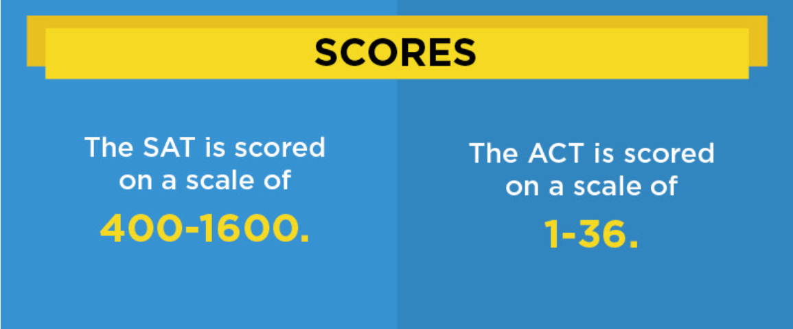

Slide 23
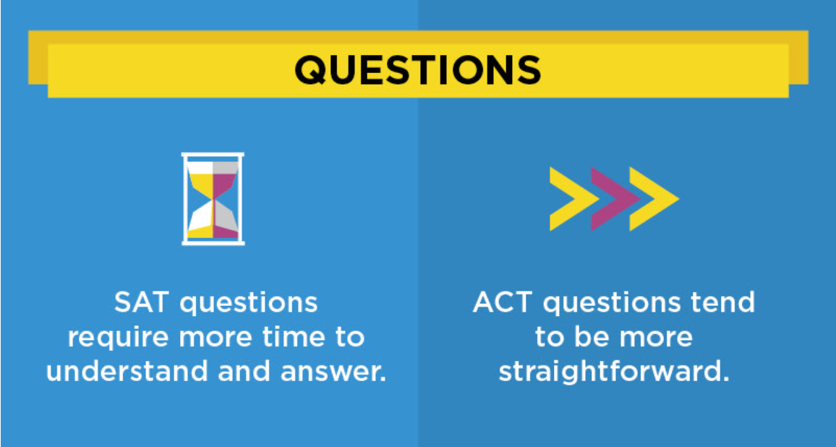

Slide 24


Slide 25


Slide 26


Slide 27
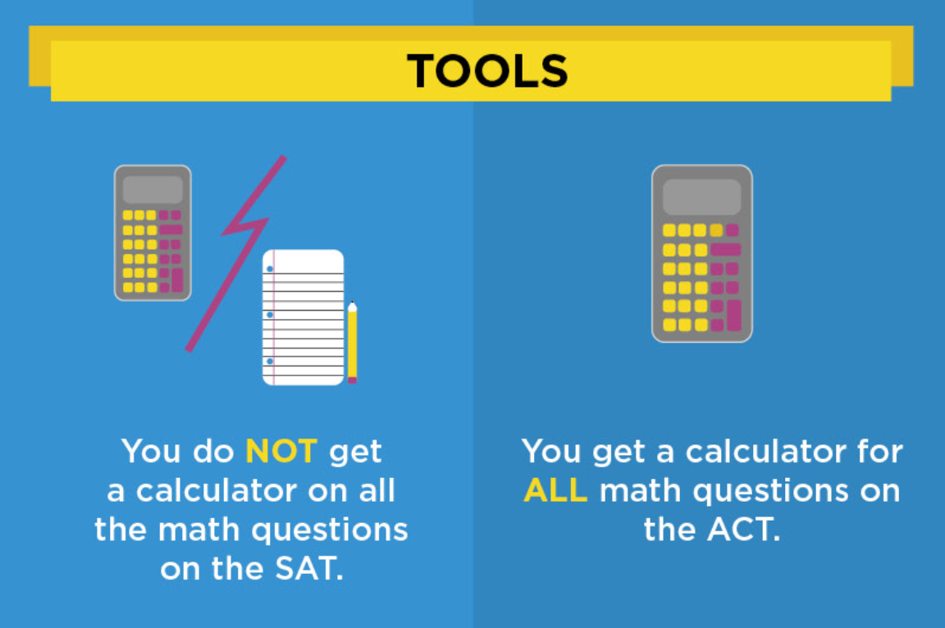

Slide 28
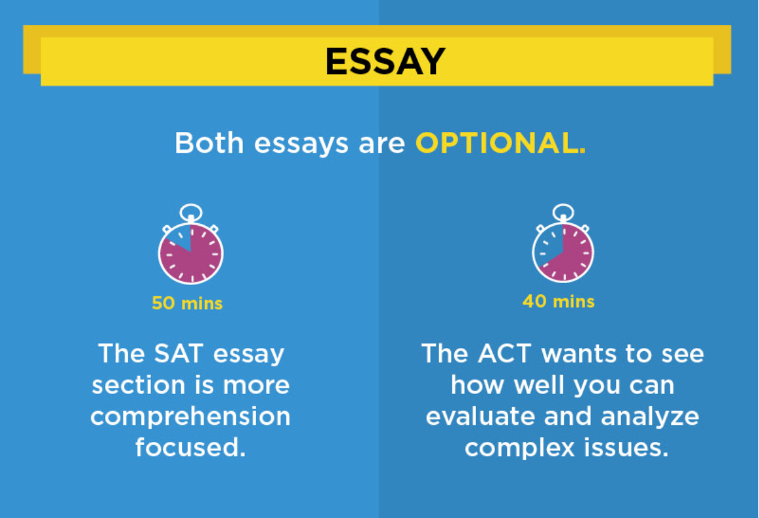

Slide 29
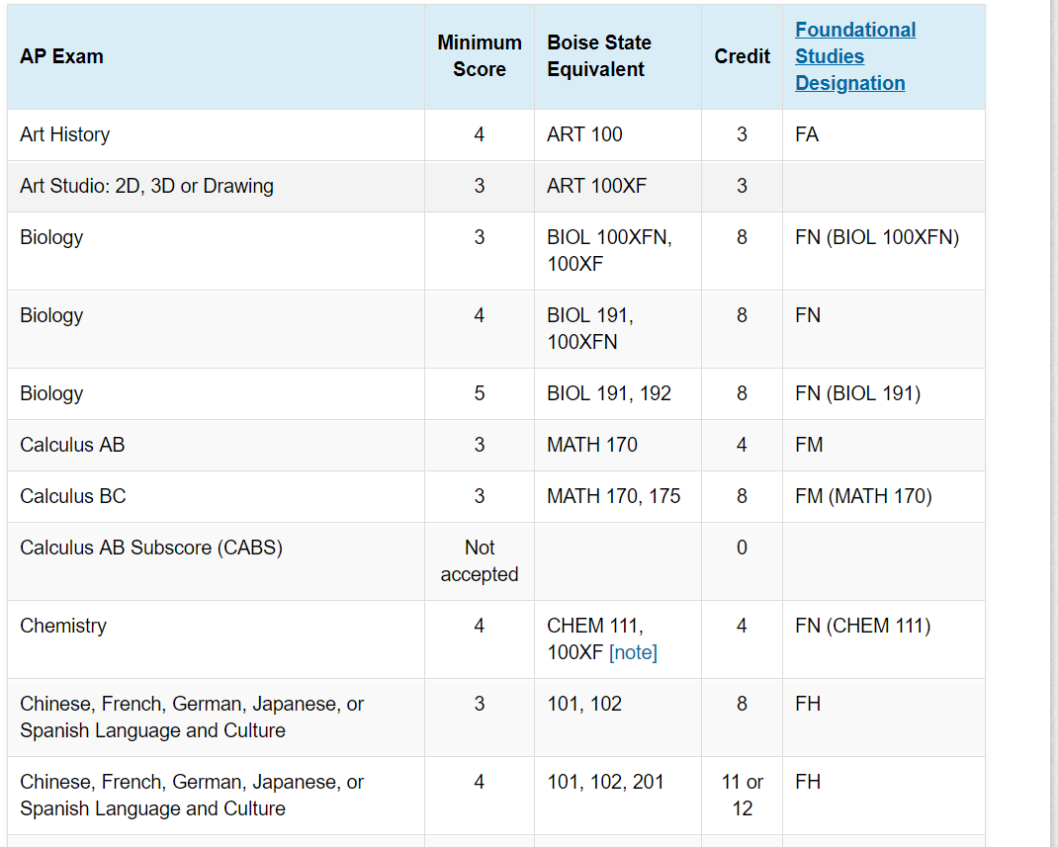
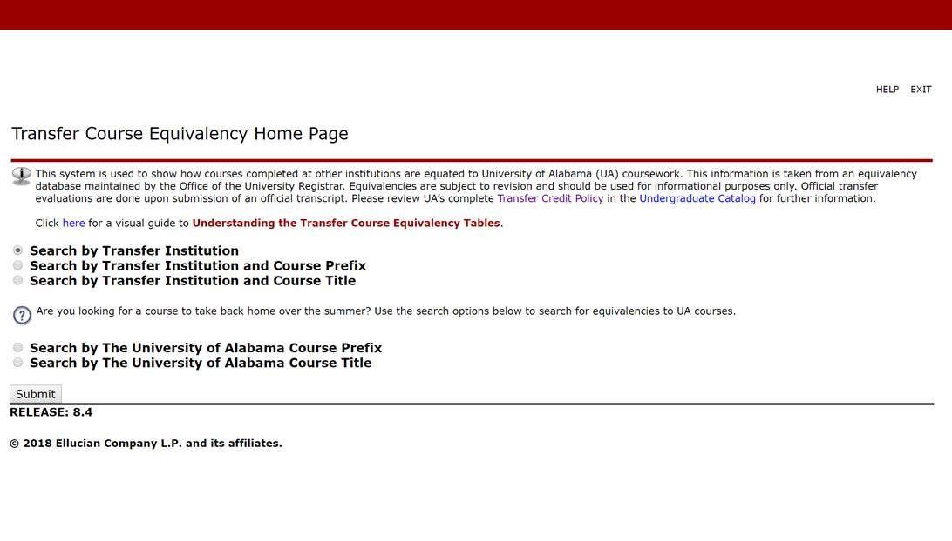
Dual Credit, AP, IB, etc.

Slide 30

UNDERSTANDING WUE AND CREATING OUT OF STATE OPTIONS FOR STUDENTS
WESTERN UNDERGRADUATE EXCHANGE (WUE) & OUT OF STATE SCHOLARSHIPS
Pronounced “woo-wee”

Slide 31
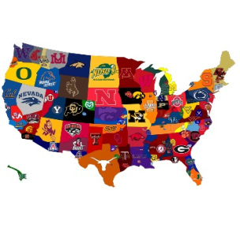
WHY GO OUT OF STATE?
Less impacted majors
Specialized programs
Affordability
Internships with out of state companies
Building awareness of other parts of the country
Gaining independence

Slide 32
WHAT IS WUE?
Western Interstate Commission of Higher Education (WICHE)
Regional tuition-reciprocity agreement
Up to 150% of in state resident tuition
Choose from hundreds of majors at 160 schools
Valid for full 2 and 4 year degrees

Slide 33
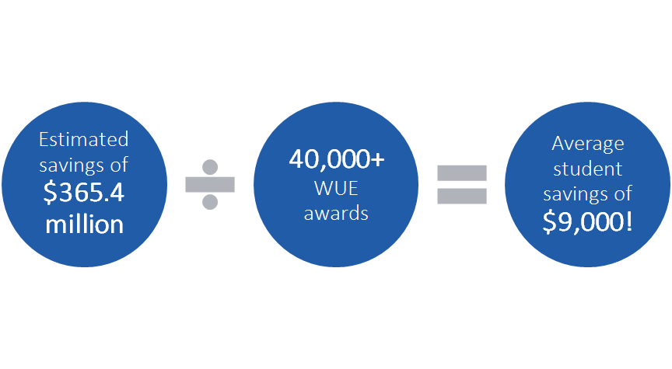

Slide 34
SO IN A NUTSHELL….
WUE = Tuition Reduction!
*http://wiche.edu/wue

Slide 35
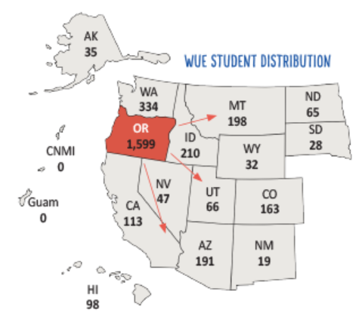
In 2017-18, 1,599 students from Oregon were enrolled in out-of-state programs at reduced rates (150 percent of resident tuition), saving $15.8 million in tuition and fees – the average student savings amounted to $9,900. In the last 10 years, students have saved $126.4 million.

Slide 36
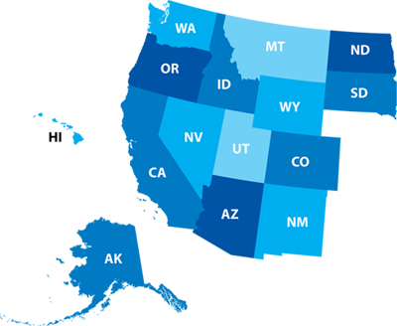
WHO IS PART OF WUE?
New Mexico
Montana
Arizona
Utah
Oregon
Colorado
Wyoming
Idaho
Alaska
Washington
California
Nevada
Hawaii
North Dakota
South Dakota

Slide 37
School | GPA | Test Score | Deadline | WUE application
Boise State University | 3.2 | SAT 1060 ACT 21 | Dec 15th | No
Montana State University | 3.5 | SAT 1310 ACT 28 | Feb 1st | Yes
University of Alaska Anchorage | No Requirement |  | No | Yes
University of Alaska Fairbanks | No Requirement |  | No | Yes
University of Idaho | 3.2 | No Requirement | No | No

Slide 38
Example of Savings
 | Idaho Resident | Out of State Students | WUE Eligible
Boise State University | $7,326 | $23,976 | $11,541
University of Idaho | $7,860 | $25,500 | $11,795

Slide 39
APPLYING FOR WUE
There is not a general WUE application:
Apply directly to the institution.
When you apply, look for:
­Early deadlines or first-come, first-served programs
­Is a separate application required?
­Minimum GPA and SAT/ACT scores
­Restrictions on eligible majors
(i.e.: University of Arizona only offers WUE for mining engineering)

Slide 40

Things to Remember
WUE awards are time-limited, or may max out after a certain number of credits are earned
Students must remain in good academic standing
Check with the school for specific GPA/minimum credit hours requirements
Students can’t use time paying the WUE rate to gain in-state residency

Slide 41
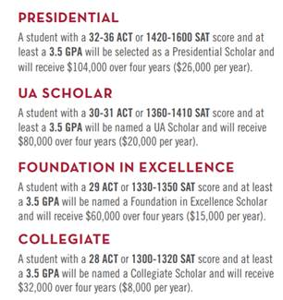
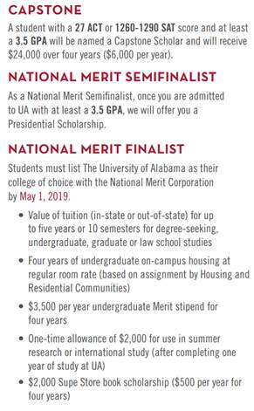
Other Merit Scholarships

Slide 42

SCHOLARSHIPS AND FINANCIAL AID
Scholarship Application
Academic Scholarships
Financial Aid
-FAFSA.ed.gov
-https://oregonstudentaid.gov/scholarships.aspx
-bigfuture.collegeboard.org/scholarship-search
Important Dates
Opens October 1, 2018
Priority deadline (varies):
February 2019

Slide 43


CONTACT US HUNTER.DENSON@UA.EDU
SYDNEYMONTGOMERY@BOISESTATE.EDU
Any questions?

