Slide 1


Absolutes of Pitching
Presented by Coach Tony Tichy

Slide 2
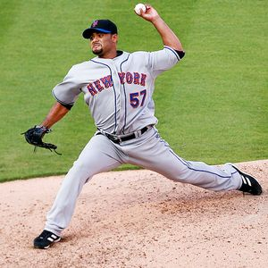
Stride Long be tall
Straight
100% of pitchers height
Drill: hat drill
Notes:
Use your hat to mark the distance and keep you straight.

Slide 3
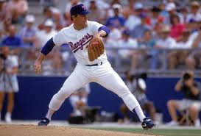
Hip leads to target
Moves first to target
Slightly bent, but not collapsed back knee
Before ball comes out of glove
Drill: partner lean
Notes:
When your knee is lifted you fall like a tree.

Slide 4
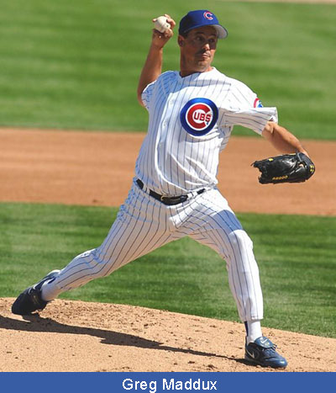
Back leg drive
Complete back leg drive before landing
Back leg should be straight
Make sure to push off
Drill: drag back foot

Slide 5
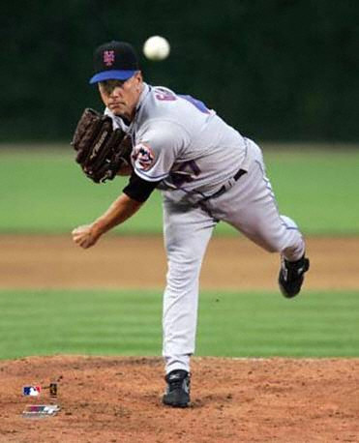
Land flat footed in straight line
foot will be straight or slightly closed upon landing
Drill: one legged drill
Notes:
Practice finishing on one leg with your head in line with your knee.

Slide 6
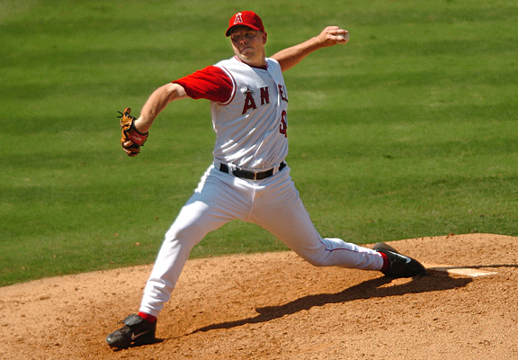
Front leg and hip
Need to brace
Do not allow to drift forward
The arm should be up and semi-cocked behind the head
Drill: equal and opposite

Slide 7
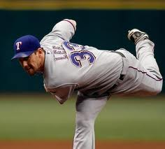
Trunk-slam the trap door
Flex trunk forward(nose over toes)
Back gets parallel to ground
Drill: one knee progression

Slide 8
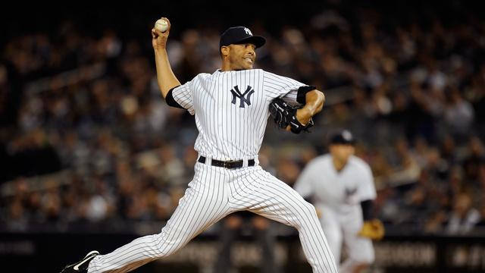
Throwing is movement
No delays
No hesitations
No slow movements
No swinging the leg
Drill: Happy Gilmore
Mariano Rivera

Slide 9
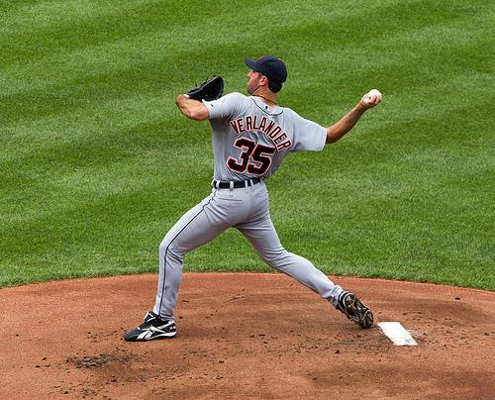
Faults
Q: What is wrong?
A: Short stride, not equal and opposite at landing
Notes:
Short stride, not equal and opposite at landing

Slide 10
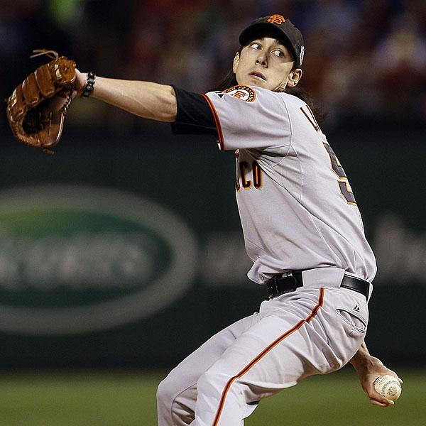
Faults
Q: What is wrong?
A: Glove too far away from the body and arm circle/ball behind the back.
Notes:
Glove too far away from the body and arm circle/ball behind the back.

Slide 11
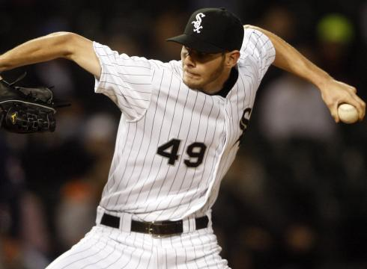
Faults
Q: What is wrong?
A: Dangerous M position with elbows at foot strike.
Notes:
Dangerous M position with elbows at foot strike.

Slide 12
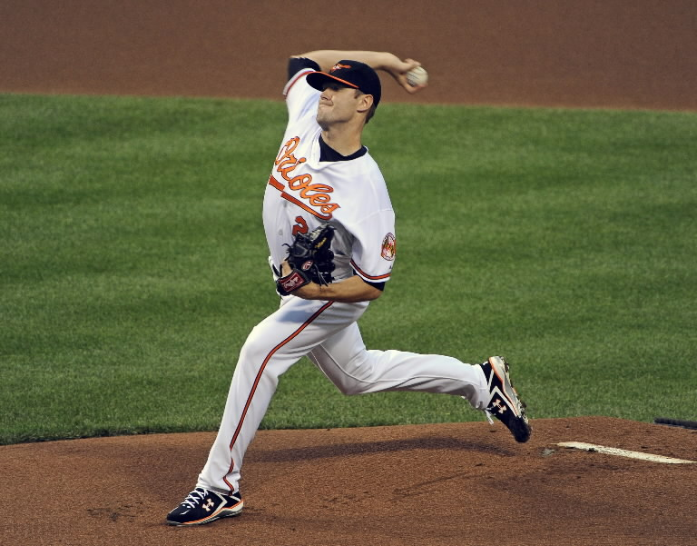
Faults
Q: What is wrong?
A:Foot in the air with ball in hand. Elbow too high.
Q: What is correct?
A: long stride and straight stride.
Notes:
Foot in the air with ball in hand. Elbow too high.
Correct- long stride and straight stride.

