Slide 1


Eagan volleyball coach meeting
Spring 2026 in house

Slide 2
Agenda
Eagan Athletic Association Volleyball
Quick Intros
General Info - practice & game info, sports engine
Rules & Coach Resources
Net Set Up Videos & Demonstration
Pick up Equipment!!

Slide 3
Eagan Athletic Association
Volleyball
Who we are
Part of the EAA (EAGAN ATHELTIC ASSOCIATION) serving kids in Eagan & the surrounding communities
Our Goal
Provide a fun & rewarding way for kids to learn the fundamentals of volleyball in a structured & energetic environment that is a positive & engaging experience for players at all ages & abilities

Slide 4
Eagan Volleyball Board
Current members
Program Director – open
Travel girls – Kasha Zeman
Travel boys – Jason Lyons
JO – Amber Johnson
Equipment/Uniforms – Leah Frenning
Communication – KellyJohannsen
Treasurer – open
At Large – Ashley Daley
In House – Stacey Oberg & Holly Grunklee
We are looking for new board members!
Notes:
There is a lot of work that goes on behind the scenes to run the program. Join a great group & help shape the future of the volleyball program. Great if you have a 3rd or 4th grader – meet other parents, families, connect in the community.

Slide 5

Spring 2026 Program summary
Grade | Participants | Teams | Coaches
3rd Girls | 43 | 4 | 10
4th Girls | 70 | 6 | 12
5th Girls | 68 | 6 | 12
6th Girls | 44 | 6 | 12
7th Girls | 31 | 3 | 7
8th – 10th Girls | 35 | 4 | 8
3rd & 4th Boys | 23 | 3 | 7
5th – 8th Boys | 21 | 3 | 6
Total | 336 | 35 | 70
Thank you coaches! Introduce yourself!
Notes:
We again have over 330 participants in our Spring volleyball program! While there is important work that goes on behind the scenes to make a season happen, the coaches are invaluable! Thank you for your time and commitment to the program week after week!

Slide 6

General info
Spring 2026 in house

Slide 7

schedules & locations!!
Date | Event | Participants | Location/Time
Saturday April 4th | 3rd Grade Clinic | 3rd Grade Girls & Boys with Coaches | DHMS 9:00AM – 10:30 AM
April 6th – May 15th | Weekly Practices 6PM – 9PM | Players & Coaches | DHMS BHMS SHMS Glacier Hills Pinewood Red Pine (Limited) Silver Bell (Limited)
Friday April 24th | Pictures | Players & Coaches | DHMS Cafe
Saturday April 11th – Saturday May 16th | Saturday Games (6 weeks!) | Players & Coaches | DHMS 9am – 1pm & BHMS 9am – 2pm Last week @ SHMS
Coaches have the ability to schedule in Sports Engine; however, any scheduling changes must be submitted to in-house volleyball director for approval before being made in Sports Engine. Also, you must coordinate with the other coaches and get their approval if it requires swapping gym time. Remember to notify parents!

Slide 8
Practice Dates
Monday | Tuesday | Wednesday | Thursday
5th & 6th Grade Girls | 7th & 8th Grade Girls | 3rd & 4th Grade Girls | 3rd & 4th Grade Boys 5th – 8th Grade Boys
Please check Sports Engine weekly for schedules. 1 Practice, 1 Saturday game. 7th grade girls & both boys teams will have double headers
Must have 2 coaches at each practice or it will need to be cancelled. If only 1 coach is available, the coach is responsible to identify a parent to be at the practice for observation purposes only. They cannot assist with practice.
We have tried to minimize 8pm-9pm practices but there are some teams that will have practice at these times.
There are some weeks and some teams that may have a shared practice!
There are a few Friday evening practices.

Slide 9
Game & Practice locations
Venue | Gym Space |  |  | Location | Event
Black Hawk Middle School (BHMS) | Gym A | Gym B | Gym B | Eagan | Games & Practice
Dakota Hills Middle School (DHMS) | Gym A | Gym B | Gym B | Eagan | Games & Practice
Glacier Hills Elementary | Café/Gym A/Gym B - Combined |  |  | Eagan | Practice
Pinewood Elementary | Café/Gym A/Gym B - Combined |  |  | Eagan | Practice
Red Pine Elementary | Café/Gym A/Gym B - Combined |  |  | Eagan | Practice
Scott Highlands Middle School | Gym A |  | Gym B | Apple Valley (Limited Dates) | Games & Practice
Silver Bell Learning Center | Gym – 1 Gym |  |  | Eagan (Limited dates) | Practice
Please check Sports Engine weekly for schedules. Day of the week will be consistent (except for some teams the last week of practice) but the location & time will vary.

Slide 10
Game schedules & locations
 | DHMS |  | BHMS/SHMS*
 | Gym A | Gym B | Gym A | Gym B
9am–10am | 3rd Grade Girls | 3rd Grade Girls | 3rd & 4th Grade Boys | 5th – 8th Grade Boys
10am–11am | 4th Grade Girls | 4th Grade Girls | 3rd & 4th Grade Boys | 5th – 8th Grade Boys
11am-12pm | 4th Grade Girls | 5th Grade Girls | 7th Grade Girls | 6th Grade Girls
12pm – 1pm | 5th Grade Girls | 5th Grade Girls | 7th Grade Girls | 6th Grade Girls
1pm – 2pm |  |  | 8th Grade Girls | 8th Grade Girls
* Last week of games usually at BHMS will be at Scott Highlands Middle School
7th Grade Girls, 3rd & 4th Grade Boys, 5th – 8th Boys will have double headers

Slide 11

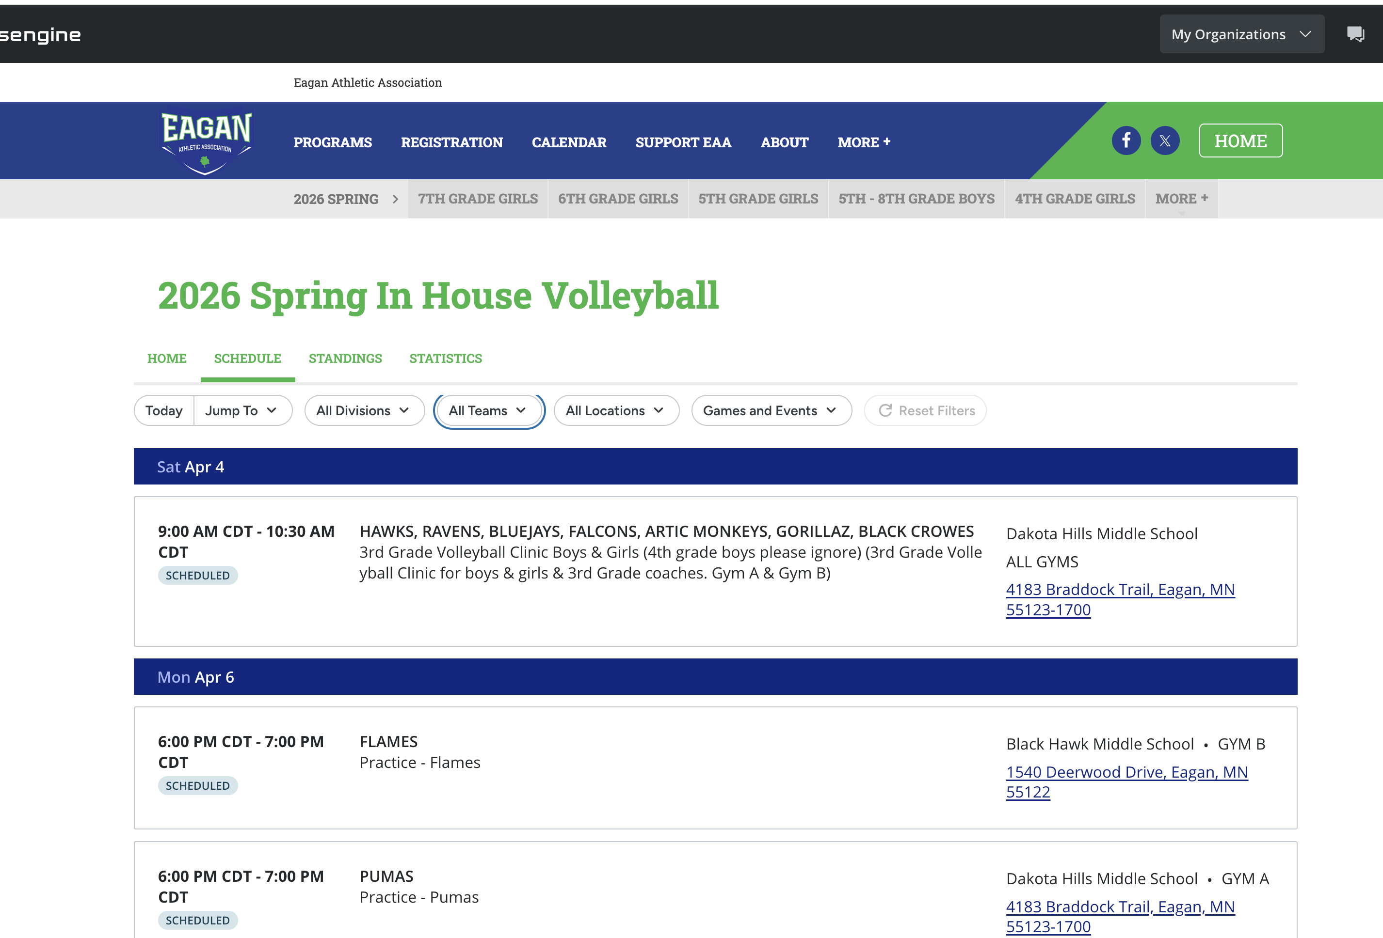
Sports engine – PRACTICE & GAME SCHEDULES
View schedules by division, team, games/event (practice)

Slide 12
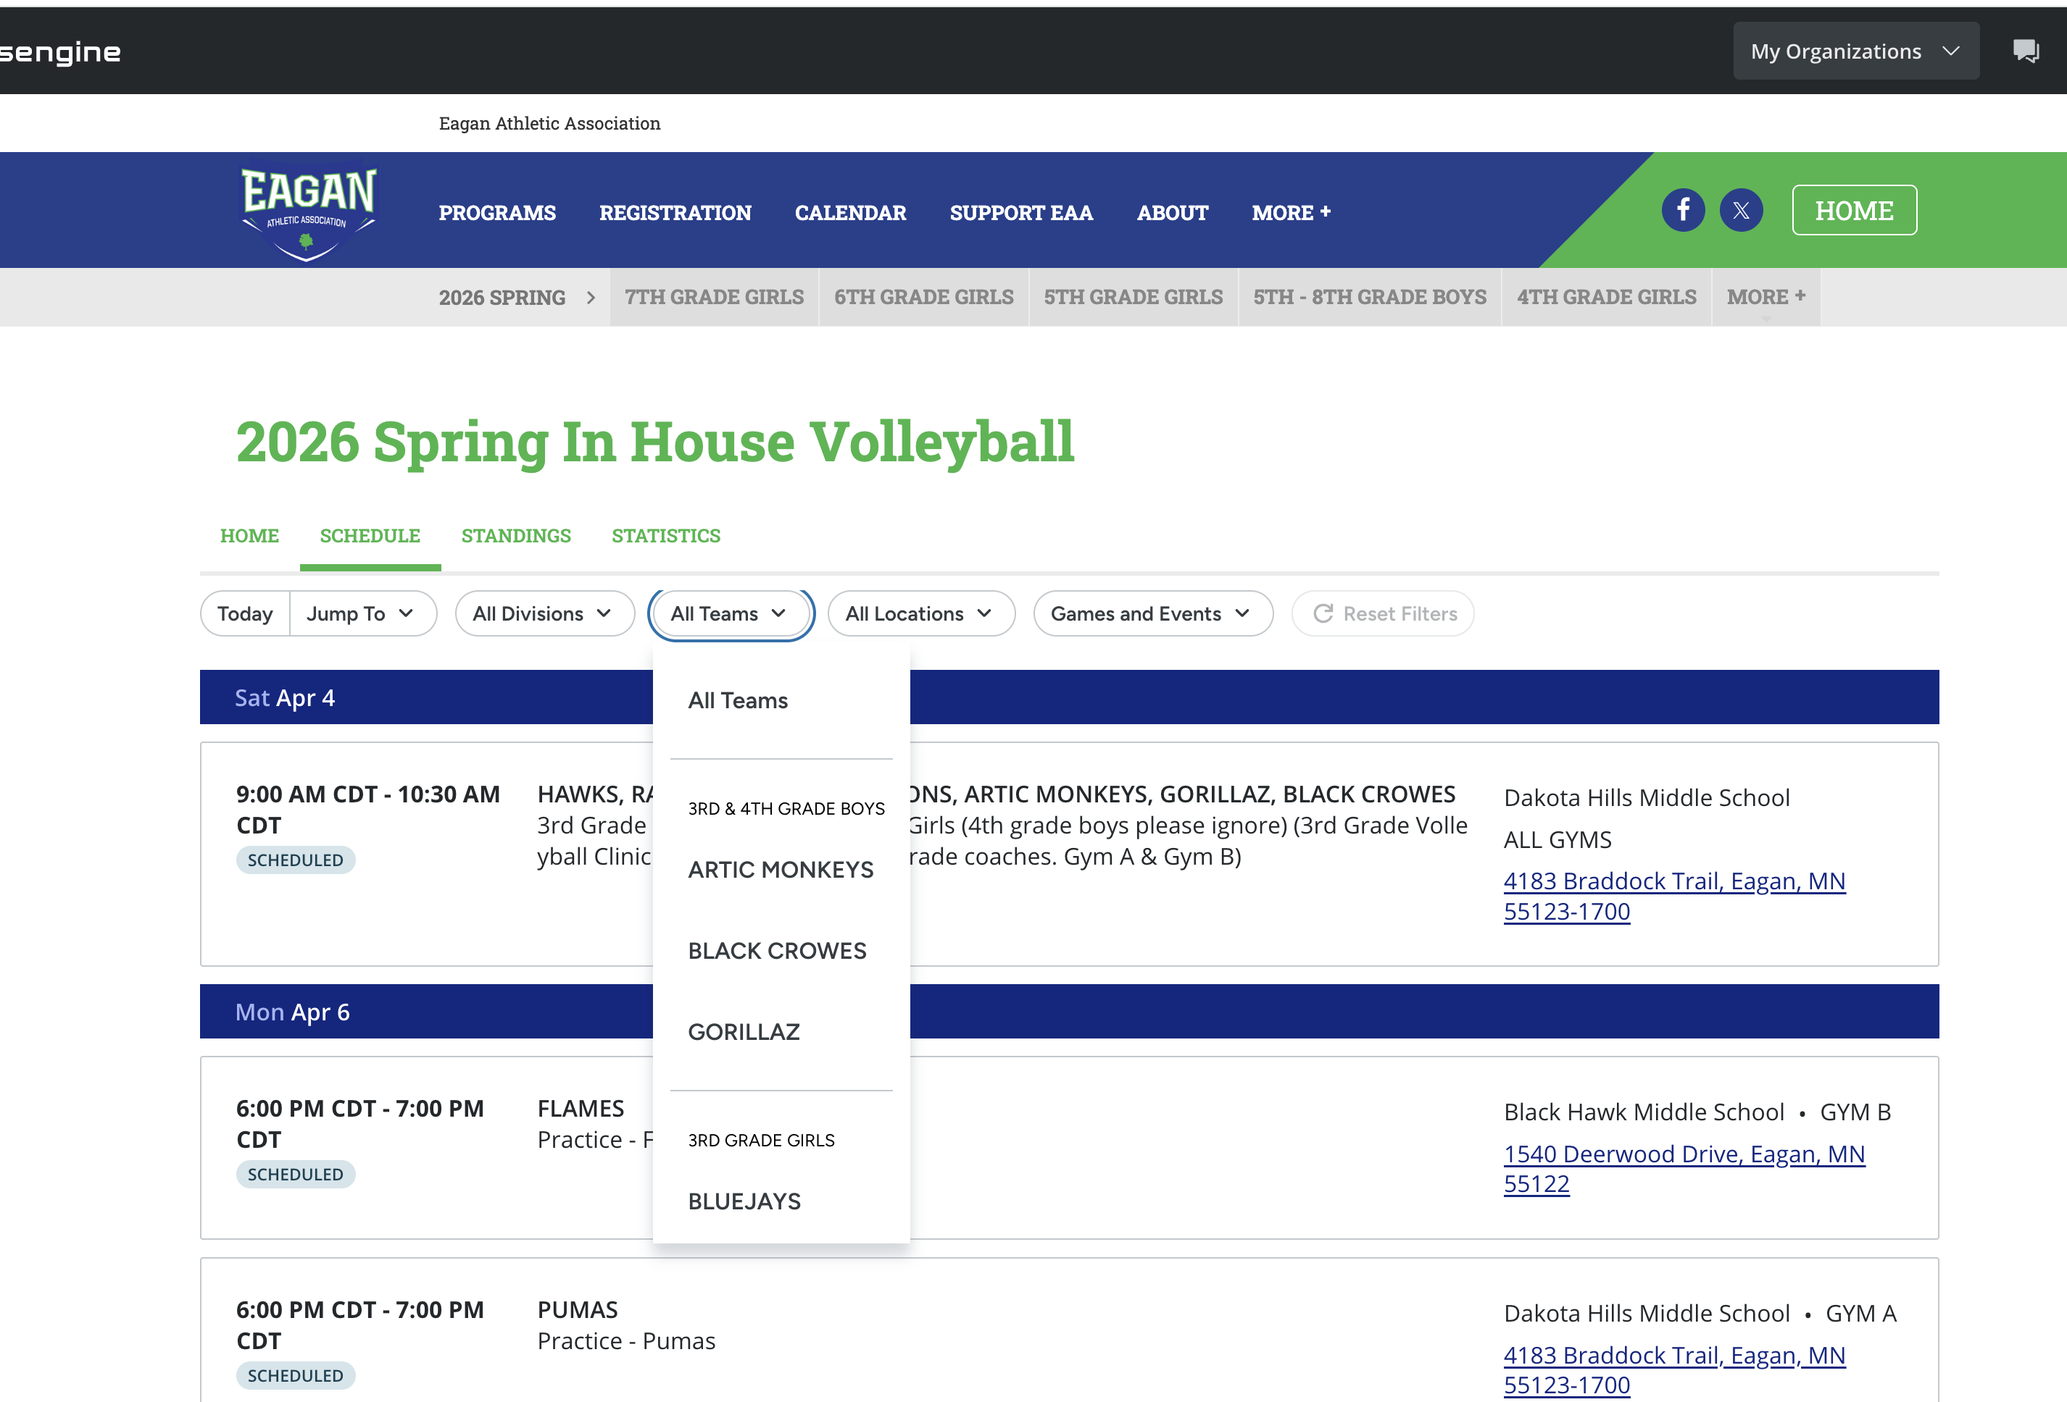
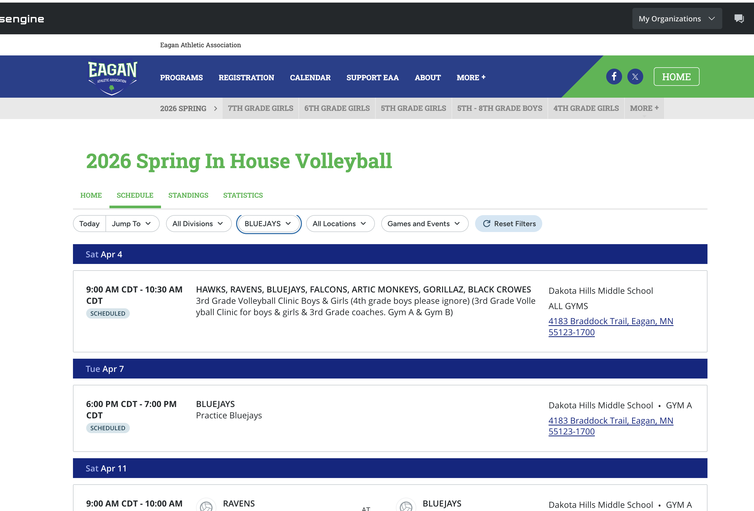
Sports engine – PRACTICE & GAME SCHEDULES

Slide 13
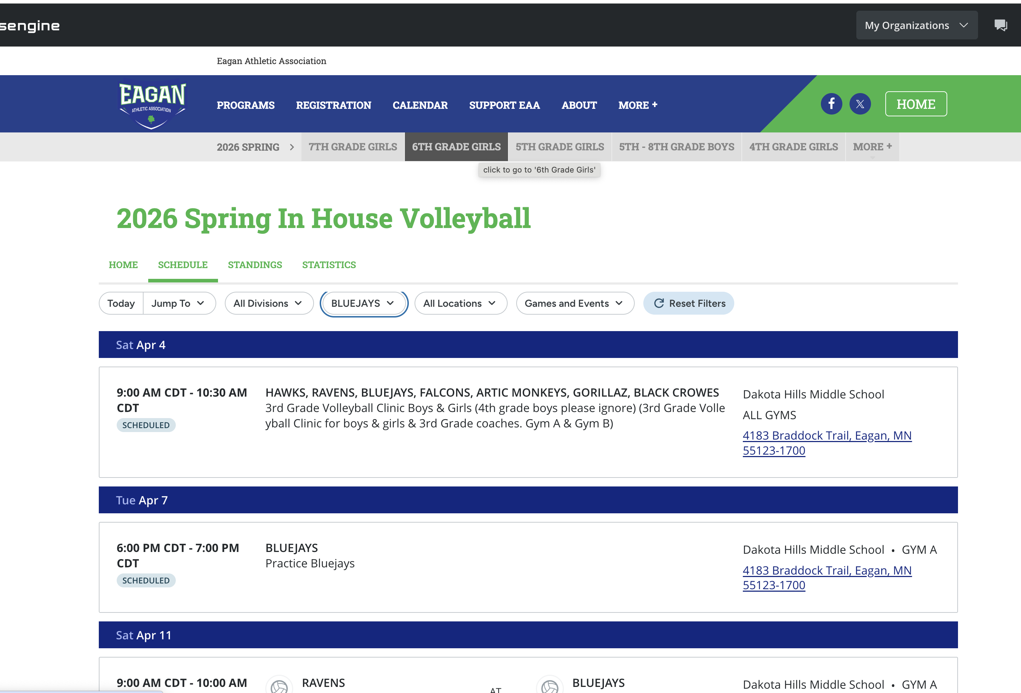
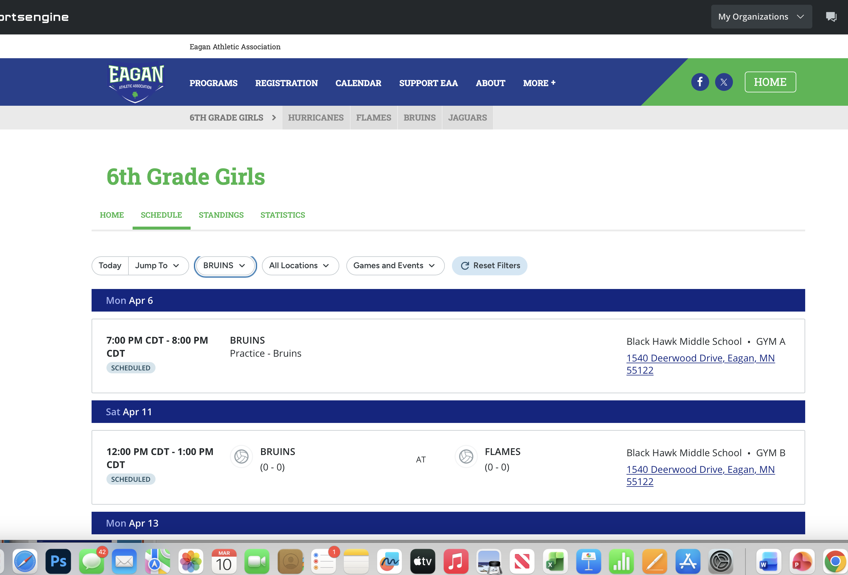
Sports engine – PRACTICE & GAME SCHEDULES

Slide 14
Coach Resources
Spring 2026 in house

Slide 15
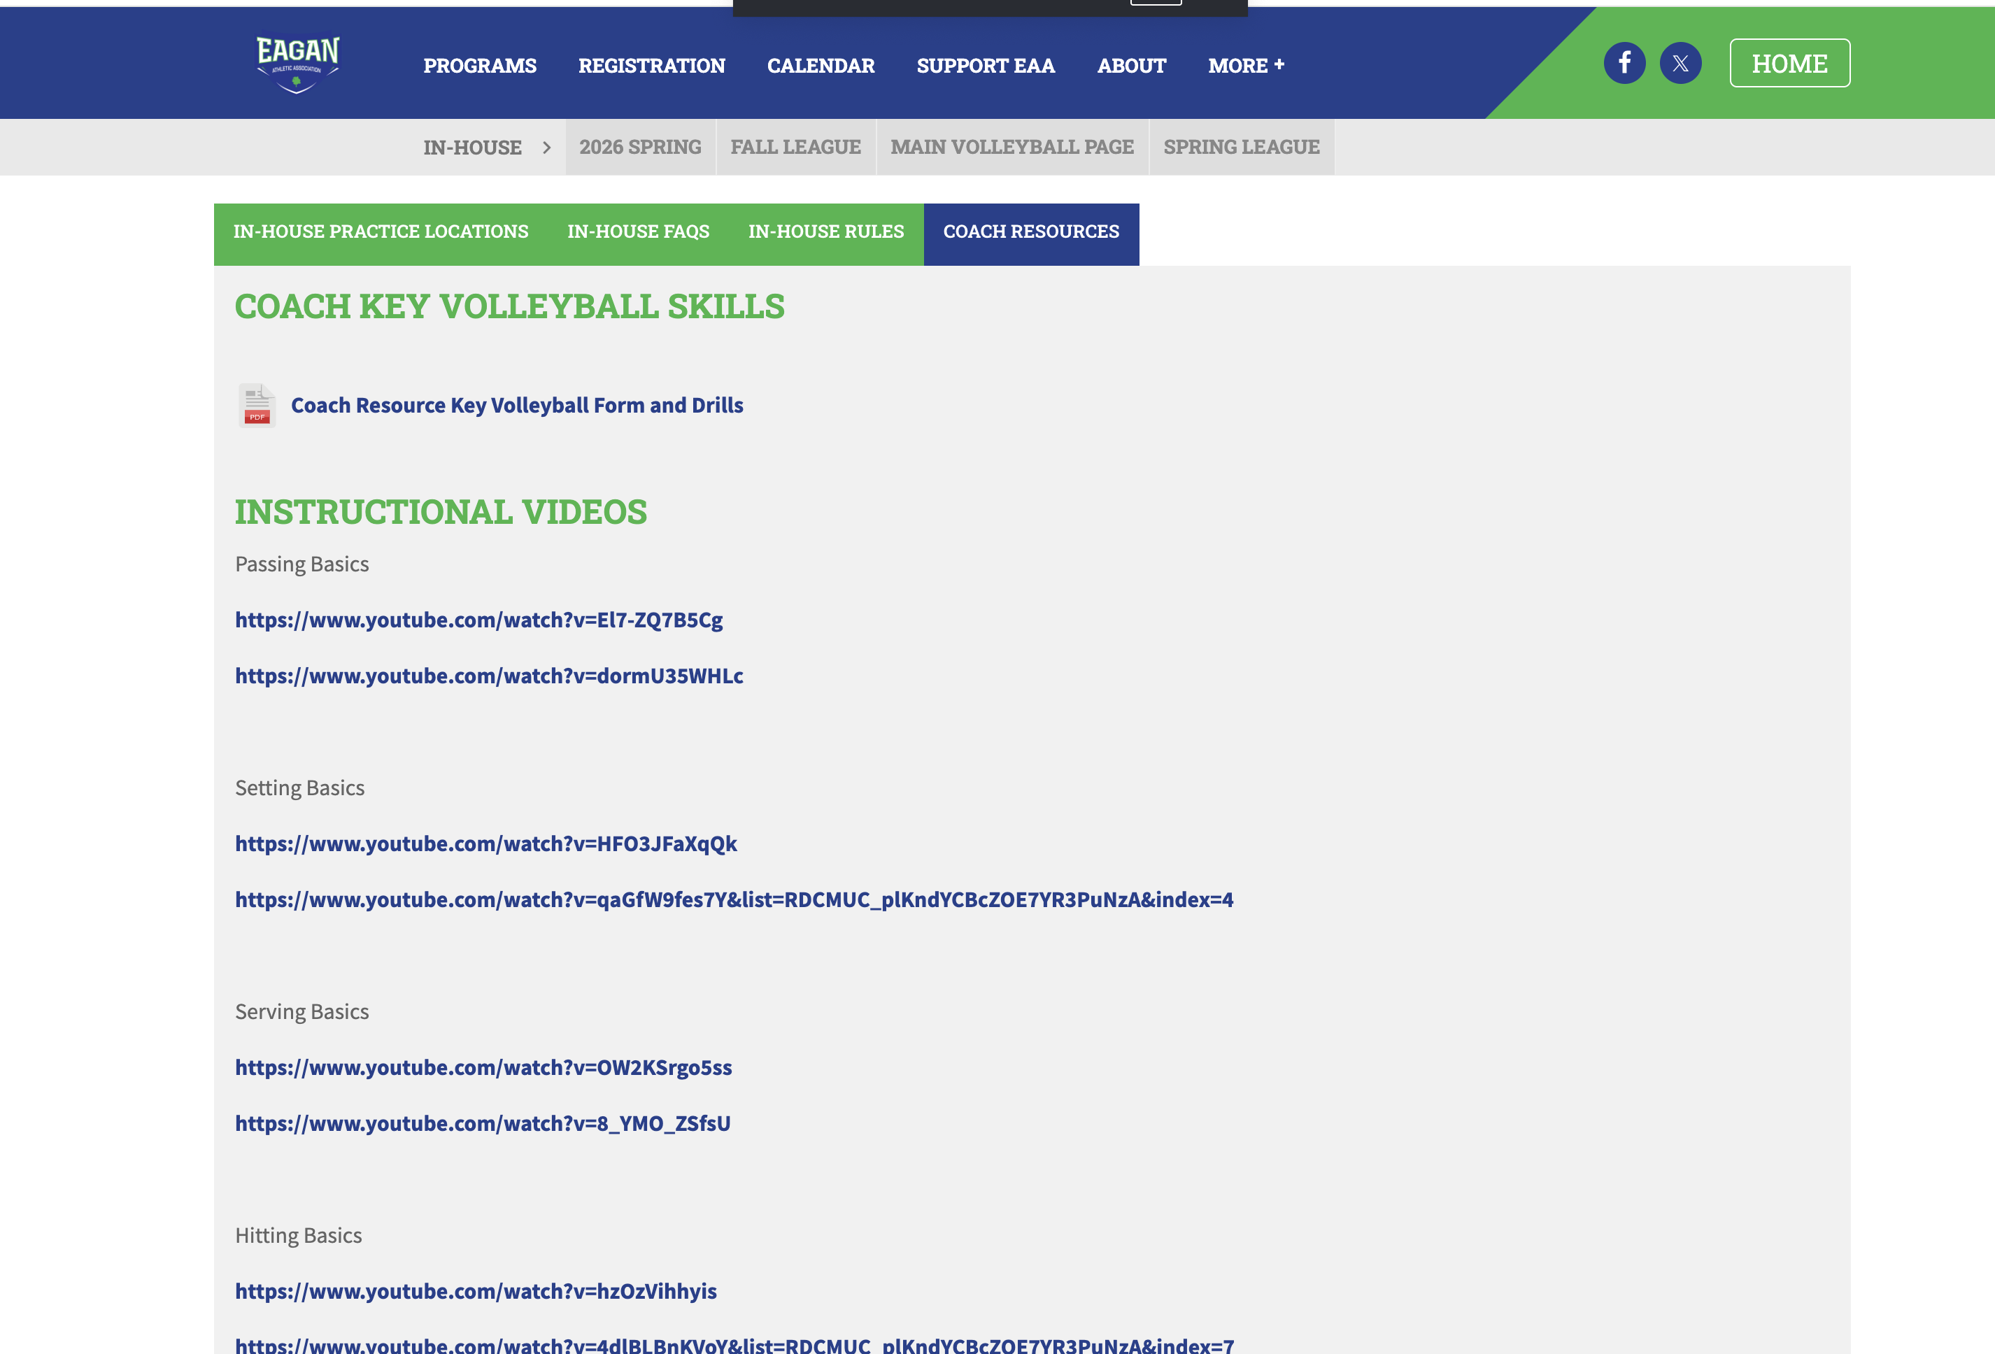
Coach resources
Key Volleyball Forms & Drills
You tube instructional videos

Slide 16
rules
Spring 2026 in house

Slide 17
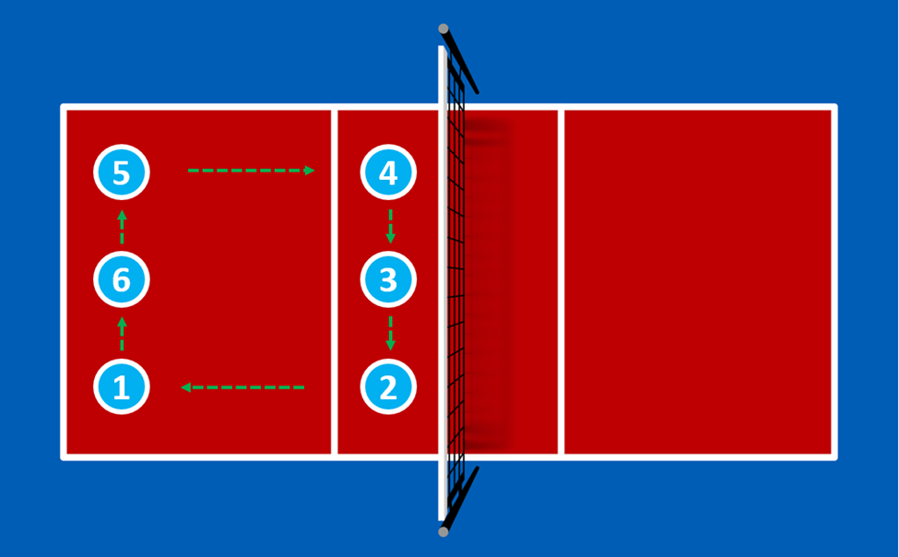
Court layout/rotations
Rotation – 3 front/3 back
Setter – middle front
30’
30’
Serve Line 30’
10’/Attack Line
(Also Serve Line 3rd/4th Grade)
Serve Line 30’
Notes:
3 in front / 3 in back
Setter can be the person in middle front
Server is the person in right back
Demonstrate the rotation direction - everyone should get a chance to rotate in

Slide 18
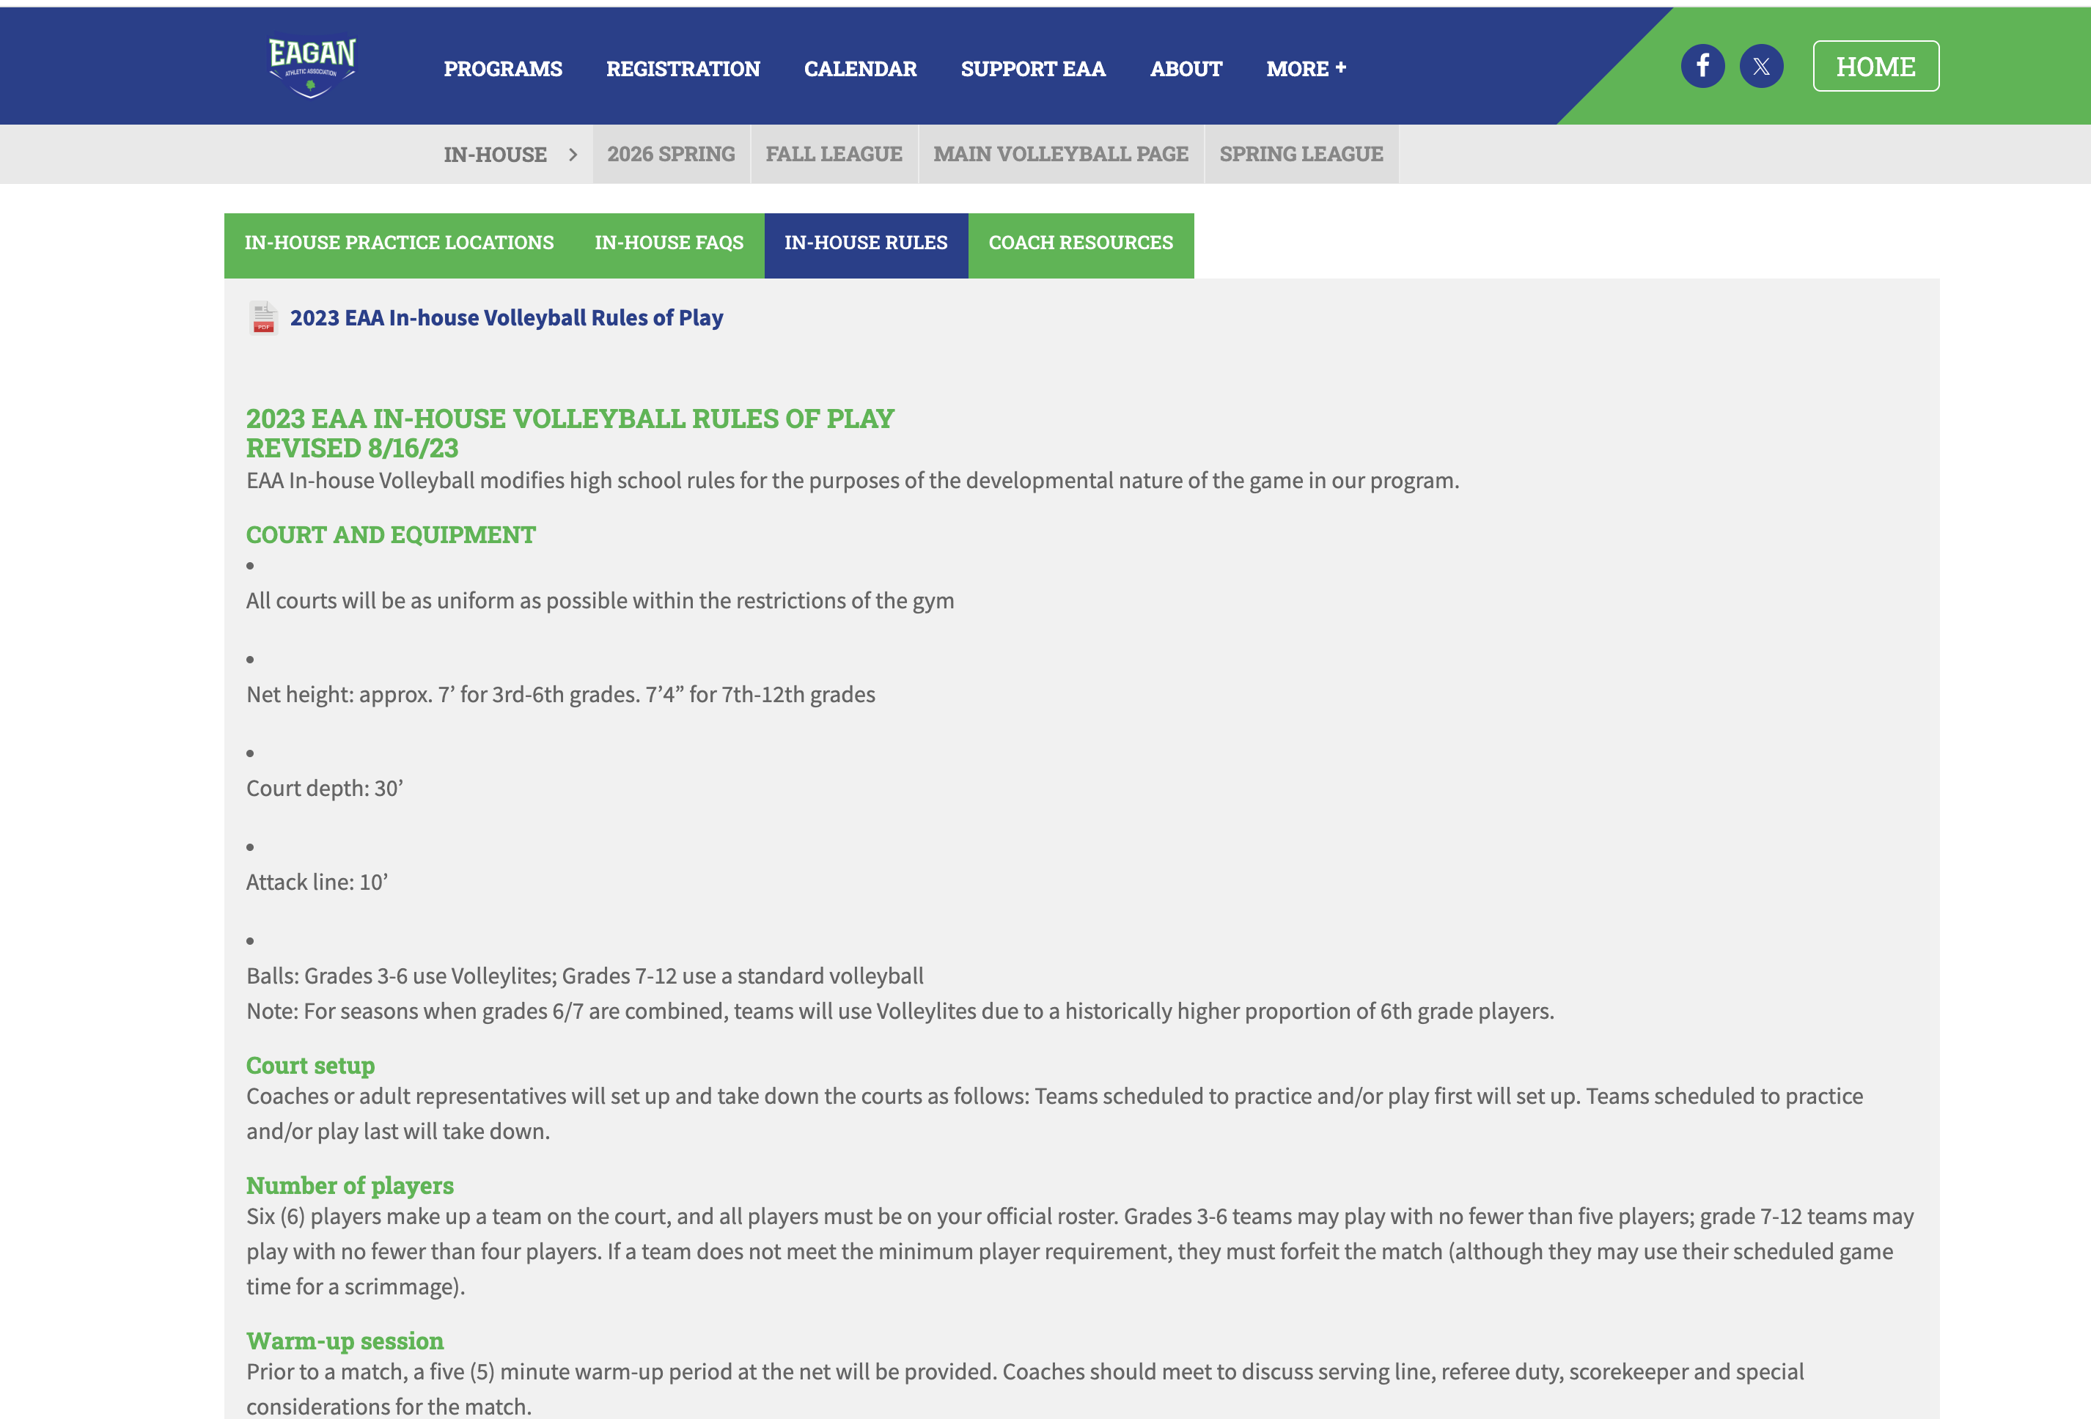
In house rules of play

Slide 19
Game play & scoring
5 minute warm-up
Coaches are referees & scorekeepers
Use whistle for signal for serve!!
Playing time – equal playing time, rotate in
Rotation – 6 players, 3 front row/3 back row rotate to every position. Can switch position after serve in play
Match – won when 1 teams wins 2 out of 3 games
Rally scoring – point is scored on every serve
1st 2 games are played to 25 points, 3rd Game played to 15 points
win by 2 (cap of 29)
3 Hits max on a side

Slide 20
Serving
Grade | Location | # of Tosses | # of Attempts | Max # of Serves
3rd & 4th | 10’ | No Limit | 2 | 3 consecutive Then goes to the other team
5th | 20’ | No Limit | 2 | 3 consecutive Team rotates & new server for same serving team
6th | 20’ | 2* | 1 | No Max
7th & 8th | 30’ | 2* | 1 | No Max
5th – 8th Boys | 20’ | No Limit | 2 | 3 consecutive Team rotates & new server for same serving team
Overhand serving is encouraged & players may step up closer as needed. Encouraged to back up as able.
Serves hitting the net & continuing over the net to the receiving team is legal & will be scored.

Slide 21
Gym important info – your help needed!
Please ensure water bottles are closed tight & if there are spills that they are cleaned up immediately! May need to leave outside of the gym if it becomes an issue
Nets will need to be set up by the first team that practices/game and then taken down by the last team
Chairs for spectators – will be set up and taken down at the start & end of the games. Encourage parents to help. Do not drag chairs across the gym floor!

Slide 22
Net set up
Videos online, can vary by location
7’ 3rd – 6th grade
7’ 4’’ – 7th & up
Boys 5th – 8th - 7’

Slide 23
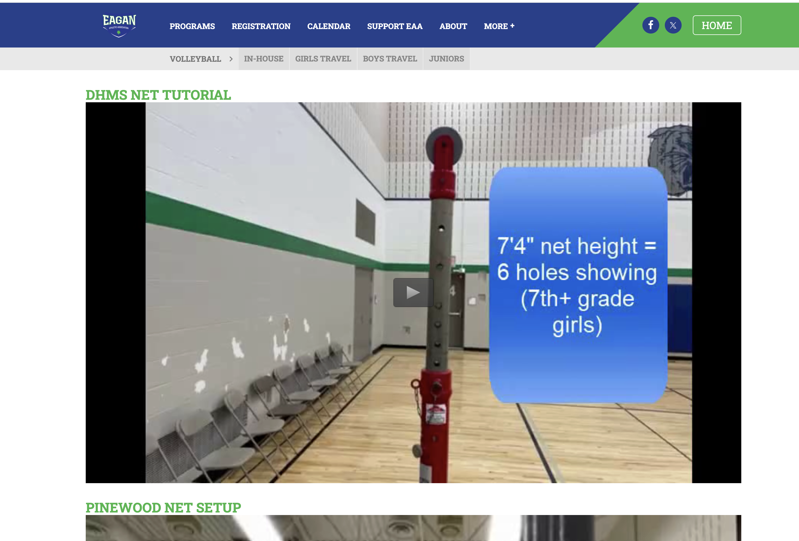
Net Set up by locatioN
FIRST PRACTICE OR GAME TEAM SETS UP NET, LAST TEAM TAKES THEM DOWN!!
Videos for each location On-line
If equipment needs including net repairs or parts email volleyballequipment@eaasports.org

Slide 24
lead by example, demonstrate & encourage SPORTSMANSHIP & teamwork, ENCOURAGe your team to HAVe FUN!
Have a great season!
Questions?
** Pick up your equipment **

