Slide 1

OAK HILLS
BASKETBALL
COACHES CLINIC

Slide 2
TOPICS
1
Purpose. WHY?
2
Practice/Planning
3
Shared Practices
4
Parent Meeting/ Resources

Slide 3

Your role and your goal
WHY WE DO WHAT WE DO
01

Slide 4

Ambassadors for our program. We ask that you use our core values to provide a great experience for the young men and young women you coach.
More than X’s and O’s and more than wins and loses.
Are kids excited the season is over or excited to get in the gym
Thankless job

Slide 5
COACHING PHILOSOPHY
This isn’t your full time job
Teach kids how to play the game -
we must prepare them to play without us.
Fewer sets, less numbered positions! We know it is hard to score.
We want to eliminate kids looking to the bench for the next set play or for approval for what they should do next.

Slide 6
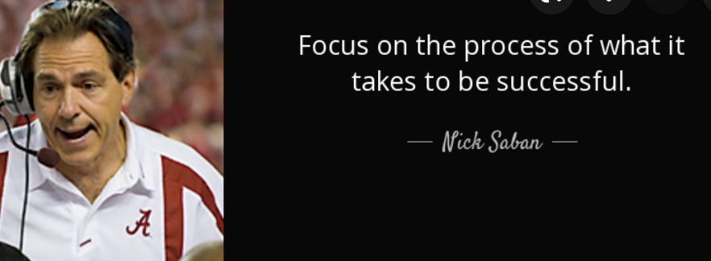
The Journey
Focus on the process and less on results
Show kids how to work hard, work together and be great teammates

Slide 7
HOW?
1. Share Experiences - Trust
2. Core Values - Positive Coaching
3. Intentional Practices
4. Great Teammates - Servant Leadership
5. Accountability
6. Don’t focus on the outcome

Slide 8
Share Experiences - Trust
1. Tough competitive practices
2. Meals before/after games
3. Non-basketball activities - culture (we can share activities with you)
4. What’s your why/Group Circle
5. Things we did well, things we need to improve

Slide 9
2. Core Values - Positive Coaching
1. I love it when you…
2. Minimum 5 positive to 1 negative
3. Don’t discuss other players in front of teammates
4. Daily progress
5. “Coach ahead”- be verbal during practice
6. Show vs. tell….

Slide 10
3. Intentional Practices
1. Practice plans - doesn’t have to be fancy
2. K.I.S.S.
3. 2 days, 2 weeks, 2 months
4. Echo Drills/Echo Commands
5. Install Schedule

Slide 11
4. Great Teammates - Servant Leaders
1. Connection - high fives
2. Coming off/on floor during games
3. Bench Mob (Ben Zahneis)
4. Team Circle - Positives
5. Stars in your role - focus praise on non-scorers. Billy Donovan. Why?

Slide 12
5. Accountability
1. No excuses - officials, luck, unfair
2. How do we compete?
3. Academics
4. Practice behavior/expectations
5. Gold Jersey

Slide 13
6. Don’t Focus On Results
1. Charlie Coles
2. Results distract from the process
3. If we play bad and win is that better than playing well and losing?
4. I get it - can’t have good experience unless we win.
Kids want to continue to play in sports they have a good experience “fun”.

Slide 14
Practice/Planning
02

Slide 15
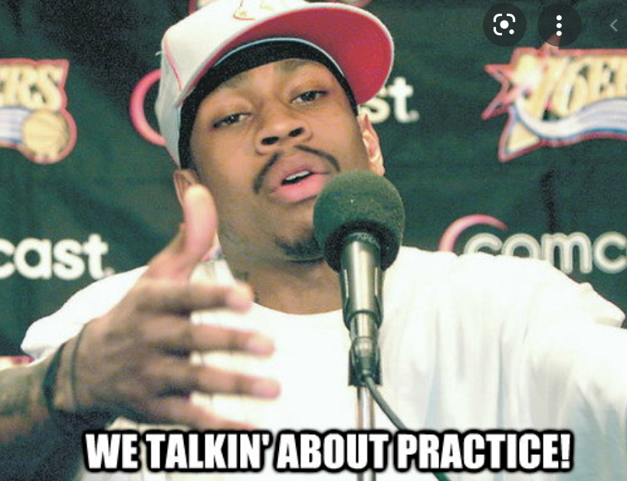
Practice Planning

Slide 16
Always, always, always have a practice plan
Doesn’t have to be fancy - KISS (Matt Painter)
First 20-30 don’t change - change the challenge, change the rules, make them compete
Google docs - all coaches can share/add. Give your assistants a role/job
COMPETE, COMPETE, COMPETE
Most undercoached skill we see - kids don’t know how to compete/struggle/not win
Create pairs for each drills - STOPWATCH

Slide 17
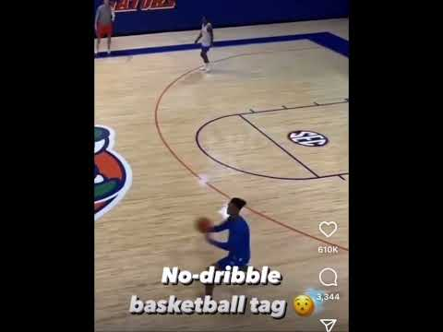
Make practice “fun”

Slide 18

These are the only leagues that you have more games than practices!
With limited gym time this season it is going to be critical that you maximize the gym time that you have. It also would help if you are willing to practice with other teams to increase your time in the gym

Slide 19
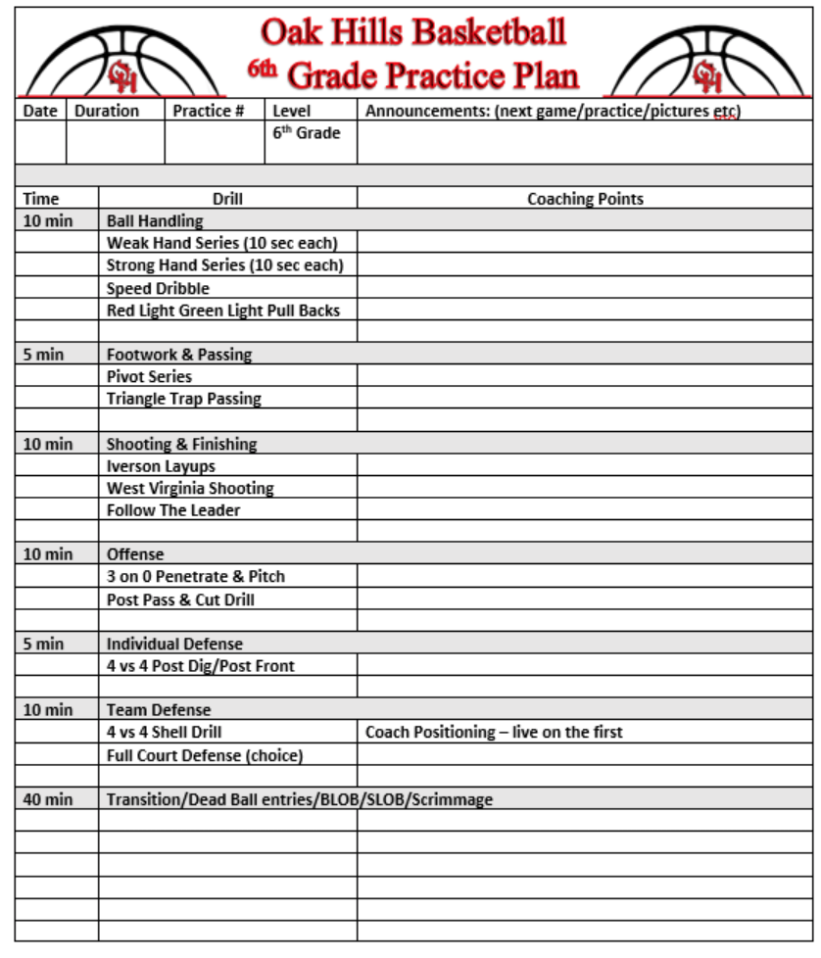
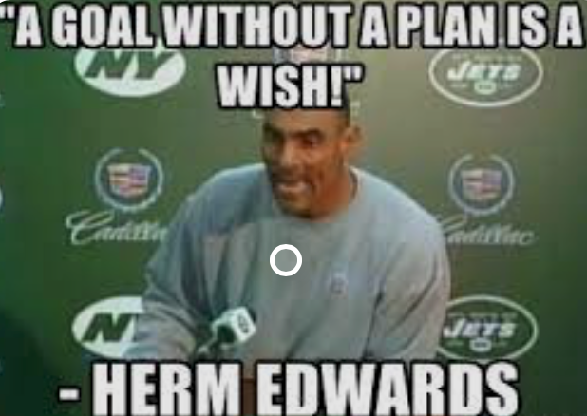
Practice Planning
Simple and organized
2 days, 2 weeks, 2 months
Google Docs
Access to all my 3rd/4th and 5th grade practice plans
We had 34 practices last year
3,060 mins
51 hours

Slide 20
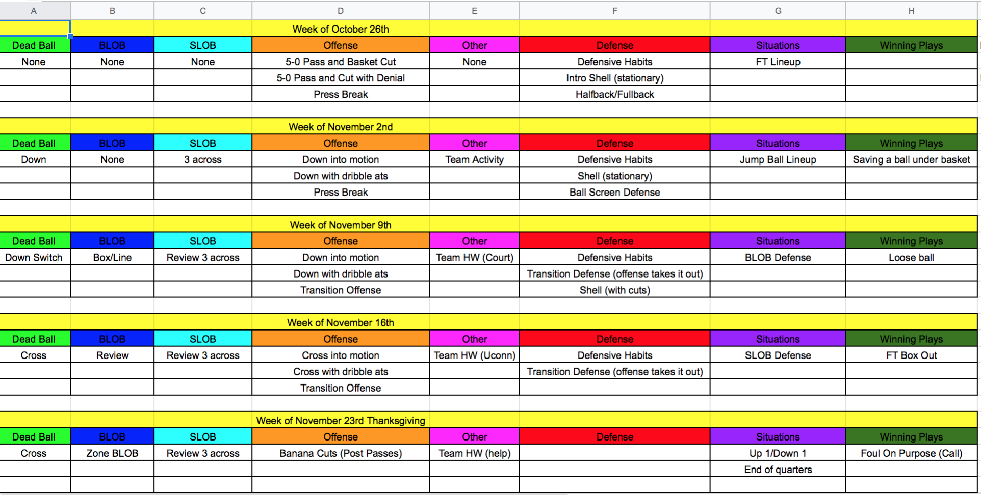
5th Grade Girls Install Schedule

Slide 21
Practice Planning
Major Areas of Focus
Ball Handling
Passing
Footwork & Body Control
Shooting
Movement & Finishing
Rebounding
Team Offense
Team Defense
Basketball IQ
Grade by grade standards - scaffolding(year to year)

Slide 22
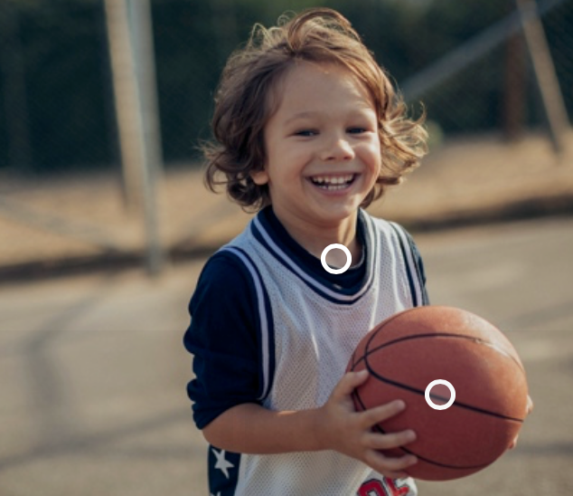
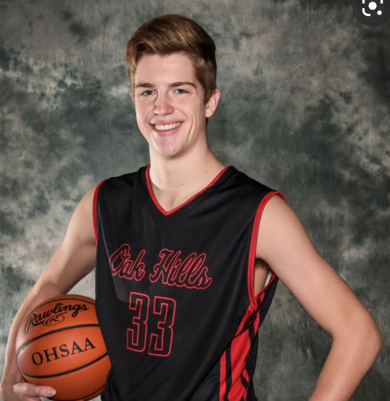
Why these drills?
Why this terminology?

Slide 23
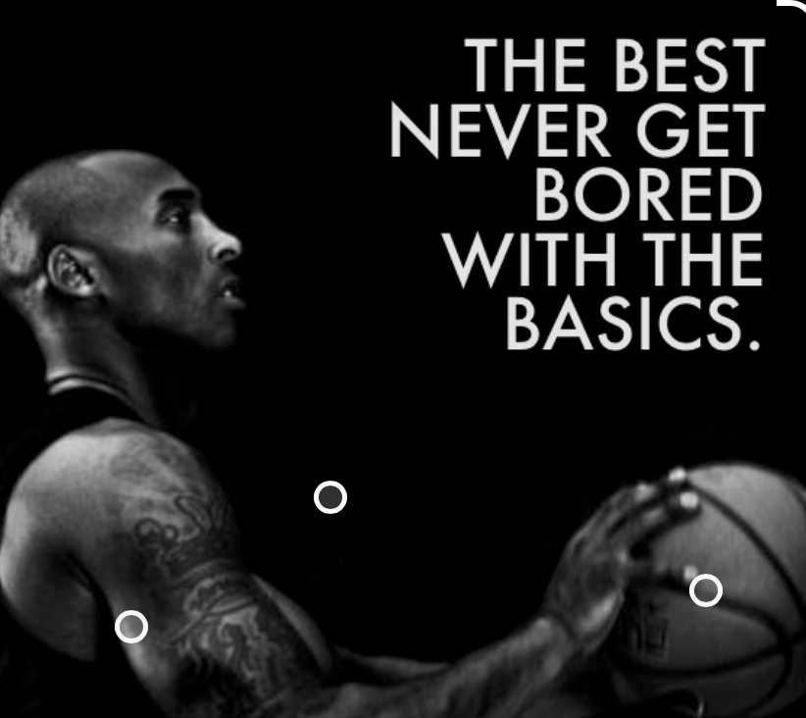
If I always do the same drills won’t the kids get bored?
The best players on your team want to compete. Make drills competitive and they will never be bored.

Slide 24
Shared Practices
Two Teams Per Grade
03

Slide 25
Structure & Format
Are you practicing at the same time or practicing together?
The best part of practicing together is…
1. Competition
2. All players get the same coaching. At least two coaches coaching. One program - two teams
3. Breaks the glass ceiling - player flexibility
4. Potential to extend tryout. Tryouts vs. Practice
5. It does allow 5 vs. 5

Slide 26
Competition
1. Mix and match players from each team for all drills
we do focus on winners/losers (great teammate)
2. Split Ends - more reps
3. Players are coaches by different coaches and different styles while getting the same message
4. Allows others to coach your son/daughter

Slide 27
Same Coaching - Same Instruction
1. Kids are used to both sets of coaches - easier transition if kids move teams.
2. I can’t keep this kid he doesn’t know our plays.
3. All kids get the same experience - I didn’t make the A team so I am quitting basketball
4. Coaches can help each other - diverse backgrounds, pick each other up
5. Excited for successes of each team - parents/kids attend other teams games

Slide 28
Glass Ceiling is Being Broken!
1. As we run tryouts and help with team formations you are going to have more turnover of A/B/C/D teams. (how we create teams)
2. Practicing together give you a greater ability to move up and down between the two teams as kids develop year to year
3. Kids are more motivated at practice

Slide 29
Parent Meeting
Resources
04

Slide 30
Parent Meeting
All teams should have a parent meeting prior to the start of your teams games in December.
Topics to discuss include
  Practice/Game Expectations (missing events)
  Playing time (sub sheet example)
  How we handle conflict (24 hr rule)
    Never discuss another player w/other parent
- Development over wins (success)
- Potential off court assignments

Slide 31

Resources
Always a call or an email away
Google - all practice plans shared (OHYA Folder)
OHYA Standards 3rd through 6th grade (website)
Coach Price or Coach Rolfes
31

Slide 32

THANK YOU
We appreciate all you do for our programs
JTAPS after skills demo

