Slide 1

MYHA Annual Membership Meeting
2018-2019

Slide 2
Agenda!!
Welcome
LTS/Mite Team Recognition
Scholarships and Donations
Team Recognition & Awards
Annual Meeting

Slide 3
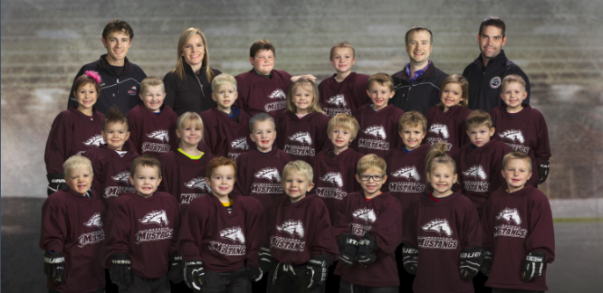
LTS
Coach: Jake Cimino
Assistant Coaches: Travis Olson, Nate Richartz, Dave Schwedler
Brian Gowling, Megan Cummings, Adam Kramschuster
Team Manager: Kate Kramschuster

Slide 4
LTS
Liam Arvold
Emmitt Bailey
Oliver Benedict
Jase Chevatal
Korbin Chevatal
Micah Cimino
Drew Closson
Molly Cummings
Sammie Curtis III
Spencer DeVries
Mason Douglas
Lillian Dowd
Augustus Elkin-Growe
Nora Gowling
Zuma Hazwood
Alex Houle
Bree Houle
Charli Jax
Gauge Johnston
Malachi Kirby
Jack Kramschuster
Noah Kramschuster
Kasey Krueger
Zoey Lomen
Finley Marincel
Braxton Mortiz
Collin Phillipps
Mallory Phillipps
Liam Pierson
Kira Pierson
Hudsen Richartz
Kaylee Roodell
Kenneth Schalte
Ethan Scheler
Lincoln Schemenauer
Issac Schwedler
Lucas Smith
Ethan Williams
Roman Wirtz
Jacoby Young

Slide 5
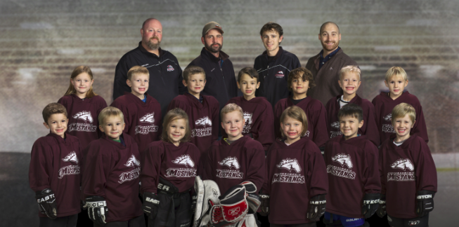
Mini Mites
Coach: Jacob Cimino
Assistant Coaches: Russ Bahr, Josh Delaney, Jesse Andrist
Team Manager: Janelle Johnson

Slide 6
Mini Mites
Steven Andrist
Graysen Bahr
Talon Baillargeon
Baron Blaisdell
Kian Brewe
Madelyn Cimino
Cayden Cummings
Samuel Czechowicz
Lexi Delaney
Hannah Hansen
Kolten Hintzman
Maddux Johnson
Zeke Skoug
Bryson Wayne

Slide 7
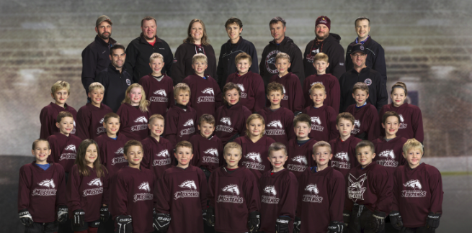
Mites
Coach: Nolan Dowd
Assistant Coaches: Ashleigh Cody, Lewis Bjork, Jacob Cimino, Josh Delaney,
Geoff Pogorelski, Dave Schwedler, Brian Gowling, Bob Weir
Team Manager: Sara Holcomb

Slide 8
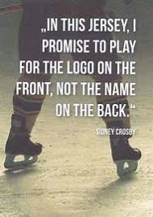
2010 Mites
Leo Foss
Matthew Bertetto
Brekkin Cody
Cashton Steinmeyer
Jaxon Giertz
Scott Holcomb
Landon Delaney
Jack Czechowicz
Remington Wayne
Dillion Kopaczewski
Pearl Swaenepoel
Kaden Farrah
Camden Berthiaume
Sam Smith

Slide 9
2011 Mites
Caz Jax
Aiden Wamboldt
Ashton Wamboldt
Kynlee Hintzman
Issac Cimino
Westen Weir
Eli Schwedler
ZoA Skoug
Franklin Pogorelski
Kinzleigh Cody
Oliver Bjork
Mason Freeland
Tyler Pember
Henry Dowd
Tatum Giertz
Joseph Gowling
Clayton Slupe

Slide 10
Special Recognition
Dale and Fisher Families

Slide 11
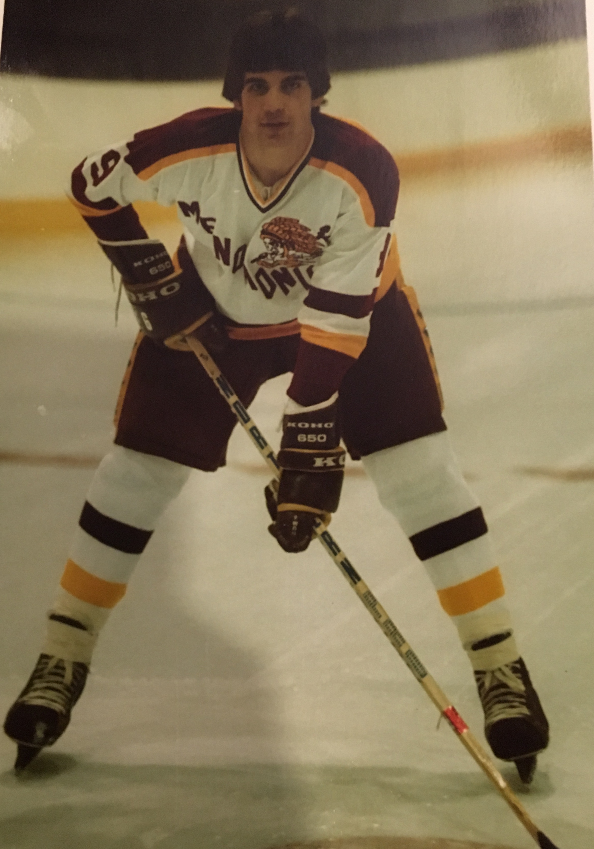
John R Dale Memorial Youth Hockey Squirt Scholarship Fund
2018 Recipient
AJ Lawrence

Slide 12
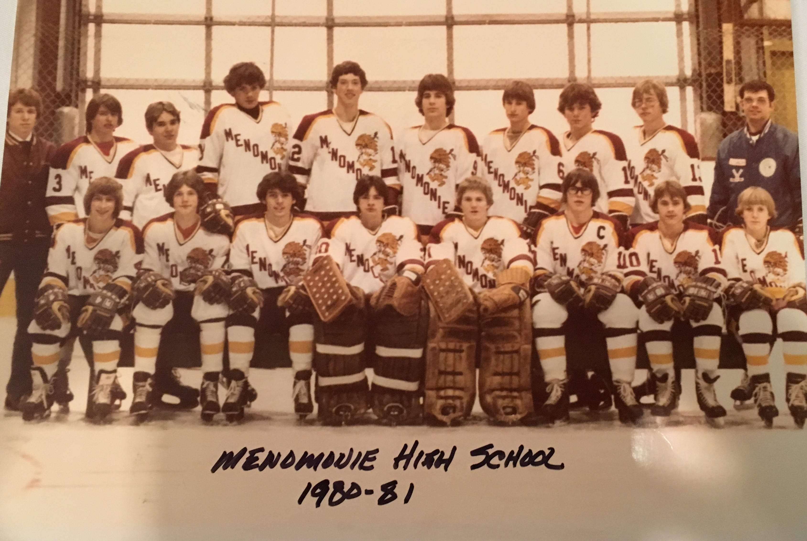
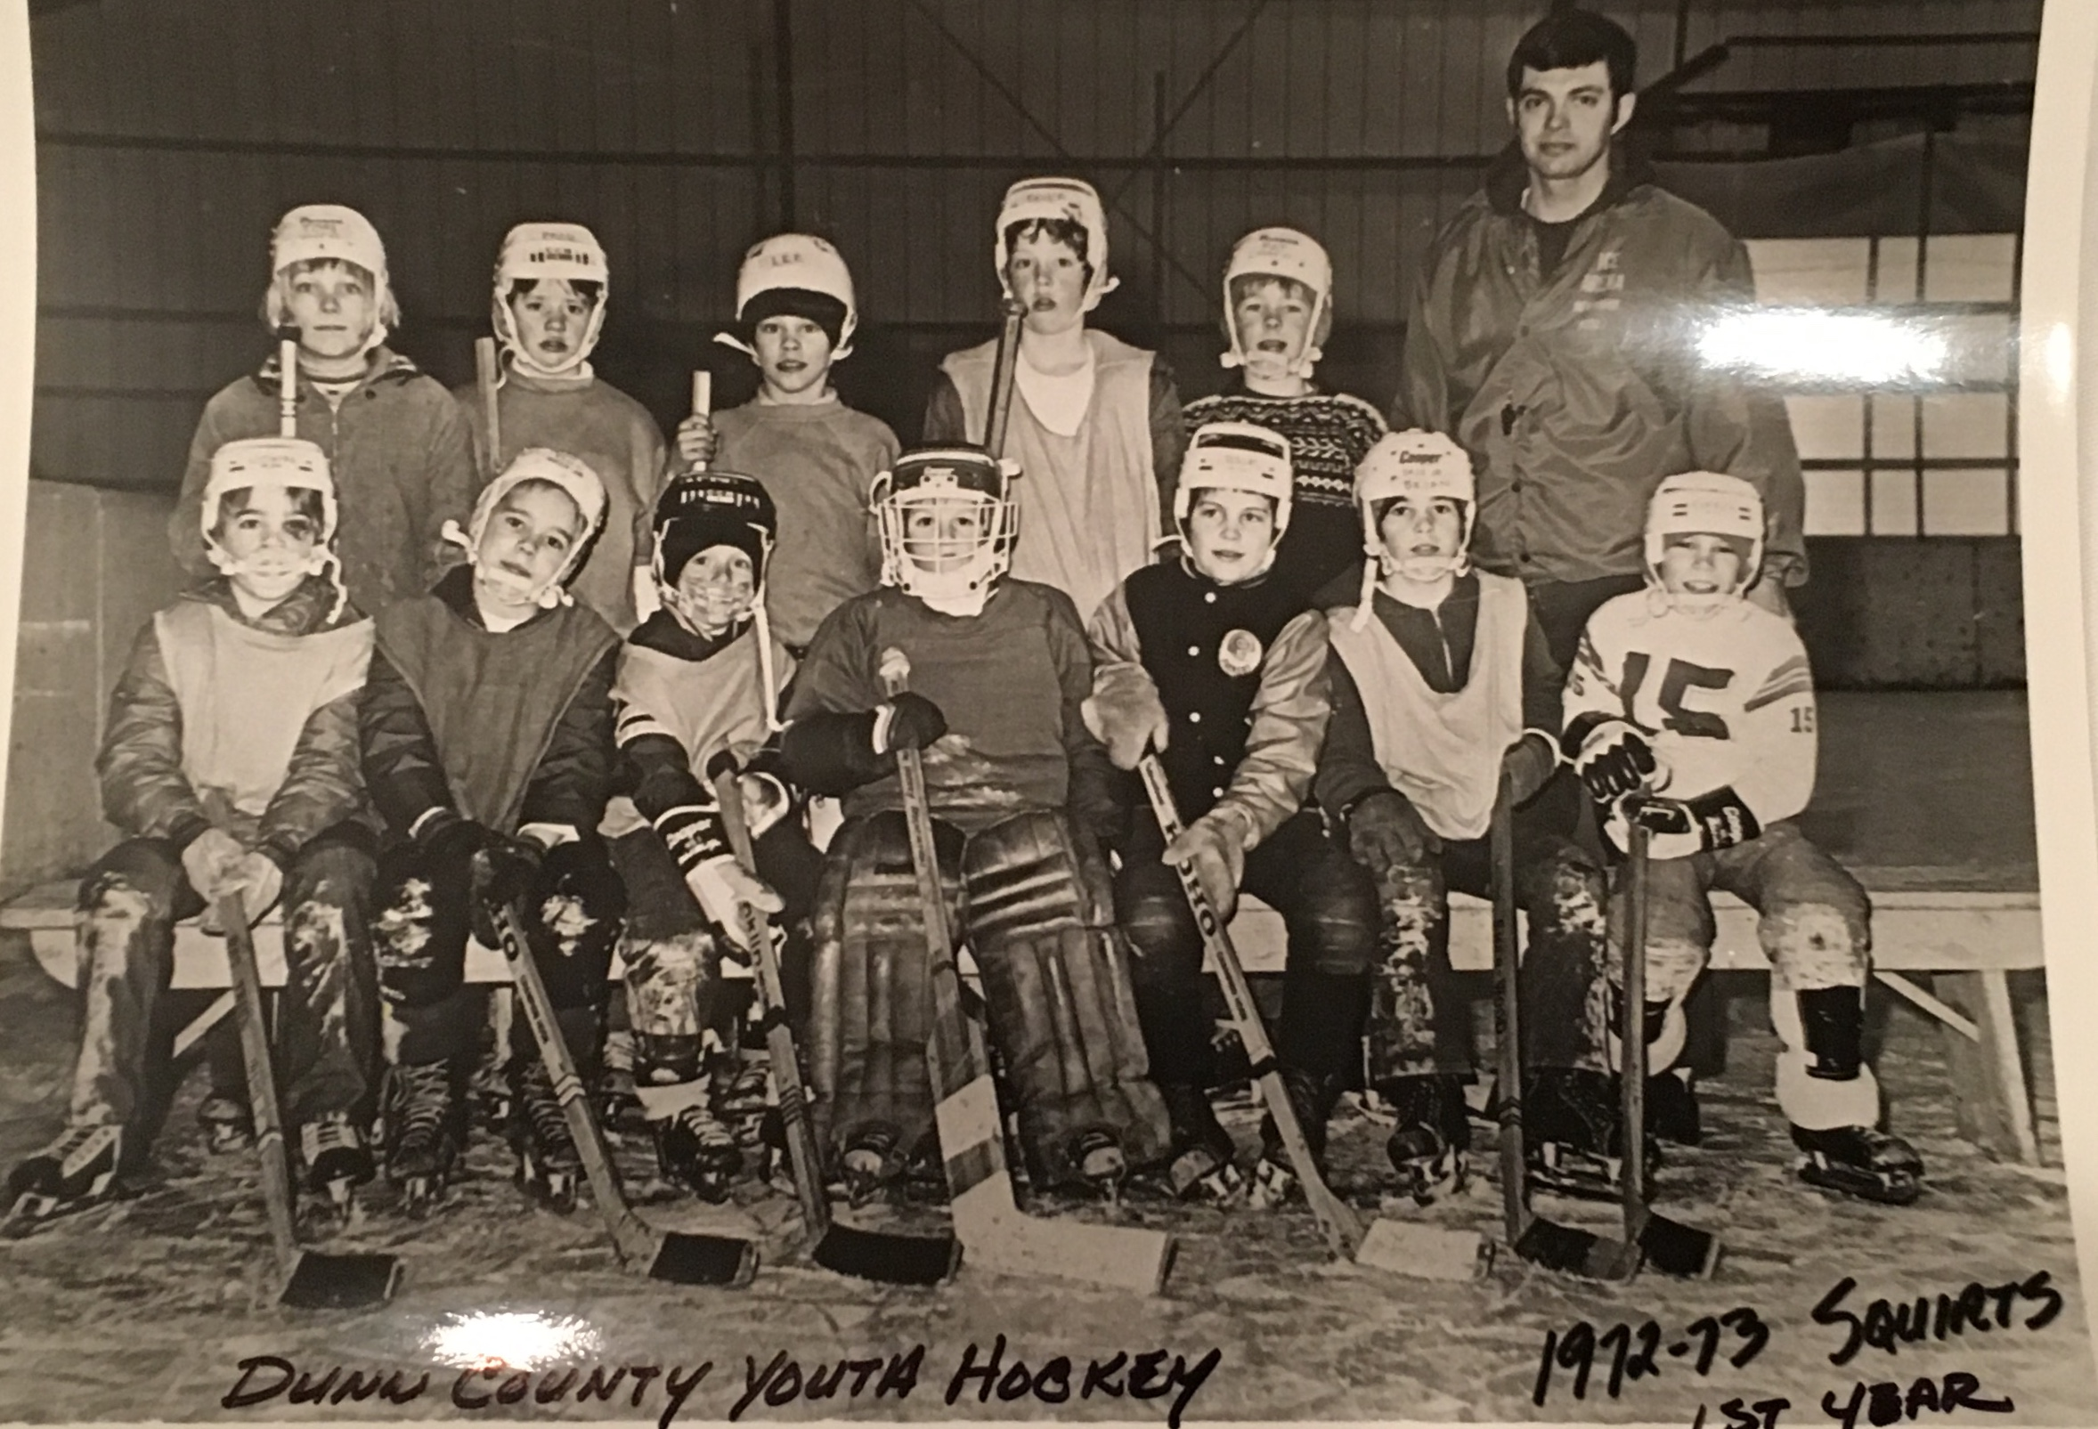

Slide 13
Thank you! For your continued support of MYHA!
Mike Fisher Family

Slide 14
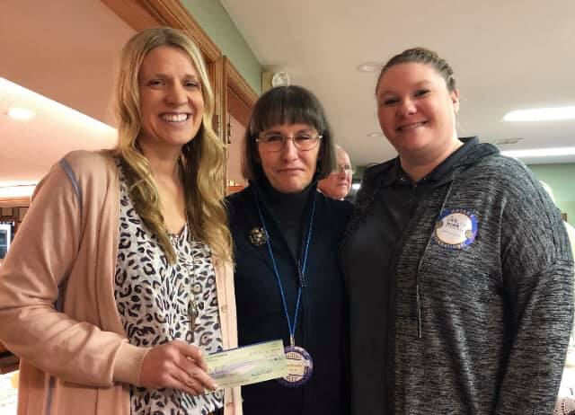


THANK YOU MENOMONIE ROTARY & MENOMONIE CHAMBER OF COMMERCE!!

Slide 15

Team Recognition & Awards

Slide 16
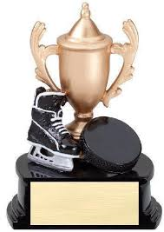
Squirt, Peewee, and Bantam Awards
Patches
Most Improved Award
Leadership Award
Sportsmanship Award

Slide 17
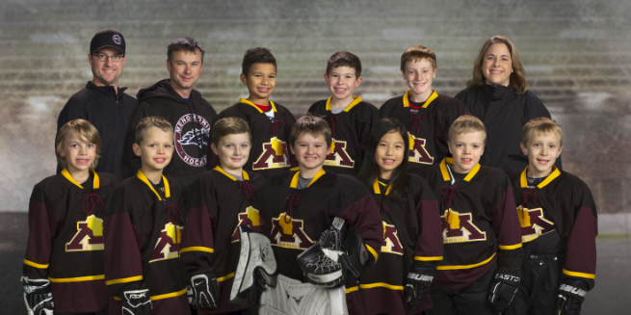
Squirt B
Head Coach: Rhonda Messerschmidt
Assistant Coaches: Nolan Dowd & Brent Pember
Team Manager: Joyce Dahms

Slide 18
Congratulations…
Hat Trick:
Corbin Cockeram
Ben Dahms
Aiden Mork
Allison Xu
Play Maker:
Ben Dahms
Zero Patch:
Edmund Dowd

Slide 19
Squirt B Awards
Most Improved: Aiden Mork
Leadership: Ben Dahms
Sportsmanship: Allison Xu

Slide 20
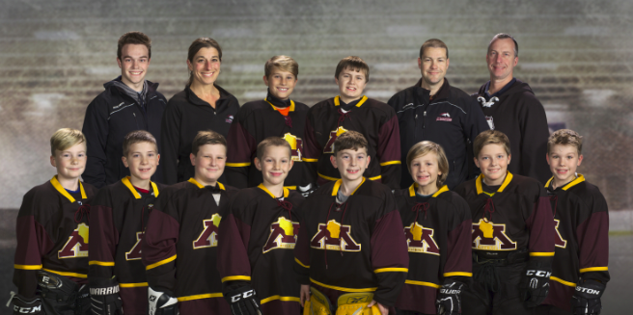
Squirt A
Head Coach: Tom Niska
Assistant Coach: Kyle DeVries, Kalani Swaenepoel, Casey Tilkins
Team Manager: Cassandra Ellis

Slide 21
Congratulations…
Hat Trick:
Jett Lenfant
Cooper Marincel
Oliver Prechel
Wren Swaenepoel
Play Maker:
Blake Niska
Zero Patch:
Davin Ellis

Slide 22
Squirt A Awards
Most Improved: Liam Wachewicz
Leadership: Davin Ellis
Sportsmanship: Wren Swaenepoel

Slide 23
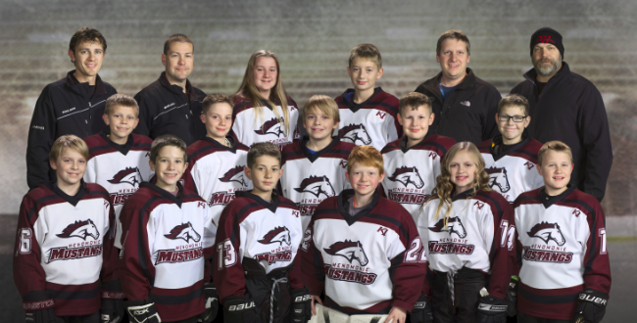
Peewee B
Head Coach: Chad Ayres
Assistant Coaches: Bruce Neverdahl, Kyle DeVries & Jacob Cimino
Team Manager: Margo Neverdahl

Slide 24
Congratulations…
Hat Trick:
Logan Cockeram
Mitchell Kopaczewski
Peter Cimino
Zero Patch:
Caleb DeVries

Slide 25
Peewee B Awards
Most Improved: Bryce Neverdahl
Leadership: Logan Cockeram
Sportsmanship: Deven Ayres

Slide 26
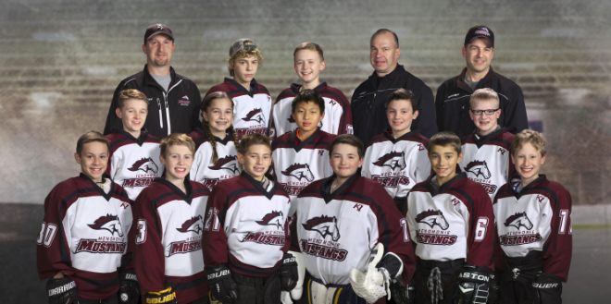
Peewee A
Head Coach: Greg Slupe
Assistant Coaches: Shawn Slind & Bob Weir
Team Manager: Luke Welch

Slide 27
Congratulations…
Hat Trick:
Parker Marincel
Colton Szotkowski
Ryan Xu
Alex Slind
Play Maker:
Cody Dahms
Rex Drout
Hayden Weir
Zero Patch:
Carl Rabeneck

Slide 28
Peewee A Awards
Most Improved: Ryan Xu
Leadership: Cody Dahms
Sportsmanship: Parker Marincel

Slide 29
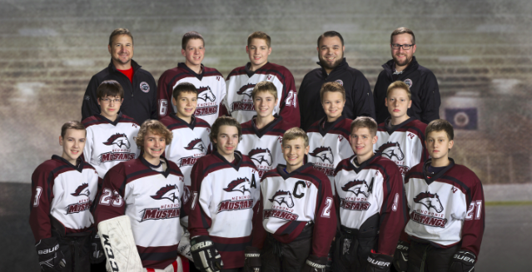
Bantam
Head Coach: Paul Wurtz
Assistant Coach: Max Steuer & Mike Sullivan
Team Manager: Joyce Dahms

Slide 30
Congratulations…
Hat Trick:
Waylon Rogers
Play Maker:
Reid Fenton
Caleb Schneider
Connor Dean
Zero Patch:
Jack Drout

Slide 31
Bantam Awards
Most Improved: Caleb Schneider
Leadership: Connor Dean
Sportsmanship: Jack Drout

Slide 32
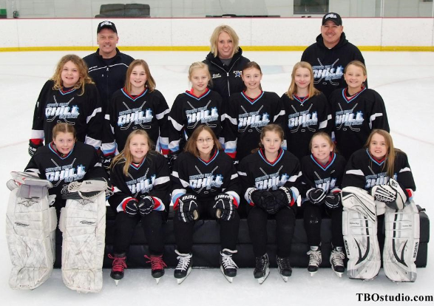
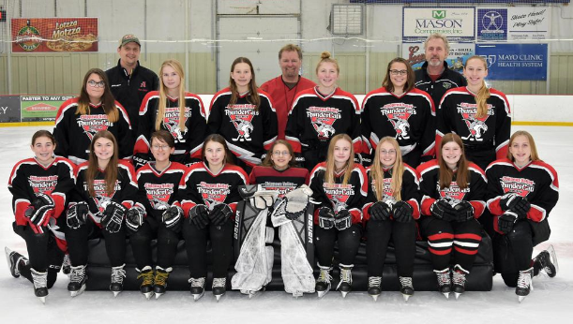
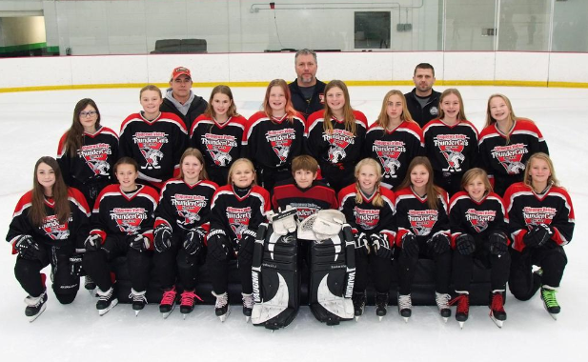
Girls Co-op
10U
Aubrie Dowd
Brooke Fenton
12U
Tessa Leisses
Addison Sobota
14U
Rhyenne Furstenberg

Slide 33
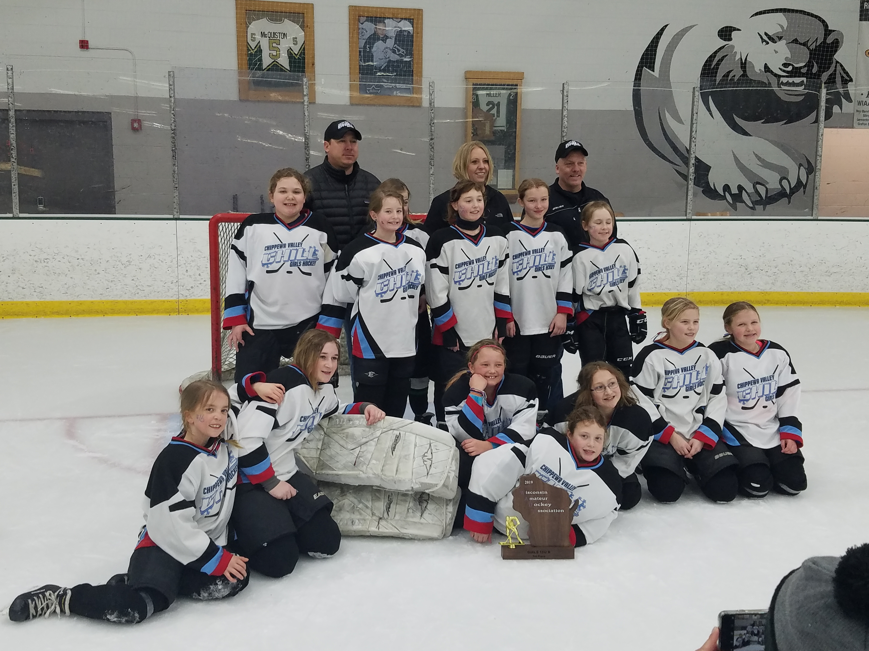
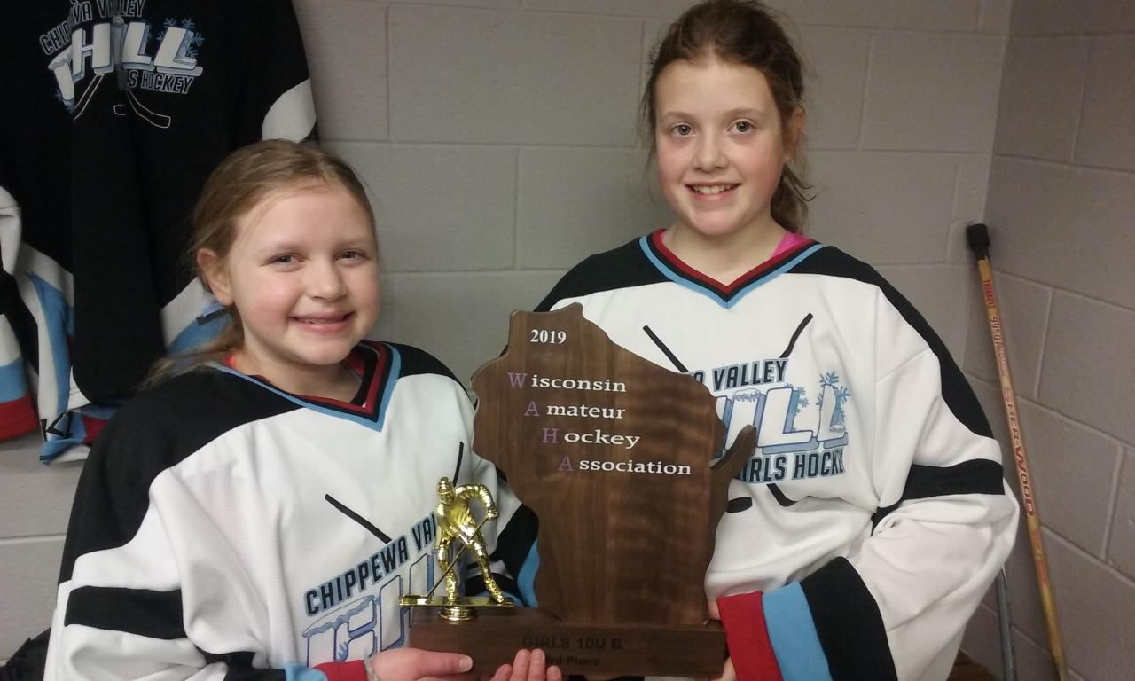
CONGRATULATIONS….

Slide 34

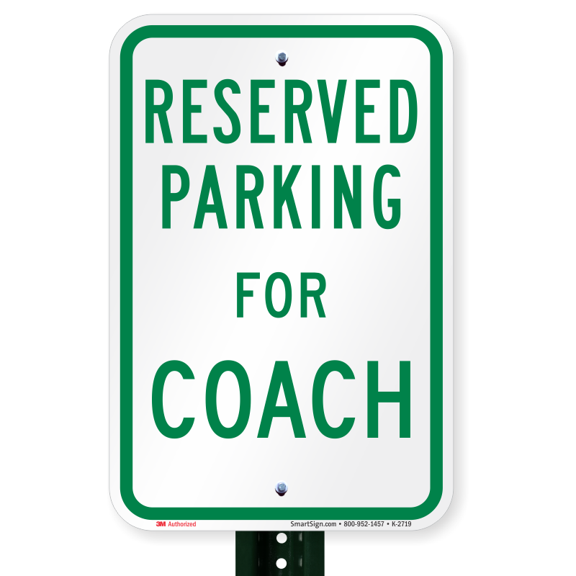
Reserved For…

Slide 35
Member of the Year Nominations
Cassandra Ellis
Glenna Family
Kate & Adam Kramschusters
Heidi Neverdahl
Dave Schneider
Jason Wayne
Troy Wilkens
Congratulations & Thank You to
Dave Schneider
Notes:
Russ

Slide 36
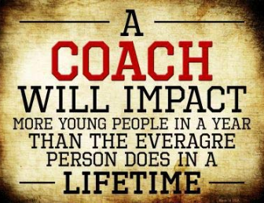
Coach of the Year Nominations
Congratulations & Thank You to
Paul Wurtz
Notes:
Russ

Slide 37
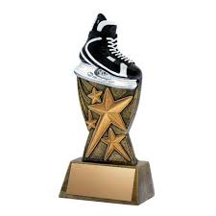
Rob Smith Memorial Award
Rob Smith, who played youth hockey from 1977-1987 and was a gifted and committed athlete.
The criteria used to select the recipient best describe Smith’s ideals on the ice, and include:
1.) Appreciate and respect your coaches
2.) Develop an understanding of organized sports
3.) Learn the importance of team play
4.) Represent team spirit and good sportsmanship
5.) Be the best that you can be

Slide 38
Congratulations…
Ashley Slupe

Slide 39
Annual Meeting
March, 2019

Slide 40
MYHA Board Update and Recognition
Coaches & Team Managers
Committees
Register
Board
Past President – Keila Drout
Treasurer – Gary Messerschmidt
Secretary – Adam Wamboldt
VP General Operations & Registration – Brent Pember
VP Scheduling & Tournaments – Mike Jax
VP Concessions – Sara Bahr
VP Hockey Operations & Equipment – Bob Weir
VP Communications & Recognition – Kari Berthiaume
VP Fundraising – Chelse Cockeram
Thank
You!!

Slide 41
Voting:
Board Members
Welcome Back…
Stacy Hintzman (President)
Sara Bahr(Concessions)
Mike Jax (Scheduling)
VP of Fundraising Remains Vacant
By-Law Changes
Terminology
8 Voting Members (vs 7)
New Board Positions/Titles (Equipment/Marketing)
Three Year Term (vs 2)
<40% Turnover
Ice Board:
Voting Rights
Additional Representative

Slide 42
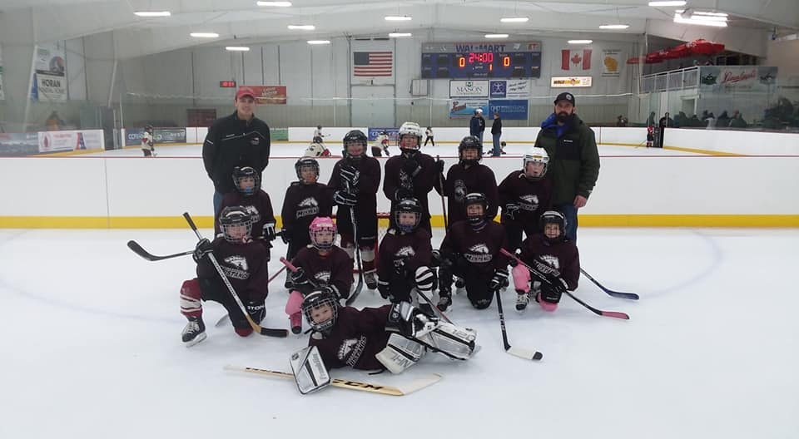
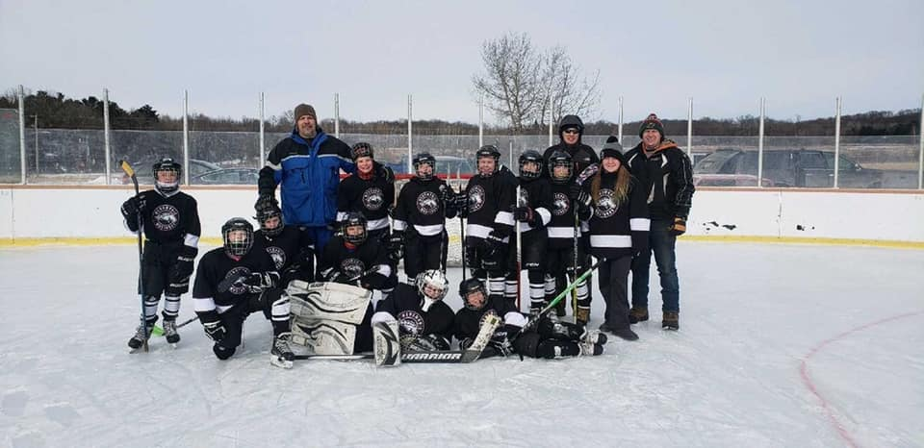
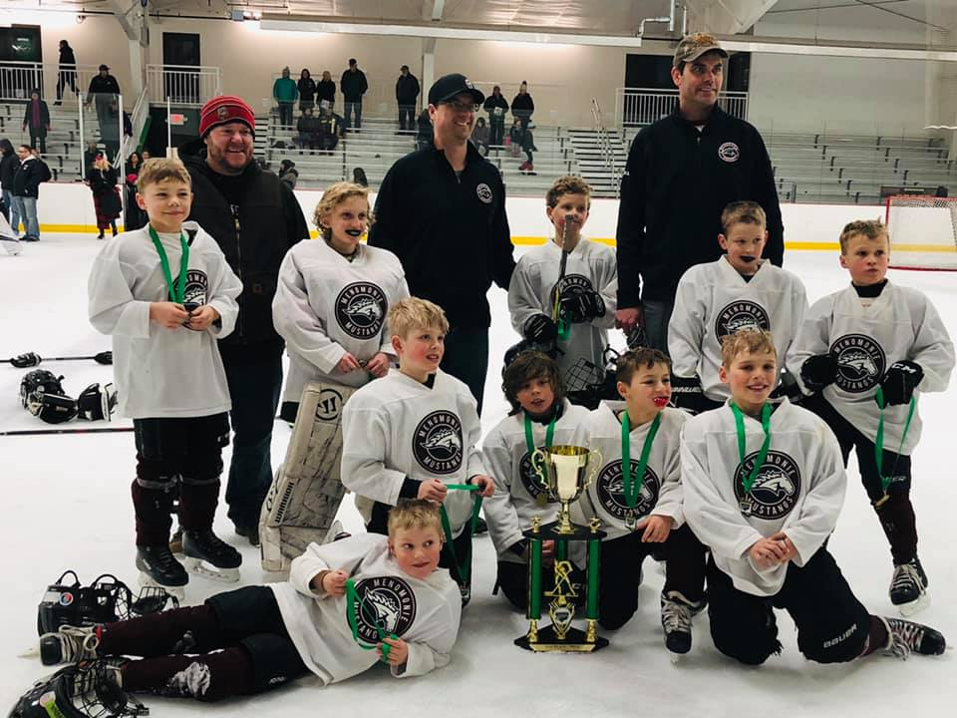
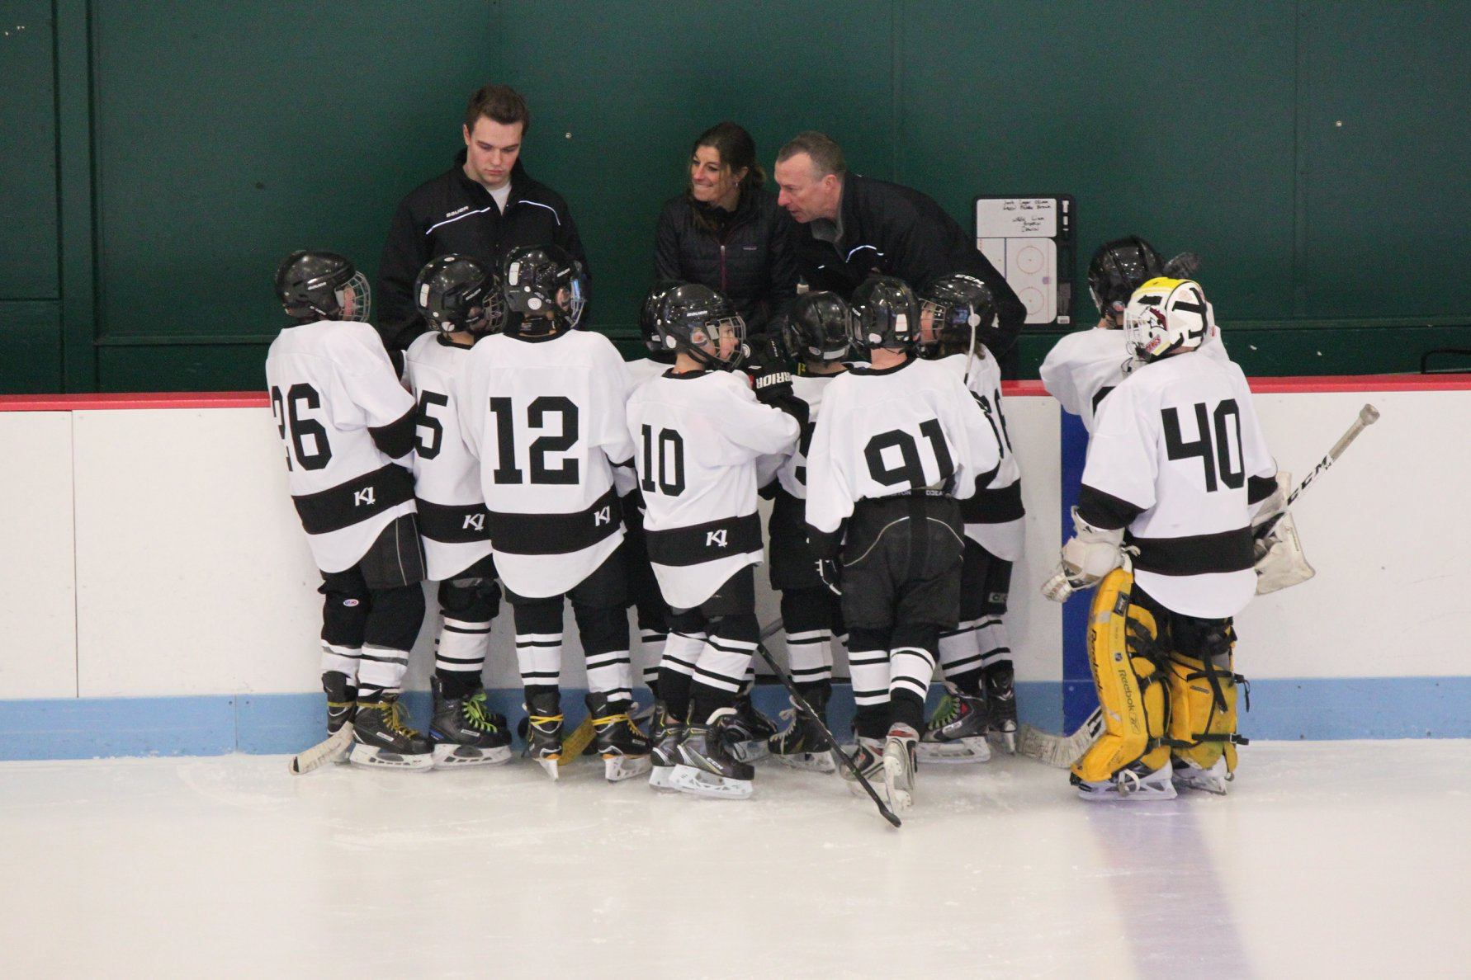
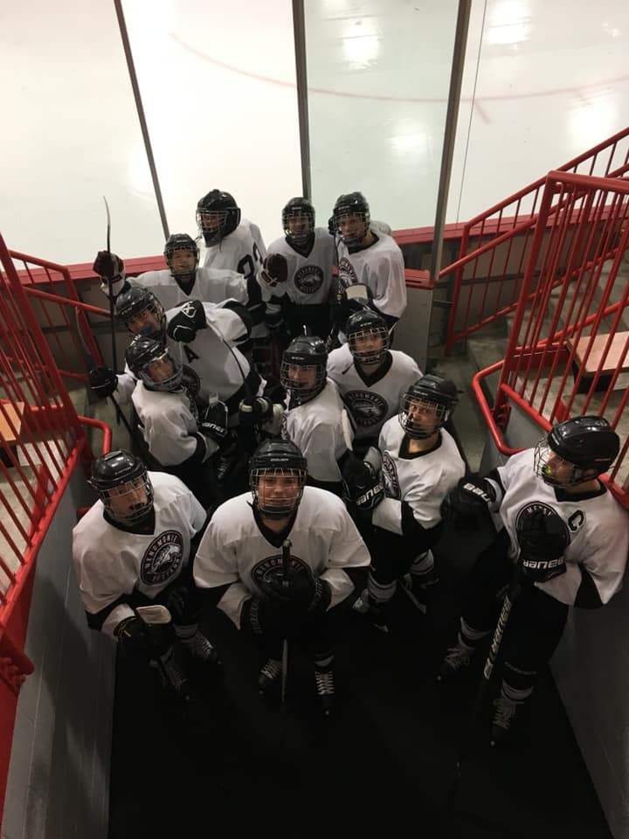
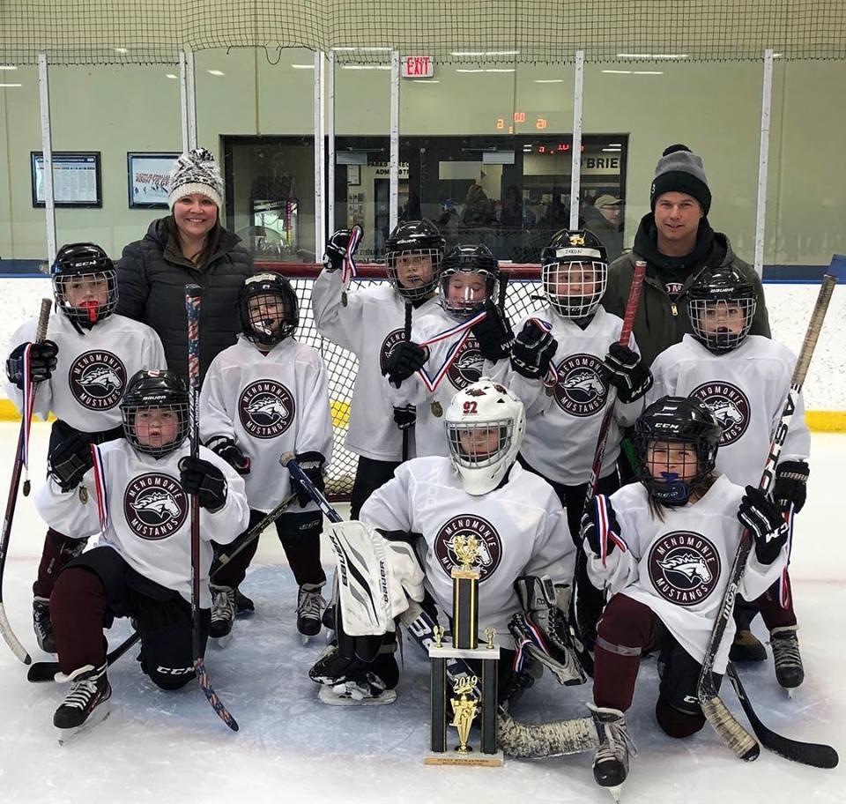
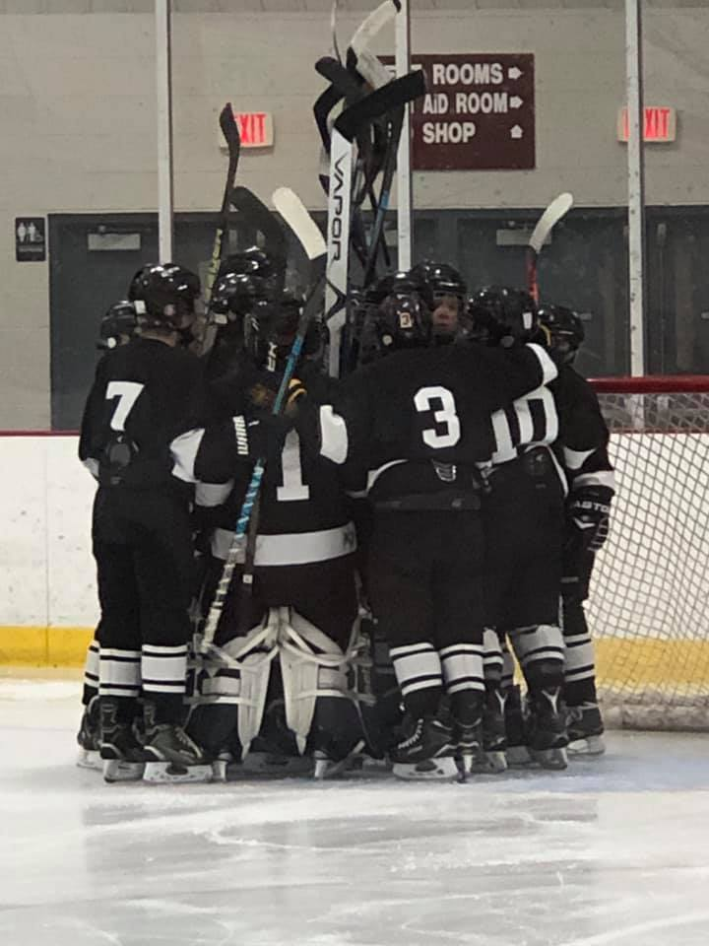
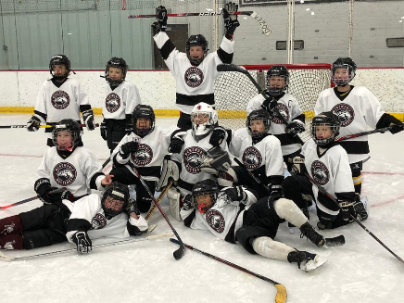
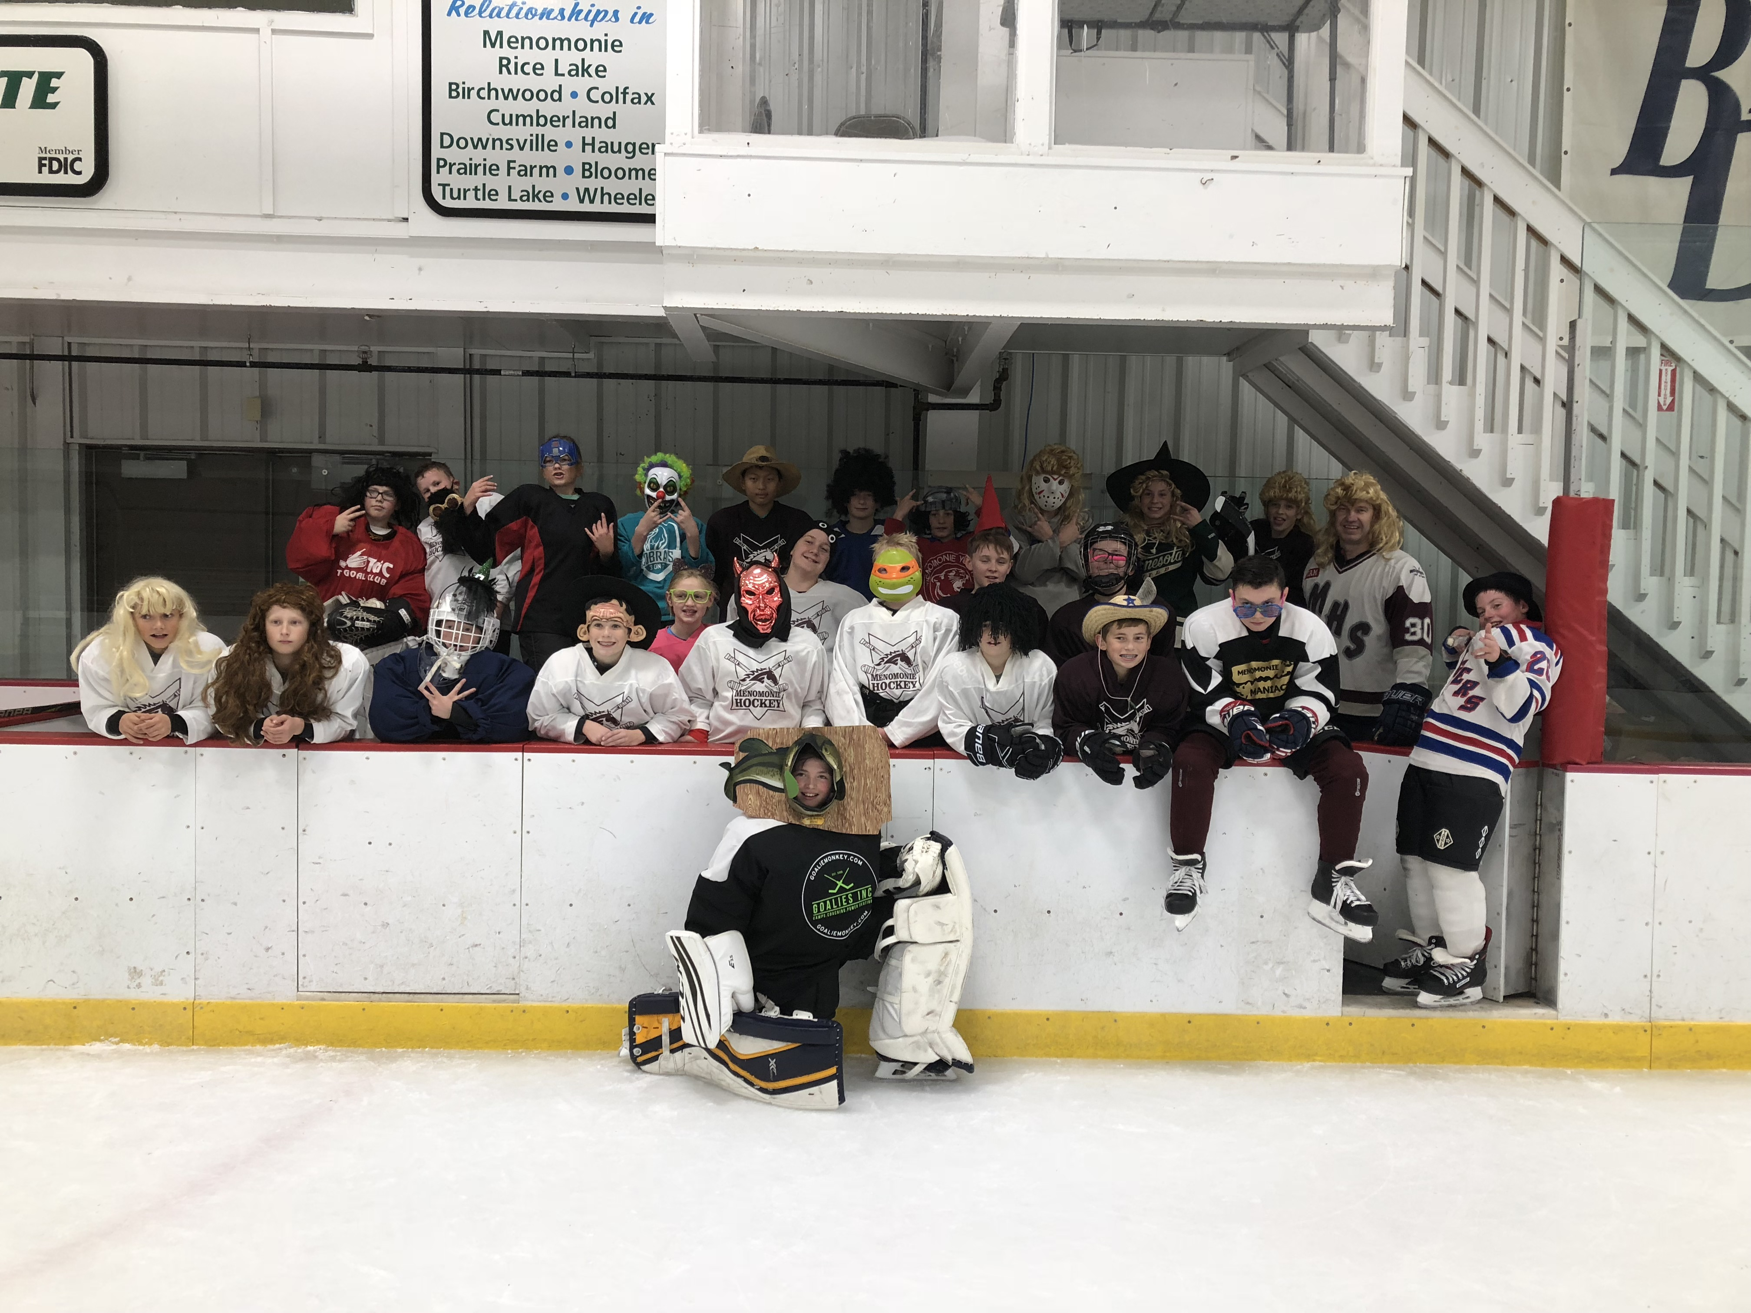
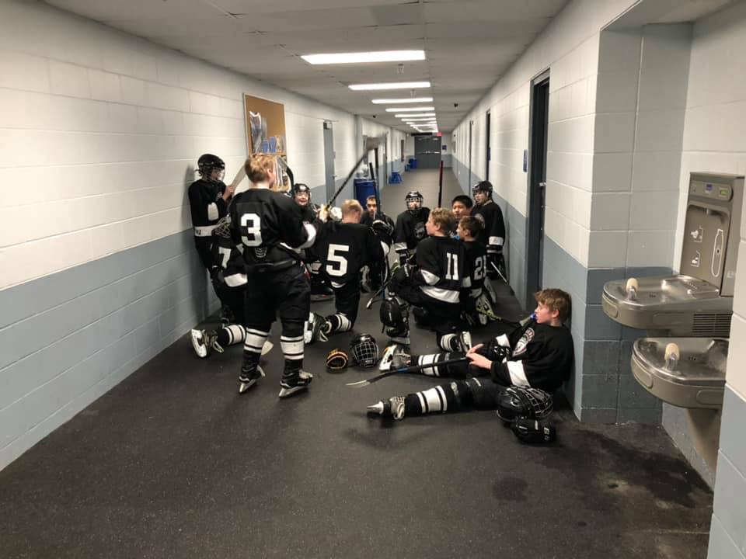
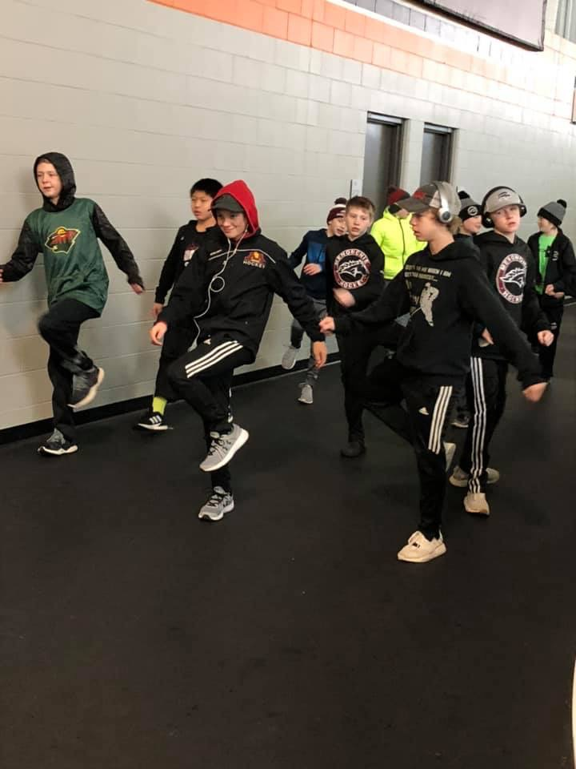
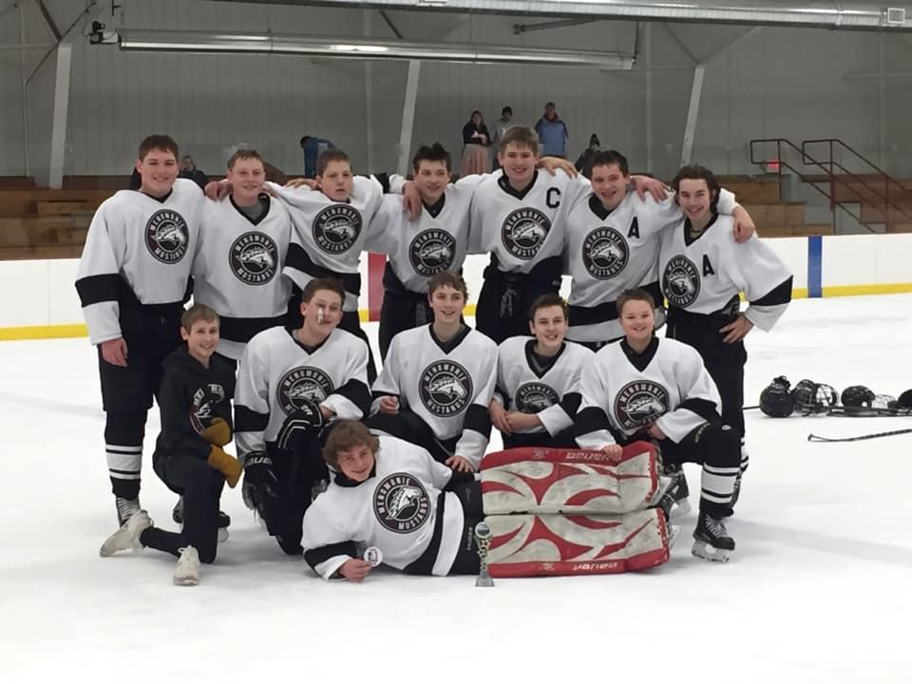

Slide 43
MYHA 2018-2019 Recap
GOALS:
Revenue Growth
Membership Growth & Retention
Utilization & Maximization of Volunteer Hours
Increase Skill & Competition Level
Create a FUN & positive culture
CHALLENGES:
Weather
Ice Time
Practice Times
Fundraiser Timing

Slide 44
2018/19 MYHA Goals Updates
Revenue Growth
Increased Ice Utilization
Concession Stand
Gift Cards added
Skate Rental
Continued Beer Sales
Fundraising
New Wreath Company
Skate-a-thon
LiveBarn Updates
3 on 3 tournament
Membership Growth & Retention Continued First Year FREE program
Recruitment of top talent coaches
Stout Research Project
Increase Marketing
Sports Expo, Kids Night, Community Cookout
Utilization/Maximize Volunteer Hours
Continue to evaluate
Increase Skill & Competition Level
Scheduling (w/in conference)
Goalie Program/Coach
ETS Dryland Program Off-Site
Paid Non-Parent Coaches
MYHA Paid On-Site Camps
Create a FUN & Positive Culture
Communication to Membership
Culture Shift
By-Law Update/Board Position
Fun & Safe Environment
High School Collaboration
Open House/Kick Off Meeting
Transition Meetings
Conduct Committee/Policy Updates

Slide 45

Surviving, Not Thriving.

Slide 46
Registration Trends:
113
Notes:
155 2018 - 2019

Slide 47
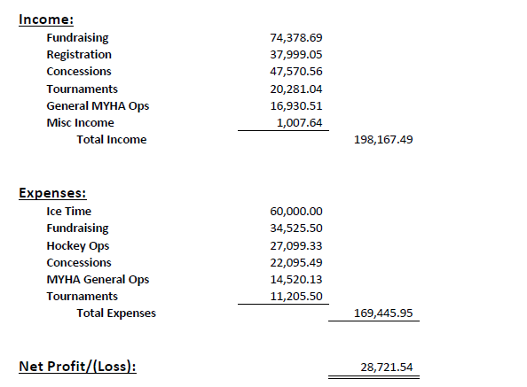
2018/2019 Financials
Notes:
Expenses:
Ice Bill: $90,112.50
Tournament Expenses (Fees, Trophies/Medals): $8,994.66
Hockey Operations (Equipment, Fees, Coaching, ETS): $22,546.92
TOTAL: $121,654.08 ($1,193 per skater)
Income:
Registration: $35,506.13
Fundraising: $47,853.75
Tournaments: $1,9811.41
Concessions: $21,889.91
TOTAL: $125,061.20

Slide 48
WAP Hours – 2018/2019

Slide 49
Surviving, Not Thriving. Awareness…$15,000-$25,000
Improvements made:
ETS Off-Site
Jerseys Program
Nonparent Coaches
Equipment
New Lighting
On-Site Camps
Security Cameras
Outdoor rink with Boards
Increased Ice Utilization
Improvements Coming:
Divider Boards
Second Scoreboard
Press Box Renovations
Continued Jersey Program
Updated Shooting Area
Outdoor Rink Updates
Concession Stand Updates
Notes:
Expand
Renovated Press Box
Score Board
Divider Boards

Slide 50
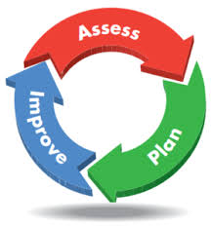
Surviving, Not Thriving. Action…
Improve operational practices
Improve membership education & engagement
Strengthen relationships with all user groups
Ice Board By-Law Changes
High School/Athletic Director Collaboration
Sports Advisory Group
Ownership and updating of policies
Conduct Committee Improvements
Policy Review
By-law Updates

Slide 51

Surviving, Not Thriving. Action…
Drive financial growth and sustainability
Execution of MYHA annual budget
Continue to quantify hours needed to operate
Increase revenue and manage expenses
Revamp sponsorship and fundraising program
Look at new/different fundraising opportunities
Fundraising meeting for all membership
NEED New VP and committee members/team
Notes:
2018 Strategic Initiatives
Improve Operation Practices: Conduct Committee and Form

Slide 52

Surviving, Not Thriving. Action…
Develop comprehensive growth and retention program
LTS/Mite structure/program
Free First Year
Mini Mite Program
Competitive Mite Program
Transition Program
Increase competition level of players, teams and coaches
ETS
Paid Non Parent Coaches
On-Site Camps
Off-Season Incentives
Develop positive marketing campaign
Development of FUN/GROWTH Committee
Continued culture shift
Increased communication

Slide 53
VP Hockey Operations – Player Assessments
Process Improvements?
The assessments took to long!
They were to detailed.
Updates some drills.
Key Takeaways:
Now have data points to drive improvements.
We reaffirmed our largest development gaps.
Independent feedback to coach per level
Player Development Trends:
Skills Assessments
Shooting
Stickhandling
Passing (Giving and Receiving)
Puck Control
Timed Assessments
Straight line speed
Skating agility
Speed is with puck
Individual feedback is coming!

Slide 54
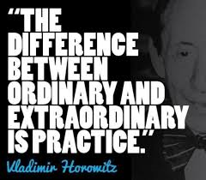
Off Season
Incentive Program Coming
Instructions/Idea sheets coming
Website Page
Summer Hockey Program: Mites and Older
Deadline May 31st
Contact Russ Bahr for questions

Slide 55

THANK YOU!!
Special Thank You…
Keila Drout
Chelse Cockeram
Thank you Parents!!!

Slide 56
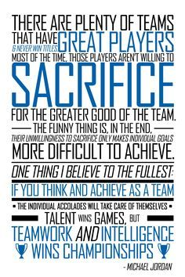
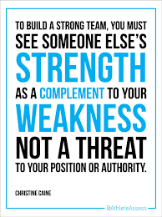
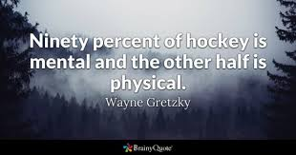
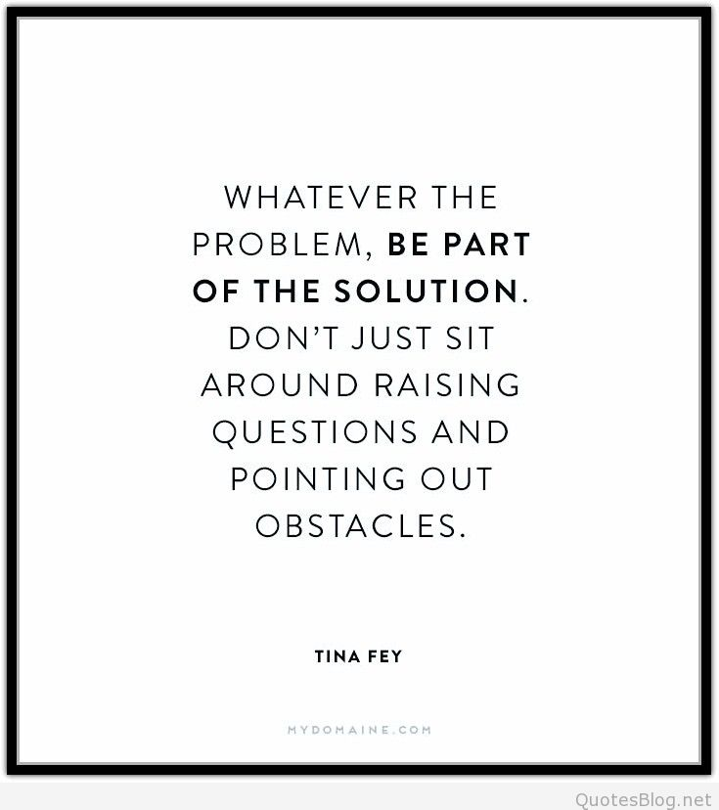
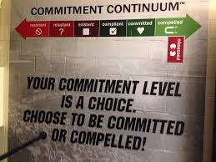

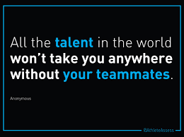
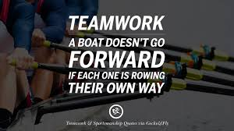
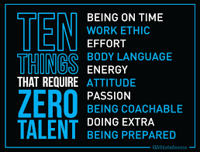


Slide 57

Questions, Ideas, Suggestions…

