Slide 1
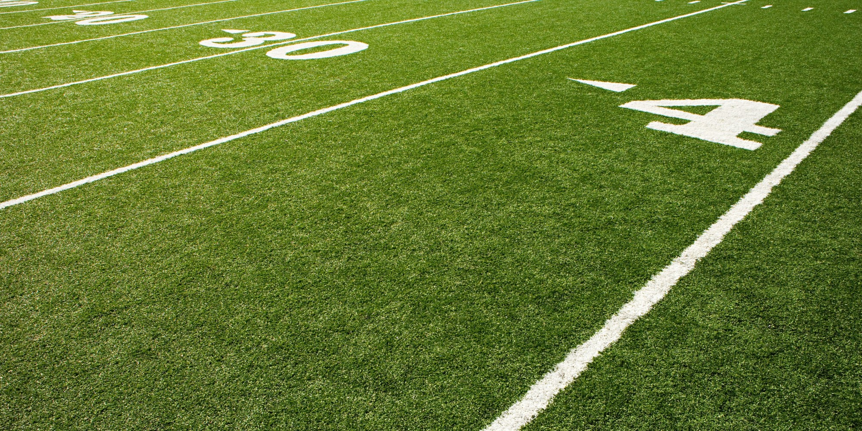
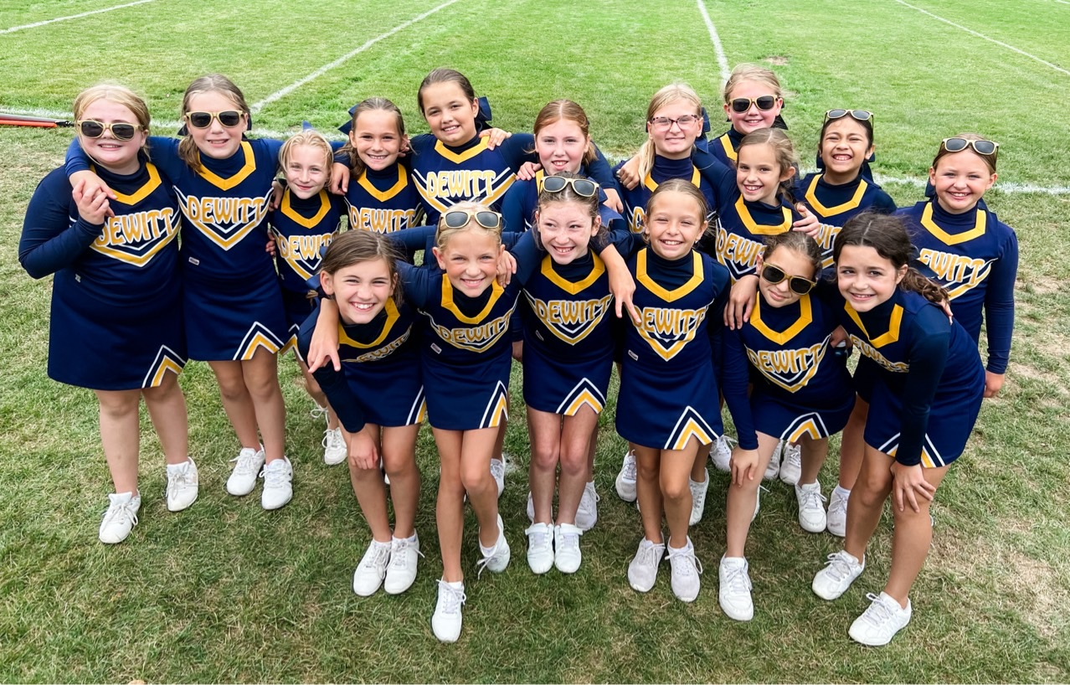
Dewitt Junior Panthers Sideline Cheer Information Meeting
April 9, 2025 @6:30pm

Slide 2
DeWitt Junior Panthers Board Members
President: Brian Brown
Vice President: Jody McKean
Treasurer: Tara Miller
Secretary: Kristen Hampton
Board members: Heidi Lenneman, April Babb, Leah Clark, Krista Cornell, Kristi Coe, Ron Slater, Bruce Gallagher, Corey Feldpausch, Todd Jorns

Slide 3
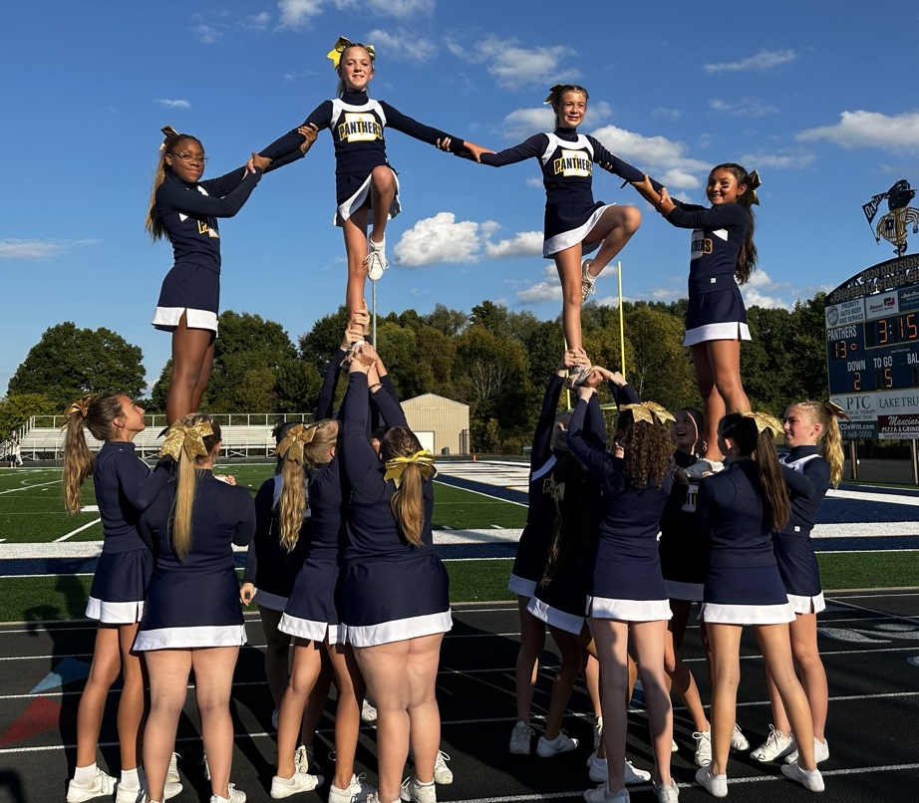
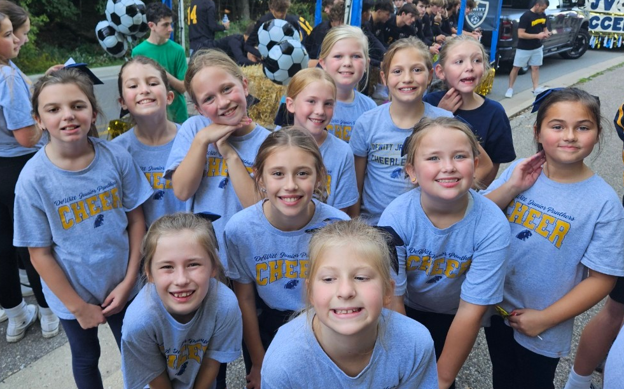
DJP Program Overview
Volunteer Based Program
Established in 1995 to promote organized and structured football and cheerleading within the community of DeWitt.
To teach and promote fair play and good sportsmanship
Provide a safe and healthy environment for youth allowing them to develop athletic skills and advocate teamwork
Develop team spirit, camaraderie and leadership skills.

Slide 4
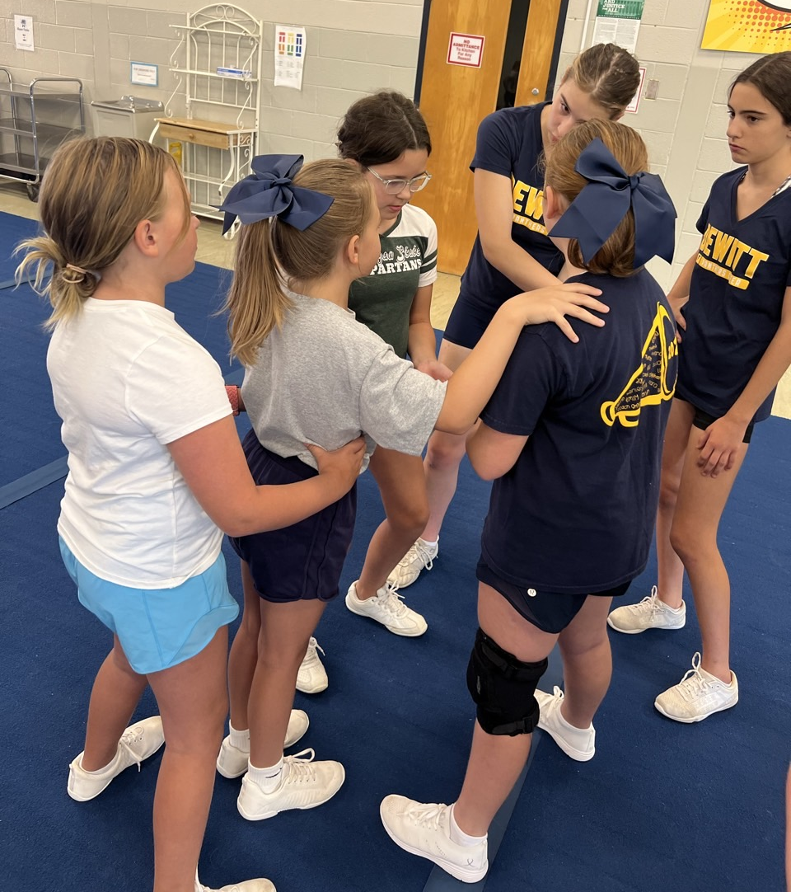
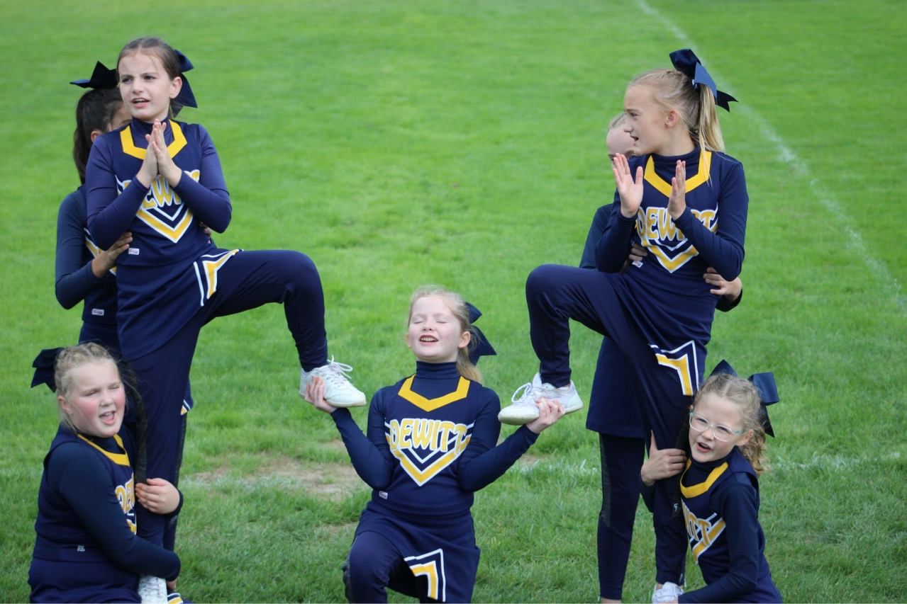
Typical Practices/Games
2-3 days a week for 1-2 hours
Warm up (running, stretching, sit ups, etc)
Practicing Cheers
Stunting as appropriate per grade and skill
Closed practices- no visitors
4th-6th games Saturday @ DJP Field
7th & 8th games Wednesday @Stadium
Schedule TBD

Slide 5
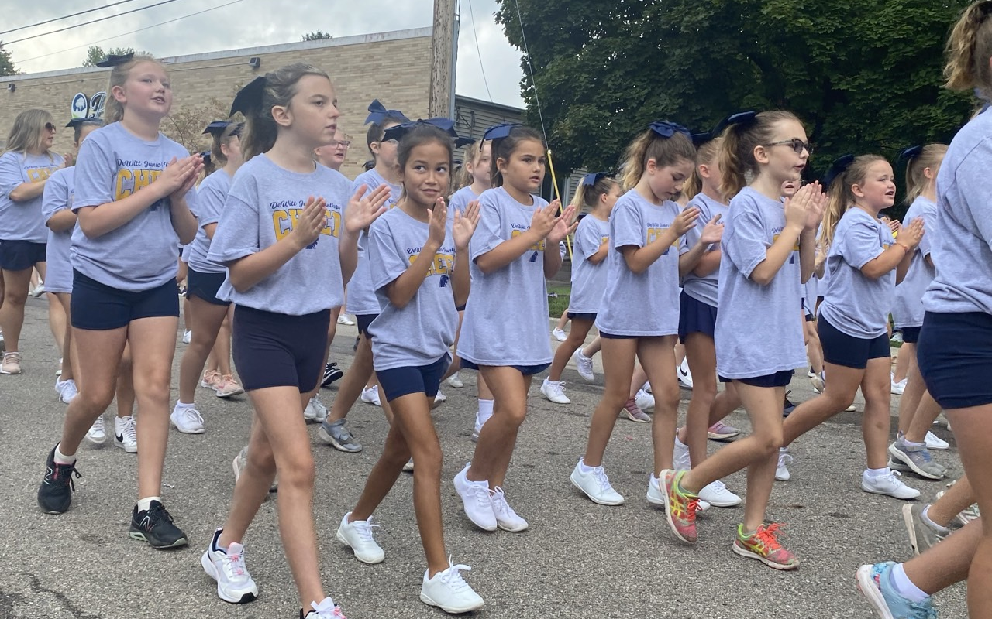
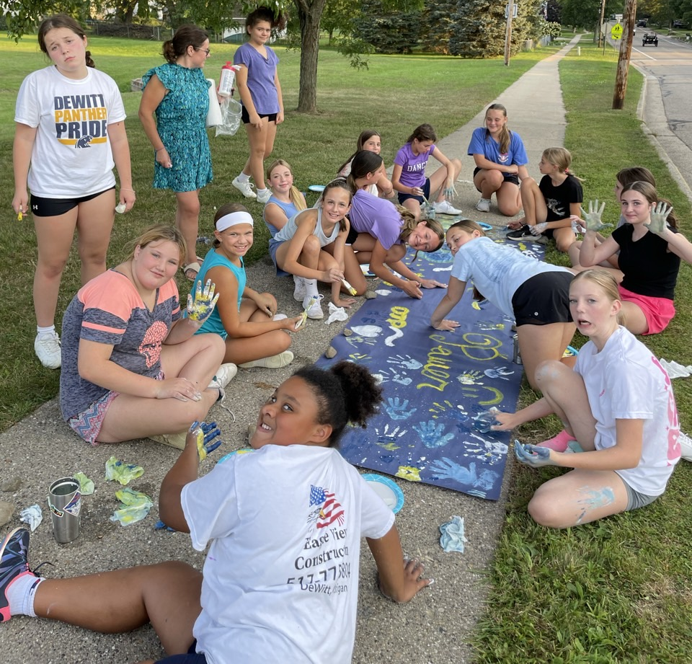
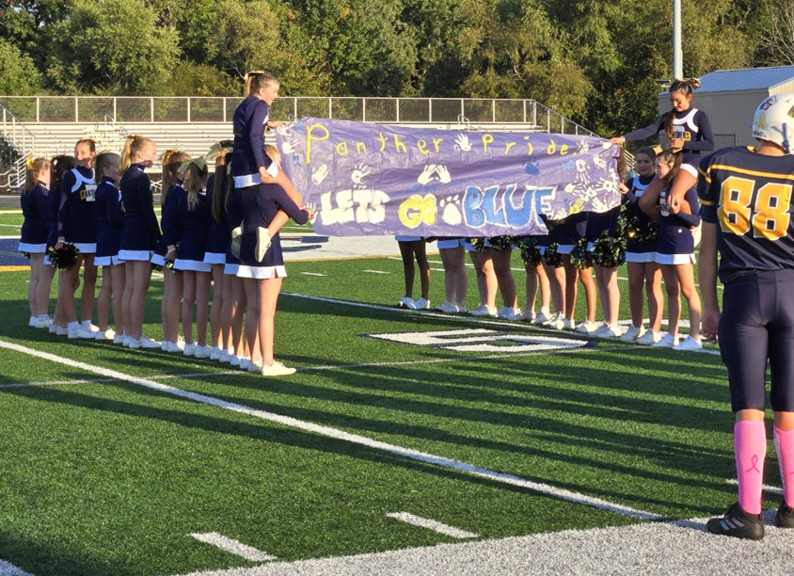
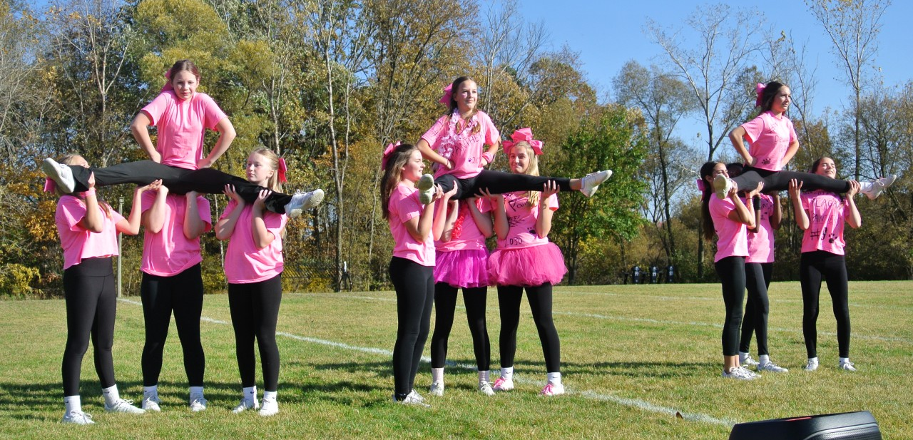
Activities
Ox Roast Parade
Homecoming Parade
End of season showcase

Slide 6




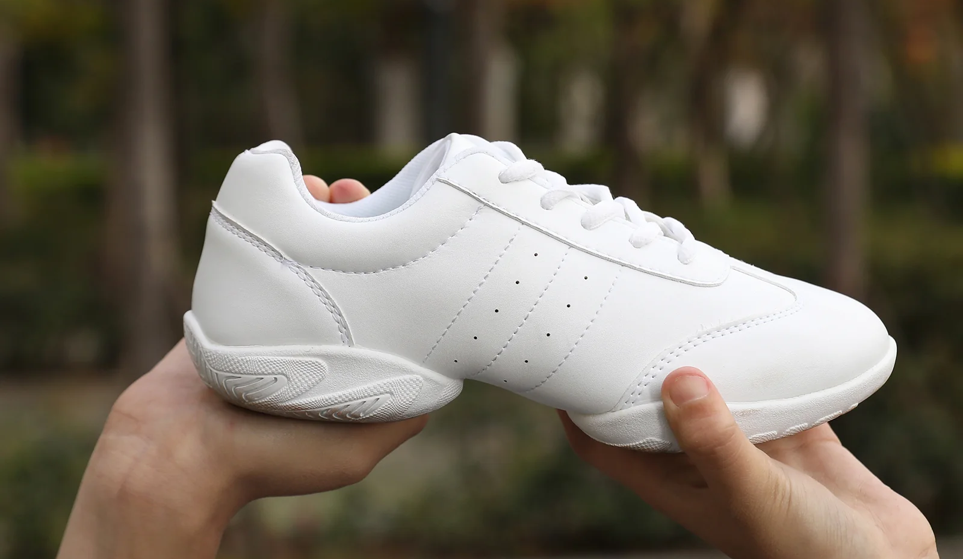
Cheer Equipment you must provide
Navy Bodysuit
Navy Lollies
Navy Tank top
Navy Legging
White Cheer Shoes
White no show socks
Poms (order during registration)

Slide 7
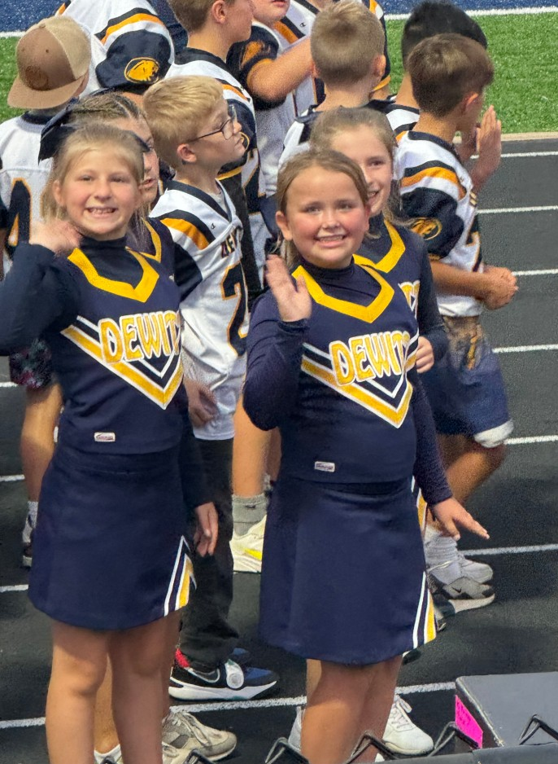
Cheer Equipment we will provide
Vest
Skirt
Bow
Warm up jacket
Warm up pants
Cheer T-shirt
Duffle (as available)

Slide 8

Registration
Early-Bird Registration
Today- April 30 $175
Regular Registration
May 1-May 31 $200
Late Registration
June 1-June 30 $250
www.dewittjrpanthers.org

Slide 9
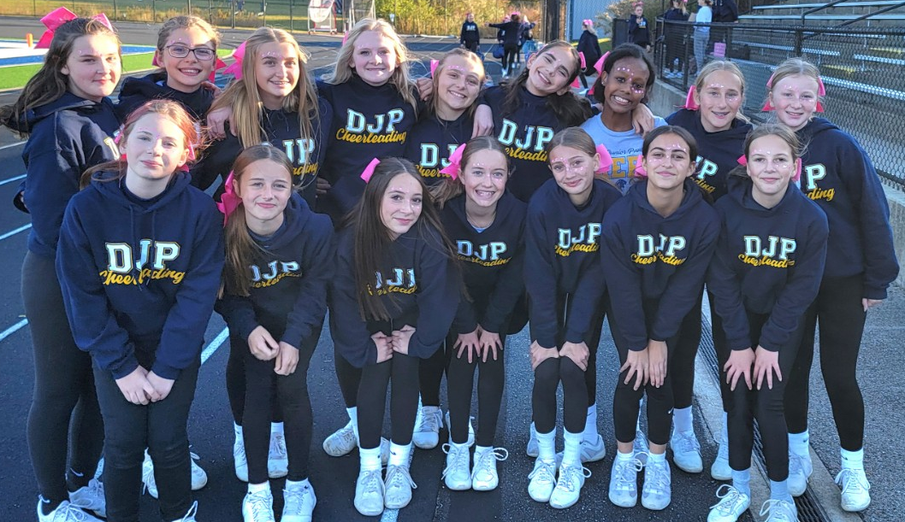
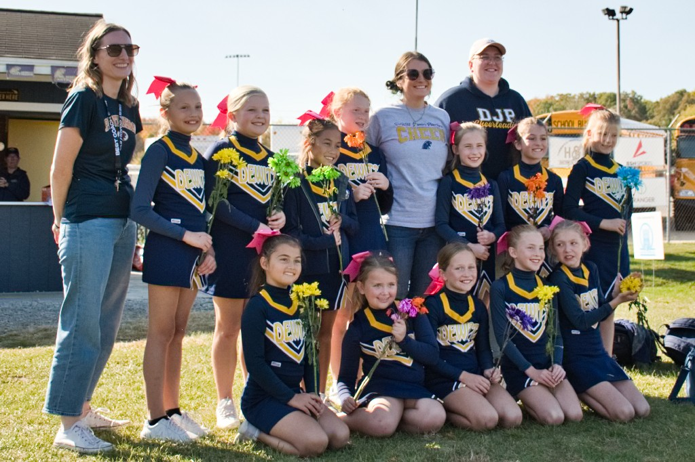
Fundraising
How Does DJP Raise Money?
Registration Fees
Spirit Wear
Concessions
50/50 Raffle
Donations
Corporate Sponsorship
Vertical Raise

Slide 10
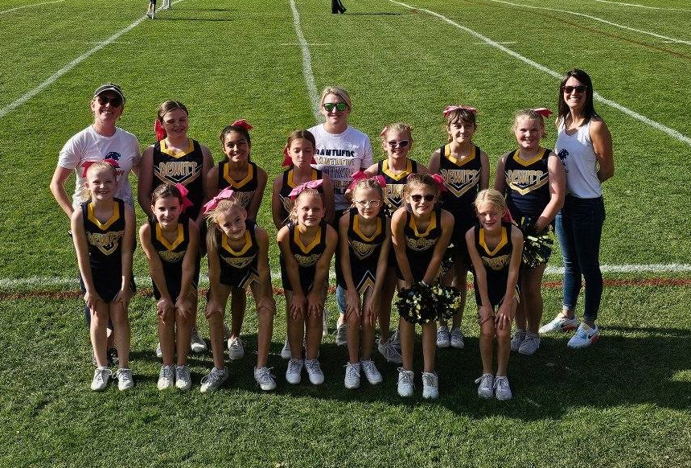
What is fundraising used for?
School field/property use
Football Field Maintenance
Press Box Maintenance
Equipment
T-shirts
Sweatshirts
Banners/supplies

Slide 11
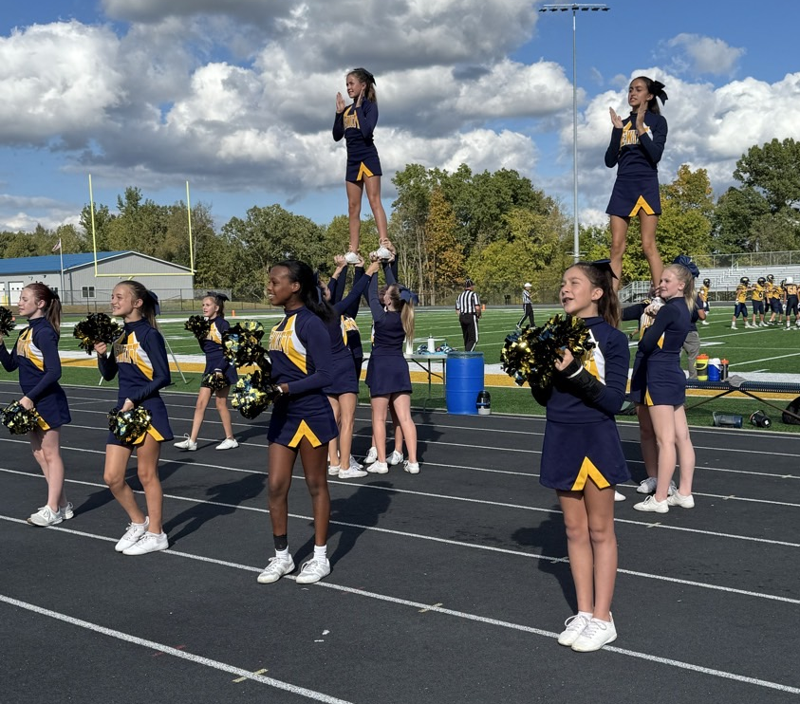
Parent Volunteering
Chain Gang
Concessions on Saturdays
50/50 Raffle
Coaching
Parade help
Uniform distribution/collection
Team Parent
Team Banquets

Slide 12



Communications
Emails
Facebook
Band app

Slide 13
Registration
Early-Bird Registration
Today- April 30 $175
Regular Registration
May 1-May 31 $200
Late Registration
June 1-June 30 $250
www.dewittjrpanthers.org
When registering
don’t forget!
Order Poms
Select correct T-shirt size
Order Yard Sign

