Slide 1
1st Association Meeting
November 12th, 2024

Slide 2
Welcome!
Our meeting will begin after a presentation from:
MHSAA Executive Director – Mark Uyl

Slide 3
website
We have a very good number of people looking at the site. I had Mark Uyl say the site looked great!
https://www.aaaa-wrestling.com

Slide 4
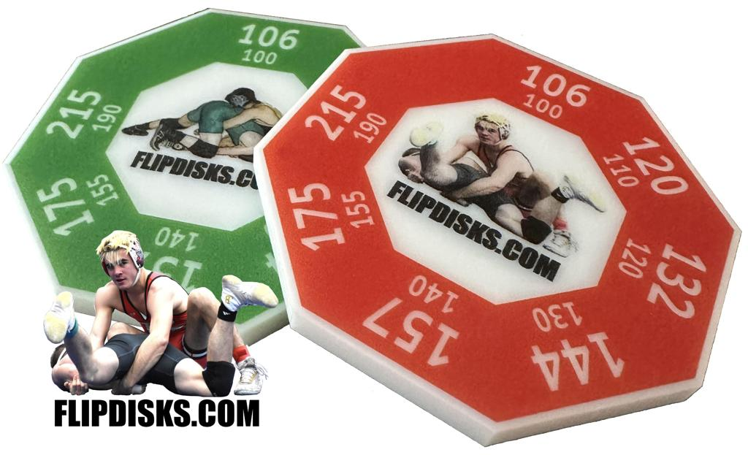
https://flipdisks.com/

Slide 5
Election of Officers
John Andrews –

Slide 6
Calendar
The amount of work on this takes days.
More work when not accurate!

Slide 7
Published matches
We have published matches through January 11th. We also have many more to assign and will send out the next group by the end of the week.
We had many issues BECAUSE so many of you did not do there calendar.
This created us many problems and that time was days!

Slide 8
Accepting Matches
We have a large number of you that have not accepted your matches. It needs to be done asap. We need to find out if we are going to have to advise schools we can’t fill their meets.

Slide 9
Short of officials on certain dates:
This is nothing new as some dates are impossible to fill.
12/14 - 1/4 - 1/11 - 1/25
In these cases, we will adjust the pay and notify the schools of this so they give you the breaks you need.

Slide 10
Cornhole Tournament
Steve Livings
The turnout was poor with only about 14 people showing up. The money raised from this was to pay for the website and other avenue for the association.
Without better support from our members, we are wasting our time.

Slide 11
WhatsApp
Some of you still need to accept the app on your phone. If you haven’t done so, make sure you see Steve or myself and get on there.
This app will be used when I lose an official or find out a school didn’t advise us on a match. Emails make it tough but this will text you and hopefully help us fill a match.
We will also use when you lose a match.

Slide 12
Draw Kits
All of the new first year officials will be getting a draw kit from me. Make sure you pick one up before leaving.

Slide 13
Scrimmage matches
We have had schools advise us they would hold a scrimmage and allow us to bring officials to officiate matches so we can practice working with the new rules. We are looking at $50 for an hour or so.
Great place to get your mindset started!

Slide 14
New Fee Schedule for 2024-26
Wrestling
V Dual (2 schools, 1 mat, 1 dual) | 1 | $100
V Quad (4 schools, 2 mats, 2 duals each) | 2 | $175
V Tri (3 schools, 1 mat, 3 duals) | 1 | $225
*Above includes up to 5 JV matches per official, $3 each additional match
*Above includes onsite weigh-in up to 75 minutes in advance
JV Mat only | 1 | $100
(1 dedicated official during entire V Quad or Tri)
JV Dual (2 schools, 1 mat, 1 dual) | 1 | $80
JV Quad (4 schools, 2 mats, 2 duals each) | 2 | $140
JV Tri (3 schools, 1 mat, 3 duals) | 1 | $180
V Team Tournament |  | $50/round
JV Team Tournament |  | $45/round
V Individual Tournament |  | $275
JV Indiv Tournament |  | $250
70
155
165
65
65
87
105
45
??
193
150
IMPORTANT

Slide 15
Middle School Fees
This is being negotiated and has been for months. I began talking to the new group called SEMLAC. They are part of the following leagues:
Leagues involved with SEMLAC are: SEMLAC includes the OAA, KLAA, CHSL, Lakes Valley, Downriver, Western Wayne, Huron, MIAC, PSL, and MAC
Middle School fees were not to be discussed until next but have advised them that every league outside are area pays a lot more then we do and if we don’t get an increase, we will have trouble filling matches.

Slide 16
Middle School continued
We discussed the problems such as:
1. Getting to the school and having to wait up to an hour before matches start.
2. Having to wait for the schools to pair up the wrestlers.
Our time is worth money!

Slide 17
Middle School continued
OAA discussed MAC
Middle School Dual |  | 55 | 70 | 60
Middle School Quad - 2 |  | 67 | 100 | 72
Middle School Tri |  | 75 | 140 | 85
* If more than 21 MS a stipend of $2.00 per extra match should be paid The meeting of the group is scheduled for 11/15 to advise if they agreeing to the new fees. Middle School fees weren’t on the agenda until next year and go 2 years. That way the HS and MS will rotate every two years but not in the same year.

Slide 18
Test
I spoke to Sam and was informed that the test should be ready sometime next week.
We plan on having a zoom meeting on Sunday, November 24th at 7:00 pm. I will send you a copy of the test prior to the meeting. We would like you to go over and answer them on the sheet to see how you did.

Slide 19
Sportsmanship Awards
We will be nominating and voting on these at the December 3rd meeting. We will nominate for:
Oakland County Macomb County Wayne County or Downriver
Other
Can be a Coach, AD or anyone who has been an asset to the wrestling.
You can see past recipients at: aaaa-wrestling.com. Once on the site go to association info then to sportsmanship awards.

Slide 20
Matt Stabley
Comments on his Lansing meeting a few weeks ago.

Slide 21
Post-Season Requirements
General Requirements (all levels):
Complete/attend the current year rules meeting - Take a rules meeting
Submit a season schedule to the MHSAA - Submit your schedule
Submit your available tournament dates - Availability & conflicts
Be listed as a Member in Good Standing with a Local Approved Association - Check MIGS status
Complete and pass the current year rules exam (≥80%) - Take exam | Exam questions
Have officiated a minimum of 10 contests during the current season
Have compiled at least 75 ratings over the previous three years - View your ratings
District Level:
Have (at minimum) a 3.0 three-year average rating - View your ratings
Regional Level:
Have (at minimum) a 3.2 three-year average rating - View your ratings
Final Level:
Have (at minimum) a 4.25 three-year average rating - View your ratings

Slide 22
Information on your assignments
 | Note | Viewable By | Posted On | Posted By
 | Clarkston Duals. 4 rounds on 4 mats. 9@ start

Slide 23
Rules Video on new rules
https://www.youtube.com/watch?v=7beelNWtH8Y

Slide 24
Discussion on Girls Wrestling
One of the local coaches who spends a ton of time with both high and low level Female wrestlers put it best, when discussing Potentially Dangerous and differences between male and females wrestlers.
“their flexibility is both a blessing and a curse. They can put their bodies into positions that a boy just can’t. The curse is a male wrestler has all kinds of muscle strains and light sprains to give you a warning before things “break”. Females don’t.”
https://www.facebook.com/share/v/19ikB2bLyH/

Slide 25
Broomstick (Jonsey tilt)
In both an olympic year and the Tic Tok era, some different moves are gaining in popularity and visibility. One notable and fairly dangerous example is the Broomstick/Kickout/Jonsey Tilt.
https://www.youtube.com/watch?v=4mEFPhT2Vn8
If the wrestler attempting this move, leaves his feet, this is illegal and highly dangerous.
https://youtu.be/0FKDY3E_Ees?si=_I70d_WSkB7u-bpx
https://youtu.be/vEunSxfGY18?si=MRpn5wwGBrHMotxR

Slide 26
Near Fall Criteria vs Situation
In situations such as OT or Tech Falls, When do you stop the match with a Near Fall situation either imminent or on going.
In most situations the easiest explanation is that Near Fall points can be earned but not awarded. Allowing wrestling to continue until the Situation has ended. The situation is concluded when the defensive wrestler gets to a defensible position. AKA breaks a cradle, slips a wing out, etc.

Slide 27
Near Fall Criteria vs Situation
There seems to be one exception to the previous slide in the new rule book.
When either held NF points or NF points that would be awarded after a “feet to back” move (think Headlock) the match is stopped for a Technical Fall, when the defensive wrestler is no longer in Criteria.
Might see this once or twice, but is highly likely to be revised next year.

Slide 28
Next Meeting
December 3rd, but will be in our regular room at 7:00 pm.

